Slide 1

Heterogeneous Graph Neural Networks for Extractive Document Summarization
Danqing Wang∗, Pengfei Liu∗, Yining Zheng, Xipeng Qiu†, Xuanjing Huang
ACL2020
Notes:
Hello everyone! Thanks for watching this video. Today I'm going to introduce our work on ACL 2020. The title of our work is Heterogeneous Graph Neural Networks for Extractive Document Summarization. I am Danqing Wang from the NLP group of Fudan University.

Slide 2
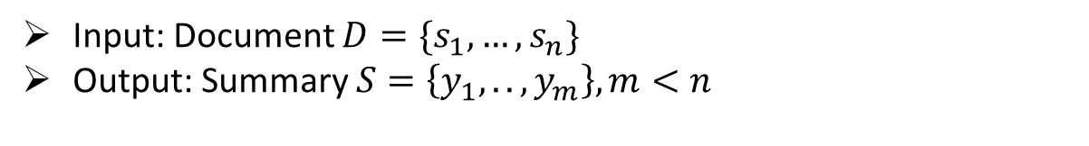
Extractive Summarization
Input: Document $D=\{s_{1},…,s_{n}\}$
Output: Summary $S=\left\{y_{1},..,y_{m}\right\}, m<n$
[1]Saracens director of rugby mark mccall lauded his young guns after their latest european heartache before declaring he has no intention of overspending in a competitive post-world cup transfer market. [2]Mccall watched his side, which contained five english-qualified forwards in the starting pack, battle in vain before losing 13-9 to the clermont on saturday. [3]Saracens' millionaire chairman nigel wray spent much of last week repeating his belief the cap should be scrapped ….[11]…
Saracens lost 13-9 to clermont at stade geoffroy-guichard on saturday. The sarries pack contained five english-qualified forwards. Saracens ' millionaire chairman nigel wray wants the salary cap scrapped.
Notes:
Firstly I will give a brief introduction of extractive summarization as the background. Automatic text summarization aims to generate a concise/kənˈsaɪs/ summary for the long document, which can help us quickly get the key points of the materials. According to the way of generation, it can be divided into abstractive and extractive. Extractive summarization selects several sentences from the original document and reorganizes them as the summary. So, formally, given a document D with n sentences, the extractive objective is to extract a subset of m sentences y from D, which ensuring m less than n. In order to get the supervised signal for each sentence, the human-written summary is usually aligned /ə'laɪn/ with document sentences via greedy algorithm. For example, the left is the document and the right is the gold summary which talks about the game results of a rugby/ˈrʌɡbi/ team and the decision of its chairman. We calculate the automatic evaluation metric ROUGE between document sentences and the gold summary and find that the second and third sentences cover most key points (with indicated by bold) and should be extracted. So they will get the label 1 while the remaining sentences will get 0.

Slide 3












Cross-sentence Relationship Modeling
Q: How to model cross-sentence relationship?
Graph-based models
RNN-based models
$$s_{4}$$
$$s_{1}$$
$$s_{4}$$
w>t
$$s_{1}$$
$$s_{2}$$
$$s_{3}$$
$$s_{4}$$
$$s_{1}$$
$$s_{3}$$
$$s_{1}$$
$$s_{3}$$
$$s_{2}$$
$$s_{3}$$
$$s_{2}$$
$$s_{2}$$
$$s_{4}$$
Similarity-based
(TextRank)
Discourse connectivity
(ADG, RST)
Fully-connected (Transformer)
Notes:
So the crucial/ˈkruːʃl/ step in extractive summarization is the learning of cross-sentence relationships in order to find the most important sentences among the long document, as well as to avoid redundancy/rɪˈdʌndənsi/ and keep consistency within the summary. Most current models capture these relations via RNN. However, RNN-based models do not work well for sentence-level long-distance dependency, especially in the case of the multi-documents. Graph structures may be more suitable for global modeling, however, it is challenging to find an effective structure for summarization. Early traditional work makes use of inter-sentence cosine similarity to build the connectivity graph like LexRank and TextRank. Recently, some works account for discourse cross-sentence relationships such as Approximate Discourse Graph and Rhetorical/rɪˈtɔːrɪkl/ Structure Tree. Also, the most popular neural network Transformer can be viewed as a fully-connected graph structure.

Slide 4









Cross-sentence Relationship Modeling
Q: How to model cross-sentence relationship?
Graph-based models
RNN-based models
$$s_{4}$$
$$s_{1}$$
$$s_{4}$$
w>t
$$s_{1}$$
$$s_{2}$$
$$s_{3}$$
$$s_{4}$$
$$s_{1}$$
$$s_{3}$$
$$s_{1}$$
$$s_{3}$$
$$s_{2}$$
$$s_{3}$$
long-distance dependency?
$$s_{2}$$
$$s_{2}$$
$$s_{4}$$
Similarity-based
(TextRank)
Discourse connectivity
(ADG, RST)
Fully-connected (Transformer)
threshold?
error propagation?
lack prior?
Notes:
However, there are several problems with the existing structure. As for similarity-based graphs, it is difficult to choose a threshold /ˈθreʃhoʊld/that can work well for all documents in the dataset. And for discourse structure, the introduction of external /ɪkˈstɜːrnl/ tools or human labeling may cause extra errors or costs. Fully-connected Transformers is the foolproof method to build graphs, but it loses the topology information and makes it harder to learn.

Slide 5









HeterSumGraph
Q: How to model cross-sentence relationship?
$$s_{4}$$
$$w_{3}$$
$$s_{1}$$
$$w_{1}$$
$$s_{1}$$
$$s_{3}$$
$$s_{2}$$
$$w_{2}$$
$$s_{2}$$
Words, Concepts, Topics …
Phrases, Sentences, Documents …
Notes:
Therefore, we try to introduce more semantic units as additional nodes in the graph to enrich the cross-sentence relationships . These additional nodes act as the intermediary/ˌɪntərˈmiːdieri/ and each unit can be viewed as a special relationship between sentences. So, the graph structure changes from the left homogeneous graph to the right heterogeneous graph which consisting of two types of nodes: basic semantic nodes as relay nodes (e.g. words, concepts, etc.) and other units of discourse as supernodes (e.g. phrases, sentences, documents, etc.). In this paper we take words as intermediary nodes, for them naturally forming sentences. We make it a bipartite/baɪˈpɑːrtaɪt/ graph which only contains edges between words and sentences to enforce the updating messages for sentences only come from those sharing the same words.

Slide 6
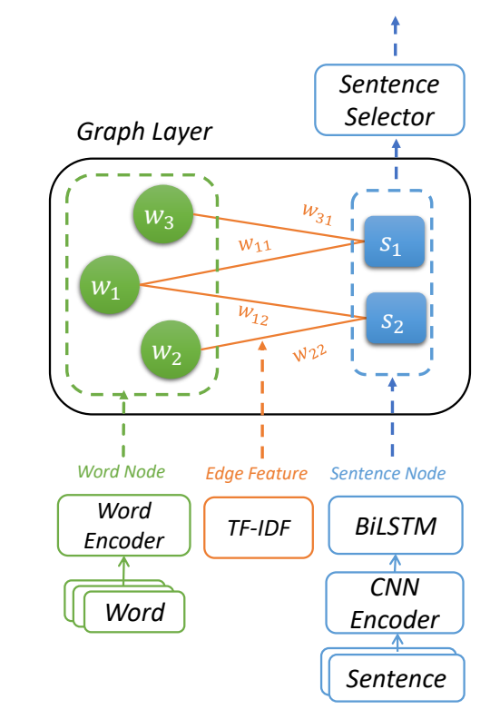
HeterSumGraph
Heterogeneous Summarization Graph (HeterSumGraph)
Graph initializers
word node
sentence node
edge feature
Heterogeneous graph layer
word -> sentence
sentence -> word
Sentence selector
Notes:
The framework is shown like this. It consists of three major modules: the graph initializer/i'niʃəlaizə/ , heterogeneous graph layer, and sentence selector. The initializer provides states for different types of nodes as well as the edge features. The sentence selector ranks sentence nodes and chooses the top k to be included in the final summary. The heterogeneous graph consists of the updating process from word to sentence and sentence to word.

Slide 7
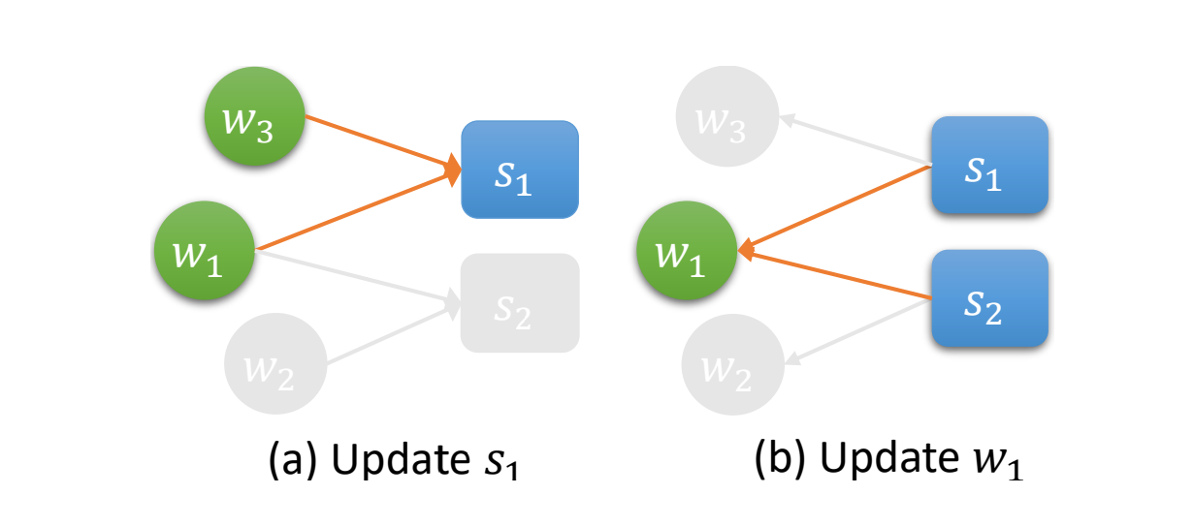
HeterSumGraph
Update Mechanism
Notes:
To be specific, firstly sentence nodes are updated with their neighbor word nodes with GAT. After that, the word nodes aggregate nearby sentence representations and update the states. The sentence2word and word2sentence run t turns (t is a hyperparameter selected based on the performance on the development set). This iterative updating can help word nodes to aggregate the document-level information from sentences and thus distinguish the keywords. This information will help in turn to select sentences with more keywords.

Slide 8
HeterDocSumGraph
Single to Multiple Document Summarization
Q: how to model cross-document relationship?
$$s_{11}$$
$$w_{1}$$
$$w_{3}$$
$$w_{31}$$
$$w_{11}$$
$$s_{1}$$
$$d_{1}$$
$$s_{12}$$
$$w_{2}$$
$$w_{1}$$
$$w_{12}$$
$$s_{2}$$
$$w_{3}$$
$$s_{21}$$
$$w_{2}$$
$$w_{22}$$
$$d_{2}$$
$$w_{4}$$
$$s_{22}$$
Notes:
As stated before, more types of nodes can be introduced into the graph. For example, document nodes can help build cross-document relationships just as the sentence. So our model can be easily adapted from single-document summarization to multi-document. The basic semantic units (words) also be the relay nodes between different documents, and then documents with more similar content will be more closely connected. Pay attention that we do not connect documents by sentences, for few documents sharing the exact/ /ɪɡˈzækt/ same sentences, and the cross-document connections will be very sparse /spɑːrs/.

Slide 9
Evaluation
Experiment Settings for single and multi-document
Datasets:
CNN/DM: 287,227/13,368/11,490
NYT50: 96,834/4,000/3,452
Multi-News: 44,972/5,622/5,622
Models
Ext-BiLSTM
Ext-Transformer
HSG
HDSG
Notes:
We evaluate our model on the CNN/DM and NYT50 datasets for single-document summarization and Multi-News for multi-document. We take BiLSTM and Transformer as the baseline model, and extra concat /kɑn'kæt/ multiple documents to a single long document and feed it to our single-document model as the comparison.

Slide 10
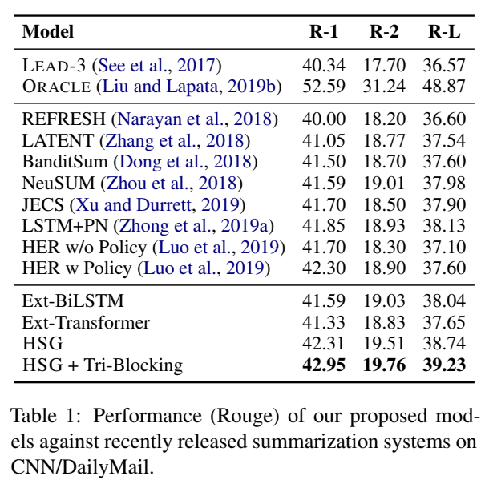
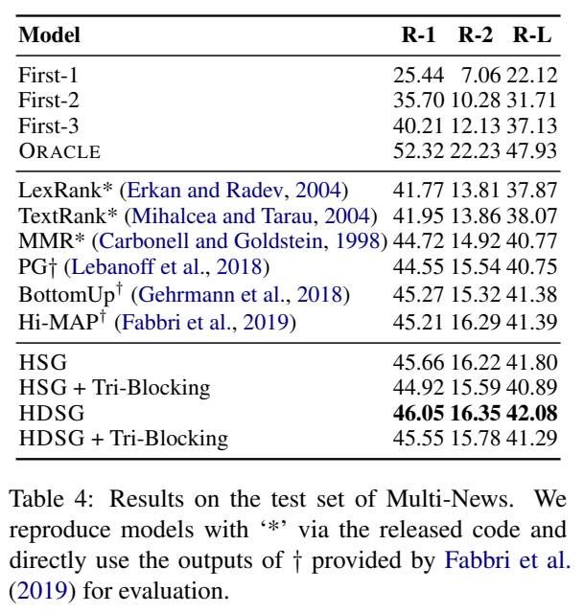
Evaluation
Some results on single and multi-document datasets
Notes:
Here we show some of our experimental results. Note that due to the limited resource, we do not apply pre-trained encoder to our models, thus we only compare with models without pre-trained language models. As the results show, our models outperform others under both single and multi-document settings.

Slide 11
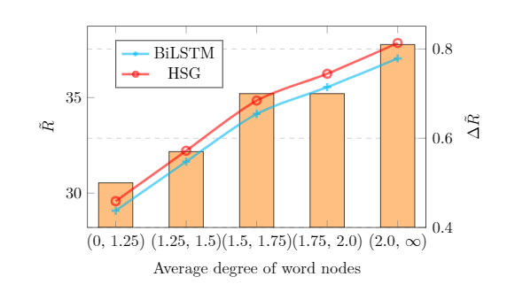
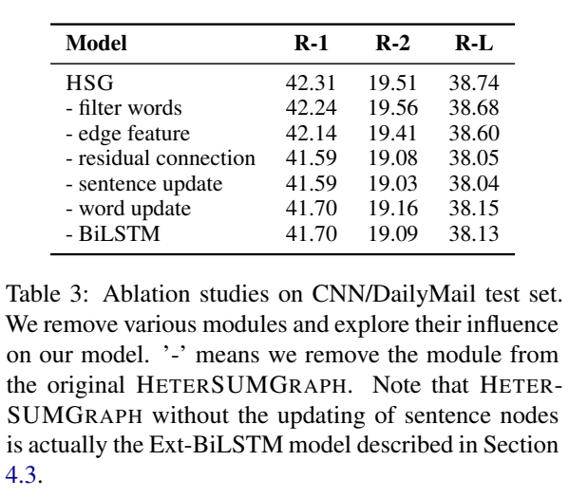
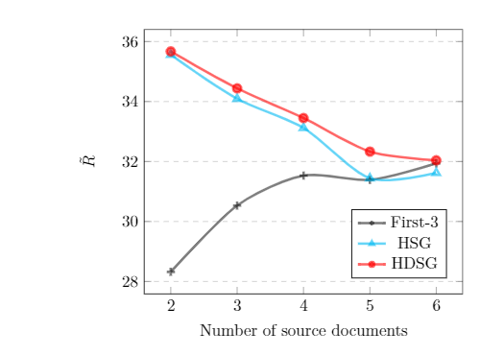
Analysis
Ablation and Analysis
Notes:
In order to better understand the contribution of different modules, we conduct ablation /əˈbleɪʃn/ study and qualitative /ˈkwɑːlɪteɪtɪv/ experiments. The ablation study shows that all modules make sense and the updating of word nodes and BiLSTM initialization for sentence nodes are the most important. Besides, by exploring the influence of the average word nodes' degrees, we find that our model performs much better for documents with a higher word degree. This proves that the benefit brought by word nodes lies in the aggregation of information from sentences, and the propagation of their global representations. The experiment of the number of source documents for multi-document summarization, indicates that the benefit of document nodes will become more significant for more complex /ˈkɒmpleks/ cross-document relationships.

Slide 12
Conclusion
Why HeterSumGraph?
Graph for summarization
model the non-local relationship
typic structure for ranking problem
Heterogeneous nodes
different semantic units (words, entities, etc.)
enrich cross-sentence relationships (sentence-word-sentence)
easily adapt from single-document to multi-document (document nodes)
Update mechanism
iterative process
Notes:
To conclude, why we choose a heterogeneous graph structure like this? Firstly, the graph is a suitable structure for extractive summarization for modeling the non-local relationship and has been proved effective in early traditional works. Secondly, by introducing different types of nodes, we can enrich cross-sentence relationships. Besides, it also makes it easier to adapt from single to multi-document summarization. Finally, the iterative updating mechanism /ˈmekənɪzəm/ makes the message propagation more effective and interpretable /ɪnˈtɜːrprətəbl/ .

Slide 13

Thanks for your listening!
Q & A
https://github.com/brxx122/HeterSumGraph
Notes:
That's all for my presentation. Thanks for listening!

