Slide 1
Operations on Arrays in Java
Reported by: Dhenise Ices Dela Cruz

Slide 2
Array
- Stores multiple values of the same type in a fixed-size structure
How:
- Declare array with type and size or values
- Access elements using 0-based index
Example:
int[] numbers = new int[5];
or
String[] names = {"Ana", "Ben", "Cara"}; Notes:
- Arrays cannot grow/shrink dynamically
- Index out of bounds causes error
Notes:
So, ano ba ang array? Isipin niyo na lang itong isang cabinet na may mga drawer.
Sa bawat drawer, pwede ka lang maglagay ng isang type ng bagay, halimbawa, mga papeles lang.
At ang pinaka-important, once you build this cabinet na may 5 drawers, hindi mo na siya pwede bigyan ng ika-6 na drawer.
Fixed size siya, kaya yun na yun.
"Now, pano ba gamitin yung array? Dalawa lang naman: pano siya icdeclare at pano kuhanin yung laman."
"First, to declare an array, you need to sabihin what type of data ang lalagay mo, tapos yung square brackets [],
at yung name ng array mo. Pwede kang gumawa ng empty array by specifying the size, like this:"
int[] numbers = new int[5]; // Magagawa ka ng array na may 5 slots for numbers
O kung meron ka nang values, pwede mo na siya i-declare at i-assign sabay:
String[] names = {"Ana", "Ben", "Cara"}; // May array ka na agad with 3 names
Once you have an array, you access yung elements nila using their position, or what we call index.
And eto yung super important na part: Java arrays use a 0-based index.
This means yung first element, nasa index 0 siya, ha? Hindi one. Yung second element, nasa index 1, at ganun pa ulit."
"For our names array, to get the first name, 'Ana', gagamitin mo names[0]. To get 'Cara', names[2] naman.“
"May two very important notes na dapat niyo always tandaan when working with arrays."
"First, as I've said, hindi siya pwede palakihin o paliitin. Kung gumawa ka ng array na may size 5, 5 forever siya.
Pwede mo palitan yung values inside, pero hindi ka pwede mag-add ng ika-6. Kasi kung yun ang need mo,
you might want to look at other structures like an ArrayList."
"Second, be very careful with your indices. Kung try mo i-access yung index na wala—like index 3 sa names array na hanggang index 2 lang
—Java will throw an error called an ArrayIndexOutOfBoundsException. Eto yung isang pinakacommon error sa mga baguhan, so always check your indices, ha?"

Slide 3
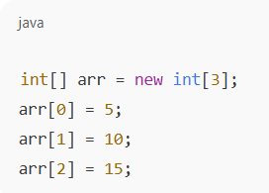
Adding Values
- Assign values to specific array index positions
How:
- Create array with fixed size
- Assign values to each index
Example:
Notes:
Let's talk about adding values. When you declare an array with a fixed size, mayroon siyang default value na lahat—for numbers, that's 0. To 'add' your own values, you just assign them to specific index positions."
"Eto yung flow:"
// 1. Gumawa ka ng array with a fixed size
int[] scores = new int[4]; // Magagawa ka ng array na: [0, 0, 0, 0]
// 2. Lagyan mo ng values yung bawat index
scores[0] = 95;
scores[1] = 88;
scores[2] = 76;
scores[3] = 99;
"Now, our scores array contains {95, 88, 76, 99}. You're just replacing the default values with your own."

Slide 4
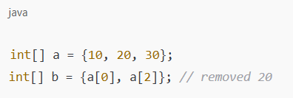
Removing Values
- Arrays cannot remove elements directly; create a new array instead
How:
- Create new smaller array
- Copy all elements except the one to remove
Example:
Notes:
Removing values is medyo tricky kasi, as we've established, fixed size ang array. You cannot just delete an element from the middle. Ang usual way is to create a new, smaller array at icopy mo lang yung mga elements na gusto mong iwan."
"Let's say gusto nating tanggalin yung score na '76' sa scores array natin, which is at index 2."
// Original array
int[] originalScores = {95, 88, 76, 99};
// 1. Gumawa ka ng new, smaller array
int[] newScores = new
int[originalScores.length - 1]; // Size is 3
// 2. I-copy mo yung elements, skip mo yung tatanggalin
int indexToRemove = 2;
int newIndex = 0;
for (int i = 0; i < originalScores.length; i++) {
// Kung yung current index ay HINDI yung tatanggalin...
if (i != indexToRemove) { // ...icopy mo yung element sa new array. newScores[newIndex] = originalScores[i]; newIndex++; } }
"After this loop, newScores will contain {95, 88, 99}. Successfully na 'removed' natin yung element by creating a new array without it."

Slide 5
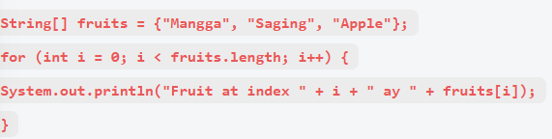
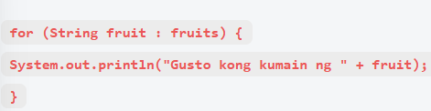
Looping Through Arrays
Arrays are looped through using a counter or a for-each loop to access each element.
For Loop: For-each Loop
Notes:
"Minsan, gusto mo gawin something sa bawat element ng array. For that, we use loops. May two common ways to loop through an array."
"First is the traditional for loop with a counter. This is useful kung kailangan mo malaman yung index ng element na pinagagawaan mo.“
String[] fruits = {"Mangga", "Saging", "Apple"};
for (int i = 0; i < fruits.length; i++)
{ System.out.println("Fruit at index " + i + " ay " + fruits[i]); }
"The second, and often mas madali, is the for-each loop. This is perfect kung gusto mo lang i-access bawat element one by one at hindi ka concerned sa index niya.“
for (String fruit : fruits) { System.out.println("Gusto kong kumain ng " + fruit); }
"Mas mas maganda basahin yung for-each loop, diba?"

Slide 6


Common Array Methods
length — Returns the total number of elements.
clone() — Creates a copy of the array.
Notes:
To make our lives easier, may built-in class sa Java called Arrays na may mga helpful methods para sa array operations. Let's look at some of the most common ones
First, we have length. Hindi siya method, ha? Property siya ng bawat array. Ito ang sasabihin sa iyo kung ilan elements ang pwede ipasok sa array.“
int[] data = {10, 20, 30, 40};
System.out.println(data.length); // Ito ang magpi-print ng 4
"Next is clone(). This method creates a copy of your array. So you'll have a new array with the exact same contents, pero separate object siya. So if you modify the copy, hindi ma-affect yung original.“
int[] original = {1, 2, 3};
int[] copy = original.clone();
copy[0] = 99; // original is still {1, 2, 3}
// copy is now {99, 2, 3}

Slide 7
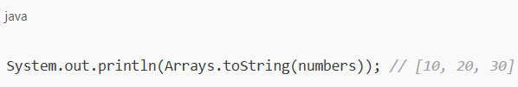

Common Array Methods
Arrays.toString() — Converts an array into a readable string.
Arrays.sort() — Sorts the elements in ascending order.
Notes:
"Eto, mga methods from the java.util.Arrays class, so kelangan niyo i-import.
First is Arrays.toString(). Kung i-print mo mo yung array directly, lalabas yang isang weird na character, yung memory address.
This method gives you a nice, readable string representation.“
import java.util.Arrays;
int[] numbers = {5, 1, 4, 2, 3};
System.out.println(numbers); // Nagpi-print ng [I@15db9742 (hindi useful)
System.out.println(Arrays.toString(numbers)); // Nagpi-print ng [5, 1, 4, 2, 3]
"Next is Arrays.sort(). Powerful method 'to na nagso-sort sa elements ng array mo in ascending order, in place."
Arrays.sort(numbers);
System.out.println(Arrays.toString(numbers)); // Ngayon, [1, 2, 3, 4, 5] na ang laman

Slide 8
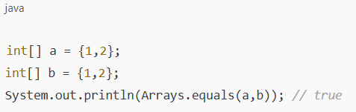
Common Array Methods
Arrays.equals()- Checks if two arrays are equal.
Notes:
"Lastly, we have Arrays.equals(). Common mistake is to use the double equals == to compare arrays. This checks kung pareho yung object sa memory, hindi kung pareho yung contents nila."
"To properly check kung pareho ang contents ng dalawang arrays, you must use Arrays.equals()."
int[] a = {1, 2, 3};
int[] b = {1, 2, 3};
int[] c = {1, 2, 4};
System.out.println(a == b); // false, separate objects sila
System.out.println(Arrays.equals(a, b)); // true, pareho ang contents nila
System.out.println(Arrays.equals(a, c)); // false, magkaiba ang contents nila

