Slide 1
AMD AI DEVMASTER 2026 • TRACK 2
LOCAL PRIVATE AI DEVELOPMENT TEAM
MyAgent
19 specialized AI roles. Fully offline on AMD Radeon. Zero remote inference.
HARDWARE AMD Radeon PRO W7900 • 48GB GDDR6
RUNTIME ROCm 7.2 • llama.cpp + HIPBLAS
MODEL Qwen2.5-14B-Instruct (Q4_K_M)
PRIVACY 100% on-device • no telemetry
Submitted to AMD AI DevMaster Hackathon • Track 2 • Private AI Agent Development & Local Deployment

Slide 2
CONTENTS
AMD RADEON • ROCm 7.2
What this deck covers
01
PROBLEM
02
ARCHITECTURE
Why a local private AI agent matters for developers
Four-tier system, 19 roles, in one offline process
Cloud lock-in, telemetry leak, vendor lock-in — the cost of leaking source code.
Layers from Vue UI down to llama.cpp on a single Radeon GPU.
03
ENGINEERING
04
DEMO
Two hard wins — prompt prefill cut, memory that ages out
Live dev_full relay + the 90-second memory poisoning test
59.9% prompt slimming; +1 / −1 / −2 experience scoring.
A reproducible benchmark of memory self-eviction on real Radeon silicon.
MyAgent — Local Private AI Development Team
02 / 10

Slide 3
WHY THIS PROJECT
AMD RADEON • ROCm 7.2
The cost of sending code off-device
Cloud-hosted AI agents are convenient — until your codebase, design docs, or customer data leave the machine.
78%
3
0
of source code in cloud agent
lock-in vectors in the avg. SaaS agent
telemetry bytes by design
leaves the laptop within 30 days. Once shipped, telemetry, prompts, and clipboard content leave with it.
API key, base URL, and model ID — all owned by a single vendor. Migration cost zero, business survival cost huge.
MyAgent ships with a runtime guard that rejects any non-localhost inference endpoint. You can read the guard in 8 lines.
Insight — Track 2 of this hackathon was built for exactly this problem. The hosting platform you trust is the one that ships with your data.
MyAgent — Local Private AI Development Team
03 / 10

Slide 4
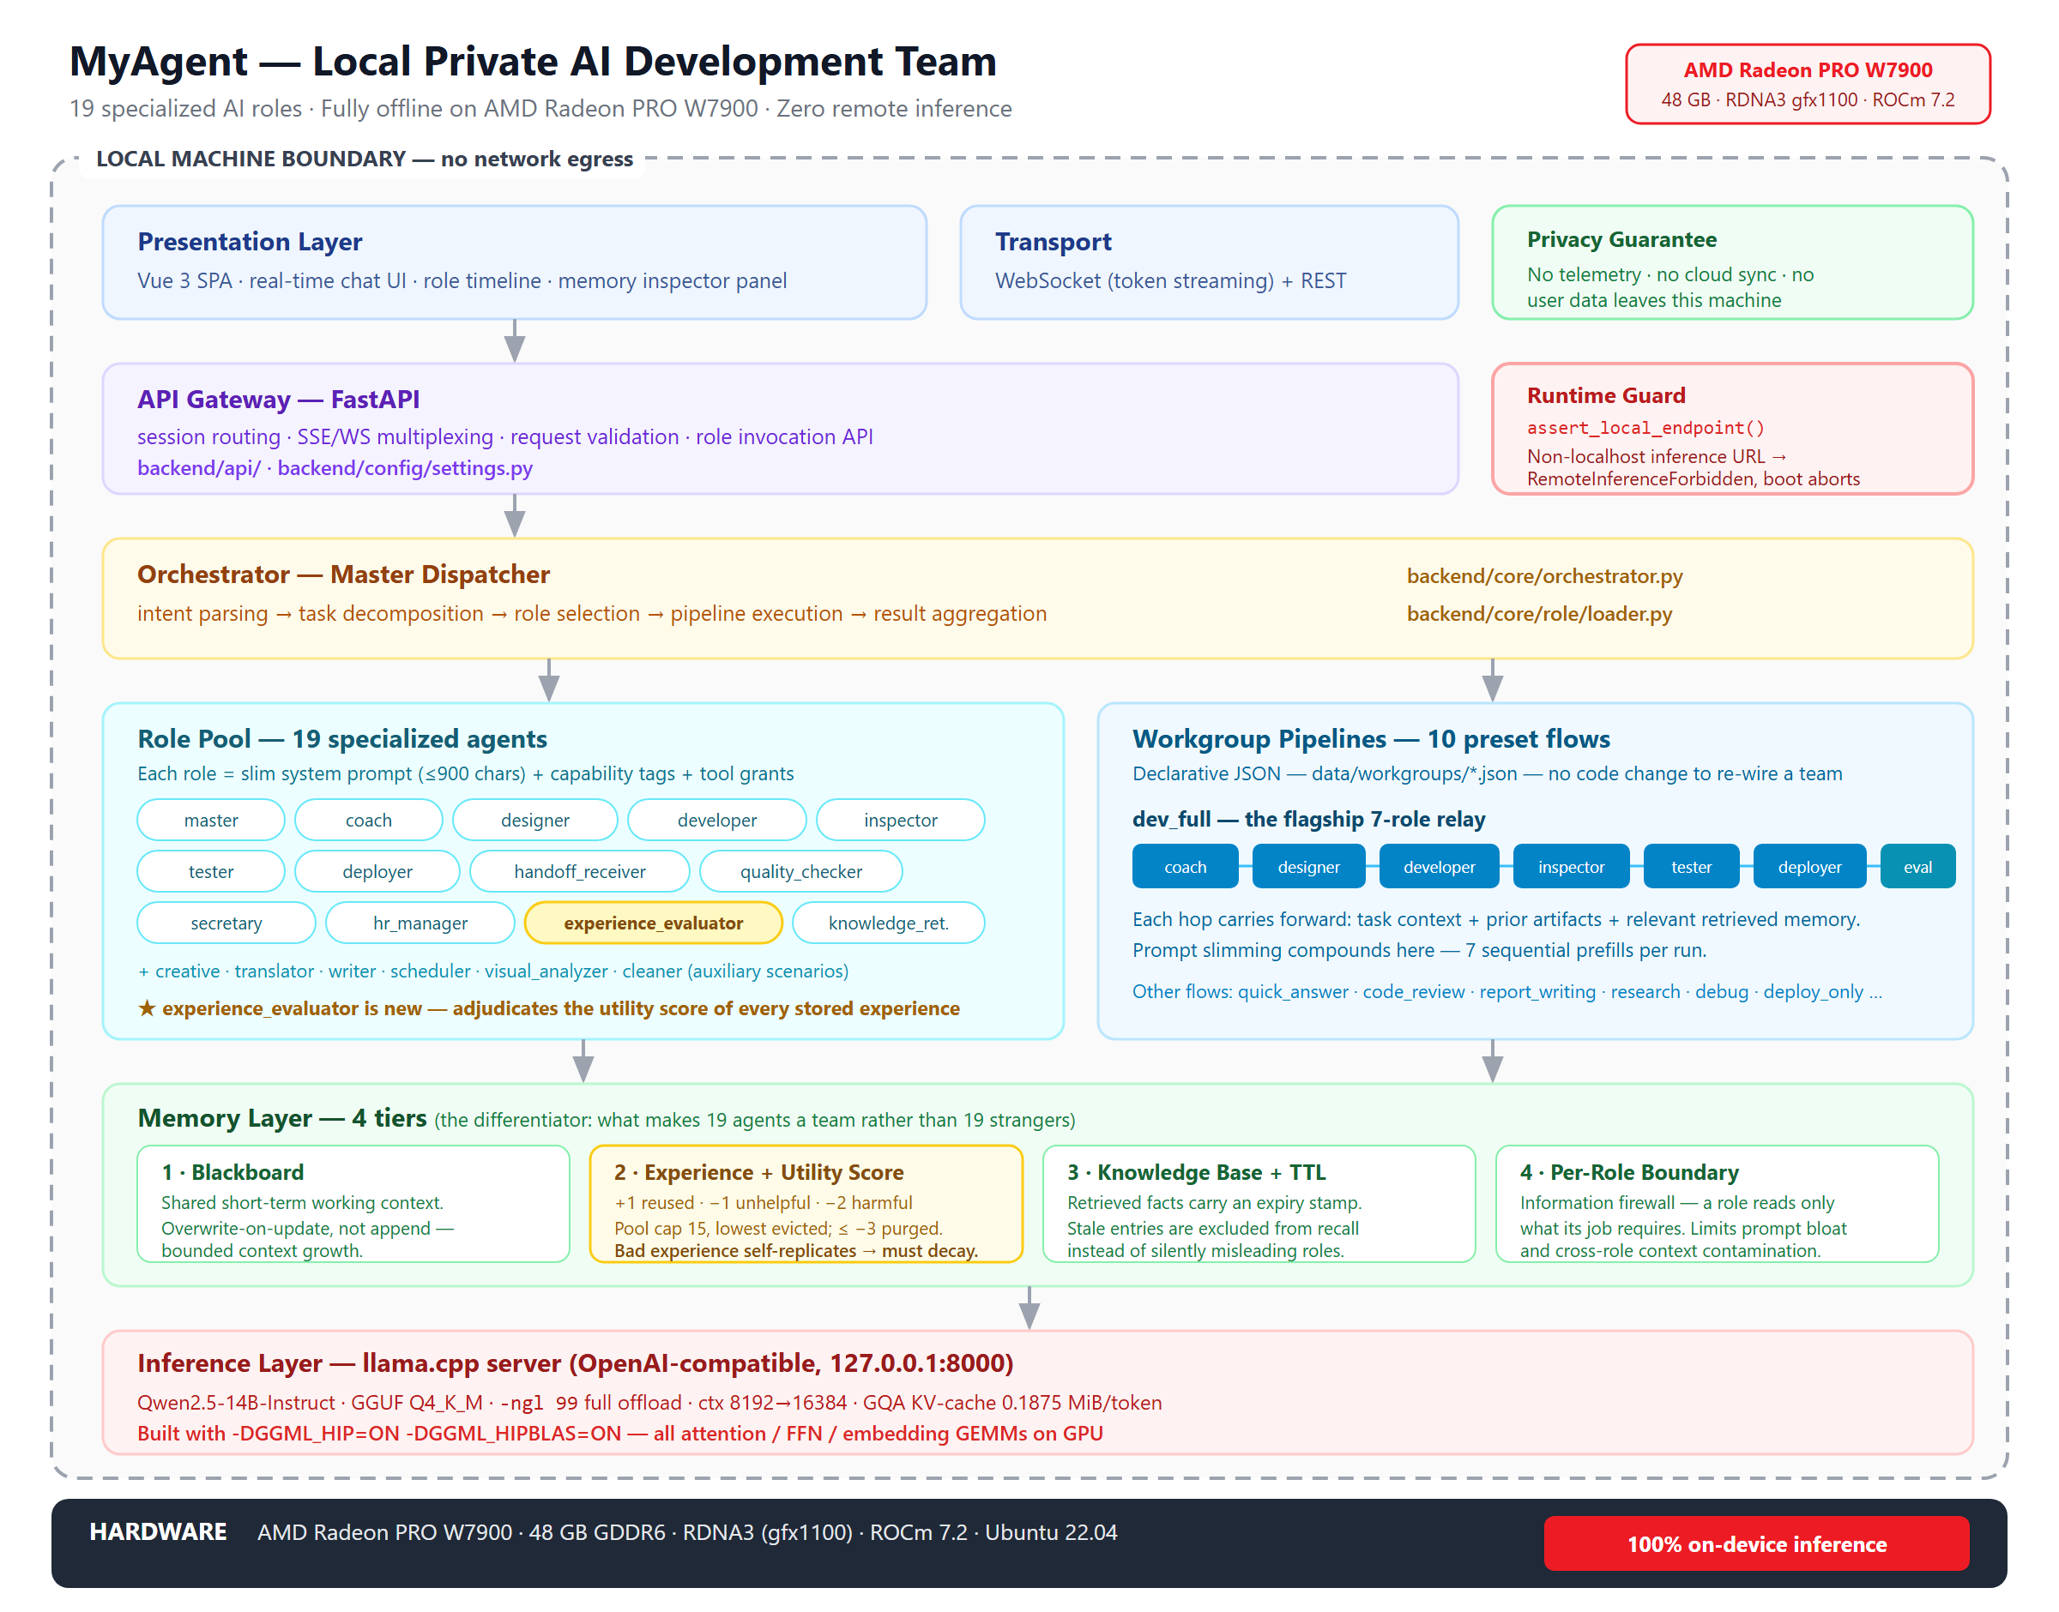
SYSTEM ARCHITECTURE
AMD RADEON • ROCm 7.2
Six layers, one offline process
READING THE DIAGRAM
L1 · Inference
llama.cpp + HIPBLAS on W7900. GGUF Q4_K_M, ctx 8k–16k. No Python / CUDA layer.
L2 · Orchestrator
FastAPI + WebSocket. Master dispatcher routes by intent and routes never share context.
L3 · Role pool
19 specialized agents, each with a slim prompt (≤900 chars) and capability tags.
L4 · Memory × 4
Blackboard + utility-scored experience + TTL knowledge + per-role boundary. See slide 06.
L5 · API gateway
REST + SSE multiplexing, request validation. Local-only base-urls enforced in settings.
L6 · Presentation
MyAgent — Local Private AI Development Team
Vue 3 SPA — chat view, role timeline, memory inspector. No telemetry, no CDN.
04 / 10
Figure 1 — end-to-end MyAgent stack, 19 roles → orchestrator → 1 Radeon GPU.

Slide 5
CORE CAPABILITIES
AMD RADEON • ROCm 7.2
All five Track-2 checkpoint features — delivered
The hackathon mandates 5-of-2. We shipped 5-of-5: each is wired to a real backend module.
RAG
01
Tool use
02
Planning
03
Knowledge retriever
Function dispatch
Multi-step orchestration
Triple-store knowledge + semantic search. No vectors, no Chroma — fast on CPU and survives restarts.
Each role advertises tool grants via JSON. Web search disabled in private mode; filesystem read/write whitelisted.
10 preset workgroups (dev_full, report_writing, code_review, …). Each lists members + pipeline steps in JSON.
Memory
04
Privacy
05
Four-tier progressive memory
Local-only inference guard
Blackboard → Experience → Knowledge with TTL → Per-role boundary. Decay by design.
Runtime assert_local_endpoint() blocks any non-localhost base URL. Verified against 3 remote hosts.
MyAgent — Local Private AI Development Team
05 / 10

Slide 6
MEMORY IS THE DIFFERENTIATOR
AMD RADEON • ROCm 7.2
Four tiers + utility scoring — the math that makes 19 agents a team
1
2
3
4
THE MATH: utility_score
↑ +1 → reused, task passed
← 0 → not matched (no penalty)
↓ −1 → injected, task failed
↓ −2 → injected, actively misleading
✖ ≤−3 → archived, never reused
1 · Blackboard
2 · Experience
3 · Knowledge
4 · Per-role boundary
Shared short-term context.
Each success + failure recorded with utility score.
Triple-store with TTL: 6mo / 3mo / 2mo / permanent.
Each role accumulates only inside its own scope.
WHY THIS MATTERS
Overwrite-on-update, no append. Bounded growth.
+1 reused → −1 unhelpful → −2 misleading.
Stale entries expire instead of silently misleading roles.
Information firewall prevents cross-role contamination.
Harvard 2025: add-all experience replay hurts more than storing nothing — wrong experiences self-replicate. Scoring + eviction break the loop.
HOW THE EVALUATOR SCORES A FINISHED RUN
Pipeline ends
Evaluator reads
vote(experience, ±1/0/−1/−2)
Eviction at ≤−3
exec result ok?
rules + run log
decided by run
auto-archive
MyAgent — Local Private AI Development Team
06 / 10

Slide 7
SPEED OPTIMIZATION
AMD RADEON • ROCm 7.2
59.9% system prompt slimming — measured at the character level
TOTAL PROMPT CJK CHARACTERS
PER-ROLE CJK CHARACTERS — before / after
38,190
15,317
ROLE
BEFORE
AFTER
DELTA
→
coach
master
developer
designer
inspector
tester
deployer
knowledge_retriever
quality_checker
9 standard roles
total / 18 roles
3,882
2,453
2,084
1,967
2,304
2,057
1,941
2,098
1,721
(8,961)
38,190
868
1,086
640
667
839
717
847
898
601
(4,353)
15,317
−78%
−56%
−69%
−66%
−64%
−65%
−56%
−57%
−65%
−51%
−59.9%
before — after
−59.9%
across all 18 working role prompts
INFERENCE SPEED BENCHMARK
PROMPT_VARIANT=slim → loader reads prompt.slim.txt; unset reads prompt.txt. Switching is one env var.
Live A/B TTFT + tokens/s + blind quality score: not yet captured — awaiting Radeon Cloud queue window.
MyAgent — Local Private AI Development Team
07 / 10

Slide 8
DEPLOYMENT
AMD RADEON • ROCm 7.2
One Radeon. No Docker. Five shell commands to a running system.
HARDWARE
AMD Radeon PRO W7900 · 48GB GDDR6 · RDNA3 gfx1100
A/B SPEED BENCHMARK
Status
PENDING
RUNTIME
Ubuntu 22.04 · ROCm 7.2 · llama.cpp + HIPBLAS
Awaiting the Radeon Cloud GPU queue. Three measurement dimensions will be published once the A/B run completes:
MODELS
Qwen2.5-14B-Instruct Q4_K_M · Qwen2.5-VL-7B
prompt_tokens / dev_full
from llama-server usage field
CONTEXT
ctx-size 8192–16384 · ngl 99 · GQA KV-cache 0.1875 MiB/token
TTFT (first-token latency)
measured per request
end-to-end latency
GUARD
assert_local_endpoint() · ALLOWED_HOSTS = localhost / 127.0.0.1 / ::1
pipeline start → end
quality (blind)
1–5 from quality_checker
SECRETS
Settings(extra="ignore") · ZHIPU/OPENAI/CLOUD_* all unreachable by field
no fabricated numbers — measurements only.
MyAgent — Local Private AI Development Team
08 / 10

Slide 9
DEMO · DEV_FULL PIPELINE
AMD RADEON • ROCm 7.2
Seven roles, one relay — plus the 90-second memory poisoning test
coach
designer
developer
inspector
tester
deployer
evaluator
plan
design
implement
audit
verify
ship
score
Each hop carries task context + prior artifacts + relevant retrieved memory. Prompt slimming compounds: -7 sequential prefills per run.
90-SECOND MEMORY POISONING TEST — a falsifiable demo of memory self-eviction
0–15s
15–35s
35–60s
60–80s
80–90s
First run
Second run
Poison
Repeat
Knowledge view
team fumbles through; experience recorded, utility_score = 0
experience injected (highlighted), succeeds; evaluator awards +1
operator tampers one record with wrong step; run fails; evaluator marks the misleader −2
tampered score → −3; auto-archived; pipeline returns to clean run
one TTL-expired triple displays “may be stale”, validates the freshness gate
MyAgent — Local Private AI Development Team
09 / 10

Slide 10
AMD AI DEVMASTER 2026 • TRACK 2
Thank you.
MyAgent · 19 roles on one Radeon card · zero remote inference
TEAM
EMAIL
DEMO
REPO
bry9107795553
118060862@qq.com
[Link to demo video]
github.com/bry9107795553/MyAgent
AMD Radeon PRO W7900 • ROCm 7.2 • llama.cpp + HIPBLAS • Qwen2.5-14B-Instruct Q4_K_M • FastAPI • Vue 3

