Slide 1
Basic Docker and Docker Compose
Tuesday Sept 24, 2019

Slide 2
Bare essentials for a microservice
Web server
API server
Data store
Web pages, JavaScript, CSS
Learn enough to containerize these.

Slide 3
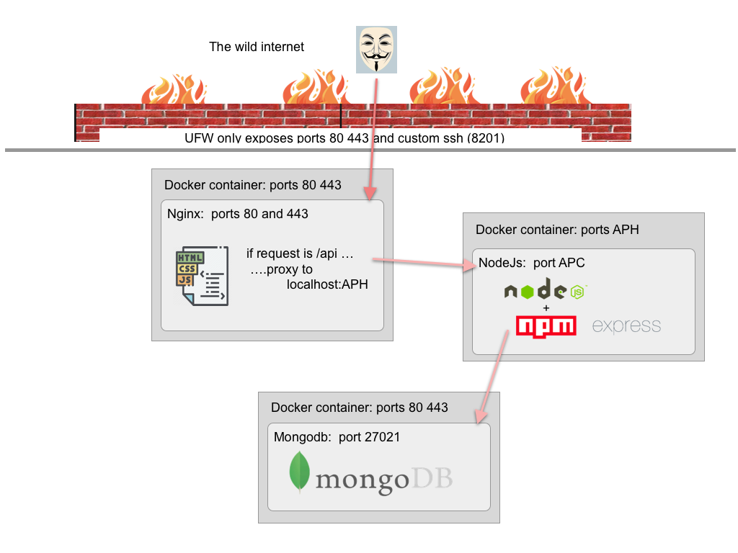
More secure

Slide 4
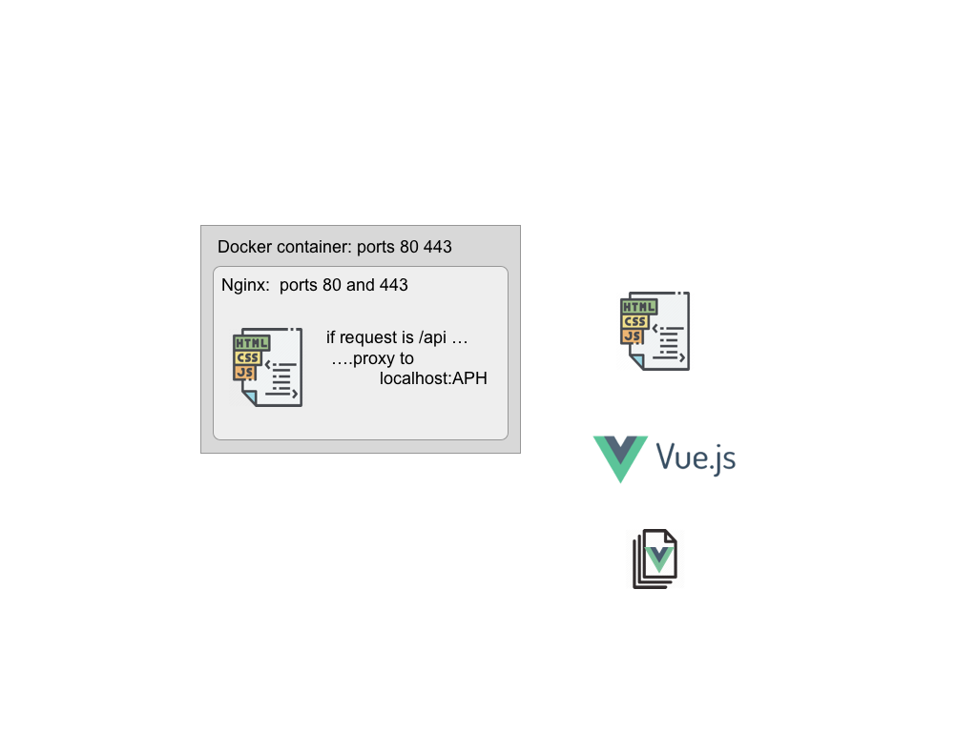
Brief intro to vue js
How does Vue produce the static web site and
How the files get into the web server container?

