Slide 1
Weather Station Architecture
Bryan Starbuck

Slide 2
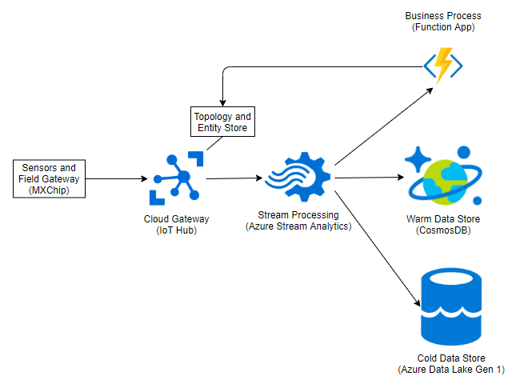
Proof of Value Architecture

Slide 3
Core Systems and Subsystems
Field Gateway to read sensor data and communicate with the cloud
Cloud Gateway for a secure connection for all devices
Stream processing to process IoT messages and route to appropriate location
Cold Data Store for large historical data queries
Warm Data Store for simpler time series analytics like alerting
Topology and Entity Store to manage catalog of devices. Each device Twin maintains the device state.
This is needed to report the wind speed and increase or decrease the rate of messages coming from the weather station.

Slide 4
Future Subsystems
Other subsystems omitted from the Proof of Value architecture:
UI and Reporting
User Management
For the PoV phase all data access will use the warm or cold data stores directly. Future user management will be built with Azure Active Directory.
UI and Reporting could be added in a future phase.

