Slide 1
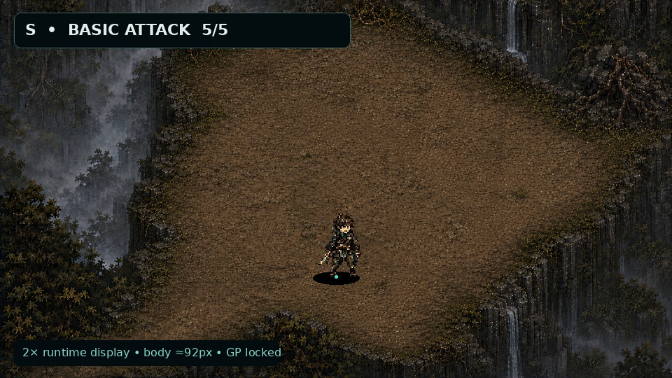
UNMAEK
PLAYER RUNTIME
MOTION PILOT v1
8-DIRECTION LOCK
S / E REAL FRAME PROOF
기준: 컨셉 원본 + hero runtime keyposes · 2026-08-05
S · 960×540 gameplay composite · 2× nearest · body ≈92px
UNMAEK_PLAYER_RUNTIME_MOTION_PILOT_v1
01
Notes:
[Sources]
- project_sources/08-png
- project_sources/07-hero_runtime_keyposes.png
- PLAYER_RUNTIME_LOCK.md
- previews/gameplay_960x540/player_s_gameplay_960x540.mp4

Slide 2








주인공 — 8방향 standing lock
64×64 canonical canvas · Ground Point (32,57) · 모든 방향 오른손 단검
01 · N · 64×64 RGBA
02 · NE · 64×64 RGBA
03 · E · 64×64 RGBA
04 · SE · 64×64 RGBA
05 · S · 64×64 RGBA
06 · SW · 64×64 RGBA
07 · W · 64×64 RGBA
08 · NW · 64×64 RGBA
player/direction_lock/ · canonical standing frame 8
N · rear authority
SW · asymmetry corrected
NE · asymmetry corrected
W · right-hand dagger
E · right-hand dagger
NW · asymmetry corrected
SE · asymmetry corrected
bag · left-rear hip
S · front authority
cape asymmetry · GP (32,57)
PLAYER · DIRECTION LOCK
02
Notes:
[Sources]
- PLAYER_RUNTIME_LOCK.md
- player/direction_lock/player_n.png … player_nw.png

Slide 3


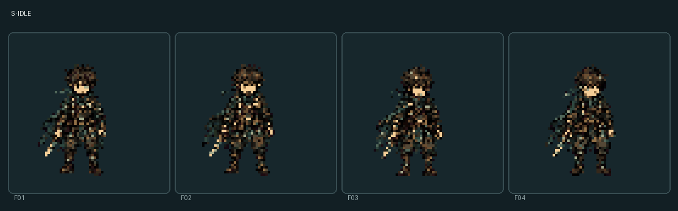
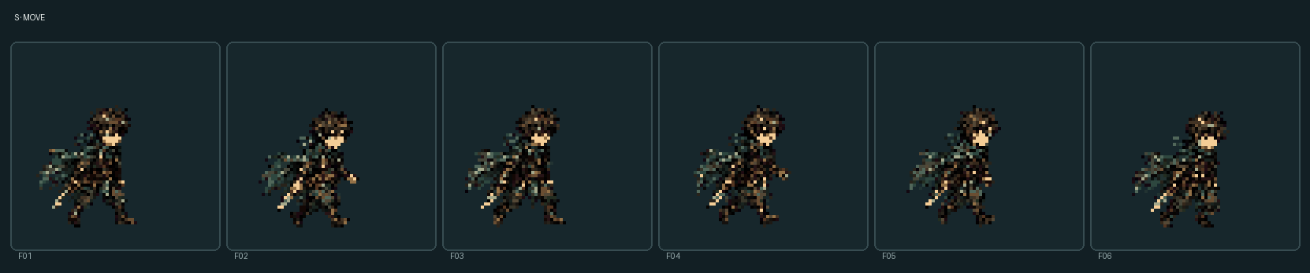
S — idle / move
idle 발 고정 호흡 4f · move 실제 디딤·무릎·장비 후행 6f
01 · S IDLE · 4 FRAME
02 · S MOVE · 6 FRAME
03 · IDLE NATIVE FRAME
04 · MOVE CONTACT FRAME
actual sequence evidence · 64×64 RGBA · nearest only
S idle · 4f · 180ms each
S move · 6f · 90ms each
feet fixed · breath / weight shift
actual step and knee change
cape and bag follow one beat late
loop GP delta 0px · slide 0
PLAYER · S LOCOMOTION
03
Notes:
[Sources]
- player/s/idle/*.png
- player/s/move/*.png
- previews/motion/player_s_all_motion.mp4

Slide 4


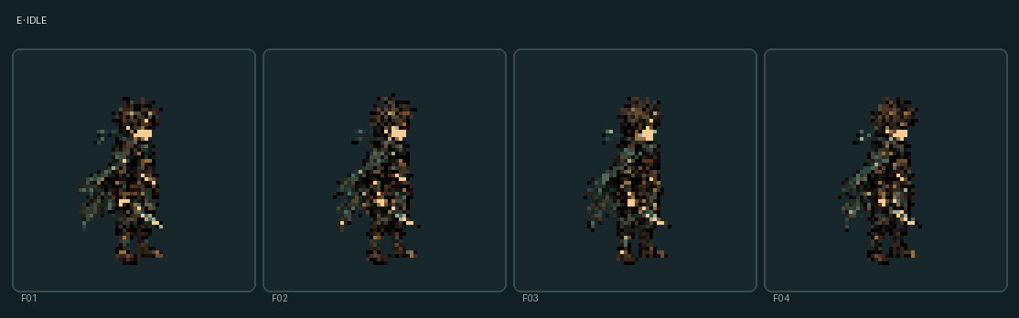
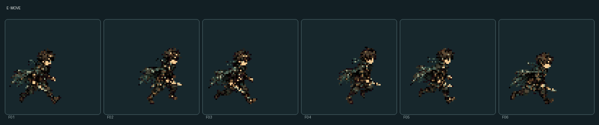
E — idle / move
side silhouette에서 발 디딤·어깨–골반 역회전·망토 후행이 분리됨
01 · E IDLE · 4 FRAME
02 · E MOVE · 6 FRAME
03 · IDLE NATIVE FRAME
04 · MOVE CONTACT FRAME
actual sequence evidence · S 회전 복제 아님
E idle · 4f · 180ms each
E move · 6f · 90ms each
feet fixed · no whole-body float
step / shoulder / pelvis change
dagger remains in right hand
loop GP delta 0px · slide 0
PLAYER · E LOCOMOTION
04
Notes:
[Sources]
- player/e/idle/*.png
- player/e/move/*.png
- previews/motion/player_e_all_motion.mp4

Slide 5


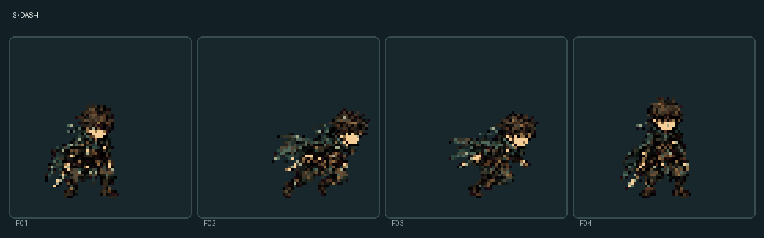
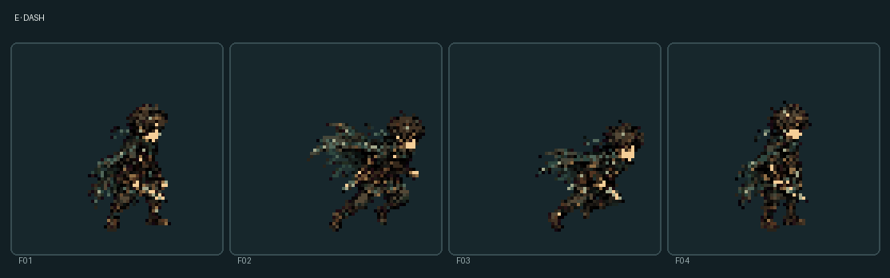
dash — 준비 → 추진 → 이동 → 복귀
순간이동·잔상 없이 짧은 회피 동작, S/E 각각 4 frame
01 · S DASH · 4 FRAME
02 · E DASH · 4 FRAME
03 · S PROPULSION
04 · E TRAVEL
actual frame change · translation-only 0
S dash · prepare / push / travel / return
E dash · independent side silhouette
low practical evasive posture
bag / cape follow propulsion
no blur · no afterimage
same canonical GP; collision unchanged
PLAYER · DASH
05
Notes:
[Sources]
- player/s/dash/*.png
- player/e/dash/*.png
- PLAYER_MOTION_VALIDATION_REPORT.md

Slide 6







basic attack — 짧고 실용적인 단검 베기
준비·어깨 회전·단검 궤적·접촉·복귀 5f; 전문 검술 과장 없음
S · PREP
S · CONTACT
S · RETURN
E · PREP
E · CONTACT
E · RETURN
E · TRAJECTORY SHEET
dagger_tip recorded per frame · attack timing unchanged
S f01 · prepare
E f03 · visible blade contact
S f03 · visible blade contact
E f05 · recovery
S f05 · recovery, no idle snap
5f sheet candidate · RGBA
E f01 · prepare
PLAYER · BASIC ATTACK
06
Notes:
[Sources]
- player/s/basic_attack/*.png
- player/e/basic_attack/*.png
- PLAYER_ANCHOR_OFFSETS.json

Slide 7







parry — 전진 공격과 분리된 중심 고정
main 5f + success 1 + failure 1; 기존 360° gameplay 판정 유지
S · ENTRY
S · CONTACT
S · SUCCESS
E · ENTRY
E · CONTACT
E · SUCCESS
E · FAILURE
success/failure are auxiliary visual frames, not new states
S entry · no forward lunge
E contact guard
S center lock
E success recoil
S success recoil
E failure loses balance, then recovers
E entry · independent silhouette
PLAYER · PARRY
07
Notes:
[Sources]
- player/s/parry/*.png
- player/e/parry/*.png
- PLAYER_MOTION_MANIFEST.json

Slide 8








word skill — 몸의 지정 동작이 공명보다 먼저
대상 확인·단검 지정·쇄골 공명·언령 발생·복귀, 상시 발광 없음
S · 5f SHEET
S · TARGET
S · RESONANCE
S · RETURN
E · 5f SHEET
E · TARGET
E · RESONANCE
E · RETURN
visual anchors: word_target + collarbone_resonance
S sequence · body cue first
E sequence · no mage pose
S f01 target check
E f01 target check
S f03 controlled resonance
E f03 designation
S f05 tension release
E f05 return
VFX is staging only
word gameplay unchanged
PLAYER · WORD SKILL
08
Notes:
[Sources]
- player/s/word_skill/*.png
- player/e/word_skill/*.png
- PLAYER_ANCHOR_OFFSETS.json

Slide 9








hit / recover — 짧은 균형 붕괴와 회수
과장된 비행 없이 3f; 단검·가방·망토가 끝까지 유지됨
S · 3f SHEET
S · HIT
S · IMBALANCE
S · RECOVER
E · 3f SHEET
E · HIT
E · IMBALANCE
E · RECOVER
damage → imbalance → recover · no state or collision change
S sequence · 3 actual frames
E sequence · 3 actual frames
S f01 impact
E f01 impact
S f02 balance loss
E f02 balance loss
S f03 recovery
E f03 recovery
dagger / bag / cape retained
no exaggerated knockback
PLAYER · HIT / RECOVER
09
Notes:
[Sources]
- player/s/hit_recover/*.png
- player/e/hit_recover/*.png
- PLAYER_MOTION_VALIDATION_REPORT.md

Slide 10
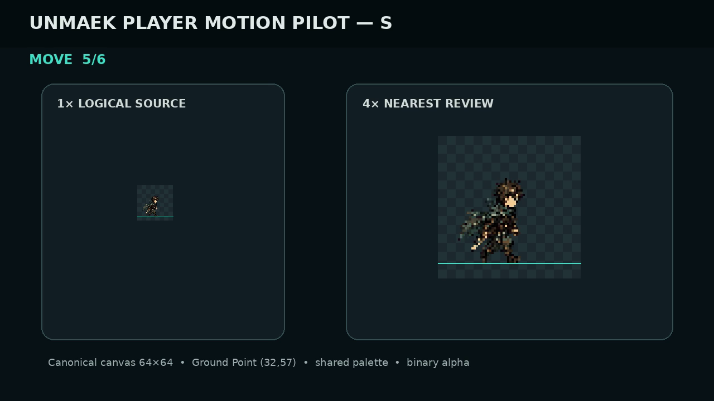
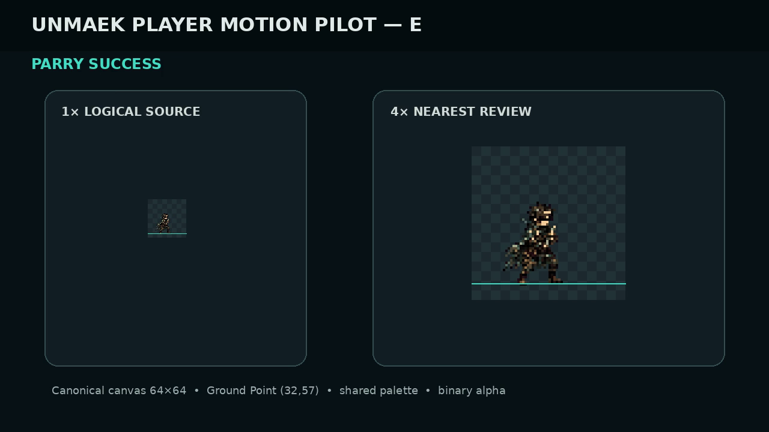
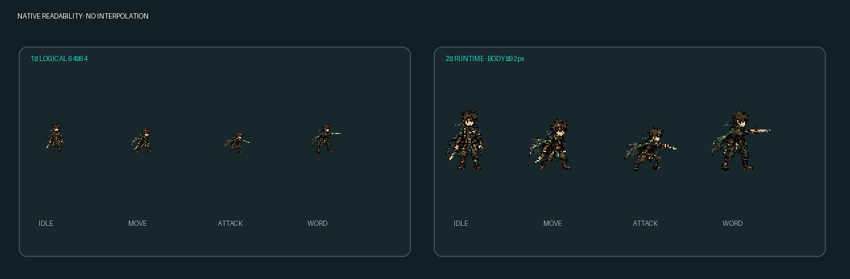
실제 1× 가독성 — 4× 확대 없이 행동 판독
logical 64×64와 runtime 2× nearest를 함께 확인; 방향·디딤·공격·지정 PASS
01 · 1× LOGICAL + 2× RUNTIME
02 · S · 1× / 4× MP4 FRAME
03 · E · 1× / 4× MP4 FRAME
motion MP4 includes actual 1× and nearest 4× simultaneously
standing body 90–94px at runtime 2×
previews/motion/player_e_all_motion.mp4
previews/motion/player_s_all_motion.mp4
PLAYER · NATIVE READABILITY
10
Notes:
[Sources]
- previews/motion/player_s_all_motion.mp4
- previews/motion/player_e_all_motion.mp4
- PLAYER_MOTION_VALIDATION_REPORT.md

Slide 11
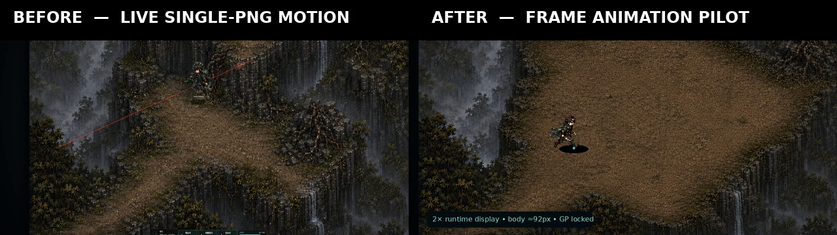
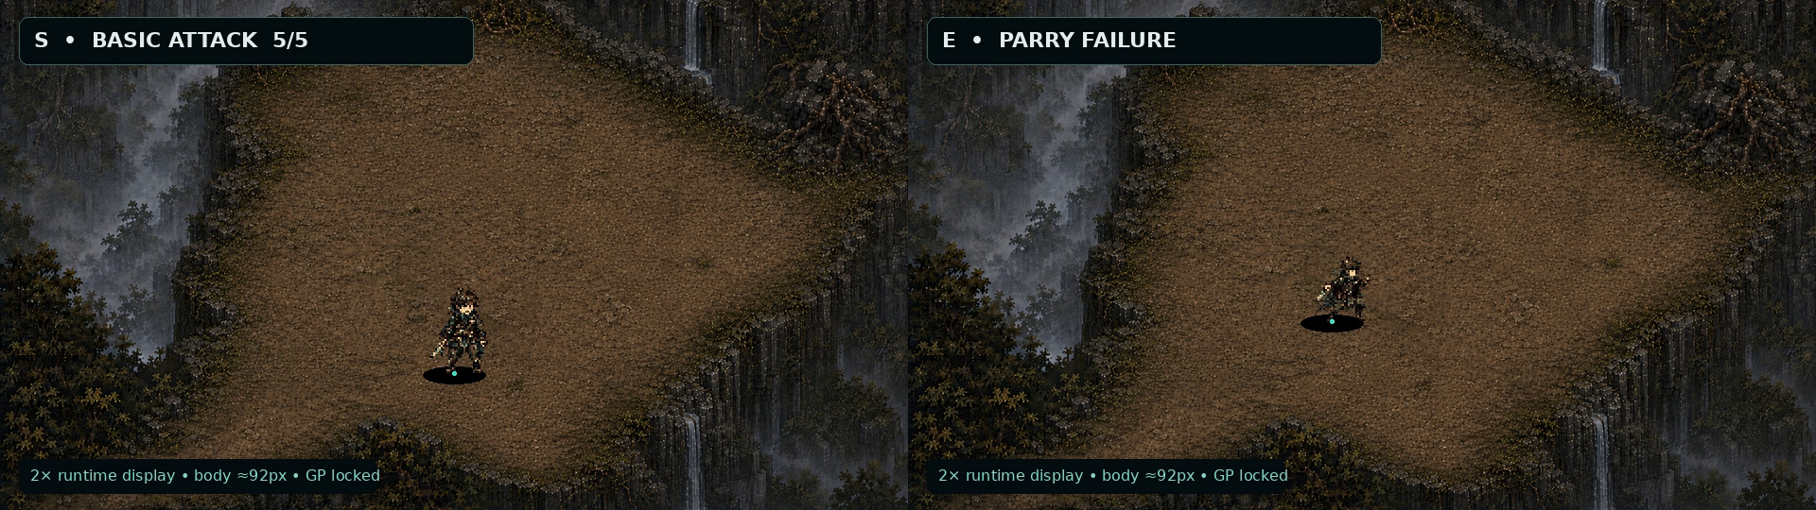
960×540 before / after — 개선이 재생에서 즉시 보임
현재 live single-PNG 이동과 새 S/E 프레임 재생을 동일 화면 배율로 비교
01 · LIVE SINGLE PNG vs NEW MOTION
02 · S / E GAMEPLAY COMPOSITE
approved ACT 1 recovery map · body ≈92px · GP locked
previews/before_after/player_single_png_vs_new_motion.mp4
previews/gameplay_960x540/player_[s|e]_gameplay_960x540.mp4
PLAYER · GAMEPLAY PROOF
11
Notes:
[Sources]
- project_sources/02-ACT1-08-04.mp4
- previews/before_after/player_single_png_vs_new_motion.mp4
- previews/gameplay_960x540/player_s_gameplay_960x540.mp4
- previews/gameplay_960x540/player_e_gameplay_960x540.mp4

Slide 12
최종 검증 PASS — blocker 0
76 actual frame PNG · 15 sprite sheets · 5 playback MP4 · gameplay change 0
8
68
5
0
방향 lock
S/E motion
검증 MP4
duplicate / translation
PASS 범위
최종 판정
RGBA 8-bit · binary alpha · transparent corners
shared palette 30 · crop/blur/nonuniform scale 0
idle/move Ground Point loop delta 0px
1× / 960×540 readability PASS
PASS
S/E 제작 방식은 나머지 6방향으로 확대 가능
개발 staging에서 timing·VFX attachment 확인 후 확장
VALIDATION & EXPANSION
12
Notes:
[Sources]
- PLAYER_MOTION_VALIDATION_REPORT.md
- PLAYER_MOTION_MANIFEST.json
- PLAYER_ANCHOR_OFFSETS.json

