Slide 1
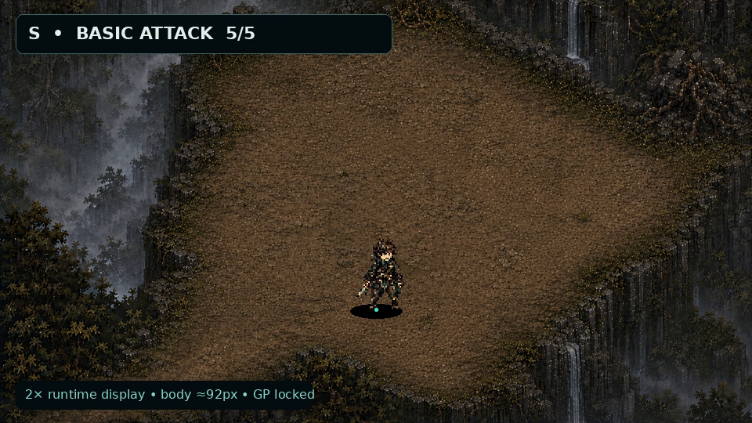
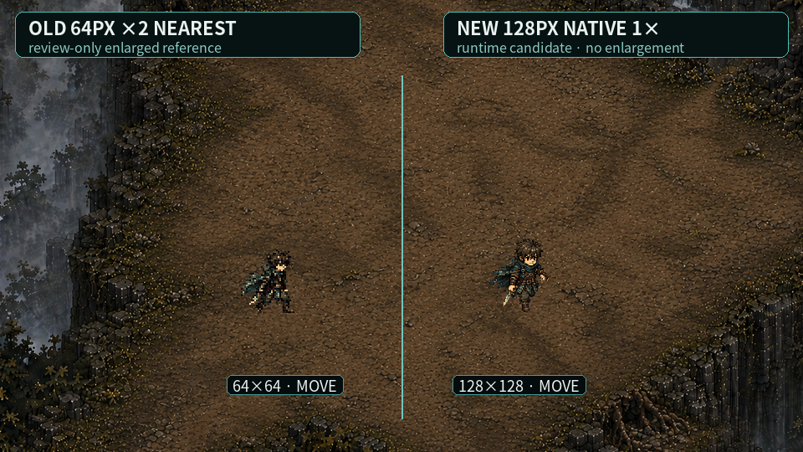
UNMAEK
ACT 1 SHOWCASE
MOTION + VFX HANDOFF
NATIVE 128PX PLAYER
FULL-8 + IDENTITY VFX
Sources: concept · keyposes · ACT 1 map/video · prior pilots
Old 64px review vs new native 128px · 960×540 proof
UNMAEK_ACT1_SHOWCASE_MOTION_VFX_HANDOFF_v1
01
Notes:
[Sources]
- UNMAEK_ACT1_SHOWCASE_MOTION_VFX_HANDOFF_v1
- User-provided 주인공 컨셉 원본.png and hero_runtime_keyposes.png
- UNMAEK_PLAYER_RUNTIME_MOTION_PILOT_v1
- UNMAEK_COMBAT_MOTION_FRAME_RECOVERY_PILOT_v1
- UNMAEK_VISUAL_RECOVERY_RUNTIME_EXPORT_v1
- Approved ACT 1 general map and supplied ACT 1 play video

Slide 2
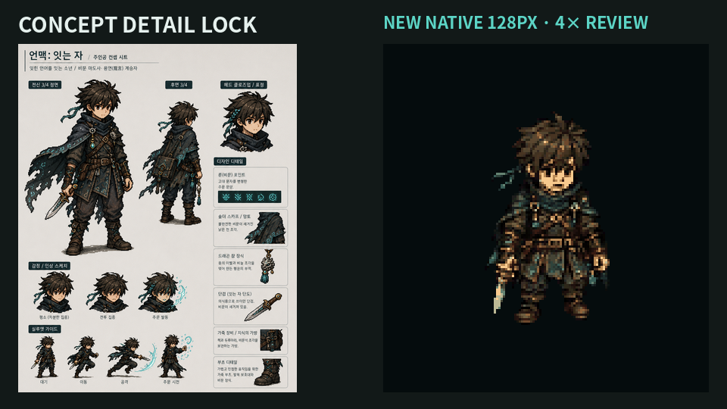
UNMAEK
CONCEPT DETAIL
LOCK
SAME 15-YEAR-OLD INVESTIGATOR
NO REDESIGN
Hair · face · teal scarf · cape · dagger · bag · boots
A details read at runtime; B details read on attack / word
UNMAEK_ACT1_SHOWCASE_MOTION_VFX_HANDOFF_v1
02
Notes:
[Sources]
- UNMAEK_ACT1_SHOWCASE_MOTION_VFX_HANDOFF_v1
- User-provided 주인공 컨셉 원본.png and hero_runtime_keyposes.png
- UNMAEK_PLAYER_RUNTIME_MOTION_PILOT_v1
- UNMAEK_COMBAT_MOTION_FRAME_RECOVERY_PILOT_v1
- UNMAEK_VISUAL_RECOVERY_RUNTIME_EXPORT_v1
- Approved ACT 1 general map and supplied ACT 1 play video

Slide 3
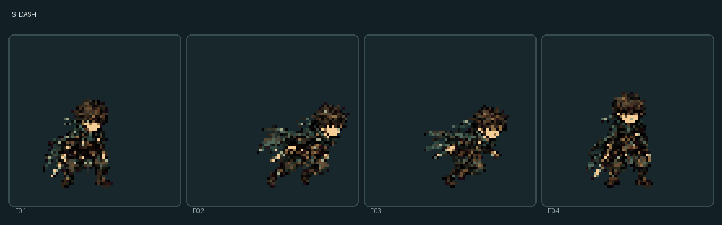
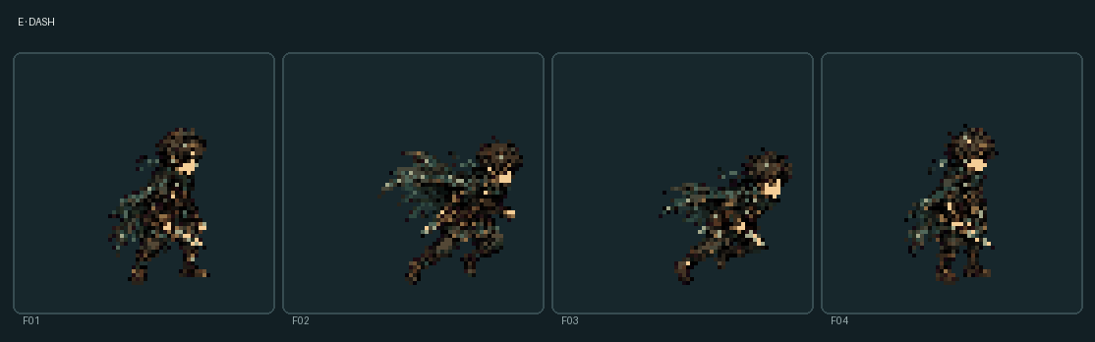



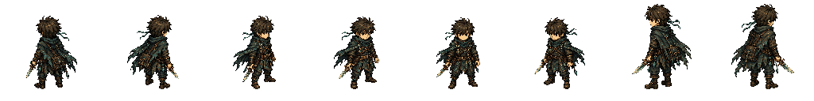
64PX → 128PX — NATIVE REPLACEMENT
Old pilot remains sequence/anchor reference only; runtime enlargement is retired
01 · OLD 64PX LOCK
02 · NEW 128PX LOCK
03 · SCREEN PROOF
04 · DETAIL LOCK
No old runtime pixels reused
Old: 64×64 · 2× review enlargement
New: 128×128 · 1.0× native
Standing body 89–96px
Canonical GP fixed at (64,112)
No bilinear / bicubic / soft AA
Visual gain: face, dagger, bag, cape, boots
UNMAEK_ACT1_SHOWCASE_MOTION_VFX_HANDOFF_v1
03
Notes:
[Sources]
- UNMAEK_ACT1_SHOWCASE_MOTION_VFX_HANDOFF_v1
- User-provided 주인공 컨셉 원본.png and hero_runtime_keyposes.png
- UNMAEK_PLAYER_RUNTIME_MOTION_PILOT_v1
- UNMAEK_COMBAT_MOTION_FRAME_RECOVERY_PILOT_v1
- UNMAEK_VISUAL_RECOVERY_RUNTIME_EXPORT_v1
- Approved ACT 1 general map and supplied ACT 1 play video

Slide 4








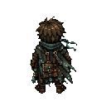
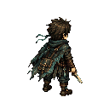
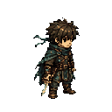
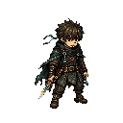
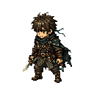
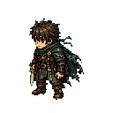
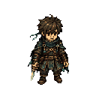
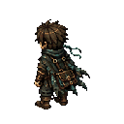
FULL-8 IDLE — SAME BOY, FIXED FEET
128×128 · 4f each direction · GP (64,112) · loop delta 0px
01 · N · IDLE F01
02 · NE · IDLE F01
03 · E · IDLE F01
04 · SE · IDLE F01
05 · S · IDLE F01
06 · SW · IDLE F01
07 · W · IDLE F01
08 · NW · IDLE F01
player/full8/idle · 32 native frames
N · rear hair / cape
SW · bag / cape corrected
NE · rear 3/4 reads
W · right-hand dagger
E · shoulder top visible
NW · left-rear bag reads
SE · face / teal scarf
S · chest / face reads
bag · left-rear hip
cape asymmetry · no halo
PLAYER · FULL-8 IDLE
04
Notes:
[Sources]
- UNMAEK_ACT1_SHOWCASE_MOTION_VFX_HANDOFF_v1
- User-provided 주인공 컨셉 원본.png and hero_runtime_keyposes.png
- UNMAEK_PLAYER_RUNTIME_MOTION_PILOT_v1
- UNMAEK_COMBAT_MOTION_FRAME_RECOVERY_PILOT_v1
- UNMAEK_VISUAL_RECOVERY_RUNTIME_EXPORT_v1
- Approved ACT 1 general map and supplied ACT 1 play video

Slide 5
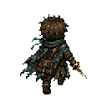
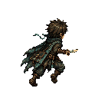
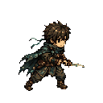
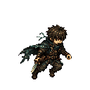
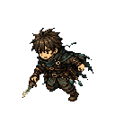
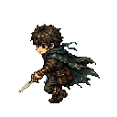
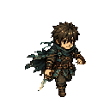
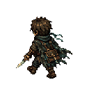
FULL-8 MOVE — FEET AND WEIGHT READ
128×128 · 6f each direction · alternating steps · loop delta 0px
01 · N · MOVE CONTACT
02 · NE · MOVE CONTACT
03 · E · MOVE CONTACT
04 · SE · MOVE CONTACT
05 · S · MOVE CONTACT
06 · SW · MOVE CONTACT
07 · W · MOVE CONTACT
08 · NW · MOVE CONTACT
player/full8/move · 48 native frames
N · leg split reads
SW · diagonal progress reads
NE · shoulder / hip counter
W · side-top camera held
E · dagger hand stable
NW · cape and bag lag
SE · opposite foot contact
S · knees remain separate
foot slide · 0
translation-only frame · 0
PLAYER · FULL-8 MOVE
05
Notes:
[Sources]
- UNMAEK_ACT1_SHOWCASE_MOTION_VFX_HANDOFF_v1
- User-provided 주인공 컨셉 원본.png and hero_runtime_keyposes.png
- UNMAEK_PLAYER_RUNTIME_MOTION_PILOT_v1
- UNMAEK_COMBAT_MOTION_FRAME_RECOVERY_PILOT_v1
- UNMAEK_VISUAL_RECOVERY_RUNTIME_EXPORT_v1
- Approved ACT 1 general map and supplied ACT 1 play video

Slide 6
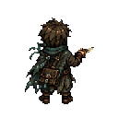
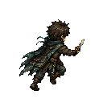
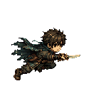
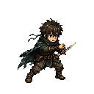
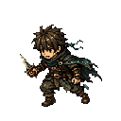
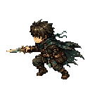
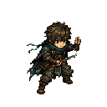
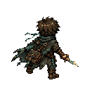
FULL-8 DASH — SHORT EVASION, NO TELEPORT
128×128 · 4f each direction · prepare / lower / push / recover
01 · N · DASH PUSH
02 · NE · DASH PUSH
03 · E · DASH PUSH
04 · SE · DASH PUSH
05 · S · DASH PUSH
06 · SW · DASH PUSH
07 · W · DASH PUSH
08 · NW · DASH PUSH
player/full8/dash · 32 native frames
N · center lowered
SW · short hazard escape
NE · propulsion silhouette
W · no light streak
E · bag follows push
NW · cape follows one beat late
SE · body remains grounded
S · no vanish / blink
afterimage · 0
dash distance / collision change · 0
PLAYER · FULL-8 DASH
06
Notes:
[Sources]
- UNMAEK_ACT1_SHOWCASE_MOTION_VFX_HANDOFF_v1
- User-provided 주인공 컨셉 원본.png and hero_runtime_keyposes.png
- UNMAEK_PLAYER_RUNTIME_MOTION_PILOT_v1
- UNMAEK_COMBAT_MOTION_FRAME_RECOVERY_PILOT_v1
- UNMAEK_VISUAL_RECOVERY_RUNTIME_EXPORT_v1
- Approved ACT 1 general map and supplied ACT 1 play video

Slide 7
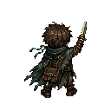
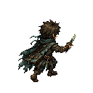
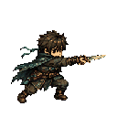
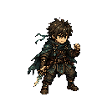
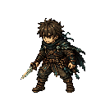
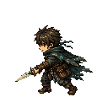
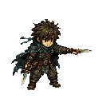
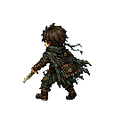
FULL-8 BASIC ATTACK — SHORT FIELD CUT
128×128 · 5f each direction · contact pose maps to existing hit timestamp
01 · N · ATTACK CONTACT
02 · NE · ATTACK CONTACT
03 · E · ATTACK CONTACT
04 · SE · ATTACK CONTACT
05 · S · ATTACK CONTACT
06 · SW · ATTACK CONTACT
07 · W · ATTACK CONTACT
08 · NW · ATTACK CONTACT
player/full8/basic_attack · 40 native frames
N · dagger direction reads
SW · practical short cut
NE · shoulder / hip turn
W · right-hand blade
E · no body teleport
NW · follow-through present
SE · contact before return
S · novice field response
dagger_tip · per-frame coords
damage / range / timing change · 0
PLAYER · FULL-8 ATTACK
07
Notes:
[Sources]
- UNMAEK_ACT1_SHOWCASE_MOTION_VFX_HANDOFF_v1
- User-provided 주인공 컨셉 원본.png and hero_runtime_keyposes.png
- UNMAEK_PLAYER_RUNTIME_MOTION_PILOT_v1
- UNMAEK_COMBAT_MOTION_FRAME_RECOVERY_PILOT_v1
- UNMAEK_VISUAL_RECOVERY_RUNTIME_EXPORT_v1
- Approved ACT 1 general map and supplied ACT 1 play video

Slide 8
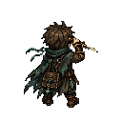
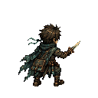
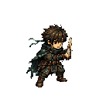
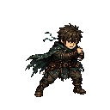
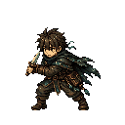
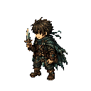
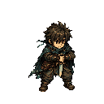
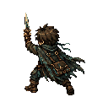
FULL-8 PARRY — CRISIS DEFENSE, NOT A LUNGE
128×128 · 5f each direction · 360° gameplay judgment unchanged
01 · N · PARRY ACTIVE
02 · NE · PARRY ACTIVE
03 · E · PARRY ACTIVE
04 · SE · PARRY ACTIVE
05 · S · PARRY ACTIVE
06 · SW · PARRY ACTIVE
07 · W · PARRY ACTIVE
08 · NW · PARRY ACTIVE
player/full8/parry · 40 native frames
N · center stays fixed
SW · guard silhouette
NE · no attack travel
W · Hurtbox center stable
E · active contact reads
NW · small impact recoil
SE · return frame present
S · success/failure body cue
parry_center · per-frame coords
event IDs · BINDING_REQUIRED
PLAYER · FULL-8 PARRY
08
Notes:
[Sources]
- UNMAEK_ACT1_SHOWCASE_MOTION_VFX_HANDOFF_v1
- User-provided 주인공 컨셉 원본.png and hero_runtime_keyposes.png
- UNMAEK_PLAYER_RUNTIME_MOTION_PILOT_v1
- UNMAEK_COMBAT_MOTION_FRAME_RECOVERY_PILOT_v1
- UNMAEK_VISUAL_RECOVERY_RUNTIME_EXPORT_v1
- Approved ACT 1 general map and supplied ACT 1 play video

Slide 9
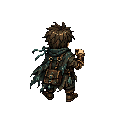
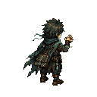
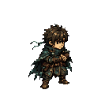
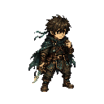




FULL-8 WORD SKILL — DESIGNATE, RESONATE, ENDURE
128×128 · 5f each direction · body designation precedes target VFX
01 · N · WORD TARGET
02 · NE · WORD TARGET
03 · E · WORD TARGET
04 · SE · WORD TARGET
05 · S · WORD TARGET
06 · SW · WORD TARGET
07 · W · WORD TARGET
08 · NW · WORD TARGET
player/full8/word_skill · 40 native frames
N · target direction reads
SW · dagger used as field tool
NE · no mage casting pose
W · collarbone tension
E · target before effect
NW · cape / bag retained
SE · hand / dagger point reads
S · chest resonance visible
word_target + collarbone anchors
word conditions / timing change · 0
PLAYER · FULL-8 WORD
09
Notes:
[Sources]
- UNMAEK_ACT1_SHOWCASE_MOTION_VFX_HANDOFF_v1
- User-provided 주인공 컨셉 원본.png and hero_runtime_keyposes.png
- UNMAEK_PLAYER_RUNTIME_MOTION_PILOT_v1
- UNMAEK_COMBAT_MOTION_FRAME_RECOVERY_PILOT_v1
- UNMAEK_VISUAL_RECOVERY_RUNTIME_EXPORT_v1
- Approved ACT 1 general map and supplied ACT 1 play video

Slide 10




PLAYER COMBAT VFX — BODY READS FIRST
Short dagger cut + compact parry resonance; damage/range/hit timing unchanged
01 · 8-DIR CUT
02 · ATTEMPT / ACTIVE
03 · SUCCESS / FAILURE
04 · 960×540 PROOF
Effects attach to actual visual anchors
Attack begins at dagger_tip
Arc never encloses the body
Parry ring stays below character height
Success uses contact flash + reverse ripple
Failure fades weakly
All engine event IDs: BINDING_REQUIRED
UNMAEK_ACT1_SHOWCASE_MOTION_VFX_HANDOFF_v1
10
Notes:
[Sources]
- UNMAEK_ACT1_SHOWCASE_MOTION_VFX_HANDOFF_v1
- User-provided 주인공 컨셉 원본.png and hero_runtime_keyposes.png
- UNMAEK_PLAYER_RUNTIME_MOTION_PILOT_v1
- UNMAEK_COMBAT_MOTION_FRAME_RECOVERY_PILOT_v1
- UNMAEK_VISUAL_RECOVERY_RUNTIME_EXPORT_v1
- Approved ACT 1 general map and supplied ACT 1 play video

Slide 11








SIX WORD VFX — SIX MOTION LANGUAGES
Compression / reverse echo / link / pressure / fixed relation / released flow
01 · N · WORD VFX
02 · NE · WORD VFX
03 · E · WORD VFX
04 · SE · WORD VFX
05 · S · WORD VFX
06 · SW · WORD VFX
07 · W · WORD VFX
08 · NW · WORD VFX
Six effects · no color-swap duplicates
STOP · inward fixed lines
REWIND · reverse state echoes
CONNECT · two real targets only
PUSH · short directional fan
HOLD · four fixed relation points
FLOW · narrow one-way ribbon
Common trigger · collarbone pulse
No magic circle / star / mana orb
Target action begins after body cue
event IDs · BINDING_REQUIRED
VFX · SIX WORDS
11
Notes:
[Sources]
- UNMAEK_ACT1_SHOWCASE_MOTION_VFX_HANDOFF_v1
- User-provided 주인공 컨셉 원본.png and hero_runtime_keyposes.png
- UNMAEK_PLAYER_RUNTIME_MOTION_PILOT_v1
- UNMAEK_COMBAT_MOTION_FRAME_RECOVERY_PILOT_v1
- UNMAEK_VISUAL_RECOVERY_RUNTIME_EXPORT_v1
- Approved ACT 1 general map and supplied ACT 1 play video

Slide 12








ACT 1 CREATURES — NATIVE READABILITY FIRST
38 / 56 / 60 / 69–80 / 178px visible · display scale 1.0×
01 · N · NATIVE CANDIDATE
02 · NE · NATIVE CANDIDATE
03 · E · NATIVE CANDIDATE
04 · SE · NATIVE CANDIDATE
05 · S · NATIVE CANDIDATE
06 · SW · NATIVE CANDIDATE
07 · W · NATIVE CANDIDATE
08 · NW · NATIVE CANDIDATE
29 corrected native candidate frames
Swift · 38px
Bat · 56px
Lizard · 60px
Spider · 69–80px
Goral · 178px
Body reads before telegraph
Selective 1px outline
No blur / non-integer scale
Original motion states preserved
AI / attack / Hurtbox change · 0
CREATURE · READABILITY
12
Notes:
[Sources]
- UNMAEK_ACT1_SHOWCASE_MOTION_VFX_HANDOFF_v1
- User-provided 주인공 컨셉 원본.png and hero_runtime_keyposes.png
- UNMAEK_PLAYER_RUNTIME_MOTION_PILOT_v1
- UNMAEK_COMBAT_MOTION_FRAME_RECOVERY_PILOT_v1
- UNMAEK_VISUAL_RECOVERY_RUNTIME_EXPORT_v1
- Approved ACT 1 general map and supplied ACT 1 play video

Slide 13




ACT 1 CREATURE ATTACK VFX — FOUR IDENTITIES
Body prep precedes effect; generic magenta projectile removed
01 · DEFLECT BAT
02 · REWIND LIZARD
03 · MINERAL SPIDER
04 · RESONANCE GORAL
Existing attack behaviors only
Bat: mouth → crescent pressure
Lizard: lowered body → snout contact
Spider: spinneret → mineral web
Goral: hoof gravel / charge dust
Phase-3 overlay byte-preserved
AI / damage / range / timing change 0
UNMAEK_ACT1_SHOWCASE_MOTION_VFX_HANDOFF_v1
13
Notes:
[Sources]
- UNMAEK_ACT1_SHOWCASE_MOTION_VFX_HANDOFF_v1
- User-provided 주인공 컨셉 원본.png and hero_runtime_keyposes.png
- UNMAEK_PLAYER_RUNTIME_MOTION_PILOT_v1
- UNMAEK_COMBAT_MOTION_FRAME_RECOVERY_PILOT_v1
- UNMAEK_VISUAL_RECOVERY_RUNTIME_EXPORT_v1
- Approved ACT 1 general map and supplied ACT 1 play video

Slide 14

UNMAEK
ACT 1 SHOWCASE
38-SECOND CLEAN PROOF
960×540 · DEBUG OFF
NATIVE 1.0×
Approved ACT 1 map · nearest sampling · UI-safe composition
player + words + creature identity · no gameplay change
UNMAEK_ACT1_SHOWCASE_MOTION_VFX_HANDOFF_v1
14
Notes:
[Sources]
- UNMAEK_ACT1_SHOWCASE_MOTION_VFX_HANDOFF_v1
- User-provided 주인공 컨셉 원본.png and hero_runtime_keyposes.png
- UNMAEK_PLAYER_RUNTIME_MOTION_PILOT_v1
- UNMAEK_COMBAT_MOTION_FRAME_RECOVERY_PILOT_v1
- UNMAEK_VISUAL_RECOVERY_RUNTIME_EXPORT_v1
- Approved ACT 1 general map and supplied ACT 1 play video

Slide 15

UNMAEK
FINAL VERDICT
PASS
CODEX STAGING READY
BIND EVENTS ONLY
Gameplay additions 0 · engine event IDs remain BINDING_REQUIRED
256 player frames · 33 VFX effects · 29 native creature corrections
UNMAEK_ACT1_SHOWCASE_MOTION_VFX_HANDOFF_v1
15
Notes:
[Sources]
- UNMAEK_ACT1_SHOWCASE_MOTION_VFX_HANDOFF_v1
- User-provided 주인공 컨셉 원본.png and hero_runtime_keyposes.png
- UNMAEK_PLAYER_RUNTIME_MOTION_PILOT_v1
- UNMAEK_COMBAT_MOTION_FRAME_RECOVERY_PILOT_v1
- UNMAEK_VISUAL_RECOVERY_RUNTIME_EXPORT_v1
- Approved ACT 1 general map and supplied ACT 1 play video

