Slide 1
SphinxCheck: Secure Login System
24_CS_CYS_3A_01
Bryan Christy
Aradhya Pandey
Abhishek Pal
Mazhar Alam
Nitya Gupta

Slide 2
Introduction – Problem Statement
In the contemporary digital landscape, safeguarding user accounts against unauthorized access is paramount due to the rising prevalence of cyber threats.
This project focuses on developing a Secure Ticketing Service that enhances user authentication processes through innovative security measures.
The system is designed to ensure that only legitimate users can access their accounts, thereby mitigating the risks associated with identity theft and unauthorized logins.

Slide 3
Rate Limiting
Rate Limiting refers to the practice of capping the number of login attempts that can be made from a single IP address within a defined timeframe.
This mechanism is crucial in preventing brute-force attacks, where attackers systematically try numerous combinations of usernames and passwords to gain unauthorized access.

Slide 4
Token-based Authentication
Token-based Authentication is a method of session management that generates secure tokens upon successful login.
These tokens are used to validate user sessions without relying on traditional passwords, significantly reducing the risk of session hijacking and enhancing overall security.

Slide 5
Project Objective
Enhance user authentication security
Implement rate limiting
Incorporate IP-based session tracking
Implement token-based authentication
Ensure user-friendly experience

Slide 6
End user benefits
Increased account security
Prevention of brute-force attacks
Alerts regarding suspicious activities

Slide 7
Technical study
Infrastructure requirements: Cloud based platforms, scaling, etc.
Technology stack: NodeJS, MongoDB, Redis, Python, React, etc.
Security mechanisms: JWT, session based cookies, etc.
Integration capabilities: Integration with third party application.

Slide 8
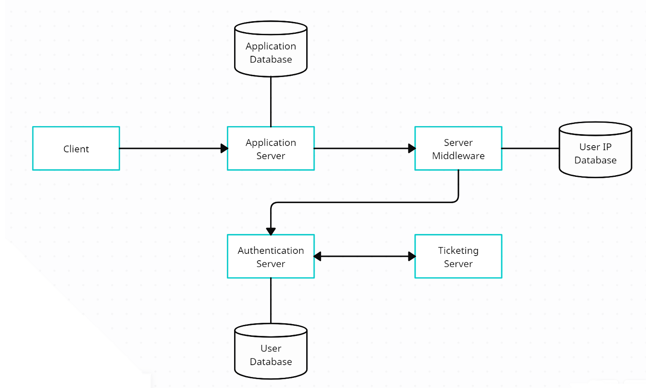
System Architecture Design

Slide 9
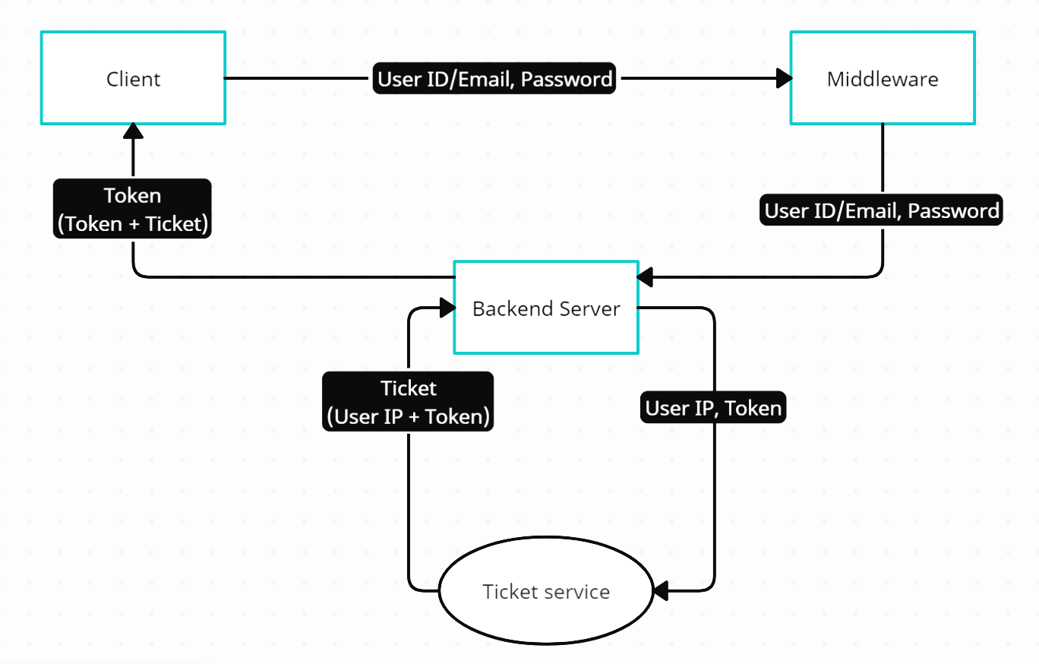
Data Flow

Slide 10
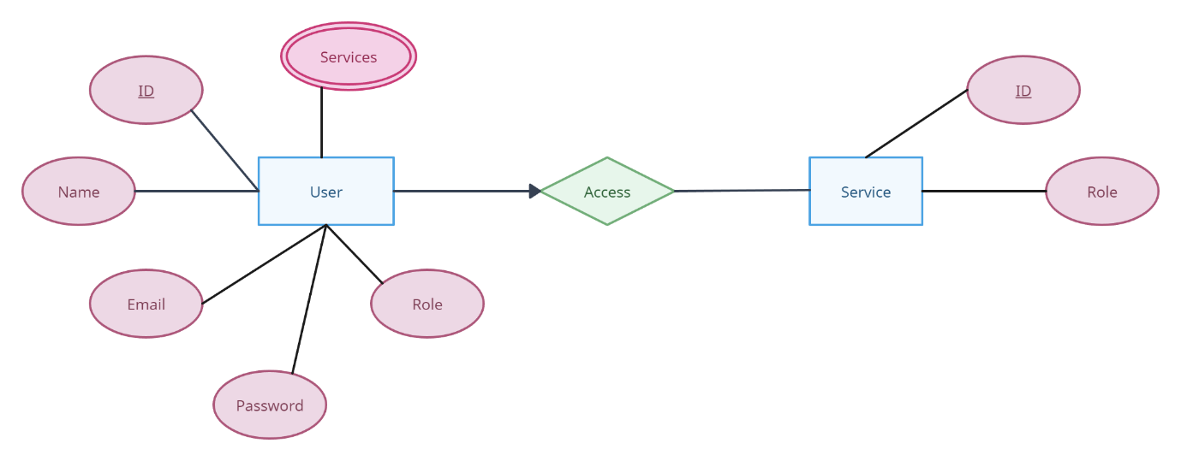
Entity-Relationship Model

Slide 11
Conclusion
The project operates within the field of cybersecurity, specifically addressing user authentication and access control.
Key components of this service include rate limiting, IP-based session tracking, and token-based authentication.

