Slide 1
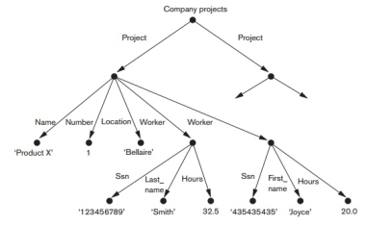

CZ2007 Introduction to Databases
Semi-Structured Data
This is NOT tested in Quiz-2
Arijit Khan
Assistant Professor
School of Computer Science and Engineering
Nanyang Technological University, Singapore
arijit.khan@ntu.edu.sg

Slide 2

Roadmap (Semi-Structured Data)
Semi-structured Data
XML
JSON
They are NOT tested in Quiz-2.
arijit.khan@ntu.edu.sg
2/49

Slide 3
Schedule after Recess Week
- Week 8 (Oct 04-Oct 08)
- Week 9 (Oct 11-Oct 15)
- Week 10 (Oct 18-Oct 22)
- Week 11 (Oct 25-Oct 29)
SQL
Week 12 (Nov 01-Nov 05)
Quiz during Tutorial session
- Quiz syllabus: everything on SQL (Week 8, 9, 10 11)
Semi-Structured Data
- Week 13 (Nov 09-Nov 13)

Slide 4
Roadmap (Semi-Structured Data)
Semi-structured Data
XML
JSON
Today’s lecture: Chapter 4.6, 4.7 of the Book “Database Systems: The Complete Book; Hector Garcia-Molina Jeffrey D. Ullman, Jennifer Widom
They are NOT tested in Quiz-2.
arijit.khan@ntu.edu.sg
4/49

Slide 5
Questions?
arijit.khan@ntu.edu.sg
5/49

Slide 6
The More Data, The Merrier
Power of Data
the more data the merrier (GB -> TB -> PB)
data comes from everywhere in all shapes
value of data often discovered later
data has no owner within an organization (no silos!)
Services turn data into $$$
the more services the merrier (10 -> 1000 -> 1M -> 1B)
need to adapt quickly
Goal: Platforms for data and services
any data, any service, anywhere and anytime
arijit.khan@ntu.edu.sg
6/49

Slide 7
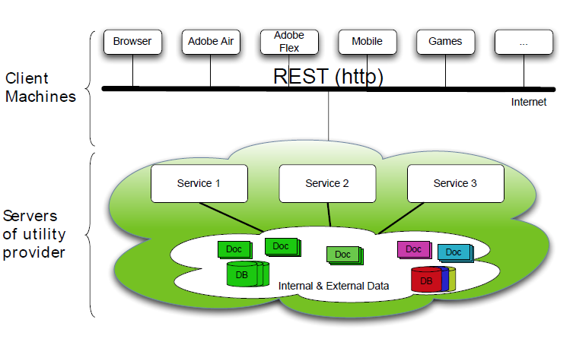
Data Arrive in Many Shapes
arijit.khan@ntu.edu.sg
7/49

Slide 8
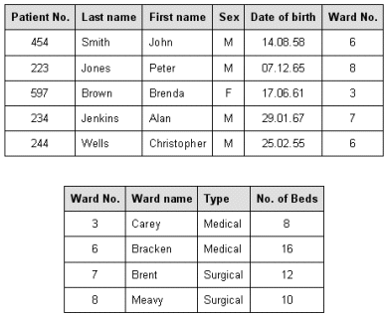
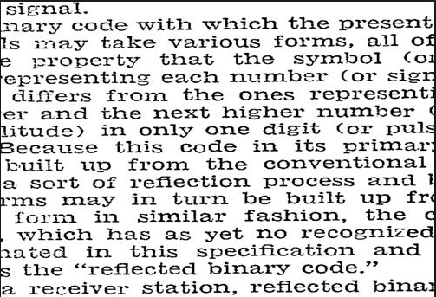
Structured vs. Unstructured Data
Relational databases are highly structured
All data resides in tables
Must define schema before entering data
Every row confirms to the table schema
Changing the schema is hard and may break many things
Texts are highly unstructured
Data is free-form
No schema and it’s hard to define one
Readers need to infer structures & meanings
What’s in between these two extremes?
arijit.khan@ntu.edu.sg
8/49

Slide 9
Semi-Structured Data
Observation: most data have “some” structure, e.g.
Book: chapters, sections, titles, paragraphs, references, index, etc.
Item for sale: name, picture, price, ratings, promotion, etc.
Web page: HTML
Ideas
Ensure data is “well-formatted”
If needed, ensure data is also “well-structured”
- But make it easy to define and extend this structure
Make data “self-describing”
arijit.khan@ntu.edu.sg
9/49

Slide 10
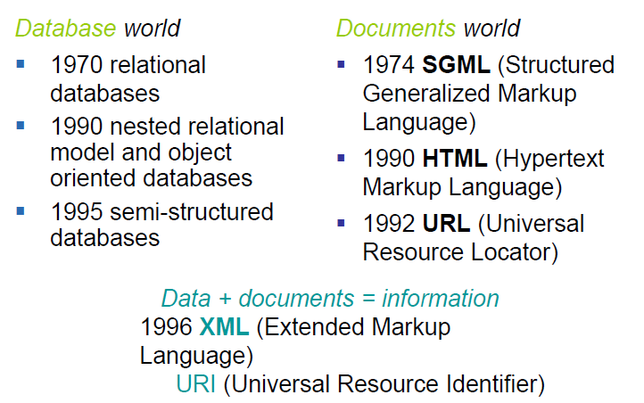
A Little Bit of History …
arijit.khan@ntu.edu.sg
10/49

Slide 11
XML as Semi-Structured Data
XML - The EXtensible Markup Language
A flexible syntax for data: semi-structured data
Used in:
– Configuration files, e.g. Web.Config
– Replacement for binary formats (MS Word)
– Document markup: e.g. XHTML
– Data: data exchange, semistructured data
(sensor data, logs, blogs)
• Warning: not normal form! Not even 1NF
XML is about half as popular as SQL
arijit.khan@ntu.edu.sg
11/49

Slide 12
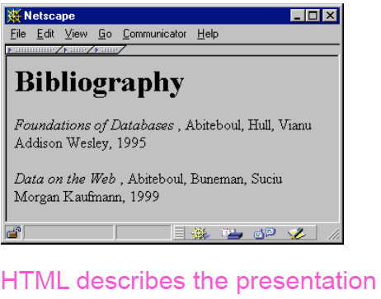
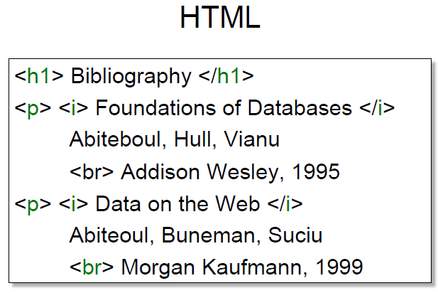
From HTML to XML
HTML
- The HyperText Markup Language

Slide 13
From HTML to XML
HTML
- The HyperText Markup Language
• It’s mostly a “formatting” language
• It mixes presentation and content

Slide 14

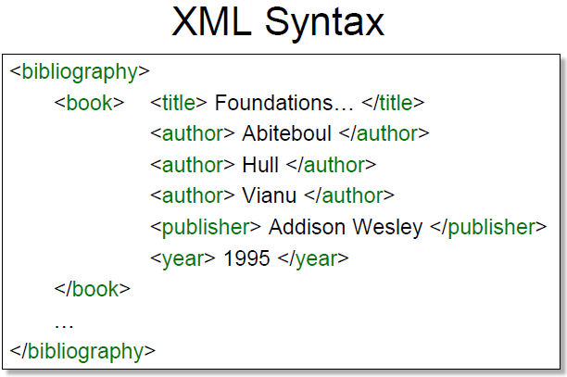
From HTML to XML
XML
- The EXtensible Markup Language

Slide 15
From HTML to XML
XML
- The EXtensible Markup Language
• Text-based
• Capture data (content), not presentation
• Data self-describes its structure
- Names and nesting of tags have meanings!

Slide 16
HTML vs. XML
What are the differences between XML and HTML ?
Difficulties with HTML
• Fixed set of tags
• Elements have document structuring semantics
• For presentation to human readers
• Applications cannot consume and process HTML easily
These difficulties are not in XML
arijit.khan@ntu.edu.sg
16/49

Slide 17
Questions?
arijit.khan@ntu.edu.sg
17/49

Slide 18
XML Terminology
• Tag names: book, title, …
• Start tags: <book>, <title>, …
• End tags: </book>, </title>, …
• An element is enclosed by a pair of start and end tags: <book>…</book>
• Elements can be nested:
<book>…<title>…</title>…</book>
• Empty elements: <is_textbook></is_textbook>
- Can be abbreviated: <is_textbook/>
• Elements can also have attributes: <book
ISBN="…" price="80.00">
<bibliography>
<book ISBN="ISBN-10" price="80.00">
<title>Foundations of Databases</title>
<author>Abiteboul</author>
<author>Hull</author>
<author>Vianu</author>
<publisher>Addison Wesley</publisher>
<year>1995</year>
</book>…
</bibliography>
Ordering generally matters, except for attributes
18/49

Slide 19
Well-formed XML documents
A well-formed XML document
• Follows XML lexical conventions
- Wrong: <section>We show that x < 0…</section>
- Right: <section>We show that x &lt; 0…</section>
- Other special entities: > becomes &gt; and & becomes &amp;
• Contains a single root element
• Has properly matched tags and properly nested elements
- Right: <section>…<subsection>…</subsection>…</section>
- Wrong: <section>…<subsection>…</section>…</subsection>
arijit.khan@ntu.edu.sg
19/49

Slide 20
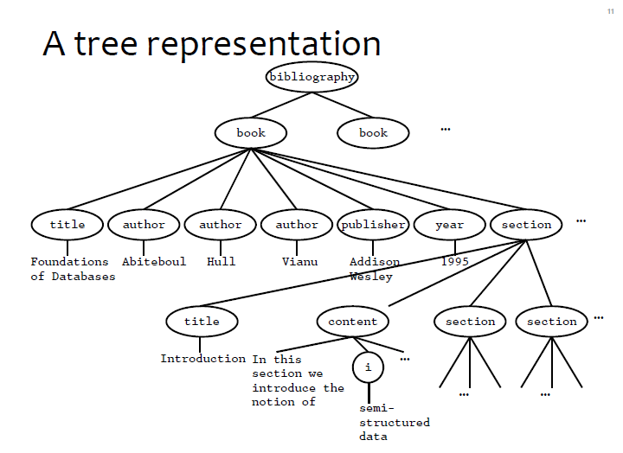
Tree Representation of XML Documents
arijit.khan@ntu.edu.sg
20/49

Slide 21
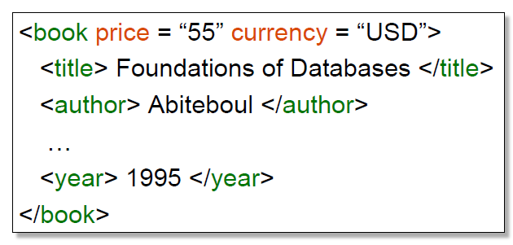
More XML Example: Attributes
arijit.khan@ntu.edu.sg
21/49

Slide 22
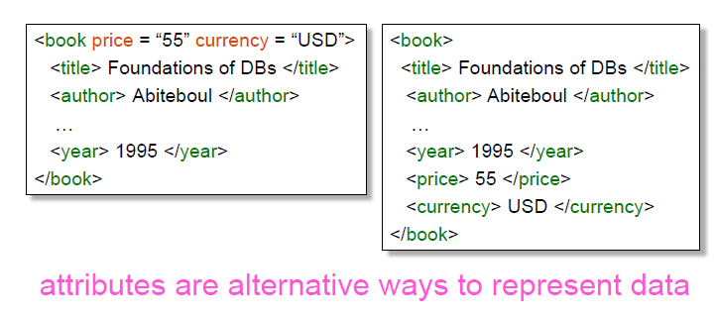
Attributes vs. Elements
arijit.khan@ntu.edu.sg
22/49

Slide 23
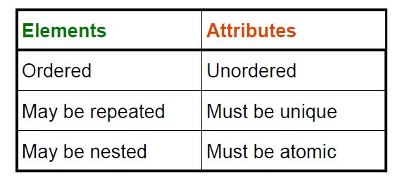
Attributes vs. Elements
Attribute names must be unique! (No Multisets) <person name = "Wilde" name = "Wutz"/> is illegal!
arijit.khan@ntu.edu.sg
23/49

Slide 24
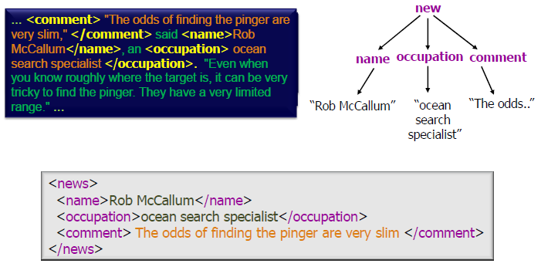
Documents to XML
Documents are a quite natural way to represent “objects”
- A great deal of text and semi-structured info
arijit.khan@ntu.edu.sg
24/49

Slide 25
De-normalized Data in XML
You have learnt to normalize schemas
- Avoid redundancy
- Avoid update anomalies
Real data is often de-normalized
- Think of a FAX with an order
- immutable: updates -> new version
- No (or, less) deletes in Facebook
Technology Trends make Normalization less critical
Cheap storage, good indexing, ...
But you can also normalize XML data!
arijit.khan@ntu.edu.sg
25/49

Slide 26
Benefits of XML over Relational Data
• Portability: Just like HTML, you can ship XML data across platforms
• Relational data requires heavy-weight API’s
• Flexibility: You can represent any information
(structured, semi-structured, documents, …)
• Relational data is best suited for structured data
• Extensibility: Since data describes itself, you can change the schema easily
• Relational schema is rigid and difficult to change
arijit.khan@ntu.edu.sg
26/49

Slide 27
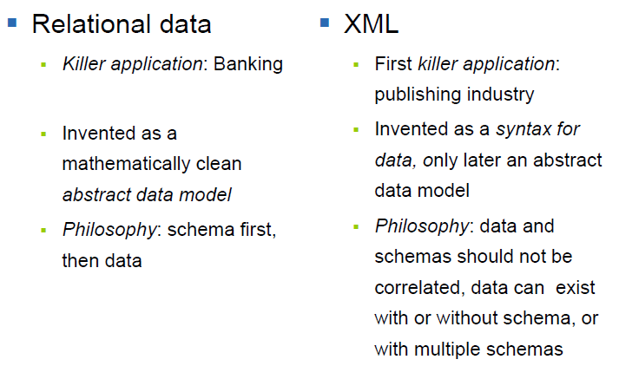
XML vs. Relational Data
arijit.khan@ntu.edu.sg
27/49

Slide 28
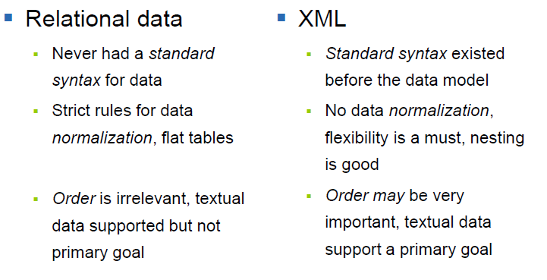
XML vs. Relational Data
arijit.khan@ntu.edu.sg
28/49

Slide 29
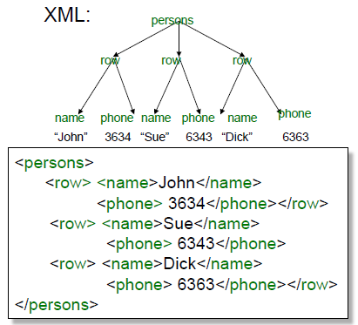
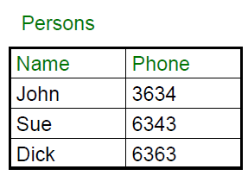
Mapping Relational Data to XML
arijit.khan@ntu.edu.sg
29/49

Slide 30
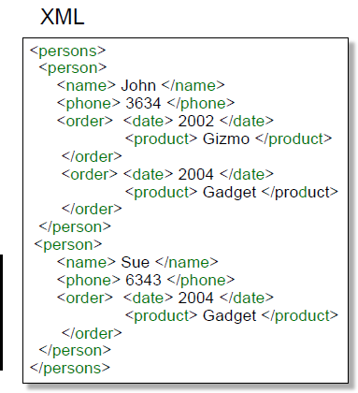
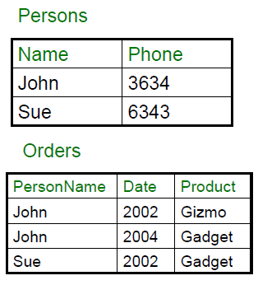
Mapping Relational Data to XML
arijit.khan@ntu.edu.sg
30/49

Slide 31
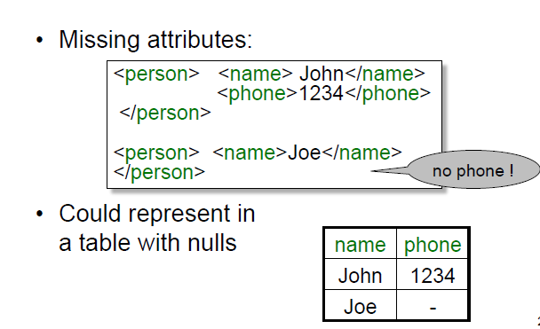
XML is Semi-Structured
arijit.khan@ntu.edu.sg
31/49

Slide 32
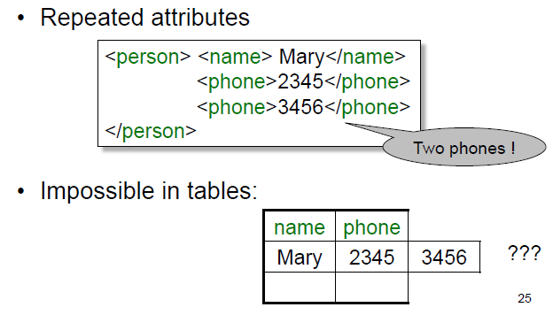
XML is Semi-Structured
arijit.khan@ntu.edu.sg
32/49

Slide 33
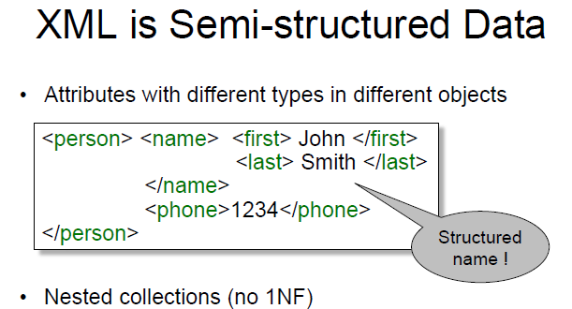
XML is Semi-Structured
arijit.khan@ntu.edu.sg
33/49

Slide 34

Questions?
Semi-structured Data
XML
JSON
arijit.khan@ntu.edu.sg
34/49

Slide 35
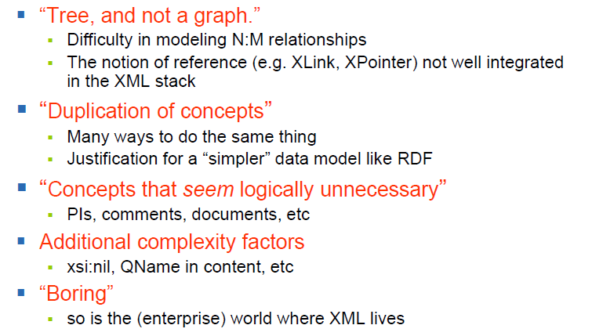
Difficulties with XML
arijit.khan@ntu.edu.sg
35/49

Slide 36
Other Semi-Structured Data
JSON
CSV
Avro
Protocol Buffers
RDF
Property Graphs
…
arijit.khan@ntu.edu.sg
36/49

Slide 37
Why do we still talk about XML ?
It is a standard (not owned by anybody)
Very well documented
Many tools available
Mother of all semi-structured data
has the most features
XML is here to stay
It actually works!
arijit.khan@ntu.edu.sg
37/49

Slide 38
JSON
JSON
JavaScript Object Notation
lightweight text-based open standard designed for human-readable data interchange.
Interfaces in C, C++, Java, Python, Perl, etc.
The filename extension is .json.
Semistructured data model
Flexible, nested structure (trees)
Does not require predefined schema ("self describing”)
Text representation: good for exchange, bad for performance
Most common use: Language API
arijit.khan@ntu.edu.sg
38/49

Slide 39
JSON - Syntax
arijit.khan@ntu.edu.sg
39/49

Slide 40
JSON - Terminology
Curly braces
Hold objects
Each object is a list of name/value pairs separated
by , (comma)
Each pair is a name is followed by ':’ (colon) followed by the value
Square brackets
Hold arrays and values are separated by , (comma).
What is the data made up of?
Objects, lists, and atomic values (integers, floats, strings, booleans).
arijit.khan@ntu.edu.sg
40/49

Slide 41
JSON – Data Structure
Collection
Collections of name-value pairs:
{“name1”: value1, “name2”: value2, …}
The “name” is also called a “key”
Ordered lists of values: [obj1, obj2, obj3, ...]
arijit.khan@ntu.edu.sg
41/49

Slide 42
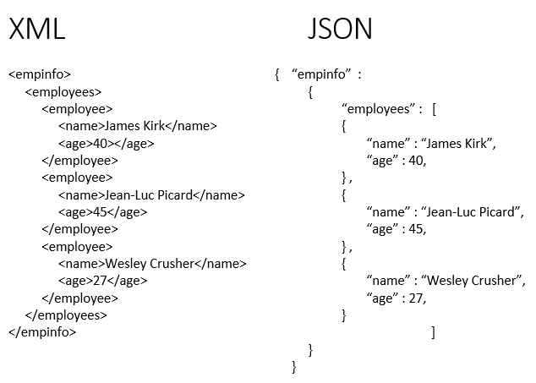
XML vs. JSON
arijit.khan@ntu.edu.sg
42/49

Slide 43
Tree View of JSON Data
Self-describing
arijit.khan@ntu.edu.sg
43/49

Slide 44
Mapping Relational Data to JSON
arijit.khan@ntu.edu.sg
44/49

Slide 45
Mapping Relational Data to JSON
arijit.khan@ntu.edu.sg
45/49

Slide 46
Handling NULL and Repeated Values
arijit.khan@ntu.edu.sg
46/49

Slide 47
Handling Heterogeneous Objects
arijit.khan@ntu.edu.sg
47/49

Slide 48
Summary
Data Exchange Format
Well suited for exchanging data between applications
XML, JSON
Data Models
Some systems use them as data models
SQL Server – supports XML-valued relations
CouchBase, Mongodb – JSON as data model
Query Languages
Will NOT discuss in this lecture!
Xpath, Xquery
CouchBase – N1QL
JSONiq

Slide 49
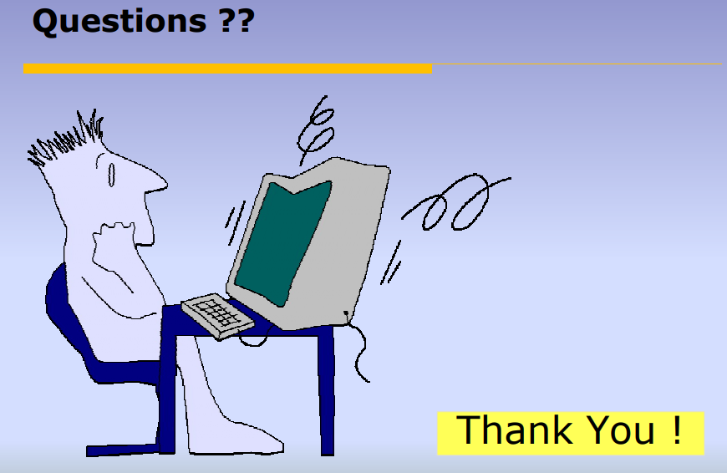
arijit.khan@ntu.edu.sg

