Slide 1


Spotify and Billboard 100 Comparison
Bryan Colson

Slide 2
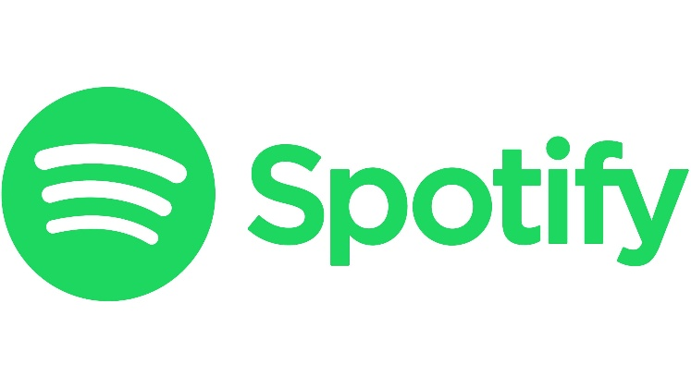
Spotify
Created April 23, 2006.
Spotify is a digital music, podcast, and video service that gives you access to millions of songs and other content from creators all over the world.
433 million active monthly listeners.

Slide 3
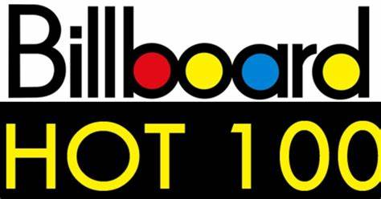
Started Aug. 4, 1958.
The week’s most popular current songs across all genres, ranked by streaming activity from digital music sources tracked by Luminate, Radio Airplay Audience Impressions as measured by Luminate and sale data as complied by Luminate.
244.5 million American Adult listeners.

Slide 4
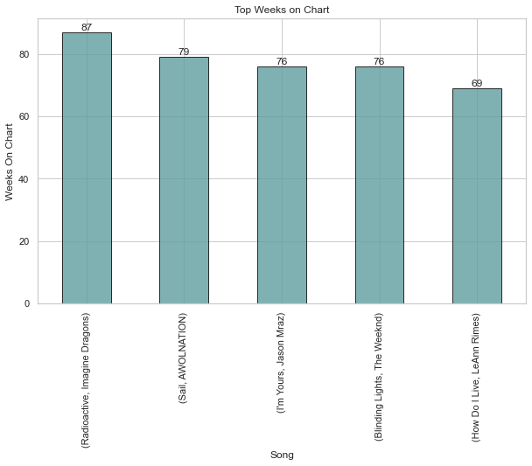
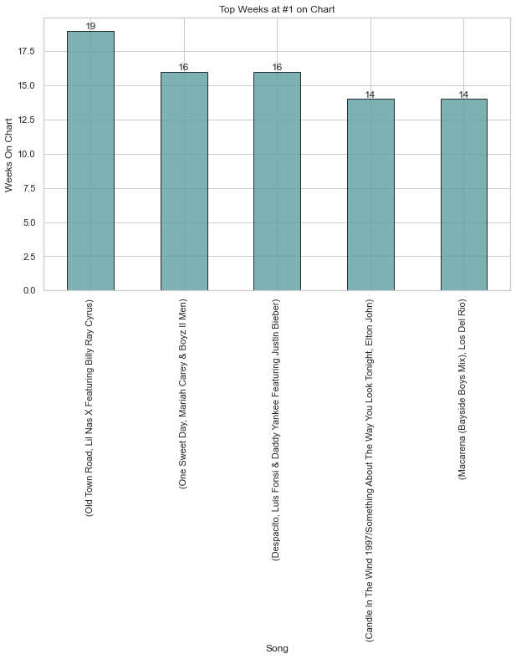
Top Weeks on Chart vs Top Weeks at #1

Slide 5
Popularity
The Spotify Popularity Index is a 0-to-100 score that ranks how popular an artist is relative to other artists on Spotify.

Slide 6
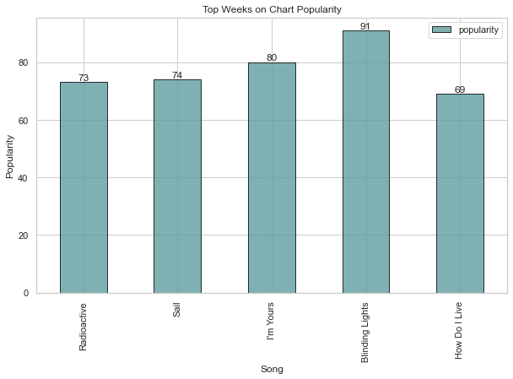
Top Weeks Streams and Popularity
Streams
Radioactive - 1,442,672,579
Sail- 709,596,791
I’m yours- 1,484,482,331
Blinding lights - 3,302,055,414
How Do I live - 162,216,076

Slide 7
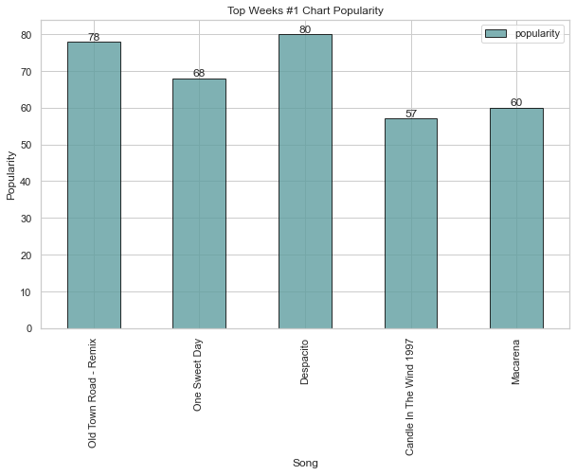
Weeks at #1 Streams and Popularity
Streams
Old Town Road- 1,389,776,003
One Sweet Day- 146,214,031
Despacito- 1,583,589,883
Candle in the wind- null
Macarena- 61,465,825

Slide 8
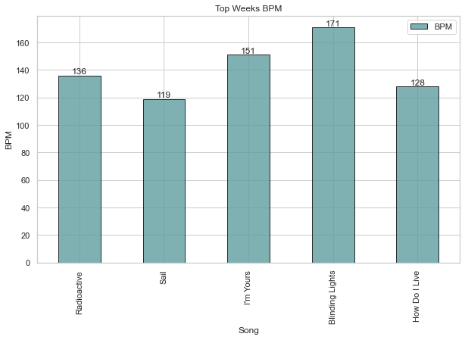
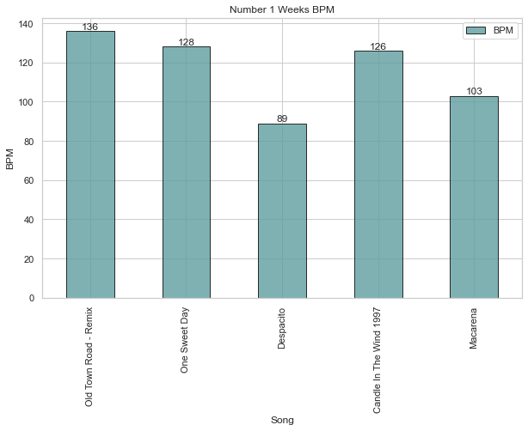
Top Weeks and #1 Weeks BPM

Slide 9
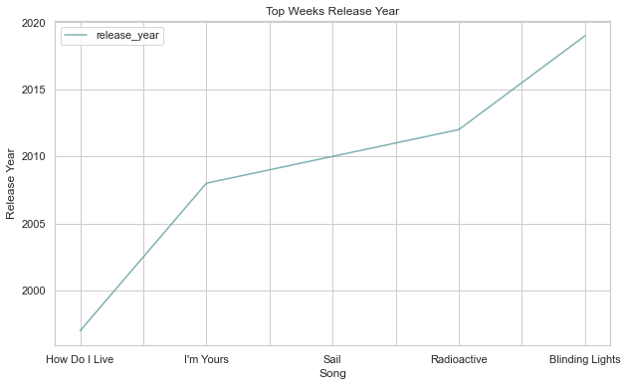
Top Weeks Release Year

Slide 10
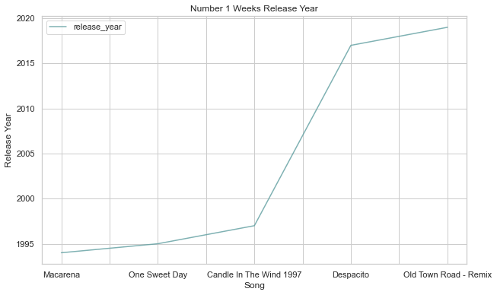
#1 Weeks Release Year

Slide 11
Power BI
Capstone_BI - Power BI

Slide 12
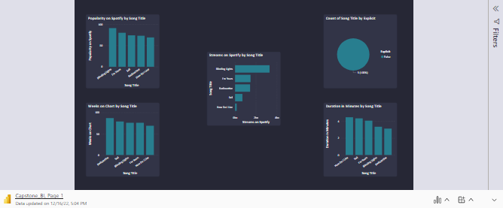

Slide 13
