Slide 1


Spotify and Billboard 100 Comparison
Bryan Colson

Slide 2
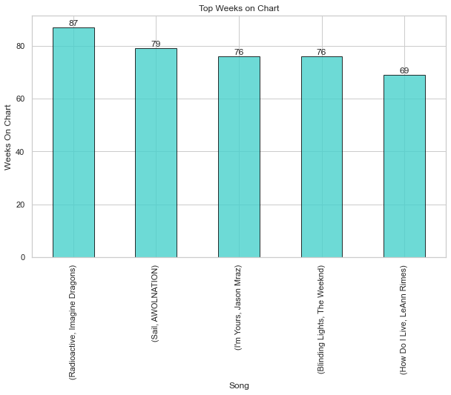
Top Weeks on Chart

Slide 3
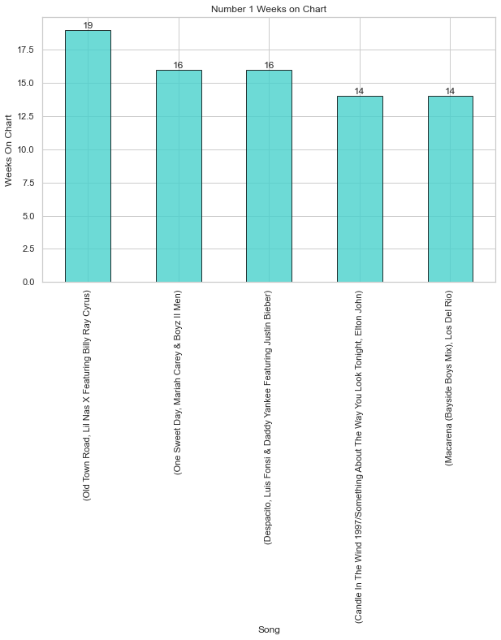
Top weeks at #1

Slide 4
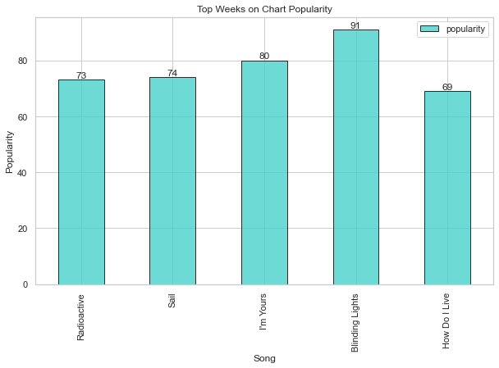
Popularity of Top weeks

Slide 5
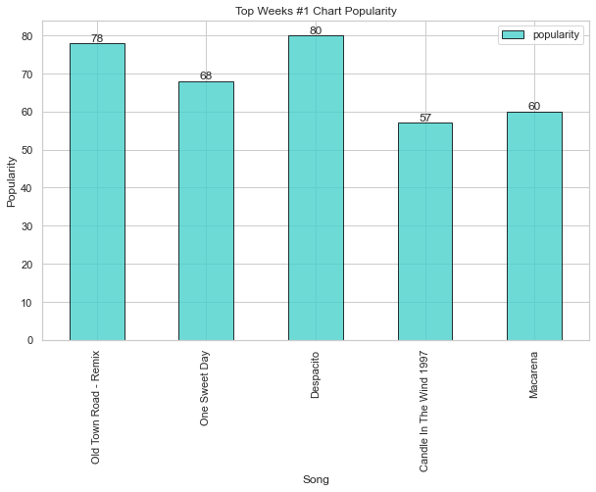
Popularity of #1

Slide 6
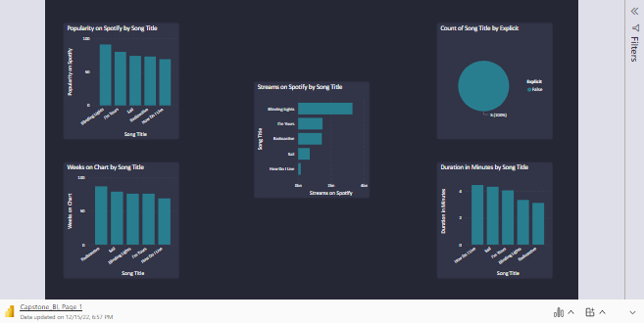

Slide 7
