Slide 1


Spotify and Billboard 100 Comparison
Bryan Colson

Slide 2
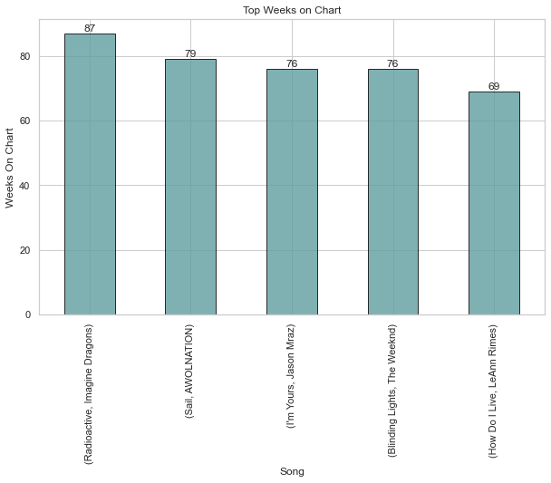
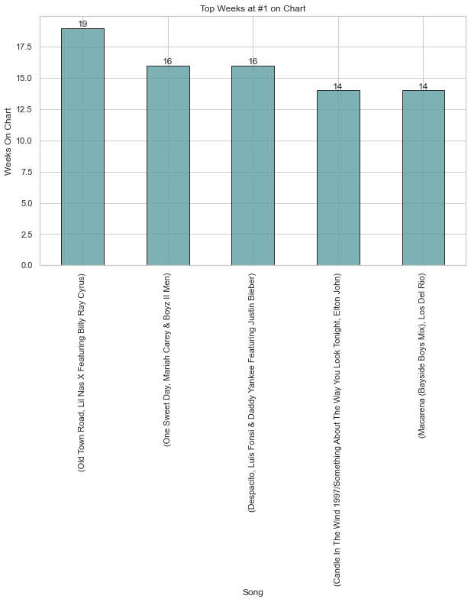
Top Weeks on Chart vs Top Weeks at #1

Slide 3
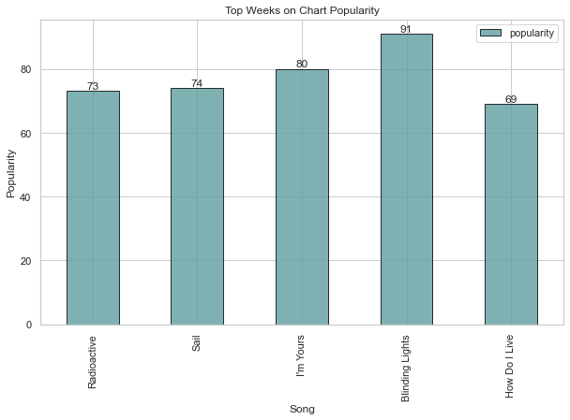
Top Weeks Streams and Popularity
Streams
Radioactive - 1,442,672,579
Sail- 709,596,791
I’m yours- 1,484,482,331
Blinding lights - 3,302,055,414
How Do I live - 162,216,076

Slide 4
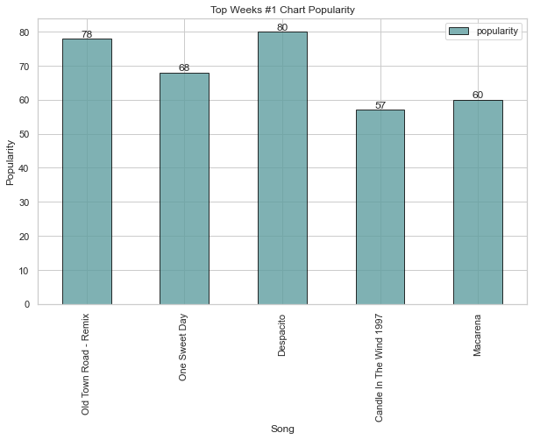
Weeks at #1 Streams and Popularity
Streams
Old Town Road- 1,389,776,003
One Sweet Day- 146,214,031
Despacito- 1,583,589,883
Candle in the wind- null
Macarena- 61,465,825

Slide 5
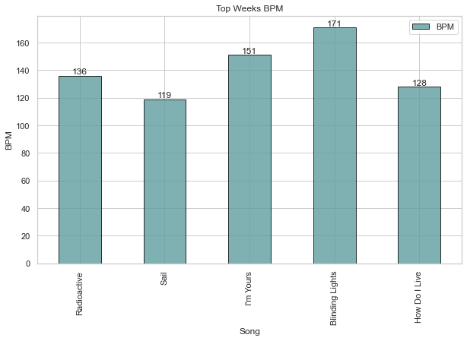
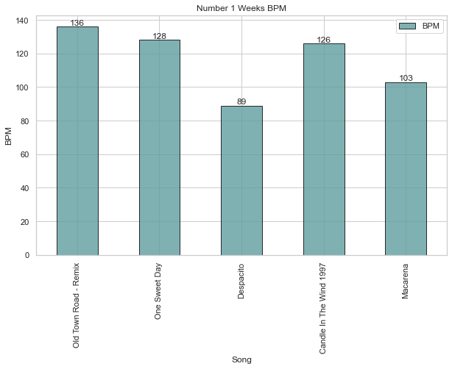
Top Weeks and #1 Weeks BPM

Slide 6
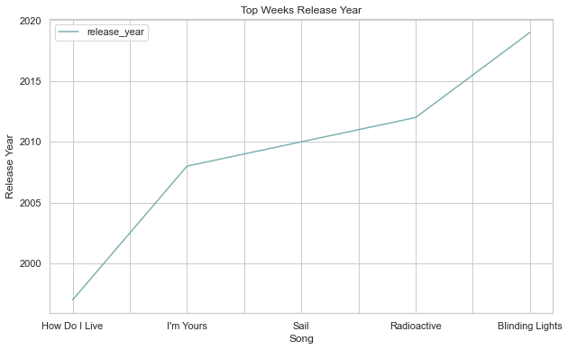
Top Weeks Release Year

Slide 7
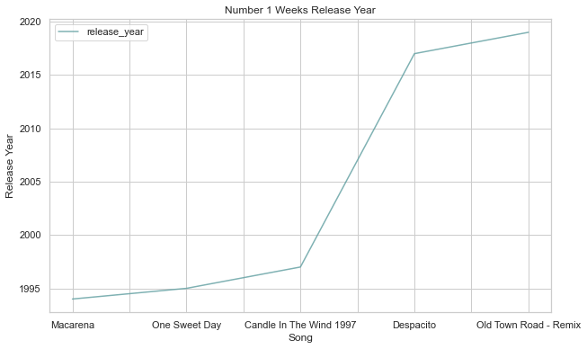
#1 Weeks Release Year

Slide 8
Power BI
Capstone_BI - Power BI

