Slide 1
Mental Health of Teenagers
Presented by Bryana A.S. Thieret

Slide 2
Participants
920 people
Ages 13-17
“Representative sample” of American teenagers
“… weighted to match the U.S. Census’s distribution by age, gender, education, race, and other factors.”
September to November 2018

Slide 3
Questions
“Is _________________ a major or minor problem among people your age in the community they live in.”
anxiety and depression
bullying
drugs
drinking
poverty
pregnancy
gangs
Response Categories: Major, Minor, Not

Slide 4
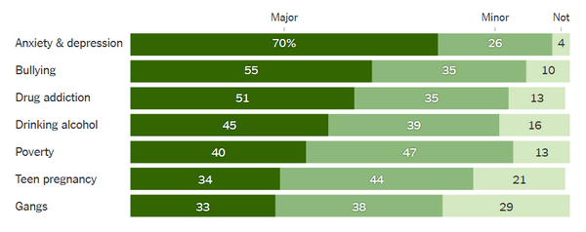

Slide 12
Cons
Aggregated across subpopulations
People operationalize what a major or minor problem differently.
Subjective
Grouping anxiety and depression together
Drug addiction is too broad

Slide 13
Thank You!

