Slide 1

NOIP Language Basics (12)
Files
Note: Please turn off your microphone and camera
Mr. Gao's Algorithm Competition
Training Camp

Slide 2
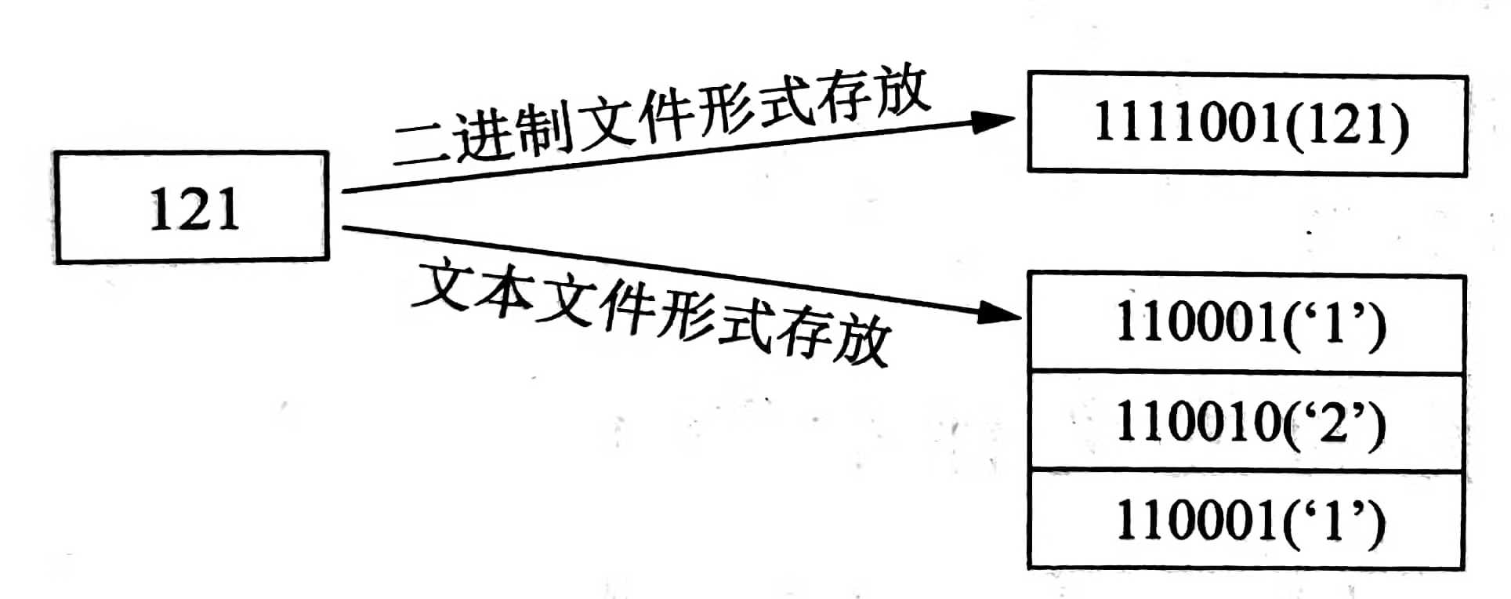
What is a file
A collection of data stored on external media
In plain language: save data on disk as a sequence of bytes
Types of files
Binary files
Text files
Binary files
Pro: high efficiency
Con: You need to know the encoding format to decode it correctly
Text file:
Pro: Directly translate into text using ASCII table
Con: low efficiency
Binary format
Text format
Binary format
When opened with text editor, you see meaningless characters.
Can open directly with text editors (Notepad, VSCode , etc.).

Slide 3
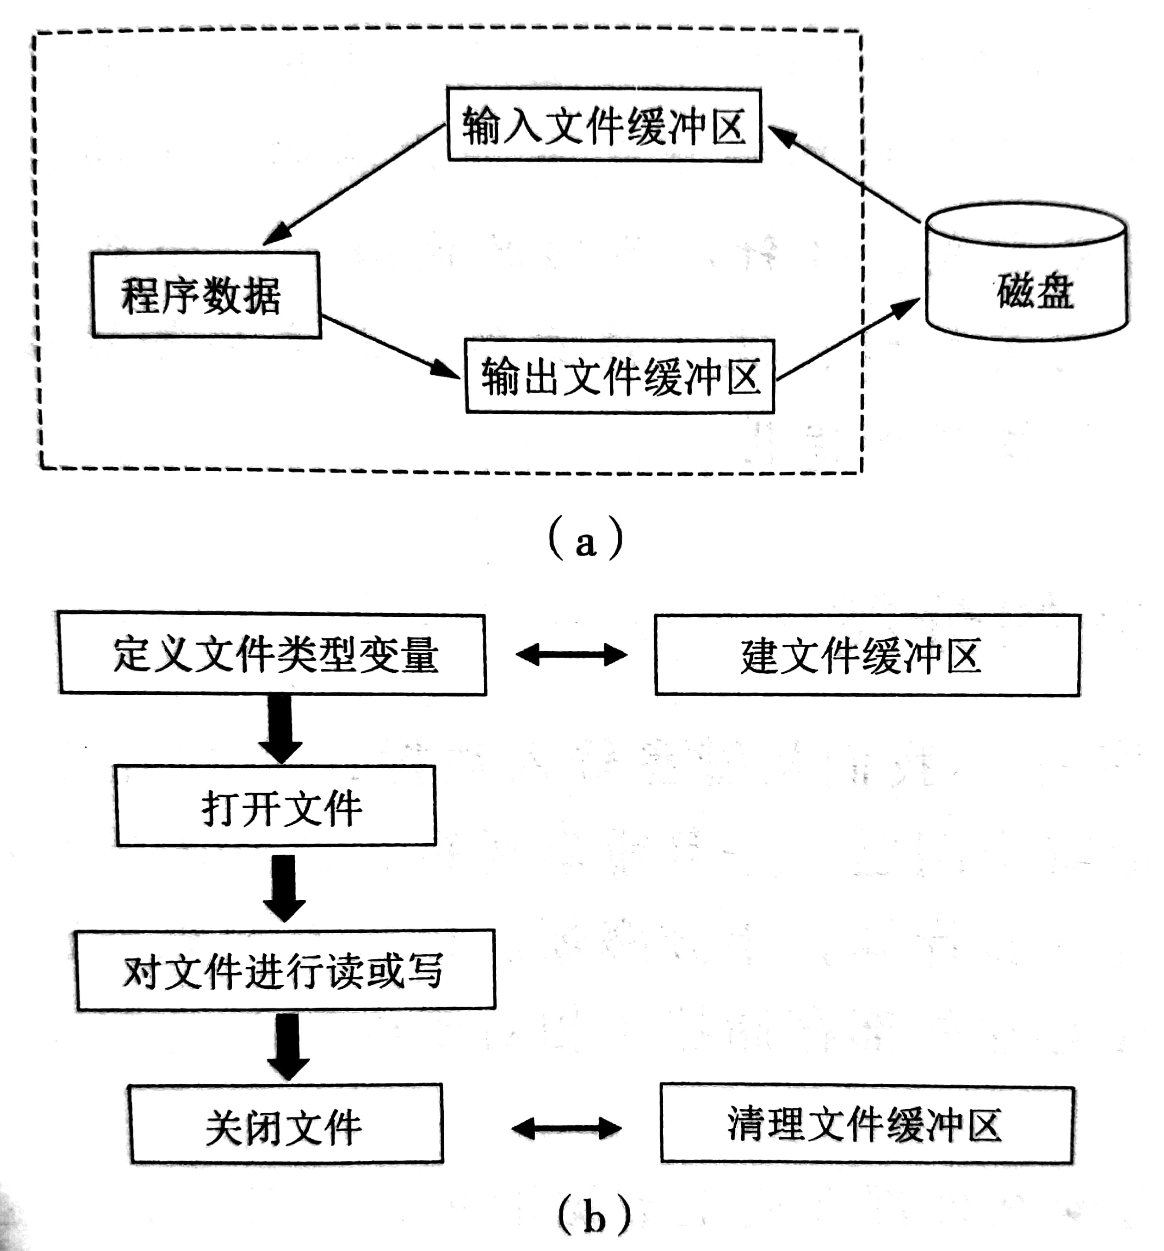
Programs and files
Where are they?
Programs: in Memory
Files: on Disks
Operation process (see figures)
How C++ programs operate file buffers
Stream-oriented
I/O method
Types of stream-oriented files
stream classes
FILE pointers
Input file buffer
Pgm data
Disk
Output file buffer
Define file variable
Create file buffer
Informatics competitions only focus on streams
Open file
Read/write file
Close file
Flush file buffer
Not at this stage

Slide 4
Stream classes
Header file: <fstream>
Classes: ifstream / ofstream
Operations: >> and <<
Close statement: fin.close ();
#include <bits/stdc++.h>
using namespace std;
ifstream fin("ab.in");
ofstream fout("ab.out");
int a,b;
int main() {
fin>>a>>b;
fout<<a+b<<endl;
return 0;
}
fin and fout are customs. You can use whatever names you like.
Replace cin and cout with fin and fout.

Slide 5
Determining end of input data
(Early days) Some OI questions required logic to determine end of input due to unknown input size.
#include <bits/stdc ++.h>
using namespace std;
ifstream fin("sum.in");
ofstream fout ("sum.out");
int x,sum ;
int main(){
while(fin>>x)
sum+=x;
fout<<sum<<endl;
return 0;
}
#include <bits/stdc++.h>
using namespace std;
ifstream fin("sum.in");
ofstream fout("sum.out");
int x,sum;
int main(){
while(!fin.eof())
fin>>x, sum+=x;
fout<<sum<<endl;
return 0;
}
Files opened at start of program execution.
Use the return value of operator >> to judge. 0 (false) means end of input.
This way is recommended, less prone to mistakes.
This way depends on the file to work as intended. More mistake prone, not recommended.

Slide 6
Opening and closing files
In some special cases, file variables cannot be initialised and need to be opened and closed with the open/close functions.
#include <bits/stdc++.h>
using namespace std;
ifstream fin;
ofstream fout;
int x,sum;
int main(){
fin.open("sum.in");
fout.open("sum.out");
while (fin>>x)
sum+=x;
fout<<sum<<endl ;
fin.close();
fout.close();
return 0;
}
The file is not open at this time
The file being opened must be in the same folder as the source and executable files.
When you need to open a file, call the open function to open it.
You can also use an absolute path:
fin.open ("C:/sum.in");
Or a relative path:
fin.open ("../sum.in");
close function is used to close the file. For competitions, these 2 statements can be omitted

Slide 7
File redirection
Standard input and standard output
The input device used by cin or scanf is the keyboard (console), also known as standard input: stdin
cout or printf is the display (console), also known as standard output: stdout
The C++ language can use the freopen function to redirect stdin and stdout to related files, turning the original standard input and standard output into file input and file output.
#include <bits/stdc++.h>
using namespace std;
int n,x,sum;
int main(){
freopen("ab.in","r",stdin);
freopen(“ab.out”,“w”, stdout);
cin>>n;
for(int i=0;i<n;++i){
cin>>x;
sum+=x;
}
cout<<sum<<endl;
return 0;
}
freopen should be at the beginning of program, before all other code
stdin is redirected to the file ab.in. All subsequent cin (or scanf ) code not changed, but they will read from the file ab.in instead
stdout is redirected to the file ab.out. All Subsequent cout (or printf ) code not changed, but they will write to the file ab.out.
#include <bits/stdc++.h>
using namespace std;
int n,x,sum;
int main() {
freopen("ab.in","r",stdin);
freopen("ab.out","w",stdout);
scanf("% d",&n);
for(int i=0;i<n;++i){
scanf("%d",&x);
sum+=x;
}
printf("%d\n",sum);
return 0;
}
scanf+printf example

Slide 8
Speed matters
How to improve efficiency when reading from large files
ifstream + fin
FILE* + fscanf
freopen + cin
freopen + cin + ios :: sync_with_stdio (false)
freopen + scanf
Fast Read
These two are harder to write, not recommended.
Slowest. Do not use with large data.
Speed is good.
Speed is good.

Slide 9
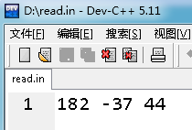

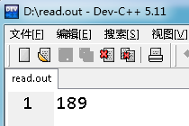
Fast Read
Ideas
Use getchar() to read characters one by one and assemble them into digital types
step
1. Filter non-numeric characters until the first numeric character (handle negative signs)
2. Read the numeric characters and assemble the results until a non-numeric character is found
3. Return
For example
123 -456 789
987,654,-123
Fast read function
Function Call Example
Save as D:\test.cpp
template <typename T> void read(T &a){
a=0; int flag=1; char ch = getchar();
while (ch <'0' || ch>'9') {
if (ch == '-') flag = -1;
ch = getchar();
}
do{
a = a *10 + ch – '0';
ch = getchar();
} while('0' <= ch && ch <= '9');
a *= flag;
}
int main(){
freopen("read.in","r",stdin);
freopen("read.out","w",stdout);
int x,y;
long long z;
read(x);
read(y);
read(z);
cout<<x+y+z;
}
Make sure that the .cpp file and read.in are in the same folder. D:\ is just a guide.
In DevC ++ , create a file through "File- > New- > Source Code", write 3 numbers, and save it as D:\read.in .
【 Notice 】
All files "
C++ will automatically create D:\read.out and output the results to this file, which can be opened and viewed with

Slide 10
Fast Read
template <typename T> void read(T &a){
a=0; int f=1; char ch=getchar();
while (ch <'0'||ch>'9') { if(ch=='-') f=-1; ch=getchar(); }
do { a = a *10+ch-'0'; ch=getchar(); } while('0'<=ch&&ch<='9');
a *= f;
}

Slide 11
Thank you everyone
Note: Please turn off your microphone and camera
Teacher Gao's Algorithm Competition Training Camp

