Slide 1
xproc.xq Jim Fuller, MarkLogic 2013
Architecture of an xproc processor

Slide 2













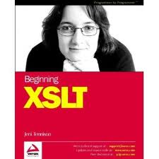


James Fuller
Senior engineer
http://jim.fuller.name
@xquery
http://exslt.org
XSLT UK 2001
http://www.xmlprague.cz
@perl6
Perlmonks
Pilgrim

Slide 3
Overview
Why XProc?
xproc.xq project
xproc.xq Architecture
Points of Interests
Summary

Slide 4
XProc Overview

Slide 5
Xproc Goals
The language must be expressed as declarative XML and be rich enough to address practical interoperability concerns but also beconcise
The language must allow the inputs, outputs, and other parameters of a components to be specified with information passed between steps using XML
The language must define the basic minimal set of processing options and associated error reporting options required to achieve interoperability.
Given a set of components and a set of documents, the language must allow the order of processing to be specified.
Agnostic in terms of parallel, serial or streaming processing
The model should be extensible enough so that applications can define new processes and make them a component in a pipeline.
The model could allow iteration and conditional processing which also allow selection of different components as a function of run-time evaluation.
Make xml pipelines

Slide 6
Xproc Refresher
(<root/>,<root/>,<test/>)
<p:pipeline version=“1.0” name="main">
<p:count/>
</p:pipeline>
<c:result>3</c:result>

Slide 7
Show simple xproc

Slide 8
That’s not quite the whole story …
<p:declare-step version='1.0’ name="main">
<p:input port="source"/>
<p:output port="result”/>
<p:count name=”step1”/>
</p:declare-step>

Slide 9
Really, not at all…
<p:declare-step name="main" xmlns:p="http://www.w3.org/ns/xproc" version="1.0">
<p:input port="source"/>
<p:output port="result">
<p:pipe step="step1" port="result"/>
</p:output>
<p:count name="step1">
<p:input port="source">
<p:pipe step="main" port="source"/>
</p:input>
</p:count>
</p:declare-step>

Slide 10
Why Xproc ?
‘pipes’ are a natural idiom for xml processing
Flow based versus FSM (draw diagram)
State is the enemy of dynamic computation
Complex workflow still possible but YAGNI
Main control loop

Slide 11
Current news
http://mesonet.info/
http://code.google.com/p/daisy-pipeline/wiki/XProcOverview-
http://balisage.net/Proceedings/vol8/html/Williams01/BalisageVol8-Williams01.html
https://github.com/gimsieke/epubcheck-xproc
https://github.com/josteinaj/xprocspec

Slide 12
Current news
W3C XML Processing WG working on Xproc vnext
Improve ease of use (syntactic improvements)
Increase the scope for working with non XML content
Address known shortcomings in the language
Improve relationship with streaming and parallel processing
Fix params, non xml doc processing, drop Xpath 1.0, let options+variables contain fragments, allow AVT

Slide 13
xproc.xq

Slide 14
xproc.xq Project
Xproc processor built with Xquery 3.0 on MarkLogic
Github Project - https://github.com/xquery/xproc.xq
Build/test system
xray
run w3c unit test suite
dist layout
compact
extensible
Xquery entry points
flags

Slide 15
Architecture
Parse: consume and parse Xproc pipeline
Dynamic evaluation: runtime engine
Serializer: output results
Notes:
static analysis- consume and parse the XProc pipeline, generating a runnable representation of said pipeline
dynamic evaluation- engine that dynamically evaluates the runnable pipeline representation
serialization- output interim results for further processing or final results

Slide 16
Parsing

Slide 17
Decorated pipeline
demo

Slide 18
Static analysis - unordered
<p:declare-step version='1.0' name="main">
<p:input port="source"/>
<p:output port="result">
<p:pipe step="i1" port="result"/>
</p:output>
<p:identity>
<p:input port="source">
<p:pipe step="main" port="source"/>
</p:input>
</p:identity>
<p:identity name="i3"/>
<p:identity name="i1">
<p:input port="source">
<p:pipe step="i3" port="result"/>
</p:input>
</p:identity>
</p:declare-step>

Slide 19
Static analysis - ordered
<p:declare-step version='1.0' name="main">
<p:input port="source"/>
<p:output port="result">
<p:pipe step="i1" port="result"/>
</p:output>
<p:identity>
<p:input port="source">
<p:pipe step="main" port="source"/>
</p:input>
</p:identity>
<p:identity name="i3"/>
<p:identity name="i1">
<p:input port="source">
<p:pipe step="i3" port="result"/>
</p:input>
</p:identity>
</p:declare-step>

Slide 20
Runtime

Slide 21
Runtime

Slide 22
TIMECHECK

Slide 23
Pipeline decomposition

Slide 24
Pipeline decomposition

Slide 25
Pipeline decomposition

Slide 26
Serializer

Slide 27
File Layout

Slide 28
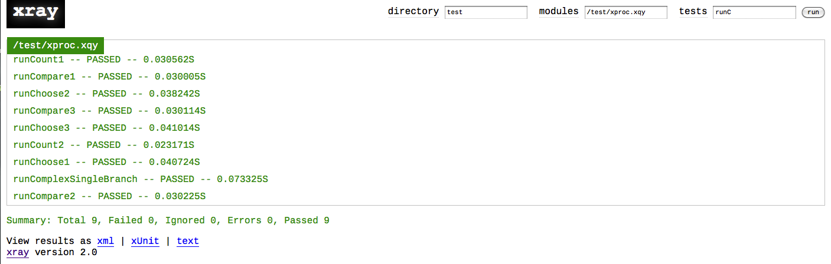
XRAY testing

Slide 29
points of interest

Slide 30
Xquery 3.0 to the rescue
Using a Reducer, such as left-fold(), in combination with dynamic function calls underpin the heart of xproc.xq dynamic evaluation engine.
XQuery 3.0 annotations feature is employed to identify in the codebase step functions, making it straightforward to author new steps in pure XQuery.
The choice of the 'flow' work flow model is a perfect match for a functional programming language which has functions as first class citizens. All step inputs and outputs are written once and never mutated thereafter. Changing state 'in-place' is destructive and can represent a loss of fidelity.

Slide 31
Steps with XSLT
‘XSLT's polymorphism and dynamic dispatch makes static analysis difficult.’ – Mkay 2009
Spent many years pipelining XSLT
XProc dependency on XSLT match patterns combined with the fact that many of the steps lent themselves to implementation using XSLT v2.0,
Notes:
Michael Kay noted in a paper ‘you push, ill pull’ that XSLT polymorphism and dynamic dispatch make analysis difficult

Slide 32
BYOSR
demo
Notes:
Bring your own steprunner

Slide 33
morefun with a fold engine
Graph out steps
Journaling/Logging … etc (inject in ML properties)
Architectural side effects = powerful runtime idiom
Notes:
In a lot of data systems normalisation happens on data entry,
Map reduce algorithm defers this cost at mapping time …

Slide 34
Extensibility and reuse
Create new step libs at xproc level
Easily create custom xproc libs from xquery
Use steps in your own xquery programs as functions

Slide 35
Create new extension step
Add src/steps/ext.xqy
Add src/extensions/pipeline-extensions.xml

Slide 36
Invoke xproc step in XQuery
xquery version "3.0";
import module namespace std = "http://xproc.net/xproc/std" at "/xquery/steps/std.xqy";
declare namespace p="http://www.w3.org/ns/xproc";
declare namespace xproc = "http://xproc.net/xproc";
std:count( (<test><a>test</a></test>, <test/>),
(),
<xproc:options>
<p:with-option name="limit" select="1000"/>
</xproc:options>,
())

Slide 37
summary

Slide 38
Review
XProc has many favorable characteristics
XProc getting better
xproc.xq will get better

Slide 39
The Future
Support other xquery engines (Saxon …)
Deeper integration, better compliance
Analyze performance in database
CXAN integration

Slide 40
References
[apache-lic-v2] [Apache v2 License] Apache v2.0 License - http://www.apache.org/licenses/LICENSE-2.0.html
[xml-calabash] [XML Calabash] Norm Walsh's XProc processor XML Calabash - http://xmlcalabash.com/
[EXIST] eXist XML Database - http://exist.sourceforge.net
[fsm] [Finite State Machine] Finite State Machine (FSM) entry at wikipedia - https://en.wikipedia.org/wiki/Finite- state_machine
[saxon] [SAXON] Michael Kay's XSLT & XQUERY Processor - http://www.saxonica.com [transform-xq] [transform.xq] John Snelson's transform.xq - https://github.com/jpcs/transform.xq [MarkLogic] MarkLogic - http://www.marklogic.com
[kay2010] [Kay2010] Kay, Michael. “A Streaming XSLT Processor.” Presented at Balisage: The Markup Conference 2010, Montréal, Canada, August 3 - 6, 2010. In Proceedings of Balisage: The Markup Conference 2010. Balisage Series on Markup Technologies, vol. 5 (2010). doi:10.4242/BalisageVol5.Kay01. - http://www.balisage.net/Proceedings/vol5/html/Kay01/ BalisageVol5-Kay01.html
[xmlprocwg] [XMLPROCWG] XML Processing Working Group - http://www.w3.org/XML/Processing/
[xml-catalog] [XML-CATALOG] XML catalog - http://en.wikipedia.org/wiki/XML_Catalog
[xproc-spec] [XProc] XProc: An XML Pipeline LanguageW3C Recommendation 11 May 2010 - http:// www.w3.org/TR/xproc
[xproc-use-case-note] [XProc Requirements] XProc XML Processing Model Requirements W3C Working Group Note 05 April 2004 - http://www.w3.org/TR/2004/NOTE-proc-model-req-20040405/
29xproc.xq - Architecture of an XProc processor
[xproc-member-submission-xpl] [XPL] XML Pipeline Language (XPL) Version 1.0 (Draft) W3C Member Submission 11 April 2005 - http://www.w3.org/Submission/xpl/
[xproc-use-cases] [XProc Use Cases] XProc Use Cases - http://www.w3.org/TR/xproc-requirements/
[xprov-vnext-requirements] [XProc vnext] XProc vnext language requirements - http://www.w3.org/XML/XProc/ docs/langreq-v2.html
[known-impl] [XProc Implementations] Known Implementations - http://xproc.org/implementations/
[XPROC-PARALLELISM] [XPROC- PARALLELISM] XProc specification H. Sequential Steps, parallelism, and side-effects - http://www.w3.org/TR/xproc/#parallelism
[XPROC-TEST-SUITE] [XPROC-TEST-SUITE] XProc Test Suite - http://tests.xproc.org/
[xray] [XRAY] - Rob Whitby's XRay - https://github.com/robwhitby/xray
[xproc-system-properties] [XPROC-SYSTEM-PROPERTIES] XProc system properties - http://www.w3.org/TR/ xproc/#f.system-property
[xslt-2] [XSLT 2.0] XSL Transformations (XSLT) Version 2.0. Michael Kay, editor. W3C Recommendation. 23 January 2007. - http://www.w3.org/TR/xslt20/
[xproc.xq] [xproc.xq project] xproc.xq github - https://github.com/xquery/xproc.xq
[zergaoui2009] [Zergaoui2009] Mohamed Zergaoui. Memory management in streaming: Buffering, lookahead, or none. Which to choose? Int Symp on Processing XML Efficiently. 10 Aug 2009, Montreal, Canada. Balisage Series on Markup Technologies, vol. 4 (2009). doi: 10.4242/BalisageVol4.Zergaoui02. - http:// www.balisage.net/Proceedings/vol4/html/Zergaoui02/BalisageVol4-Zergaoui02.html

