Slide 1
Contributing Factors to TennCare Enrollment
Presented by
Bryan Clanton

Slide 2
Medicaid
Is a federal and state program that began in the 1980’s
Helps with medical costs for some people with limited income and resources
The largest source of funding for medical and health-related services for people with low income
Provides free health insurance to 74 million low-income and disabled people (23% of Americans) as of 2017.
Notes:
Medicaid is a federal and state program
began in the 80’s
the largest source of medical/health-related services for those with low income.

Slide 3
TennCare
Tennessee’s Medicaid program
1.4 million members
Annual budget of approximately $12 billion
Notes:
TennCare is Tennessee’s Medicaid program
roughly 1.4 million members
an annual budget of 12 billion.
As mentioned, it’s members are primarily low-income pregnant women, children and individuals who are elderly or have a disability

Slide 4
TennCare Eligibility Groups
Children
Pregnant Women
Parents and Caretaker Relatives
Individuals with disabilities
Individuals needing nursing home care
Notes:
The groups that make up TennCare Eligibility are
Children, Pregnant Women, Parents/Caretakers, those with disabilities and those needing nursing home care.

Slide 5
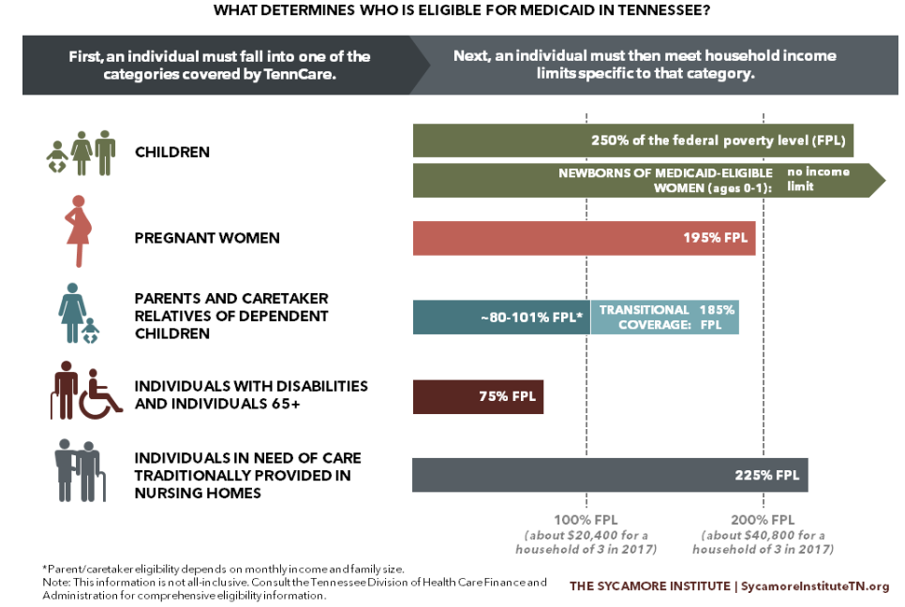
Federal Poverty Levels (FPL)
Notes:
All TennCare eligibility groups are also impacted by Federal Poverty Levels

Slide 6
Possible Contributing Factors
Poverty Rates
Birth Rates
Unemployment Rates
Population Rates
Notes:
Based on the TennCare eligibility groups, some possible contributing factors are:
Poverty
Birth rates
Unemployment rates
population numbers could be contributing factors to TennCare enrollment numbers.

Slide 7
Annual TennCare Enrollment Numbers
Notes:
Over the last 9 years, the number of TennCare members has remained mostly constant, minimal changes from 2010 – 2014 and a decent spike in 2015 with the numbers starting to return to earlier rates in 2018

Slide 8

Enrollment Change vs Birth Change
Notes:
The number of births mirrors enrollment changes some but not enough to list it as a primary factor. Notice in 2015, TennCare enrollment spikes while the birth rates start to shrink. In 2017, births rise while enrollment drops.

Slide 9

Enrollment Change vs Population Change
Notes:
Population rate changes shows no correlation

Slide 10
Enrollment Change vs Unemployment Change
Notes:
Unemployment also shows no correlation outside of a couple years

Slide 11

Enrollment Change vs Poverty Change
Notes:
Poverty rate changes on the other hand mirror enrollment changes 6 out of 7 years

Slide 12
County Comparison – Poverty vs Enrollment
Top 10 Counties by Poverty 2018
Top 10 counties by enrollment 2018
Notes:
As we start comparing the top 10 counties for Poverty and Enrollment, we see that 7 of the top 10 counties with the highest rates of TennCare enrollment are also in the top 10 counties with the highest poverty rate.

Slide 13
County Comparison – Unemployment vs Enrollment
Top 10 Counties by Unemployment 2018
Top 10 counties by enrollment 2018
Notes:
Looking at the top 10 counties for unemployment, we also see a correlation between 4 of the top 10 counties.

Slide 14
Social & Economic Factors
 | Hancock County | Tennessee
Unemployment | 5.8% | 3.7%
Children In Poverty | 42% | 21%
Some College | 39% | 60%
Notes:
The County Health Rankings & Roadmaps program lists for 2019 that Hancock County ranks 95th out of 95 Tennessee counties when it comes to social and economic factors. Children in poverty is doubled the Tennessee percentage.

Slide 15
Social & Economic Factors
 | Grundy County | Tennessee
Unemployment | 5.0% | 3.7%
Children In Poverty | 31% | 21%
Some College | 37% | 60%
Notes:
Grundy County ranks 85th out of 95 Tennessee counties when it comes to social and economic factors and was named by 24/7 Wall Street as the worst place in TN to live. Grundy has no hospital, no college, no major retailers and no dentist.

Slide 16
TennCare and Poverty
/
Each TennCare eligibility group is impacted by poverty levels
For the last 7 years, TennCare changes mirrors poverty levels almost every year
Notes:
Based on this data, the main contributing factor to TennCare enrollment numbers is poverty. The poverty changes over the last 7 years matches enrollment numbers every year but one and each eligibility group is impacted by poverty.

Slide 17
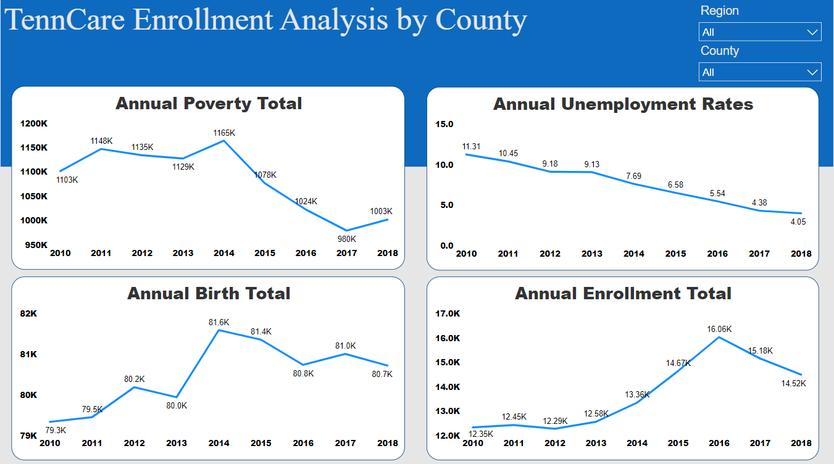
Power BI Dashboard
Notes:
I created a Power BI dashboard that allows you to see view the annual Poverty, Birth, Unemployment and Enrollment numbers by region and by county

Slide 18
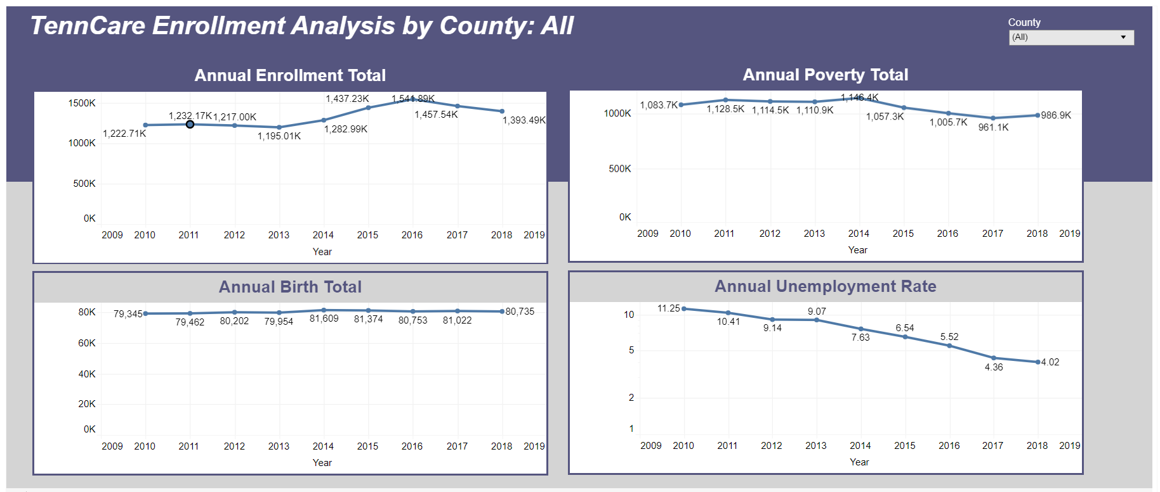
Tableau Dashboard
Notes:
I’ve also created a Tableau dashboard that allows you to see view the annual Poverty, Birth, Unemployment and Enrollment numbers by county

Slide 19
Data Sources
Birth Data
https://www.tn.gov/health/health-program-areas/statistics/health-data/birth-statistics.html
Poverty Data
https://census.gov/data/datasets/2018/demo/saipe/2018-state-and-county.html
Unemployment Data
https://data.bls.gov/lausmap/showMap.jsp
Enrollment Data
https://www.tn.gov/tenncare/information-statistics/enrollment-data.html
Population Data
https://www.cubitplanning.com/
Social and Economic Reporting
https://www.countyhealthrankings.org/app/tennessee/2019/rankings/hancock/county/outcomes/overall/snapshot

