Slide 1
VTK
The Visualisation Toolkit
Bryan Cole - 8/9/10

Slide 2
What is VTK
Toolkit for scientific and informational visualisation
C++ Core with bindings for Python, Tcl, Java
Maintained by Kitware Inc.
Open source with liberal license (commercial usage is OK, but certain algorithms are patented)
Big (1200 classes, or so)

Slide 3
VTK
What it's good for:
  Visualising datasets with 2,3 or more dimensions
  Interactive visualisation
  Screen / bitmap output
What it's not so good for:
  Data analysis / numerical processing
  2D plotting / charts
  Vector graphic output

Slide 4
Using VTK The Easy Way
Open Source Visualisation Apps:
  Paraview (http://www.paraview.org/ )
  Mayavi2 (http://code.enthought.com/projects/mayavi/)
Point 'n Click interface makes one-off visualisations easy
Becomes tedious if you've got many datasets - Better to script it!

Slide 5
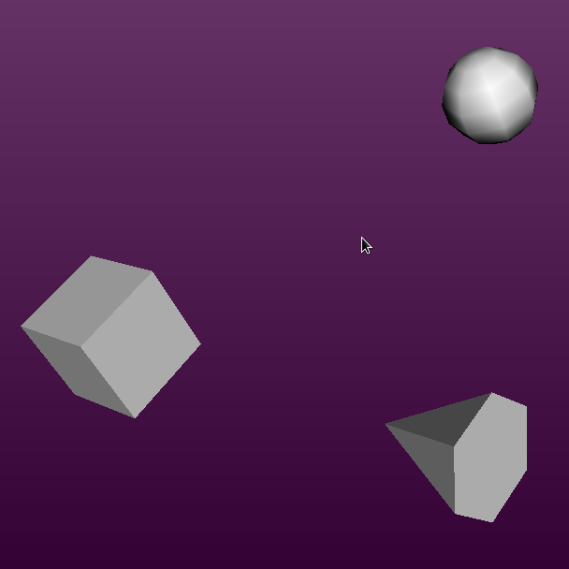
VTK Basics
vtkActors – the 'things' in the scene
vtkRenderer – the scene
vtkRenderWindow – the display window

Slide 6
Anatomy of a vtkDataSet
p2
p3
p1
c1
c3
c2
p4
p5
Points – locations in 3D space
Cells – connectivity between points
Attribute data – values associated with points and/or cells
  may be scalar, 3-vector or tensor

Slide 7
The Visualisation Pipeline
Source
creates the input vtkDataSet
Filter
transform dataset
Filter
transform dataset
Mapper
Pipeline is composed of Process Objects
Pipeline acts on Data Objects and cache their output
Pipeline objects execute lazily
Actor

Slide 8
Getting Data In
vtkXXXReaders
  Data Source objects which load data from file
Including
  vtkDelimitedTextReader
  vtkImageReader
  vtkXMLReader
  vtkPolyDataReader
  ... and 96 or so others

Slide 9
Types of vtkDataSet

Slide 10
Don't Fight The Pipeline
VTK filters are designed to function in an execution pipeline
Using them procedurally will only end in tears...
Hook yo own code into the pipeline using vtkProgrammableFilter, vtkProgrammableSource

Slide 11
What is TVTK
Part of the Enthought Tool Suite
Traited wrapper for VTK
Adds all the benefits of traits:
  easy GUI creation
  notifications
Makes the VTK API more pythonic
  (a matter of opinion)

Slide 12
Common Visualisation Techniques
Colour-mapping
Contouring
Glyphing
Warping
Streamlines / Hedgehog view
Probing
Cutting / Clipping

Slide 13
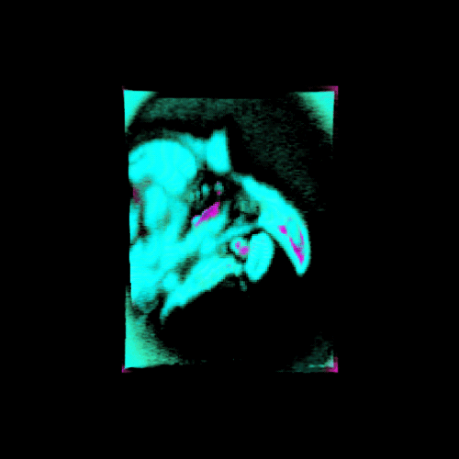
Volume Visualisation
Ray-casting
3D vtkImageData
Map scalar values to colour and opacity
vtkPiecewiseFunction
THz image of a bird's head, set in wax

Slide 14
New Stuff
Compound DataSets
  Heirarchical DataSets
  Temporal Data
InfoViz
  Graphs and Graph Layouts
  Views, Selections
  TreeMaps
  GeoViews
Charting Framework
New Widgets

Slide 15
vtkGraph and Graph Layout
Infoviz functionality built on core VTK concepts:
  points
  cells (edges and vertices)
  attribute data
Point positions set by graph layout
Create either MutableDirectedGraph or MutableUndirectedGraph
Copy data into other concrete types (vtkTree, for example)

Slide 16
More on Informatics
Existing presentations give excellent introductions to VTK informational visualisation
  http://paraview.org/Wiki/images/e/eb/ParaViewVis08_InfoVisInParaView.ppt
  http://www.sandia.gov/Titan/media/Information_Visualization_in_VTK.pdf
  Titan project web site / wiki
  http://www.kitware.com/InfovisWiki/index.php/Main_Page

Slide 17
More on VTK (www.vtk.org)
Hardcopy literature from Kitware:
  User Guide – explains how to use it
  "The Visualisation Toolkit" Textbook – a good explamation of the concepts behind VTK
  Paraview documentation (anything you can do with Paraview, applied to VTK as well)
VTK Wiki and mailing lists
VTK Doxygen reference docs – essential for browsing classes
Kitware "Source" news-sheet – useful discussion of new features in VTK

Slide 18
Code Examples
Examples and code used during this talk can be found on bitbucket at: https://bitbucket.org/bryancole/vtk_presentation_examples
The VTK source code comes with many many examples (in Python, C++ and TCL)

