Slide 1
Single page webapps with
Mojolicious and Backbone.js

Slide 2
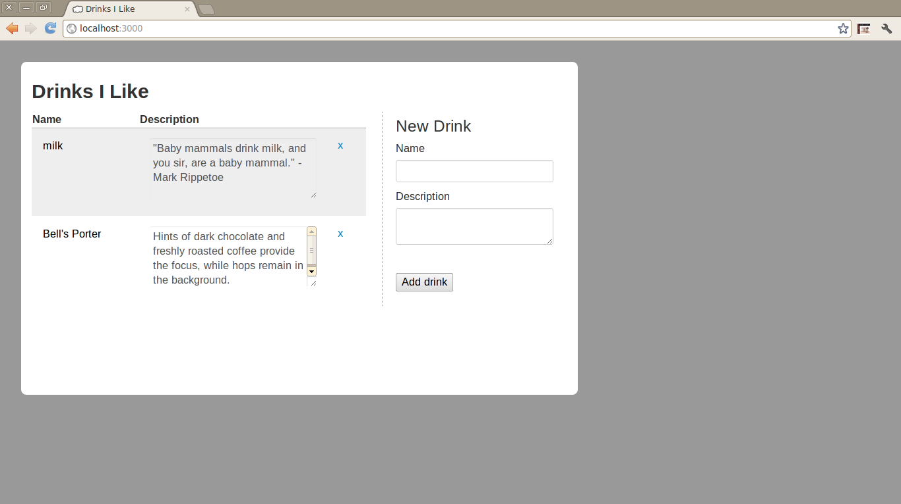
Here’s the app...

Slide 3
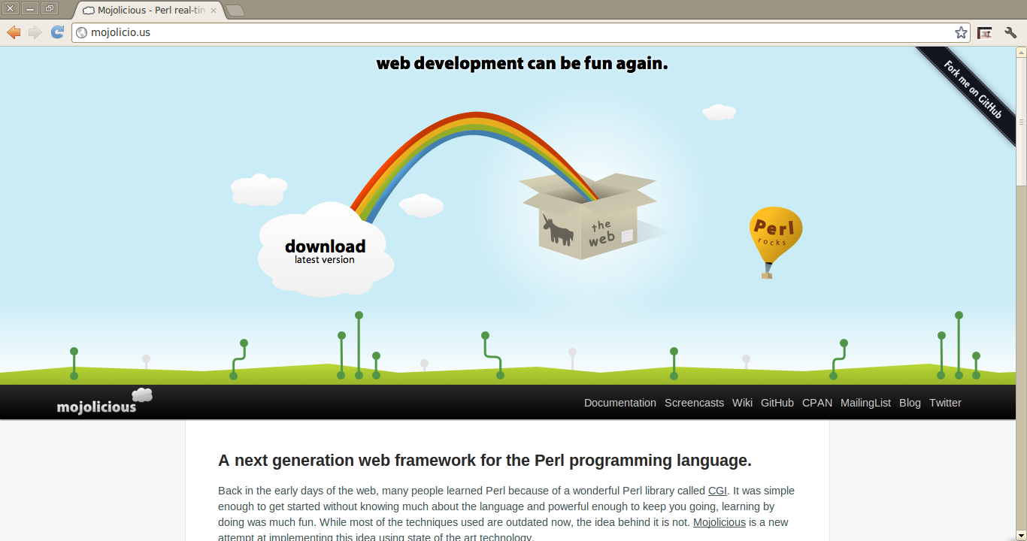
Mojolicious, Backbone.js & Bootstrap

Slide 4
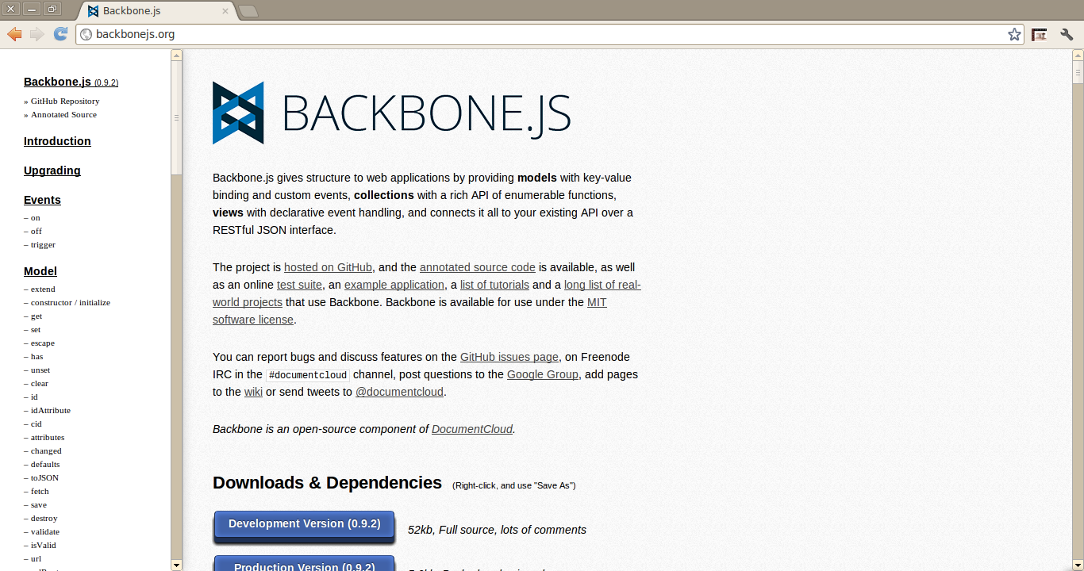
Mojolicious, Backbone.js & Bootstrap

Slide 5
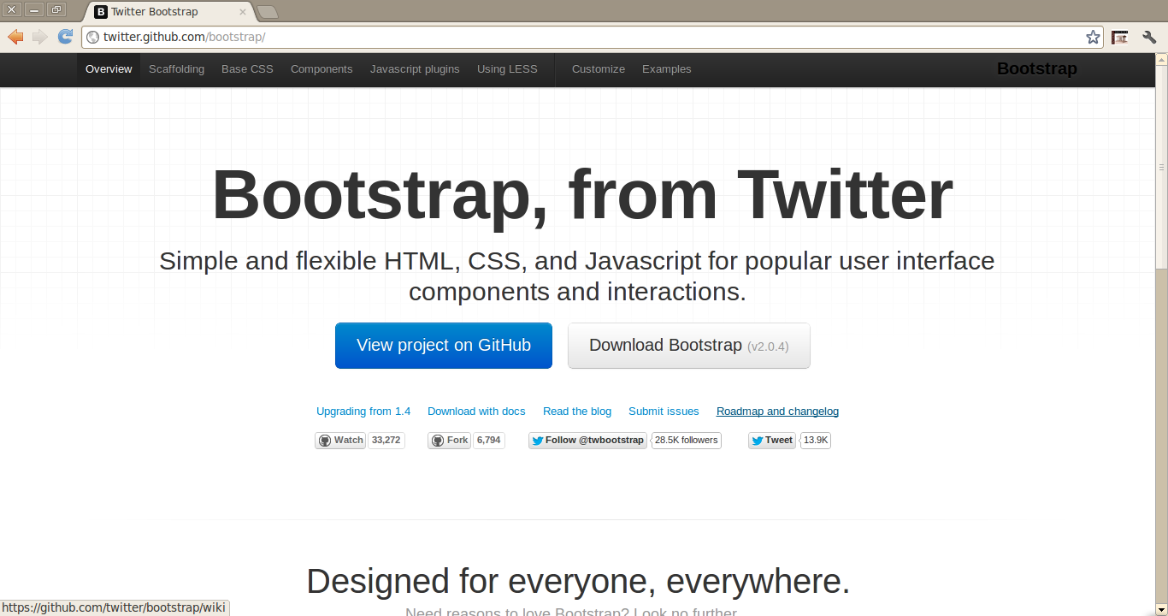
Mojolicious, Backbone.js & Bootstrap

Slide 6
REST
Data formats (e.g., XML, JSON, YAML, etc.)
HTTP method (“verbs”) + resource
  POST -> CRUD
  GET * -> CRUD
  PUT * -> CRUD
  DELETE * -> CRUD
* Should be idempotent

Slide 7
RESTful design
Method | Route
POST | /api/drink (JSON object in body)
GET | /api/drink/ (Return all drinks) /api/drink/:id (Return one drink)
PUT | /api/drink/:id (JSON obj in body)
DELETE | /api/drink/:id

Slide 8
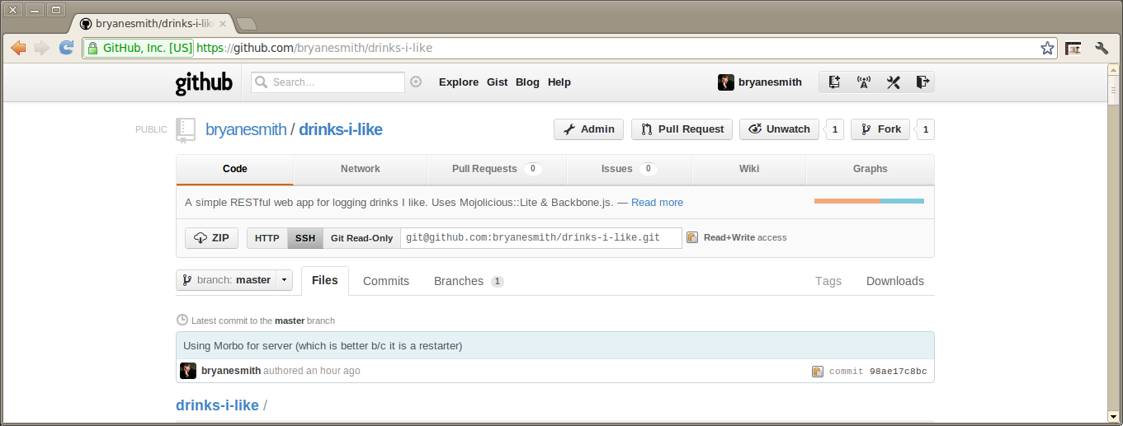
Let’s install from GitHub
git clone git@github.com:bryanesmith/drinks-i-like.git

Slide 9
Mojolicious
38 # - - - - - - - - - - - - - - - - - - - - - - - - - - - -
39 # Routes
40 # - - - - - - - - - - - - - - - - - - - - - - - - - - - -
41
42 # Home page
43 get '/' => \&handle_home;
44
45 # Add a drink
46 post '/api/drink' => \&handle_post_drink;
47
48 # Get all drinks
49 get '/api/drink' => \&handle_get_drinks;
50
51 # Get drink
52 get '/api/drink/:id' => \&handle_get_drink;
53
54 # Update a drink
55 put '/api/drink/:id' => \&handle_put_drink;
56
57 # Delete a drink
58 del '/api/drink/:id' => \&handle_delete_drink;
59 del '/api/drink' => \&handle_delete_drink;
60
61 app->start;

Slide 10
Backbone.js: Model, Collection, View & misc
public/js/library.js:
$(document).ready( function() {
...
});

Slide 11
Backbone.js: Model, Collection, View & misc
var Drink = Backbone.Model.extend({
urlRoot: '/api/drink'
});

Slide 12
Backbone.js: Model, Collection, View & misc
var DrinkCollection = Backbone.Collection.extend({
model:Drink,
url: '/api/drink'
});
var drinks = new DrinkCollection();

Slide 13
Backbone.js: Model, Collection, View & misc
var DrinksView = Backbone.View.extend({
el: $('#drinks'),
templateId: '#drinks-template',
events: {
'click .remove-drink' : 'removeDrink',
'change .title' : 'updateTitle',
'change .description' : 'updateDescription'
},
...
});

Slide 14
Backbone.js: Model, Collection, View & misc
var DrinksView = Backbone.View.extend({
...
initialize: function() {
// Bind events to collection
this.collection.bind('add', this.render, this);
this.collection.bind('remove', this.render, this);
// Grab template
this.template = $.template(this.templateId);
// Render
this.render();
},
...
});

Slide 15
Backbone.js: Model, Collection, View & misc
var DrinksView = Backbone.View.extend({
...
render: function() {
var that = this;
$(this.el).find('td').remove();
// Render each drink
_(this.collection.models).each(function(drink) {
$.tmpl(that.template, drink.toJSON()).appendTo(that.el);
});
},
...
});

Slide 16
Backbone.js: Model, Collection, View & misc
Add drink?
var drink = new Drink({title: title, description: desc });
drink.save({wait: true});
Update drink?
var drink.set(newValues);
drink.save({wait: true});
Delete drink?
drink.destroy({success: function(model, res) { coll.remove( drink ); });
Fetch drinks?
drink.fetch();

Slide 17
Backbone.js: Model, Collection, View & misc
// Grab drinks from server
drinks.fetch({
success: function() {
var drinksView = new DrinksView( { collection: drinks } );
}
});

Slide 18
Backbone.js: Model, Collection, View & misc
// Handle add drink button
$('#add-drink').click(function () {
// Create drink from form values
var drink = new Drink({
title: $('#add-title').val(),
description: $('#add-description').val()
});
// Reset form
$('#new-drink').each (function(){ this.reset(); });
drink.save({wait: true});
drink.fetch({
success: function() { drinks.add(drink); }
});
});

Slide 19
Awesome
Asynchronous HTTP > page reload
RESTful design keeps API simple
Backbone.js makes it easy easier
Bootstrap makes it pretty
Mojolicious makes it fun

Slide 20
Needs improvement
Delete should be idempotent
Standard urls & Backbone.Router (History API)
OO design improvements (e.g., fetching & helper functions should be part of view obj)
More idiomatic Backbone.js

Slide 21
Resources
Mojolicious
Backbone.js
Bootstrap
drinks-i-link on GitHub
Designing a RESTful Web Application
About me
bryanesmith.com

