Slide 1


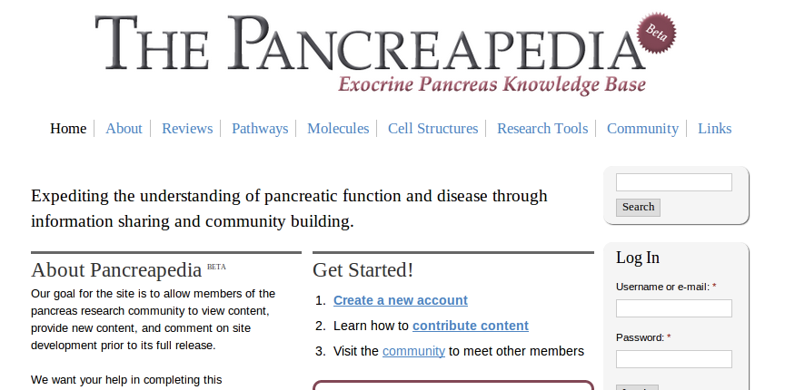

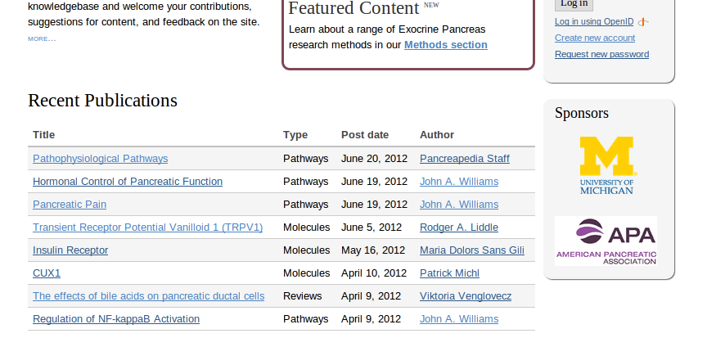

Slide 2
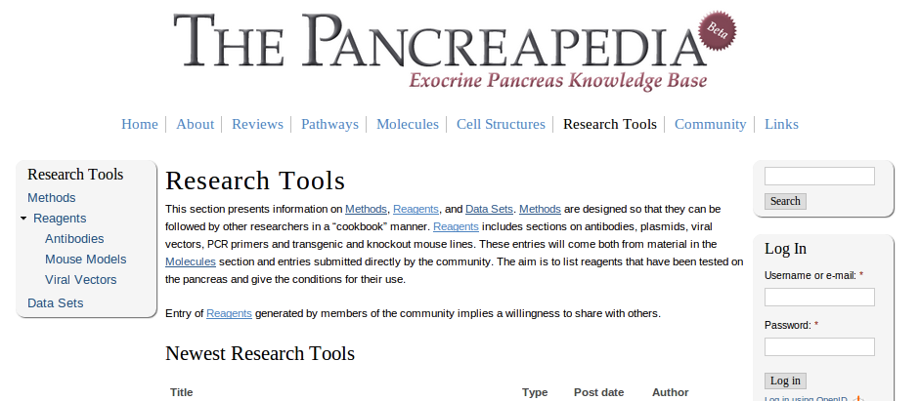
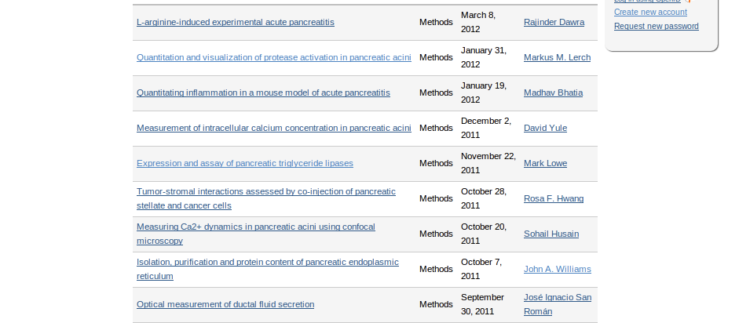
Exocrine pancreas research community
Expedite research on the pancreas
Reference book, methods book, cellular atlas and directory
What is Pancreapedia?

Slide 3
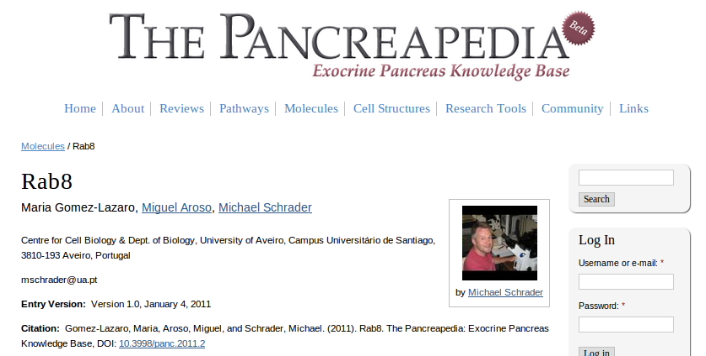
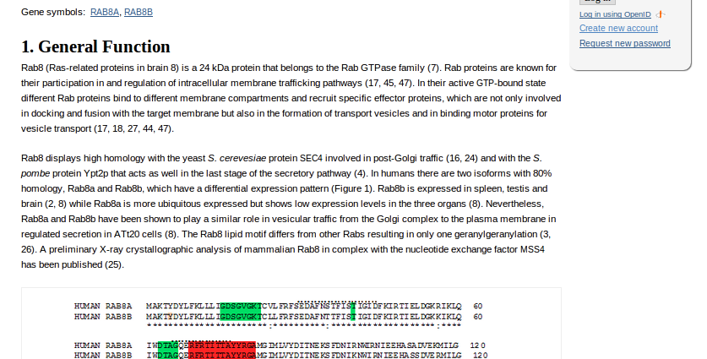
Reviews
Pathways, molecules & cell structures
Research tools
Communitty

Slide 4
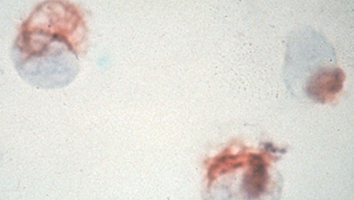
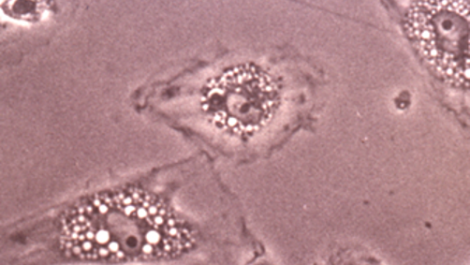

Two distinct sets of functions
Distinct function from other organs
Unique diseases

Slide 5



Slide 6
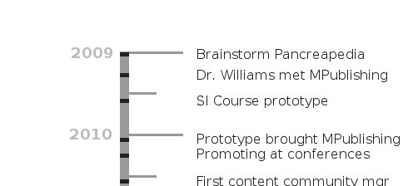


Slide 7




Slide 8




Slide 9

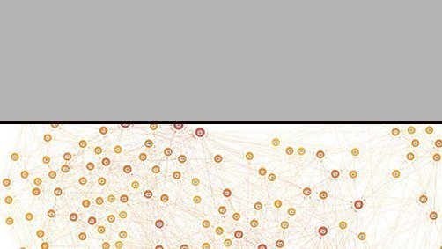


Slide 10
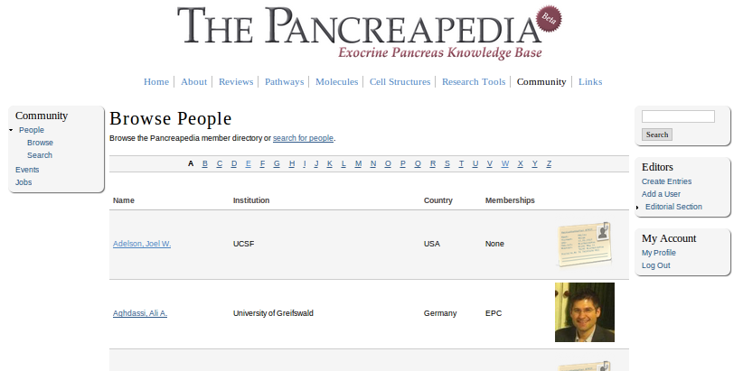
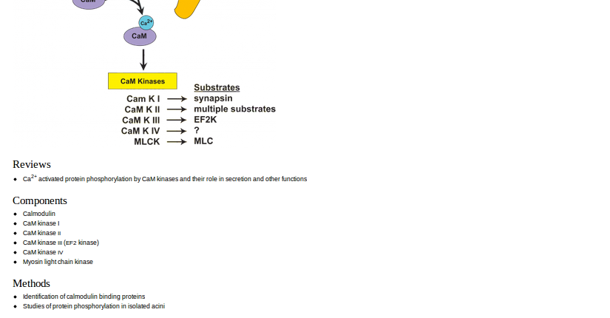
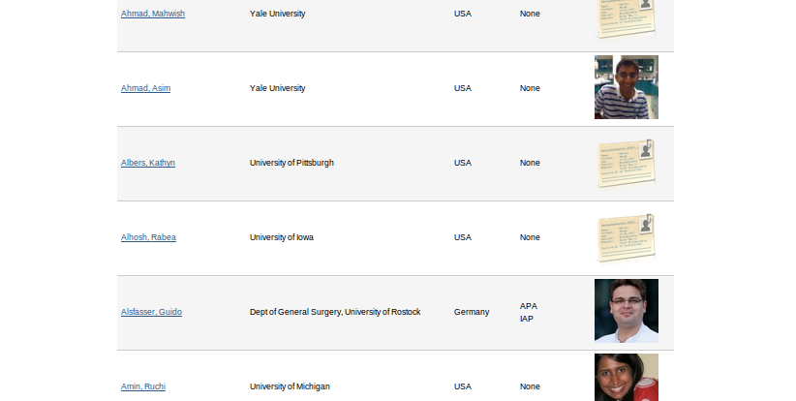

Slide 12
Images
http://bit.ly/LLkTtV
(Pancreapedia)
http://bit.ly/PERpOK
(public domain, NCI)
http://bit.ly/NtkQUH
http://bit.ly/N01EIk
(CC Attr, Wikimedia Commons)
http://bit.ly/SSsR4O
(CC Attr/Share, Wikimedia Commons)

