Slide 1


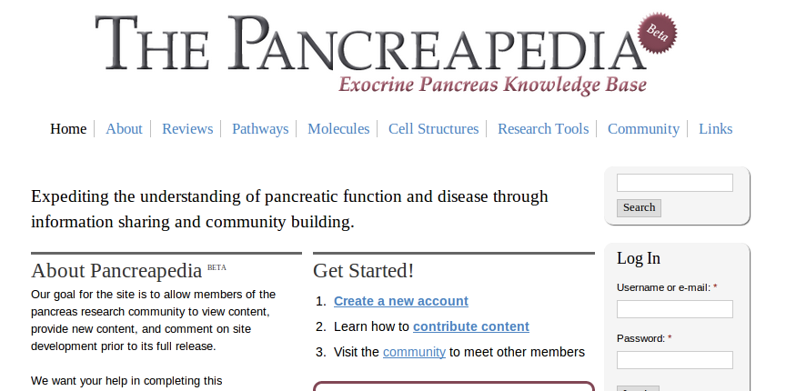

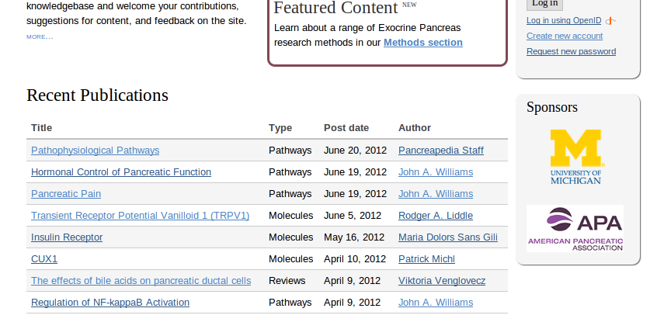

Slide 2
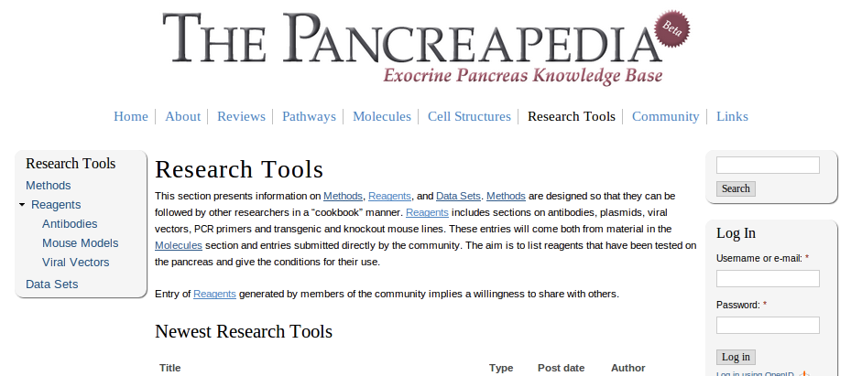
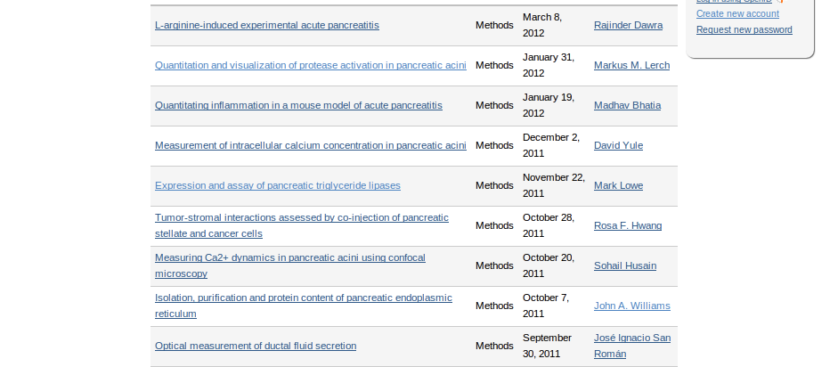
Exocrine pancreas research community
Expedite research on the pancreas
Reference book, methods book, cellular atlas and directory
What is Pancreapedia?

Slide 3
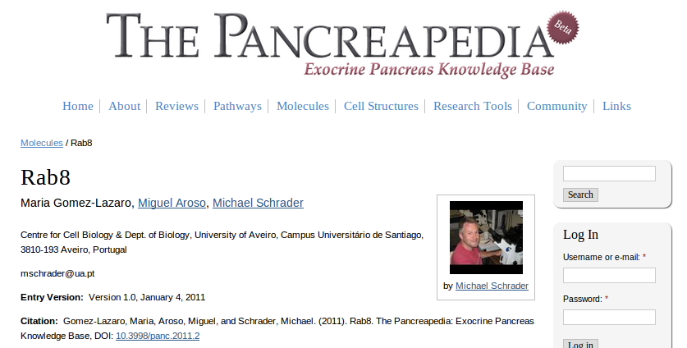
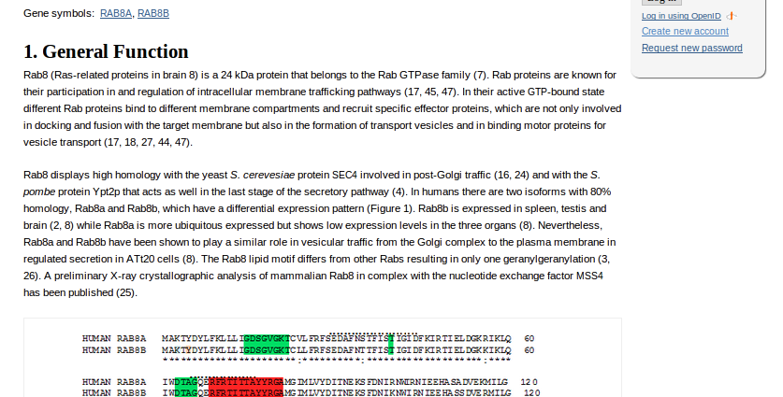
Reviews
Pathways, molecules & cell structures
Research tools
Community

Slide 4
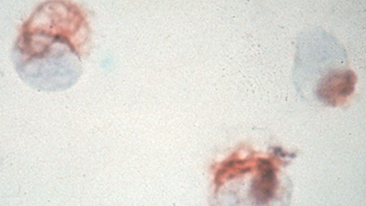
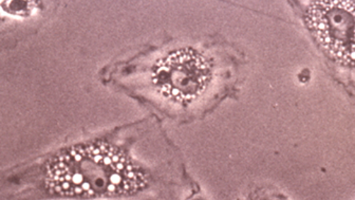

Two distinct sets of functions
Distinct function from other organs
Unique diseases

Slide 5



Slide 6
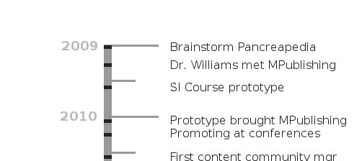


Slide 7



Challenge:
Getting potential contributors to view
Pancreapedia as serious publisher.

Slide 8

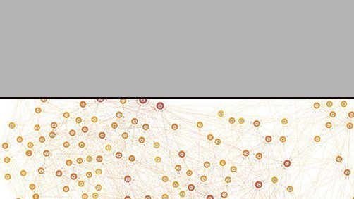

80% curation,
20% social networking

Slide 9



Community:
357 registered users
* As of July 24, 2012

Slide 10
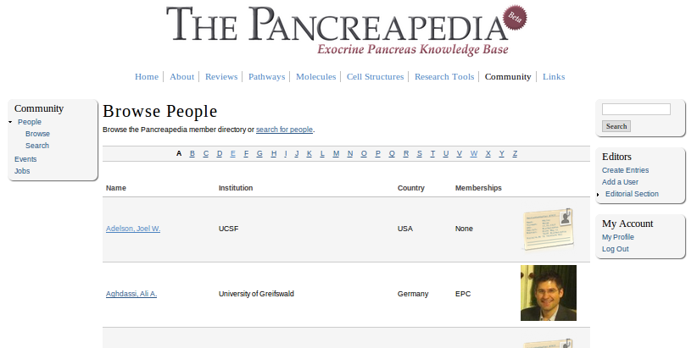
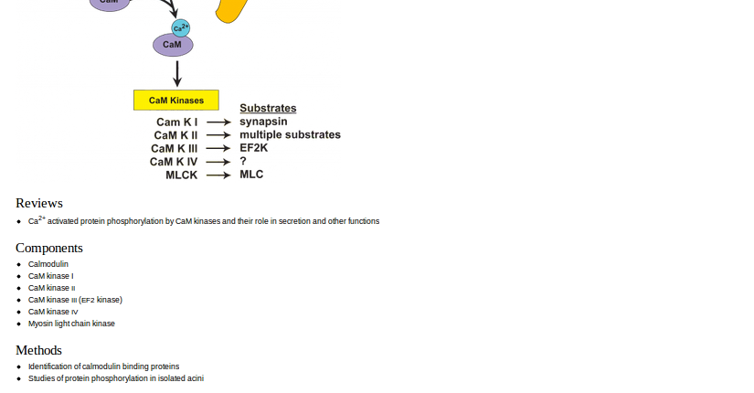
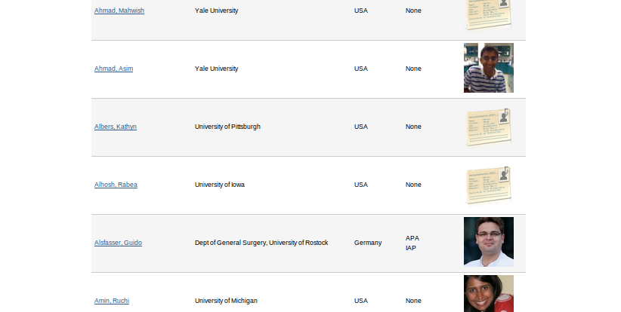
Building participation is the single most critical issue.
Expecting a tipping point.

Slide 11
Bottom-up approach to building community resource.

Slide 12
Images
http://bit.ly/LLkTtV
(Pancreapedia)
http://bit.ly/PERpOK
(public domain, NCI)
http://bit.ly/NtkQUH
http://bit.ly/N01EIk
(CC Attr, Wikimedia Commons)
http://bit.ly/SSsR4O
(CC Attr/Share, Wikimedia Commons)

