Slide 1
Phase Transitions and Hysteresis in the Ising Model.
What is the Ising Model?
Description of the Model implemented.
The Results
The Conclusions
Bryan Foley
ID: 109221484

Slide 2
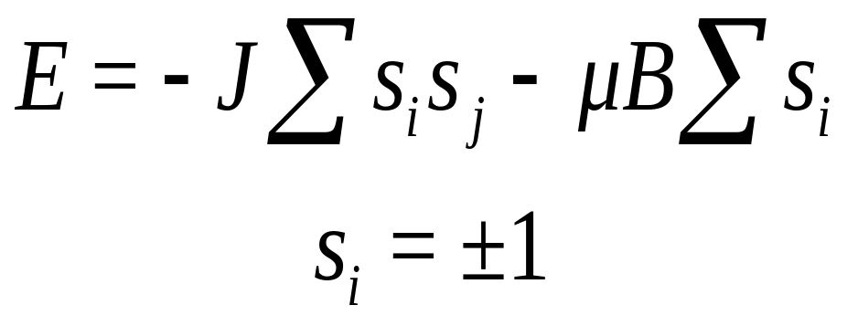
What is the Ising Model?
Ernst Ising - 1923
A quantised description of Ferromagnetic material.
The Spin of the Electron is limited to two states: Spin up & Spin down
The sum of all spin site gives the Magnetisation of the system.
The total Energy of the system can then be calculated.
The effect of an external magnetic field is also accounted for.

Slide 3
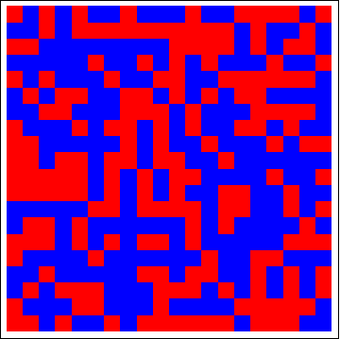
The Model Implemented
A 20x20 lattice with Periodic Boundary Conditions.
A Monte Carlo simulation.
Takes into account the disordering effect of Temperature on Ferromagnetic material.
A spin is flipped if the energy of the system is decreased.
Or is flipped if the Boltzmann Factor is greater than a random number between 0 & 1.
Pass through the lattice at least 100 times and take an average.
The 4 Immediate neighbours are used to calculate the energy to flip

Slide 4
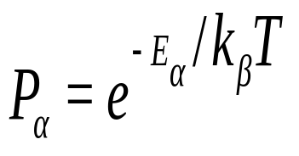
The Model Implemented
The exchange constant is assumed positive, J = 1.
The probability of a flip increases as Temperature increases.
Parallel alignment of Spins is favoured, as it reduces the energy.
All Spin Up or All Spin Down gives Ferromagnetic behaviour.
Random Spins gives Paramagnetic behaviour .
Keep the Applied field constant.
Sweep through the Temperatures.
Keep the Temperature constant,
Sweep through the applied field from negative to positive and back down again.

Slide 5
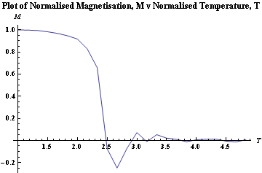
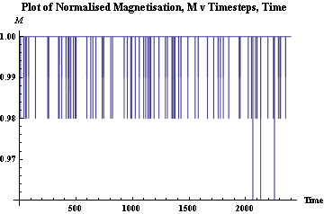
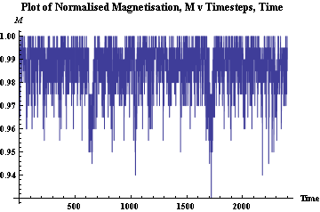
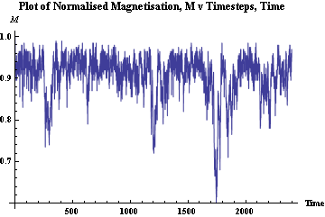
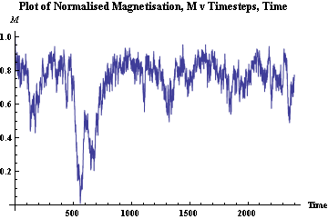
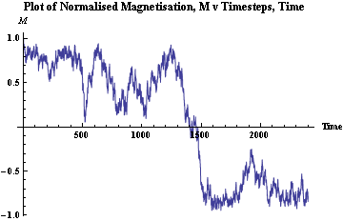
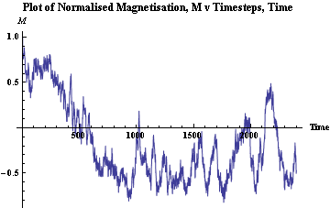
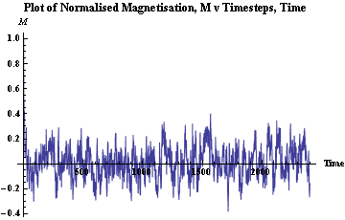
Results A
  Magnetism as a function of Temperature.
  No applied Magnetic Field.
  Temperature ranges from 1 to 5.

Slide 6
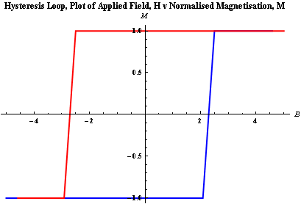
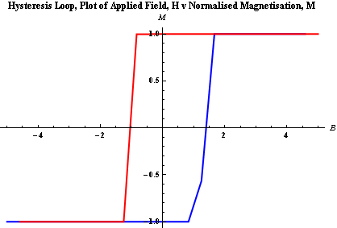
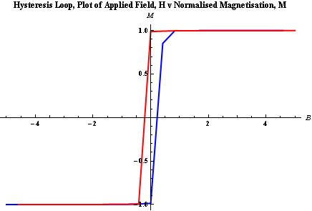
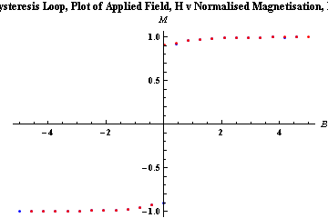
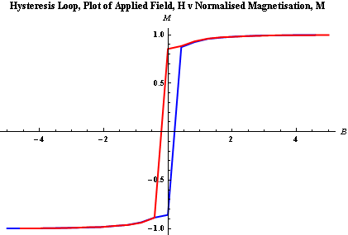
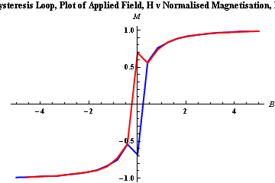
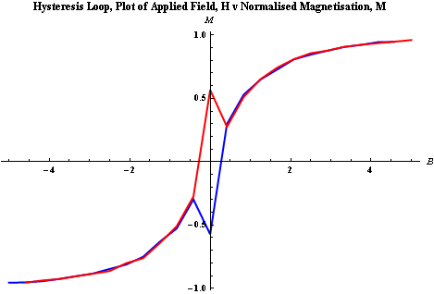
Results B
  Magnetisation as a function of Applied Field.
  The Temperature is held constant.
  The applied field is increased from -5 to +5.
  Then decreased back down to -5.

Slide 7
Conclusions.
1st and 2nd order phase transitions exist in the Model
Below the critical temperature, the material is Ferromagnetic
At the critical temperature, the material exhibits spontaneous magnetisation.
Above the critical temperature, the material is Paramagnetic
Hysteresis is observed in the model. It is greatest when the temperature is well below the critical temperature.
Spontaneous magnetisation leads to non-linear behaviour.
Above the critical temperature, the non-linear behaviour ceases.

