Slide 1

MDI1 113: Mobile Applications for Wearables – Intermediate
Class 3

Slide 2
Agenda
01 | Overview of HealthKit & Xcode project setup
02 | Integrating Swift Charts or a custom chart view. Reading HealthKit data (steps, calories, distance).
03 | Creating views to show metrics. Using Combine to update UI with live HealthKit data.
04 | Displaying historical data (e.g., steps over time).
05 | Formatting and styling for clarity and elegance.

Slide 3
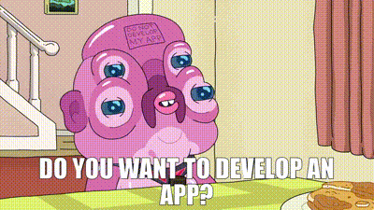

Slide 4
App Overview
This SwiftUI app integrates with Apple HealthKit to display and manage health metrics such as heart rate, steps, and active energy (calories). It provides a dashboard with charts and progress rings, plus options to manually add calories and heart rate data.
Key Features
Health Data Manager
  Requests HealthKit authorization for reading/writing heart rate, steps, and active energy.
  Fetches daily steps and calories burned.
  Observes heart rate changes in real time using HKObserverQuery.
  Allows adding custom heart rate and calorie samples to HealthKit.
UI Components
  MetricChartsView: Displays heart rate trend (line chart), steps, and calorie progress rings.
  AddCaloriesView: Simple input to add calories burned.
  AddHeartRateView: Uses Digital Crown for heart rate input and saves to HealthKit.
  CalorieRingView & StepsRingView: Circular progress indicators for goals (2500 kcal, 10,000 steps).
Architecture
  Built with SwiftUI and Charts for visualization.
  Uses @ObservedObject and @StateObject for reactive updates.
  Background delivery enabled for heart rate updates.
Purpose
A lightweight health dashboard for Apple Watch/iOS that combines real-time monitoring, manual input, and visual progress tracking for fitness goals.

Slide 5
MDI1 113: Mobile Applications for Wearables – Intermediate
Class 4

Slide 6
Overview
In the final class, students will learn how to implement contextual notifications and manage sensor data synchronization for wearable apps. Wearable apps require efficient data handling to ensure that they provide real-time feedback without draining the device’s battery. This class will focus on designing apps that respond to changes in sensor data by triggering notifications or feedback loops. Contextual notifications are used to alert users about important events, such as reaching a step goal or exceeding a target heart rate.
Students will also explore how to manage large streams of sensor data from various sources like the accelerometer, gyroscope, and health sensors in a way that is power-efficient. The challenge is to synchronize this data in a manner that does not overtax the system’s resources while still providing real-time responses to the user. Techniques such as reducing the frequency of updates or using batch processing for sensor data will be covered.
Moreover, students will learn about implementing background tasks to ensure that sensor data collection continues even when the app is not actively in the foreground. The class will also cover how to implement user feedback loops, providing actionable responses to the user based on real-time sensor data (e.g., “Great job, you’ve hit your target!” or “Take a break, your heart rate is elevated”).
By the end of this class, students will have a solid understanding of how to design and implement responsive, power-efficient wearable apps that leverage contextual notifications, manage sensor data effectively, and offer real-time feedback to users.

Slide 7
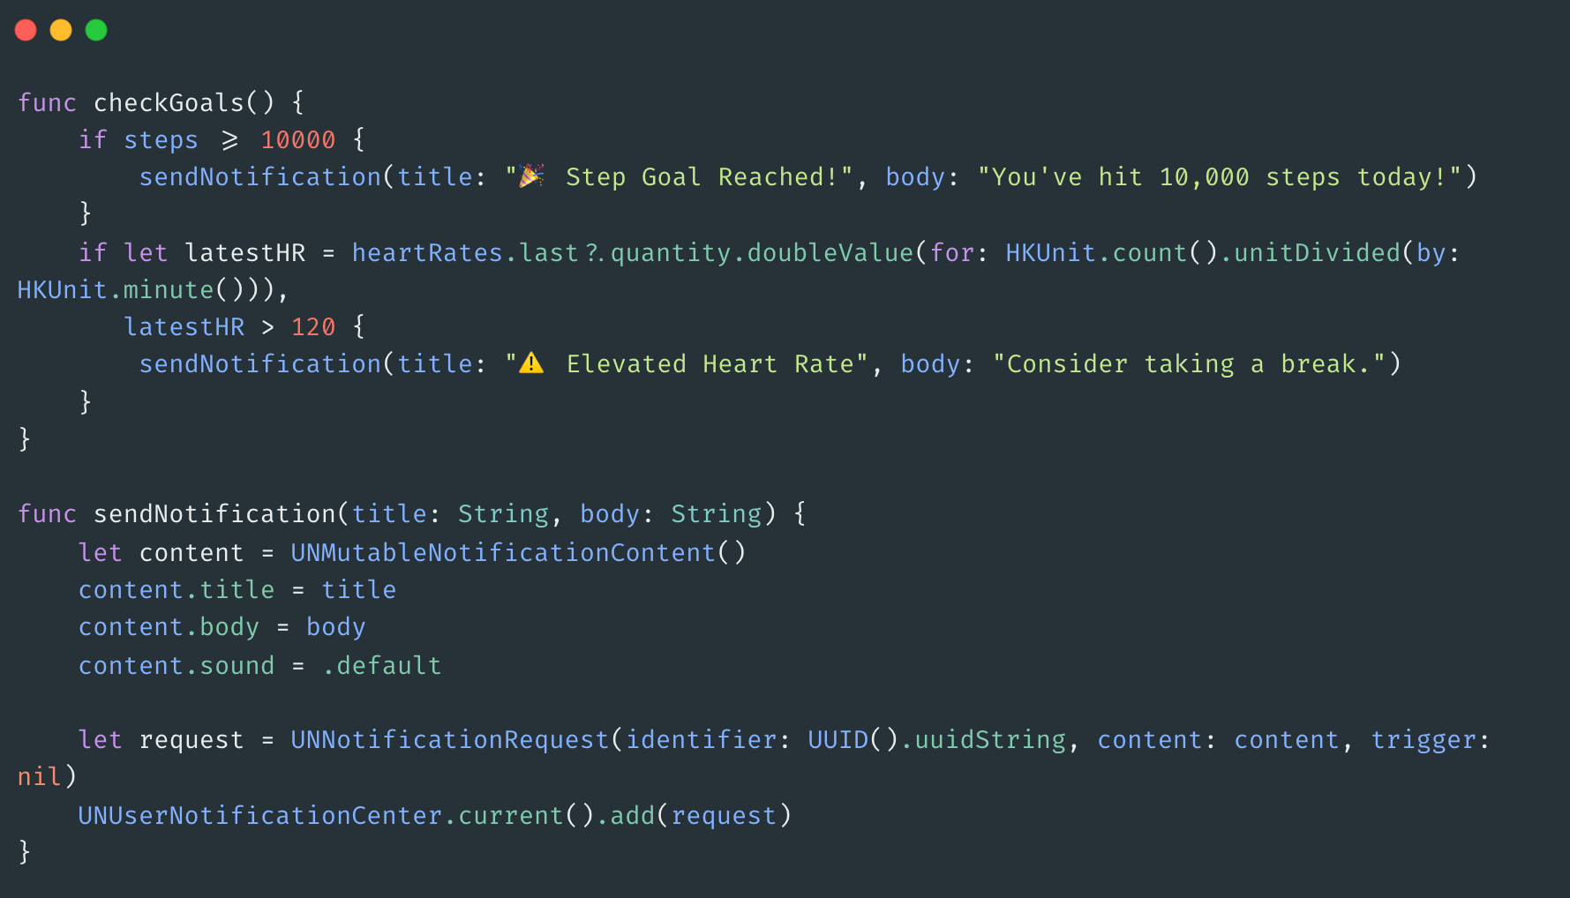
Contextual Notifications
Concepts:
Triggering alerts based on sensor thresholds.
Examples: step goal reached, elevated heart rate.

Slide 8

Battery Management
Efficient Sensor Data Handling
Used HKObserverQuery to listen for changes in heart rate data without polling.
Avoided frequent HKSampleQuery calls by triggering updates only when new data is available.
2. Background Delivery
Enabled background updates using enableBackgroundDelivery for heart rate.
Ensures data sync continues even when the app is not in the foreground.
3. Reduced Update Frequency
Limited the number of samples fetched per query (e.g., limit: 100).
Used HKStatisticsQuery for cumulative metrics like steps and calories to avoid processing raw samples.
4. Feedback Loop Optimization
Triggered feedback and notifications only when thresholds are crossed (e.g., heart rate > 120 bpm).
Prevented unnecessary UI updates or alerts.
5. Avoided Polling
No use of timers or continuous loops for data refresh.
Relied on HealthKit’s event-driven architecture for updates.
6. Lightweight UI Components
Used ProgressView and Chart with minimal animation and layout overhead.
Ensured smooth rendering without draining resources.

