Slide 1

MDI1 113: MOBILE APPLICATIONS FOR WEARABLES -
INTERMEDIATE

Slide 2
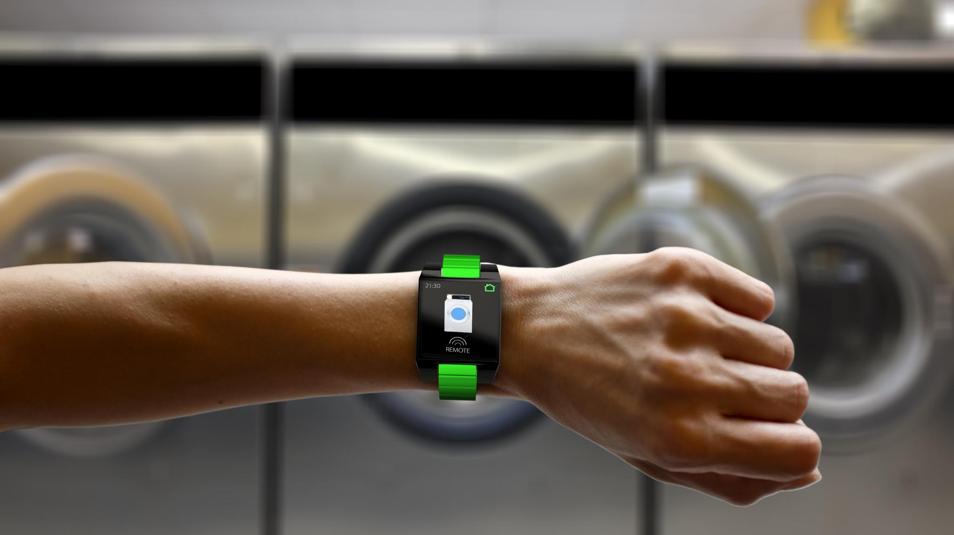
Swift Wearables Class: Core Motion
Understanding motion data for wearable app development
Notes:
---

Slide 3
Core Motion Basics
Notes:
Overview of Core Motion and Sensor Types, Hands-On Setup with CMMotionManager

Slide 4
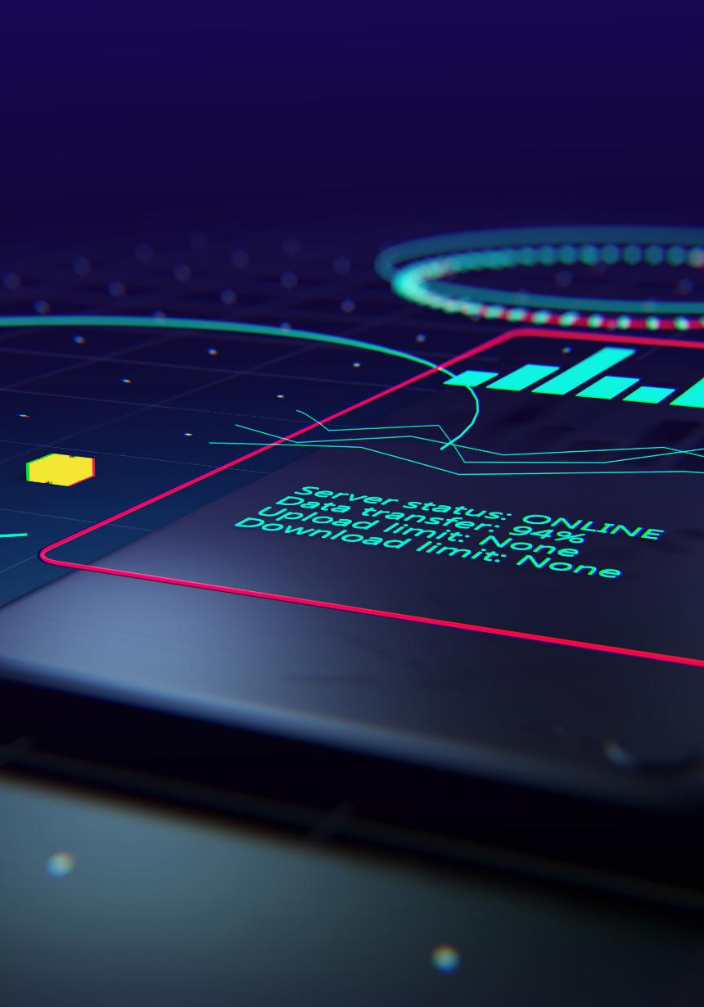
Overview of Core Motion and Sensor Types
Core Motion Framework
  Core Motion provides access to motion data from multiple sensors on iOS and watchOS devices for app development.
Sensor Functions Explained
  Accelerometer measures linear acceleration, gyroscope captures rotation, magnetometer detects magnetic fields for heading.
Device Motion Fusion
  Device motion fuses sensor data to provide attitude, rotation rate, and gravity vector for comprehensive motion tracking.
Platform Differences and Efficiency
  Developers must consider sensor availability, sampling rates, and battery constraints when using Core Motion on devices.
Notes:
Core Motion is a powerful framework in iOS and watchOS that allows developers to access motion-related data from device sensors. It supports various types of motion data including accelerometer, gyroscope, magnetometer, and device motion, which is a fusion of multiple sensors to provide a comprehensive view of the device's movement and orientation. The accelerometer measures linear acceleration, the gyroscope captures rotational velocity, and the magnetometer detects magnetic fields to determine heading. Device motion combines these inputs to provide data such as attitude, rotation rate, and gravity vector. Understanding these sensors is crucial for building responsive and context-aware applications on Apple Watch. Additionally, developers must consider the differences between iPhone and Apple Watch capabilities, especially in terms of sensor availability and battery constraints. Sampling rates and data accuracy can vary, and efficient handling of motion updates is essential to preserve battery life while maintaining app performance.

Slide 5

Hands-On Setup with CMMotionManager
Setup of CMMotionManager
  Students will initialize CMMotionManager and configure update intervals to start capturing motion data effectively.
Real-Time Accelerometer Data
  Accelerometer updates will stream x, y, and z acceleration values to the console for live observation and analysis.
CMMotionManager vs CMPedometer
  Understanding differences: CMMotionManager provides raw sensor data; CMPedometer offers processed info like step count.
Notes:
In this hands-on segment, students will create a new watchOS app using Xcode and integrate Core Motion by setting up the CMMotionManager. This class provides access to accelerometer, gyroscope, and device motion data. Students will initialize CMMotionManager, configure update intervals, and start accelerometer updates using the method startAccelerometerUpdates(to:withHandler:). They will print the x, y, and z acceleration values to the console to observe real-time data. This exercise introduces the concept of motion data streaming and lays the foundation for more advanced motion handling. A deep dive into the differences between CMMotionManager and CMPedometer will help students understand when to use each class. While CMMotionManager offers raw sensor data, CMPedometer provides higher-level information such as step counts and distance traveled, making it suitable for fitness and activity tracking apps.

Slide 6
Detecting Patterns
Advanced Motion Detection
Pattern Recognition:
  Combine accelerometer and gyroscope data to detect activities like jumping or squatting.
Real-Life Example:
  A fitness app provides feedback on running posture using motion data.

Slide 7
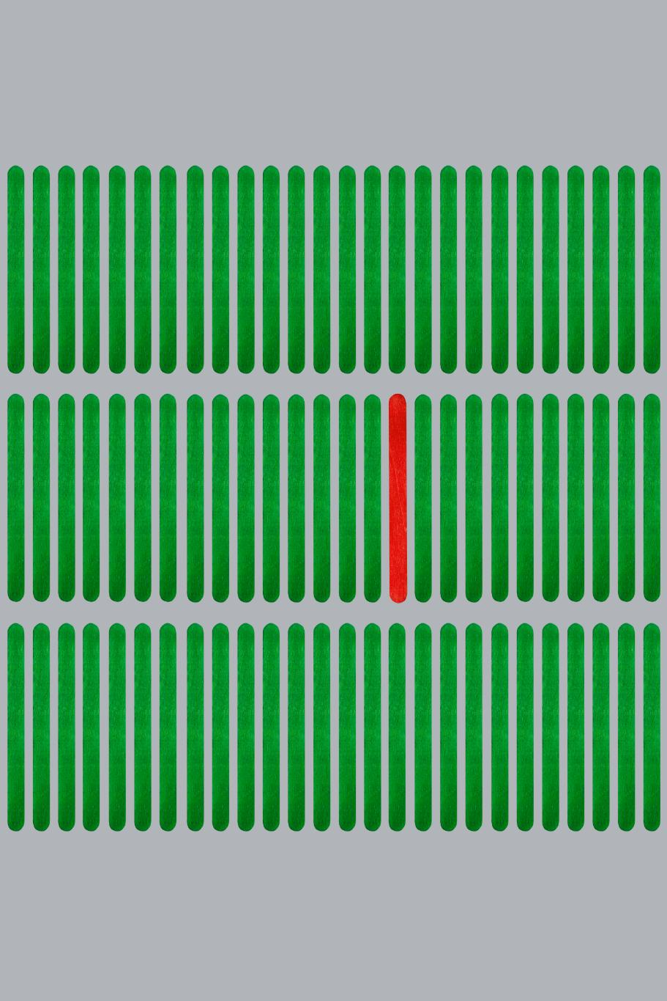
Filtering motion data for stability
Sensor Noise Challenges
  Sensor motion data often contains noise due to vibrations and rapid movements, affecting accuracy.
Low-Pass Filtering Formula
  Low-pass filtering smooths data using a weighted average of current and previous readings with alpha factor.
  filtered = α * new_value + (1 - α) * previous_filtered_value
Benefits for UI and Gestures
  Filtering reduces sudden spikes, enabling stable motion data visualization and accurate gesture detection.
Notes:
Motion data from sensors can be noisy, especially when the device is subject to small vibrations or rapid movements. To improve stability and accuracy, developers often apply filtering techniques such as low-pass filters. A common formula for low-pass filtering is: filteredX = alpha * currentX + (1 - alpha) * previousX, where alpha is a smoothing factor typically between 0.1 and 0.5. This approach reduces the impact of sudden spikes and provides a smoother signal for visualization or gesture detection. Filtering is particularly useful when displaying motion data on the UI or when detecting subtle gestures that require consistent input. Implementing filters helps create more reliable and user-friendly motion-based applications.

Slide 8
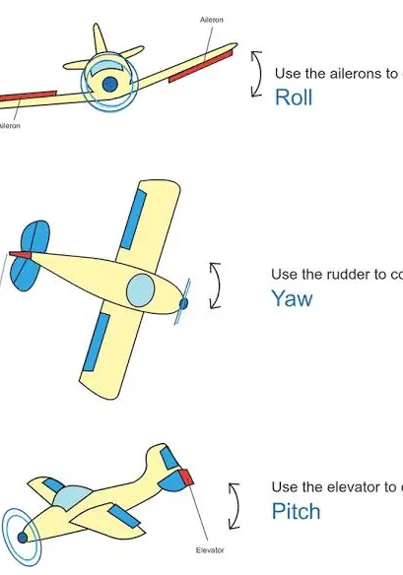
1. gravity (CMAcceleration)
Represents the direction and magnitude of gravity relative to the device.
Used to determine the tilt of the device.
2. userAcceleration (CMAcceleration)
Measures acceleration caused by user movement (excluding gravity).
Useful for detecting shakes, taps, or sudden motion.
Not directly used to tilt the ball in this demo, but shown in the UI for reference.
3. rotationRate (CMRotationRate)
Measures angular velocity (how fast the device is rotating) around each axis.
Also not used to tilt the ball here, but could be used for more dynamic effects like spinning.
4. attitude (CMAttitude)
Contains pitch, roll, and yaw — the orientation of the device in 3D space.
Displayed in the UI as degrees, but not used to move the ball in this example.

Slide 9
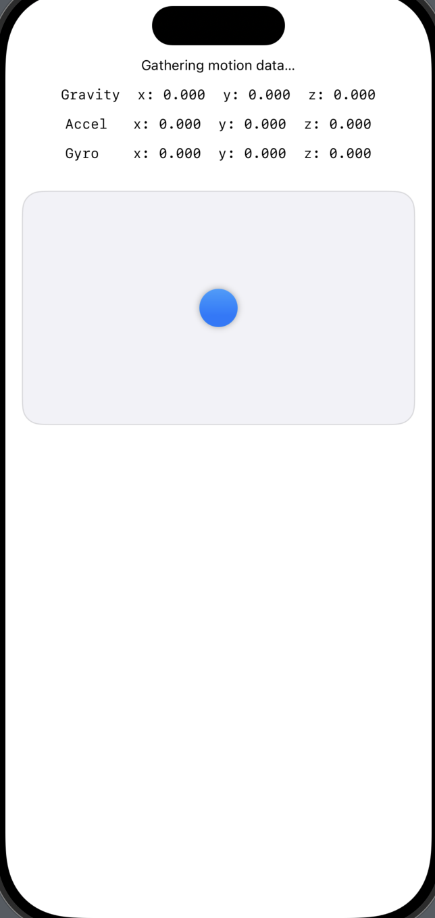
Tilt Ball Demo — Explore your device’s motion sensors in real time!
This interactive app visualizes how your device responds to movement using Core Motion. It tracks and displays key motion metrics like:
Pitch, Roll, and Yaw — the orientation of your device in 3D space.
Gravity vector — showing how gravity is perceived based on tilt.
User acceleration — movement caused by you (excluding gravity).
Gyroscope rotation rate — how fast the device is spinning.
Tilt Ball Feature:
Watch a ball move smoothly across the screen as you tilt your device! The app uses filtered gravity data to simulate realistic motion, making it a great demo for physics, sensor tech, or just fun experimentation.
Perfect for students, developers, or anyone curious about how motion sensors work under the hood.

Slide 10
Advanced Motion Handling
Notes:
Using CMPedometer and CMDeviceMotion

Slide 11
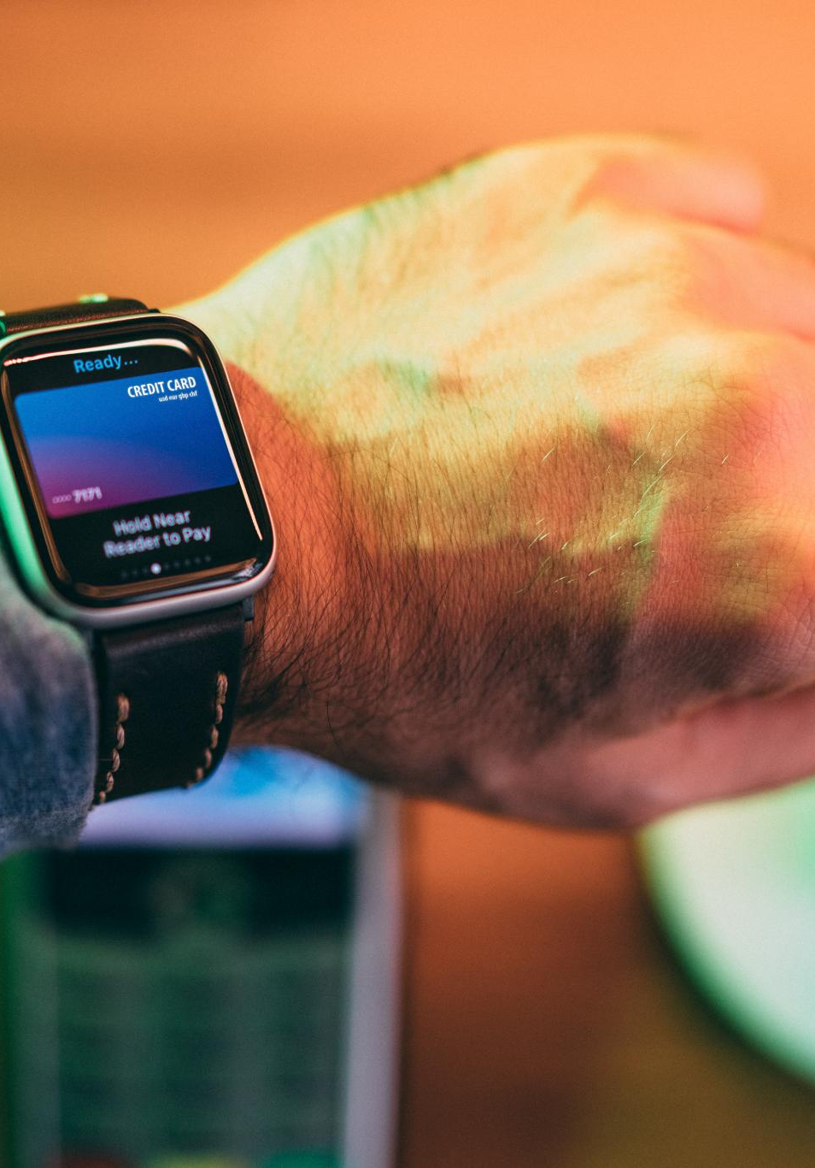
Using CMPedometer and CMDeviceMotion
CMPedometer Overview
  CMPedometer tracks steps, distance, and cadence, optimized for fitness apps with energy efficiency.
CMDeviceMotion Data
  CMDeviceMotion provides detailed orientation and movement using multiple sensors like attitude and rotation rate.
Motion Data Handling
  Efficient motion updates with managed intervals, background processing, and filtering enhance motion data accuracy.
Real-Time Visualization
  Real-time display of motion data on Apple Watch includes x, y, z values and pitch, roll, yaw visualization.
Notes:
CMPedometer is a high-level API in Core Motion that simplifies the process of tracking steps, distance, and cadence. It is particularly useful for fitness applications and is optimized for energy efficiency. CMDeviceMotion, on the other hand, provides detailed information about the device’s orientation and movement by combining data from multiple sensors. It includes properties such as attitude, rotation rate, gravity, and user acceleration. In this segment, students will learn how to access and interpret CMDeviceMotion data to understand the device’s orientation in space. They will also explore how to handle motion updates efficiently by managing update intervals and using background threads to process data. Visualization techniques will be introduced, allowing students to display motion data in real-time on the Apple Watch interface. This includes updating labels with x, y, z values and showing pitch, roll, and yaw. The session will also cover motion data filtering techniques, such as low-pass filters, to smooth out noisy data and improve accuracy. Event thresholds will be discussed to help students detect specific motion patterns like shakes or falls.

Slide 12
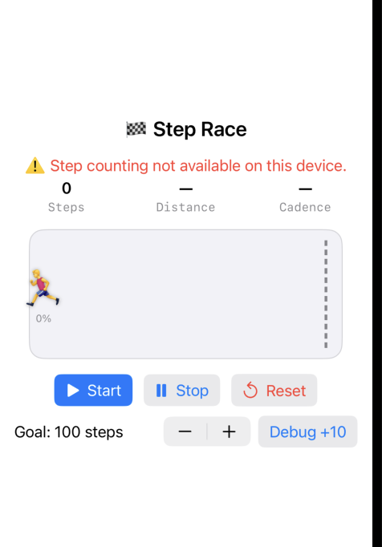
Step Race Game — A fun and interactive pedometer-powered challenge!
This app turns your steps into a race! Using your device’s motion sensors, it tracks your real-time walking activity and visualizes your progress toward a step goal with a playful runner animation.
Features:
Live step tracking using Core Motion’s pedometer.
Displays key metrics like:
  Total steps
  Distance walked
  Cadence (steps per minute)
  Pace (seconds per meter)
A progress bar with a moving runner emoji that races toward the finish line.
Customizable step goal — set your own challenge!
Debug mode for classroom demos — simulate steps without walking.
Celebratory alert when you reach your goal
Perfect for fitness motivation, classroom activities, or just having fun while staying active!

Slide 13
Mini Project: Motion Tracker App
Notes:
Building the Motion Tracker App

Slide 14
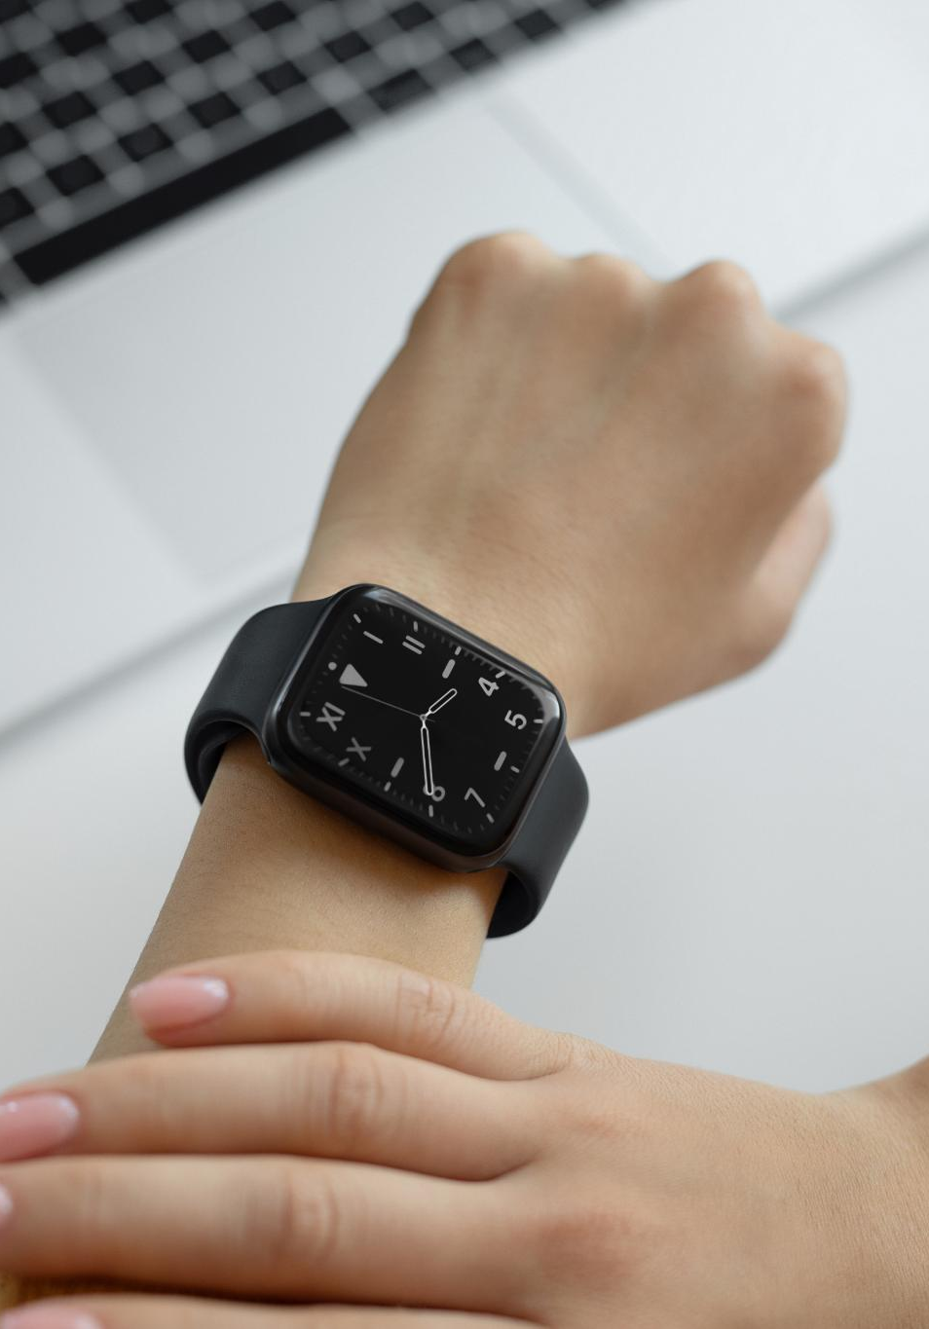
Building the Motion Tracker App
Core Motion Integration
  The app uses Core Motion to track user steps and detect sudden movements like shakes and jumps using accelerometer data.
User Interface Features
  Includes start/stop tracking button and live display of motion data on the watch screen for user interaction.
Session Summary and Metrics
  Displays total steps, maximum acceleration, and session duration on a summary screen for user feedback.
Advanced Stretch Goals
  Advanced features include local data storage, haptic feedback on shake detection, and motion intensity graphing.
Notes:
The mini project involves building a Motion Tracker app for Apple Watch that utilizes Core Motion to monitor user activity. The app will track steps using CMPedometer and detect sudden movements such as shakes or jumps using accelerometer data. Students will implement a start/stop tracking button to control data collection and display live motion data on the watch screen. The app will include a summary screen that shows total steps, maximum acceleration detected, and the duration of the tracking session. This project reinforces the concepts learned in the previous segments and provides practical experience in integrating multiple Core Motion features. Stretch goals will be introduced for advanced students, including saving session data locally using Core Data or UserDefaults, adding haptic feedback when a shake is detected, and displaying a graph of motion intensity over time. These enhancements encourage students to think creatively and explore additional watchOS capabilities. The project will be completed during the final hour of the class, with guidance and support from the instructor.

Slide 15
Wrap-Up and Homework
Notes:
Review and Next Steps

