Slide 1
Designing for Wearables (watchOS) - Advanced Workshop
Exploring advanced techniques to enhance wearable app design
Notes:
---

Slide 2
Introduction & Goals
Notes:
---
This slide references information from the following file: https://insulet-my.sharepoint.com/personal/rgarciaduran_insulet_com/_layouts/15/Doc.aspx?sourcedoc=%7BC4CF4B3E-F4EC-40A5-97A6-702212ADA1BC%7D&file=class_2.pptx&action=edit&mobileredirect=true
Workshop Overview and Objectives

Slide 3

Workshop Overview and Objectives
Workshop Purpose
  Understand key goals for mastering watchOS design and UI/UX strategies in wearables.
Hands-On Learning
  Build practical skills through hands-on SwiftUI projects and group critiques.
Ergonomic Interfaces
  Emphasize glanceable, ergonomic UI for small screens using Digital Crown and haptics.
Tools and Resources
  Overview of Xcode, SwiftUI, and Human Interface Guidelines for wearable design.
Notes:
---
This slide references information from the following file: https://insulet-my.sharepoint.com/personal/rgarciaduran_insulet_com/_layouts/15/Doc.aspx?sourcedoc=%7BC4CF4B3E-F4EC-40A5-97A6-702212ADA1BC%7D&file=class_2.pptx&action=edit&mobileredirect=true
This introductory section sets the stage for the 3-hour advanced workshop on designing for wearables using watchOS. Participants will gain a comprehensive understanding of the unique constraints and opportunities presented by wearable devices, particularly the Apple Watch. The session outlines the goals of the workshop, which include mastering watchOS design principles, implementing effective UI/UX strategies, and building a hands-on project using SwiftUI. Attendees will be introduced to the instructor, Ramses García Duran, and the course structure, which includes theoretical discussions, practical exercises, and group critiques. The importance of designing glanceable, ergonomic interfaces for small screens will be emphasized, along with the role of the Digital Crown and haptics in user interaction. This section also provides an overview of the tools and resources that will be used throughout the workshop, including Xcode, SwiftUI, and Apple's Human Interface Guidelines.

Slide 4
Why Wearables Are Different
Notes:
---
This slide references information from the following file: https://insulet-my.sharepoint.com/personal/rgarciaduran_insulet_com/_layouts/15/Doc.aspx?sourcedoc=%7BC4CF4B3E-F4EC-40A5-97A6-702212ADA1BC%7D&file=class_2.pptx&action=edit&mobileredirect=true
Design Constraints and User Context

Slide 5
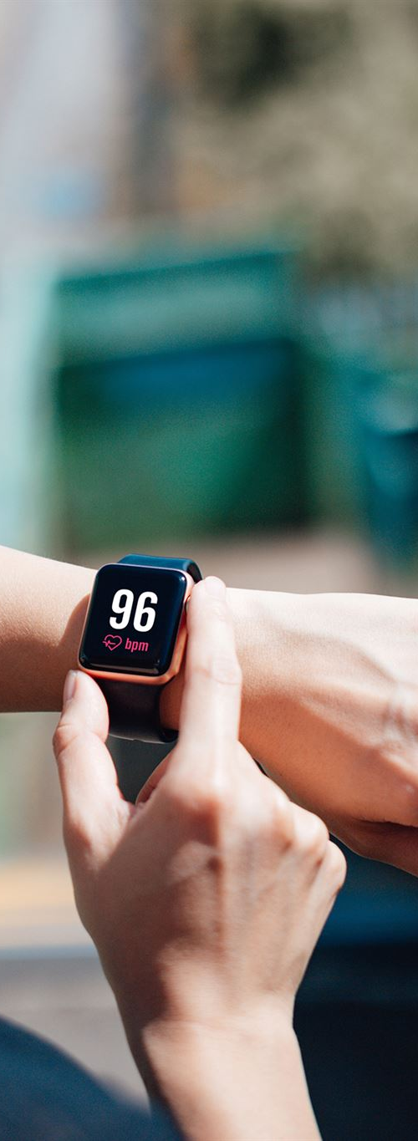
Design Constraints and User Context
Display Size Limitations
  Wearables have tiny screens requiring concise and clear content for quick viewing.
Glanceability Priority
  Users must quickly absorb key information within seconds while moving or multitasking.
Navigation with Digital Crown
  The Digital Crown enables vertical scrolling and reduces complex gestures for navigation.
Contextual Usage Environments
  Wearables are used while walking, exercising, or multitasking, demanding responsive design.
Notes:
---
This slide references information from the following file: https://insulet-my.sharepoint.com/personal/rgarciaduran_insulet_com/_layouts/15/Doc.aspx?sourcedoc=%7BC4CF4B3E-F4EC-40A5-97A6-702212ADA1BC%7D&file=class_2.pptx&action=edit&mobileredirect=true
Wearable devices, especially smartwatches, present a unique set of design challenges that differ significantly from smartphones and tablets. This section delves into the constraints imposed by tiny displays, limited interaction time, and the in-motion context in which wearables are used. Designers must prioritize glanceability, ensuring that users can absorb key information within seconds. The proximity of the device to the user's eyes and the frequent use of complications over full apps necessitate a focus on brevity and clarity. The Digital Crown serves as the primary navigation tool, supporting vertical scrolling and minimizing the need for complex gestures. This section also explores how wearables are often used in dynamic environments—while walking, exercising, or multitasking—which demands intuitive and responsive interfaces. Real-world examples and diagrams illustrate how successful wearable apps address these constraints through thoughtful design choices.

Slide 6
watchOS Design Principles
Notes:
---
This slide references information from the following file: https://insulet-my.sharepoint.com/personal/rgarciaduran_insulet_com/_layouts/15/Doc.aspx?sourcedoc=%7BC4CF4B3E-F4EC-40A5-97A6-702212ADA1BC%7D&file=class_2.pptx&action=edit&mobileredirect=true
Core Guidelines and Personalization

Slide 7

Core Guidelines and Personalization
Prioritize the Moment
  Designers should prioritize immediate, context-relevant information to enhance user focus and efficiency.
Shallow Navigation
  Navigation should be simple and shallow, requiring minimal effort to complete user tasks quickly.
Quick Gestures
  Use one or two quick gestures for targeted actions to improve usability and speed.
Adaptive Interfaces
  Interfaces should adapt dynamically based on device context like time, activity, and location.
Notes:
---
This slide references information from the following file: https://insulet-my.sharepoint.com/personal/rgarciaduran_insulet_com/_layouts/15/Doc.aspx?sourcedoc=%7BC4CF4B3E-F4EC-40A5-97A6-702212ADA1BC%7D&file=class_2.pptx&action=edit&mobileredirect=true
Apple's watchOS design principles emphasize immediacy, simplicity, and personalization. This section provides an in-depth analysis of these principles, starting with the concept of 'prioritize the moment,' which encourages designers to surface the most relevant information based on context. Navigation hierarchies should be shallow, enabling users to complete tasks with minimal effort. Quick, targeted actions using one or two gestures are preferred, and interfaces should adapt to on-device context such as time, activity, and location. The session includes visual examples of apps that successfully implement these principles, along with code snippets demonstrating how to use SwiftUI to create responsive and context-aware interfaces. Participants will engage in exercises that challenge them to redesign existing app flows to align with watchOS guidelines, fostering a deeper understanding of effective wearable UX.

Slide 8
Navigation & Layout Best Practices
Notes:
---
This slide references information from the following file: https://insulet-my.sharepoint.com/personal/rgarciaduran_insulet_com/_layouts/15/Doc.aspx?sourcedoc=%7BC4CF4B3E-F4EC-40A5-97A6-702212ADA1BC%7D&file=class_2.pptx&action=edit&mobileredirect=true
Implementing Shallow Hierarchies and Scrollable Views

Slide 9
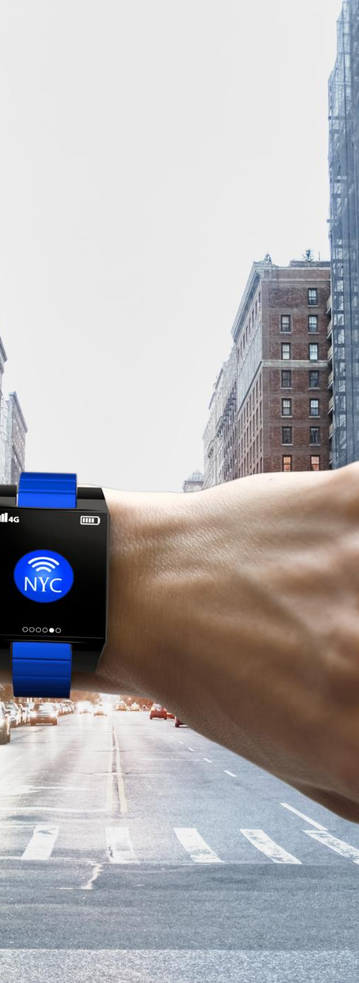
Implementing Shallow Hierarchies and Scrollable Views
NavigationStack Usage
  NavigationStack helps create shallow, easy-to-follow app hierarchies on watchOS devices.
Vertical Scrolling Preference
  Vertical scrolling is favored for clarity and performance; nested scroll views should be avoided.
Content Margins and Safe Bounds
  Using contentMargins prevents UI clipping, ensuring safe and clear display of elements.
Code and Sample Interface
  Code samples and projects demonstrate implementing these layout principles effectively.
Notes:
---
This slide references information from the following file: https://insulet-my.sharepoint.com/personal/rgarciaduran_insulet_com/_layouts/15/Doc.aspx?sourcedoc=%7BC4CF4B3E-F4EC-40A5-97A6-702212ADA1BC%7D&file=class_2.pptx&action=edit&mobileredirect=true
Effective navigation and layout are critical to the usability of watchOS apps. This section explores best practices for structuring content using NavigationStack and carousel-style lists that feel native to the platform. Vertical scrolling is preferred, and nested scroll views should be avoided to maintain performance and clarity. Designers are encouraged to use contentMargins to ensure safe bounds and prevent UI elements from being clipped. Code samples illustrate how to implement these layouts using SwiftUI, and participants will build a sample interface that demonstrates these principles. The session also includes a critique of common layout mistakes and how to resolve them. Visual diagrams and mockups help clarify the spatial relationships between UI components, and exercises guide attendees through optimizing navigation flows for glanceability and ease of use.

Slide 10
Typography, Color, and Imagery
Notes:
---
This slide references information from the following file: https://insulet-my.sharepoint.com/personal/rgarciaduran_insulet_com/_layouts/15/Doc.aspx?sourcedoc=%7BC4CF4B3E-F4EC-40A5-97A6-702212ADA1BC%7D&file=class_2.pptx&action=edit&mobileredirect=true
Designing for Legibility and Performance

Slide 11
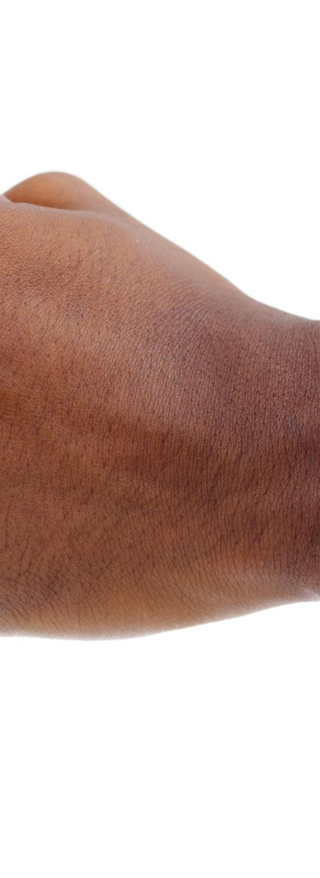
Designing for Legibility and Performance
Typography Guidelines
  Use SF Compact fonts from Regular to Bold for legibility on small screens. Avoid ultralight and thin styles for clarity.
Color Usage
  Apply color sparingly to encode state or highlight key elements while maintaining high contrast, especially with Bold Text enabled.
Imagery Optimization
  Optimize images using AsyncImage for remote loading and scale images with scaledToFill. Clip images to rounded rectangles or circles.
Performance Considerations
  Consider caching and battery usage when handling images and typography to enhance app performance and user experience.
Notes:
---
This slide references information from the following file: https://insulet-my.sharepoint.com/personal/rgarciaduran_insulet_com/_layouts/15/Doc.aspx?sourcedoc=%7BC4CF4B3E-F4EC-40A5-97A6-702212ADA1BC%7D&file=class_2.pptx&action=edit&mobileredirect=true
Typography, color, and imagery play a vital role in the visual clarity and aesthetic appeal of watchOS apps. This section provides detailed guidance on using SF Compact fonts with Regular to Bold weights to ensure legibility on small screens. Designers should avoid ultralight and thin styles and maintain high contrast, especially when Bold Text is enabled. Color should be used sparingly and primarily for encoding state or drawing attention to key elements. Imagery must be optimized for performance; AsyncImage is recommended for remote images, and resizing should be handled within content closures using scaledToFill. Images should be clipped to rounded rectangles or circles to match the watchOS aesthetic. Participants will review examples of effective and ineffective use of typography and imagery, and complete exercises that involve designing UI components with proper font and image settings. Performance considerations such as caching and battery usage are also discussed.

Slide 12
Input & Feedback
Notes:
---
This slide references information from the following file: https://insulet-my.sharepoint.com/personal/rgarciaduran_insulet_com/_layouts/15/Doc.aspx?sourcedoc=%7BC4CF4B3E-F4EC-40A5-97A6-702212ADA1BC%7D&file=class_2.pptx&action=edit&mobileredirect=true
Using the Digital Crown, Gestures, and Haptics

Slide 13
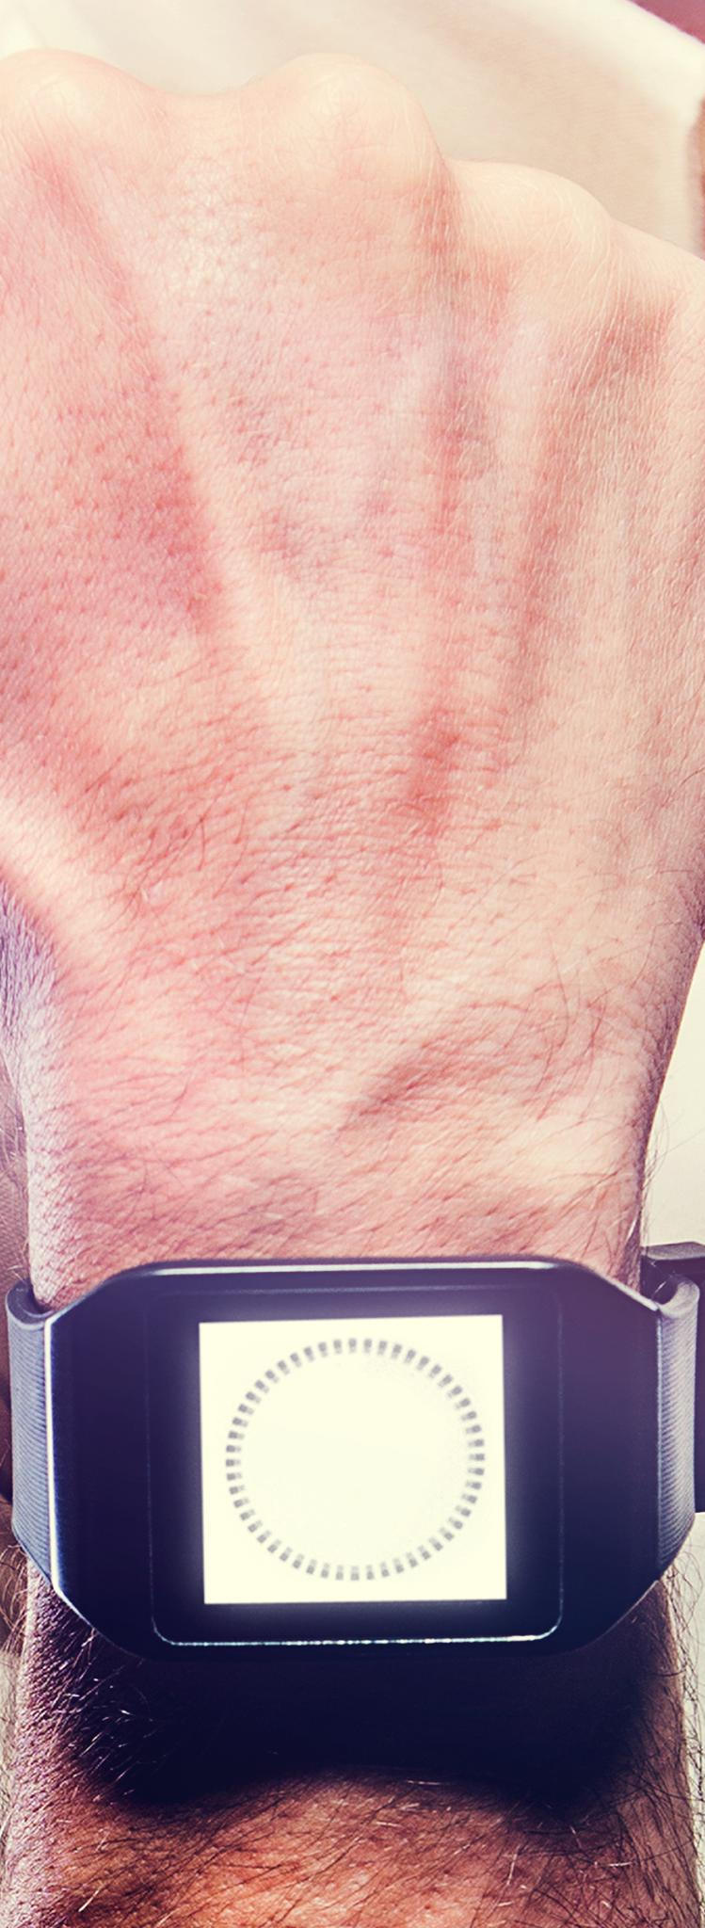
Using the Digital Crown, Gestures, and Haptics
Digital Crown Navigation
  Use the Digital Crown for smooth vertical navigation on watchOS interfaces. It enables precise scrolling and selection control.
Simple Gesture Controls
  Implement tap and swipe gestures for intuitive user input while avoiding complex gesture flows to maintain usability.
Haptic Feedback Importance
  Haptic feedback provides tactile confirmation for actions, enhancing the user’s interactive experience and engagement.
Accessibility with Touch Equivalents
  Offer touch alternatives for Digital Crown inputs to ensure accessibility for all users, improving inclusive design.
Notes:
---
This slide references information from the following file: https://insulet-my.sharepoint.com/personal/rgarciaduran_insulet_com/_layouts/15/Doc.aspx?sourcedoc=%7BC4CF4B3E-F4EC-40A5-97A6-702212ADA1BC%7D&file=class_2.pptx&action=edit&mobileredirect=true
Input and feedback mechanisms on watchOS are limited but powerful. This section explores how to effectively use the Digital Crown for vertical navigation, and how to implement simple gestures such as tap and swipe. Complex gesture flows should be avoided to maintain usability. Haptic feedback is a key component of user interaction, providing confirmation for important actions and enhancing the tactile experience. Designers should also provide touch equivalents for Crown interactions to ensure accessibility. Code samples demonstrate how to integrate haptics and gesture recognizers in SwiftUI. Participants will engage in hands-on exercises to build interactive components that respond to user input with appropriate feedback. Visual examples and diagrams illustrate the role of input mechanisms in guiding user behavior and improving engagement.

Slide 14
Accessibility & Inclusive Design
Notes:
---
This slide references information from the following file: https://insulet-my.sharepoint.com/personal/rgarciaduran_insulet_com/_layouts/15/Doc.aspx?sourcedoc=%7BC4CF4B3E-F4EC-40A5-97A6-702212ADA1BC%7D&file=class_2.pptx&action=edit&mobileredirect=true
Designing for All Users

Slide 15
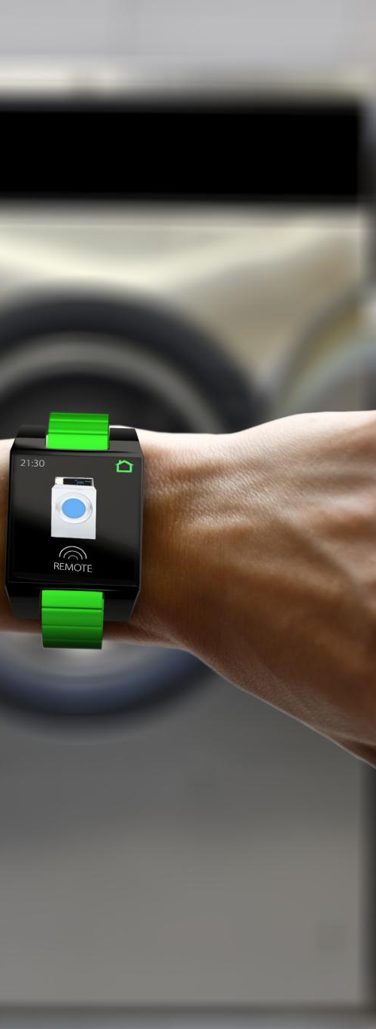
Designing for All Users
Accessible VoiceOver Labels
  VoiceOver labels must be concise and descriptive for clear user guidance.
Proper Hit Target Size
  Buttons and controls should have appropriately sized hit targets for small screens.
Readable Text Options
  Support Dynamic Type and Bold Text to enhance readability for diverse users.
Inclusive Testing Practices
  Use accessibility settings and tools to test and improve app usability.
Notes:
---
This slide references information from the following file: https://insulet-my.sharepoint.com/personal/rgarciaduran_insulet_com/_layouts/15/Doc.aspx?sourcedoc=%7BC4CF4B3E-F4EC-40A5-97A6-702212ADA1BC%7D&file=class_2.pptx&action=edit&mobileredirect=true
Accessibility is a critical aspect of wearable design. This section covers essential practices for making watchOS apps usable by people with diverse abilities. VoiceOver labels should be concise and descriptive, and hit targets must be appropriately sized for the small screen. Support for Dynamic Type and Bold Text ensures readability, and designers must avoid relying solely on color to convey information. Participants will learn how to test their apps using accessibility settings and tools, and review examples of inclusive design. Exercises include auditing an existing interface for accessibility issues and implementing improvements. The session emphasizes the importance of empathy and user-centered design, encouraging participants to consider the needs of all users in their work.

Slide 16
Performance Optimization & Battery Considerations
Notes:
---
This slide references information from the following file: https://insulet-my.sharepoint.com/personal/rgarciaduran_insulet_com/_layouts/15/Doc.aspx?sourcedoc=%7BC4CF4B3E-F4EC-40A5-97A6-702212ADA1BC%7D&file=class_2.pptx&action=edit&mobileredirect=true
Efficient Resource Management

Slide 17
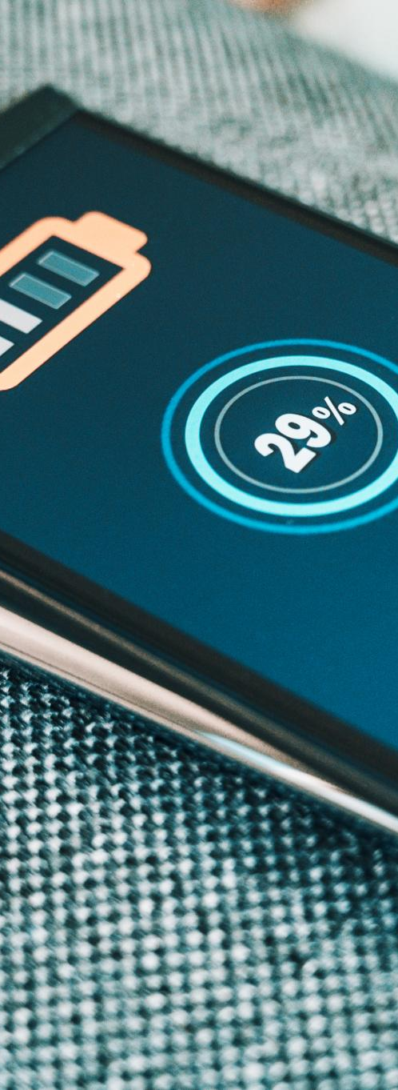
Efficient Resource Management
Optimize Image and Network Usage
  Reducing image size and network calls significantly lowers battery consumption in wearable apps.
Profile and Identify Bottlenecks
  Profiling apps helps find performance issues that drain battery life on wearables.
Use AsyncImage and Lazy Loading
  AsyncImage and lazy loading improve remote content handling and reduce resource use.
Test Under Network Conditions
  Testing apps on various network speeds and watch sizes ensures smooth, responsive user experience.
Notes:
---
This slide references information from the following file: https://insulet-my.sharepoint.com/personal/rgarciaduran_insulet_com/_layouts/15/Doc.aspx?sourcedoc=%7BC4CF4B3E-F4EC-40A5-97A6-702212ADA1BC%7D&file=class_2.pptx&action=edit&mobileredirect=true
Performance and battery life are paramount in wearable app development. This section explores strategies for optimizing image and network usage to reduce battery drain. Developers should profile their apps to identify performance bottlenecks and use caching wisely to minimize network calls. AsyncImage and lazy loading techniques are recommended for handling remote content. Participants will learn how to test their apps under different network conditions and on various watch sizes. Exercises include analyzing performance metrics and implementing optimizations. Visual diagrams illustrate the impact of resource usage on battery life, and best practices are provided for maintaining smooth scrolling and responsive interfaces.

Slide 18
Hands-on Project: Advanced Rick & Morty Grid
Notes:
---
This slide references information from the following file: https://insulet-my.sharepoint.com/personal/rgarciaduran_insulet_com/_layouts/15/Doc.aspx?sourcedoc=%7BC4CF4B3E-F4EC-40A5-97A6-702212ADA1BC%7D&file=class_2.pptx&action=edit&mobileredirect=true
Building a Feature-Rich Interface

Slide 19
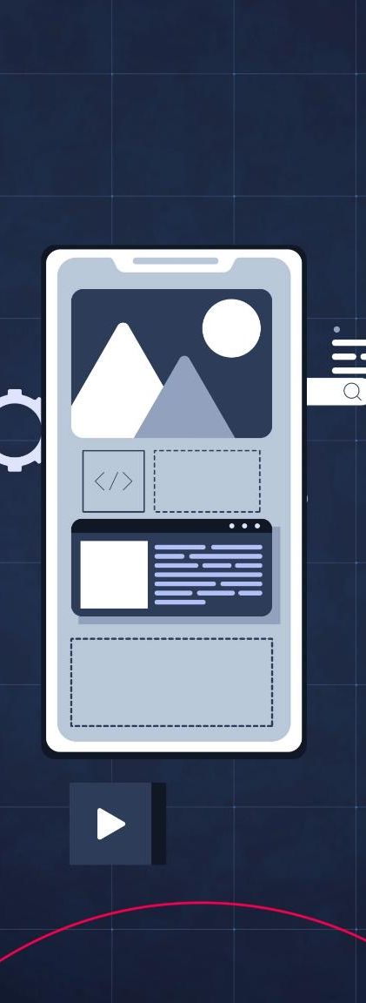
Building a Feature-Rich Interface
App Architecture Overview
  Architecture includes models, API integration, data store, and views to build the interface.
Grid Display of Characters
  Character data fetched via HTTP GET is shown in a two-column LazyVGrid with AsyncImage tiles.
Dynamic States and Interaction
  Includes loading, empty, error states, plus search, filter, favorites, image caching, and haptics.
Detail View Experience
  Detail view offers scrollable additional character info with enriched user experience features.
Notes:
---
This slide references information from the following file: https://insulet-my.sharepoint.com/personal/rgarciaduran_insulet_com/_layouts/15/Doc.aspx?sourcedoc=%7BC4CF4B3E-F4EC-40A5-97A6-702212ADA1BC%7D&file=class_2.pptx&action=edit&mobileredirect=true
In this hands-on project, participants will build an advanced version of the Rick & Morty character grid using SwiftUI. The architecture includes models, API integration, a data store, and views. A single HTTP GET request retrieves character data, which is displayed in a LazyVGrid with two columns. Each tile uses AsyncImage and includes metadata. The detail view presents a scrollable interface with additional character information. Participants will implement loading, empty, and error states, as well as search and filter functionality. Exercises include adding favorites with persistence, image caching, and haptic feedback. Optional features such as complications and iPhone companion apps are also discussed. Code samples and diagrams guide participants through each step of the project.

Slide 20
Practical Exercises & Group Critique
Notes:
---
This slide references information from the following file: https://insulet-my.sharepoint.com/personal/rgarciaduran_insulet_com/_layouts/15/Doc.aspx?sourcedoc=%7BC4CF4B3E-F4EC-40A5-97A6-702212ADA1BC%7D&file=class_2.pptx&action=edit&mobileredirect=true
Collaborative Design Review

Slide 21

Collaborative Design Review
Interactive Peer Feedback
  Participants present projects and receive constructive feedback from peers and instructors. This fosters an open critique environment.
UI Redesign Exercises
  Exercises focus on redesigning UI components based on critique to improve usability and aesthetics.
Collaboration and Critical Thinking
  Group discussions encourage collaboration, critical thinking, and iterative improvement of design solutions.
Design Iteration and Refinement
  Session highlights the importance of iteration and refinement, supported by visual examples and best practice sharing.
Notes:
---
This slide references information from the following file: https://insulet-my.sharepoint.com/personal/rgarciaduran_insulet_com/_layouts/15/Doc.aspx?sourcedoc=%7BC4CF4B3E-F4EC-40A5-97A6-702212ADA1BC%7D&file=class_2.pptx&action=edit&mobileredirect=true
This interactive session allows participants to present their project work and receive feedback from peers and the instructor. Exercises include redesigning UI components based on critique, identifying accessibility improvements, and optimizing performance. Group discussions foster a collaborative learning environment and encourage critical thinking. Participants will learn how to articulate design decisions and respond to constructive feedback. The session emphasizes the value of iteration and refinement in the design process. Visual examples and mockups are used to illustrate key points, and best practices for conducting design reviews are shared.

Slide 22
Student Backlog & Sprint Planning
Notes:
---
This slide references information from the following file: https://insulet-my.sharepoint.com/personal/rgarciaduran_insulet_com/_layouts/15/Doc.aspx?sourcedoc=%7BC4CF4B3E-F4EC-40A5-97A6-702212ADA1BC%7D&file=class_2.pptx&action=edit&mobileredirect=true
Organizing Development Tasks

Slide 23

Organizing Development Tasks
Sprint Structure
  Development tasks are divided into three focused sprints to manage workload effectively.
Feature Prioritization
  Prioritizing features helps allocate resources and effort efficiently during development.
Acceptance Criteria and Tasks
  Each story has clear acceptance criteria and defined tasks to ensure quality and progress tracking.
Agile Best Practices
  Using visual diagrams and agile methods improves sprint planning and team collaboration.
Notes:
---
This slide references information from the following file: https://insulet-my.sharepoint.com/personal/rgarciaduran_insulet_com/_layouts/15/Doc.aspx?sourcedoc=%7BC4CF4B3E-F4EC-40A5-97A6-702212ADA1BC%7D&file=class_2.pptx&action=edit&mobileredirect=true
Effective sprint planning is essential for managing wearable app development. This section introduces a Jira-style backlog with stories organized into three sprints. Sprint 1 focuses on loading states, search, and filters. Sprint 2 adds favorites, persistence, caching, and haptics. Sprint 3 includes complications, accessibility QA, and performance optimization. Each story includes acceptance criteria and tasks. Participants will learn how to prioritize features, estimate effort, and track progress. Exercises include creating backlog items for their own projects and planning a sprint. Visual diagrams illustrate the workflow, and best practices for agile development are discussed.

Slide 24
Evaluation Rubric & Submission Guidelines
Notes:
---
This slide references information from the following file: https://insulet-my.sharepoint.com/personal/rgarciaduran_insulet_com/_layouts/15/Doc.aspx?sourcedoc=%7BC4CF4B3E-F4EC-40A5-97A6-702212ADA1BC%7D&file=class_2.pptx&action=edit&mobileredirect=true
Assessing Project Quality

Slide 25
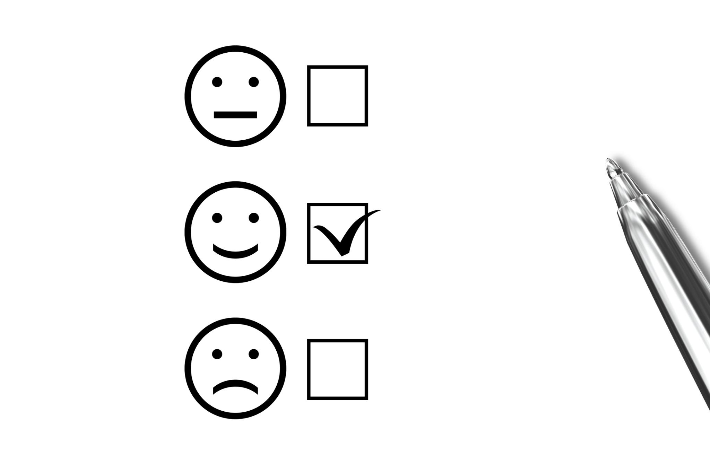
Assessing Project Quality
UX Quality Criteria
  UX quality is evaluated by glanceability, clear hierarchy, and feedback mechanisms.
Code Quality Focus
  Code quality emphasizes MVVM architecture and the use of async/await for efficiency.
Performance Metrics
  Performance is judged by smooth scrolling and minimal network usage to enhance experience.
Accessibility Standards
  Accessibility is assessed through labels, contrast, and Dynamic Type support for inclusivity.
Notes:
---
This slide references information from the following file: https://insulet-my.sharepoint.com/personal/rgarciaduran_insulet_com/_layouts/15/Doc.aspx?sourcedoc=%7BC4CF4B3E-F4EC-40A5-97A6-702212ADA1BC%7D&file=class_2.pptx&action=edit&mobileredirect=true
This section outlines the criteria used to evaluate participant projects. UX quality is assessed based on glanceability, hierarchy, and feedback mechanisms. Code quality focuses on MVVM architecture and use of async/await. Performance is evaluated through smooth scrolling and minimal network usage. Accessibility is judged by the presence of labels, contrast, and support for Dynamic Type. Participants will receive a rubric with detailed scoring guidelines and submission instructions. Exercises include self-assessment and peer review. Visual examples illustrate high-quality submissions, and tips are provided for improving project outcomes.

Slide 26
References & Further Reading
Notes:
---
This slide references information from the following file: https://insulet-my.sharepoint.com/personal/rgarciaduran_insulet_com/_layouts/15/Doc.aspx?sourcedoc=%7BC4CF4B3E-F4EC-40A5-97A6-702212ADA1BC%7D&file=class_2.pptx&action=edit&mobileredirect=true
Resources for Continued Learning

Slide 27

Resources for Continued Learning
Human Interface Guidelines
  Explore Apple's watchOS Human Interface Guidelines to design intuitive user experiences.
SwiftUI Documentation
  Review SwiftUI docs for AsyncImage, Lists, and ScrollViews to build responsive interfaces.
Typography Guidance
  Learn about SF Compact typography to enhance readability and visual appeal on watchOS.
WWDC Sessions
  Watch WWDC sessions for expert advice on designing and building for watchOS.
Notes:
---
This slide references information from the following file: https://insulet-my.sharepoint.com/personal/rgarciaduran_insulet_com/_layouts/15/Doc.aspx?sourcedoc=%7BC4CF4B3E-F4EC-40A5-97A6-702212ADA1BC%7D&file=class_2.pptx&action=edit&mobileredirect=true
To support continued learning, this section provides a curated list of resources including Apple's Human Interface Guidelines for watchOS, Digital Crown usage guidelines, SwiftUI documentation for AsyncImage, Lists, and ScrollViews, and typography guidance for SF Compact. WWDC sessions on designing and building for watchOS are also recommended. Participants are encouraged to explore these materials to deepen their understanding and stay updated on best practices. Visual examples and links are provided for easy access.

