Slide 1
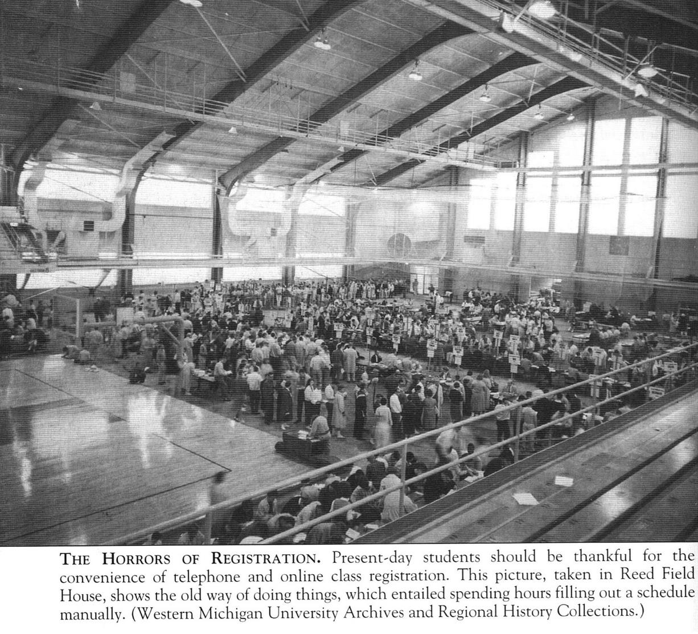

Slide 2
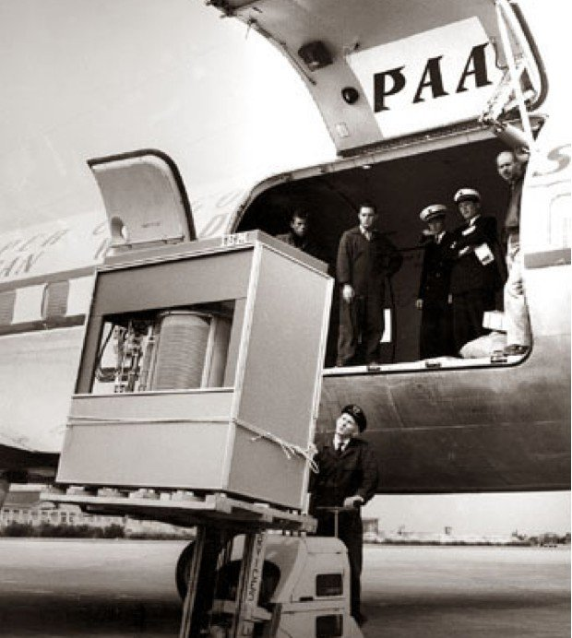
IBM 350 hard disk getting loaded into a PanAm airplane in 1956.
(3.75 Mbytes, available for rent @ $3,200/month)

Slide 3
Modern Interesting Stuff About Databases
It used to be about boring stuff: employee records, bank records, etc.
Today, the field covers all the largest sources of data, with many new ideas.
Web search.
Data mining.
Scientific and medical databases.
Integrating information.

Slide 4
More Interesting Stuff
Database programming centers around limited programming languages.
Only area where non-Turing-complete languages make sense.
Leads to very succinct programming, but also to unique query optimization problems.

Slide 5
Still More …
You may not notice it, but databases are behind almost everything you do on the Web.
Google searches.
Amazon, eBay, etc.

Slide 6
And More…
Databases often have unique concurrency control problems
Many activities (transactions) at the database at all times.
Must not confuse actions, e.g., two withdrawals from the same account must each debit the account.
Recovery?

Slide 7
What is a Data Model?
Mathematical representation of data.
Examples: relational model = tables; semistructured model = trees/graphs.
Operations on data.
Constraints.

Slide 8
A Relation is a Table
Attributes
(column
headers)
name manf
Winterbrew Pete’s
Bud Lite Anheuser-Busch
Beers
Tuples
(rows)
Relation
name

Slide 9
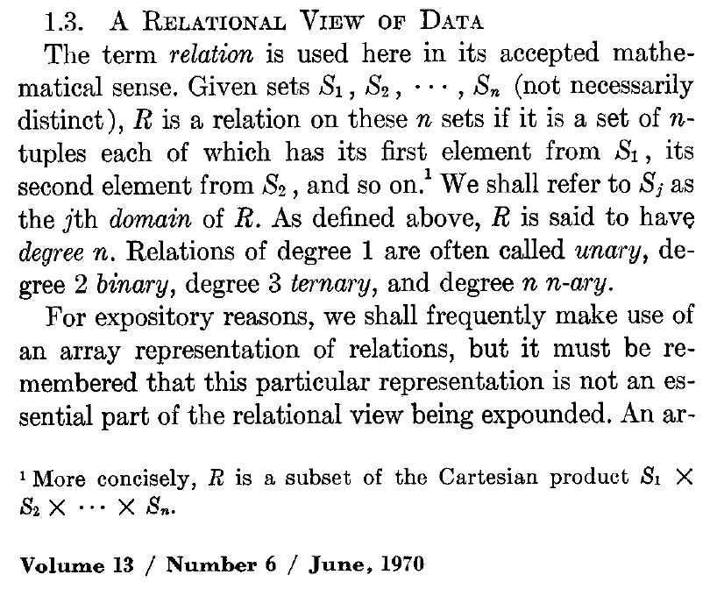
Edgar F. Codd’s Definition
E.F. Codd. A Relational Model of Data for Large Shared Data Banks.
Communications of the ACM. 13(6), 377-387, June 1970

Slide 10
Relational Model
Data Collectors:
SET
LIST
BAG (Multi-Set)
Attribute: ATOMIC value.
Tuple: a LIST of attribute values.
Relation: a SET of tuples.

Slide 11
Schemas
Relation schema = relation name and attribute list.
Optionally: types of attributes.
Example: Beers(name, manf) or Beers(name: string, manf: string)
Database = collection of relations.
Database schema = set of all relation schemas in the database.

Slide 12
Why Relations?
Very simple model.
Often matches how we think about data.
Abstract model that underlies SQL, the most important database language today.

Slide 13
Our Running Example
Beers(name, manf)
Bars(name, addr, license)
Drinkers(name, addr, phone)
Likes(drinker, beer)
Sells(bar, beer, price)
Frequents(drinker, bar)
Underline = key (tuples cannot have the same value in all key attributes).
Excellent example of a constraint.

Slide 14
Database Schemas in SQL
SQL is primarily a query language, for getting information from a database.
But SQL also includes a data-definition component for describing database schemas.

Slide 15
Creating (Declaring) a Relation
Simplest form is:
CREATE TABLE <name> (
<list of elements>
);
To delete a relation:
DROP TABLE <name>;

Slide 16
Elements of Table Declarations
Most basic element: an attribute and its type.
The most common types are:
INT or INTEGER (synonyms).
REAL or FLOAT (synonyms).
CHAR(n ) = fixed-length string of n characters.
VARCHAR(n ) = variable-length string of up to n characters.

Slide 17
Example: Create Table
CREATE TABLE Sells (
bar CHAR(20),
beer VARCHAR(20),
price REAL
);

Slide 18
SQL Values
Integers and reals are represented as you would expect.
Strings are too, except they require single quotes.
Two single quotes = real quote, e.g., ’Joe’’s Bar’.
Any value can be NULL.

Slide 19
Dates and Times
DATE and TIME are types in SQL.
The form of a date value is:
DATE ’yyyy-mm-dd’
Example: DATE ’2007-09-30’ for Sept. 30, 2007.

Slide 20
Times as Values
The form of a time value is:
TIME ’hh:mm:ss’
with an optional decimal point and fractions of a second following.
Example: TIME ’15:30:02.5’ = two and a half seconds after 3:30PM.

Slide 21
Declaring Keys
An attribute or list of attributes may be declared PRIMARY KEY or UNIQUE.
Either says that no two tuples of the relation may agree in all the attribute(s) on the list.
There are a few distinctions to be mentioned later.

Slide 22
Declaring Single-Attribute Keys
Place PRIMARY KEY or UNIQUE after the type in the declaration of the attribute.
Example:
CREATE TABLE Beers (
name CHAR(20) UNIQUE,
manf CHAR(20)
);

Slide 23
Declaring Multiattribute Keys
A key declaration can also be another element in the list of elements of a CREATE TABLE statement.
This form is essential if the key consists of more than one attribute.
May be used even for one-attribute keys.

Slide 24
Example: Multiattribute Key
The bar and beer together are the key for Sells:
CREATE TABLE Sells (
bar CHAR(20),
beer VARCHAR(20),
price REAL,
PRIMARY KEY (bar, beer)
);

Slide 25
PRIMARY KEY vs. UNIQUE
There can be only one PRIMARY KEY for a relation, but several UNIQUE attributes.
No attribute of a PRIMARY KEY can ever be NULL in any tuple. But attributes declared UNIQUE may have NULL’s, and there may be several tuples with NULL.

Slide 26
Semistructured Data
Another data model, based on trees.
Motivation: flexible representation of data.
Motivation: sharing of documents among systems and databases.

Slide 27
Graphs of Semistructured Data
Nodes = objects.
Labels on arcs (like attribute names).
Atomic values at leaf nodes (nodes with no arcs out).
Flexibility: no restriction on:
Labels out of a node.
Number of successors with a given label.

Slide 28
Example: Data Graph
root
Notice a
new kind
of data.
beer
beer
bar
manf
manf
prize
name
A.B.
name
servedAt
year
award
Bud
M’lob
1995
Gold
name
addr
Joe’s
Maple
The beer object
for Bud
The bar object
for Joe’s Bar

