Slide 1
Web Application Design
Chapter 14

Slide 2
Objectives
1
2
Real World Web Software Design
Principle of Layering
3
4
Design Patterns in Web Context
Data and Domain Patterns
5
Presentation Patterns
7

Slide 3
Real World Web Software Design
Section 1 of 5

Slide 4
Real-World Software Design
Software design can mean many things.
In general, it is used to refer to the planning activity that happens between gathering requirements and actually writing code.
We provide an overview of some of the typical approaches used in the software design of web applications

Slide 5
Challenges
In designing real-world applications
it is quite possible to create complex web applications with little to no class design.
The page-oriented development approach sees each page contain most of the programming code it needs to perform its operations.
For sites with few pages and few requirements, such an approach is quite acceptable.

Slide 6
Challenges
In designing real-world applications
Real software projects are notoriously vulnerable to shifting requirements; web projects are probably even more so.
New features will be added and other features will be dropped.
The data model and its storage requirements will change.
The execution environment will change from the developers’ laptops to a testing server, a production server, or perhaps a farm of web servers

Slide 7
Principle of Layering
Section 2 of 5

Slide 8
Challenges
In designing real-world applications
It is in this type of web development environment that rapid ad-hoc design practices may cause more harm than benefit, since rapidly thought-out systems are rarely able to handle unforeseen changes in an elegant way.
For these reasons, many web developers make use of a variety of software design principles and patterns

Slide 9
Layering
Break apart a complicated system
A layer is simply a group of classes that are functionally or logically related; that is, it is a conceptual grouping of classes.
Each layer in an application should demonstrate cohesion
The goal of layering is to distribute the functionality of your software among classes so that the coupling of a given class to other classes is minimized.
A dependency is a relationship between two elements where a change in one affects the other.

Slide 10
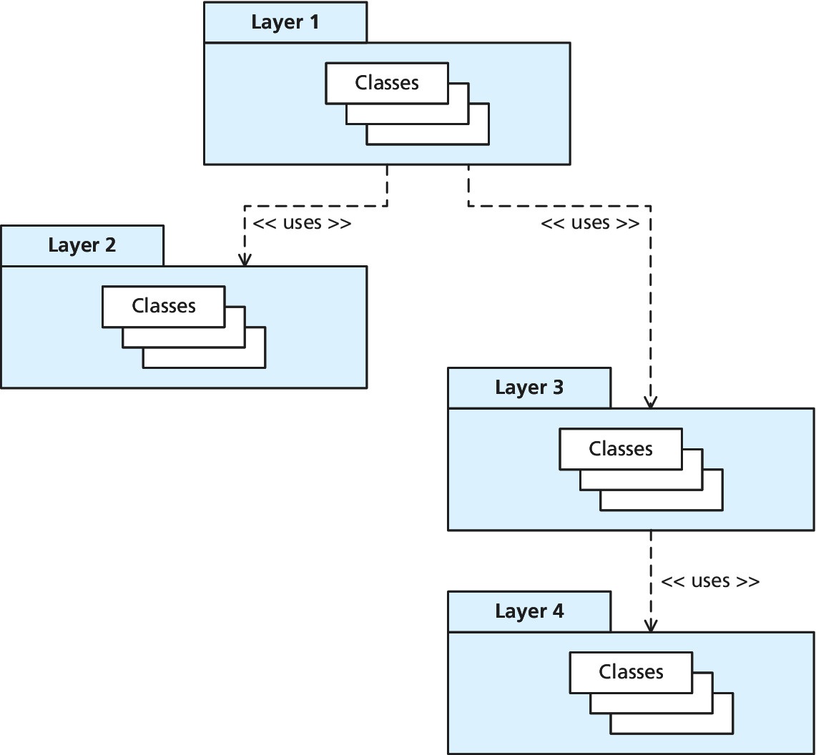
Layering
See the relationships

Slide 11
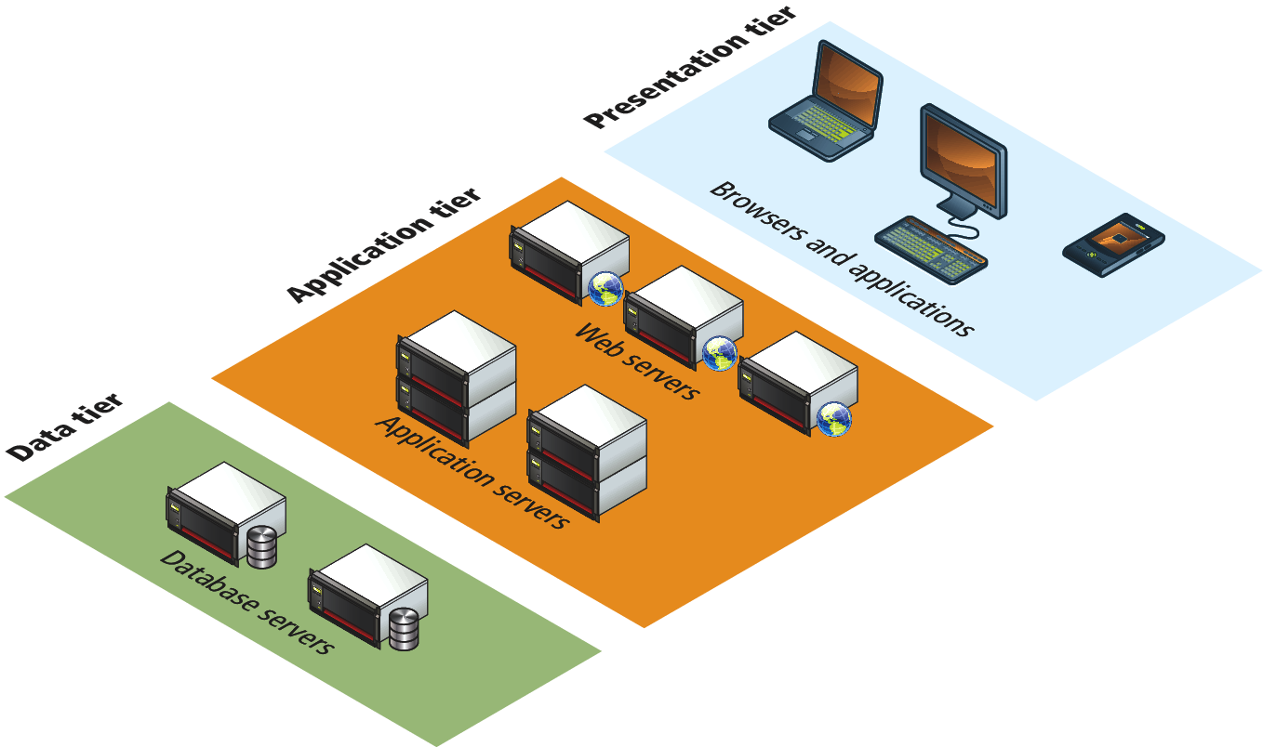
Tiers
A tier refers to a processing boundary

Slide 12
Layers
Benefits
The application should be more maintainable and adaptable to change since the overall coupling in the application has been lowered
When an application has a reliable and clearly specified application architecture, much of the page’s processing will move from the page to the classes within the layers.
A given layer may be reusable in other applications, especially if it is designed with reuse in mind

Slide 13
Layers
Disadvantages
The numerous layers of abstraction can make the resulting code hard to understand at first
the extra levels of abstraction might incur a small performance penalty at run time

Slide 14
Common Layering Schemes
Principle Software Layers
Presentation Principally concerned with the display of information to the user, as well as interacting with the user.
Domain/Business The main logic of the application. Some developers call this the business layer since it is modeling the rules and processes of the business for which the application is being written.
Data Access Communicates with the data sources used by the application. Often a database, but could be web services, text files, or email systems. Sometimes called the technical services layer.

Slide 15
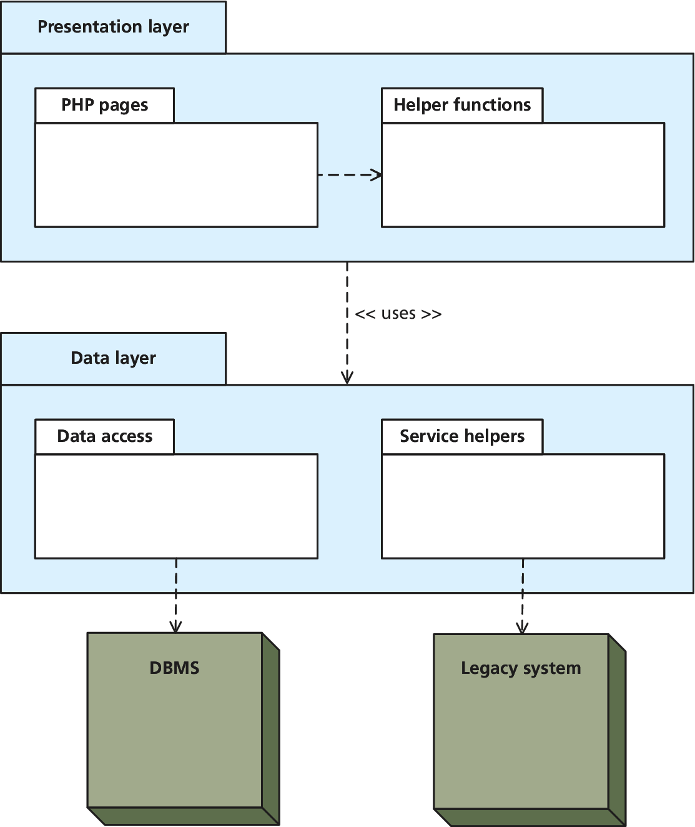
Two Layer Model
A Common Layering Scheme

Slide 16
Two Layer Model
A Common Layering Scheme
The advantage of the two-layer model is that it is relatively easy to understand and implement.
In a two-layer model, each table typically will have a matching class responsible for CRUD (create, retrieve, update, and delete) functionality for that table.
The drawbacks of the two-layer model are perhaps most clearly seen in the case of business rules and processes

Slide 17
Business Rules
What are they?
A business rule refers not only to the usual user-input validation and the more complex rules for data that are specific to an organization’s methods for conducting its business.
Do they belong within the PHP of the order form?
Do they belong instead in the data access layer?

Slide 18
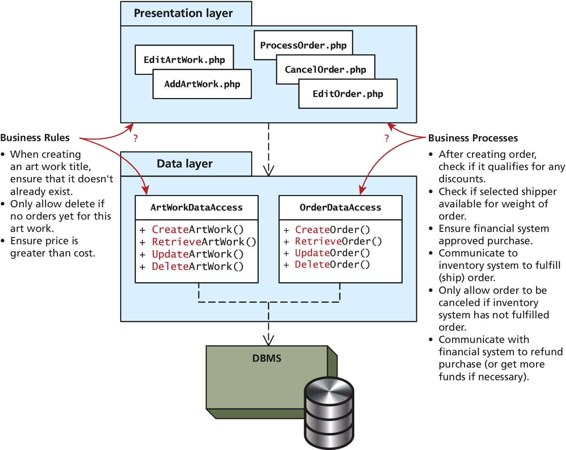
Business Rules
Where do they go?

Slide 19
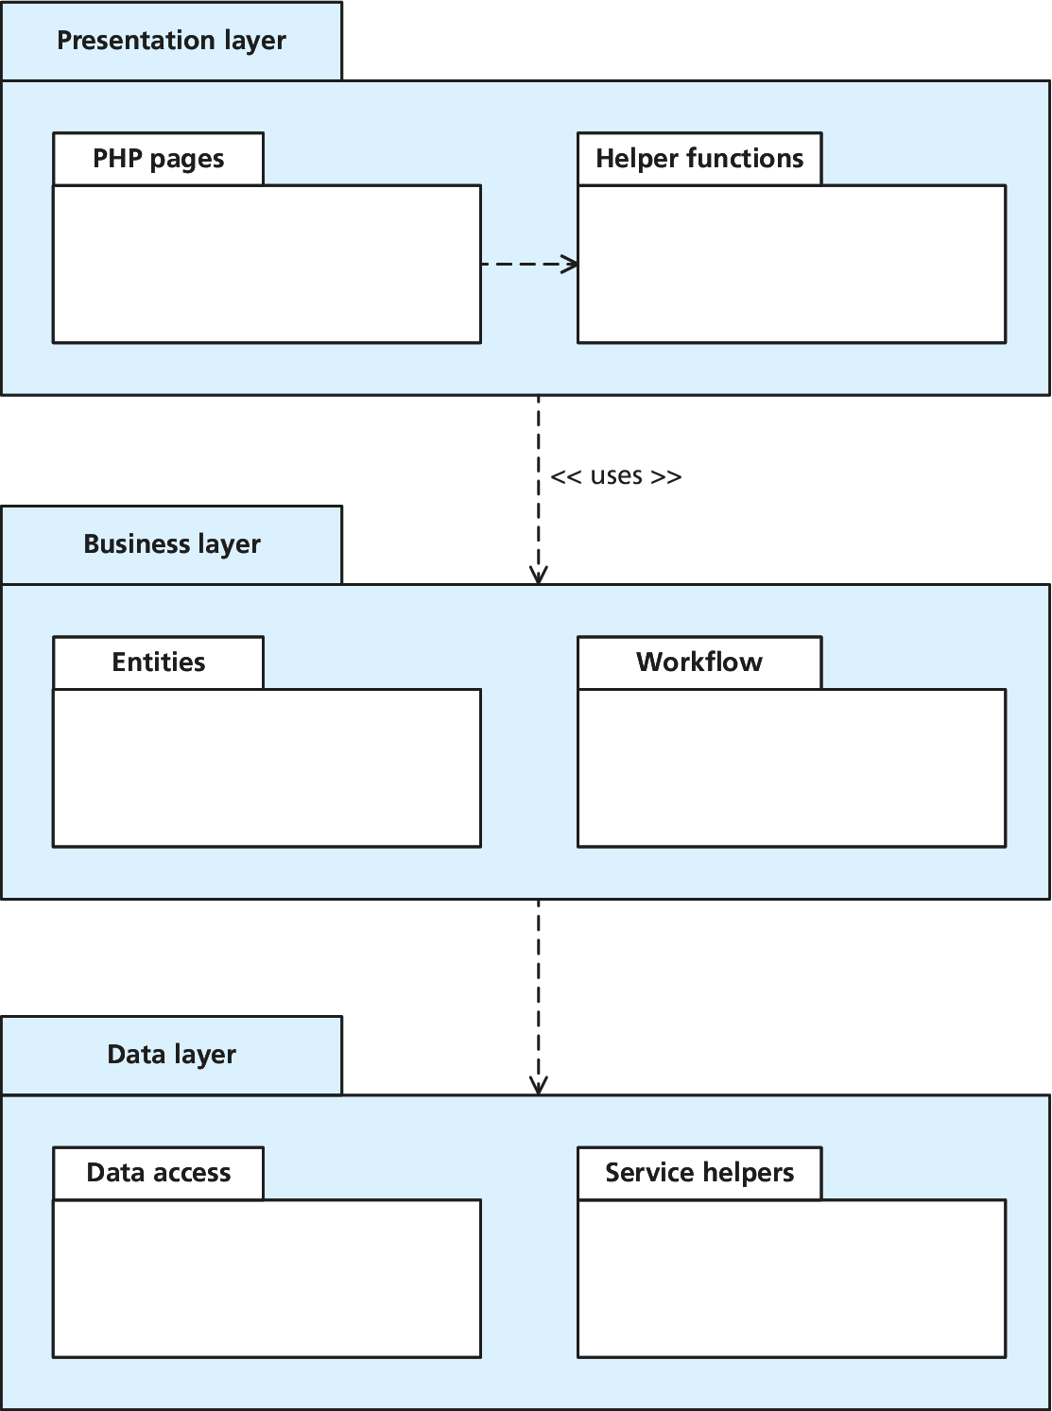
Business Rules
Add another layer

Slide 20
Business Rules
In the middle layer
Some authors refer to the classes within the “middle” layer of a three-layer model as business objects; other authors call them entities or domain objects.
Regardless of what they are called, business objects represent both the data and behavior of objects that correspond to the conceptual domain of the business.

Slide 21
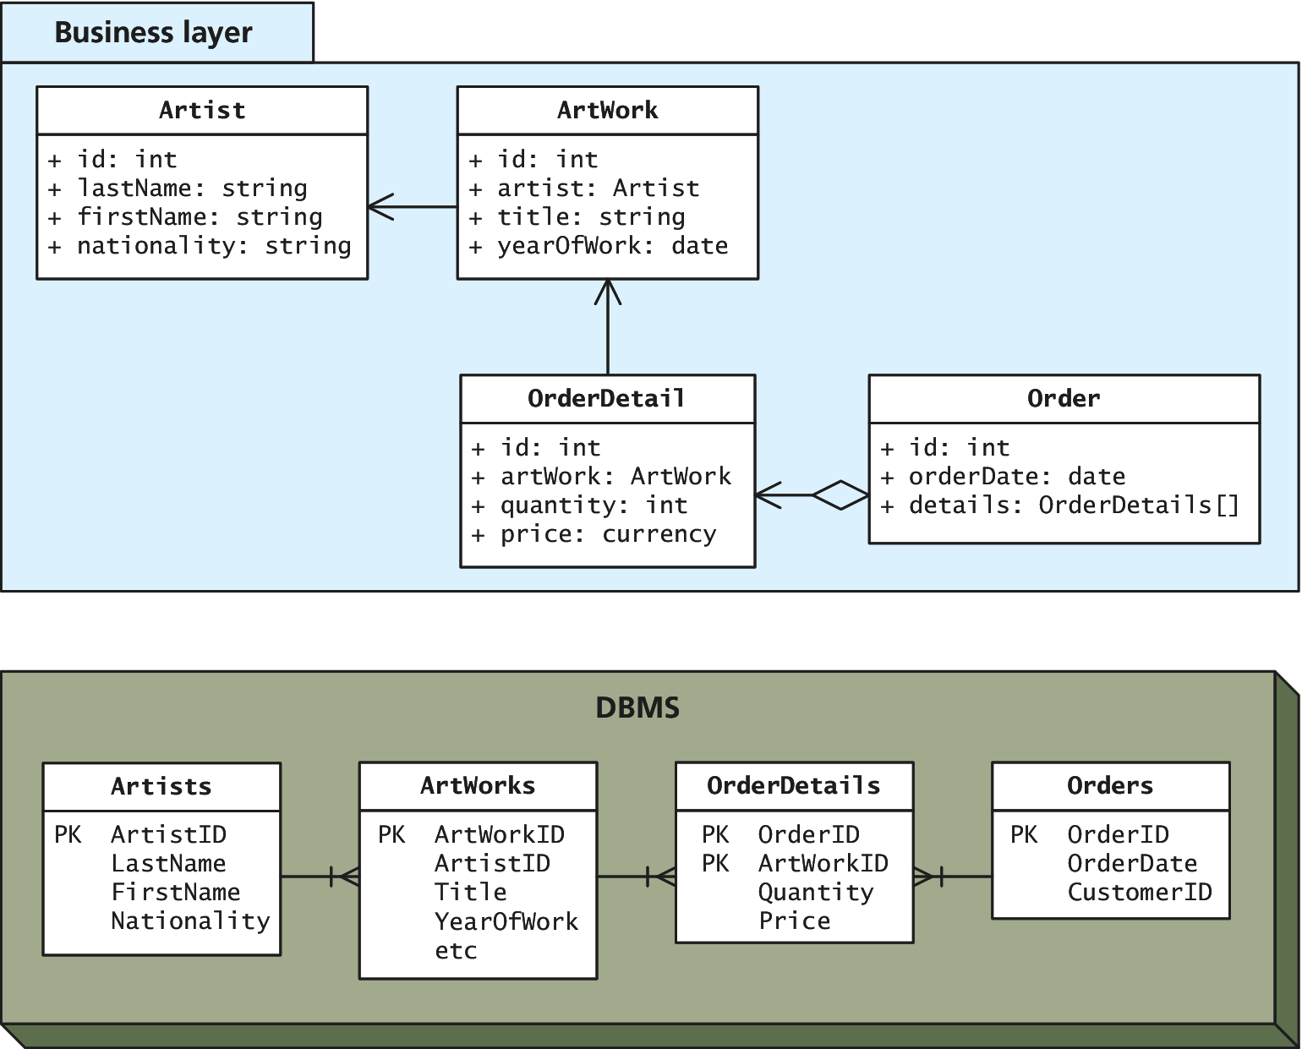
Business Layer
The middle layer

Slide 22
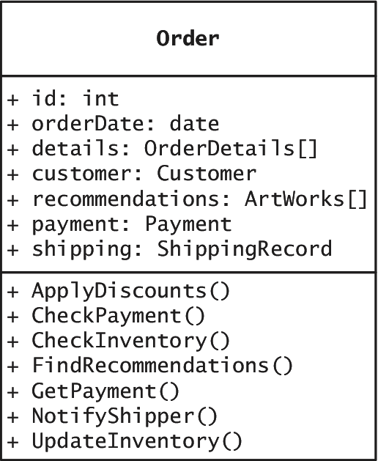
Business Layer
An example complex layer

Slide 23
Design Patterns in the Web Context
Section 3 of 5

Slide 24
Software Design Patterns
Same old problem
Over time as programmers repeatedly solved whole classes of problems, consensus on best practices emerged for how to design software systems to solve particular problems.
These best practices were generalized into reusable solutions that could be adapted to many different software projects. They are commonly called design patterns, and they are useful tools in the developer’s toolbox.

Slide 25
Software Design Patterns
Design patterns are not panaceas that will solve all your problems, but they will help you design better code if used thoughtfully.
It is a clear and concise way to describe algorithms/code
The most common design patterns are those that were identified and named in the classic 1995 book Design Patterns: Elements of Reusable Object-Oriented Software

Slide 26
Adapter Pattern
The Adapter pattern is used to convert the interface of a set of classes that we need to use to a different but preferred interface.
The Adapter pattern is frequently used in web projects as a way to make use of a database API (such as PDO or mysqli) without coupling the pages over and over to that database API.

Slide 27
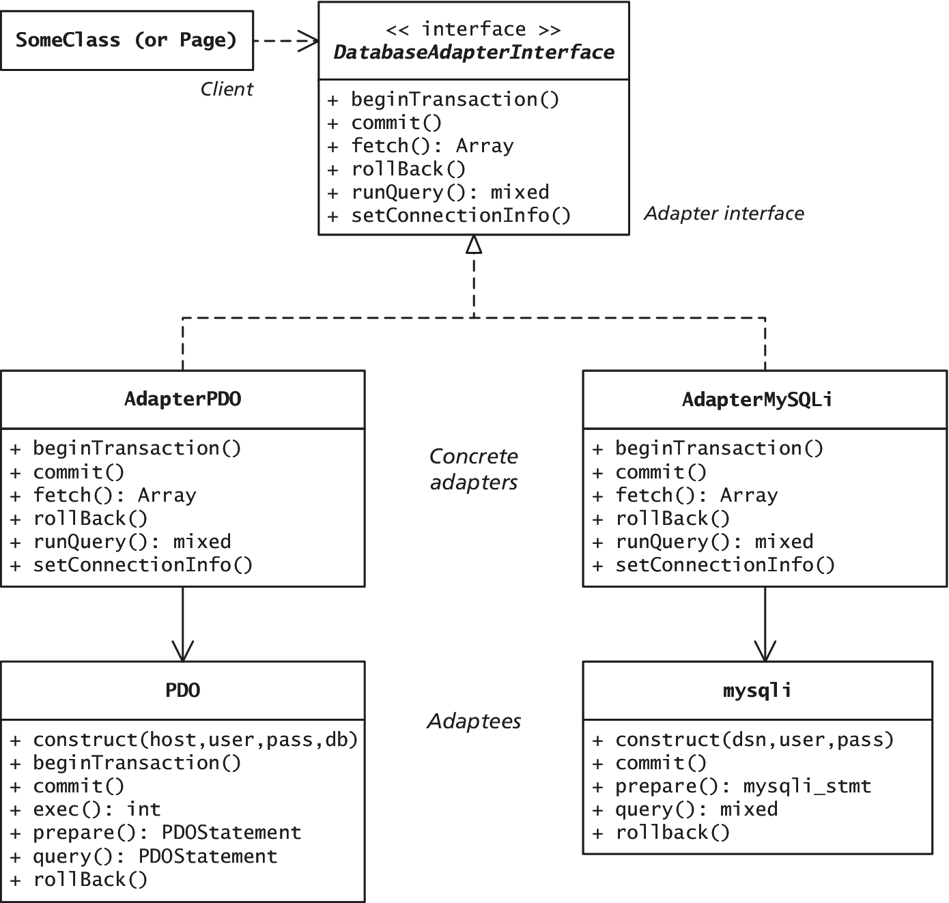
Adapter Pattern
UML Diagram

Slide 28
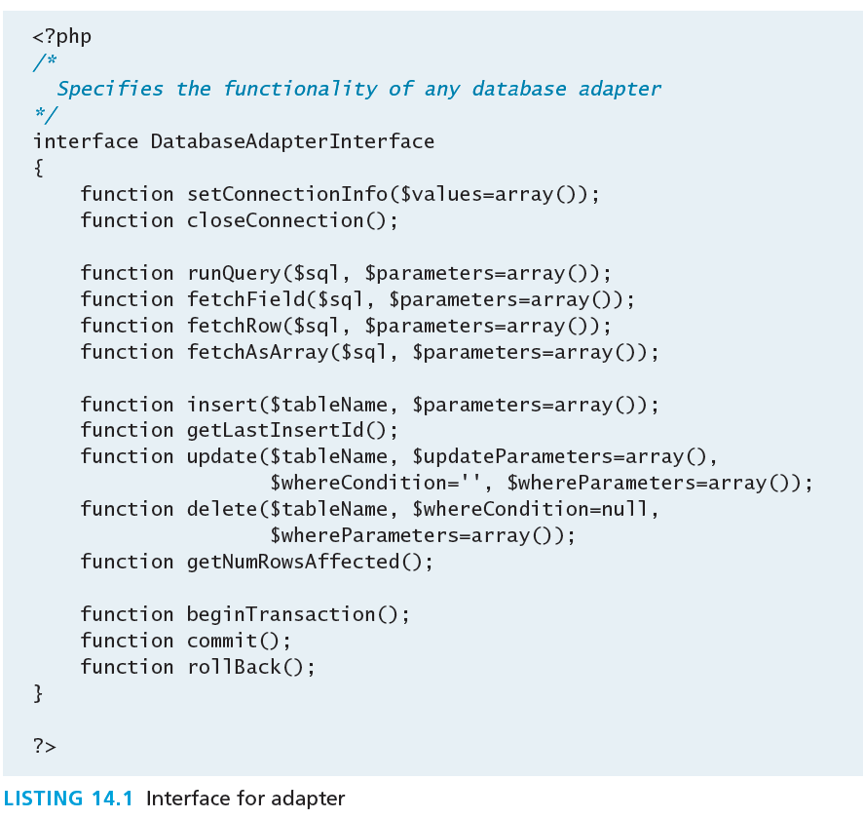
Adapter Pattern
Interface for adaptor

Slide 29
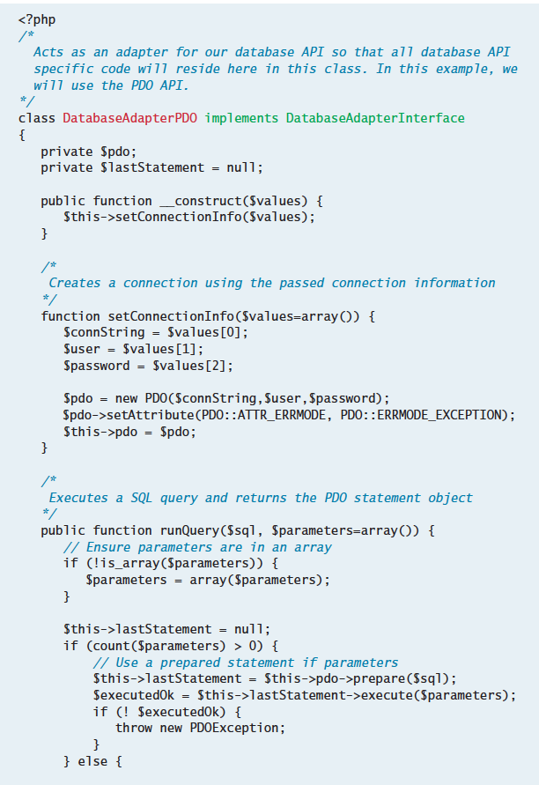
Adapter Pattern
Concrete Classes (partial implementation)

Slide 30
Adapter Pattern
Concrete Classes (partial implementation)
Any client classes (or pages) that needs to make use of the database will do so via the concrete adapter:
$connect = array(DBCONNECTION, DBUSER, DBPASS);
$adapter = new DatabaseAdapterPDO($connect);
$sql = 'SELECT * FROM ArtWorks WHERE ArtWorkId=?';
$results = $adapter->runQuery($sql, array(5));
This code sample contains a dependency via the explicit instantiation of the DatabaseAdapterPDO class. If you at some point switch to a different adapter, you will need to change every instantiation to the appropriate concrete adapter.

Slide 31
Simple Factory
Addresses the dependency of Adaptor
A factory is a special class that is responsible for the creation of subclasses, so that clients are not coupled to specific subclasses or implementations.
Since PHP is a late-binding language, you can create a factory class that avoids conditional logic by dynamically specifying at run time the specific class name to instantiate
$adapter = DatabaseAdapterFactory::create('PDO', $connectionValues);
$results = $adapter->runQuery('SELECT * FROM Artists');

Slide 32
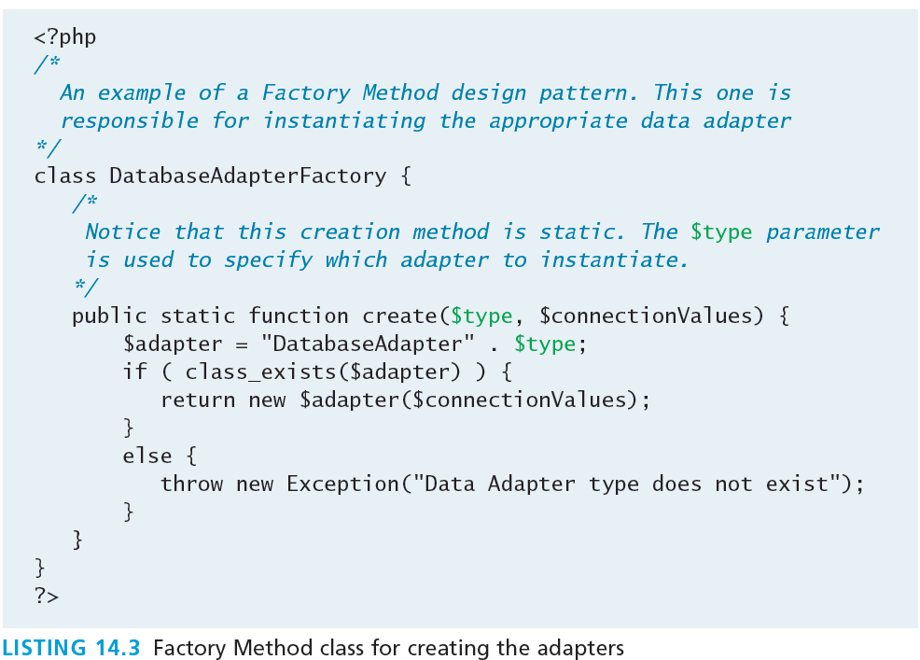
Simple Factory
Addresses the dependency of Adaptor

Slide 33
Template Method Pattern
In the Template Method pattern, one defines an algorithm in an abstract superclass and defers the algorithm steps that can vary to the subclasses.

Slide 34
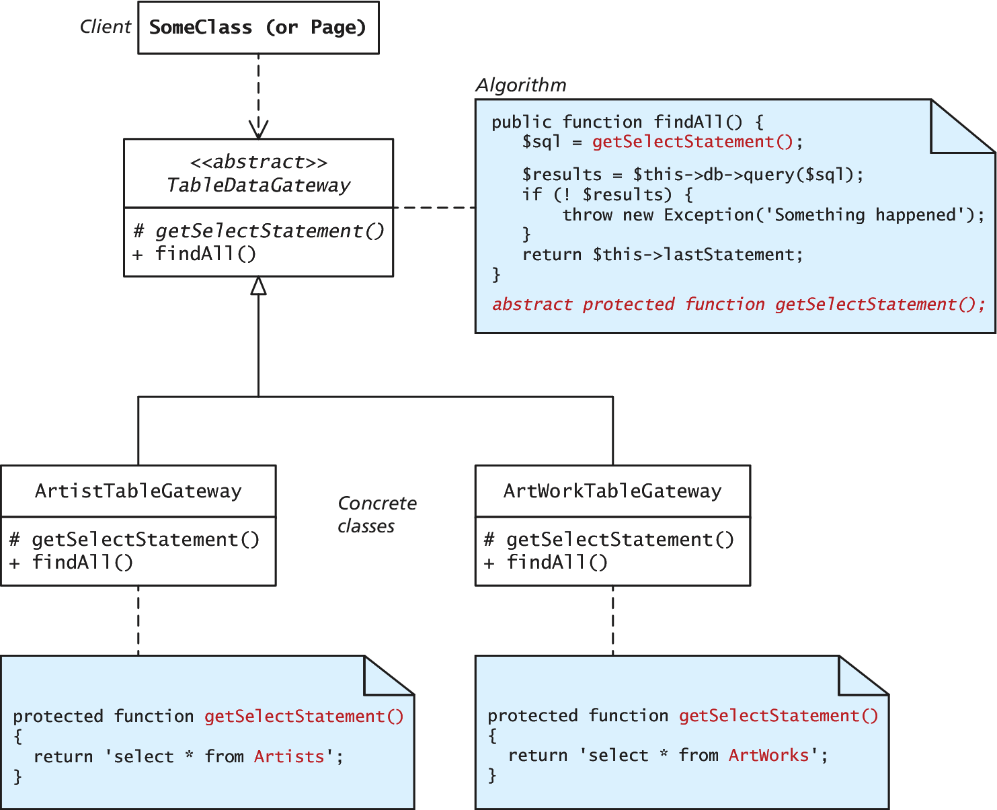
Template Method Pattern

Slide 35
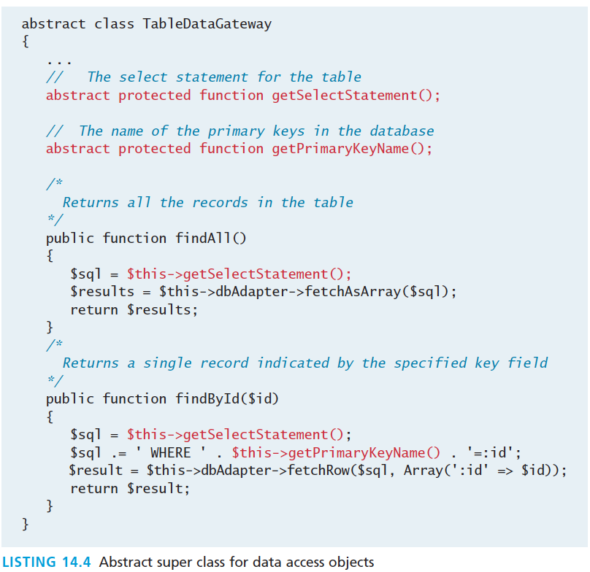
Template Method Pattern
Abstract Superclass

Slide 36
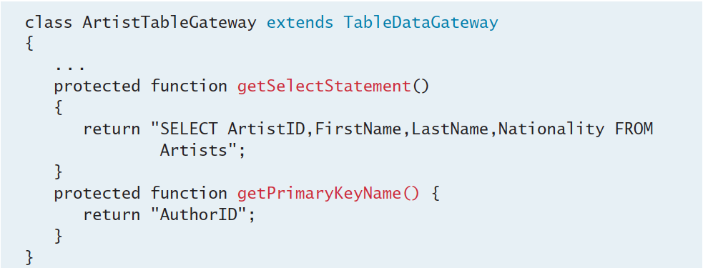
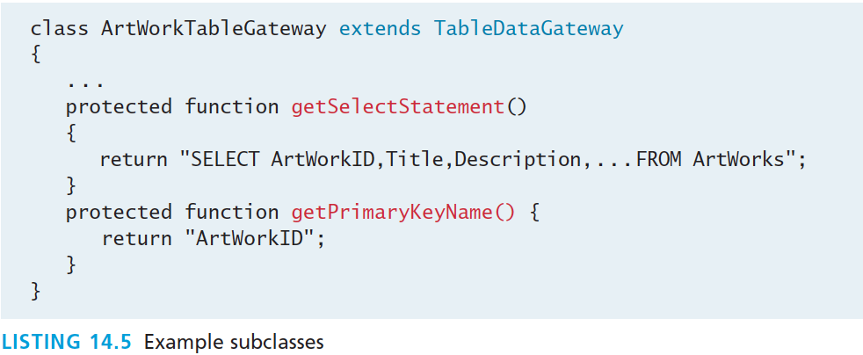
Template Method Pattern
Example Subclasses

Slide 37
Dependency Injection
reduce the number of dependencies
its purpose is to reduce the number of dependencies within a class, by passing (injecting) potential dependencies into a class rather than hard-coding them.
Consider the TableDataGateway class from Listing 14.4.
The class needs an object that implements the DatabaseAdapterInterface in order to perform queries.
One approach would be to provide a private data member in the TableDataGateway and instantiate the object in the constructor:

Slide 38
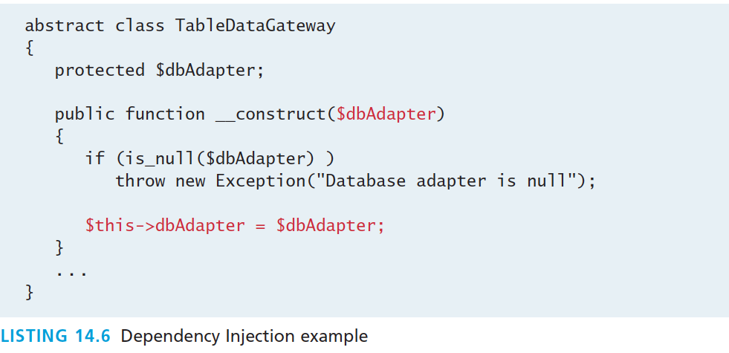
Dependency Injection
Example
$connect = array(DBCONNECTION, DBUSER, DBPASS);
$dbAdapter = DatabaseAdapterFactory::create(ADAPTERTYPE,$connect);
$gate = new ArtistTableGateway($dbAdapter);

Slide 39
Data and Domain Patterns
Section 4 of 5

Slide 40
Enterprise Patterns
Many in the software development community have been focusing on so-called enterprise patterns, which provide best practices for the common type of big-picture architectural
problems faced by application developers. This section will introduce some of these enterprise patterns as they apply to the context of web Development.

Slide 41
Table Data Gateway Pattern
Data access Object
A gateway is simply an object that encapsulates access to some external resource.
Thus a table data gateway provides CRUD access to a database table (or perhaps joined tables).

Slide 42
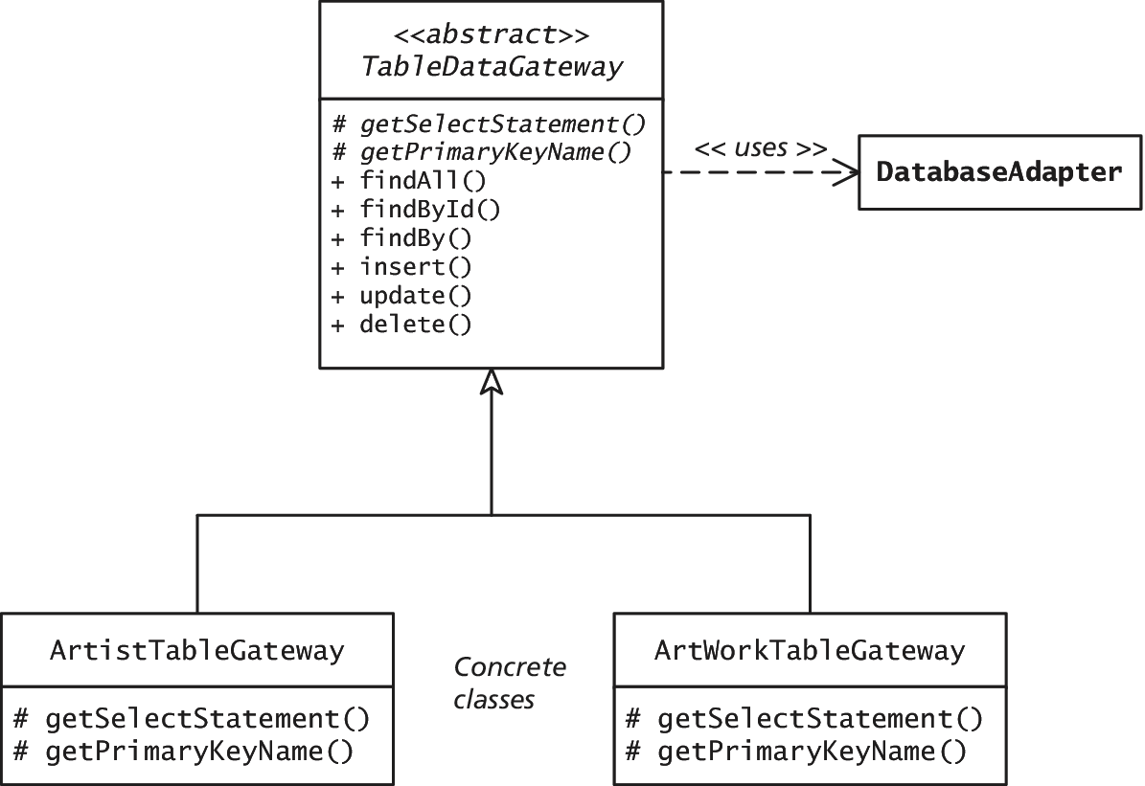
Table Data Gateway Pattern
In UML

Slide 43
Domain Model Pattern
In the Domain Model pattern , the developer implements an object model: that is, a variety of related classes that represent objects in the problem domain of the application.
The classes within a domain model will have both data and behavior and will be the natural location for implementing business rules.

Slide 44
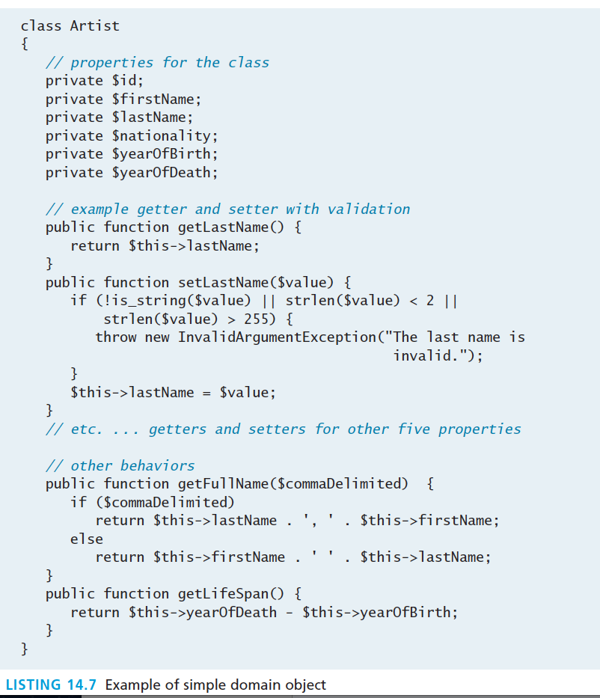
Domain Model Pattern

Slide 45
Getters and Setters
In Domain Objects
Creating the properties along with their getters and setters for all the domain objects in a model can be very tedious, especially if there are many classes with many properties.
PHP does provide its own type of shortcut via the __get() and __set() magic methods
The __get() method is called when a client of a class tries to access a property that is not accessible.

Slide 46
Getters and Setters
Magic
We could replace all of the property getters in Listing 14.7 with the following magic method:
public function __get($name) {
if ( isset($this->$name) ) {
return $this->$name;
}
return null;
}
Part of the magic in this magic method resides in PHP’s ability to have variable variables whose variable name is determined dynamically at run time based on the value of the variable

Slide 47
Variable Variables
Magic Indeed
For instance
if $name contains the string 'yearOfBirth'
then $this->$name == $this->yearOfBirth.

Slide 48
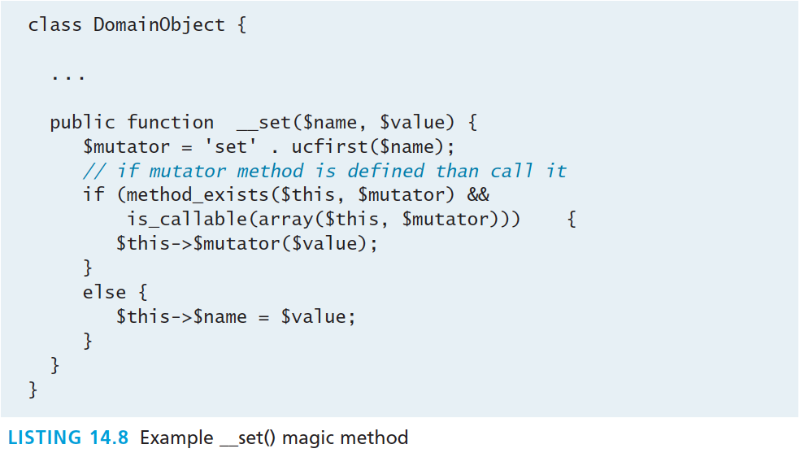
__Set()
Example usage

Slide 49
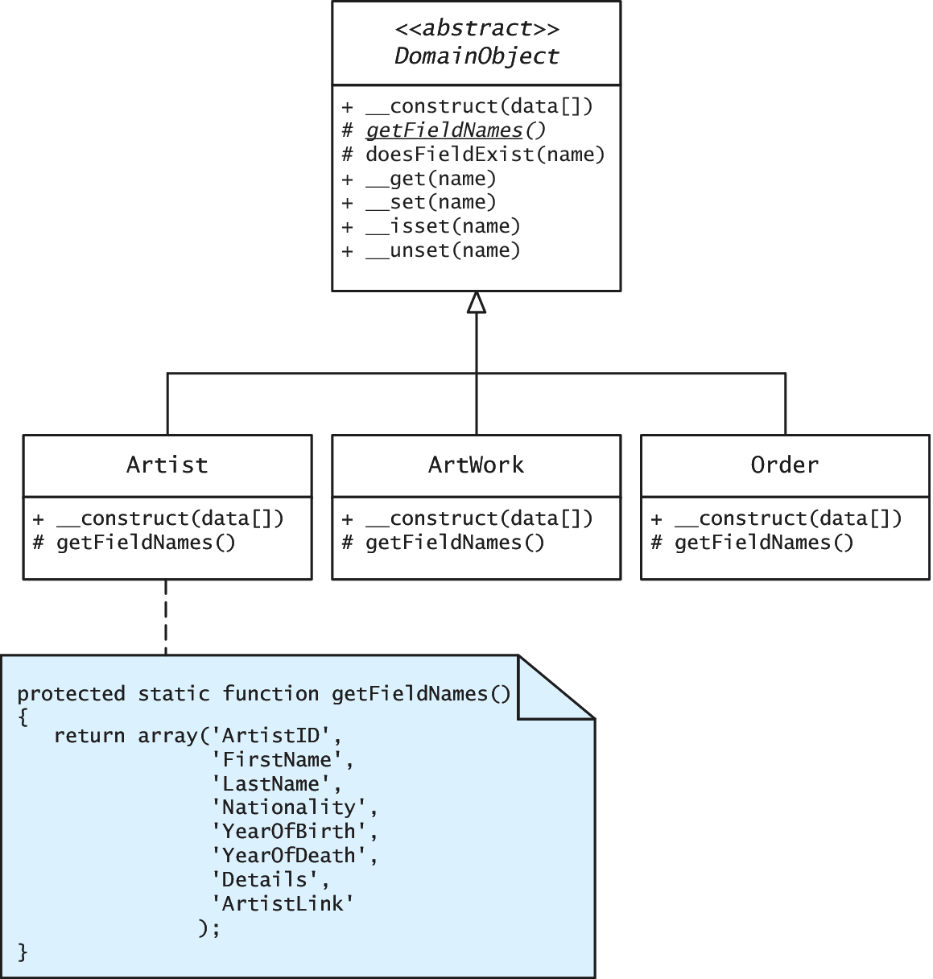
Example
Example Domain Model

Slide 50
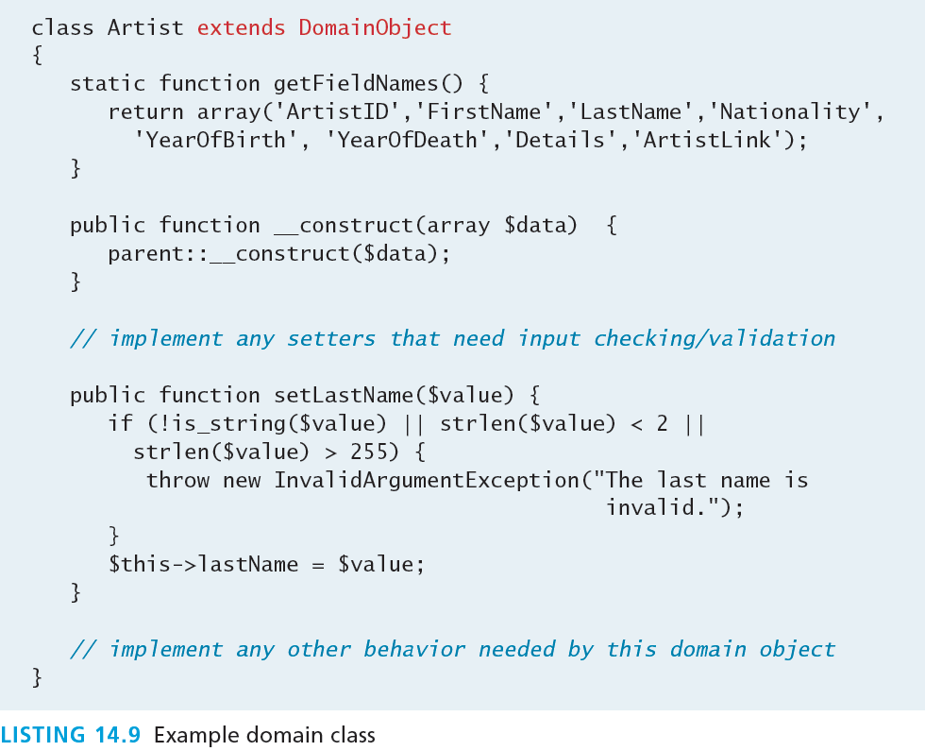
Example
Example Domain Class

Slide 51
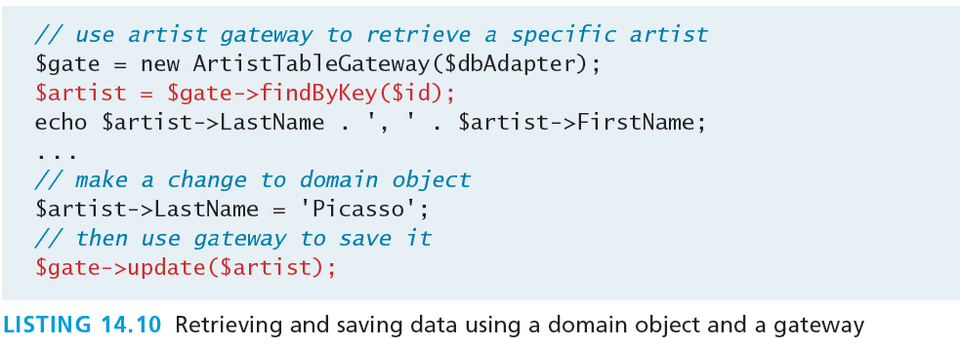
Domain Object and Gateway
Retrieving and Saving

Slide 52
Active Record Pattern
Interface with the database
You may be wondering what class would have the responsibility of populating the domain objects from the database data or of writing the data within the domain object back out to the database.

Slide 53
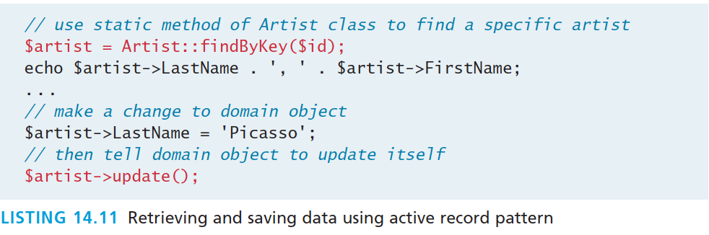
Active Record Pattern
Interface with the database

Slide 54
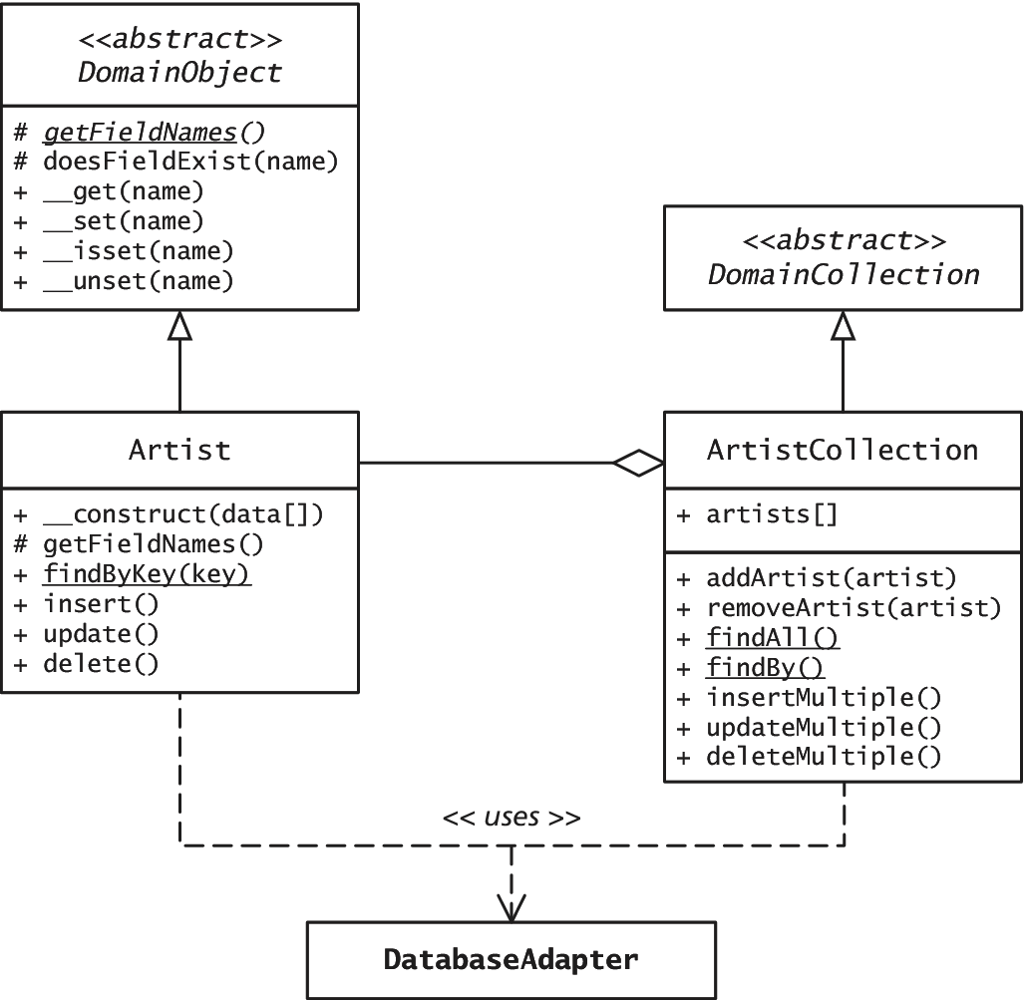
Active Record Pattern
Retrieving and Saving

Slide 55
Presentation Patterns
Section 5 of 5

Slide 56
Model View Controller
MVC
The Model-View-Controller (MVC) pattern actually predates the whole pattern movement.
The model represents the data of the application
The view represents the display aspects of the user interface.
The controller acts as the “brains” of the application and coordinates activities between the view and the model.

Slide 57
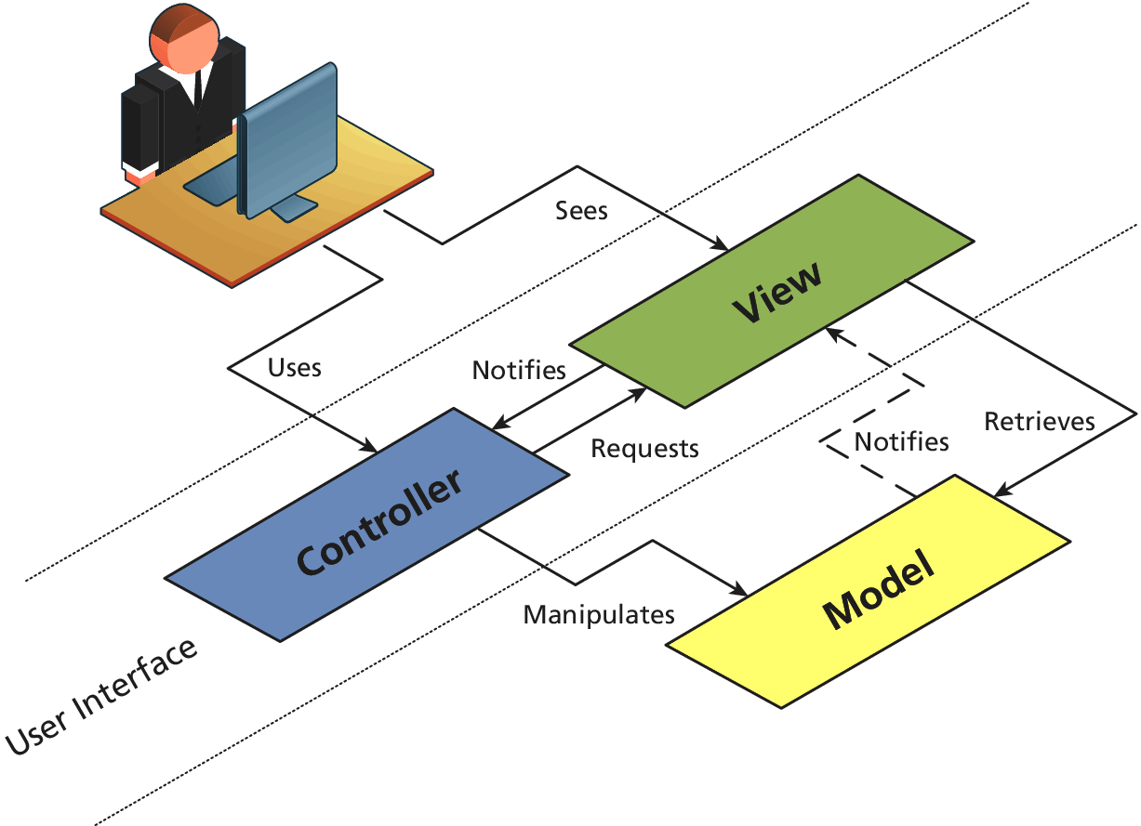
Model View Controller
MVC Classic

Slide 58
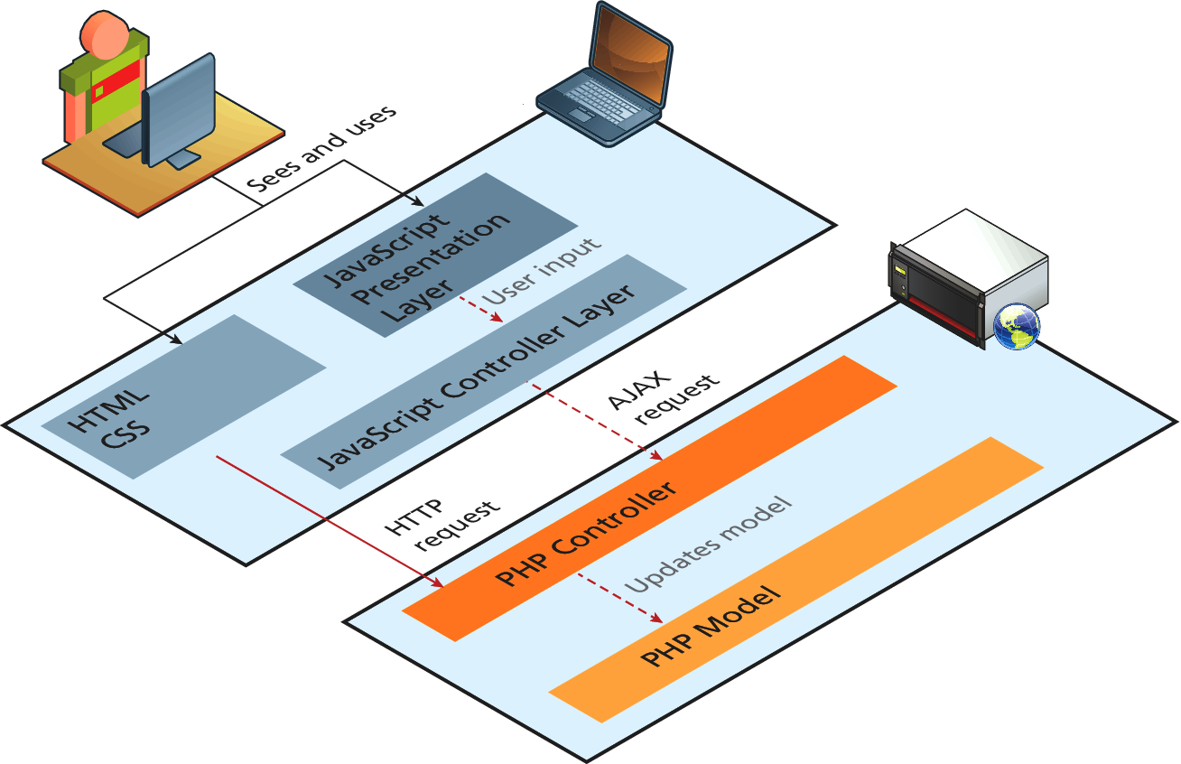
Model View Controller
MVC split between client and browser

Slide 59
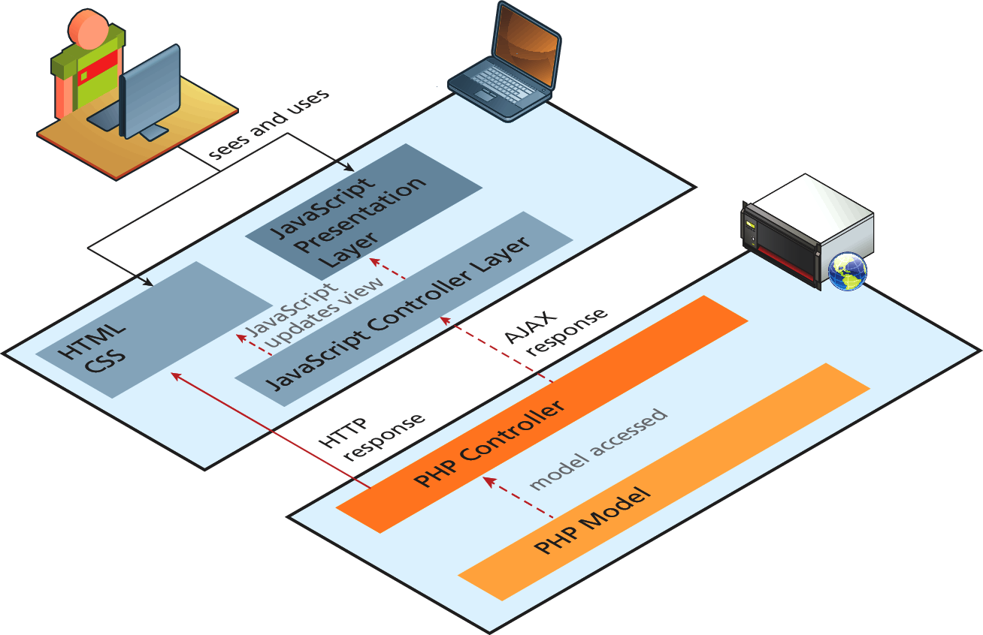
Model View Controller
MVC split between client and browser (illustrated response)

Slide 60
Front Controller Pattern
The Front Controller pattern consolidates all request handling into a single-handler class.
The rationale for the front controller is that in more complex websites every request requires similar types of processing.
One approach to this standardized behavior is to provide this functionality to each page via common include files.
A more object-oriented approach is to use a front controller, in which one (or a small number) script or class is responsible for handling every incoming request and then delegating the rest of the handling to the appropriate handler.

Slide 61
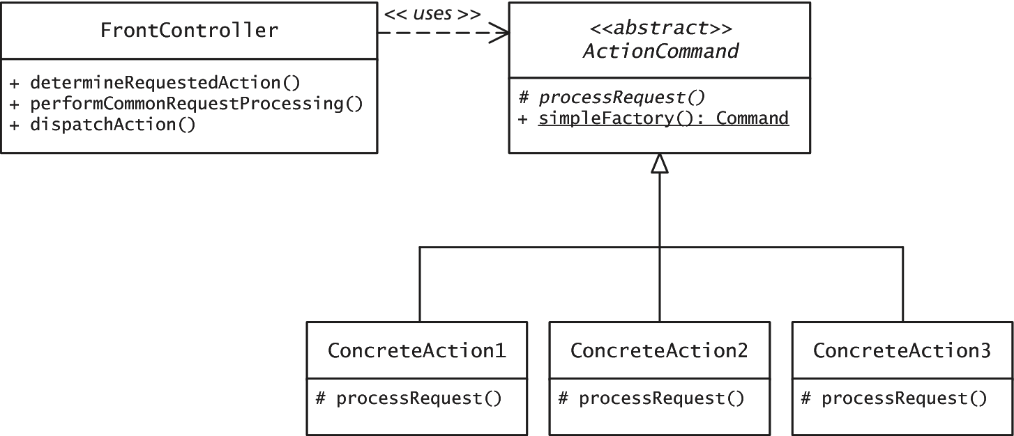
Front Controller Pattern

Slide 62
What You’ve Learned
1
2
Real World Web Software Design
Principle of Layering
3
4
Design Patterns in Web Context
Data and Domain Patterns
5
Presentation Patterns
7

