Slide 1


Bryan Headrick
10/6/2024

Slide 2

Outline
Executive Summary
Introduction
Methodology
Results
Conclusion
Appendix

Slide 3
Executive Summary
Summary of methodologies
  Data was collected from the SpaceX REST API and through web scraping
  Data was processed using pandas to standardize and group the data in meaningful ways and perform statistical analysis
Summary of all results

Slide 4
Introduction
Project background and context
Problems you want to find answers

Slide 5

Section 1

Slide 6
Methodology
Executive Summary
Data collection methodology:
  Data was collected from the SpaceX REST API and through webscraping
Perform data wrangling
  Data was processed using pandas to standardize and group the data in meaningful ways and perform statistical analysis
Perform exploratory data analysis (EDA) using visualization and SQL
Perform interactive visual analytics using Folium and Plotly Dash
Perform predictive analysis using classification models
  Using GridSearchCV, various alrorithms were tested to determine the best for predicting successful launches

Slide 7
Data Collection
Describe how data sets were collected.
Present data collection process using key phrases and flowcharts

Slide 8
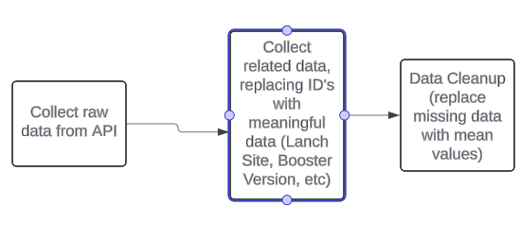
Data Collection – SpaceX API
https://github.com/catmanstudios/Applied-Data-Science-Capstone/blob/main/jupyter-labs-spacex-data-collection-api.ipynb

Slide 9
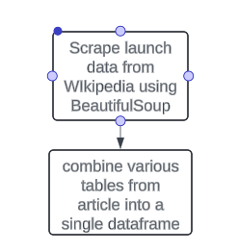
Data Collection - Scraping
https://github.com/catmanstudios/Applied-Data-Science-Capstone/blob/main/jupyter-labs-webscraping.ipynb

Slide 10
Data Wrangling
Identify missing values in each column
Identify the data types of each column
Analyze the data getting the counts of:
  Orbit Types
  Launch Sites
  Landing Outcomes
Add a class field to the dataframe to identify the overall landing success/failure
Analyze the overall landing success rate
https://github.com/catmanstudios/Applied-Data-Science-Capstone/blob/main/labs-jupyter-spacex-Data%20wrangling.ipynb

Slide 11
EDA with Data Visualization
Scatter charts were used to illustrate the relationship between flight number, payload mass, and landing success. The data shows that landings became increasingly more likely to be successful, and larger payloads were used as there were more launches.
https://github.com/catmanstudios/Applied-Data-Science-Capstone/blob/main/edadataviz.ipynb

Slide 12
EDA with SQL
Displayed overview of dataset
Listed launch site names and booster names
Displayed high level statistics of dataset, such as overall successes, failures, average payload mass, count of each outcome
https://github.com/catmanstudios/Applied-Data-Science-Capstone/blob/main/jupyter-labs-eda-sql-coursera_sqllite.ipynb

Slide 13
Build an Interactive Map with Folium
Added circles and markers to identify launch sites.
Added marker clusters to indicate successful/unsuccessful launches
Added other markers to indicate distance from various landmarks, such as:
  Coastlines
  Cities
The rationale for this is to illustrate some of the factors that go into finding an optimal location for a launch site.
https://github.com/catmanstudios/Applied-Data-Science-Capstone/blob/main/lab_jupyter_launch_site_location.ipynb

Slide 14
Build a Dashboard with Plotly Dash
First, there is a pie chart to show success/failure rate for each launch site as well as a pie chart to show the success rate for each site as a percentage of all successes.
Next is a scatter chart to show the relationship between booster version, payload mass, and launch success.
The charts are intended to answer 5 questions:
Which site has the largest successful launches?
Which site has the highest launch success rate?
Which payload range(s) has the highest launch success rate?
Which payload range(s) has the lowest launch success rate?
Which F9 Booster version (v1.0, v1.1, FT, B4, B5, etc.) has the highest launch success rate?
https://github.com/catmanstudios/Applied-Data-Science-Capstone/blob/main/spacex_dash_app.py

Slide 15
Predictive Analysis (Classification)
Data was gathered from csv files. The dependent feature (class) was assigned to a separate variable. The data was then standardized to ensure all features were weighted the same. Data was, then split into train and test sets. Various predictive models were created, including logistic regression, support vector machine, decision tree classifier, and k nearest neighbor.
https://github.com/catmanstudios/Applied-Data-Science-Capstone/blob/main/SpaceX_Machine%20Learning%20Prediction_Part_5.ipynb

Slide 16
Results
Exploratory data analysis results
Interactive analytics demo in screenshots
Predictive analysis results

Slide 17

Section 2

Slide 18
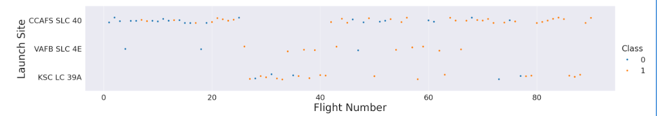
Flight Number vs. Launch Site
Flight Number vs. Launch Site
The majority of the 1st 3rd of launches were from CCAFS
The 2nd 3rd of launches had a comparable number of launches between all 3 sites with the majority of the initial launches in KSC LC 39A.
The majority of the final 3rd of launches were from CCAFS

Slide 19
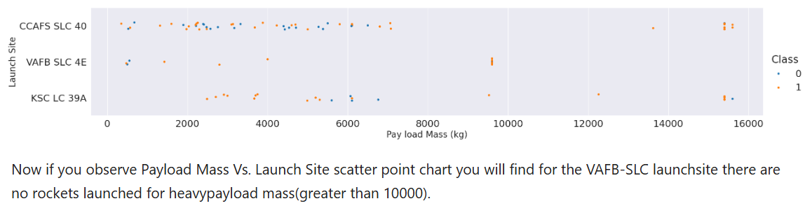
Payload vs. Launch Site

Slide 20
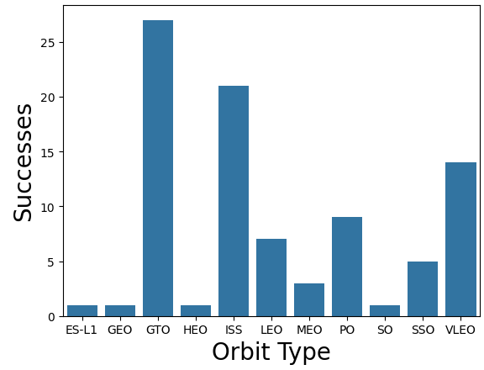
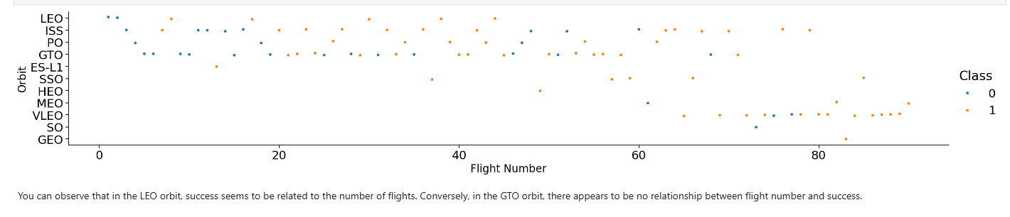
Success Rate vs. Orbit Type

Slide 21
Flight Number vs. Orbit Type

Slide 22
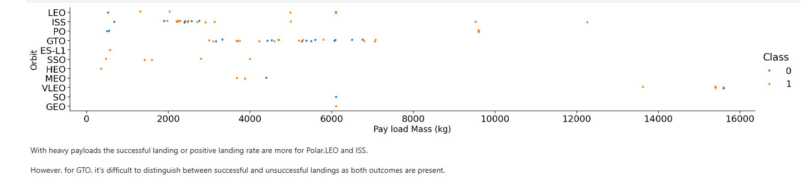
Payload vs. Orbit Type

Slide 23
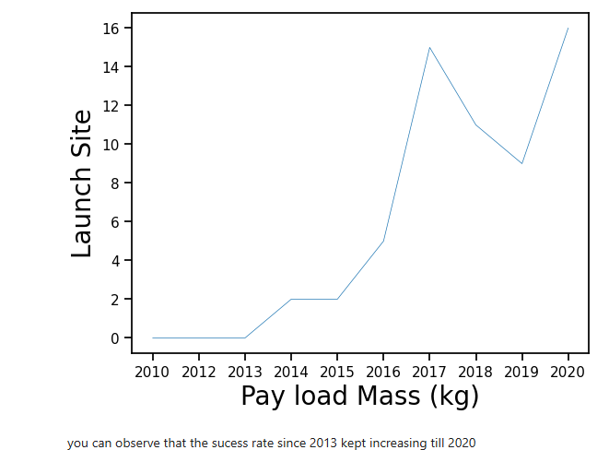
Launch Success Yearly Trend

Slide 24
All Launch Site Names
Query:
select distinct Launch_Site from SPACEXTBL
Explanation:
Launch_Site is the column name where the launch site names are stored, the distinct directive ensures no duplicates are listed

Slide 25
Launch Site Names Begin with 'CCA'
Query:
select * from SPACEXTBL WHERE Launch_Site like 'CCA%' limit 5
Explanation:
The ‘like’ directive looks for partial text matches, and the % is the wildcard character in the expression.
The ‘limit 5’ directive means we’re only displaying the first 5 results.

Slide 26
Total Payload Mass
Query:
select sum(PAYLOAD_MASS__KG_) from SPACEXTBL where Customer = 'NASA (CRS)'
Explanation:
The where clause isolates records matching that condition, and the sum directive sums values in that column across all filtered records.

Slide 27
Average Payload Mass by F9 v1.1
Query:
select avg(PAYLOAD_MASS__KG_) from SPACEXTBL where Booster_Version like '%F9 v1.1%'
Explanation:
The where clause filters records matching the condition where the Booster_Version partially matches the ‘F9 v1.1’ string, and the avg directive averages values in the specified column across all filtered records.

Slide 28
First Successful Ground Landing Date
Query:
select min(Date) from SPACEXTBL where Landing_Outcome='Success (ground pad)'
Explanation:
The where clause filters records matching the specfied value for Landing_Outcome, and the min directive selects the lowest value in the date column within the filtered results.

Slide 29
Successful Drone Ship Landing with Payload between 4000 and 6000
Query:
select Booster_Version from SPACEXTBL where Landing_Outcome ='Success (drone ship)' and PAYLOAD_MASS__KG_ >4000 and PAYLOAD_MASS__KG_ <6000
Explanation:
This lists the Booster_Version values with landing_outcomes matching values for successful drone ship and payload mass is greater than 4000kg and less than 6000kg

Slide 30
Total Number of Successful and Failure Mission Outcomes
Query:
select sum(success) as success, sum(failure) as failure from ( select case WHEN Mission_Outcome = 'Success' then 1 else 0 end success, case WHEN Mission_Outcome = 'Success' then 0 else 1 end failure from SPACEXTBL) t
Explanation:
This uses a subquery with case statements to independently count successes and failures (based on whether the mission_outcome field is ‘Success’)

Slide 31
Boosters Carried Maximum Payload
Query:
select distinct Booster_Version FROM spacextbl where PAYLOAD_MASS__KG_ = (select max(PAYLOAD_MASS__KG_) from spacextbl)
Explanation:
This lists all booster_version values having a record where the payload mass is at the maximum value for the entire dataset, and only lists each booster_version once.

Slide 32
2015 Launch Records
Query:
select substr(Date, 6,2) as month, Booster_Version, Landing_Outcome, Launch_site from spacextbl where substr(Date,0,5)='2015' and Landing_Outcome like 'Failure%'
Explanation:
This extracts the month portion of the date, booster version, landing outcome (failure type), and launch site for launches that failed to land in 2015

Slide 33
Rank Landing Outcomes Between 2010-06-04 and 2017-03-20
Query:
select count(Date) as "outcome count", Landing_Outcome from spacextbl where Date between '2010-06-04' and '2017-03-20' group by Landing_Outcome order by count(Date) desc
Explanation:
This returns the count of records in the above date range grouped by landing outcome and sorted with the highest counts first.

Slide 34

Section 3

Slide 35
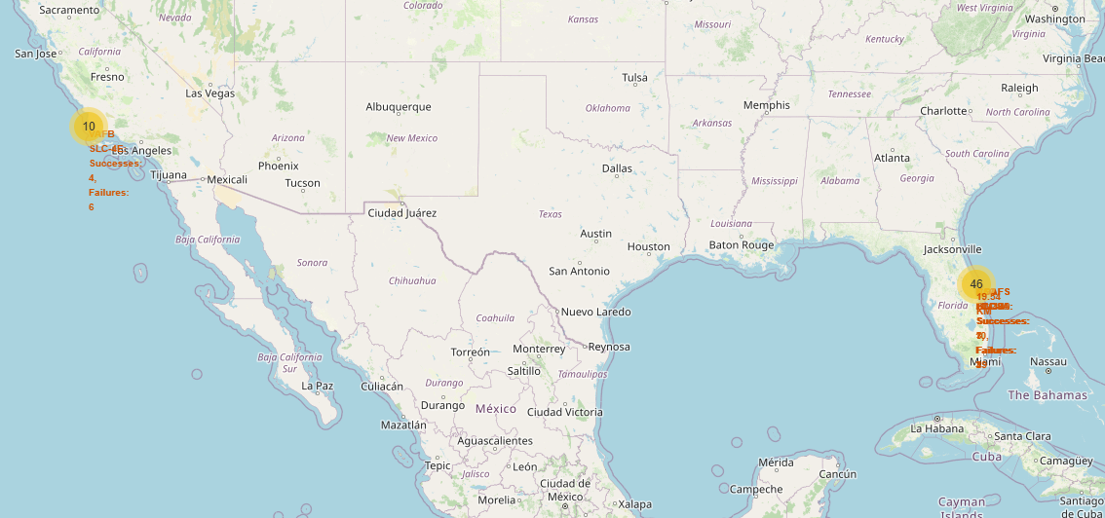
SpaceX Launch Site Locations
All sites are near the coast, but roughly 1km or more inland
All sites are reasonably far away from major cities

Slide 36
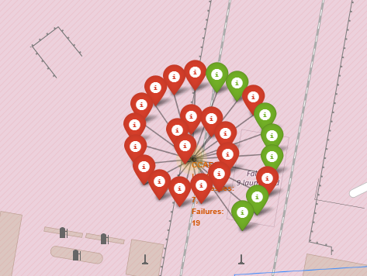
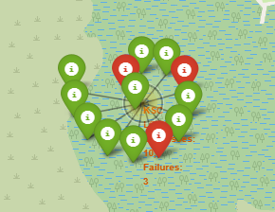
Success and Failure Markers
The markers make it easier to quickly identify sites with higher success rates
KSC LC-39A had a much higher success rate than other launch sites. It was also much further inland than the other launch sites, although this is not enough data to suggest a causal link

Slide 37
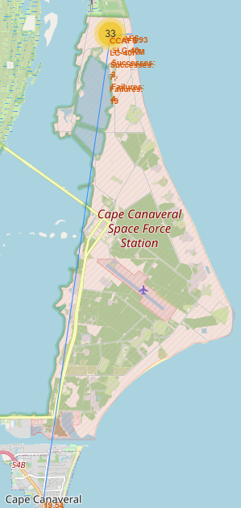
Proximities Map
The launch sites are reasonably close to coasts and railways to facilitate ease of transporting massive parts, but very distant from neighboring cities to limit potential noise pollution and collateral damage in the event of crashes.

Slide 38

Section 4

Slide 39
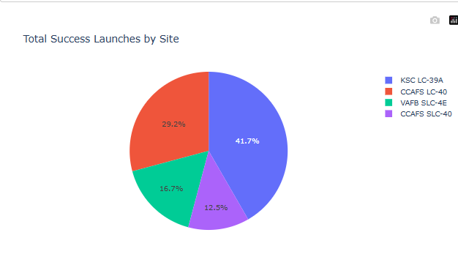
Launch Success Statistics
KSC LC-39A had the greatest share of successes (41.7%) as well as the highest success rate, at 78%.

Slide 40
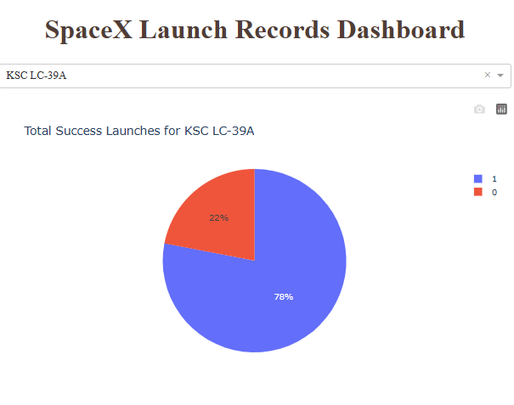
Launch Site With Highest Success Ratio
KSC LC-39A had 78% successes and 22% failures.

Slide 41
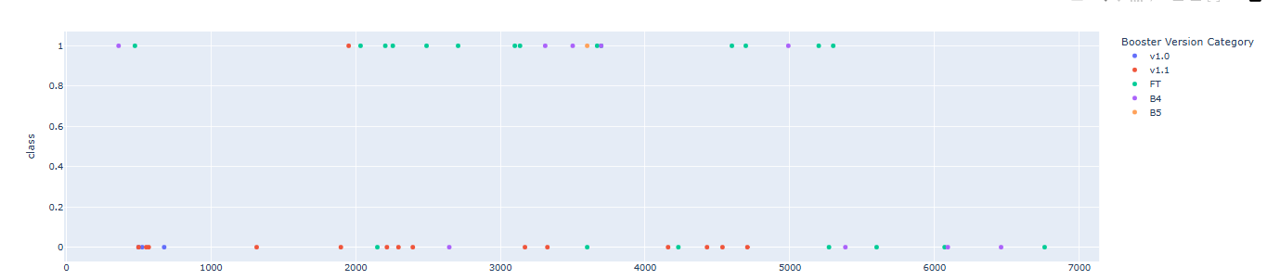
Payload vs Launch Outcome
Payloads from 2000 to 4000 appear to have the highest success rate, and FT appears to be the most successful Booster Version category.

Slide 42

Section 5

Slide 43
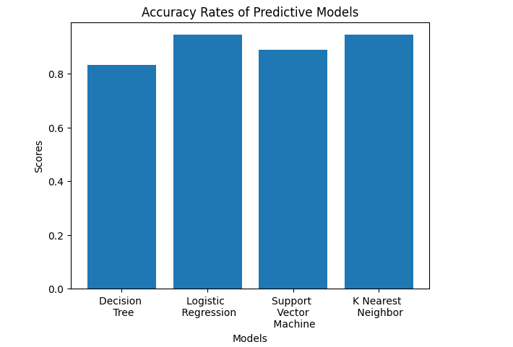
Classification Accuracy
Logistic Regression and K Nearest Neighbor are tied at 94% for the most accurate predictive model

Slide 44
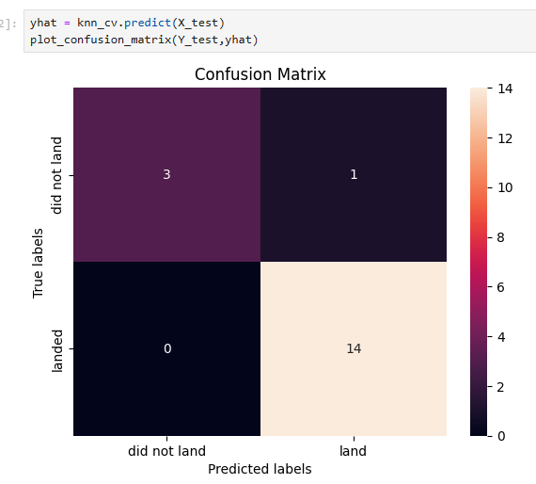
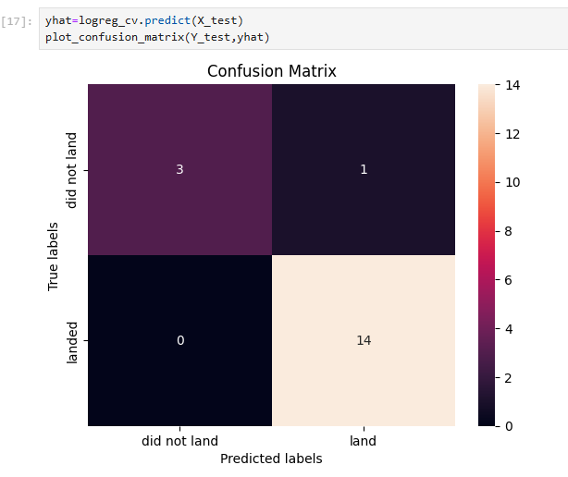
Confusion Matrix
Both KNN and Logistic Regression models only had a single false-positive prediction and no false-negative predictions.

Slide 45
Conclusions
Payloads from 2000 to 4000 appear to have the highest success rate
FT appears to be the most successful Booster Version category.
GTO and ISS were the two most successful orbit types
Logistic Regression and K Nearest Neighbor are tied at 94% for the most accurate predictive model in predicting successful landing
The most successful launch site was the furthest inland

Slide 46
Appendix

Slide 47


