Slide 1

Caliburn.Micro an open source micro-framework for WPF, Silverlight and Windows Phone 7
Presented by Bryan Hunter Partner , Software Engineer Firefly Logic , Inc.
Twitter hash tags Tweeps @bryan_hunter (your presenter) #caliburn @EisenbergEffect (the creator of Caliburn)

Slide 2
Brief History of Caliburn.Micro
I use it. I’m a fan
Based on the mature Caliburn project
Created by Rob Eisenberg
Grew from Rob’s MIX10 talk “Build Your Own MVVM Framework”
Around 2,000 lines of code
Made public July 2010
Now the mainline

Slide 3


Slide 4
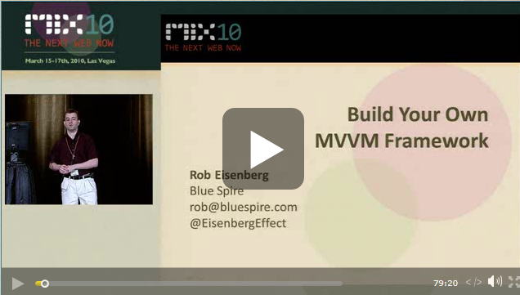

Slide 5

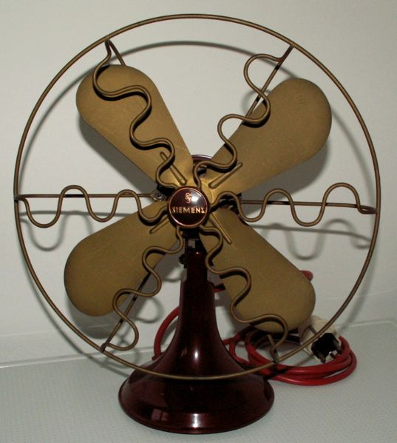


Slide 6

$$\sim$$
********** ********** ********** ********** ********** ********** ********** ********** ********** **********
********** ********** ********** ********** ********** ********** ********** ********** ********** **********
********** ********** ********** ********** ********** ********** ********** ********** ********** **********
********** ********** ********** ********** ********** ********** ********** ********** ********** **********
********** ********** ********** ********** ********** ********** ********** ********** ********** **********
********** ********** ********** ********** ********** ********** ********** ********** ********** **********
********** ********** ********** ********** ********** ********** ********** ********** ********** **********
********** ********** ********** ********** ********** ********** ********** ********** ********** **********
********** ********** ********** ********** ********** ********** ********** ********** ********** **********
********** ********** ********** ********** ********** ********** ********** ********** ********** **********
********** ********** ********** ********** ********** ********** ********** ********** ********** **********
********** ********** ********** ********** ********** ********** ********** ********** ********** **********
********** ********** ********** ********** ********** ********** ********** ********** ********** **********
********** ********** ********** ********** ********** ********** ********** ********** ********** **********
********** ********** ********** ********** ********** ********** ********** ********** ********** **********
********** ********** ********** ********** ********** ********** ********** ********** ********** **********
********** ********** ********** ********** ********** ********** ********** ********** ********** **********
********** ********** ********** ********** ********** ********** ********** ********** ********** **********
********** ********** ********** ********** ********** ********** ********** ********** ********** **********
********** ********** ********** ********** ********** ********** ********** ********** ********** **********

Slide 7
Caliburn.Micro Elevator Speech
A better version of what nearly every WPF veteran has attempted to home-grow
Reduces the drudgery of property binding and commands
Simplifies building a deeply composed UI
Helps unify the programming models of WPF, Silverlight and Windows Phone 7
Simplifies asynchronous programming
Built in Tombstone & Resurrection for WP7
Small enough to grok and to “own”

Slide 8

WPF

Slide 9
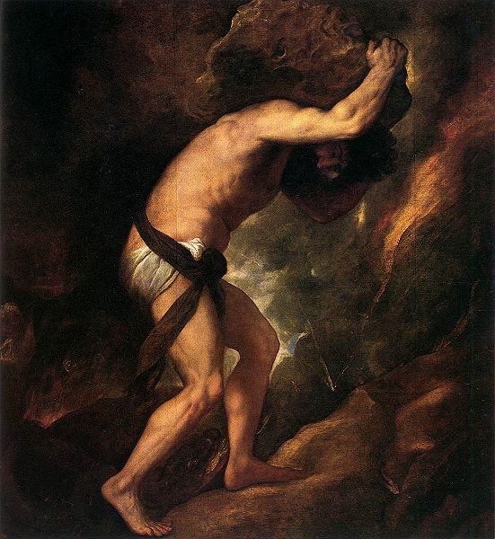

Slide 10
Can’t wait to get these Property Bindings and Commands to the top of the hill.

Slide 11
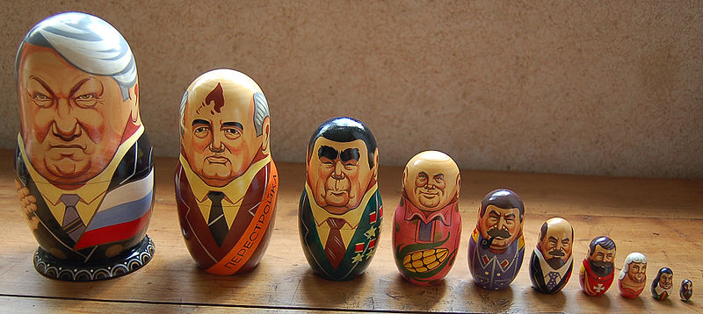

Slide 12

Windows Phone 7 Silverlight WPF

Slide 13


Slide 14
Important Terms
MVVM (Model-View-ViewModel)
Convention over Configuration
Event Aggregator (pub-sub)
Coroutines
Conductors and Screens
Bootstrapper

Slide 15
The GameLibrary Demo
Run the demo fool

Slide 16
The GameLibrary Demo
Wow that was fun!
Rob’s “Game Library” sample from “Build you won MVVM Framework” talk was the inspiration for Caliburn.Micro. After Caliburn.Micro was made public Marco Amendola ported the Game Library sample to Caliburn.Micro.

Slide 17
The lifecycle
App starts up

Slide 18
The lifecycle
App starts up
News up Bootstrapper<ShellViewModel>
public class ShellViewModel
{
public void Back() {…}
public IScreen ActiveScreen
{ get; set; }
…
}

Slide 19

The lifecycle
App starts up
News up Bootstrapper<ShellViewModel>
ViewLocator.LocateForModel finds ShellView
<ContentControl x:Name=“ActiveScreen”/>
public class ShellViewModel
{
public void Back() {…}
public IScreen ActiveScreen
{ get; set; }
…
}

Slide 20
The lifecycle
App starts up
News up Bootstrapper<ShellViewModel>
ViewLocator.LocateForModel finds ShellView
<ContentControl x:Name=“ActiveScreen”/>
ViewModelBinder.Bind()
public class ShellViewModel
{
public void Back() {…}
public IScreen ActiveScreen
{ get; set; }
…
}

Slide 21
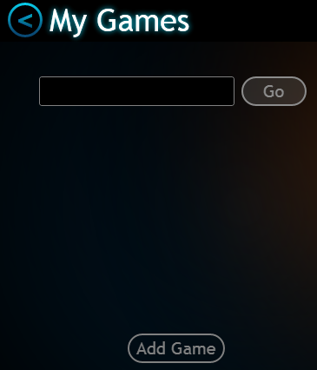
The lifecycle
App starts up
News up Bootstrapper<ShellViewModel>
<ContentControl x:Name=“ActiveScreen”/>
ViewLocator.LocateForModel finds ShellView
ViewModelBinder.Bind()

Slide 22
The lifecycle
App starts up
News up Bootstrapper<ShellViewModel>
<ContentControl x:Name=“ActiveScreen”/>
ActiveScreen set to SearchViewModel
ViewLocator.LocateForModel finds ShellView
ViewModelBinder.Bind()
public class SearchViewModel
{
public string SearchText
{ get; set; }
public void AddGame {…}
public void Search {…}
…
}

Slide 23

The lifecycle
App starts up
News up Bootstrapper<ShellViewModel>
ActiveScreen set to SearchViewModel
ViewLocator.LocateForModel finds ShellView
ViewLocator.LocateForModel finds SearchView
ViewModelBinder.Bind()
public class SearchViewModel
{
public string SearchText
{ get; set; }
public void AddGame {…}
public void Search {…}
…
}

Slide 24
The lifecycle
App starts up
News up Bootstrapper<ShellViewModel>
ActiveScreen set to SearchViewModel
ViewLocator.LocateForModel finds ShellView
ViewLocator.LocateForModel finds SearchView
ViewModelBinder.Bind()
ViewModelBinder.Bind()
public class SearchViewModel
{
public string SearchText
{ get; set; }
public void AddGame {…}
public void Search {…}
…
}

Slide 25
The lifecycle
App starts up
News up Bootstrapper<ShellViewModel>
ActiveScreen set to SearchViewModel
ViewLocator.LocateForModel finds ShellView
ViewLocator.LocateForModel finds SearchView
ViewModelBinder.Bind()
ViewModelBinder.Bind()

Slide 26
The lifecycle
App starts up
News up Bootstrapper<ShellViewModel>
ViewLocator.LocateForModel finds ShellView
ViewModelBinder.Bind()
ActiveScreen set to SearchViewModel
ViewLocator.LocateForModel finds SearchView
ViewModelBinder.Bind()
and so on, and so on, and so on…

Slide 27
The Code for the Demo
Bootstrapper
Convention over Config
View Location and composition
ViewModelBinder (Property Binding & Action Binding)
Conductors and Screen
Coroutines

Slide 28
Wrapping up
Hope this was enough to get you rolling
Caliburn.Micro is on Codeplex
http://caliburnmicro.codeplex.com
These slides and the code will be at
http://codeswamp.com

Slide 29
Big Thanks
Rob Eisenberg has stuck with it for three years and has built a great framework
Marco Amendola ported the GameLibrary to Caliburn.Micro
http://marcoamendola.wordpress.com

Slide 30
My Contact Info
Bryan Hunter Partner, Software Engineer Firefly Logic, Inc. 1000 Main Street, Suite 201 Nashville, TN 37206
Twitter: @bryan_hunter
Blog: codeswamp.com
Email: bryan.hunter@fireflylogic.com

