Slide 1




In Two Hours: a hands-on workshop
presented by Bryan Hunter Firefly Logic
Twitter #codestock #erlang @bryan_hunter
@fireflylogic

Slide 2
?

Slide 3
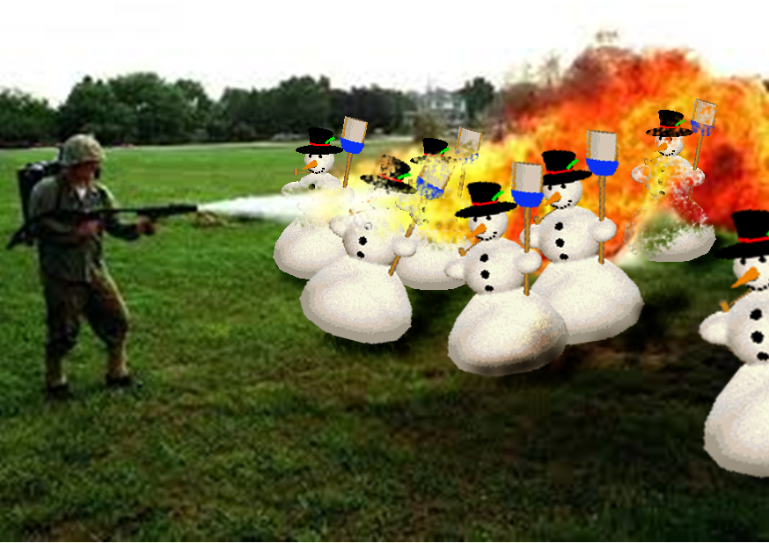
Right tool for the job!

Slide 4
What’s Erlang?
Erlang (the language)
+
OTP
+
The ERTS
(Erlang Runtime System)

Slide 5
Erlang (the Language)
Functional
immutability, higher-order functions, referential transparency, separation of behavior and data, recursion,
Declarative, Dynamic, Compiled
Concurrency- oriented
Different model of the world
Prolog roots
Pattern matching

Slide 6
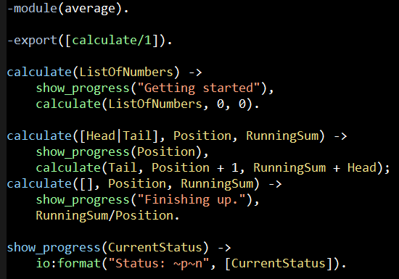
Erlang (the Language)
File: average.erl

Slide 7
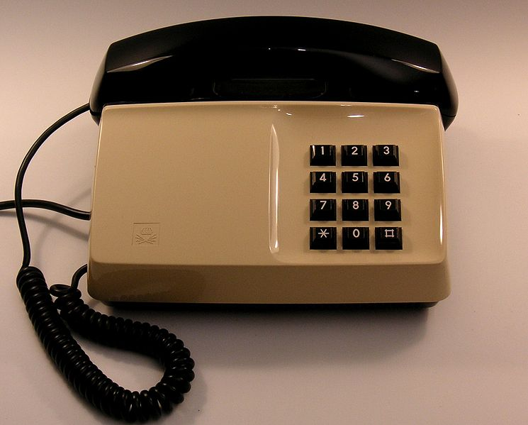
OTP

Slide 8
Erlang Runtime System (in-context)
.NET dev stack
Erlang dev stack
C# / F#
Erlang / Elixir / Joxa
.NET Framework
OTP
CLR
ERTS
VM + Kernel
+ STDLIB
OS (Windows)
OS (Windows, Linux, Mac, None)

Slide 9
Two thing to remember about
Concurrency
1) Shared memory concurrency is hard
2) Message passing concurrency is easy

Slide 10
Erlang Processes
are the unit of concurrency.
You structure your programs around these units of concurrency.

Slide 11
“The performance
of a concurrent language
is predicated by three things:
the context switching time,
The message passing time,
and the time to create a process.”
–Mike Williams

Slide 12
One .NET 4.0 Thread (allocates one megabyte)
**********
**********
**********
**********
**********
**********
**********
**********
**********
**********
**********
**********
**********
**********
**********
**********
**********
**********
**********
**********
**********
**********
**********
**********
**********
**********
**********
**********
**********
**********
**********
**********
**********
**********
**********
**********
**********
**********
**********
**********
**********
**********
**********
**********
**********
**********
**********
**********
**********
**********
Heap
Mailbox
Stack
**********
**********
**********
**********
**********
**********
**********
**********
**********
**********
**********
**********
**********
**********
**********
**********
**********
**********
**********
**********
**********
**********
**********
**********
**********
**********
**********
**********
**********
**********
**********
**********
**********
**********
**********
**********
**********
**********
**********
**********
**********
**********
**********
**********
**********
**********
**********
**********
**********
**********
Garbage Collector
Links and Monitors
One Erlang Process (allocates one kilobyte)
*
Why -> elsewhere concurrency is painful

Slide 13
*
*
*
Reductions
- Do 2,000 operations
reduction1 reduction3 .
Reduction2000
- Move to the next guy - Repeat
CPU Core
Why -> near zero context switching cost

Slide 14
worker
supervisor
*
*
CPU Core
Why -> supervision

Slide 15
***** *****
***** *****
***** *****
***** *****
Core
Core
Core
Core
Why -> elsewhere concurrency is painful

Slide 16

Distribution: built-in from the start

Slide 17




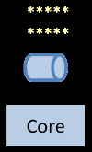
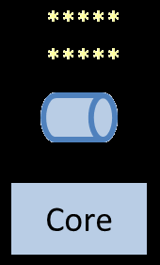
Distribution: built-in from the start

Slide 18
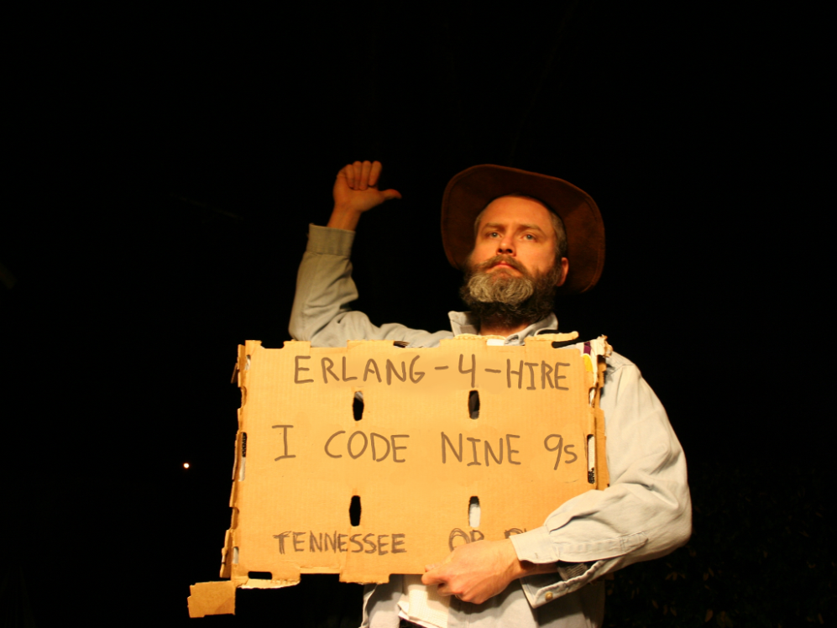
Nines | Uptime | Annual Downtime
9 | 99.9999999% | 30 milliseconds
8 | 99.9999990% | 300 milliseconds
7 | 99.9999900% | 3 seconds
6 | 99.9999000% | 32 seconds
5 | 99.9990000% | 5 minutes
4 | 99.9900000% | 53 minutes
3 | 99.9000000% | 8 hours, 46 minutes
2 | 99.0000000% | 3 days, 15 hours, 36 minutes
Safe
Supervisor
Worker
Worker
Links and monitors
No masters
Hot code loading
simple distribution, safe concurrency
Why -> reliability

Slide 19

http://erlangcamp.com
How -> Two day intense hands-on training

Slide 20

http://nashfp.org
How -> Better yet; pack up and move to Nashville!

Slide 21
Thanks!
Bryan Hunter
Twitter: @bryan_hunter
Email: bryan.hunter@fireflylogic.com
Firefly Logic, Inc.
1000 Main Street, Suite 201 Nashville, TN 37206
http://fireflylogic.com
How -> keep in touch

