Slide 1
Start New Search

Slide 2
Movie Name | Enter movie name here - Memento
Find Movies

Slide 3

Movie Name | Memento
Find Movies
Memento | A man with short-term memory loss attempts to track down his wife’s murderer.
Keep it
Discard

Slide 4
Memento | A man with short-term memory loss attempts to track down his wife’s murderer. |  | User notes:
Start New Search

Slide 5
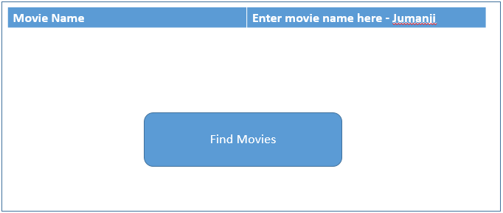
Memento | A man with short-term memory loss attempts to track down his wife’s murderer. |  | User notes:
Start New Search

Slide 6

Memento | A man with short-term memory loss attempts to track down his wife’s murderer. |  | User notes:
Jumanji | When two kids find and play a magical board game, they release a man trapped in it for decades – and a host of dangers that can only be stopped by finishing the game. |  | User notes:
Start New Search

