Slide 1
The Gastrointestinal System
20a

Slide 2
Chapter Outline
20.1 Overview of Gastrointestinal System Processes
20.2 Functional Anatomy of the Gastrointestinal System
20.3 Digestion and Absorption of Nutrients and Water
20.4 General Principles of Gastrointestinal Regulation
20.5 Gastrointestinal Secretion and Its Regulation
20.6 Gastrointestinal Motility and Its Regulation

Slide 3
20.1 Overview of Gastrointestinal System Processes
Consumed nutrients are too large to enter directly into the bloodstream
Nutrients undergo digestion before absorption
Motility and secretion aid digestion and absorption

Slide 4
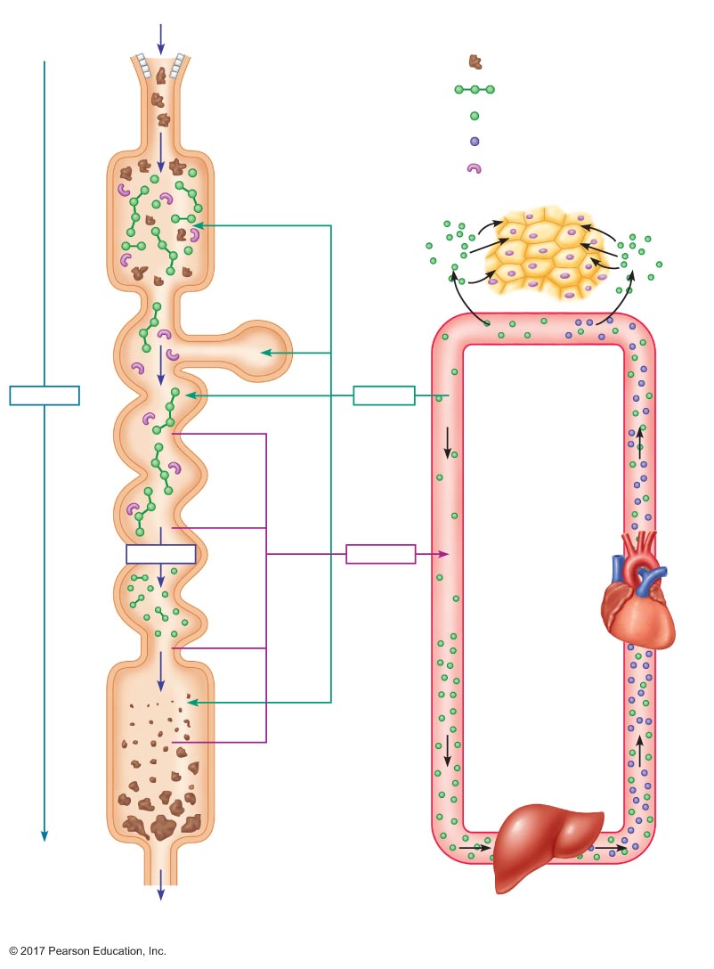
Figure 20.1 Overview of the four basic digestive processes: digestion, absorption, secretion, and motility.
Food and water
Mouth
= Food particles
Esophagus
= Large nutrient molecules
= Smaller nutrient molecules
= Processed nutrient molecules
Stomach
= Enzymes
Accessory
glands
Cells
Motility
Secretion
Digestion
Absorption
Small
intestine
Heart
Colon
Feces
Rectum
and anus
Liver
Unabsorbed material
Digestive tract
Cardiovascular system

Slide 5
20.2 Functional Anatomy of the Gastrointestinal System
Divisions of the gastrointestinal system
Gastrointestinal (GI) tract
Hollow tube, 15 feet long
Mouth → pharynx → esophagus → stomach → small intestine → colon → rectum → anus
Accessory glands
Several glands outside the GI tract secrete fluids and enzymes into the lumen of the GI tract

Slide 6
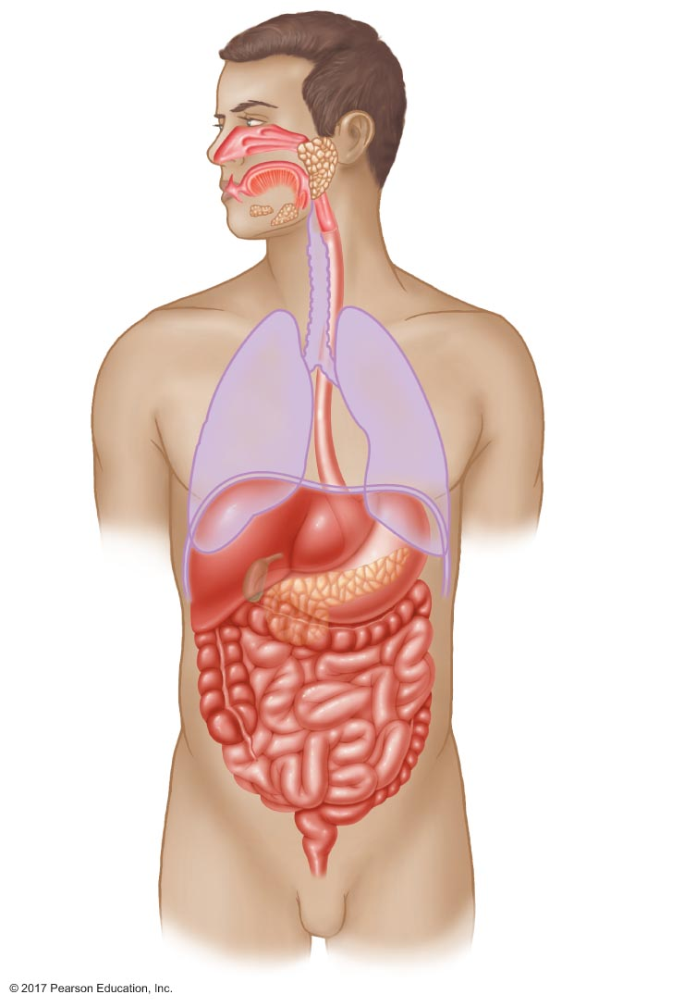
Figure 20.2 Major structures of the gastrointestinal system.
Organs of GI tract
Accessory glands and
associated structures
Mouth
Salivary glands
Pharynx
Trachea
Esophagus
Lung
Diaphragm
Liver
Stomach
Gallbladder
Pancreas
Small intestine
Colon
Vermiform
appendix
Rectum
Anus

Slide 7
The Gastrointestinal Tract
Wall of GI tract
Mucosa
Lining of the lumen
Submucosa
Connective tissue
Muscularis externa
Smooth muscle
Serosa
Connective tissue

Slide 8
The Gastrointestinal Tract
Mucosa: mucous membrane
Separates GI lumen from internal environment
Enterocytes: epithelial cell types
Absorptive cells
Exocrine cells
Endocrine cells
Three layers
Epithelial lining
Lamina propria: connective tissue
Muscularis mucosae: thin smooth muscle

Slide 9
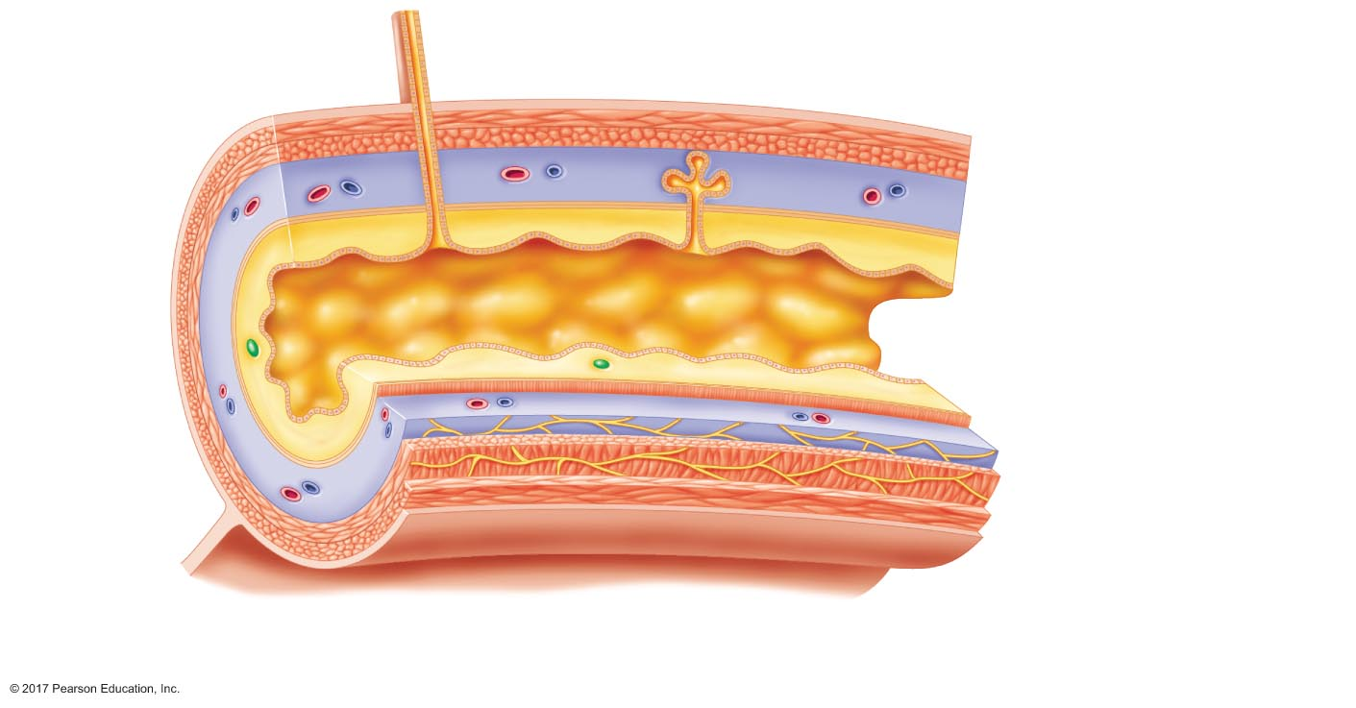
Figure 20.3 Generalized structure of the gastrointestinal wall, depicting the four major layers and the tissues within them.
Duct of
accessory
gland
Enterocytes
Gland in
submucosa
Blood vessels
Lumen
Mucous membrane
Lymph nodule
Lamina propria
Mucosa
Muscularis mucosae
Submucosa
Circular muscle
Muscularis
externa
Longitudinal muscle
Mesentery
Serosa
Submucosal plexus
Enteric nervous
system
Myenteric plexus

Slide 10
The Gastrointestinal Tract
Mucosa: lamina propria
Connective tissue
Small blood vessels and lymphatic vessels
Nerves
Lymphoid tissue
Lymph nodules
Peyer's patches

Slide 11
The Gastrointestinal Tract
Mucosa: muscularis mucosae
Thin layer of smooth muscle
Longitudinal fibers
Circular fibers
Functions in mixing lumenal contents

Slide 12
The Gastrointestinal Tract
Submucosa
Thick layer of connective tissue
Distensibility
Elasticity
Large blood vessels and lymphatic vessels
Submucosal plexus (Meissner's plexus)
Part of enteric nervous system

Slide 13
The Gastrointestinal Tract
Muscularis externa
Two layers of smooth muscle
Inner circular layer: changes diameter
Outer longitudinal layer: changes length
Myenteric plexus (Auerbach's plexus)
Second part of enteric nervous system

Slide 14
The Gastrointestinal Tract
Serosa
Inner layer: connective tissue
Outer layer: epithelial tissue (mesothelium)
Mesothelium is continuous with mesenteries, which are continuous with peritoneum

Slide 15
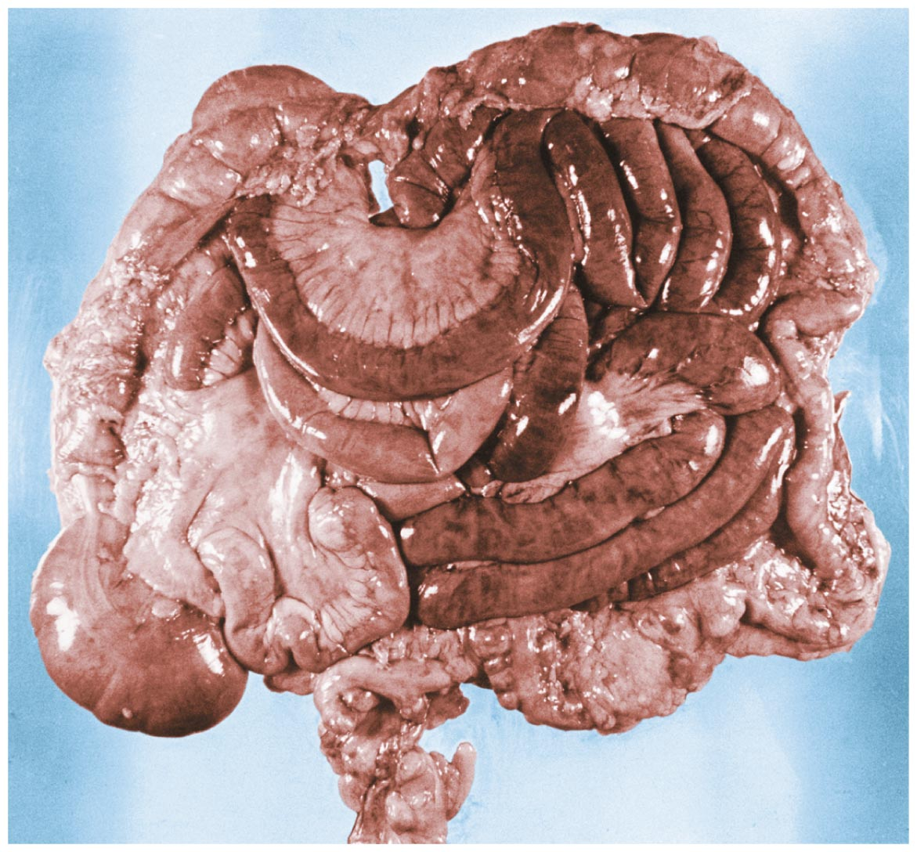
Figure 20.4 Mesenteries.

Slide 16
The Gastrointestinal Tract
Functional anatomy of gastrointestinal tract organs
Mouth, pharynx, and esophagus
Stomach
Small intestine
Colon
Rectum and anus

Slide 17
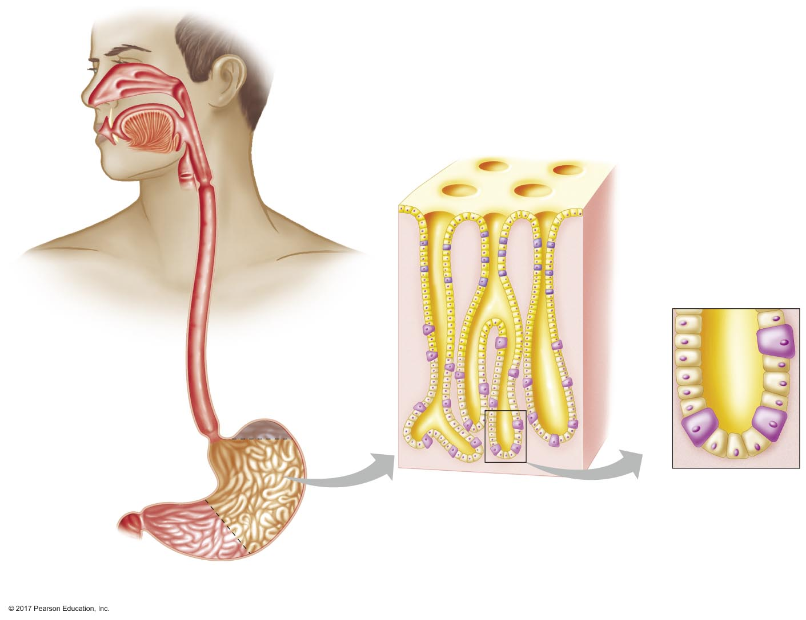
Figure 20.5 Anatomy of the mouth, pharynx, esophagus, and stomach.
Mouth
Gastric pits
Teeth
Pharynx
Epiglottis
Tongue
Upper
esophageal
sphincter
Mucosa
Neck cells
(secrete mucus)
Esophagus
Fundus of
stomach
Chief cells
(secrete
pepsinogen)
Gastric
glands
Parietal cells
(secrete acid)
Lower esophageal
sphincter
Pyloric sphincter
Rugae
Pylorus
Body of
stomach
Antrum of
stomach

Slide 18
The Gastrointestinal Tract
Mouth
Digestion begins with mastication (chewing)
Secretion: saliva
Lubricant
Salivary amylase: digests starch and glycogen
Pharynx
Throat
Common passageway for air and food
Food enters via the esophagus

Slide 19
The Gastrointestinal Tract
Esophagus
Muscular tube from pharynx to stomach
Upper one-third: skeletal muscle
Lower two-thirds: smooth muscle
Upper esophageal sphincter
Skeletal muscle
Between pharynx and esophagus
Lower esophageal sphincter
Smooth muscle
Between esophagus and stomach

Slide 20
The Gastrointestinal Tract
Stomach
Stores food after it is swallowed
Empty volume: 50 mL
Full volume: 1000 mL
Secretes gastric juice
Releases food into intestine slowly

Slide 21
The Gastrointestinal Tract
Stomach
Fundus
Body
Antrum
Contractions
Mix chyme, which is passed through pylorus
Gastric emptying
Stomach folds
Stomach expands to accommodate food as swallowed
Rugae: folds that flatten on expansion

Slide 22
The Gastrointestinal Tract
Gastric pits
Located in stomach lining; lead to gastric glands
Secretory products
Pepsinogen: secreted by chief cells
Precursor for pepsin, enzyme that digests proteins
Hydrogen ions: secreted by parietal cells
Maintain acidic environment of stomach
Intrinsic factor: secreted by parietal cells
Necessary for absorption of vitamin B₁₂
Gastrin: secreted from G cells (hormone)
Mucus: secreted from neck cells

Slide 23
The Gastrointestinal Tract
Acidic environment of stomach
pH = 2
Necessary for activating pepsinogen
Denatures proteins
Kills bacteria
Gastric mucosal barrier
Protective layer of mucus and bicarbonate
Secreted from neck cells and goblet cells

Slide 24
The Gastrointestinal Tract
Small intestine
Coiled, hollow tube
8–10 feet long
Between stomach and large intestine
Primary site of digestion and absorption
Three divisions
Duodenum
Jejunum
Ileum

Slide 25
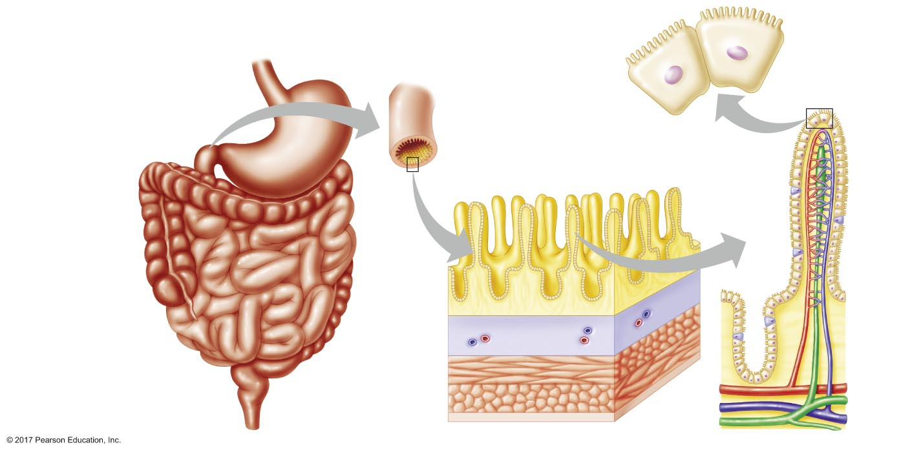
Figure 20.6 Anatomy of the small intestine.
Microvilli
Apical membrane
Stomach
Brush border
Basolateral membrane
Duodenum
Villi
Crypt of
Lieberkühn
Absorptive
cells
Capillaries
Jejunum
Small
intestine
Ileum
Mucosa
Lacteal
Submucosa
Venule
Arteriole
Muscularis
externa
Artery
Serosa
Lymph duct
Vein

Slide 26
The Gastrointestinal Tract
Secretions into duodenum
Pancreatic juice enters duodenum
Digestive enzymes
Bicarbonate: neutralizes acidic chyme
Bile enters duodenum
Secreted from liver
Can be stored in gallbladder
Contains bile salts that aid in fat digestion

Slide 27
The Gastrointestinal Tract
Absorption in small intestine
Absorption is completed within first 20% of the intestine length
Anatomically arranged to provide a large surface area for absorption

Slide 28
The Gastrointestinal Tract
Small intestine wall
Villi increase surface area of epithelium
Contain blood vessels and lacteal for absorption of nutrients
Microvilli increase surface area of epithelial cells
Form brush border
Crypts of Lieberkuhn
Epithelial cells in crypts secrete bicarbonate-rich fluid
Secreted in proximal small intestine
Absorbed in distal small intestine

Slide 29
The Gastrointestinal Tract
Role of liver in absorption
Absorbed nutrients travel in the blood to the liver before entering the general circulation
Liver functions to detoxify substances and processes certain nutrients

Slide 30
The Gastrointestinal Tract
Hepatic portal system
Vasculature that delivers absorbed nutrients to the liver before nutrients enter the general circulation
Nutrients are absorbed from the small intestine into the mesenteric veins
Nutrients travel from the mesenteric veins to the liver via the hepatic portal vein
Nutrients travel from the liver to the heart (general circulation) via the hepatic vein
Hepatic artery provides the liver with fresh blood to supply oxygen

Slide 31
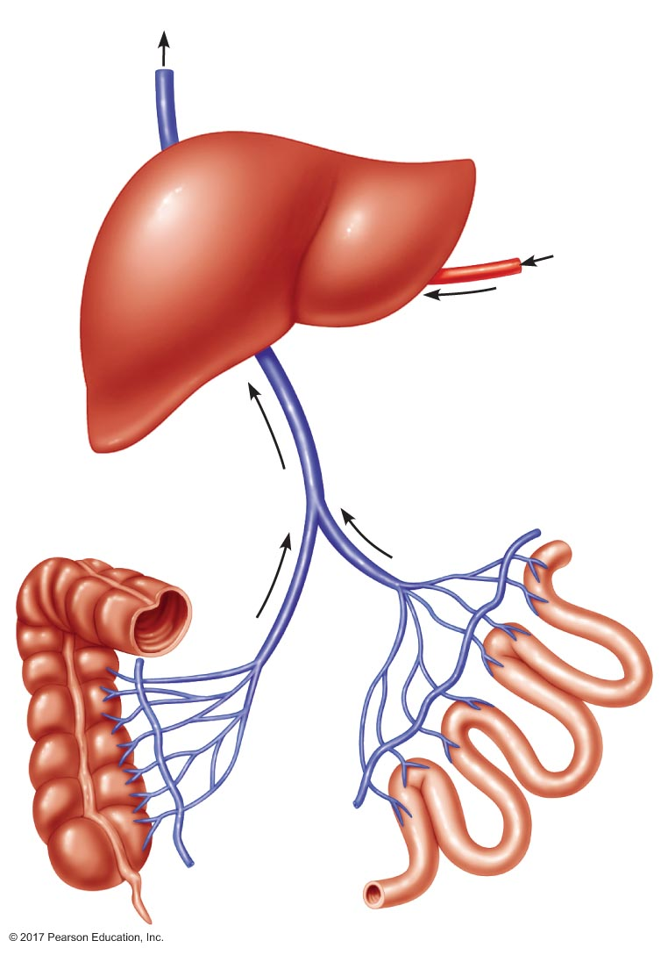
Figure 20.7 Circulatory route of materials absorbed in the small intestine and colon.
To vena cava
Hepatic vein
From aorta
Liver
Hepatic artery
Hepatic portal vein
Electrolytes
and water
Nutrients, electrolytes,
and water
Mesenteric
veins
Colon
Small
intestine

Slide 32
The Gastrointestinal Tract
Large intestine
Large intestine consists of cecum, colon, and rectum
Ileocecal sphincter is between ileum and colon
Teniae coli are bands of longitudinal smooth muscle
Colon
Hollow tube from small intestine to rectum
Functions
Concentration of wastes into feces
Absorption of most water
Storage of feces until defecation

Slide 33
The Gastrointestinal Tract
Four sections of the colon
Ascending colon
Transverse colon
Descending colon
Sigmoid colon

Slide 34
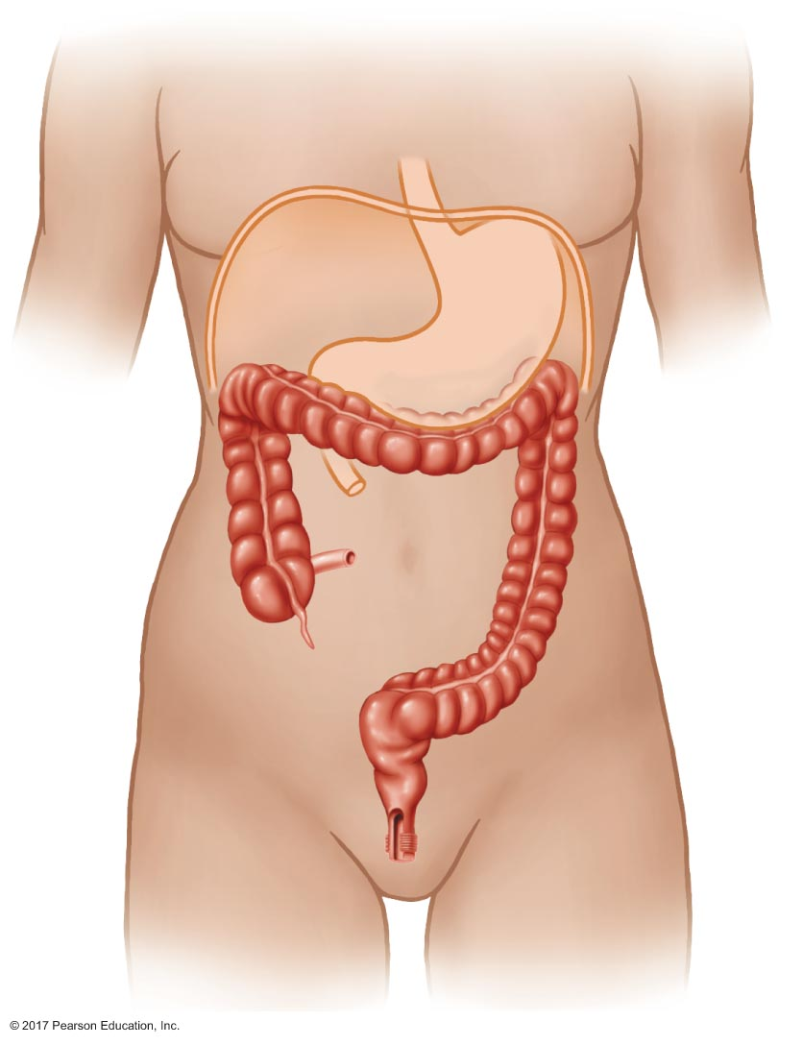
Figure 20.8 Major anatomical features of the colon.
Diaphragm
Transverse
colon
Stomach
Ileocecal
sphincter
Teniae coli
Ascending
colon
Terminal
portion of
small
intestine
Descending
colon
Cecum
Vermiform
appendix
Sigmoid
colon
Rectum
Internal
anal sphincter
External
anal sphincter
Anus

Slide 35
The Gastrointestinal Tract
Rectum and anus
Colon empties into the rectum, then feces is excreted through the anus
Colon, rectum, and cecum make up the large intestine
Internal anal sphincter: smooth muscle
External anal sphincter: skeletal muscle
Relaxation of both sphincters necessary to open sphincter and excrete feces: defecation

Slide 36
The Accessory Glands
Products are secreted via ducts into the lumen of the GI tract
Four types of glands
Salivary glands: secrete saliva
Pancreas: secretes pancreatic juice
Acini
Liver: secretes bile

Slide 37
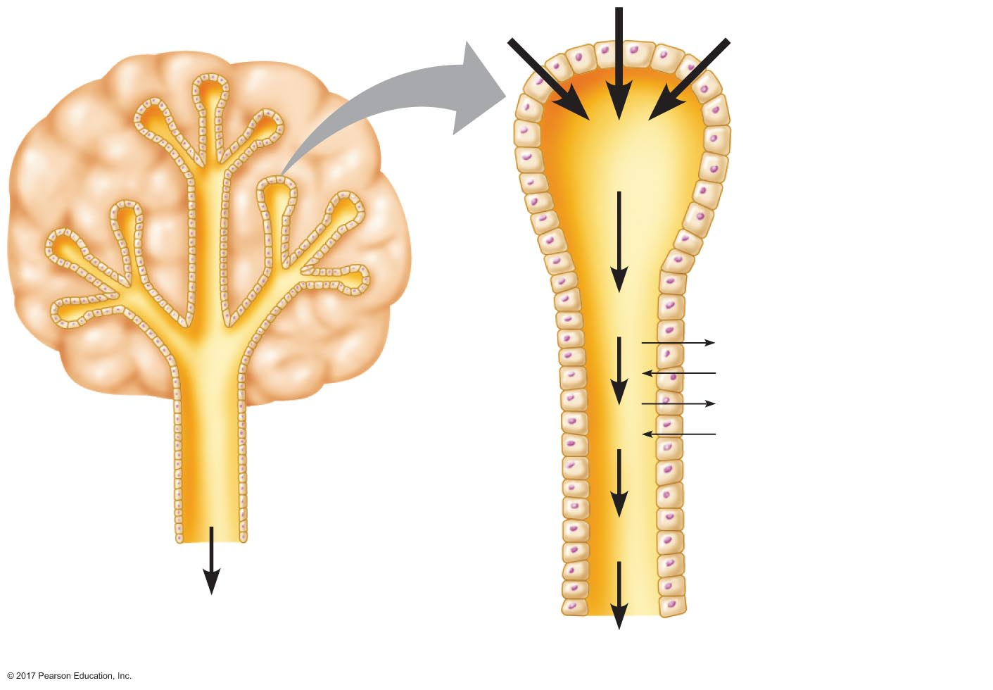
Figure 20.9 Generalized structure of an accessory gland.
Primary
secretion
Acini
Modiﬁcation by
transport of
ions and water
Body of gland
Main duct
Epithelial
cells
To lumen of
digestive tract

Slide 38
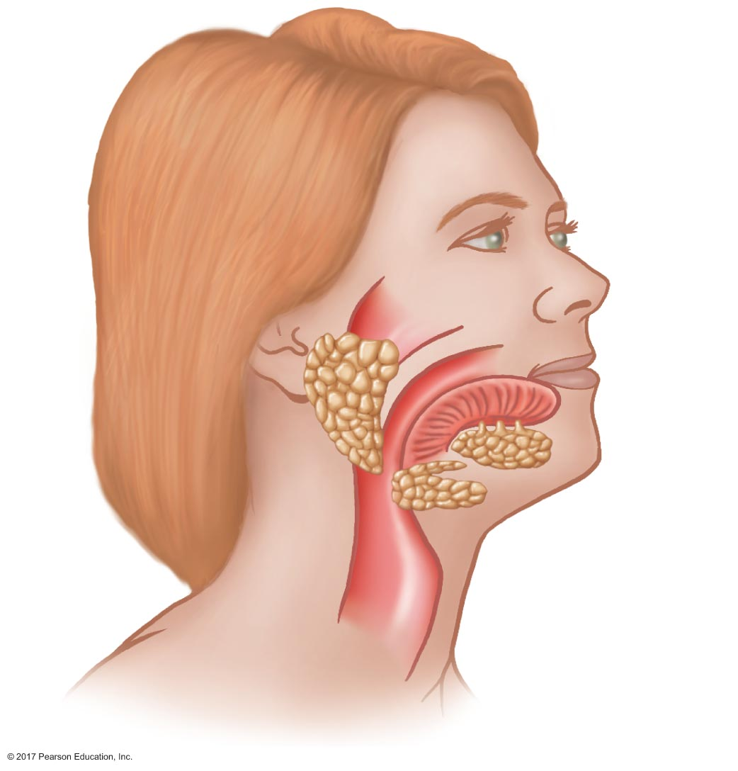
Figure 20.10 Location of the major salivary glands.
Parotid
gland
Tongue
Sublingual
gland
Submandibular
gland

Slide 39
The Accessory Glands
Characteristics of saliva
Rich in bicarbonate ions
Contains mucus
Enzymes present
Salivary amylase
Lysozyme

Slide 40
The Accessory Glands
The pancreas
Has exocrine and endocrine portions
Exocrine portion produces pancreatic juice
Rich in bicarbonate
Relative to weight, secretes more protein than any other tissue in body
Enzymes present
Pancreatic amylase and lipases
Proteases
Nucleases

Slide 41
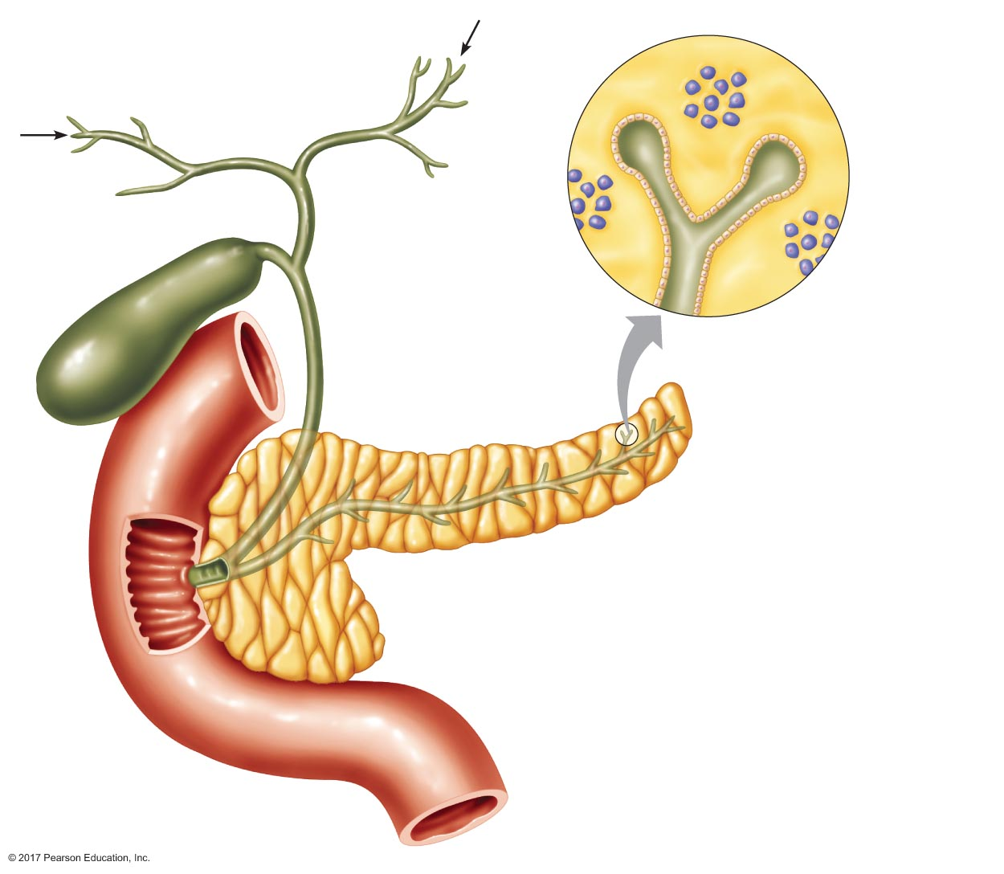
Figure 20.11 The pancreas and associated structures.
From liver
Acinar cells
(secrete
enzymes)
Hepatic
ducts
From
liver
Common
hepatic duct
Endocrine
pancreas
Islet cells
(secrete
hormones)
Exocrine
pancreas
Gallbladder
Common
bile duct
Duct cells
(secrete
bicarbonate-
rich ﬂuid)
Pancreas
Duodenum
Pancreatic duct
Ampulla of
Vater
Sphincter
of Oddi

Slide 42
The Accessory Glands
The liver
Secretes bile
Processes nutrients
Glucose → glycogen
Amino acids → fatty acids
Triglycerides and cholesterol synthesis
Lipoprotein synthesis

Slide 43
The Accessory Glands
Liver functions
Removal of old red blood cells
Catabolizes hemoglobin
Generates bilirubin
Elimination of wastes and toxins
Bilirubin is eliminated as bile pigments
Synthesis of plasma proteins
Secretion and modification of hormones

Slide 44
The Accessory Glands
Biliary system: liver, gallbladder, and associated ducts
Liver synthesizes bile
Gallbladder stores bile
Common bile duct
Transports bile from liver and/or gallbladder to duodenum
Joins with pancreatic duct to form ampulla of Vater
Sphincter of Oddi: regulates flow from pancreas and gallbladder to duodenum

Slide 45
The Accessory Glands
Liver anatomy
Materials to make bile are taken up from blood in the sinusoids into hepatocytes
Hepatocytes secrete bile into bile canaliculi, on the side opposite of the sinusoids
Canaliculi drain into bile ducts
Bile ducts drain into common hepatic duct

Slide 46
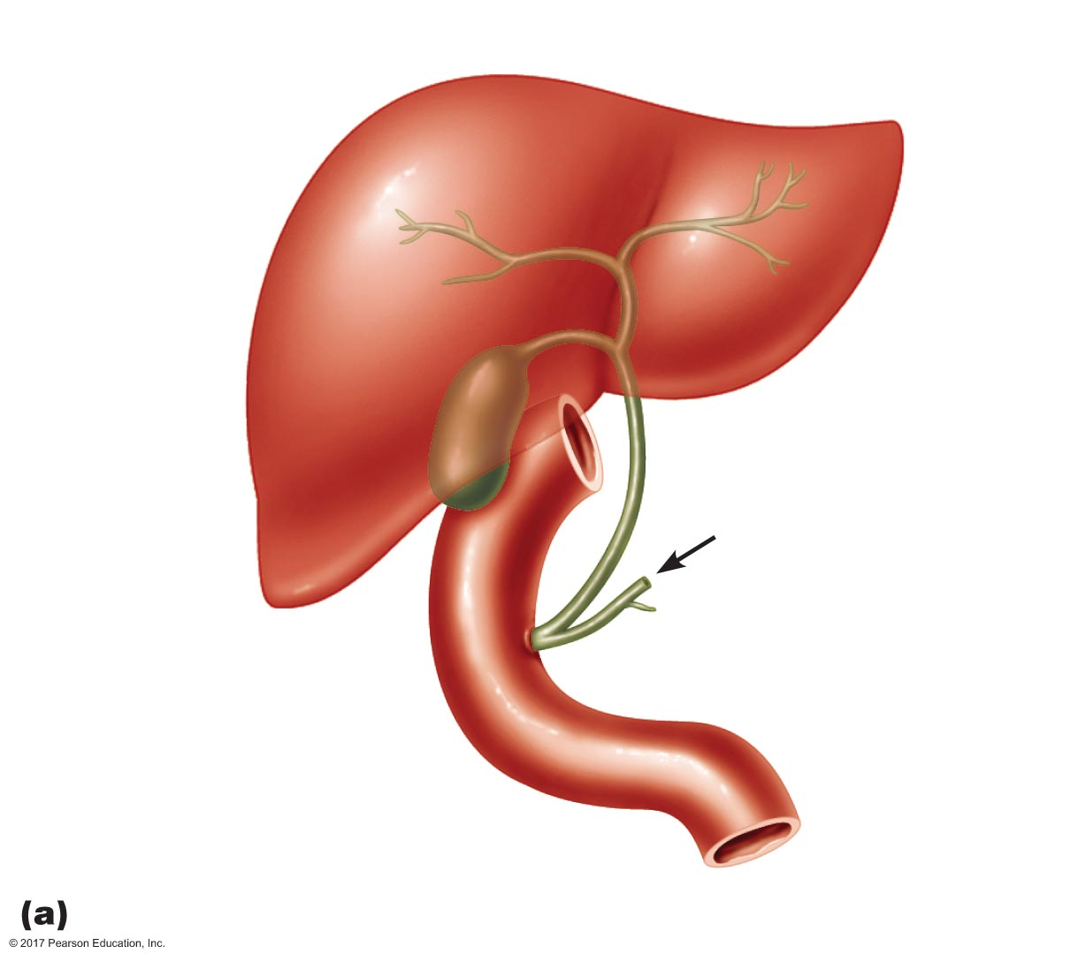
Figure 20.12a Structures of the biliary system.
Hepatic ducts
Liver
Cystic duct
Common
hepatic duct
Gallbladder
Common bile duct
From pancreas
Sphincter
of Oddi
Pancreatic duct
Ampulla of Vater
Duodenum

Slide 47
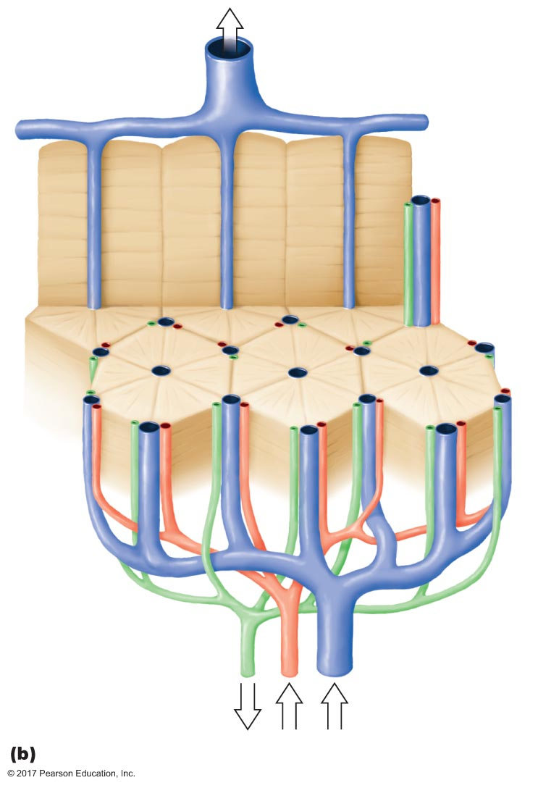
Figure 20.12b Structures of the biliary system.
Hepatic vein
Central
vein
Lobule
Hepatic artery
Hepatic
portal vein
Bile duct

Slide 48
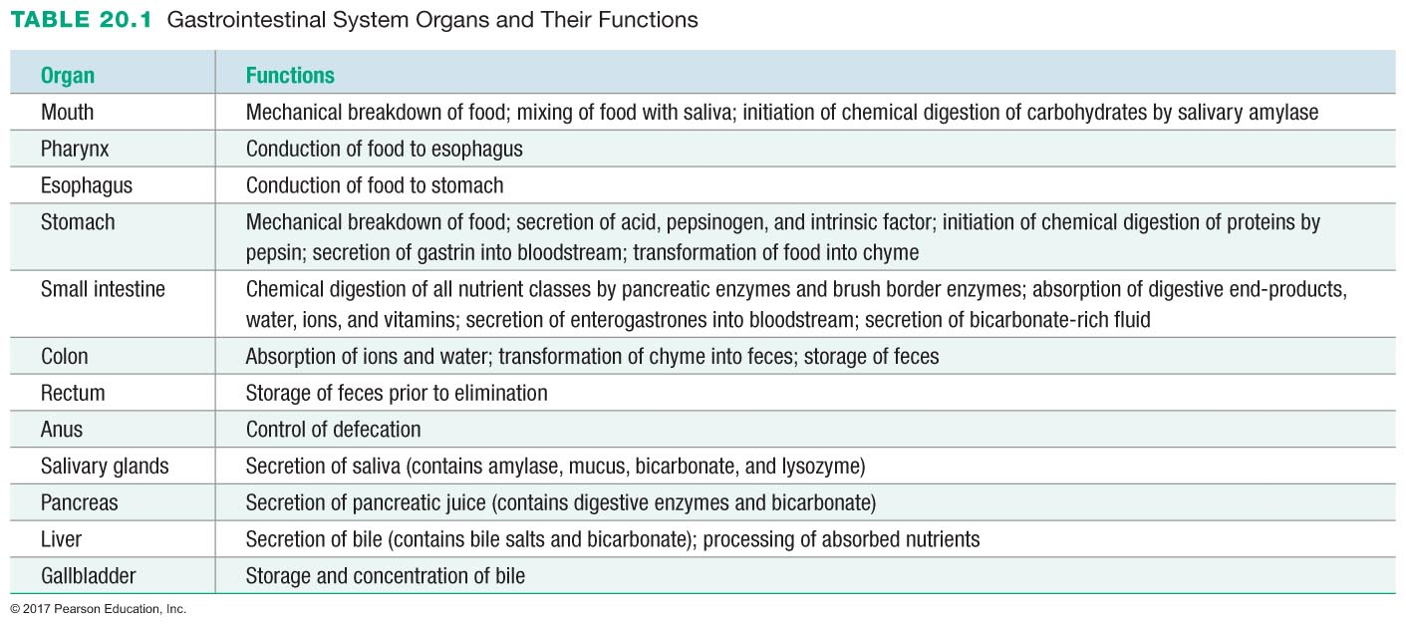

Slide 49
20.3 Digestion and Absorption of Nutrients and Water
Carbohydrates
Proteins
Lipids
Absorption of vitamins
Absorption of minerals
Absorption of water

Slide 50
Carbohydrates
Typical diet: 500 grams/day carbohydrates
Most consumed as disaccharides or polysaccharides
Sucrose
Lactose
Maltose
Starch
Glycogen
Cellulose (fiber; cannot be digested)

Slide 51
Carbohydrates
Carbohydrate digestion
Only monosaccharides are absorbed
Disaccharides and polysaccharides must be digested to monosaccharides
Digestion of starch
Enzyme of digestion
Salivary amylase
Pancreatic amylase
End-product
Disaccharides (maltose)
Limit dextrins

Slide 52
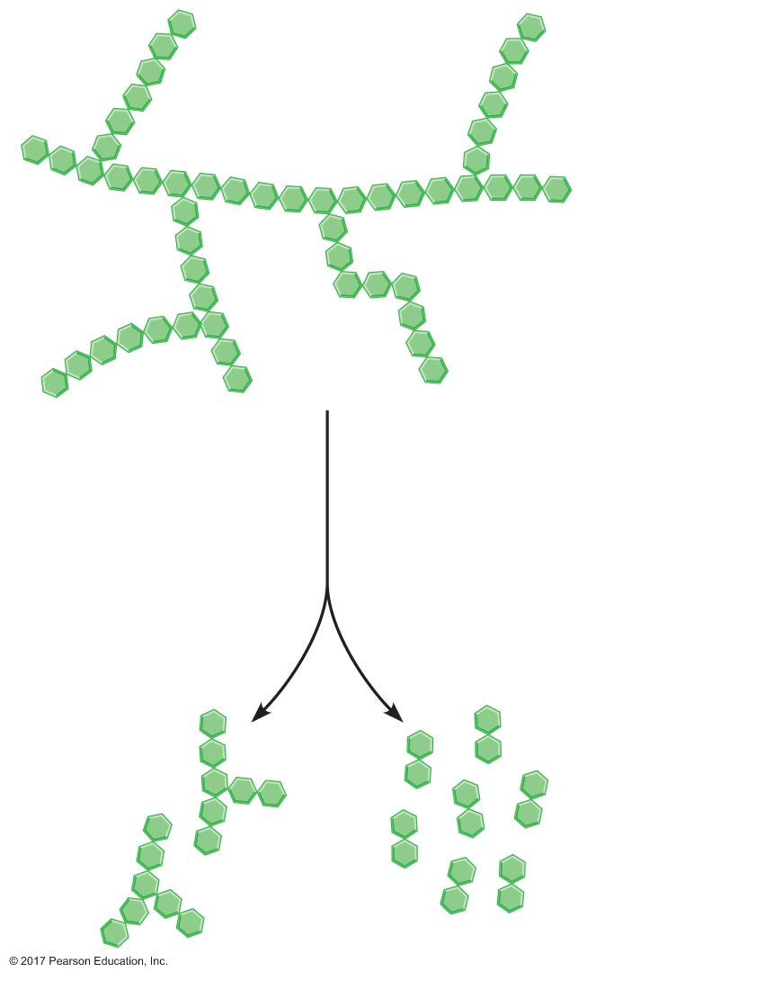
Figure 20.13 Digestion of starch by salivary or pancreatic amylase.
Glucose monomers
Starch
Salivary or
pancreatic
amylase
Limit
dextrins
Maltose
(disaccharide)

Slide 53
Carbohydrates
Enzymes of digestion
Dextrinase: limit dextrins → glucose
Glucoamylase: polysaccharides → glucose
Sucrase: sucrose → fructose + glucose
Lactase: lactose → galactose + glucose
Maltase: maltose → 2 glucose
Location of enzymes: brush border of small intestine
Brush border enzymes

Slide 54
Absorption of Carbohydrates
Absorption: transport of nutrients from lumen to blood
Glucose and galactose are absorbed in two ways:
Secondary active transport across apical membrane
Facilitated diffusion across basolateral membrane
Fructose is absorbed in one way:
Facilitated diffusion across both membranes

Slide 55
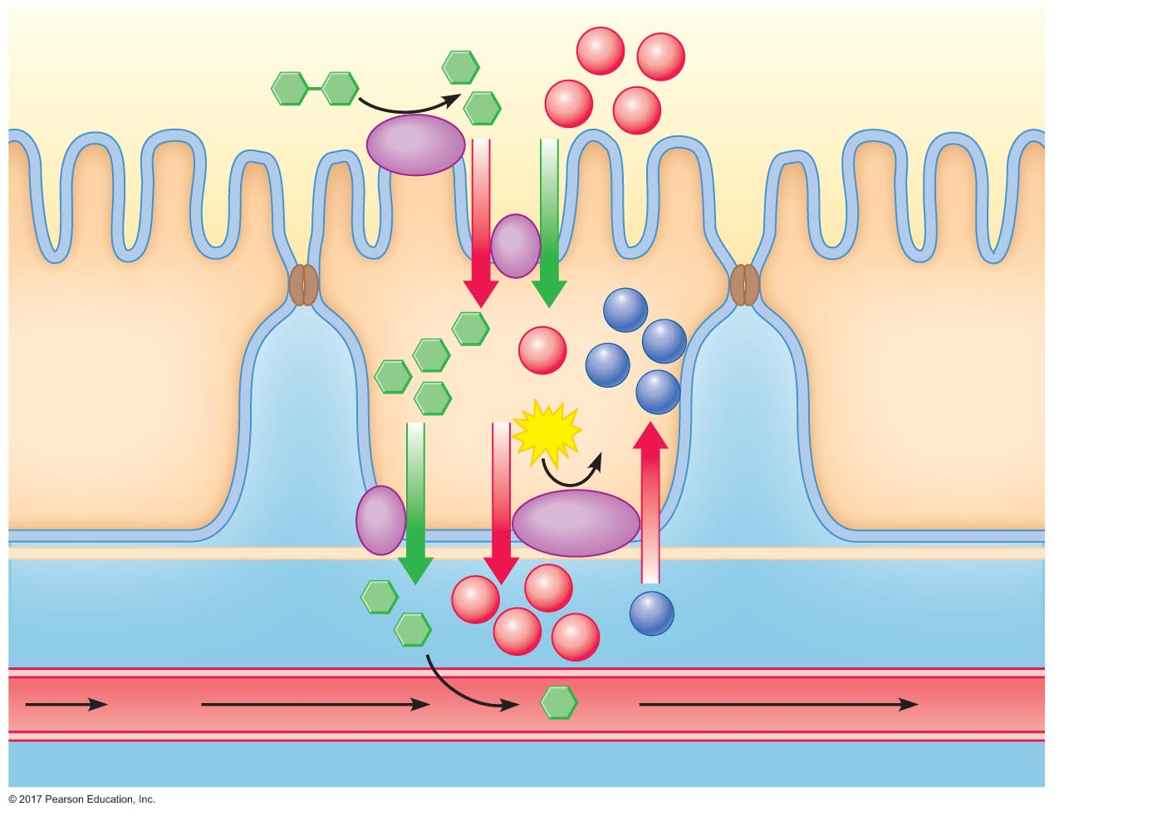
Figure 20.14 Digestion and absorption of maltose.
Lumen
Maltose
Glucose
Na⁺
Na⁺
Na⁺
Na⁺
Maltase
Brush
border
Apical
membrane
K⁺
Na⁺
K⁺
Absorptive cell
K⁺
K⁺
ATP
ADP
+ P_{i}
Basolateral
membrane
Na⁺
Na⁺
Interstitial ﬂuid
Na⁺
K⁺
Na⁺
Blood
To liver
Capillary

Slide 56
Proteins
Typical diet: 125 grams/day protein
Digestion and absorption of proteins
Consumed in diet
Secreted into lumen of intestinal tract
Sloughed off with cells lining intestinal tract
Protein digestion products
Amino acids
Dipeptides
Tripeptides

Slide 57
Proteins
Proteases
Endopeptidases
Split polypeptides at interior peptide bonds into small peptide fragments
Exopeptidases
Cleave amino acids from one end of polypeptide
Zymogens
Inactive storage form of proteases
Stored in zymogen granules
Secreted by exocytosis
Activated by proteolysis

Slide 58
Proteins
Protein digestion begins in stomach
Enzyme: pepsin
Inactive (secreted) form: pepsinogen
Activated by acid
Pepsin: activation and activity
Chief cells secrete pepsinogen
Pepsinogen: inactive form
HCl cleaves pepsinogen to pepsin
Pepsin: active form
Parietal cells secrete HCl

Slide 59
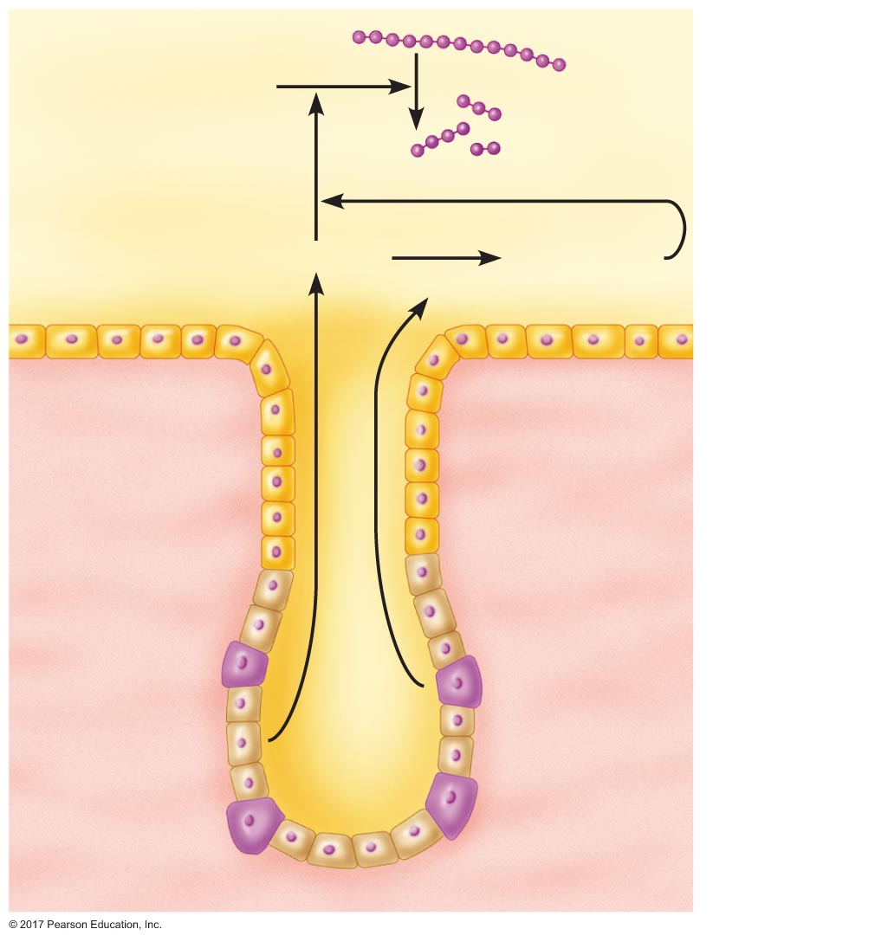
Figure 20.15 Activation and activity of pepsin in the stomach.
Lumen
Protein
Pepsin
Smaller
peptide
fragments
Pepsinogen
Pepsinogen*
HCl
Gastric
mucosa
Parietal
cells
Chief cells

Slide 60
Proteins
Protein digestion in small intestine
Pancreatic proteases
Trypsin
Chymotrypsin
Carboxypeptidase
Brush border proteases
Aminopeptidase
Enterokinase

Slide 61
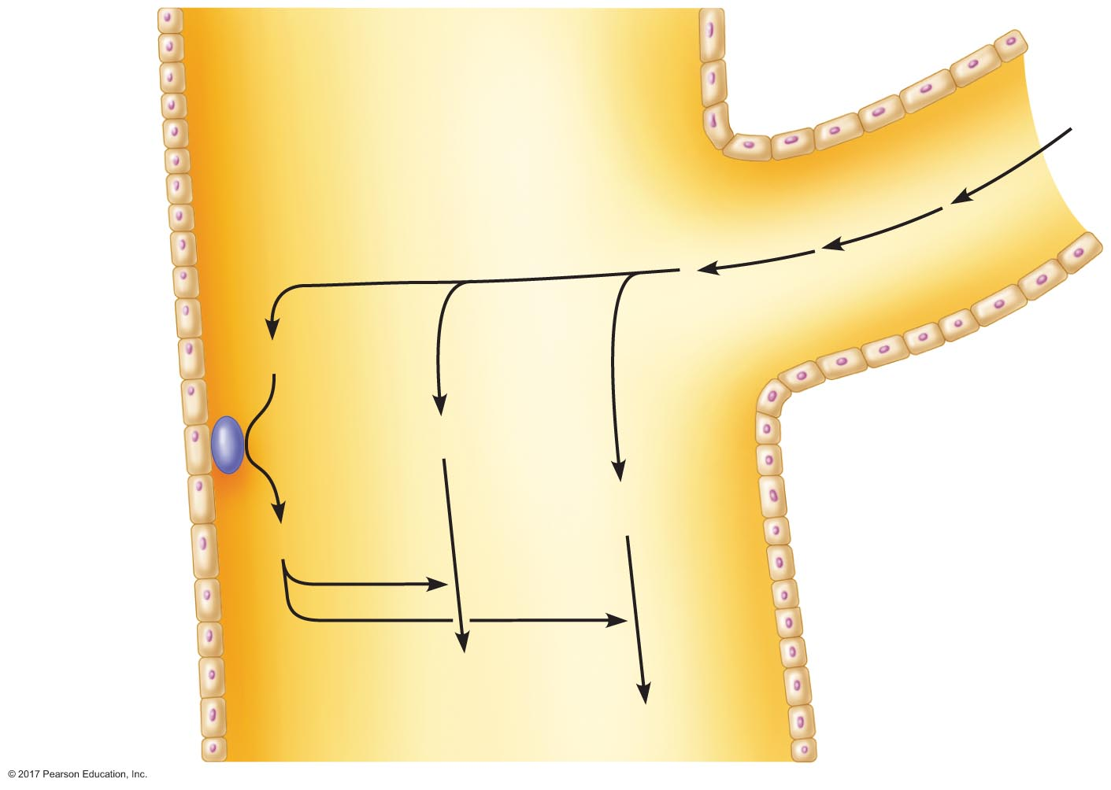
Figure 20.16 Activation of proteases in the small intestine.
Slide 1
Pancreatic
duct
Lumen of small intestine
Trypsinogen
Enterokinase
Chymotrypsinogen
Procarboxy-
peptidase
Enterocytes
Trypsin
Chymotrypsin
Carboxypeptidase

Slide 62
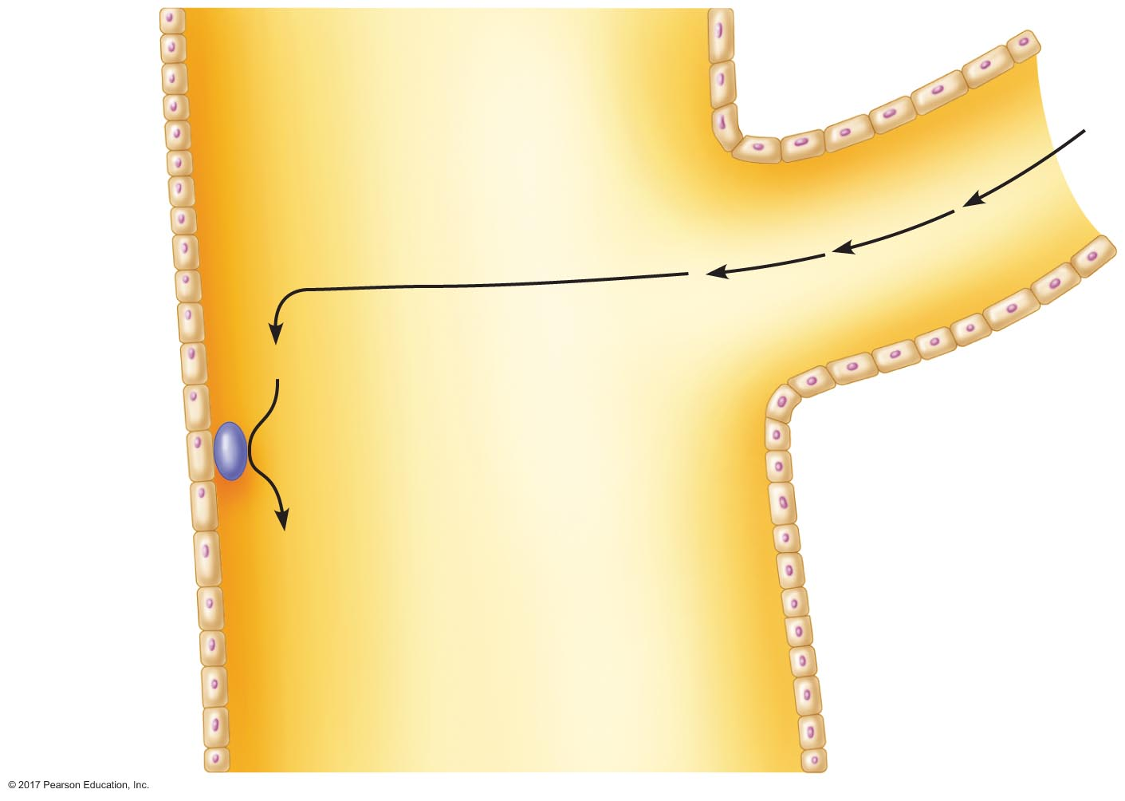
Figure 20.16 Activation of proteases in the small intestine.
Slide 2
Pancreatic
duct
Lumen of small intestine
Trypsinogen
Enterokinase
Enterocytes
Trypsin

Slide 63
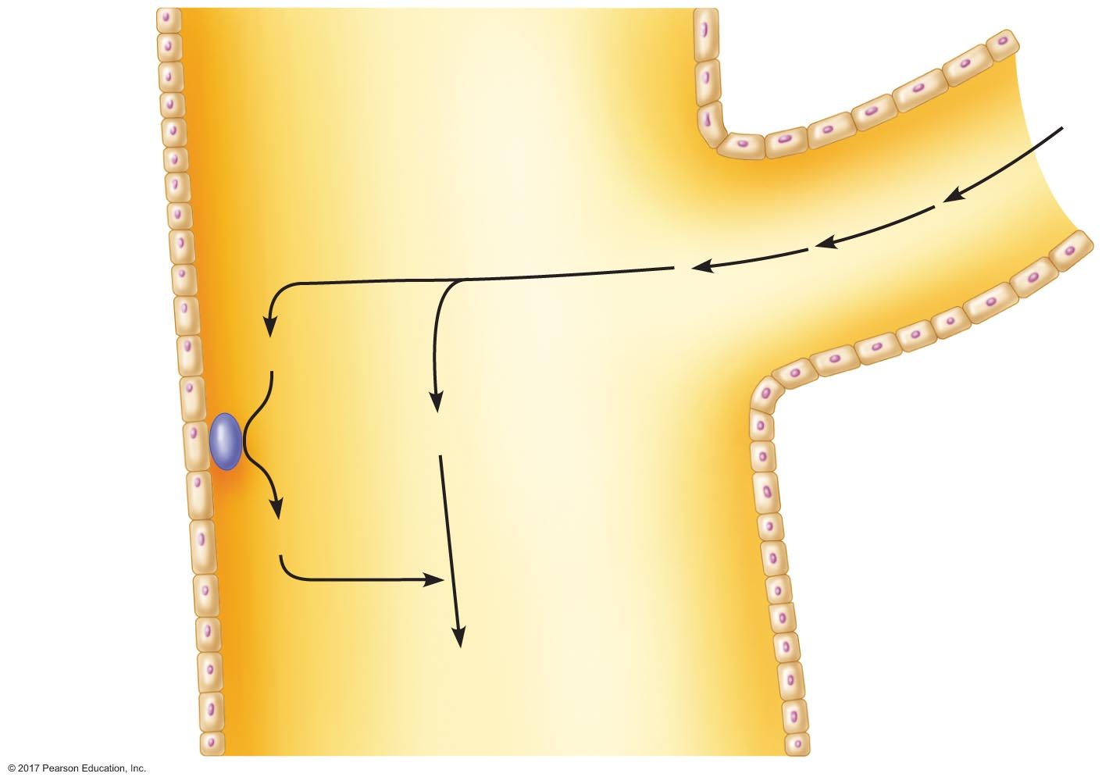
Figure 20.16 Activation of proteases in the small intestine.
Slide 3
Pancreatic
duct
Lumen of small intestine
Trypsinogen
Enterokinase
Chymotrypsinogen
Enterocytes
Trypsin
Chymotrypsin

Slide 64
Figure 20.16 Activation of proteases in the small intestine.
Slide 4
Pancreatic
duct
Lumen of small intestine
Trypsinogen
Enterokinase
Chymotrypsinogen
Procarboxy-
peptidase
Enterocytes
Trypsin
Chymotrypsin
Carboxypeptidase

Slide 65
Proteins
Absorption of amino acids
Cross the apical membrane by sodium-linked secondary active transport or facilitated diffusion
Cross the basolateral membrane by facilitated diffusion
Absorption of dipeptides and tripeptides
Cross the apical membrane by active transport
Broken down inside cells to amino acids
Amino acids cross the basolateral membrane by facilitated diffusion

Slide 66
Lipids
Typical diet: 50 grams/day lipids
90% triglycerides
Lipids face special problem in digestion and absorption
Not water soluble
Do not mix with stomach or intestinal contents
Form fat droplets

Slide 67
Lipids
Lipid digestion
Enzymes of digestion: lipases
Secreted from pancreas
Lipases can only act on molecules near the edge of a fat droplet
Bile salts increase the surface area of droplets by breaking each large droplet into several small droplets: emulsification

Slide 68
Lipids
Bile salts
Synthesized in liver from cholesterol
Secreted in bile to duodenum
Amphipathic molecule
Emulsify fat

Slide 69
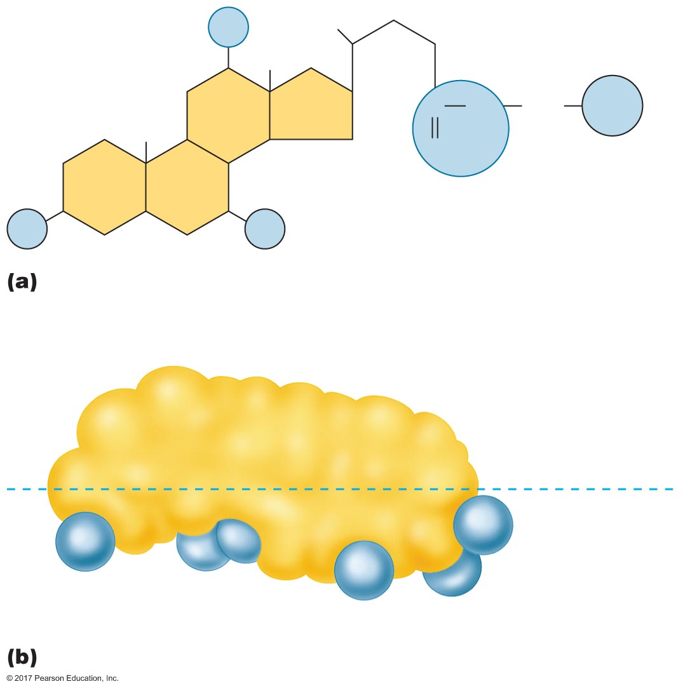
Figure 20.17 A representative bile salt.
OH
C
O
NH
CH₂
COO–
Na⁺
HO
OH
Hydrophobic
(nonpolar)
Hydrophobic side
Hydrophilic side
Hydrophilic
groups (polar)

Slide 70
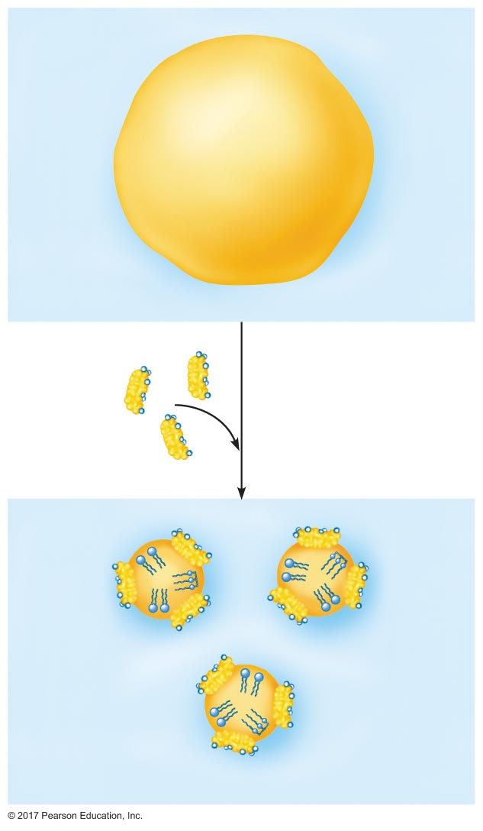
Figure 20.18 Emulsification of a fat globule by bile salts.
Fat globule (nonpolar)
Water (polar)
Bile salts
(amphipathic)
Fat droplet
(nonpolar)
Phospholipids
Triglyceride
Water (polar)

Slide 71
Lipids
Digestion by pancreatic lipases
Triglycerides → monoglyceride + 3 fatty acids
Some fatty acids and monoglycerides are absorbed
Others form micelles
Equilibrium between micelles and the fatty acids and monoglycerides formed by action of lipases

Slide 72
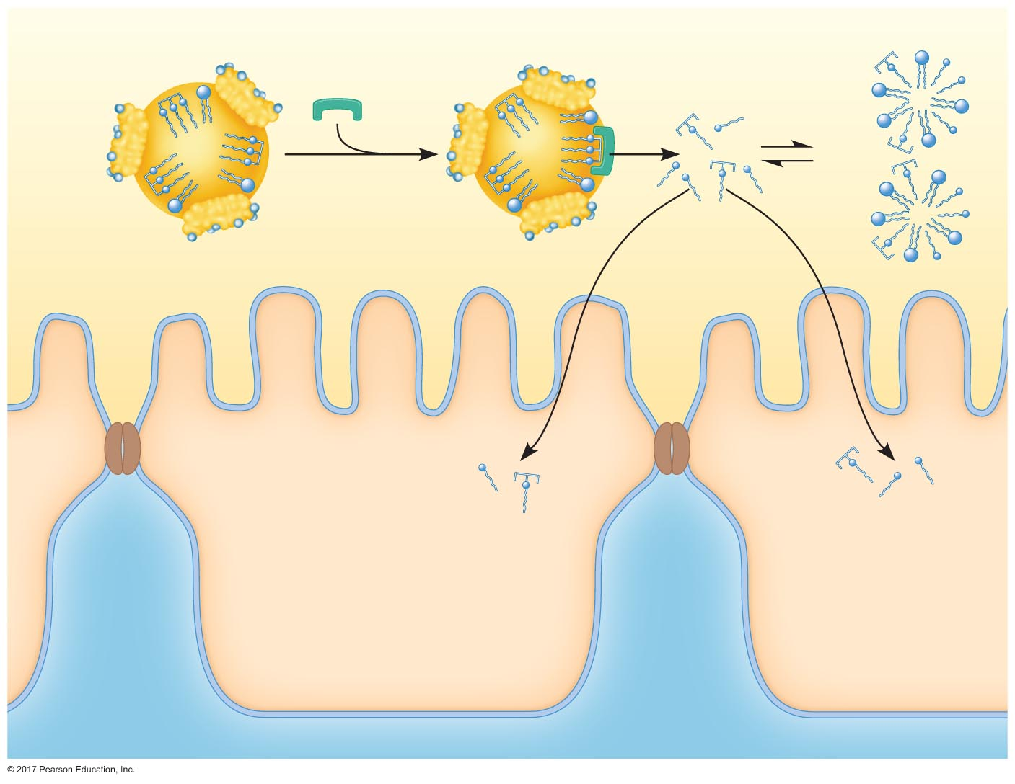
Figure 20.19 Liberation of fatty acids and monoglycerides from fat droplets by lipases.
Micelles
Fat droplet
Lipase
(from pancreas)
Monoglyceride
Fatty acid
Triglyceride
Phospholipid
Lumen
Absorptive cell
Interstitial ﬂuid

Slide 73
Lipids
Absorption of monoglycerides and fatty acids
Equilibrium between free fatty acids and monoglycerides and those inside micelles
Free form can be absorbed by simple diffusion across epithelium
Inside epithelial cell
Enter smooth ER and re-form triglycerides and other lipids
Lipids enter Golgi apparatus to be packaged into chylomicrons
Chylomicrons are secreted by exocytosis into interstitial fluid
Chylomicrons enter lymphatic system via lacteal

Slide 74
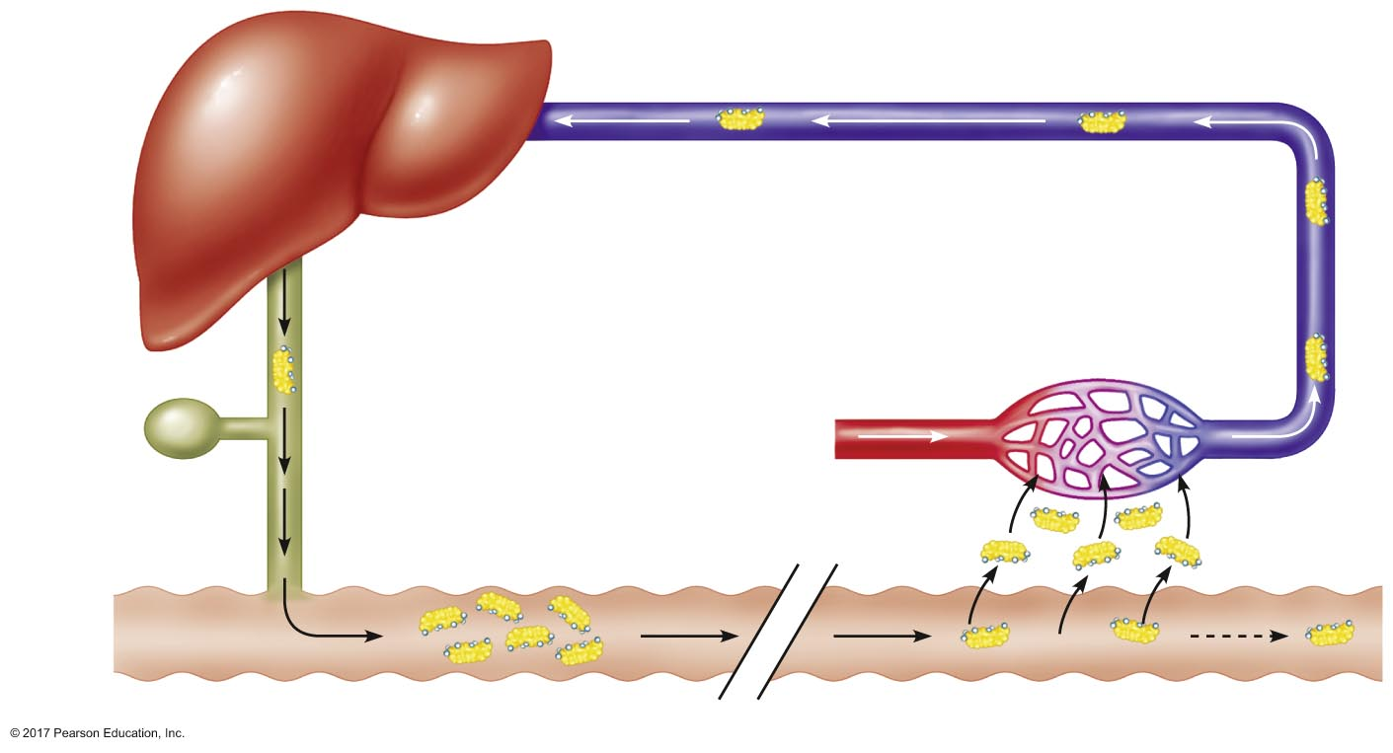
Figure 20.20 The enterohepatic circulation.
Hepatic portal vein
Liver
Capillaries
Gallbladder
Common
bile duct
Bile salts
Duodenum
Ileum

Slide 75
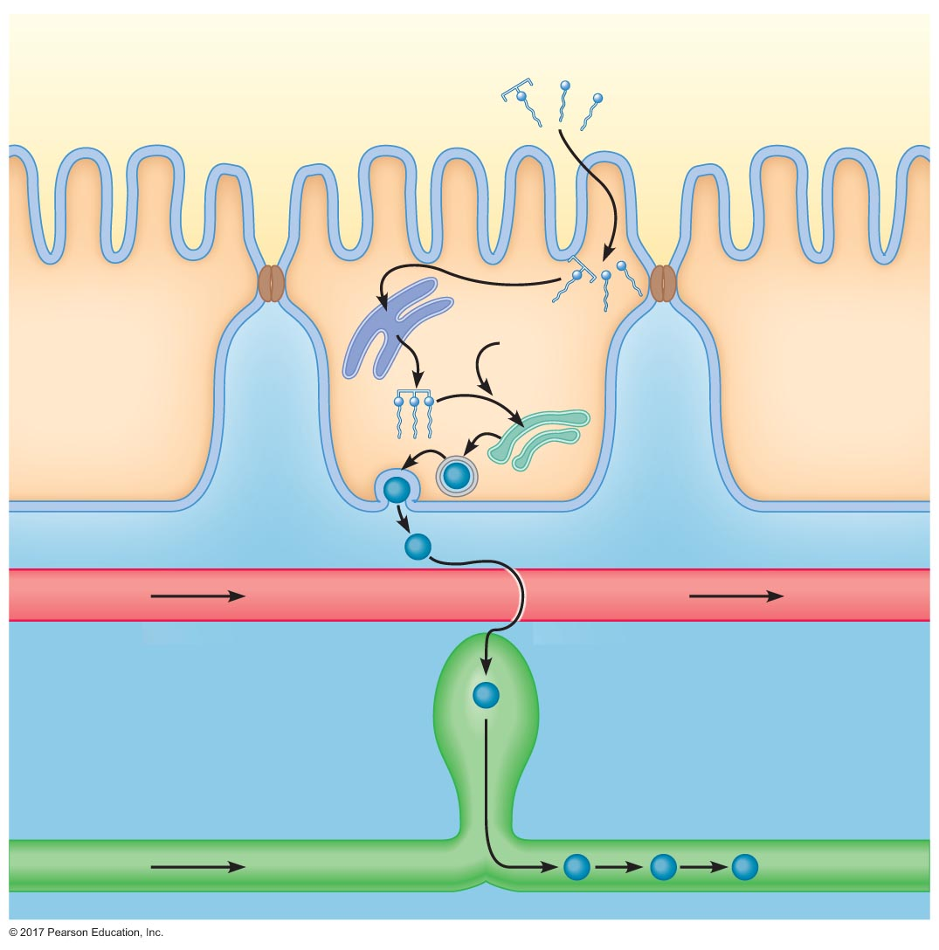
Figure 20.21 Events in the absorption of fats.
Slide 1
Lumen
Monoglyceride
Fatty acid
Smooth
endoplasmic
reticulum
Other lipids
and proteins
Golgi
apparatus
Triglyceride
Enterocyte
Chylomicron
Blood
Interstitial ﬂuid
Lacteal
To general circulation
Lymph

Slide 76
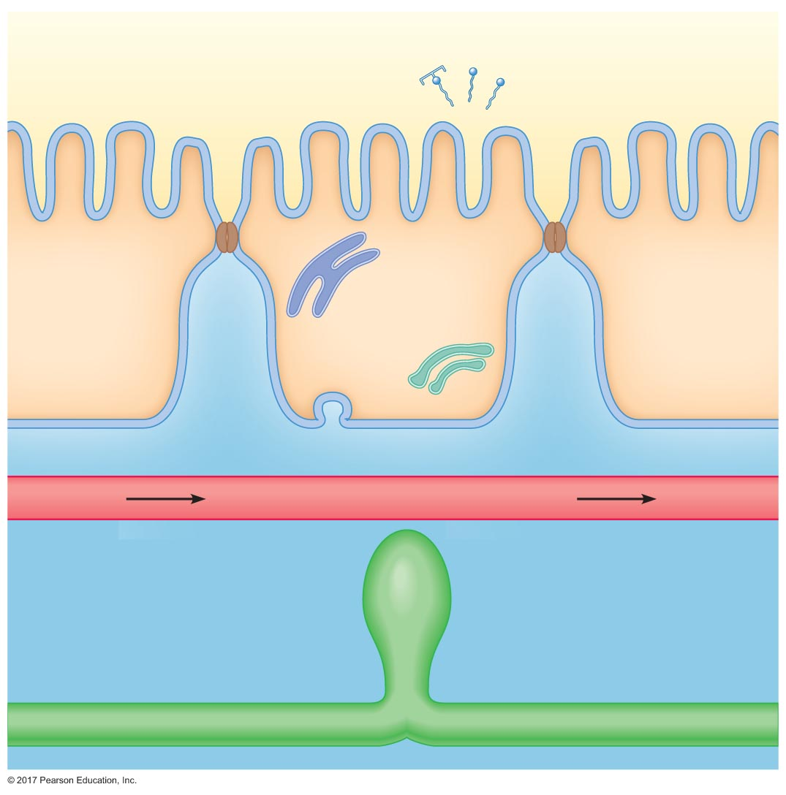
Figure 20.21 Events in the absorption of fats.
Slide 2
Lumen
Monoglyceride
Fatty acid
Smooth
endoplasmic
reticulum
Golgi
apparatus
Enterocyte
Blood
Interstitial ﬂuid

Slide 77
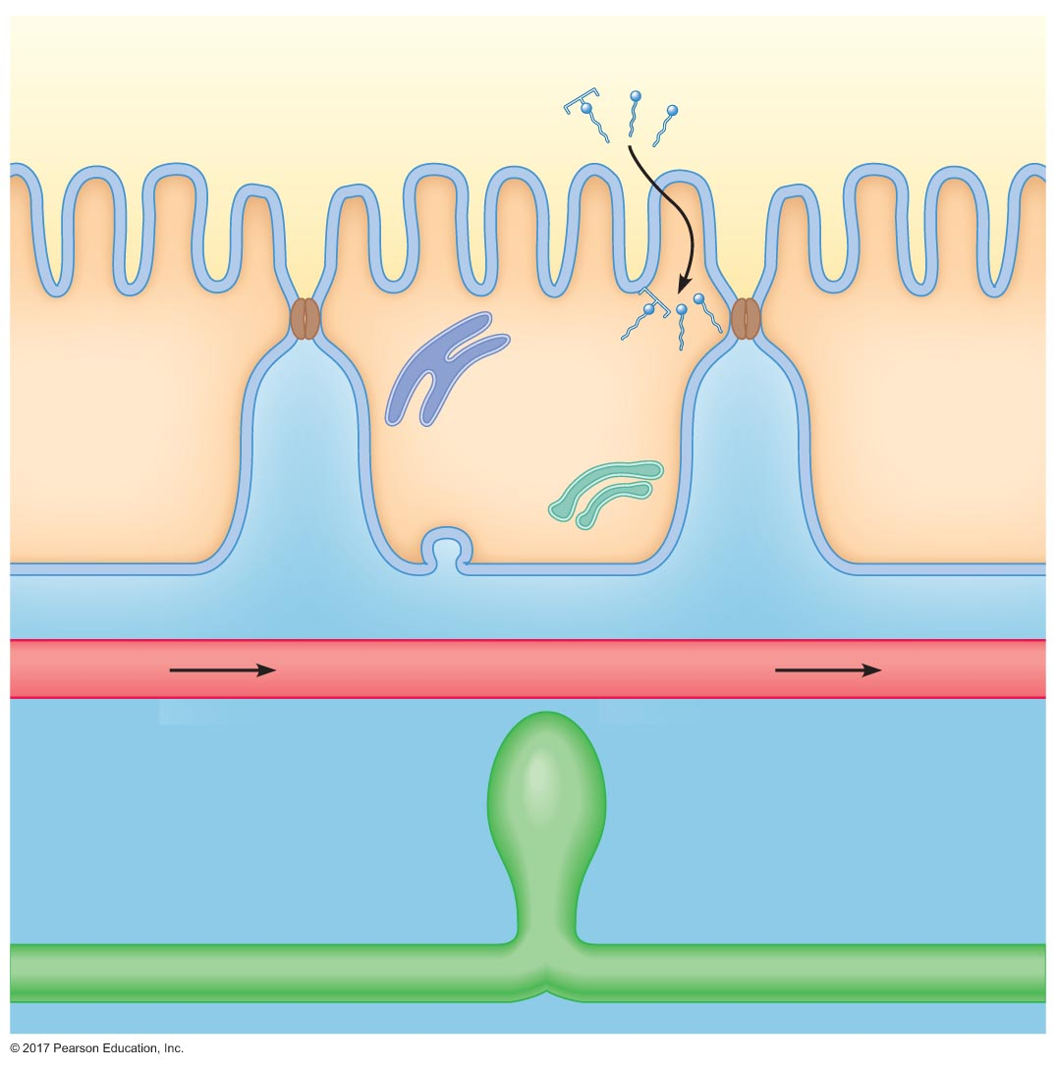
Figure 20.21 Events in the absorption of fats.
Slide 3
Lumen
Monoglyceride
Fatty acid
Smooth
endoplasmic
reticulum
Golgi
apparatus
Enterocyte
Blood
Interstitial ﬂuid

Slide 78
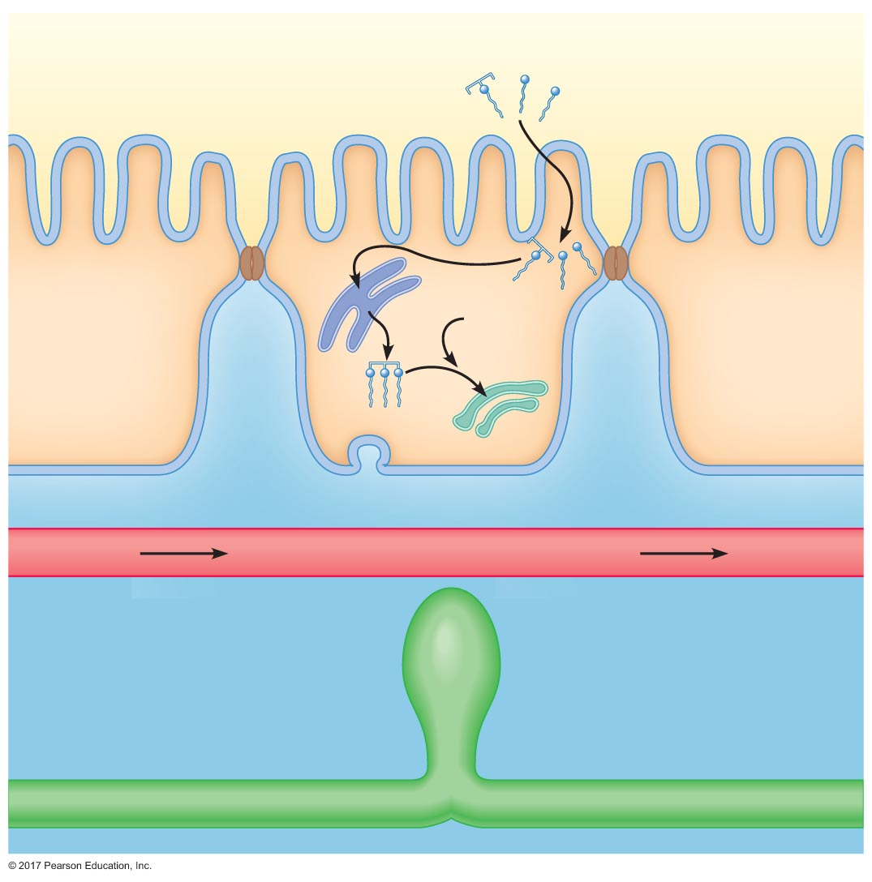
Figure 20.21 Events in the absorption of fats.
Slide 4
Lumen
Monoglyceride
Fatty acid
Smooth
endoplasmic
reticulum
Other lipids
and proteins
Golgi
apparatus
Triglyceride
Enterocyte
Blood
Interstitial ﬂuid

Slide 79
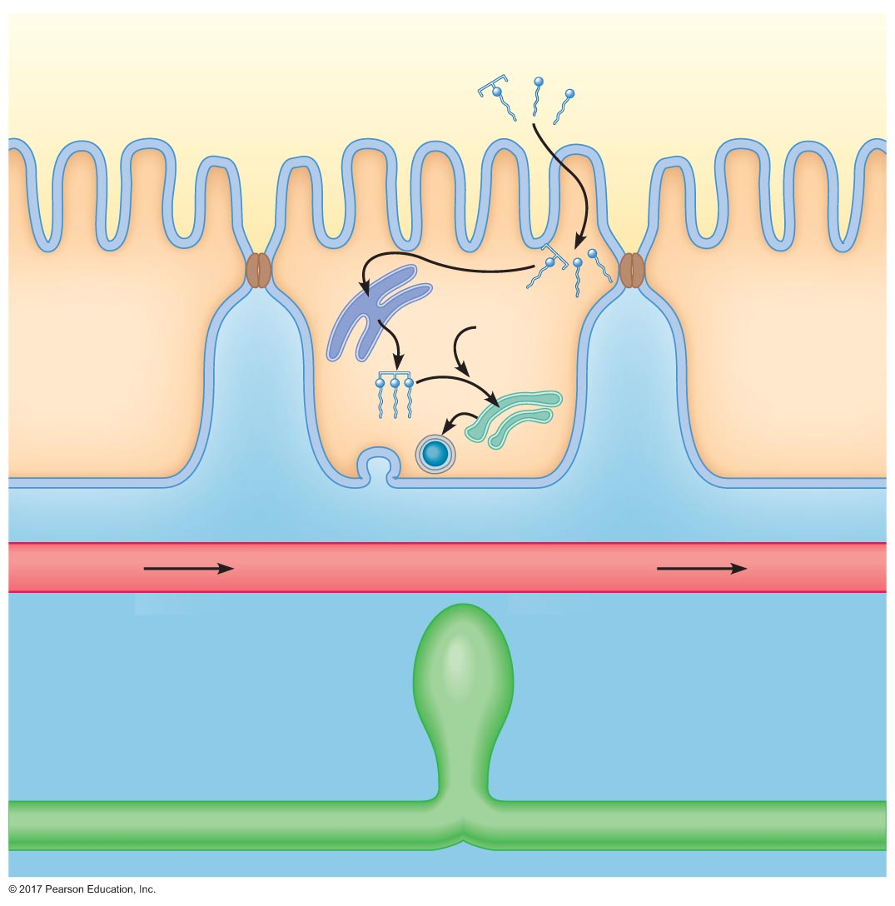
Figure 20.21 Events in the absorption of fats.
Slide 5
Lumen
Monoglyceride
Fatty acid
Smooth
endoplasmic
reticulum
Other lipids
and proteins
Golgi
apparatus
Triglyceride
Enterocyte
Chylomicron
Blood
Interstitial ﬂuid

Slide 80
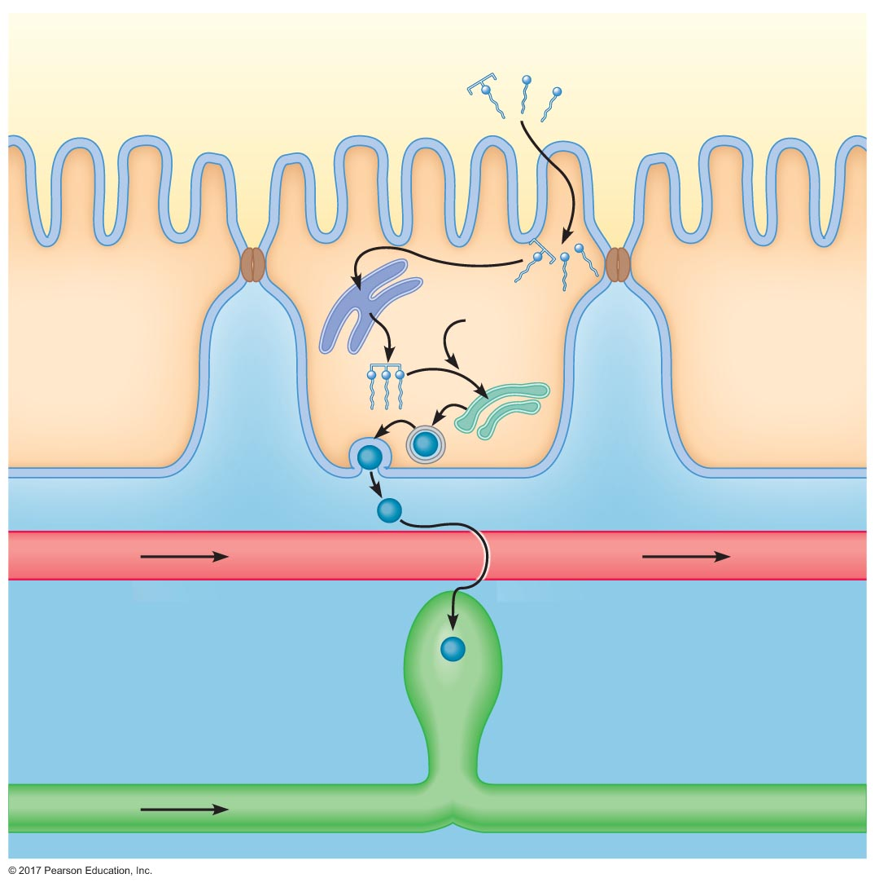
Figure 20.21 Events in the absorption of fats.
Slide 6
Lumen
Monoglyceride
Fatty acid
Smooth
endoplasmic
reticulum
Other lipids
and proteins
Golgi
apparatus
Triglyceride
Enterocyte
Chylomicron
Blood
Interstitial ﬂuid
Lacteal
Lymph

Slide 81
Figure 20.21 Events in the absorption of fats.
Slide 7
Lumen
Monoglyceride
Fatty acid
Smooth
endoplasmic
reticulum
Other lipids
and proteins
Golgi
apparatus
Triglyceride
Enterocyte
Chylomicron
Blood
Interstitial ﬂuid
Lacteal
To general circulation
Lymph

Slide 82
Absorption of Vitamins
Fat-soluble vitamins (A, D, E, and K)
Absorbed with lipids
Dissolve in lipid droplets, micelles, and chylomicrons
Water-soluble vitamins
Require special transport proteins
Vitamin B₁₂
Absorbed only if bound to intrinsic factor

Slide 83
Absorption of Minerals
Sodium
Solvent drag with water reabsorption
Actively absorbed in jejunum, ileum, and colon
Chloride
Passively follows sodium absorption
Potassium
Passively absorbed
Secreted when lumenal concentrations are very low

Slide 84
Absorption of Minerals
Absorption and secretion of bicarbonate
Jejunum
Bicarbonate ions are passively absorbed
Ileum and colon
Bicarbonate are secreted in exchange for chloride ions

Slide 85
Absorption of Minerals
Calcium
Actively absorbed in duodenum and jejunum
Binds to brush border protein: calcium-binding protein
Transported into epithelial cells
Transported out of cells across the basolateral membrane by the Ca²⁺ pump
1,25-(OH)₂D₃ increases calcium absorption by increasing the concentration of calcium-binding protein

Slide 86
Absorption of Minerals
Iron
Transferrin is secreted by enterocytes into the lumen of the small intestine
Transferrin binds iron
Transferrin–iron complex binds receptor
Taken into cells by receptor-mediated endocytosis
Some iron is stored in enterocytes as ferritin
Some iron is transported into blood: bound to transferrin

Slide 87
Absorption of Water
Water in GI tract
Secretions: 7 liters/day
Intake: 2 liters/day
Water absorption is passive
Water follows absorption of solutes by osmosis

