Slide 1
The Gastrointestinal System
20b

Slide 2
Chapter Outline
20.1 Overview of Gastrointestinal System Processes
20.2 Functional Anatomy of the Gastrointestinal System
20.3 Digestion and Absorption of Nutrients and Water
20.4 General Principles of Gastrointestinal Regulation
20.5 Gastrointestinal Secretion and Its Regulation
20.6 Gastrointestinal Motility and Its Regulation

Slide 3
20.4 General Principles of GI Regulation
Regulation of GI function is not based on the concept of homeostasis
GI function is regulated to maximize absorption, regardless of whether nutrients are needed
Conditions in the lumen of GI tract are regulated to maximize absorption

Slide 4
Neural and Endocrine Pathways of GI Control
Enteric nervous system
Submucosal plexus
Myenteric plexus
Reflexes mediated through ENS control many GI functions
CNS contributions to neural control
Generally through communication of ANS with enteric nervous system

Slide 5
Neural and Endocrine Pathways of GI Control
GI hormones are secreted from endocrine cells in the stomach and small intestine
Cholecystokinin
Secretin
Glucose-dependent insulinotropic peptide (GIP)
Sensory receptors in the GI tract detect the environment in the lumen to initiate reflexes

Slide 6
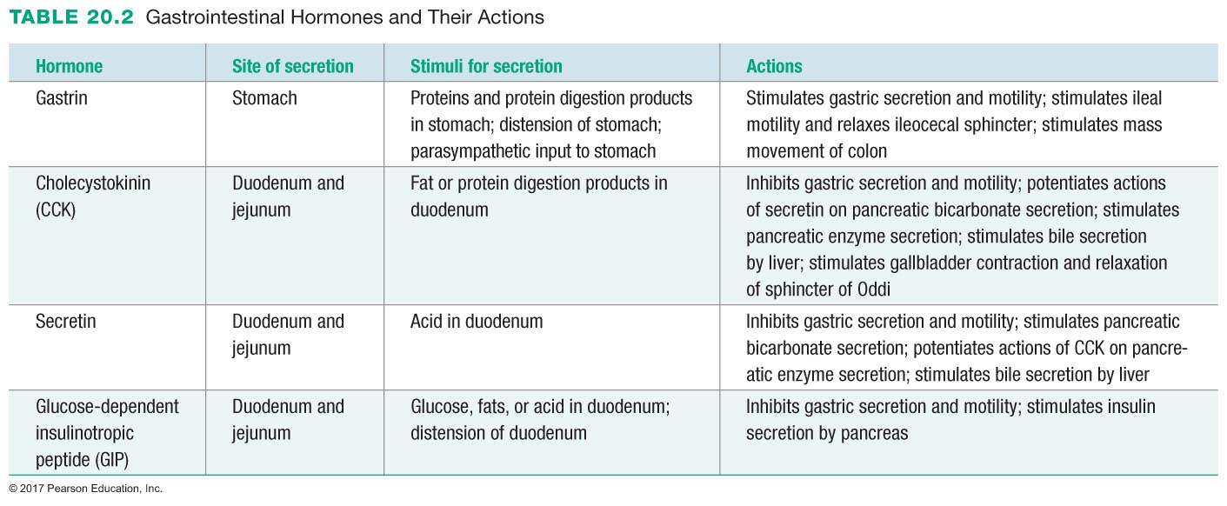

Slide 7
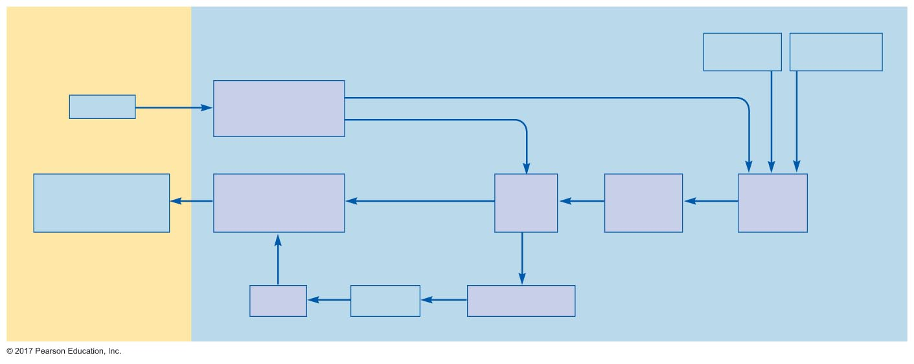
Figure 20.22 Summary of neural and endocrine control of gastrointestinal function.
Lumen of digestive tract
Emotional
states
Sight, taste,
smell of food
Chemoreceptors,
mechanoreceptors,
osmoreceptors
LONG REFLEX PATHWAY
Stimulus
SHORT REFLEX PATHWAY
Response
(change in secretory
activity or motility)
Effector cells
(smooth muscle or
endocrine gland)
Enteric
nervous
system
Autonomic
nervous
system
Central
nervous
system
Blood
Hormone
Endocrine cells

Slide 8
Neural and Endocrine Pathways of GI Control
Phases of gastrointestinal control
Cephalic phase: stimuli originate in head
Thoughts, taste, and smell
Requires input from CNS (long reflexes)
Gastric phase: stimuli originate in stomach
Long and short reflexes and GI hormones
Intestinal phase: stimuli originate in small intestine
Long and short reflexes and GI hormones

Slide 9
Regulation of Food Intake
Leptin: hormone released from adipose cells when calories exceed demands
Leptin suppresses hunger and increases metabolism: satiety signal
Leptin stimulates αMSH and CART (cocaine- and amphetamine-related transcript)
αMSH and CART increase sympathetic activity and stimulate release of TSH and ACTH
TSH and ACTH increase metabolic rate and reduce fat storage

Slide 10
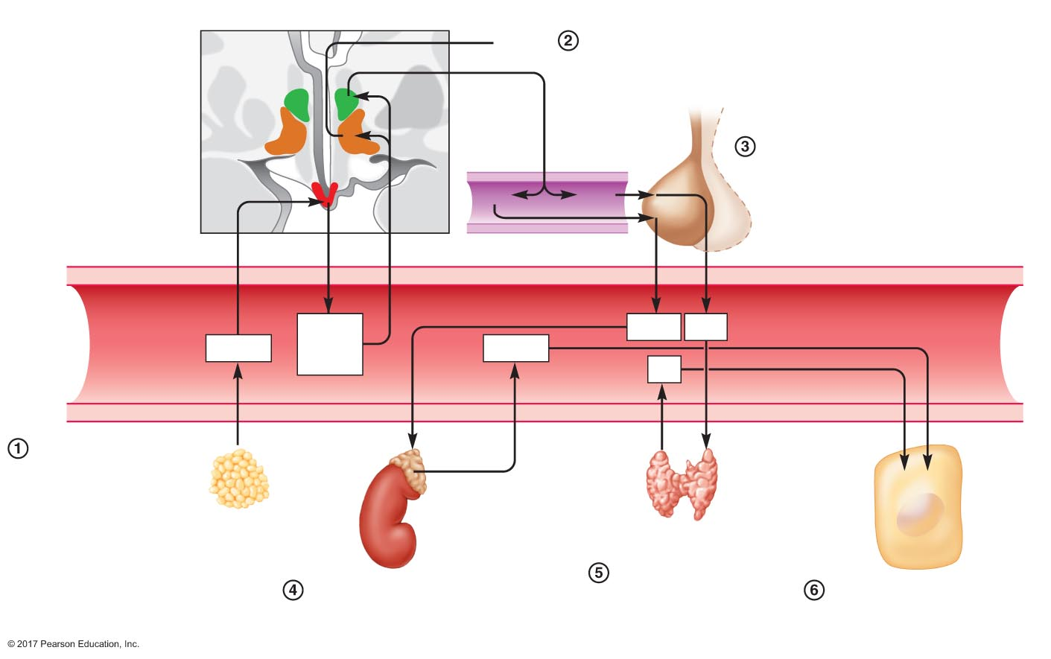
Figure 20.23 Effects of satiety and orexigenic factors on food intake.
Slide 1
Hypothalamus
Satiety
α-MSH and CART travel to the lateral hypothalamic area to
induce satiety and to the paraventricular nucleus to stimulate
release of CRH and TRH
Paraventricular
nucleus
Lateral
hypothalamic area
Anterior
pituitary
CRH and TRH trigger release of ACTH
and TSH from anterior pituitary
Optic tract
Arcuate
nucleus
CRH
TRH
Portal vein
α-MSH
and
CART
ACTH
TSH
Leptin
Cortisol
TH
Leptin from adipose
tissue stimulates
release of α-MSH and
CART from arcuate
nucleus
Adrenal
cortex
Increased
metabolism
Adipose
tissue
Thyroid gland
Body
cells
TSH stimulates release
of thyroid hormone
from thyroid gland
ACTH stimulates release of
cortisol from adrenal cortex
Cortisol and thyroid hormone
increase metabolism in body
cells

Slide 11
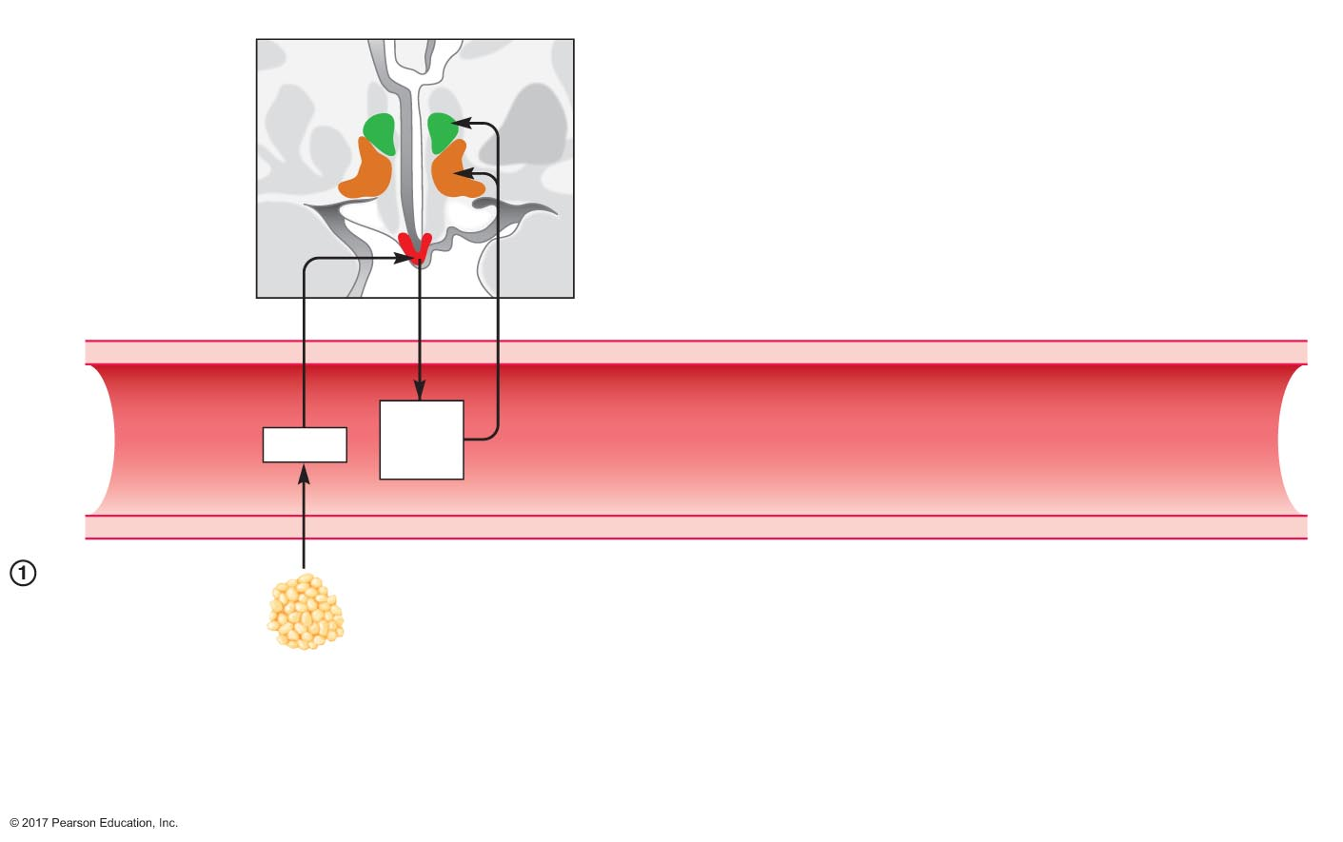
Figure 20.23 Effects of satiety and orexigenic factors on food intake.
Slide 2
Hypothalamus
Paraventricular
nucleus
Lateral
hypothalamic area
Optic tract
Arcuate
nucleus
α-MSH
and
CART
Leptin
Leptin from adipose
tissue stimulates
release of α-MSH and
CART from arcuate
nucleus
Adipose
tissue

Slide 12
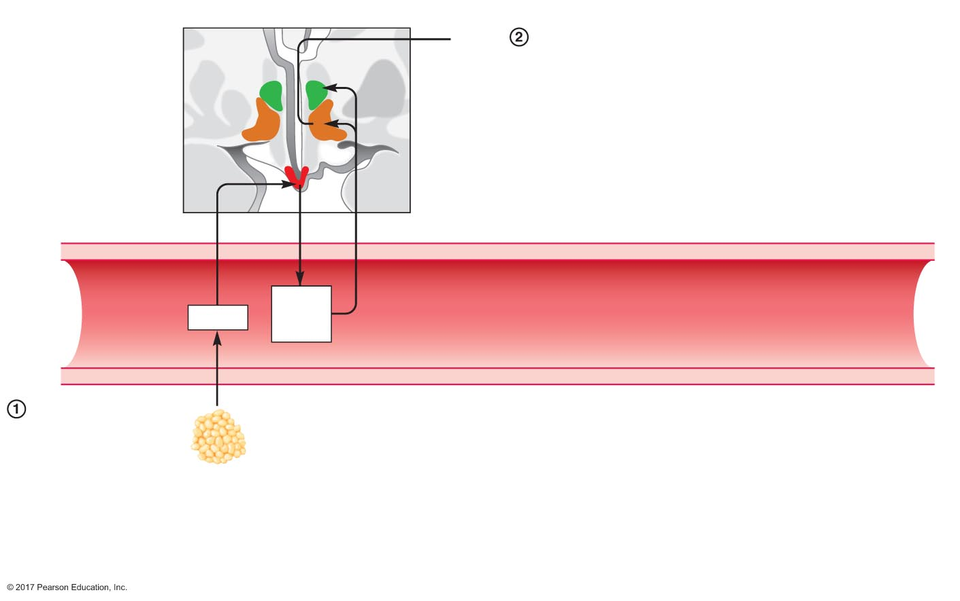
Figure 20.23 Effects of satiety and orexigenic factors on food intake.
Slide 3
Hypothalamus
Satiety
α-MSH and CART travel to the lateral hypothalamic area to
induce satiety and to the paraventricular nucleus to stimulate
release of CRH and TRH
Paraventricular
nucleus
Lateral
hypothalamic area
Optic tract
Arcuate
nucleus
α-MSH
and
CART
Leptin
Leptin from adipose
tissue stimulates
release of α-MSH and
CART from arcuate
nucleus
Adipose
tissue

Slide 13
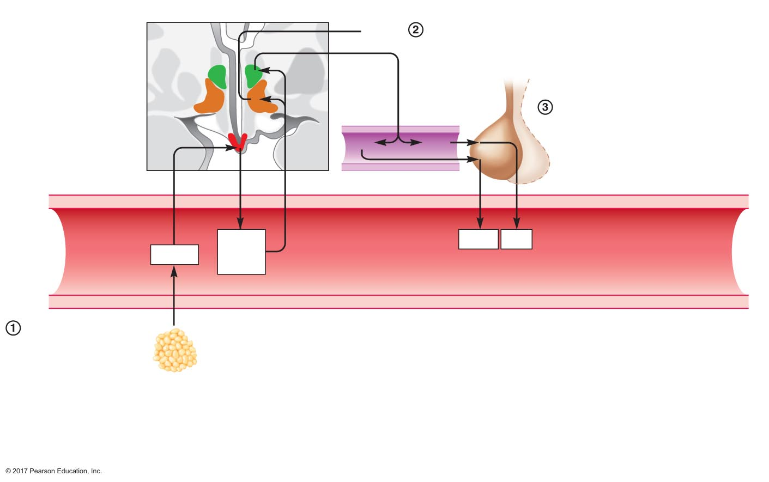
Figure 20.23 Effects of satiety and orexigenic factors on food intake.
Slide 4
Hypothalamus
Satiety
α-MSH and CART travel to the lateral hypothalamic area to
induce satiety and to the paraventricular nucleus to stimulate
release of CRH and TRH
Paraventricular
nucleus
Lateral
hypothalamic area
Anterior
pituitary
CRH and TRH trigger release of ACTH
and TSH from anterior pituitary
Optic tract
Arcuate
nucleus
CRH
TRH
Portal vein
α-MSH
and
CART
ACTH
TSH
Leptin
Leptin from adipose
tissue stimulates
release of α-MSH and
CART from arcuate
nucleus
Adipose
tissue

Slide 14
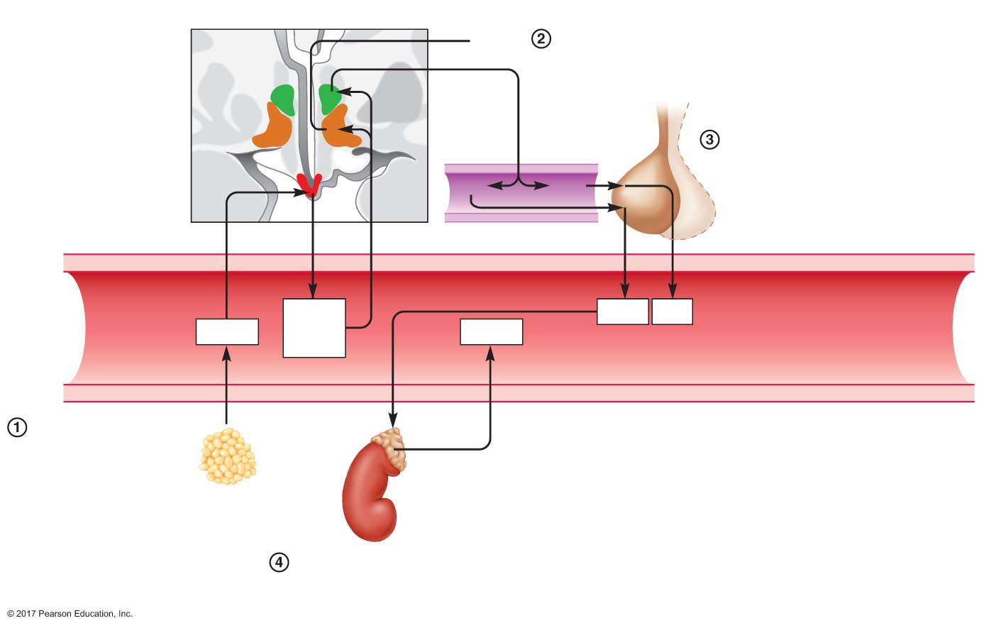
Figure 20.23 Effects of satiety and orexigenic factors on food intake.
Slide 5
Hypothalamus
Satiety
α-MSH and CART travel to the lateral hypothalamic area to
induce satiety and to the paraventricular nucleus to stimulate
release of CRH and TRH
Paraventricular
nucleus
Lateral
hypothalamic area
Anterior
pituitary
CRH and TRH trigger release of ACTH
and TSH from anterior pituitary
Optic tract
Arcuate
nucleus
CRH
TRH
Portal vein
α-MSH
and
CART
ACTH
TSH
Leptin
Cortisol
Leptin from adipose
tissue stimulates
release of α-MSH and
CART from arcuate
nucleus
Adrenal
cortex
Adipose
tissue
ACTH stimulates release of
cortisol from adrenal cortex

Slide 15
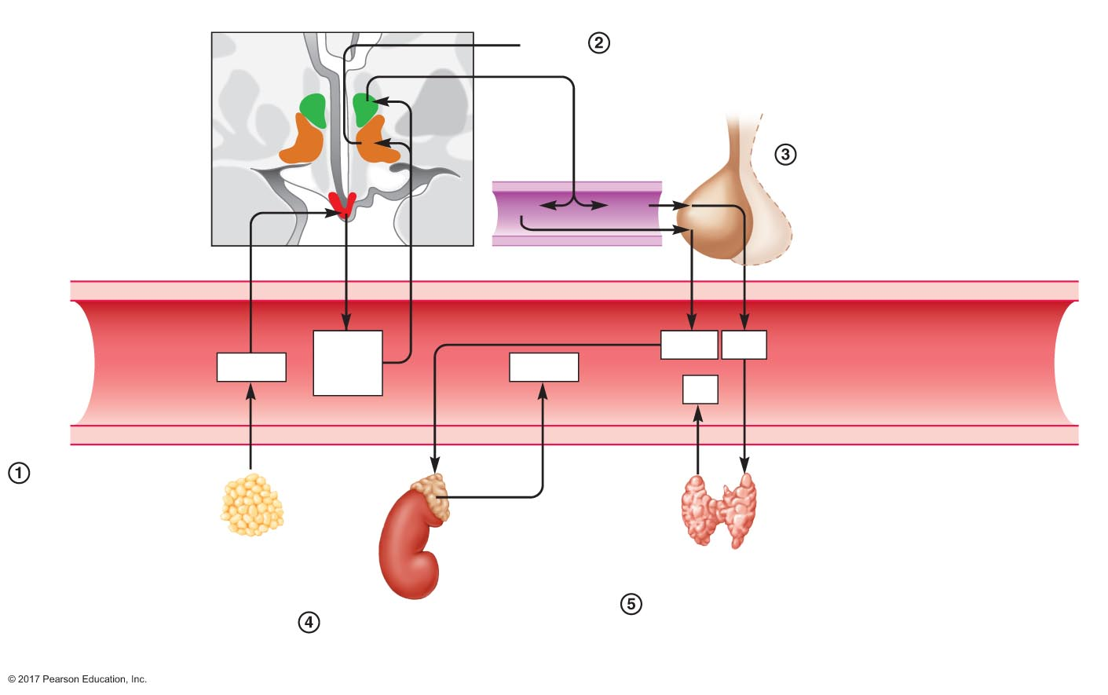
Figure 20.23 Effects of satiety and orexigenic factors on food intake.
Slide 6
Hypothalamus
Satiety
α-MSH and CART travel to the lateral hypothalamic area to
induce satiety and to the paraventricular nucleus to stimulate
release of CRH and TRH
Paraventricular
nucleus
Lateral
hypothalamic area
Anterior
pituitary
CRH and TRH trigger release of ACTH
and TSH from anterior pituitary
Optic tract
Arcuate
nucleus
CRH
TRH
Portal vein
α-MSH
and
CART
ACTH
TSH
Leptin
Cortisol
TH
Leptin from adipose
tissue stimulates
release of α-MSH and
CART from arcuate
nucleus
Adrenal
cortex
Adipose
tissue
Thyroid gland
TSH stimulates release
of thyroid hormone
from thyroid gland
ACTH stimulates release of
cortisol from adrenal cortex

Slide 16
Figure 20.23 Effects of satiety and orexigenic factors on food intake.
Slide 7
Hypothalamus
Satiety
α-MSH and CART travel to the lateral hypothalamic area to
induce satiety and to the paraventricular nucleus to stimulate
release of CRH and TRH
Paraventricular
nucleus
Lateral
hypothalamic area
Anterior
pituitary
CRH and TRH trigger release of ACTH
and TSH from anterior pituitary
Optic tract
Arcuate
nucleus
CRH
TRH
Portal vein
α-MSH
and
CART
ACTH
TSH
Leptin
Cortisol
TH
Leptin from adipose
tissue stimulates
release of α-MSH and
CART from arcuate
nucleus
Adrenal
cortex
Increased
metabolism
Adipose
tissue
Thyroid gland
Body
cells
TSH stimulates release
of thyroid hormone
from thyroid gland
ACTH stimulates release of
cortisol from adrenal cortex
Cortisol and thyroid hormone
increase metabolism in body
cells

Slide 17
Regulation of Food Intake
Orexigenic factors oppose satiety factors
NPY
AgRP
Promote eating
Decrease metabolism
Increase parasympathetic activity
Decrease sympathetic activity
Inhibit secretion of TSH and ACTH

Slide 18
Regulation of Food Intake
Short-term regulation: hunger versus satiety
Satiety factors
Insulin
CCK
Neural input from mechanoreceptors and chemoreceptors
Orexigenic factors
Ghrelin

Slide 19
20.5 Gastrointestinal Secretion and Its Regulation
Saliva secretion
Acid and pepsinogen secretion in the stomach
Secretion of pancreatic juice and bile
Rates of fluid movement in the digestive tract

Slide 20
Saliva Secretion
Taste and texture of food stimulate mechanoreceptors and chemoreceptors in the mouth
Relayed to the salivary center of the medulla, which regulates the autonomic nervous system
Sight and smell input from cerebral cortex also affects the salivary center
Salivation stimulated
Parasympathetic activation: watery saliva
Sympathetic activation: protein-rich, viscous saliva

Slide 21
Acid and Pepsinogen Secretion in the Stomach
Parietal cells produce hydrochloric acid
Carbonic anhydrase catalyzes production of bicarbonate and H⁺
H⁺ is actively secreted into lumen of the stomach
Bicarbonate is transported into interstitial fluid for Cl–
Cl– diffuses into lumen of the stomach through channels
Net result of acid production
H⁺ and Cl– are secreted into lumen of the stomach
Bicarbonate enters the interstitial fluid and then blood

Slide 22
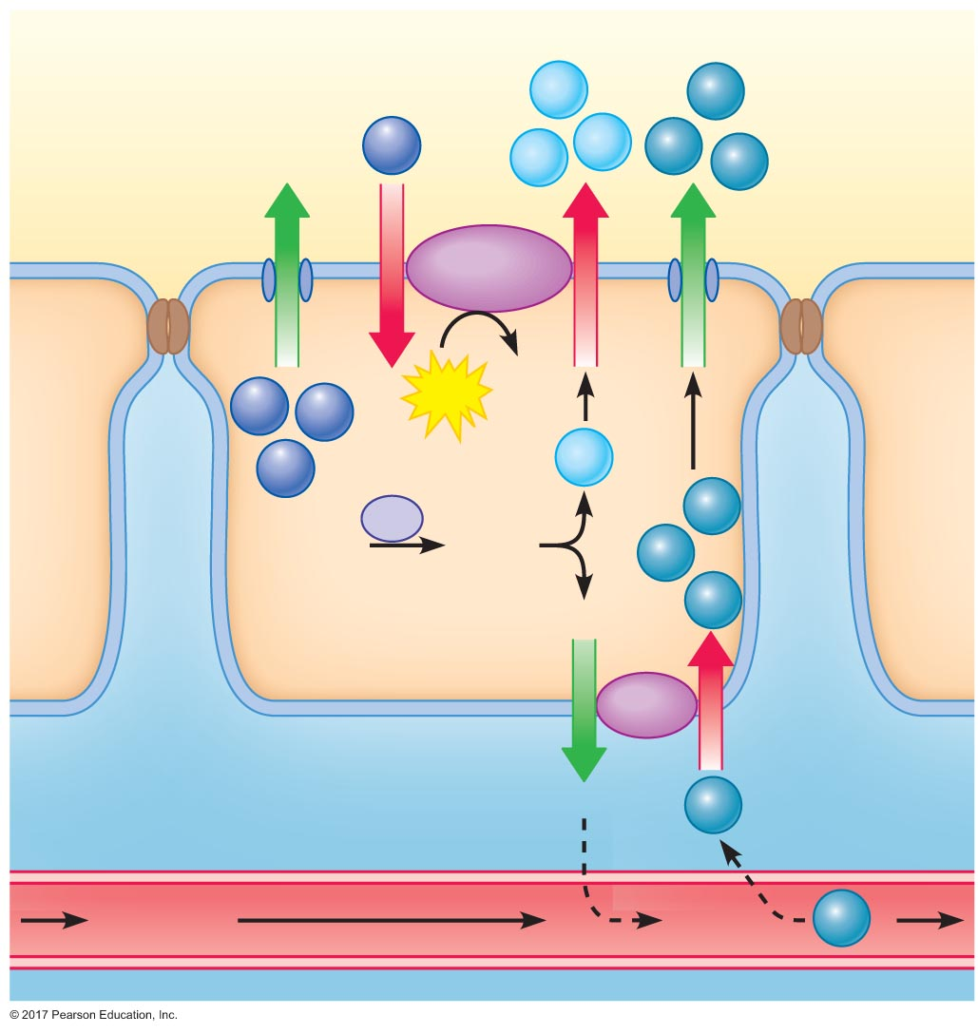
Figure 20.24 Mechanism of gastric acid secretion.
Lumen of
gastric gland
H⁺
Cl–
K⁺
H⁺
H⁺
Cl–
Cl–
ATP
ADP
+ P_{i}
K⁺
K⁺
K⁺
H⁺
CA
Cl–
CO₂ + H₂O
H₂CO₃
Cl–
HCO₃–
Cl–
Parietal cells
Interstitial ﬂuid
HCO₃–
Cl–
Capillary
Blood
HCO₃–
Cl–

Slide 23
Acid and Pepsinogen Secretion in the Stomach
Acid secretion
Parasympathetic nervous system
Gastrin
Histamine (paracrine)
Pepsinogen secretion regulated in sync with acid secretion
Parasympathetic nervous system
Gastrin
Histamine

Slide 24
Acid and Pepsinogen Secretion in the Stomach
Cephalic-phase regulation of secretion
Stimuli increase acid and pepsinogen secretion
Sight of food
Taste
Smell
Chewing
Swallowing
All activate the parasympathetic nervous system
Parasympathetic nervous system stimulates gastrin secretion

Slide 25
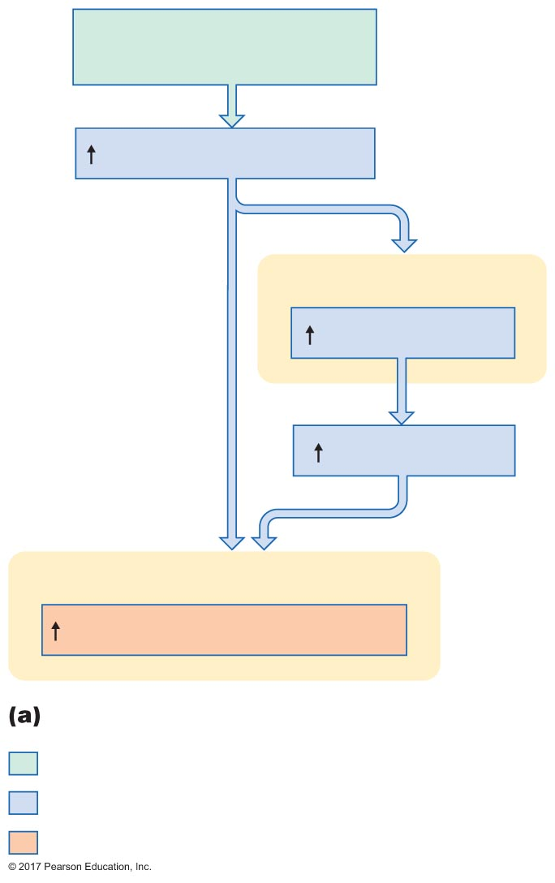
Figure 20.25a Regulation of gastric secretion.
Slide 1
Sight, smell, taste of food;
chewing and swallowing
Parasympathetic activity
G cells
Gastrin secretion
Plasma gastrin
Parietal and chief cells
Acid and pepsinogen secretion
Cephalic-phase control of gastric secretion
Initial stimulus
Physiological response
Result

Slide 26
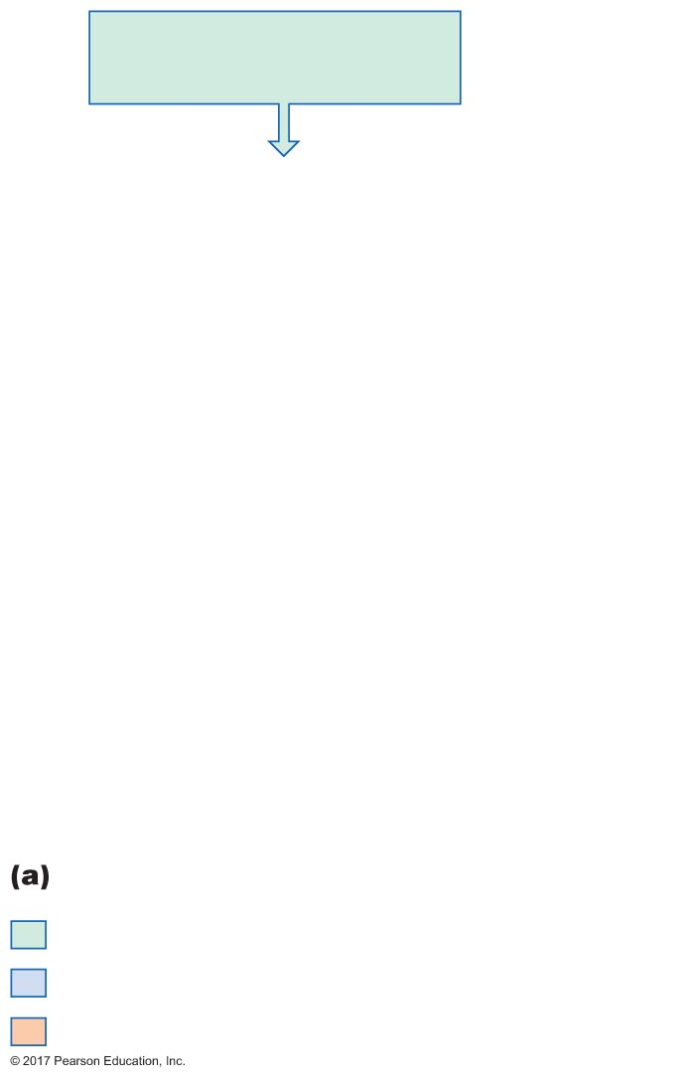
Figure 20.25a Regulation of gastric secretion.
Slide 2
Sight, smell, taste of food;
chewing and swallowing
Cephalic-phase control of gastric secretion
Initial stimulus
Physiological response
Result

Slide 27
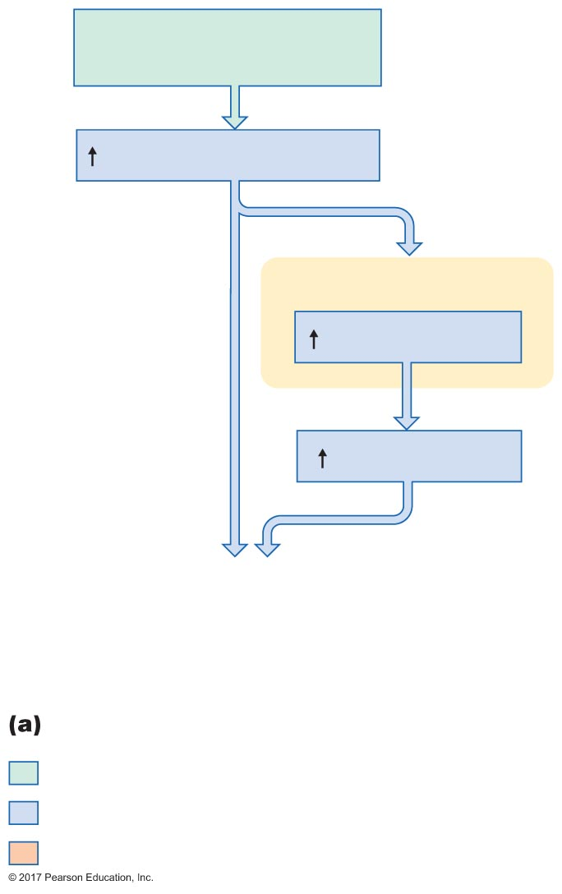
Figure 20.25a Regulation of gastric secretion.
Slide 3
Sight, smell, taste of food;
chewing and swallowing
Parasympathetic activity
G cells
Gastrin secretion
Plasma gastrin
Cephalic-phase control of gastric secretion
Initial stimulus
Physiological response
Result

Slide 28
Figure 20.25a Regulation of gastric secretion.
Slide 4
Sight, smell, taste of food;
chewing and swallowing
Parasympathetic activity
G cells
Gastrin secretion
Plasma gastrin
Parietal and chief cells
Acid and pepsinogen secretion
Cephalic-phase control of gastric secretion
Initial stimulus
Physiological response
Result

Slide 29
Acid and Pepsinogen Secretion in the Stomach
Gastric-phase regulation of secretion
Stimuli of gastric secretion
Proteins, peptides, and amino acids
Distension of stomach
Short and long reflex pathways trigger gastrin, acid, and pepsinogen release

Slide 30
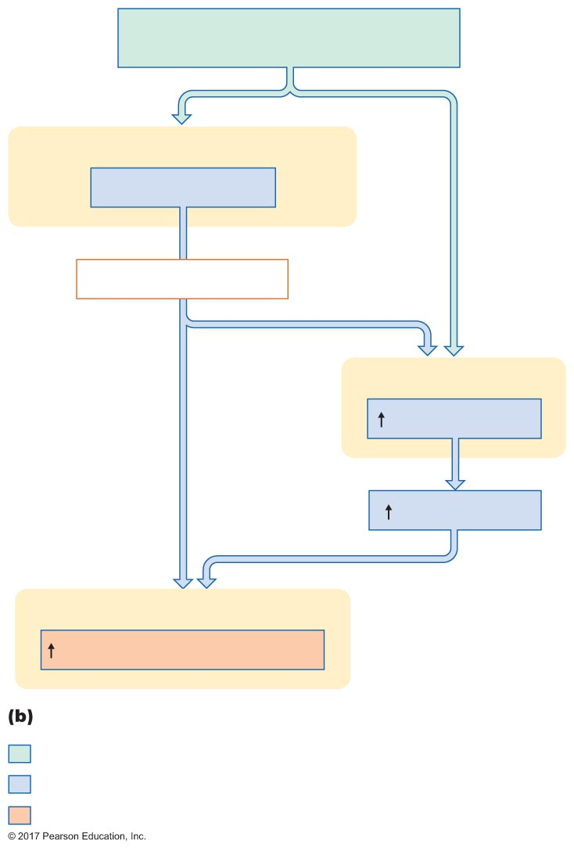
Figure 20.25b Regulation of gastric secretion.
Proteins and protein digestion products
in stomach; distension of stomach
Chemoreceptors and mechanoreceptors
Detect and respond
Short and long reﬂexes
G cells
Gastrin secretion
Plasma gastrin
Parietal and chief cells
Acid and pepsinogen secretion
Gastric-phase control of gastric secretion
Initial stimulus
Physiological response
Result

Slide 31
Acid and Pepsinogen Secretion in the Stomach
Inhibition of secretion
Gastric phase
Exit of food removes stimuli for secretion
Increased acidity inhibits gastrin release
Intestinal phase
Effects of food entry into the duodenum
Increased osmolarity
Increased fat and acid
Increased distension
Long and short reflex pathways inhibit acid and pepsinogen secretion

Slide 32
Secretion of Pancreatic Juice and Bile
Acinar cells
Small volume of primary secretion
Water, electrolytes, and digestive enzymes
Duct cells
Large volume
Bicarbonate-rich secretion

Slide 33
Secretion of Pancreatic Juice and Bile
CCK and secretin: primary stimulants
Enzyme and bicarbonate secretion regulated independently
Composition of pancreatic juice varies based on lumenal contents
CCK stimulates acinar cells to secrete enzymes
Small stimulant for bicarbonate release
CCK potentiates secretin effects on bicarbonate release
Secretin stimulates duct cells to secrete bicarbonate
Small stimulant for enzyme release
Secretin potentiates CCK effects on enzyme release

Slide 34
Secretion of Pancreatic Juice and Bile
Stimuli for CCK release
Fat and amino acids in duodenum
Stimuli for secretin release
Acidity in duodenum

Slide 35
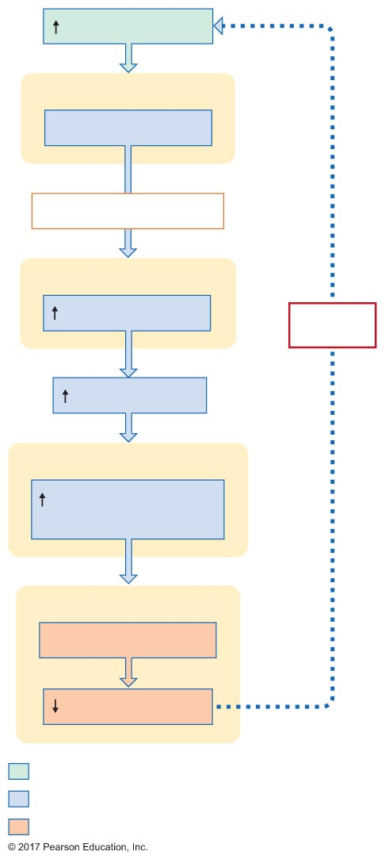
Figure 20.26 Stimulation of the secretion of bicarbonate-rich fluid by acidity in the duodenum.
Slide 1
Acid in duodenum
Chemoreceptors
Detect and respond
Short and long reﬂexes
Endocrine cells
Secretin secretion
Negative
feedback
Plasma secretin
Pancreatic duct cells
Secretion of
bicarbonate-rich ﬂuid
Duodenum
Neutralization of acid
Acid in duodenum
Initial stimulus
Physiological response
Result

Slide 36
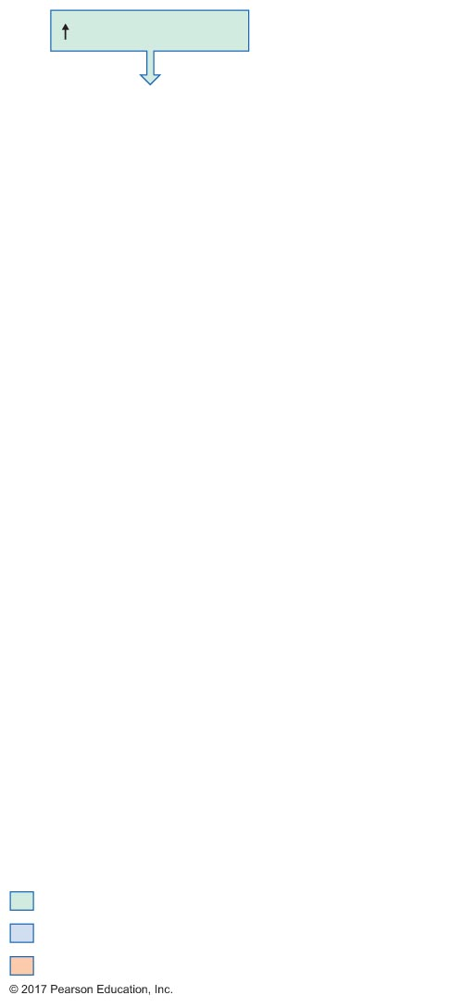
Figure 20.26 Stimulation of the secretion of bicarbonate-rich fluid by acidity in the duodenum.
Slide 2
Acid in duodenum
Initial stimulus
Physiological response
Result

Slide 37
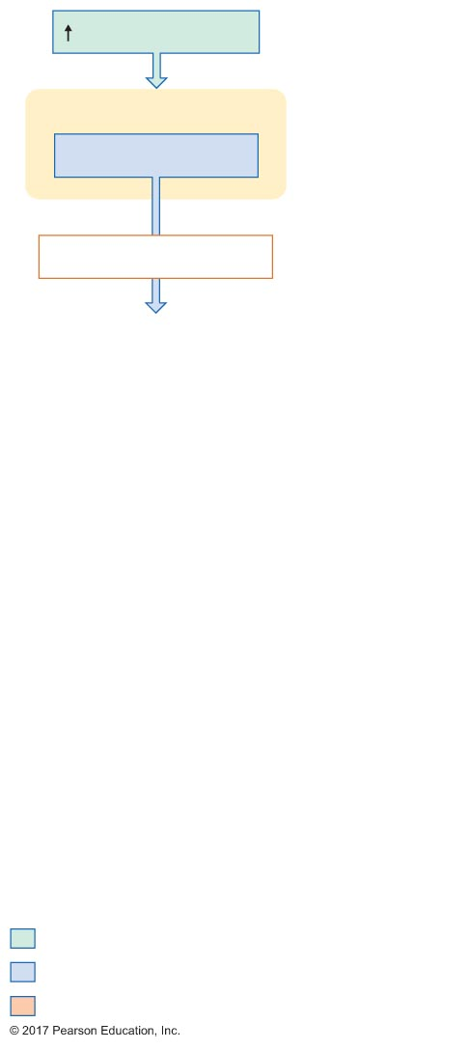
Figure 20.26 Stimulation of the secretion of bicarbonate-rich fluid by acidity in the duodenum.
Slide 3
Acid in duodenum
Chemoreceptors
Detect and respond
Short and long reﬂexes
Initial stimulus
Physiological response
Result

Slide 38
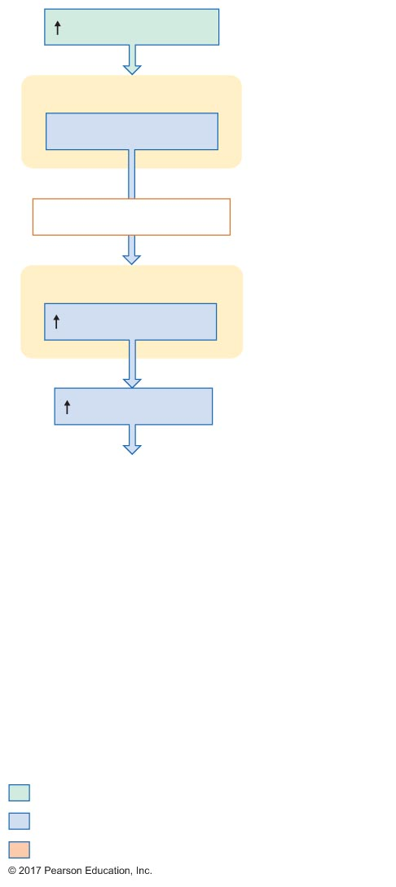
Figure 20.26 Stimulation of the secretion of bicarbonate-rich fluid by acidity in the duodenum.
Slide 4
Acid in duodenum
Chemoreceptors
Detect and respond
Short and long reﬂexes
Endocrine cells
Secretin secretion
Plasma secretin
Initial stimulus
Physiological response
Result

Slide 39
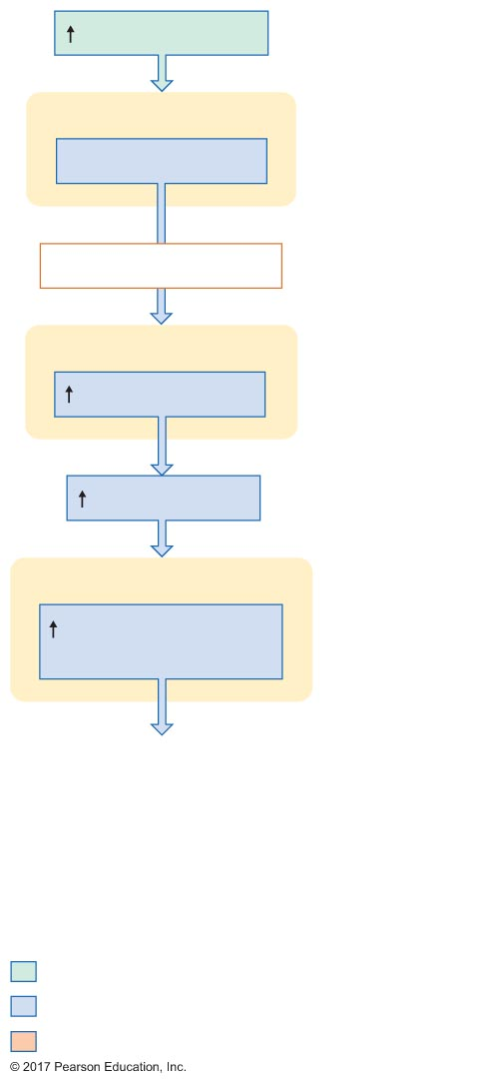
Figure 20.26 Stimulation of the secretion of bicarbonate-rich fluid by acidity in the duodenum.
Slide 5
Acid in duodenum
Chemoreceptors
Detect and respond
Short and long reﬂexes
Endocrine cells
Secretin secretion
Plasma secretin
Pancreatic duct cells
Secretion of
bicarbonate-rich ﬂuid
Initial stimulus
Physiological response
Result

Slide 40
Figure 20.26 Stimulation of the secretion of bicarbonate-rich fluid by acidity in the duodenum.
Slide 6
Acid in duodenum
Chemoreceptors
Detect and respond
Short and long reﬂexes
Endocrine cells
Secretin secretion
Negative
feedback
Plasma secretin
Pancreatic duct cells
Secretion of
bicarbonate-rich ﬂuid
Duodenum
Neutralization of acid
Acid in duodenum
Initial stimulus
Physiological response
Result

Slide 41
Secretion of Pancreatic Juice and Bile
Regulation of bile secretion into duodenum
Secretin
Stimulates bile secretion from liver
CCK
Stimulates gallbladder contraction
Stimulates relaxation of sphincter of Oddi

Slide 42
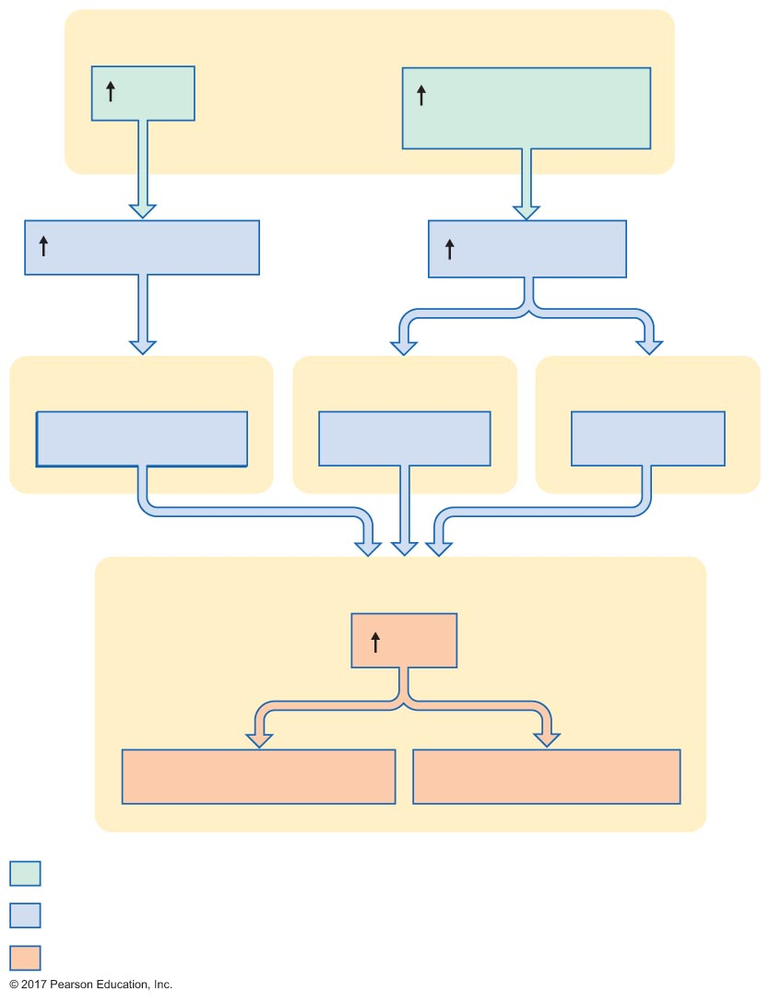
Figure 20.27 The mechanisms by which secretin and CCK regulate the entry of bile into the duodenum.
Slide 1
Duodenum
Acid
Protein digestion
products and fat
Plasma secretin
Plasma CCK
Liver
Gallbladder
Sphincter of Oddi
Bile secretion
Contraction
Relaxation
Duodenum
Bile
Neutralization of acid
Emulsiﬁcation of fats
Initial stimulus
Physiological response
Result

Slide 43
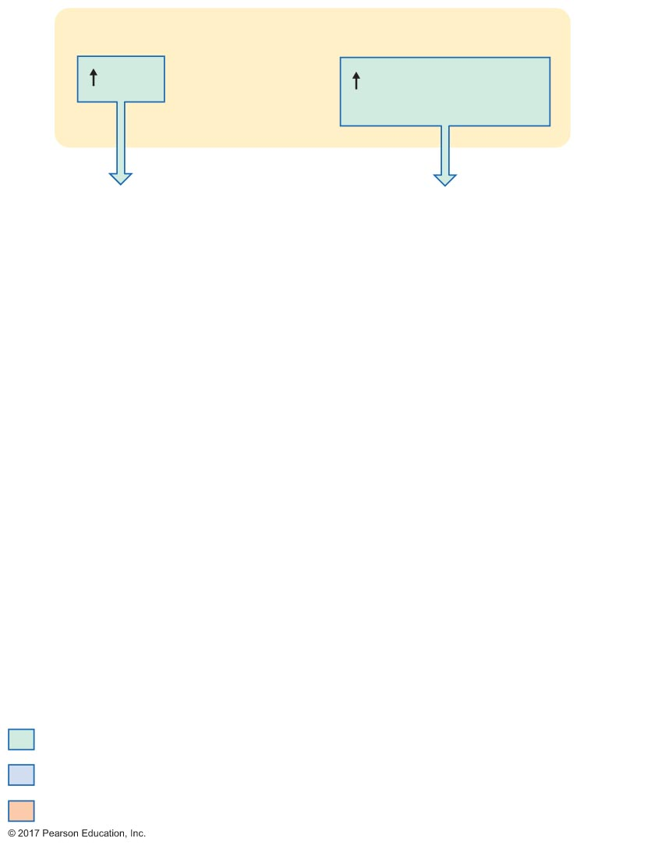
Figure 20.27 The mechanisms by which secretin and CCK regulate the entry of bile into the duodenum.
Slide 2
Duodenum
Acid
Protein digestion
products and fat
Initial stimulus
Physiological response
Result

Slide 44
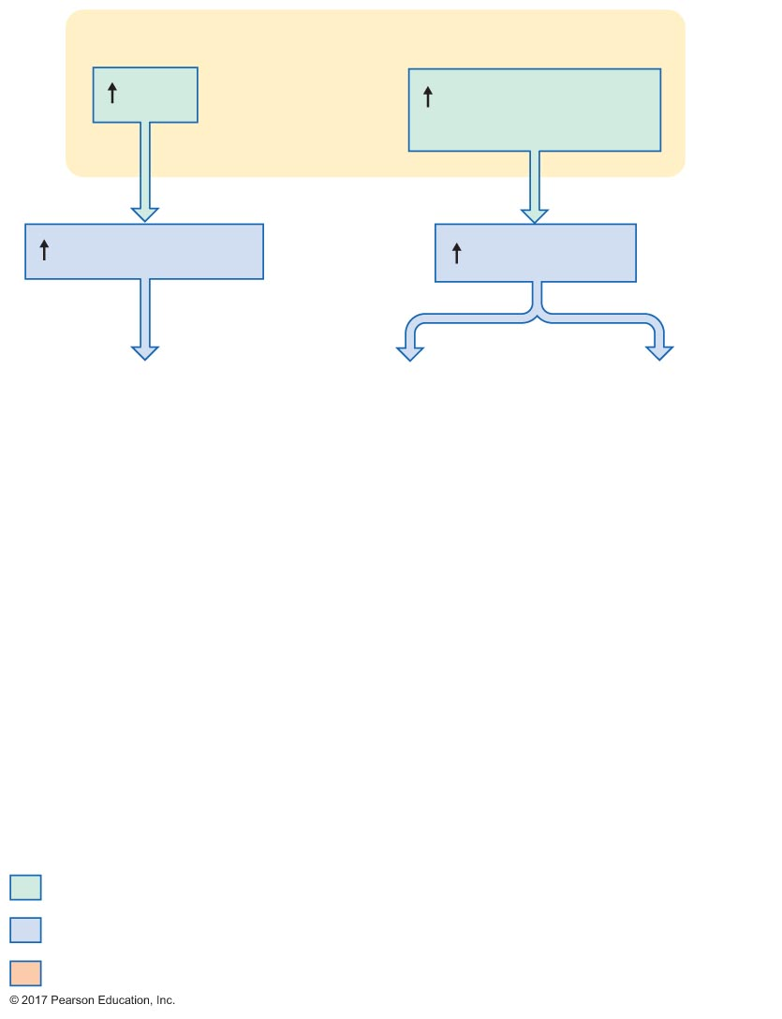
Figure 20.27 The mechanisms by which secretin and CCK regulate the entry of bile into the duodenum.
Slide 3
Duodenum
Acid
Protein digestion
products and fat
Plasma secretin
Plasma CCK
Initial stimulus
Physiological response
Result

Slide 45
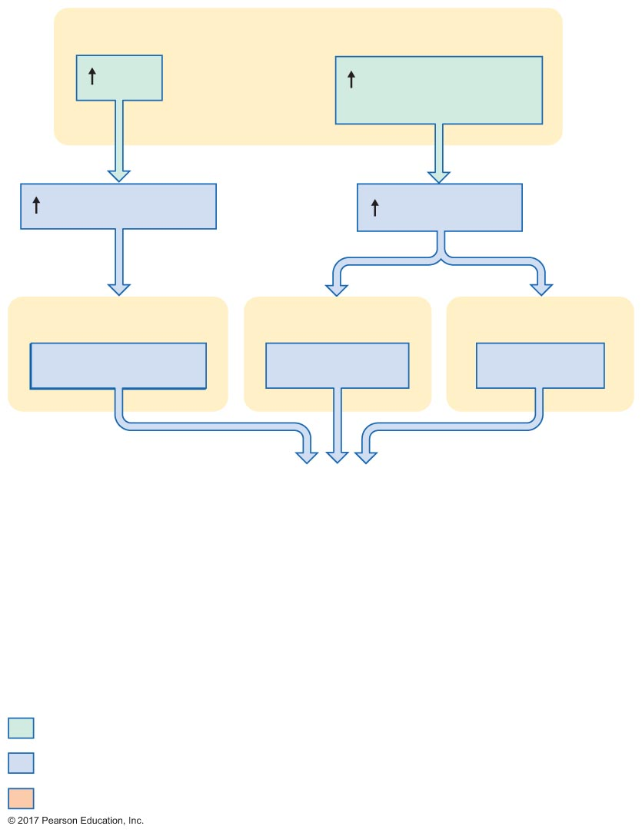
Figure 20.27 The mechanisms by which secretin and CCK regulate the entry of bile into the duodenum.
Slide 4
Duodenum
Acid
Protein digestion
products and fat
Plasma secretin
Plasma CCK
Liver
Gallbladder
Sphincter of Oddi
Bile secretion
Contraction
Relaxation
Initial stimulus
Physiological response
Result

Slide 46
Figure 20.27 The mechanisms by which secretin and CCK regulate the entry of bile into the duodenum.
Slide 5
Duodenum
Acid
Protein digestion
products and fat
Plasma secretin
Plasma CCK
Liver
Gallbladder
Sphincter of Oddi
Bile secretion
Contraction
Relaxation
Duodenum
Bile
Neutralization of acid
Emulsiﬁcation of fats
Initial stimulus
Physiological response
Result

Slide 47
20.7 Gastrointestinal Motility and Its Regulation
GI motility
Movements of the wall of the GI tract
Due primarily to contractions of the muscularis externa (outer muscle layers)
Function: mix and propel GI tract contents

Slide 48
Electrical Activity in GI Smooth Muscle
Spontaneous slow waves of depolarization = slow waves
Frequency of waves = basic electric rhythm
BER varies in different areas of the GI tract
Height of BER is affected by neural and hormonal input
Parasympathetic → excitation
Sympathetic → inhibition

Slide 49
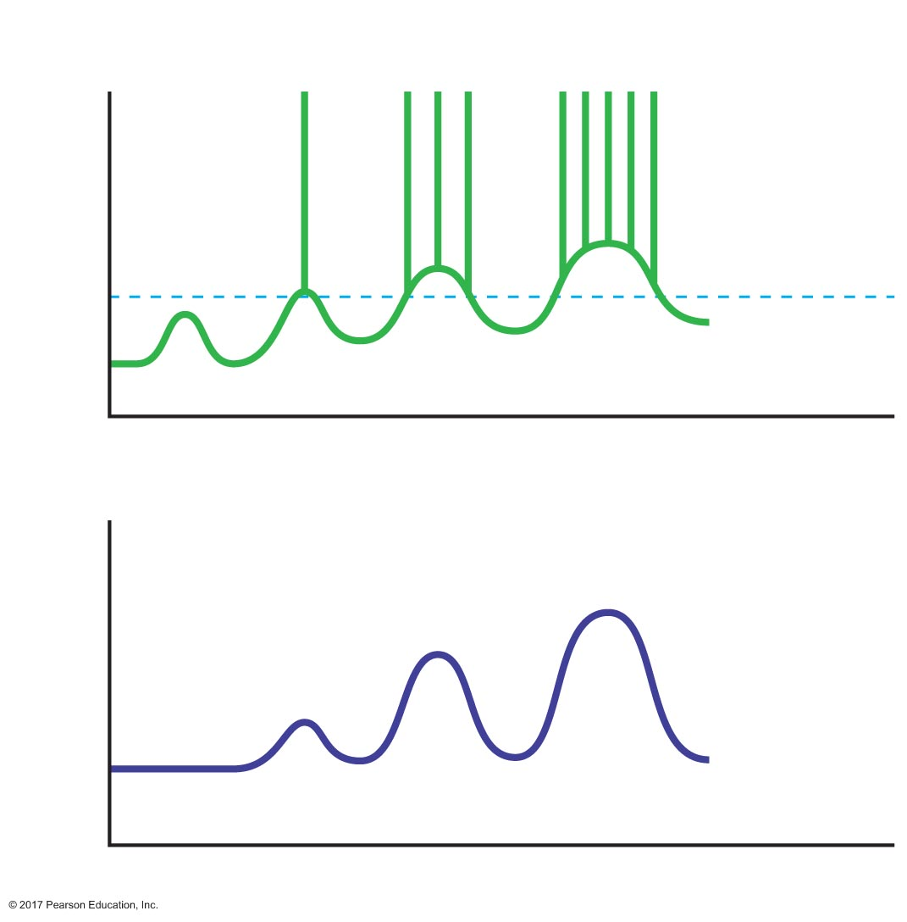
Figure 20.29 Slow-wave electrical activity in gastrointestinal smooth muscle.
Action potentials
Membrane potential (mV)
Threshold
–60
Slow waves
Time (sec)
Muscle tension (g)
Time (sec)

Slide 50
Relationship Between Electrical and Mechanical Activity in Smooth Muscle
Stomach
Larger depolarizations → stronger contractions
Action potentials → even stronger contractions
Intestines
Action potentials required for force
Strength of contraction varies with frequency of action potentials

Slide 51
Peristalsis and Segmentation
Waves of contraction in muscularis mucosae in response to basic electrical rhythm
Peristalsis
Propels contents forward
Segmentation
Mixes contents

Slide 52
Peristalsis and Segmentation
Peristalsis
Proximal segment
Circular muscle contracts; longitudinal muscle relaxes
Diameter decreases
Distal segment
Circular muscle relaxes; longitudinal muscle contracts
Diameter increases
Contents propelled forward from area of small diameter to area of large diameter

Slide 53
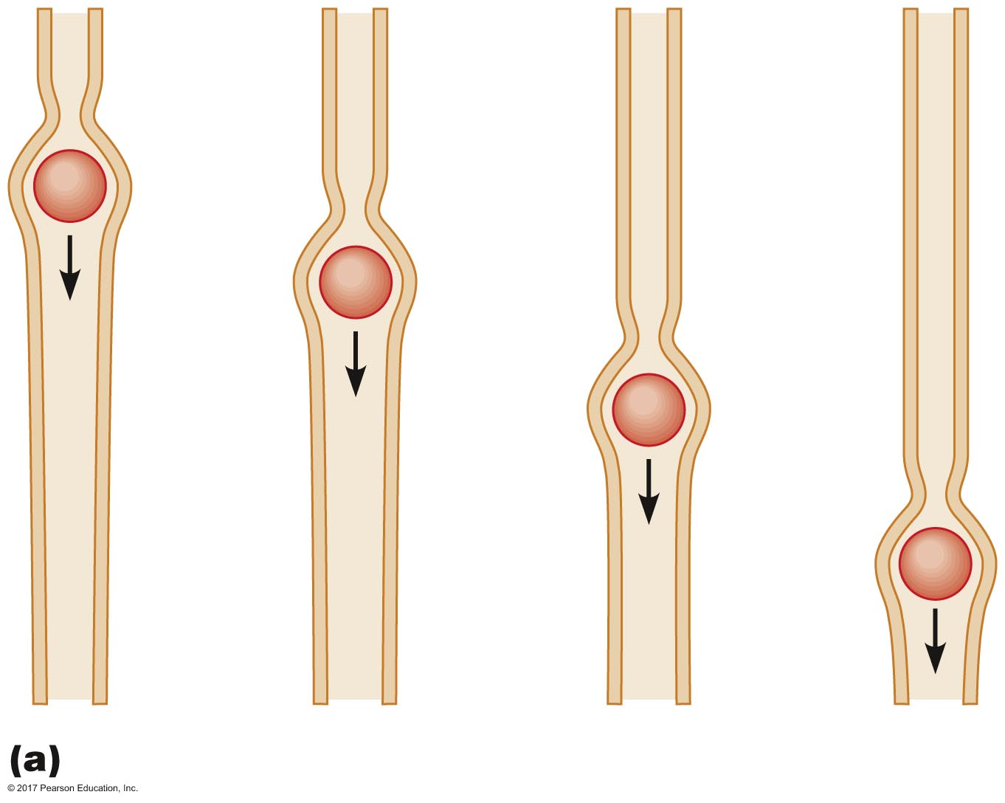
Figure 20.30a Comparison of peristalsis and segmentation.
Peristalsis

Slide 54
Peristalsis and Segmentation
Segmentation
A type of motility of the small intestine
Requires circular muscle layer
Alternating contractions between intestinal segments
Mixes chyme

Slide 55
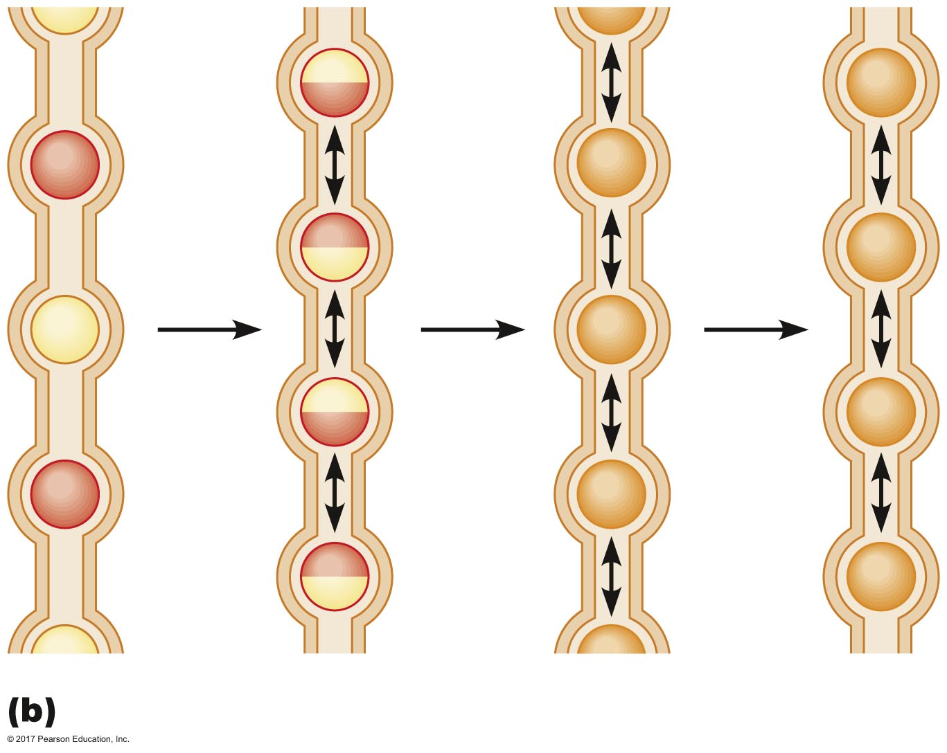
Figure 20.30b Comparison of peristalsis and segmentation.
Segmentation

Slide 56
Chewing and Swallowing
Chewing
Control is both voluntary and involuntary
Chewing reflex: cyclical reflex
Normally, jaw muscles are active; hold mouth closed
Food enters mouth; inhibits jaw muscles
Jaw dropping relieves pressure of food; contracts
Pressure from food restored; inhibited

Slide 57
Chewing and Swallowing
Swallowing
Chewed food + saliva = bolus
Tongue moves bolus to pharynx
Initiates swallowing reflex
Integration center = swallowing center of medulla oblongata

Slide 58
Chewing and Swallowing
Swallowing reflex
Bolus descends in pharynx, pressing on epiglottis
Epiglottis covers glottis so food does not enter trachea
Inspiration is inhibited
Upper esophageal sphincter relaxes
Bolus enters esophagus
Sphincter closes behind bolus
Bolus stretches esophagus, triggering peristalsis
Peristalsis propels bolus to stomach
Travel time is approximately 9 seconds

Slide 59
Chewing and Swallowing
Swallowing reflex
Bolus arrives at stomach
Triggers relaxation of lower esophageal sphincter
Bolus enters stomach
If necessary, secondary peristalsis waves occur to move bolus into stomach
Receptive relaxation of stomach
Swallowing center also initiates relaxation of stomach smooth muscle as it prepares for receipt of bolus

Slide 60
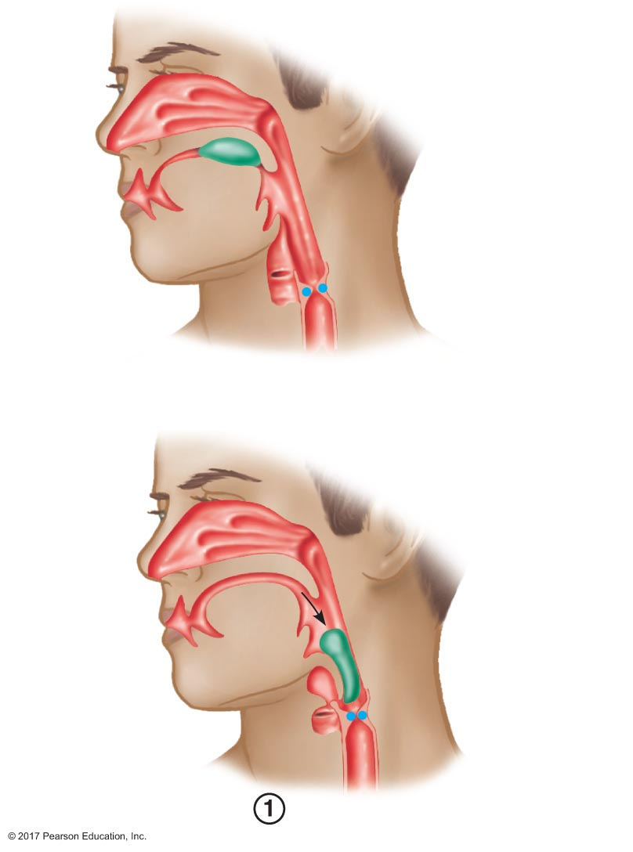
Figure 20.31 Events of the swallowing reflex.
Slide 1
Bolus in
mouth
Tongue
Epiglottis
Pharynx
Upper esophageal
sphincter (closed)
Glottis
Larynx
Esophagus
Epiglottis
moves
downward
and covers
glottis
Glottis moves
upward
and closes

Slide 61
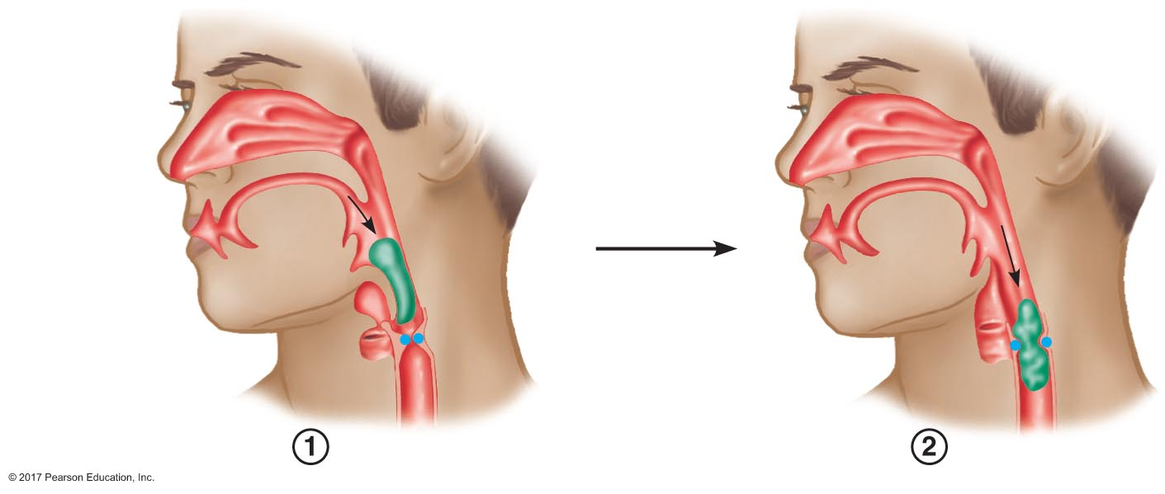
Figure 20.31 Events of the swallowing reflex.
Slide 2
Epiglottis
moves
downward
and covers
glottis
Glottis moves
upward
and closes
Upper esophageal
sphincter opens

Slide 62
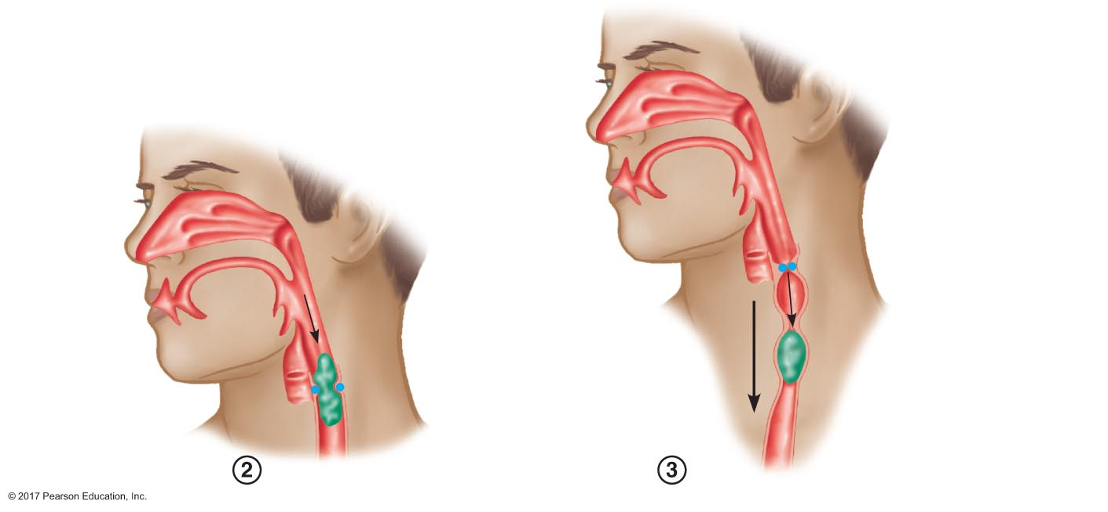
Figure 20.31 Events of the swallowing reflex.
Slide 3
Upper esophageal
sphincter closes
Wave of peristalsis
travels along
esophagus
Contracting muscles
Relaxing muscles
Upper esophageal
sphincter opens

Slide 63
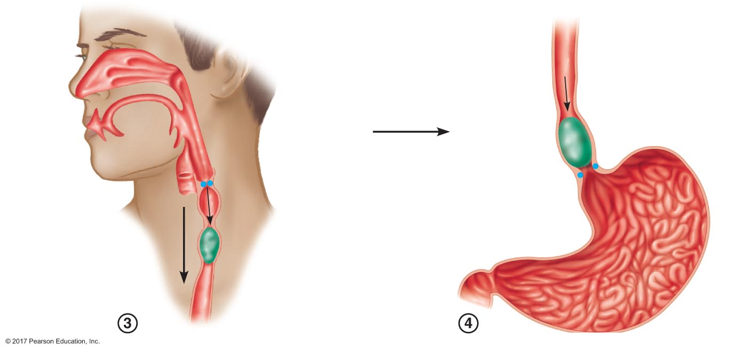
Figure 20.31 Events of the swallowing reflex.
Slide 4
Upper esophageal
sphincter closes
Lower esophageal
sphincter opens
Wave of peristalsis
travels along
esophagus
Contracting muscles
Relaxing muscles
Stomach

Slide 64
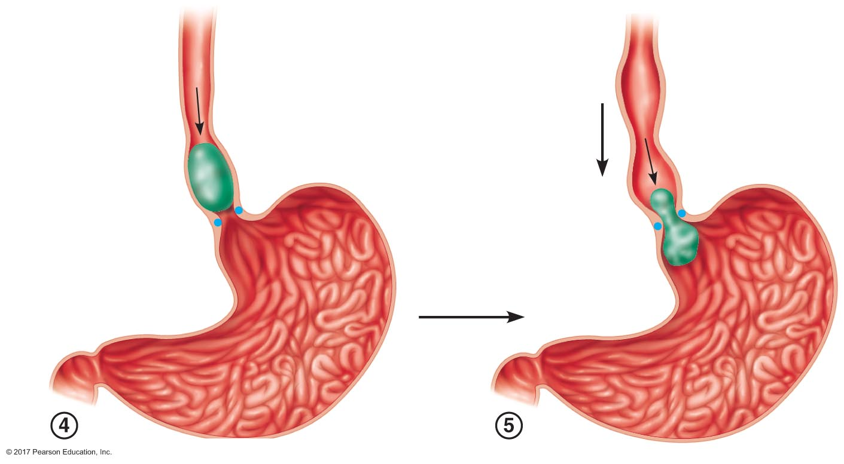
Figure 20.31 Events of the swallowing reflex.
Slide 5
Secondary wave
of peristalsis in
esophagus
Lower esophageal
sphincter opens
Stomach

Slide 65
Gastric Motility
Functions
Mix chyme
Regulate gastric emptying
Mechanism
Peristalsis
Coordinated by enteric nervous system

Slide 66
Gastric Motility
Gastric motility patterns
Waves of peristalsis
Upper body → pylorus
Strengthen as they approach the pylorus
Functions in mixing of chyme
Pyloric sphincter closed
Functions in gastric emptying
Stronger contractions open pyloric sphincter
Factors governing emptying rate
Volume of chyme in stomach
Strength of gastric peristalsis

Slide 67
Gastric Motility
Migrating motility complex
Wave of intense contractions
Travels short distances
Occurs between meals to clear stomach

Slide 68
Gastric Motility
Regulation of gastric motility
Increase force
Gastrin
Decrease force
CCK
Secretin
GIP

Slide 69
Gastric Motility
Phases of regulation
Cephalic-phase excitations
Anger, aggression
Cephalic-phase inhibitions
Pain, fear, depression
Gastric-phase excitatory stimulus
Distension of stomach
Intestinal-phase inhibitory stimuli
Distension of duodenum
Contents: osmolarity, acidity, fat

Slide 70
Gastric Motility
Vomiting
Stimuli
Illness
Emotions
Pain
Distension in GI tract
Rotation of head
Ingestion of certain substances (emetics)
Reflex mediated through vomiting center in medulla

Slide 71
Motility of the Small Intestine
Segmentation mixes chyme
Peristalsis propels chyme forward
Regulation of motility in small Intestine
Distension: increases motility
Autonomic nervous system
Parasympathetic → excites
Sympathetic → inhibits
Hormones: gastrin stimulates motility

Slide 72
Motility of the Small Intestine
Motility reflexes
Intestino-intestinal reflex
Injury or severe stress inhibits intestinal contractions
Ileogastric reflex
Distension of ileum inhibits gastric motility
Gastroileal reflex
Presence of chyme in stomach increases motility in ileum

Slide 73
Motility of the Colon
Haustrations
Proximal colon
Like segmentation, but slower
Mass movement
Propels bolus (material) toward rectum
Similar to peristalsis
Contraction lasts longer than relaxation

Slide 74
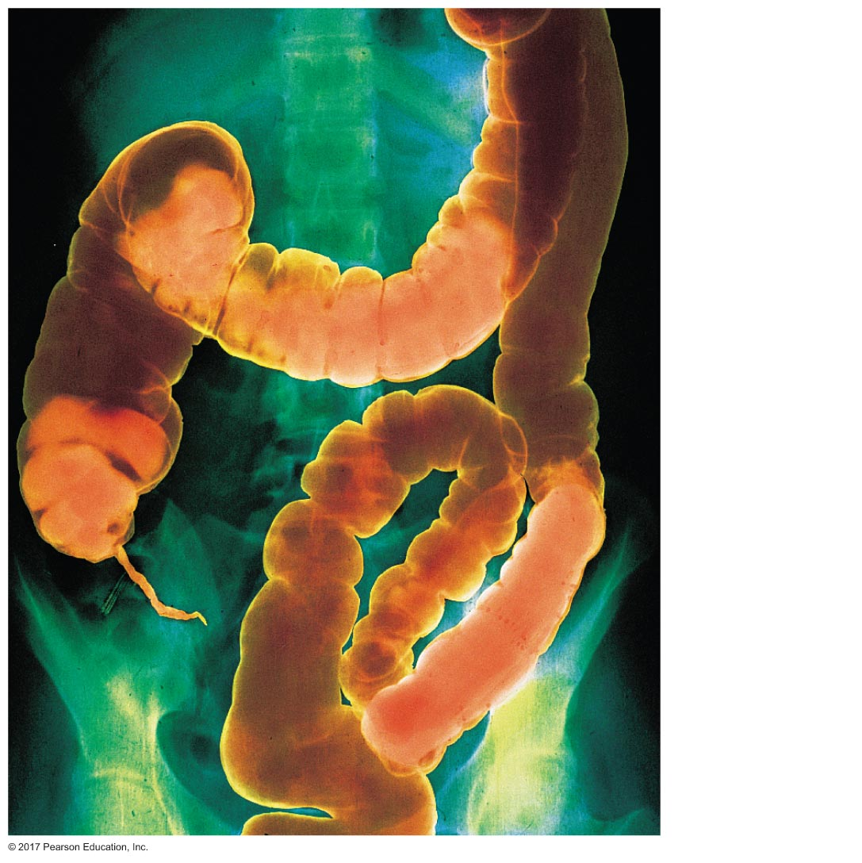
Figure 20.32 An X-ray image of a human colon showing haustra.
Transverse
colon
Haustra

Slide 75
Motility of the Colon
Regulation of colon motility
Colonocolonic reflex
Distension of colon in one area causes relaxation of other areas of colon
Gastrocolic reflex
Food in stomach increases colonic motility

Slide 76
Motility of the Colon
Defecation
Voluntary and involuntary control
Distension of colon activates stretch receptors
Smooth muscle of rectum contracts
Increases pressure in rectum
Peristaltic contractions of sigmoid colon propel more fecal material into the rectum, increasing pressure
Internal anal sphincter relaxes simultaneously as external anal sphincter contracts
Both sphincters relax
Defecation

