Slide 1
The Immune System
23a

Slide 2
Chapter Outline
23.1 Anatomy of the Immune System
23.2 Pathogens That Activate the Immune Response
23.3 Organization of the Body's Defenses
23.4 Humoral Immunity
23.5 Cell-Mediated Immunity
23.6 Immune Responses in Health and Disease

Slide 3
23.1 Anatomy of the Immune System
Physical barriers
Skin and mucous membranes
Leukocytes
White blood cells
Wide range of immune responses
Lymphoid tissues
Bone marrow, thymus, spleen, lymph nodes, and tonsils
Development and function of leukocytes

Slide 4
Physical Barriers
Skin
Epidermis
Dermis
Sebaceous glands
Mucous membranes
Viscous mucus traps foreign matter

Slide 5
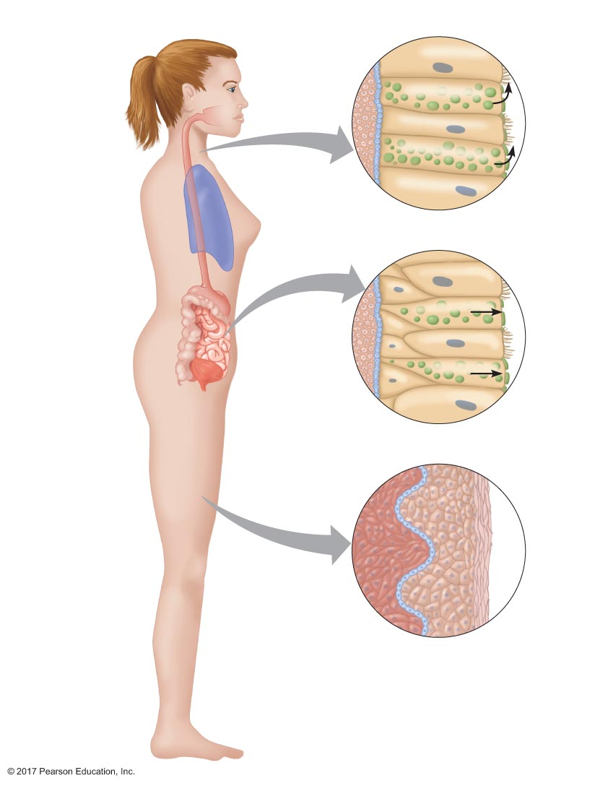
Figure 23.1 Chemical and physical barriers to pathogens.
Chemical Barriers
Physical Barriers
Goblet
cell
Lysozyme
in saliva
Mucus
Ciliated
cell
Ciliated mucosa
HCl in stomach
Epithelial
cell
Mucus
Goblet
cell
Acid in urinary
tract (and vagina
in females)
Fatty acids in
sebaceous glands
GI tract mucosa
Dermis
Epidermis
Keratin
layer
Skin

Slide 6
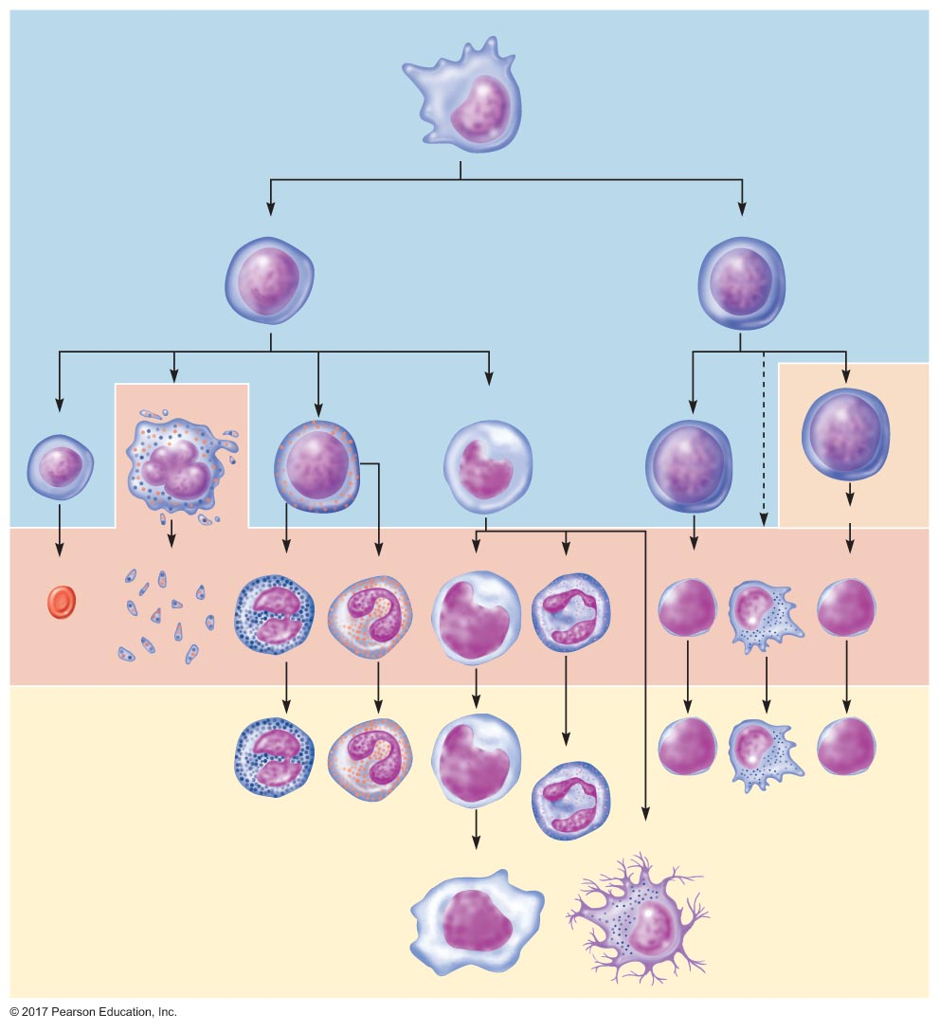
Figure 23.2 Immune cell production.
Slide 1
Hematopoietic stem cell
Myeloid stem cell
Lymphoid stem cell
Bone marrow
Megakaryocyte
Granulocyte/
monocyte progenitor
Reticulocyte
Thymus
T-lymphocytes
Platelets
Natural
killler
cells
Erythrocyte
Basophil
Eosinophil
Monocyte
Neutrophil
B-lymphocyte
T-lymphocyte
Blood
Neutrophil
Dendritic
cell
Tissue
Macrophage

Slide 7
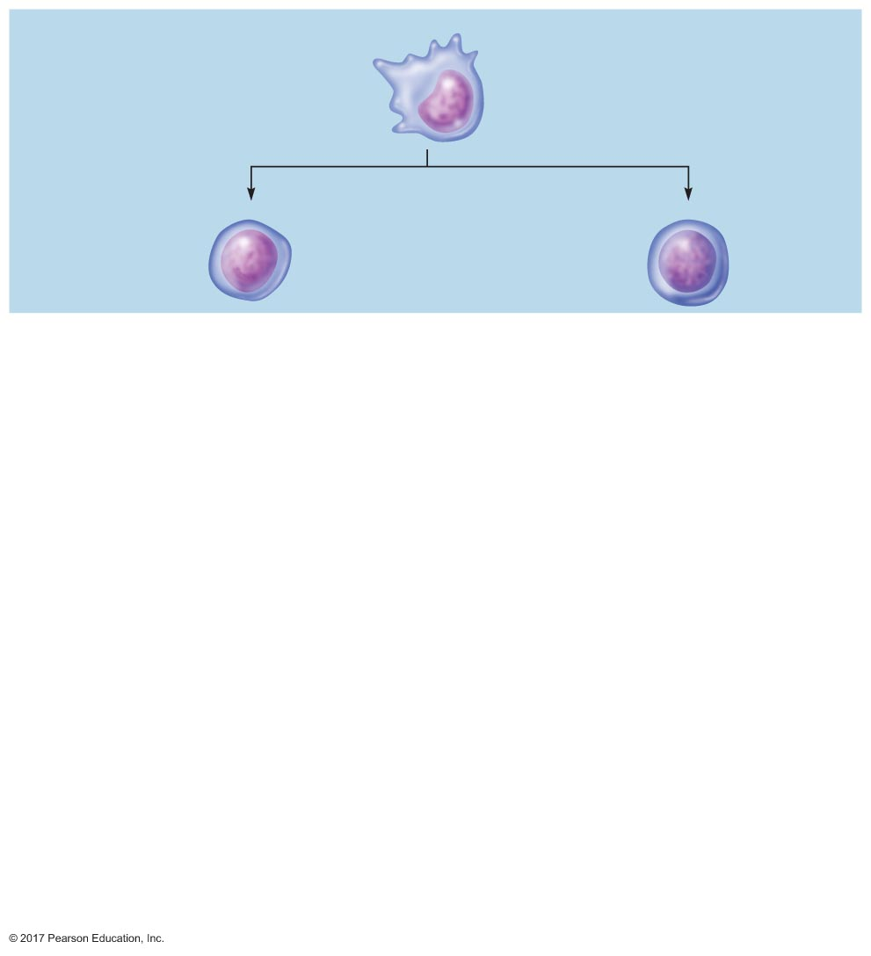
Figure 23.2 Immune cell production.
Slide 2
Hematopoietic stem cell
Myeloid stem cell
Lymphoid stem cell
Bone marrow

Slide 8
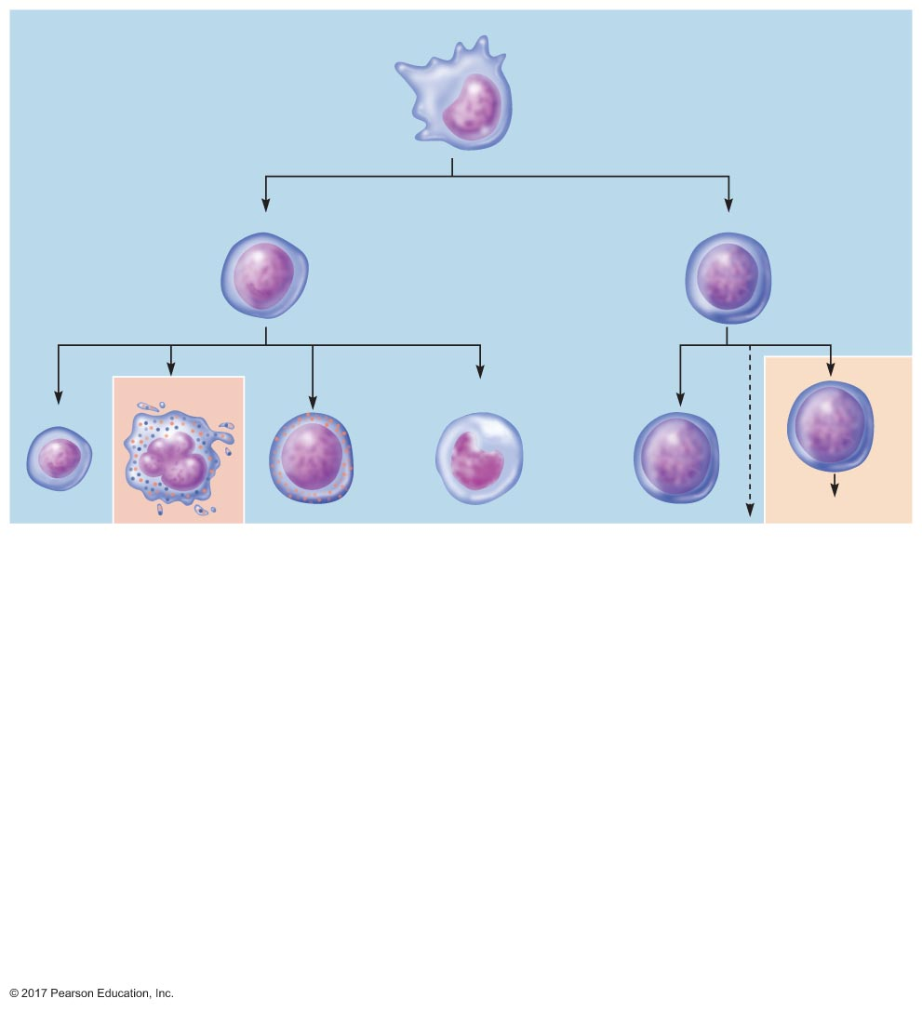
Figure 23.2 Immune cell production.
Slide 3
Hematopoietic stem cell
Myeloid stem cell
Lymphoid stem cell
Bone marrow
Megakaryocyte
Granulocyte/
monocyte progenitor
Reticulocyte
Thymus
T-lymphocytes

Slide 9
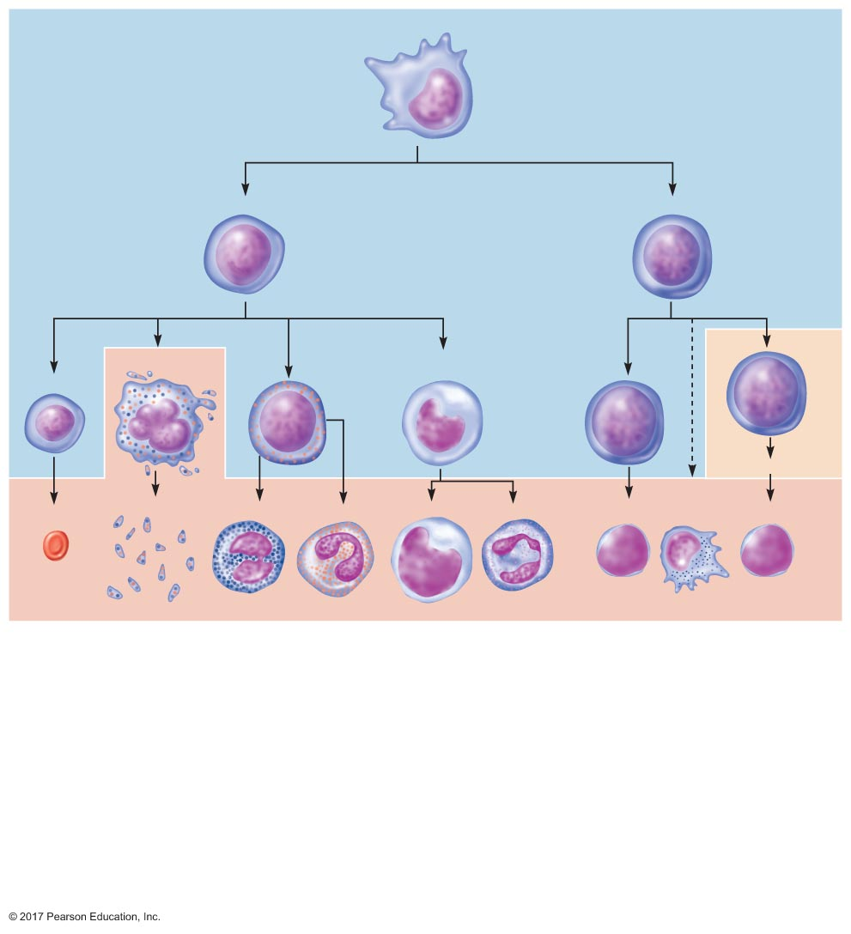
Figure 23.2 Immune cell production.
Slide 4
Hematopoietic stem cell
Myeloid stem cell
Lymphoid stem cell
Bone marrow
Megakaryocyte
Granulocyte/
monocyte progenitor
Reticulocyte
Thymus
T-lymphocytes
Platelets
Natural
killler
cells
Erythrocyte
Basophil
Eosinophil
Monocyte
Neutrophil
B-lymphocyte
T-lymphocyte
Blood

Slide 10
Figure 23.2 Immune cell production.
Slide 5
Hematopoietic stem cell
Myeloid stem cell
Lymphoid stem cell
Bone marrow
Megakaryocyte
Granulocyte/
monocyte progenitor
Reticulocyte
Thymus
T-lymphocytes
Platelets
Natural
killler
cells
Erythrocyte
Basophil
Eosinophil
Monocyte
Neutrophil
B-lymphocyte
T-lymphocyte
Blood
Neutrophil
Dendritic
cell
Tissue
Macrophage

Slide 11
Leukocytes
Derived from same hematopoietic stem cells in bone marrow
Granulocytes
Neutrophils
Eosinophils
Basophils
Agranulocytes
Monocytes
Lymphocytes

Slide 12
Leukocytes
Phagocytes
Neutrophils (most abundant)
Eosinophils
Monocytes
Macrophages
Dendritic cells
Secrete cytokines
Circulate in blood 7–10 hours
Migrate to tissues for a few days
Increase in number during infections

Slide 13
Leukocytes
Lymphocytes
Account for 20–40% of leukocytes
Account for 99% of interstitial fluid cells
Three types
B lymphocytes (B cells)
T lymphocytes (T cells)
Null cells

Slide 14
Leukocytes
B cells
Associated with antibodies
Contact antigen → plasma cell
Plasma cell secretes antibodies (immunoglobulins)
Antibodies mark invaders for destruction

Slide 15
Leukocytes
T cells
Directly damage foreign cells
Contact infected, mutant, or transplanted cells
Develop into cytotoxic T cells that destroy target cells
Takes several days
Secretory products form pores in the target cell's membrane
Lysis

Slide 16
Leukocytes
Null cells
Most are natural killer cells
Important defense against viral infections
Attack virus-infected cells
Cause lysis
Fast acting
Early immune response

Slide 17
Leukocytes
Mast cells
Immune cells of skin and mucosa
Secrete histamine and other substances
Dendritic cells
Similar to macrophages
Phagocytes
Activate certain types of T cells

Slide 18
Lymphoid Tissues
Bone marrow
Thymus
Spleen
Lymph nodes
Tonsils
Adenoids
Appendix
Peyer's patches

Slide 19
Lymphoid Tissues
Central lymphoid tissue = bone marrow + thymus
Bone marrow
Hematopoietic stem cells: precursors for all blood cells
Leukocytes (except T lymphocytes) fully develop in bone marrow
Thymus
T lymphocytes migrate from bone marrow to thymus
Reach maturity in thymus

Slide 20
Lymphoid Tissues
Peripheral lymphoid tissue
Spleen, lymph nodes, tonsils, adenoids, appendix, and Peyer's patches
Collections of B cells, T cells, and macrophages
Trap microorganisms and foreign particles
Expose them to leukocytes in high concentrations
Spleen and lymph nodes filter blood and lymph

Slide 21
Lymphoid Tissue
Tonsils and adenoids
Trap inhaled particles
Appendix and Peyer's patches
Trap ingested particles

Slide 22
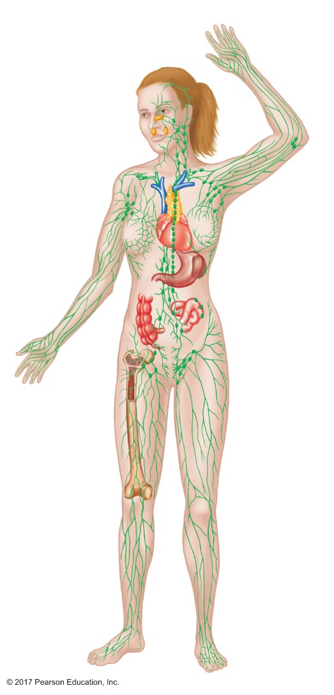
Figure 23.3 Lymphoid tissues.
Central lymphoid tissues
Peripheral lymphoid tissues
Adenoids
Tonsils
Thymus
Lymph
nodes
Heart
Spleen
Small
intestine
Peyer's patch
Large intestine
Appendix
Bone marrow
Lymphatic
vessels

Slide 23
23.2 Pathogens That Activate the Immune Response
Four different classes of pathogens
Viruses
Bacteria
Fungi
Parasites
Ability to cause a disease = virulence

Slide 24
Viruses
Smallest (20–400 nm)
Single- or double-stranded nucleic acid surrounded by protein coat
Requires a host
Uses host's metabolic machinery to reproduce
Can double the number of viral organisms hourly
Target specific cells

Slide 25
Bacteria
Smallest (1–5 μm)
Prokaryotic
Most have single circular chromosome
Gram-positive or -negative
Ability to break up cresyl violet
Invade tissue
Colonization: adhesin
Release endotoxins or exotoxins

Slide 26
Fungi
Constitute their own kingdom; neither plants nor animals
Eukaryotic
Yeast, molds, and mushrooms
Absorb nutrients from environment
Grow slowly

Slide 27
Parasites
Invading organisms
Protozoans
Example: Trypanosoma brucei (sleeping sickness)
Metazoans
Examples: worms, arthropods
10 μm to 20 cm in size; most less than 50 μm
Vector

Slide 28
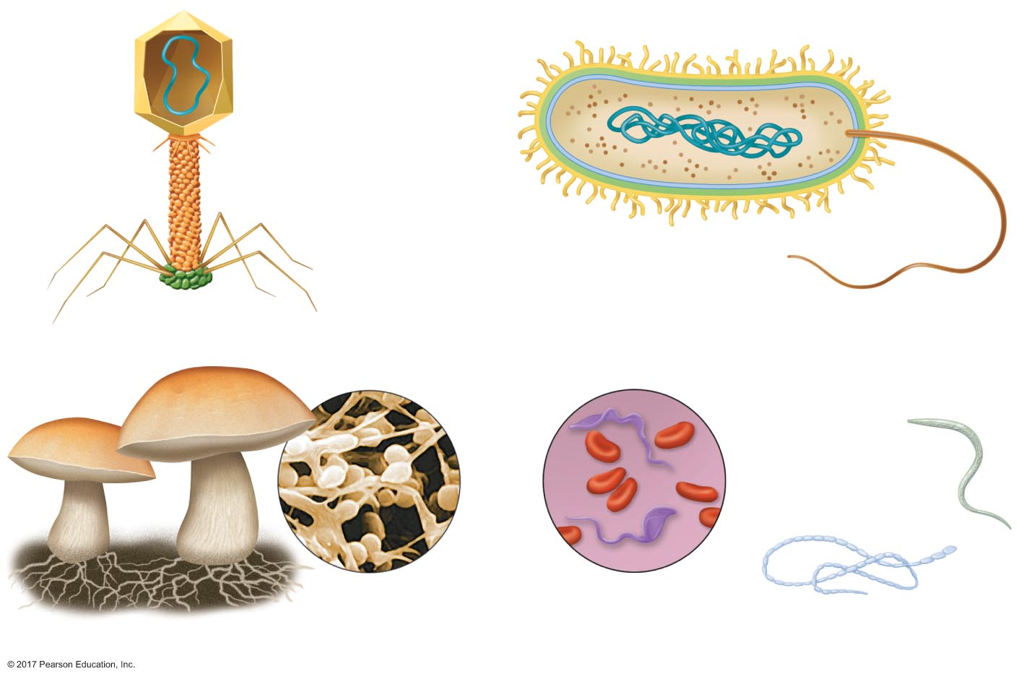
Figure 23.4 Classes of pathogens: viruses, bacteria, fungi, and parasites.
Capsid
Nucleic acid
Nucleic acid
Flagellum
Rod
Plasma
membrane
Tails
Cell wall
Virus
Bacterium
Trypanosomes
Hookworm
Erythrocytes
Microscopic
fungi
Microscopic
parasites
Tapeworm
Fungi
Parasites

Slide 29
23.3 Organization of the Body's Defenses
Nonspecific defenses (innate defenses)
Pathogen-associated molecular patterns (PAMPs)
Pattern recognition receptors: bind PAMPs
Physical barriers
Inflammation
Interferons
Natural killer cells
Complement system

Slide 30
Nonspecific defenses
Inflammation: series of events causing accumulation of proteins, fluid, and phagocytes in an injured or invaded area
Macrophages engulf debris and foreign matter
Capillaries dilate and become more permeable
Foreign matter is contained
More leukocytes migrate to area
Leukocytes clear infection

Slide 31
Nonspecific Defenses
Phagocytosis of pathogens
Proteins on microbes bound by macrophages
Triggers phagocytosis and secretions
Secretory products trigger subsequent steps

Slide 32
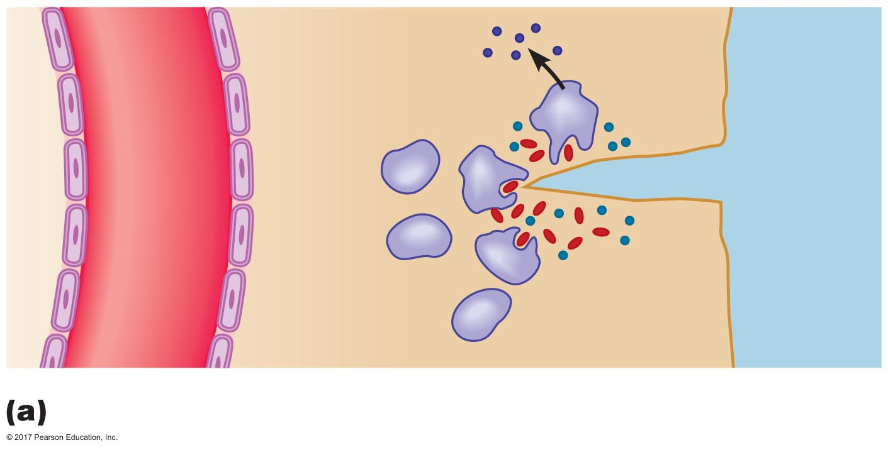
Figure 23.5a Major events in local inflammation.
Cytokines
Foreign
matter
Macrophage
Tissue
injury
Capillary
Microbes
Phagocytosis by nearby macrophages

Slide 33
Nonspecific Defenses
Dilation and increased permeability in capillaries
Damaged mast cells secrete histamine
Histamine triggers dilation and increases permeability
Result: increased blood flow and increased movement of proteins and cells to injured tissue
Symptoms of inflammation induced by effects of histamine
Redness
Heat
Edema
Pain

Slide 34
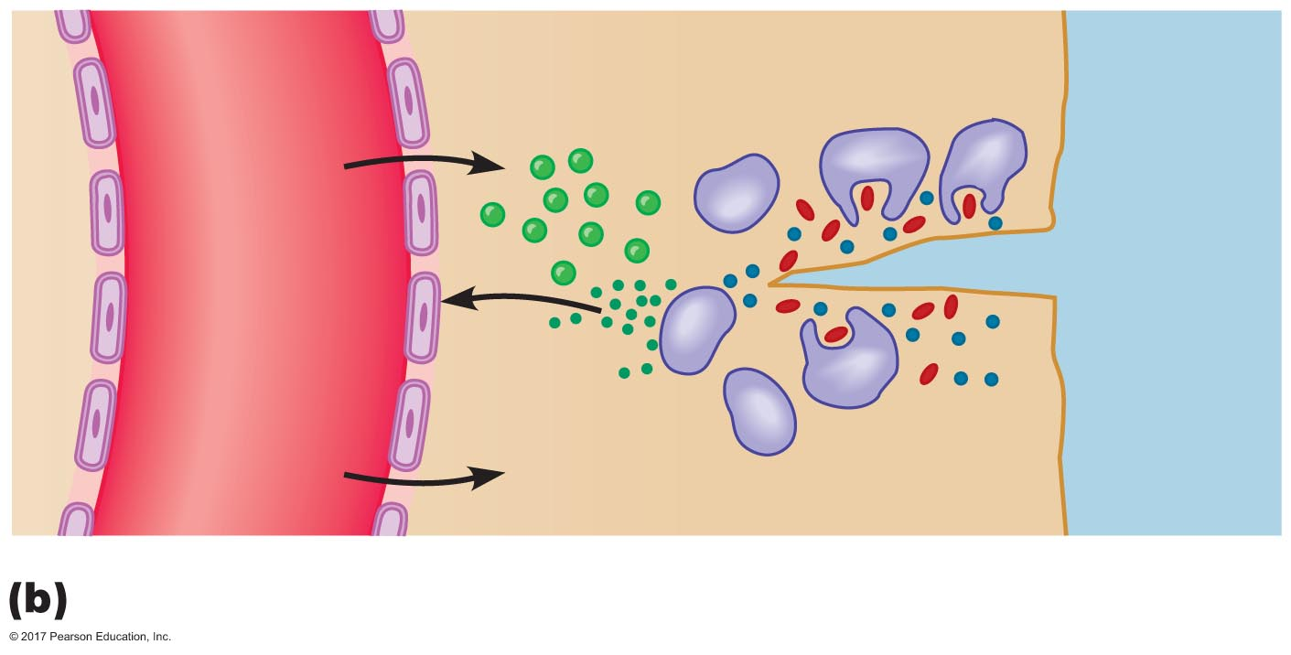
Figure 23.5b Major events in local inflammation.
Defensive
proteins
Histamine
Fluid
Dilation and increased permeability of capillary

Slide 35
Nonspecific Defenses
Containment of foreign matter
Mast cells and basophils → heparin
Heparin prevents clot formation initially so blood cells can access area
Clotting factors eventually form a clot in tissue, which prevents spread of foreign matter
Eventually forms a scab

Slide 36
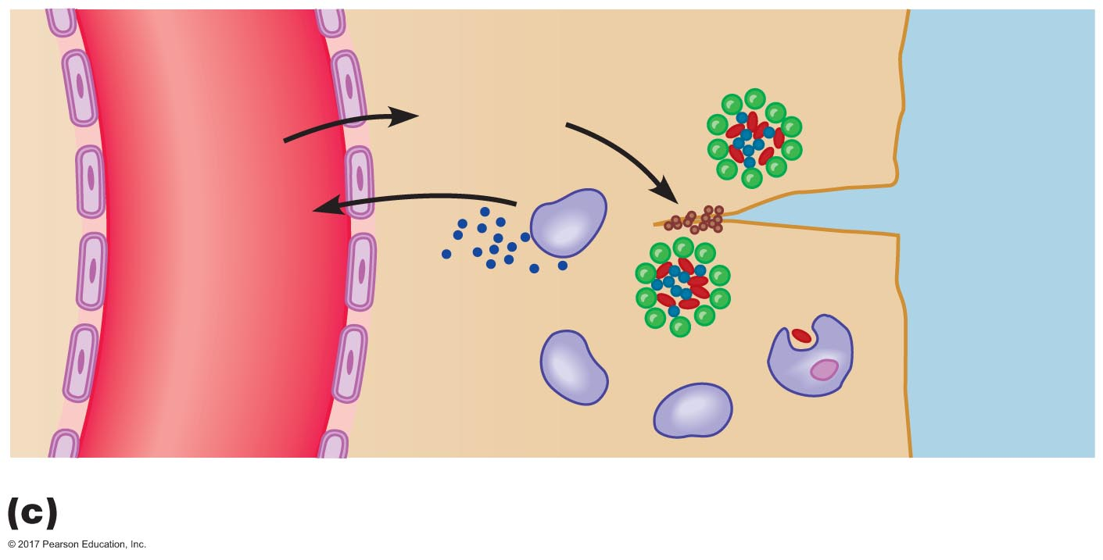
Figure 23.5c Major events in local inflammation.
Clotting
proteins
Heparin
Containment of bacteria and foreign matter

Slide 37
Nonspecific Defenses
Leukocyte migration and proliferation
1 hour: neutrophil migration
10 hours: monocyte migration → macrophages
Cells move from blood to tissue triggered by cytokines
Margination: move to vasculature wall
Attachment: bind to wall
Diapedesis: move between endothelial cells
Movement in tissue to injury: chemotaxis

Slide 38
Nonspecific Defenses
Leukocyte proliferation
Cytokines travel to bone marrow
Stimulate production of leukocytes
Increase four to five times in circulating numbers

Slide 39
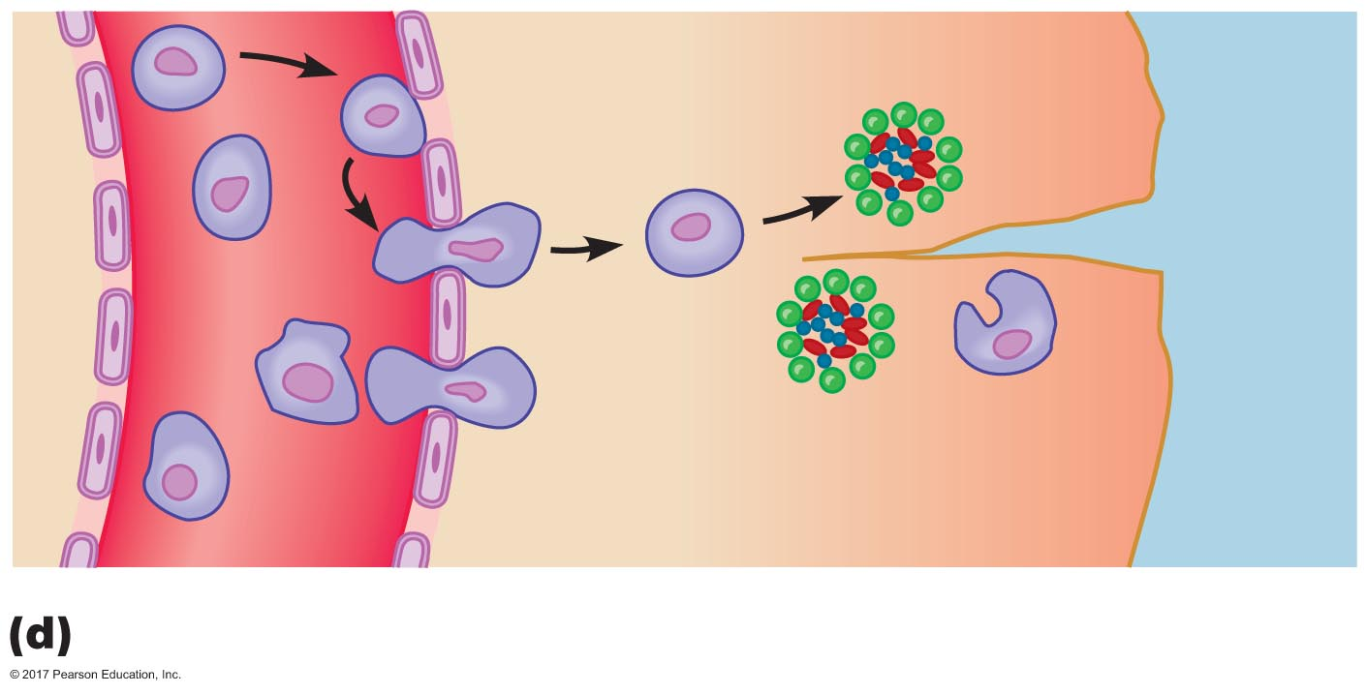
Figure 23.5d Major events in local inflammation.
Margination
Leukocyte
diapedesis
Leukocyte proliferation and migration

Slide 40
Nonspecific Defenses
Clearing of foreign particles
Once foreign particles are present in damaged or invaded tissue, leukocytes must clear the tissue
Phagocytosis
Secretion of cytokines

Slide 41
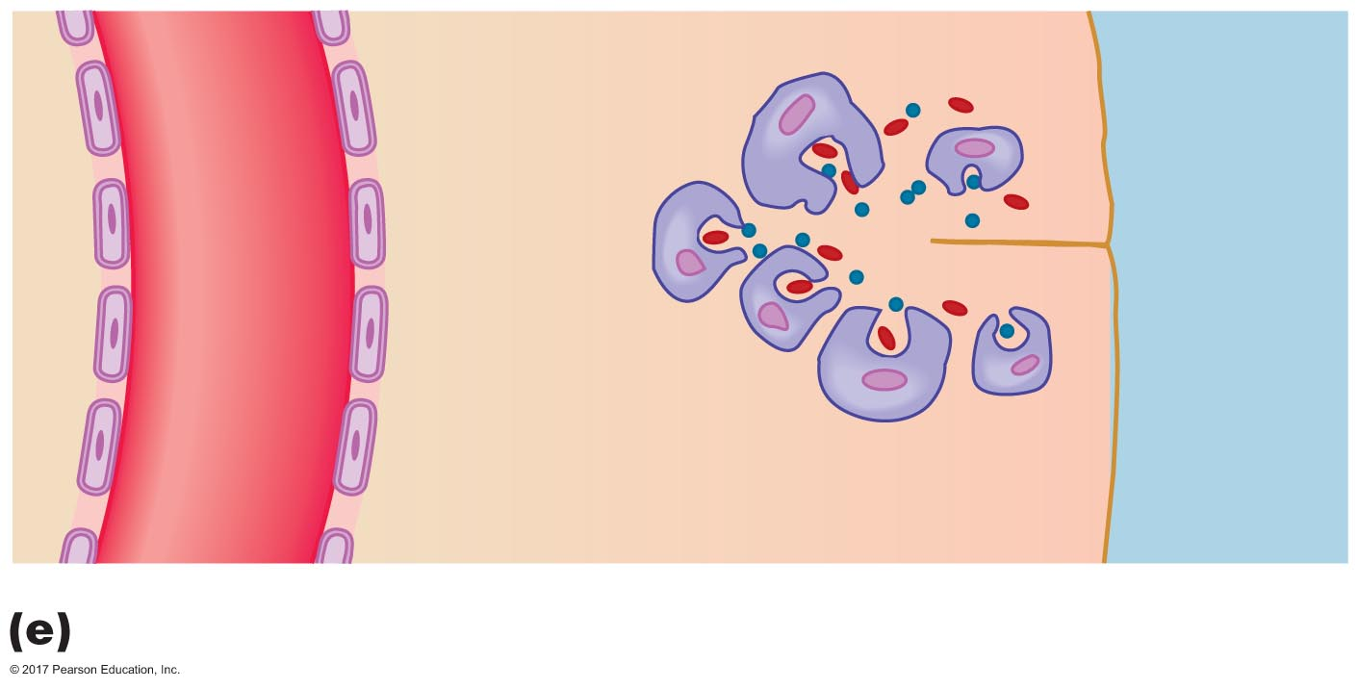
Figure 23.5e Major events in local inflammation.
Continued activity of recruited leukocytes

Slide 42
Nonspecific Defenses
Steps of phagocytosis
Attachment
Specific: damaged cells or protein-targeted cells
Proteins = opsonins
Internalization
Takes approximately 0.01 sec
Phagosome + lysosome → secondary lysosome
Degradation
Lysosome enzymes degrade phagocytosed product
Exocyosis
Elimination of some degradation products

Slide 43
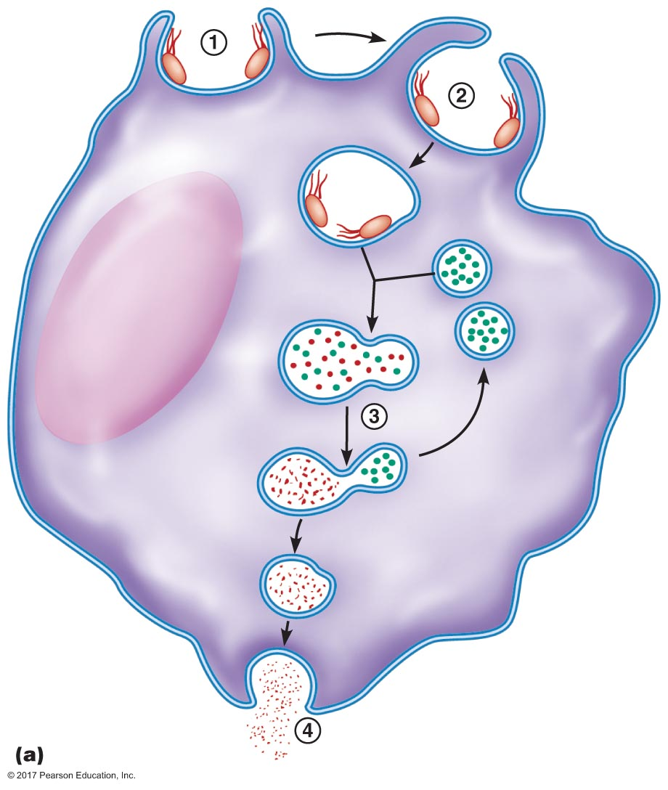
Figure 23.6a Phagocytosis.
Phagosome
Nucleus
Lysosome-
phagosome
fusion
Lysosomes
Enzymes
Secondary
lysosome
Bacterial
debris
Enzymes
Exocytotic
vesicle

Slide 44
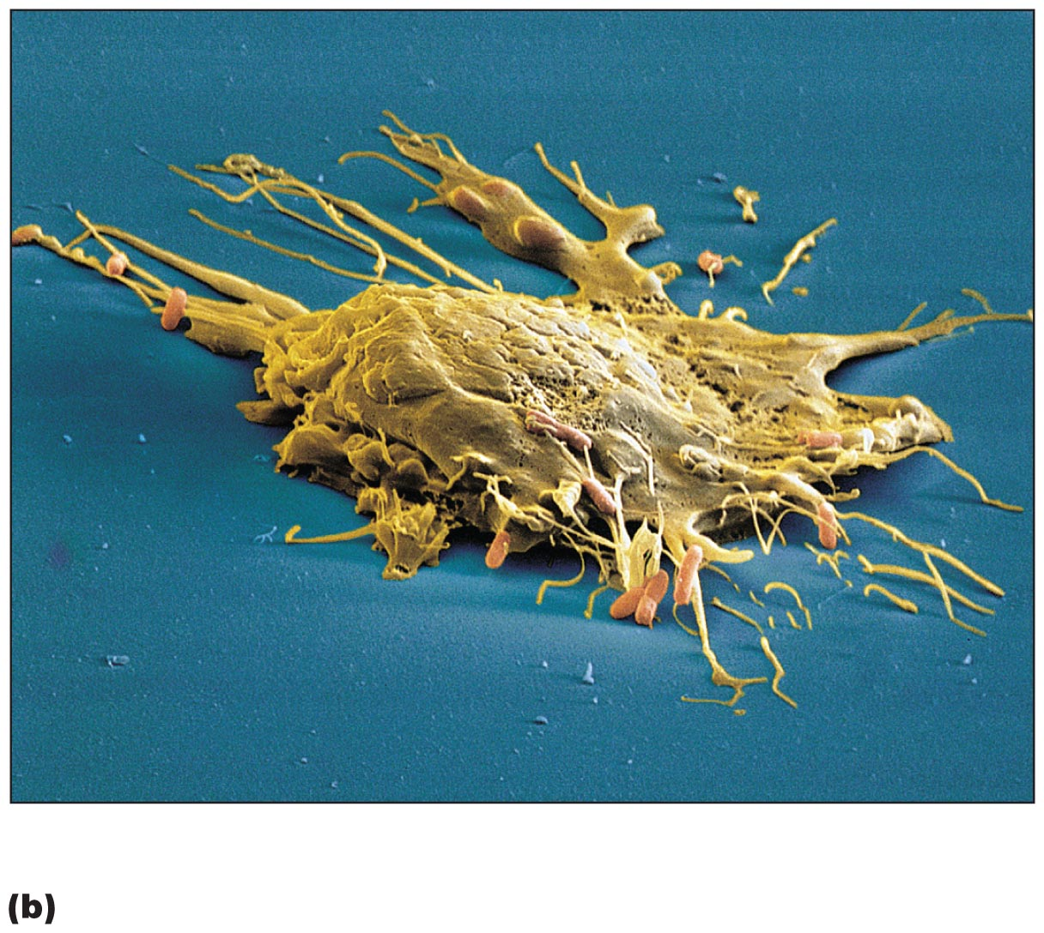
Figure 23.6b Phagocytosis.

Slide 45
Nonspecific Defenses
Secretion of cytokines by phagocytes
Trigger: attachment of foreign particle to phagocyte
Secretory products of macrophages
Interleukins: communicate between leukocytes
IL-1
IL-6
TNF-α

Slide 46
Nonspecific Defenses
Actions of interleukins and TNF-α
Bone marrow: produces and secretes more leukocytes
Act as endogenous pyrogens
Stimulate fever via hypothalamus
Hypothalamus increases body temperature via prostaglandins
Liver: acute-phase proteins
IL-1 stimulates proliferation and differentiation of B and T lymphocytes
B cells → antibody production
T cells → cell-mediated immunity

Slide 47
Nonspecific Defenses
Interferons
Proteins secreted by leukocytes and virus-infected cells
Induce virus resistance in neighboring cells
Viral infection
RNA invades host cell, using that cell's replication machinery to reproduce
Viral nucleic acid stimulates host cell to secrete interferon-α and interferon-β
Kills host cells
Induces neighboring cells to resist viral infection

Slide 48
Nonspecific Defenses
Interferon-γ
Secreted from active T cells and NK cells
Inhibits viral replication
Enhances phagocytosis by macrophages
Boosts antibody production in B cells
Helps activate NK cells and cytotoxic T cells
Inhibits cell division—defense against cancer

Slide 49
Nonspecific Defenses
Natural killer cells
Recognize abnormal or infected cells
Cause lysis of pathogen by secreting perforins
Can attack virus-infected cells without identifying virus
Early defense against viral infections
Part of specific immune response
Actions are enhanced by interleukin-2 produced by T cells as well as by antibodies produced by plasma cells

Slide 50
Nonspecific Defenses
Complement system
Plasma proteins that lyse foreign cells, especially bacteria
Part of response to antibodies (specific immunity) in addition to nonspecific response
Approximately 30 proteins participate in the response cascade, resulting in MAC reaching the surface of bacteria
MAC pierces the bacterial membrane, causing lysis

Slide 51
Nonspecific Defenses
Activation of complement system
Classical pathway
Binding to antibodies attached to bacteria
Part of specific defense mechanisms
Lectin pathway
Binding to mannose-containing carbohydrates on bacteria or viruses
Alternative pathway
Binding to carbohydrates on bacterial cell walls
Part of nonspecific defense mechanisms

Slide 52
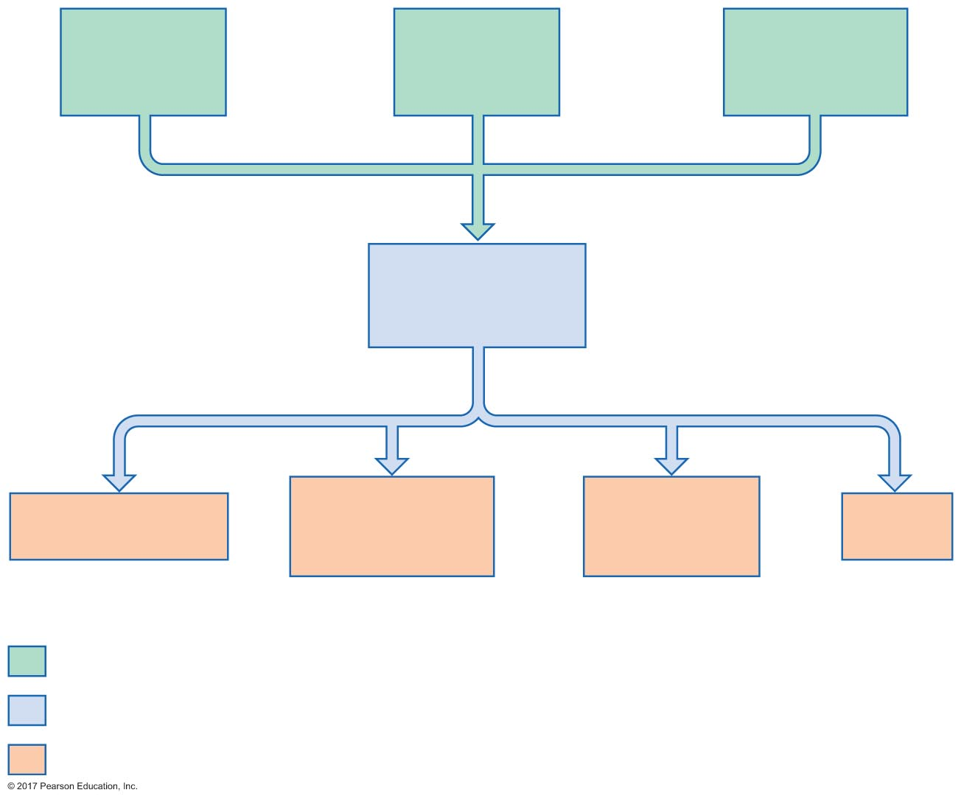
Figure 23.7 Complement activation and actions.
Classical
pathway
Lectin
pathway
Alternative
pathway
Complement
activation
Leukocyte
recruitment
Histamine
secretion
Opsonization
MAC
Initial stimulus
Physiological response
Result

Slide 53
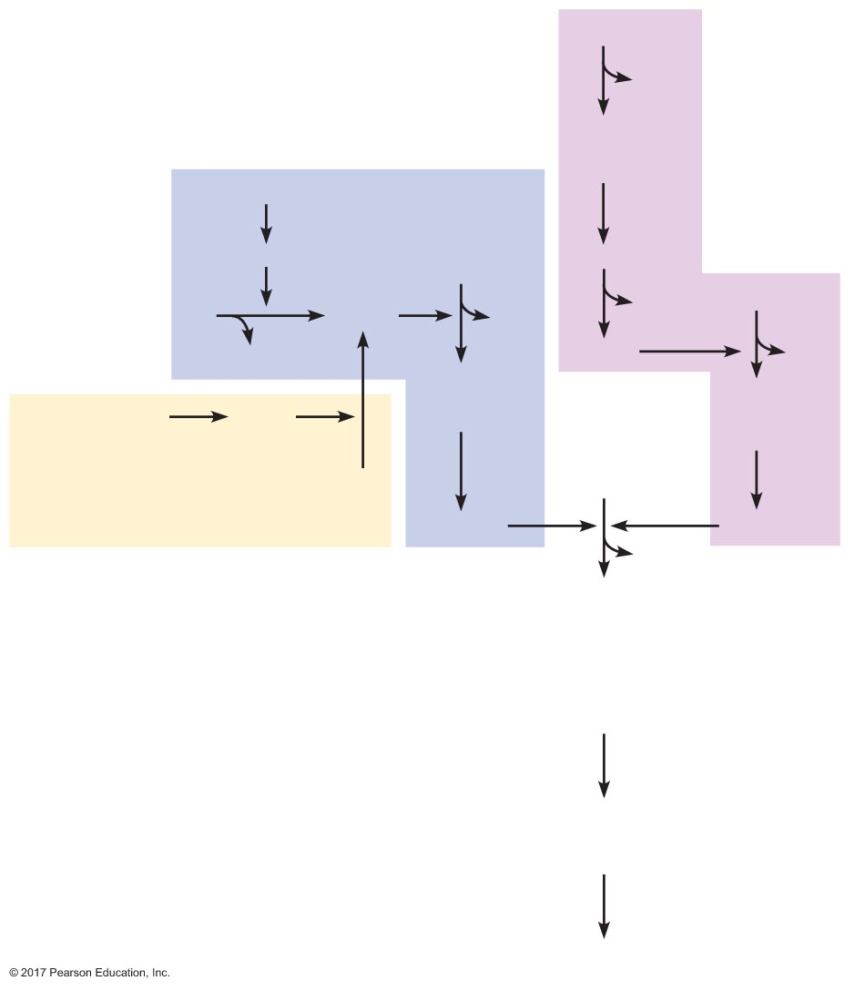
Figure 23.8 Complement pathways.
C3
Alternate
pathway
C3a
C3b
+
B
Classical pathway
Ab + Pathogen
C1
C3
C3bB
C2
C4b2a
C3a
Ba
C3
C2b
C3b
+
C4b2a
C3bBb
C3a
MBL + mannose
MASP
C3b
+
C3Bb
C4
+
C2
C5
C4b2a3b
C3bBb3b
Lectin pathway
C5a
C5b
+
C6
+
C7
+
C8
Reactions occurring
on cell membrane
MAC
+
C9
MAC

Slide 54
Nonspecific Defenses
Complement protein functions
Form MAC to lyse cell
Chemotaxis
Trigger histamine release from mast cells
Act as opsonins

Slide 55
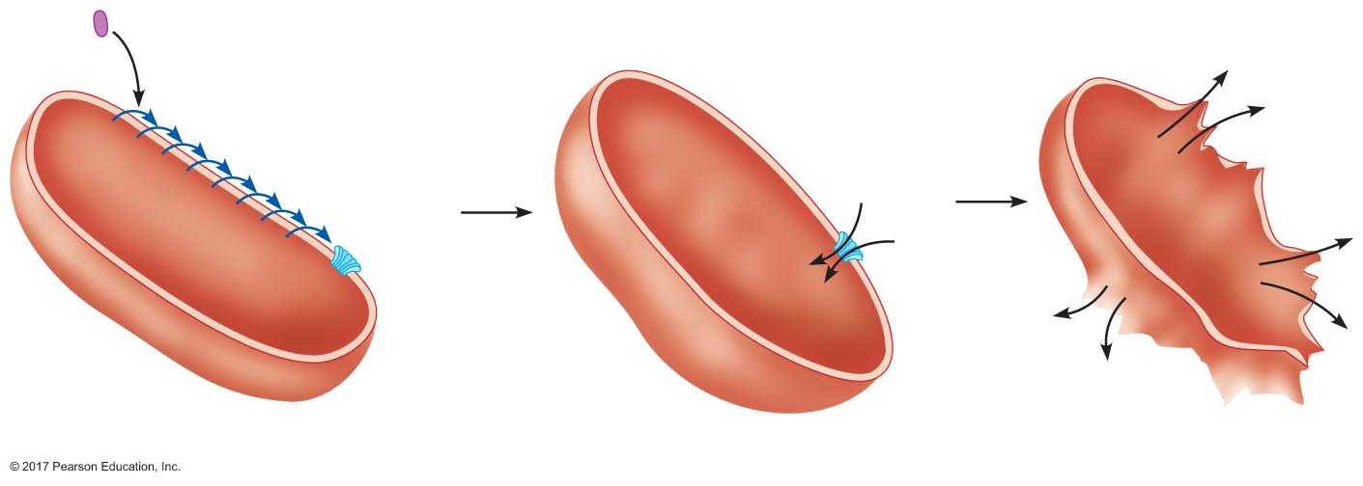
Figure 23.9 Formation of the MAC complex and cell lysis.
First complement
protein (inactive)
Cascade of protein
activation steps
on membrane
Fluid
rushes
into cell
Bacterial
cell
Pore
MAC
is formed
Pore formation
Swelling
Lysis

Slide 56
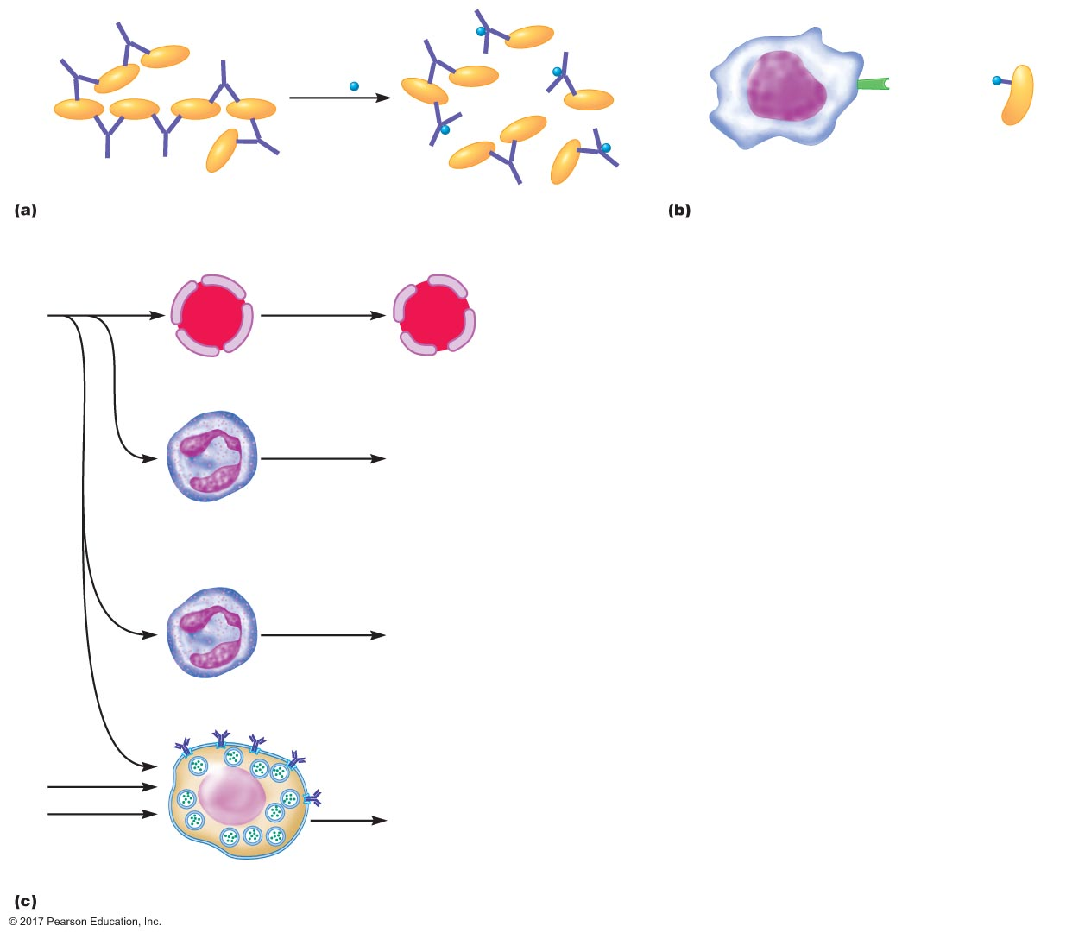
Figure 23.10 Actions of complement proteins independent of MAC.
Complement
receptor
3b
Pathogen
+3b ( )
Antibody
Bacterium
Phagocyte
Solubilization
Opsonization
C5a
Vasodilation
and increased
capillary permeability
Capillary
Chemotaxis
Neutrophil,
monocyte
and eosinophil
Hydrolytic enzymes
Neutrophil
C3a
C4a
Histamine
Mast cell
Inflammation

Slide 57
Specific Defenses: Immune Responses
Humoral immunity
B cell mediated
Involves secretion of antibodies by plasma cells
Defend against bacteria, toxins, and viruses in body fluids
Cell-mediated immunity
T cell mediated
Involves lysis of cells by cytotoxic T cells
Defend against bacteria and viruses in body cells
Part of reaction to transplants and cancer cells

Slide 58
Specific Defenses: Immune Responses
Features of specific immune response
Specificity
Diversity
Memory
Self-tolerance

Slide 59
Specific Defenses: Immune Responses
Specificity
Antigens (antibody generators) confer specificity
Complex proteins and polysaccharides
Part of foreign invaders and tumor cells
Epitopes: recognition sites for B or T cells
B cell and T cell specificity
Antigen receptors recognize certain antigens only
B cells: membrane antibodies
T cells: T cell receptors

Slide 60
Specific Defenses: Immune Responses
Antibody structure
Two heavy chains
Two light chains
Constant region: same within a class of antibodies
Variable region: differs for different antigens, gives specificity to antigen-binding site
Two antigen-binding sites

Slide 61
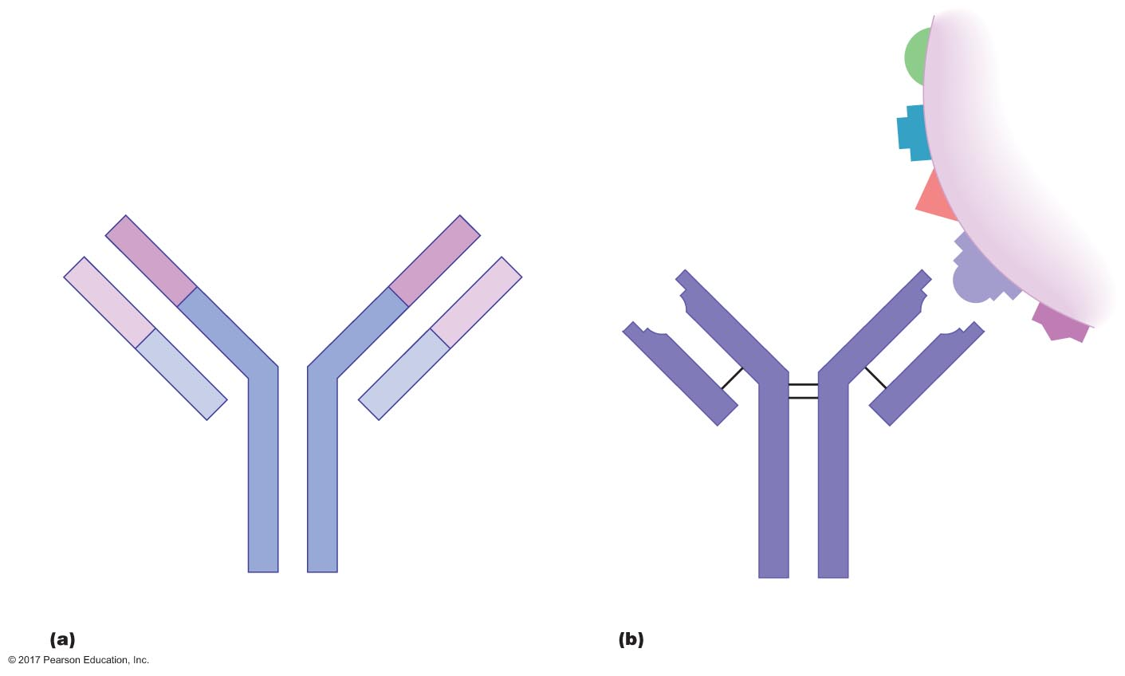
Figure 23.11 The basis of antigen-antibody specificity.
Antigen
Antigen-
binding
site
Antigen-
binding
site
Epitopes
V
V
V
Disulﬁde
bridge
V
C
C
C
-S-S-
-S-S-
-S-S-
C
Light
chain
-S-S-
Light
chain
C
C
Heavy chains
Antibody

Slide 62
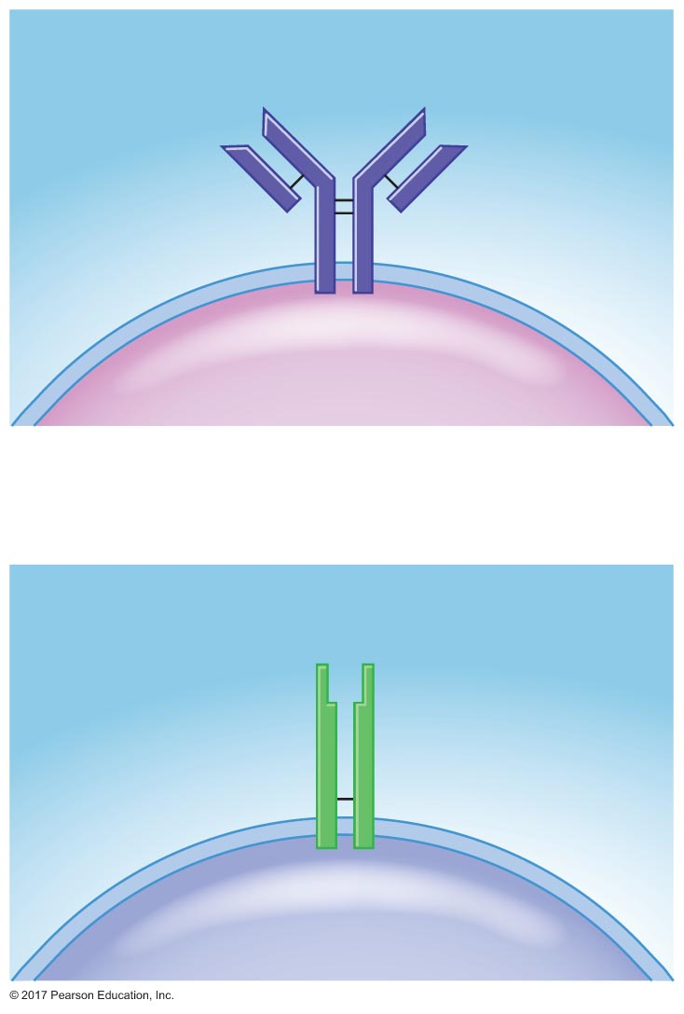
Figure 23.12 B cell and T cell antigen receptors.
Antigen-
binding sites
Membrane
antibody
B cell
Antigen-
binding site
T cell
receptor (TCR)
T cell

Slide 63
Specific Defenses: Immune Responses
Diversity
Specificity means that a B or T cell can recognize only a few of many antigens; determined genetically
Diversity in B- and T-cell antigen receptor types allows the immune system to recognize millions of antigens
Antigen interacts with specific lymphocyte
Induces those lymphocytes to proliferate and differentiate
Activation of lymphocytes = clonal selection

Slide 64
Specific Defenses: Immune Responses
Two types of clones
Effector cells
Combat the antigen that stimulated their production
Short lived
Memory cells
Long lived
Antigen specific

Slide 65
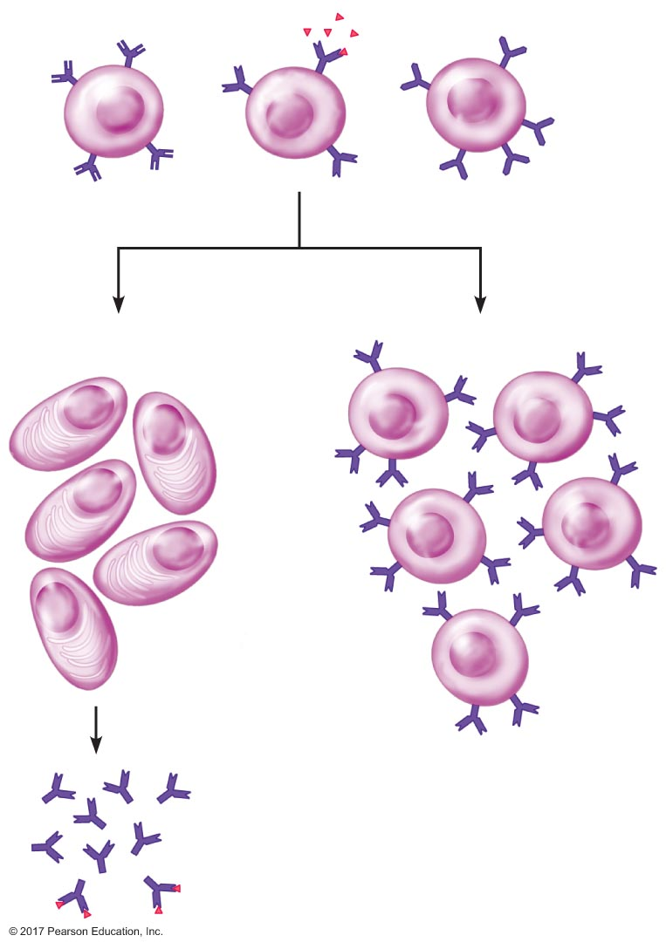
Figure 23.13 Clonal selection in B lymphocytes.
Antigen
Cell proliferation
Cell differentiation
Plasma cells
(effector cells)
Memory B cells
Antibody
secretion
Antibodies
bind to
antigen

Slide 66
Specific Defenses: Immune Responses
Memory
First exposure to antigen
Takes 10–17 days to occur after exposure
Symptoms of illness occur during these days
Antigen-selected B and T cells proliferate and differentiate into effector cells
Plasma cells
Cytotoxic T cells

Slide 67
Specific Defenses: Immune Responses
Secondary immune response
Subsequent exposures to antigen
Takes 2–7 days to occur
Response has greater magnitude and is more prolonged
Occurs due to presence of memory cells

Slide 68
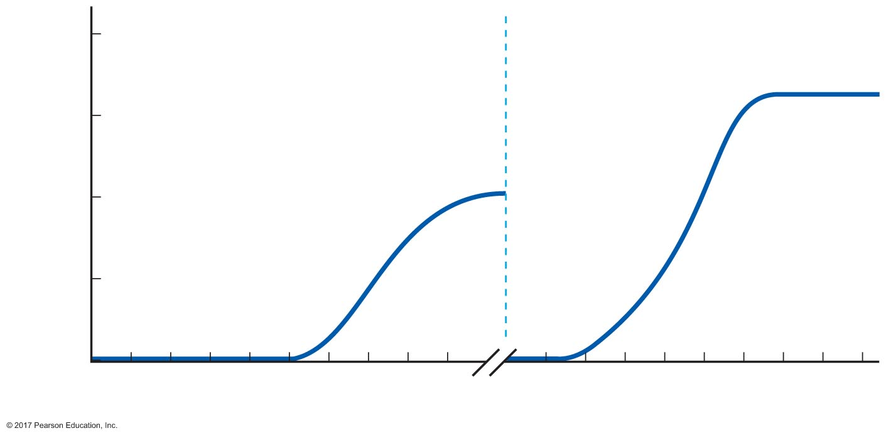
Figure 23.14 Primary and secondary responses to a given antigen.
100
Primary response
Secondary response
10
Serum antibody concentration
(logarithmic scale)
1.0
Second
exposure
to the same
antigen
First exposure
to antigen
0.1
0.01
0
2
4
6
8
10
12
14
16
18
2
4
6
8
10
12
14
16
18
Time after infection (days)

Slide 69
Specific Defenses: Immune Responses
Self-tolerance
B and T cells do not attack normal cells of body
As cells develop in bone marrow and thymus, any that have antigen receptors against normal body cells are destroyed by apoptosis (programmed cell death)
Autoimmune diseases caused by failure of self-tolerance

