Slide 1
The Immune System
23b

Slide 2
Chapter Outline
23.1 Anatomy of the Immune System
23.2 Pathogens That Activate the Immune Response
23.3 Organization of the Body's Defenses
23.4 Humoral Immunity
23.5 Cell-Mediated Immunity
23.6 Immune Responses in Health and Disease

Slide 3
23.4 Humoral Immunity
Role of B lymphocytes in antibody production
B lymphocyte exposure to antigen triggers clonal selection
Memory B cells + plasma cells
Plasma cells
Life span: 4–7 days
Secrete 2000 antibodies specific for antigen per second
Antibodies circulate several weeks, binding to and marking antigen for destruction
Phagocytosis
Complement-mediated lysis

Slide 4
Role of B Lymphocytes in Antibody Production
Sometimes proliferation and differentiation of B cells in response to antigen depends on helper T cells
Antigens: T-dependent antigens
Helper T cells respond to specific antigen
Secrete IL-2 (among other cytokines)
IL-2 + T-dependent antigens → activate B cells

Slide 5
Role of B Lymphocytes in Antibody Production
B cells can proliferate and differentiate into plasma cells (but not memory cells) in the absence of T cells
Antigens: polysaccharides on bacterial surfaces
Response weaker than helper T cell–dependent response
No memory for subsequent exposures

Slide 6
Antibody Function in Humoral Immunity
Antibody functions
Binds to specific antigen
Aids in inactivation or destruction of antigen
Antibody: antigen-binding site and tail
Antigen-binding site recognizes and binds antigen
Tail is involved in inactivation or destruction of antigen

Slide 7
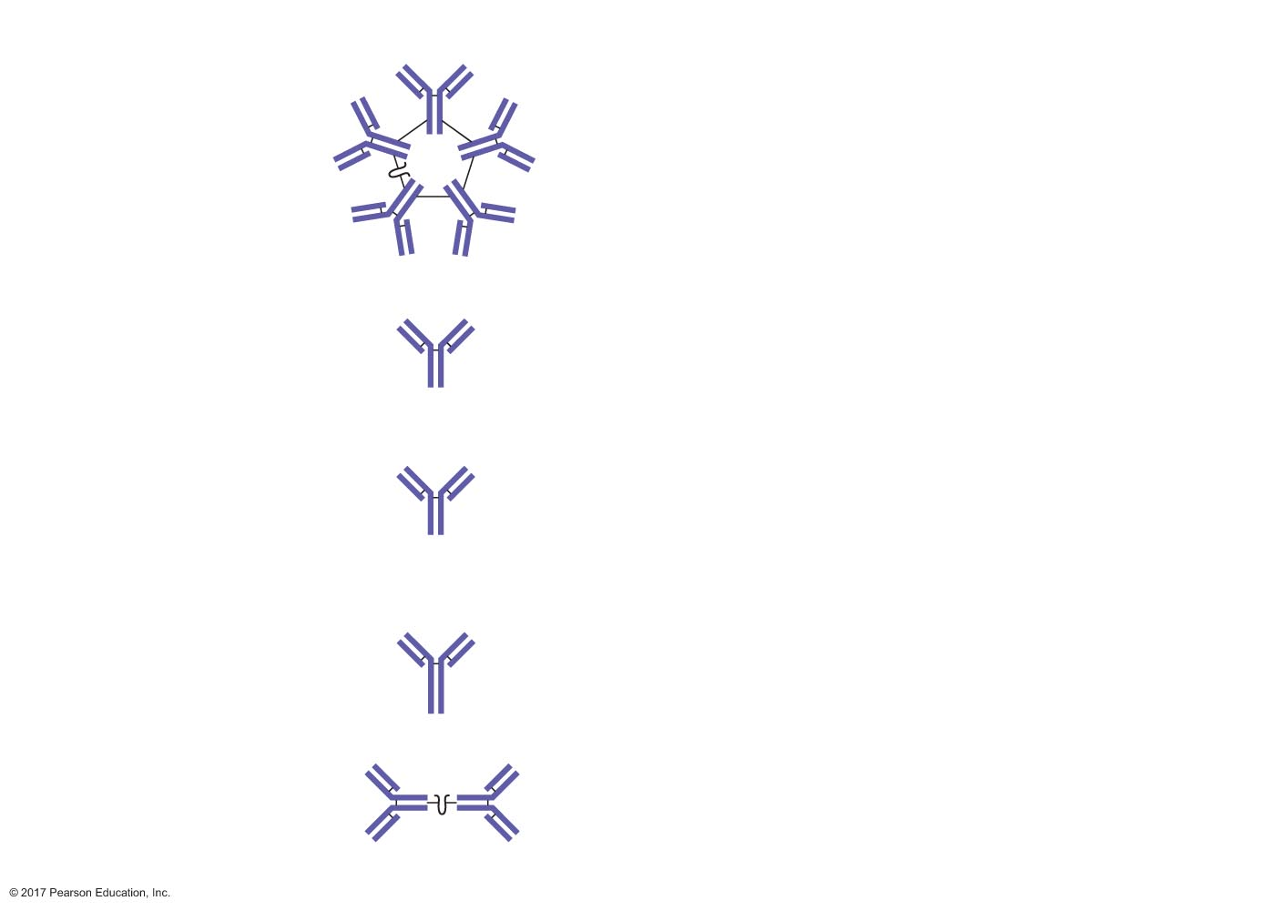
Figure 23.15 The five major classes of antibodies.
Class of
antibody IgM
Structure
Features
Roles in antigen disposal
IgM
The most common class of
antibody produced in the
primary response to antigen
Neutralizes antigen
Agglutinates antigen
Activates complement
J (joining) chain
IgD
Important as an antigen
receptor on B cells
Neutralizes antigen
Agglutinates antigen
IgG
The most common class of
antibody in the blood, and the
major class of antibody produced
in secondary responses. Crosses
the placenta, so it is important in
fetal and newborn immunity
Neutralizes antigen
Agglutinates antigen
Activates complement
Opsonizes antigen
Enhances NK cell activity
IgE
Involved in allergies
such as hay fever
Neutralizes antigen
Agglutinates antigen
Binds to mast cells and basophils,
causing them to release histamine
IgA
Crosses epithelial cells, so is
present on mucosal surfaces
and in breast milk; is important
in immunity in newborns
Neutralizes antigen
Agglutinates antigen
J (joining) chain

Slide 8
Antibody Function in Humoral Immunity
Antibody actions
All classes: neutralization and agglutination
IgM and IgG: activate complement
IgG: opsonization
IgE: histamine release from mast cells and basophils
IgG: NK cells
NK cells have receptors for the antibody tail
Antibodies mark cells for destruction
NK cells produce pores in the membranes of cells, causing lysis

Slide 9
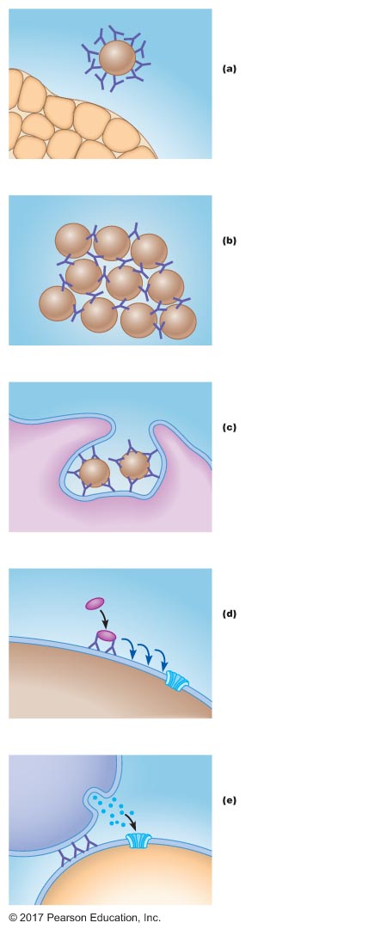
Figure 23.16 Antibody-mediated mechanisms of antigen disposal.
Pathogen
Neutralization:
Antibodies block the
activity of a pathogen.
Antibody
Target tissue
Pathogen
Antibody
Agglutination:
Multiple pathogens
are aggregated by
antibody molecules.
Antibody
Pathogen
Opsonization:
Pathogens bound by
antibodies are more
efﬁciently engulfed
by phagocytes.
Macrophage
First complement
component
Complement activation:
Antibodies bound to
pathogens activate the
complement cascade,
resulting in lysis of the cell.
Pathogen
Pore
NK cell
Perforin
Enhanced NK cell activity:
Abnormal body cells that
are bound by antibodies are
recognized by NK cells and
are subsequently lysed.
Pore
Abnormal body cell

Slide 10
23.5 Cell-Mediated Immunity
Roles of T lymphocytes in cell-mediated immunity
Helper T cells
Secrete cytokines that enhance activity of B cells and other T cells
Enhance activity of macrophages and NK cells
Cytotoxic T cells
Kill virus-infected cells, abnormal cells, and bacteria
Suppressor T cells
Secrete cytokines that suppress activity of B cells and other T cells

Slide 11
Roles of T Lymphocytes in Cell-Mediated Immunity
Major histocompatibility complex (MHC) molecules
T cells have antigen receptors
Only recognize antigen when it is associated with MHC molecules
MHC molecules bind antigen within the cell and transport antigen to the surface, where it can be recognized by T cells: antigen presentation

Slide 12
Roles of T Lymphocytes in Cell-Mediated Immunity
MHC marks body cells as "self"
Two classes of MHC molecules
Class I MHC: surface of all nucleated cells
Class II MHC: surface of macrophages, activated B cells, activated T cells, and thymus cells
MHC molecules unique to individual person: human leukocyte antigen (HLA)
Tissue type
Marks person as "self"
Responsible for tissue or organ rejection—stimulates immune response to foreign tissue

Slide 13
Roles of T Lymphocytes in Cell-Mediated Immunity
Final maturation of T cells depends on contact with MHC molecules
Bind with Type I MHC → cytotoxic T (CD8) cells
Bind with Type II MHC → helper T (CD4) cells

Slide 14
Roles of T Lymphocytes in Cell-Mediated Immunity
Role of MHC molecules in antigen presentation
MHC molecules have binding sites for antigen
MHC + antigen → cell surface (presentation)
Type I MHC
Bind antigens in infected cells or tumor cells (which can be any nucleated cell)
Type II MHC
Bind antigens taken into cell by phagocytosis or receptor-mediated endocytosis (which can occur only in cells that perform these functions—B cells, T cells, macrophages)

Slide 15
Roles of T Lymphocytes in Cell-Mediated Immunity
Recognition by T cells
Helper T cells
CD4: binds class II MHC; enhances macrophage–T cell interaction
Cytotoxic T cells
CD8: binds class I MHC; enhances abnormal cell–T cell interaction

Slide 16
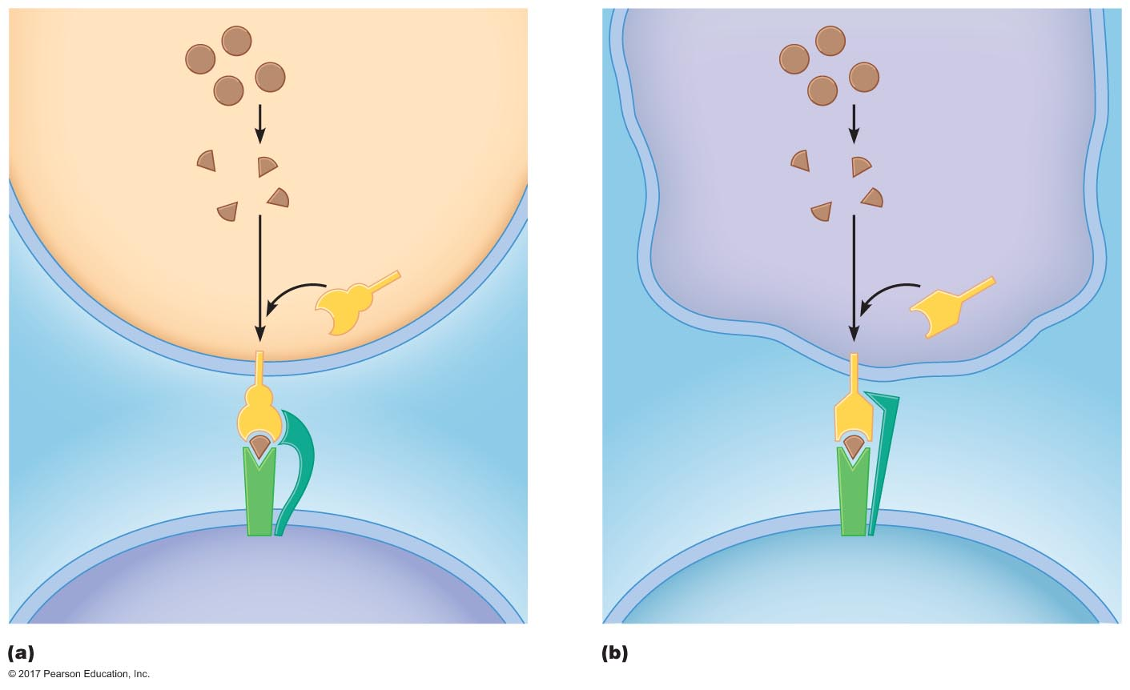
Figure 23.17 Presentation of antigens to T cells by major histocompatibility complex (MHC) molecules.
Virus-
infected cell
Macrophage or
dendritic cell
Newly synthesized
virus proteins
Internalized
virus proteins
Fragmented
virus proteins…
Fragmented
virus proteins…
…associate with
class I MHC
…associate with
class II MHC
Class I MHC
Class II MHC
Virus antigen
fragment
CD8
Virus antigen
fragment
CD4
TCR
TCR
Cytotoxic T cell
Helper T cell

Slide 17
Helper T Cell Activation
Helper T cells coordinate immune response
Events of activation
Bind to class II MHC–foreign antigen complex on surface of macrophages and B cells
Macrophages and B cells secrete IL-1, which induces proliferation and differentiation of helper T cells
Helper T cell differentiation
Secretory cells (effector cells) and memory cells
Secretory cells: secrete cytokines that stimulate and regulate immune response

Slide 18
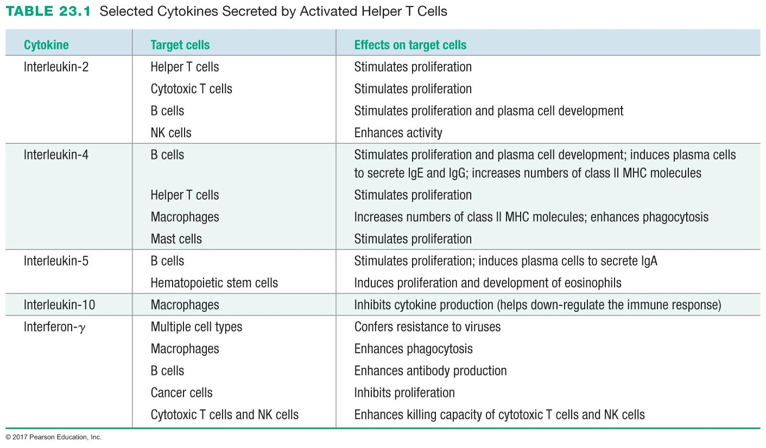

Slide 19
Cytotoxic T Cell Activation: The Destruction of Virus-Infected Cells and Tumor Cells
Cell binds to class I MHC–foreign antigen complex on surface of infected cell or tumor cell
Helper T cell secretes IL-2, which signals activation of cytotoxic T cell
Cell secretes perforins
Form pores in the membranes of infected cells
Lysis
Cell secretes fragmentins
Enter infected cells through perforin-induced pores
Trigger apoptosis

Slide 20
Cytotoxic T Cell Activation: The Destruction of Virus-Infected Cells and Tumor Cells
Tumor cells → tumor antigens
Class I MHC molecules bring antigens to surface and present them to cytotoxic T cells
Cytotoxic T cells destroy tumor cells
Some cancers and viruses inhibit production of class I MHC molecules, thereby protecting them from the immune system

Slide 21
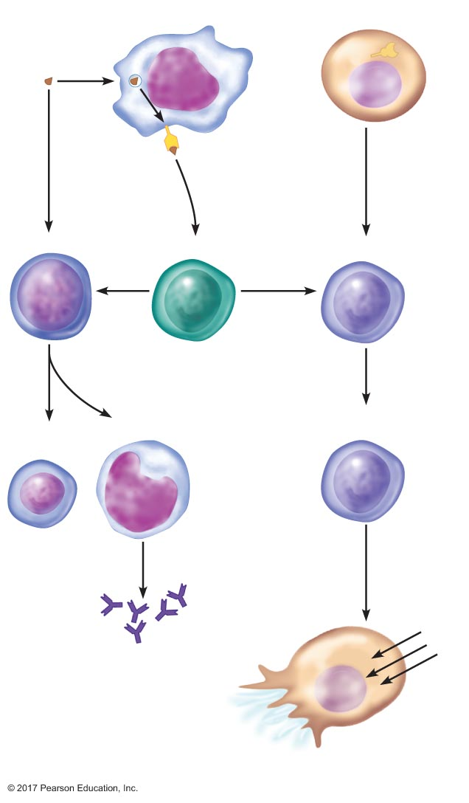
Figure 23.18 The role of helper T cells in activation of B cells and cytotoxic T cells.
Slide 1
Macrophage
Infected cell
Antigen
Antigen
presentation
Antigen
presentation
B-cell
Helper T-cell
Cytotoxic T-cell
IL-2
IL-2
Memory
B-cell
Plasma cell
Activated
cytotoxic T-cell
Perforins
fragmenting
H₂O
Antibodies
Infected cell lysis

Slide 22
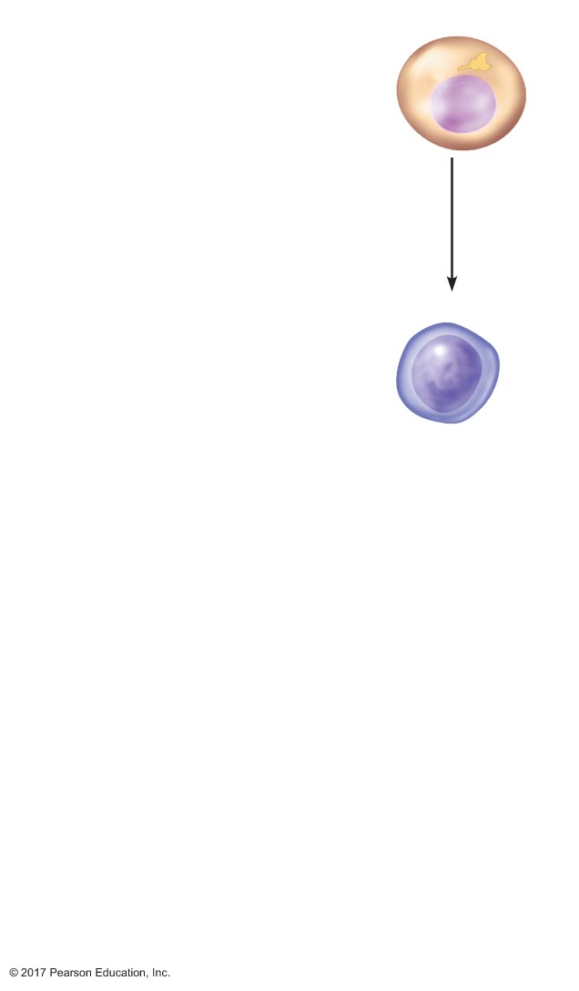
Figure 23.18 The role of helper T cells in activation of B cells and cytotoxic T cells.
Slide 2
Infected cell
Antigen
presentation
Cytotoxic T-cell

Slide 23
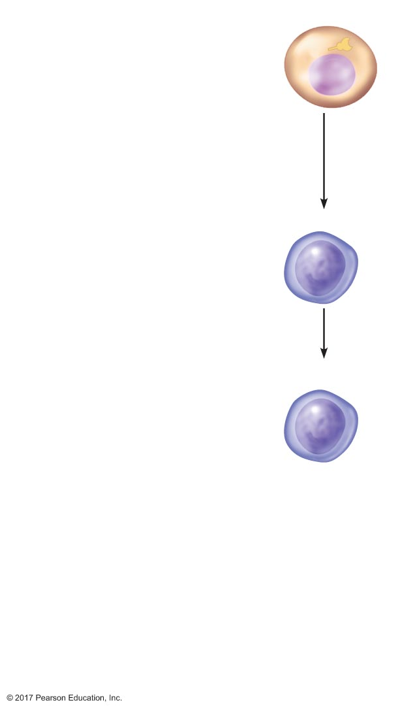
Figure 23.18 The role of helper T cells in activation of B cells and cytotoxic T cells.
Slide 3
Infected cell
Antigen
presentation
Cytotoxic T-cell
Activated
cytotoxic T-cell

Slide 24
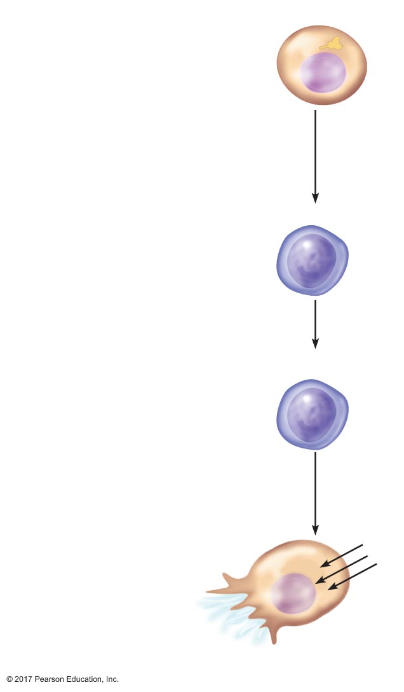
Figure 23.18 The role of helper T cells in activation of B cells and cytotoxic T cells.
Slide 4
Infected cell
Antigen
presentation
Cytotoxic T-cell
Activated
cytotoxic T-cell
Perforins
fragmenting
H₂O
Infected cell lysis

Slide 25
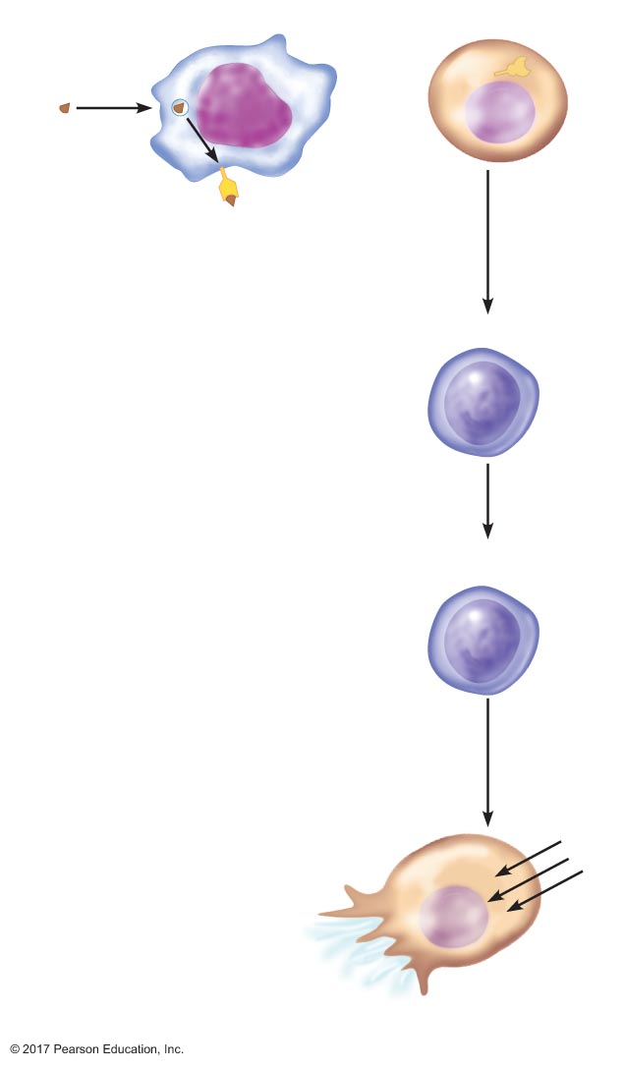
Figure 23.18 The role of helper T cells in activation of B cells and cytotoxic T cells.
Slide 5
Macrophage
Infected cell
Antigen
Antigen
presentation
Cytotoxic T-cell
Activated
cytotoxic T-cell
Perforins
fragmenting
H₂O
Infected cell lysis

Slide 26
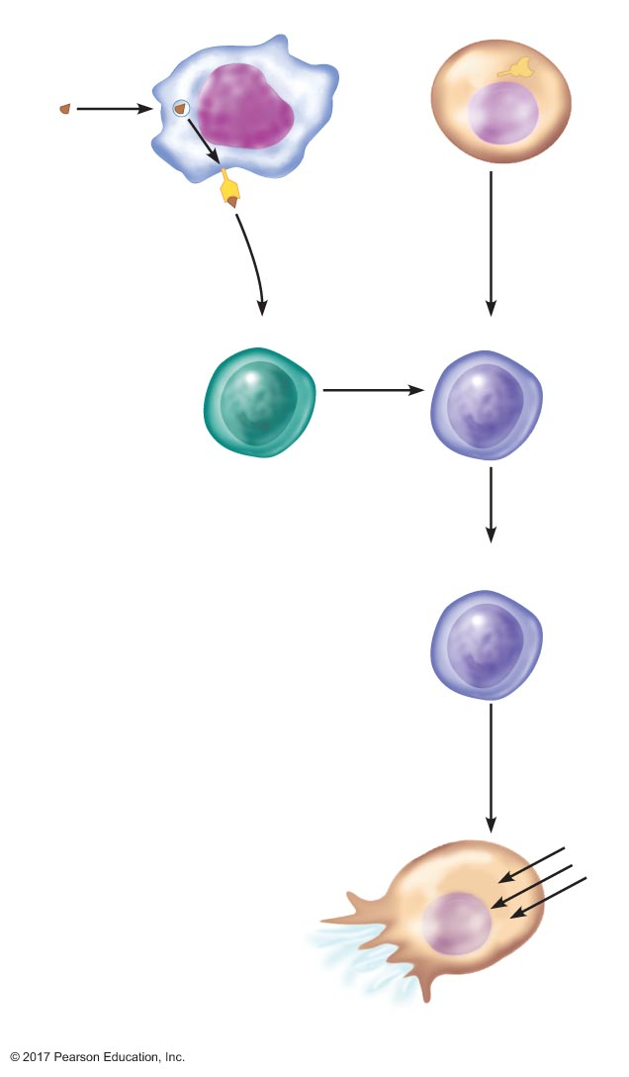
Figure 23.18 The role of helper T cells in activation of B cells and cytotoxic T cells.
Slide 6
Macrophage
Infected cell
Antigen
Antigen
presentation
Antigen
presentation
Helper T-cell
Cytotoxic T-cell
IL-2
Activated
cytotoxic T-cell
Perforins
fragmenting
H₂O
Infected cell lysis

Slide 27
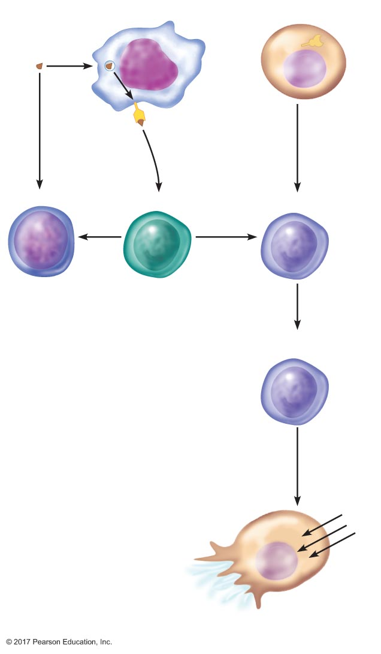
Figure 23.18 The role of helper T cells in activation of B cells and cytotoxic T cells.
Slide 7
Macrophage
Infected cell
Antigen
Antigen
presentation
Antigen
presentation
B-cell
Helper T-cell
Cytotoxic T-cell
IL-2
IL-2
Activated
cytotoxic T-cell
Perforins
fragmenting
H₂O
Infected cell lysis

Slide 28
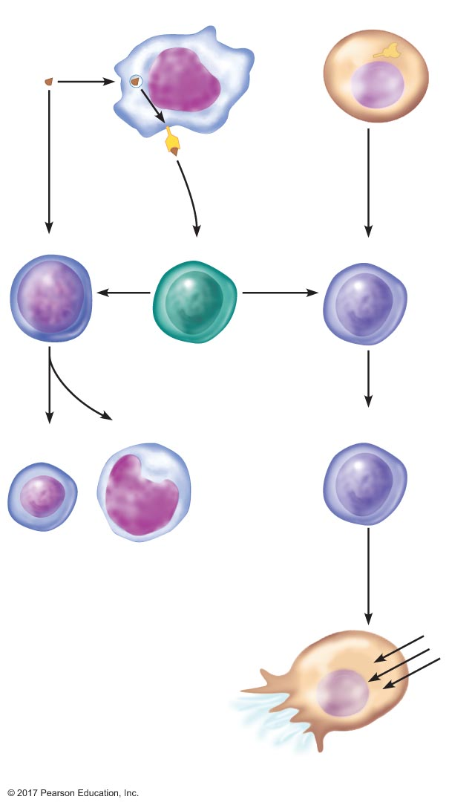
Figure 23.18 The role of helper T cells in activation of B cells and cytotoxic T cells.
Slide 8
Macrophage
Infected cell
Antigen
Antigen
presentation
Antigen
presentation
B-cell
Helper T-cell
Cytotoxic T-cell
IL-2
IL-2
Memory
B-cell
Plasma cell
Activated
cytotoxic T-cell
Perforins
fragmenting
H₂O
Infected cell lysis

Slide 29
Figure 23.18 The role of helper T cells in activation of B cells and cytotoxic T cells.
Slide 9
Macrophage
Infected cell
Antigen
Antigen
presentation
Antigen
presentation
B-cell
Helper T-cell
Cytotoxic T-cell
IL-2
IL-2
Memory
B-cell
Plasma cell
Activated
cytotoxic T-cell
Perforins
fragmenting
H₂O
Antibodies
Infected cell lysis

Slide 30
23.6 Immune Responses in Health and Disease
Generating immunity: immunization
Vaccine: introduction of microorganism or its antigens in a form not expected to cause disease
Induces immune response, including production of memory cells
Active immunity
Immune response to vaccine or pathogen in individual gives immunity
Passive immunity
Administration of ready-made antibodies
No memory cells, so no long-term immunity

Slide 31
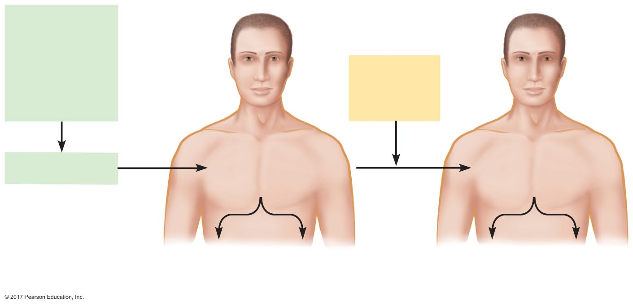
Figure 23.19 Acquisition of long-term immunity through vaccination (immunization).
Inactivated
microorganism
or harmless
components
of pathogen
(inoculum)
Natural
exposure
to pathogen
Slow, weak
primary immune
response
Fast, strong
secondary immune
response
Immunization
Antibody
production
(not needed)
Memory
cells
Antibody
production
(needed)
Memory
cells

Slide 32
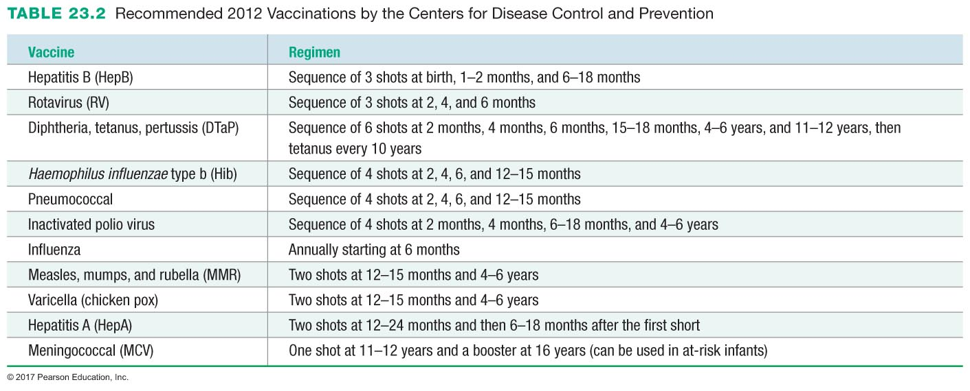

Slide 33
Generating Immunity: Immunization
Passive immunity from mother to fetus or baby
IgG passes to fetus via the placenta
IgA passes to baby in breast milk

Slide 34
Role of Immune System in Transfusion and Transplantation
Immune system recognizes difference between self and non-self
Need to match donor to recipient closely
Must suppress immune system in recipient

Slide 35
Role of Immune System in Transfusion and Transplantation
Blood group compatibility
Blood types: A, B, AB, O
Due to antigens on surface of RBCs
Type A → A antigens, anti-B antibodies
Type B → B antigens, anti-A antibodies
Type AB → A and B antigens, no A or B antibodies
Type O → no antigens, anti-A and anti-B antibodies
Universal donor: O
Universal recipient: AB

Slide 36
Role of Immune System in Transfusion and Transplantation
Tissue grafts and organ transplantation
HLA molecules (MHC) stimulate rejection by inducing an immune response
Tissue typing: matches HLA molecules between donor and recipient
Must suppress immune response of recipient
Cyclosporin A and FK506 inhibit IL-2

Slide 37
Role of Immune System in Transfusion and Transplantation
Bone marrow transplants: some are more successful than others
Radiation treatment destroys bone marrow cells, inactivating immune system
Donated marrow may mount an immune response against recipient: graft versus host reaction
Necessary to match donor and recipient HLA molecules

Slide 38
Immune Dysfunctions
Allergy: hypersensitive immune response
Antigens that induce allergic reactions: allergens
Antibodies of allergies: IgE
IgE activates mast cells to release histamine

Slide 39
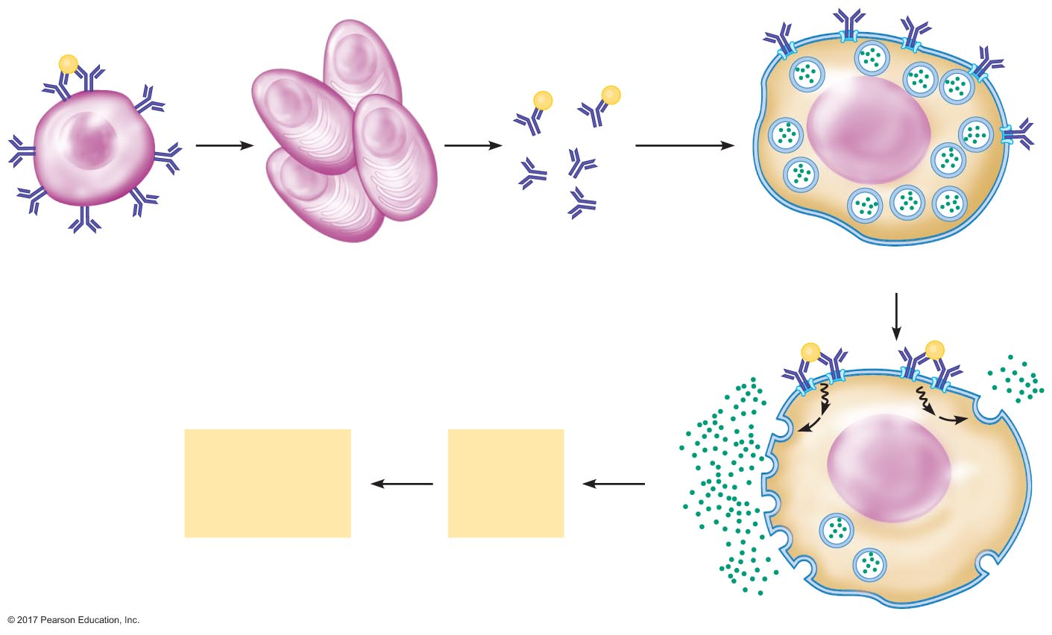
Figure 23.20 Events in hay fever, an allergic response.
Slide 1
Pollen
(ﬁrst exposure)
Pollen
Excess IgE
antibodies
B cell
Plasma cells
IgE antibodies
Mast cell
Pollen
(subsequent
exposure)
Histamine and other
inﬂammatory agents
Symptoms of
hay fever:
coughing, sneezing,
snifﬂes
Vasodilation
Increased
capillary
permeability

Slide 40
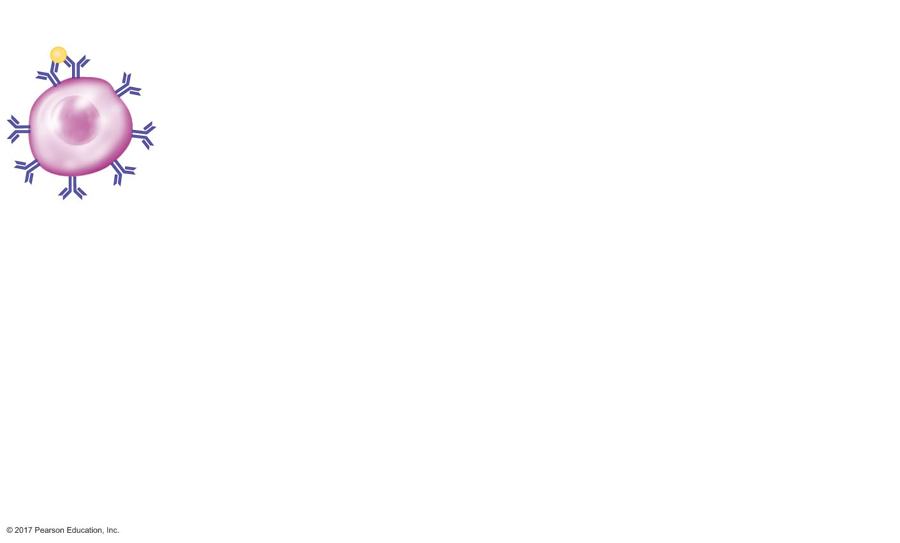
Figure 23.20 Events in hay fever, an allergic response.
Slide 2
Pollen
(ﬁrst exposure)
B cell

Slide 41
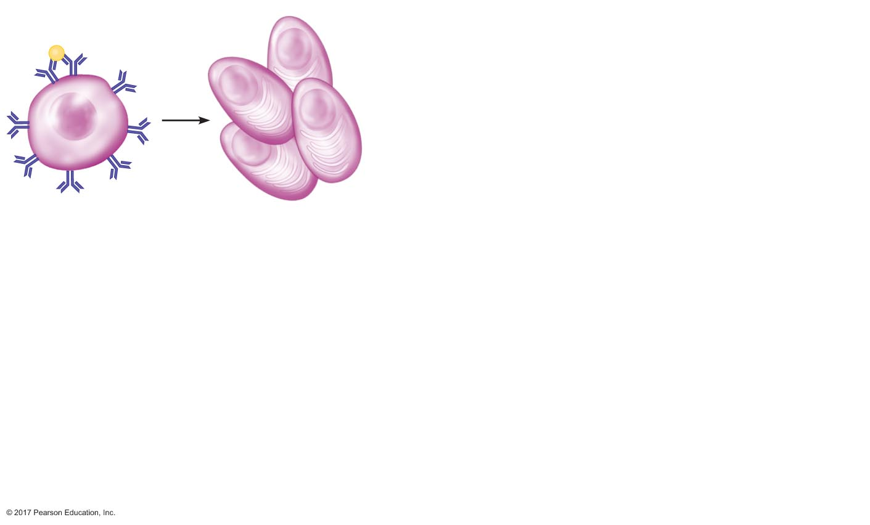
Figure 23.20 Events in hay fever, an allergic response.
Slide 3
Pollen
(ﬁrst exposure)
B cell
Plasma cells

Slide 42
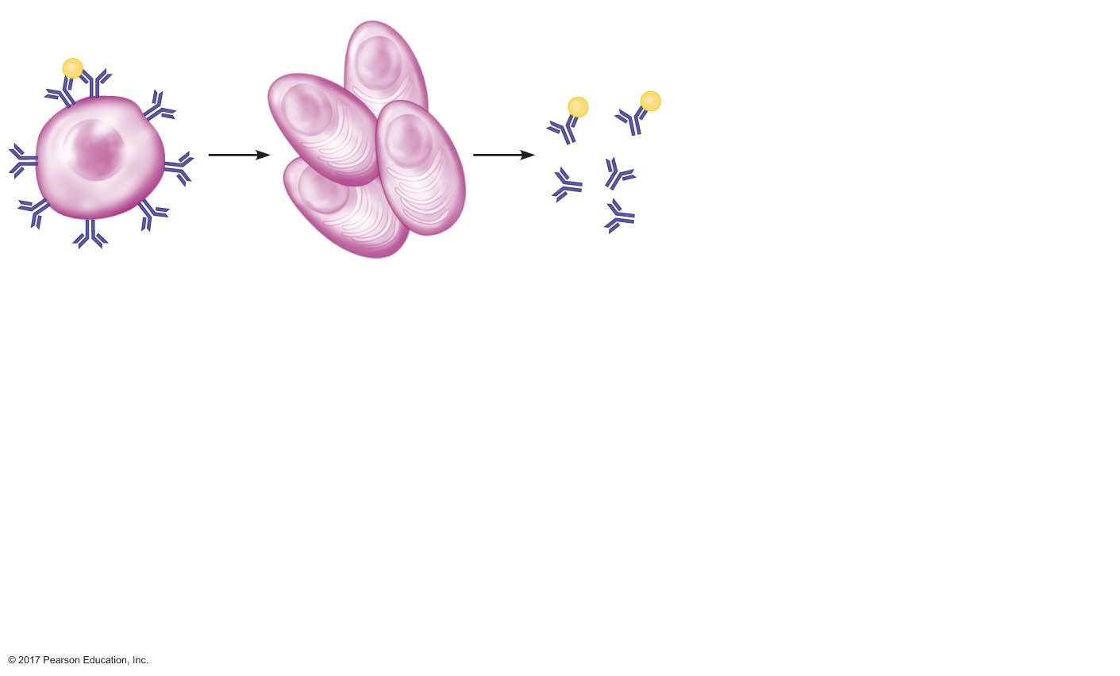
Figure 23.20 Events in hay fever, an allergic response.
Slide 4
Pollen
(ﬁrst exposure)
Pollen
B cell
Plasma cells
IgE antibodies

Slide 43
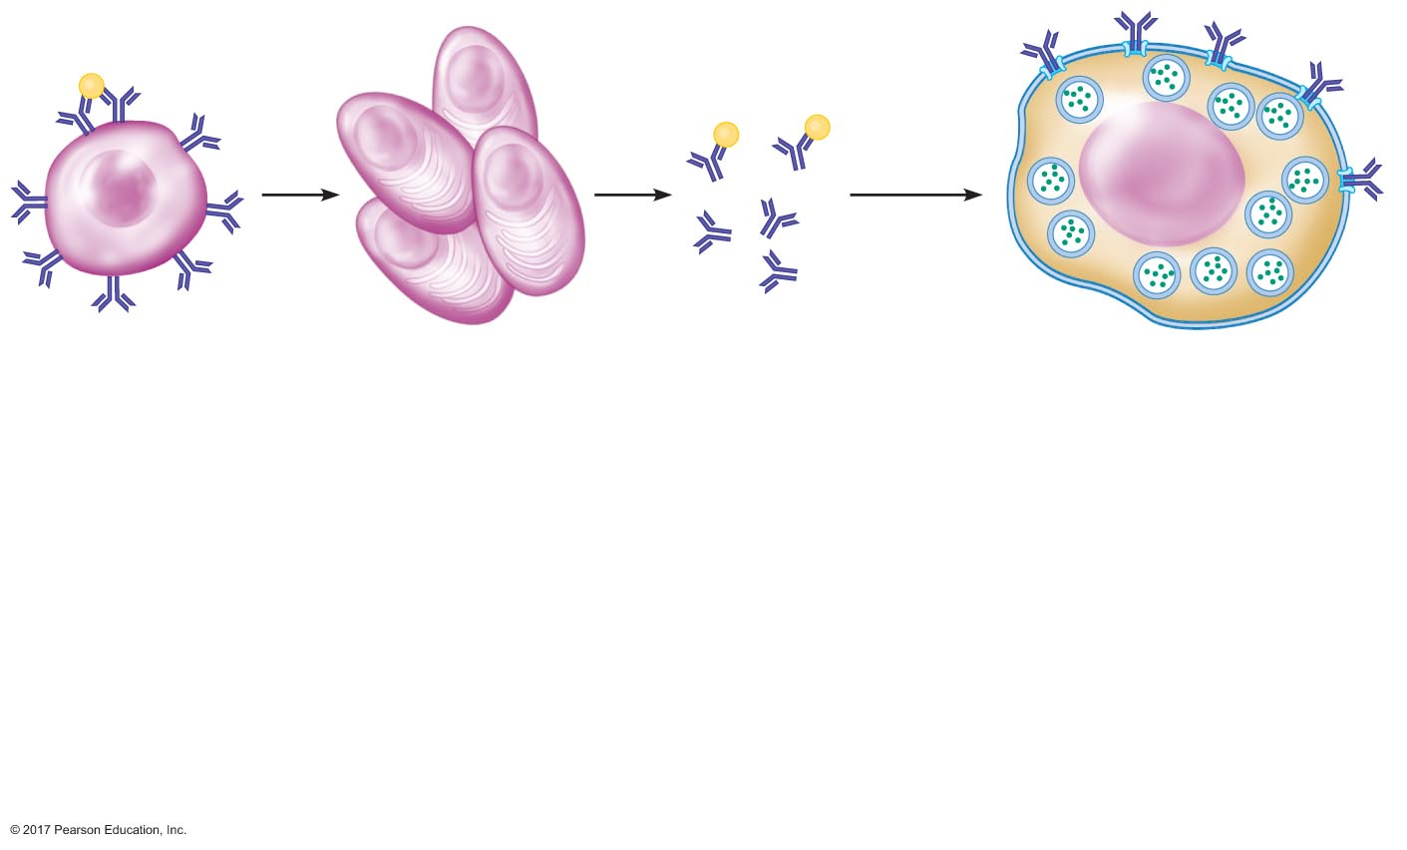
Figure 23.20 Events in hay fever, an allergic response.
Slide 5
Pollen
(ﬁrst exposure)
Pollen
Excess IgE
antibodies
B cell
Plasma cells
IgE antibodies
Mast cell

Slide 44
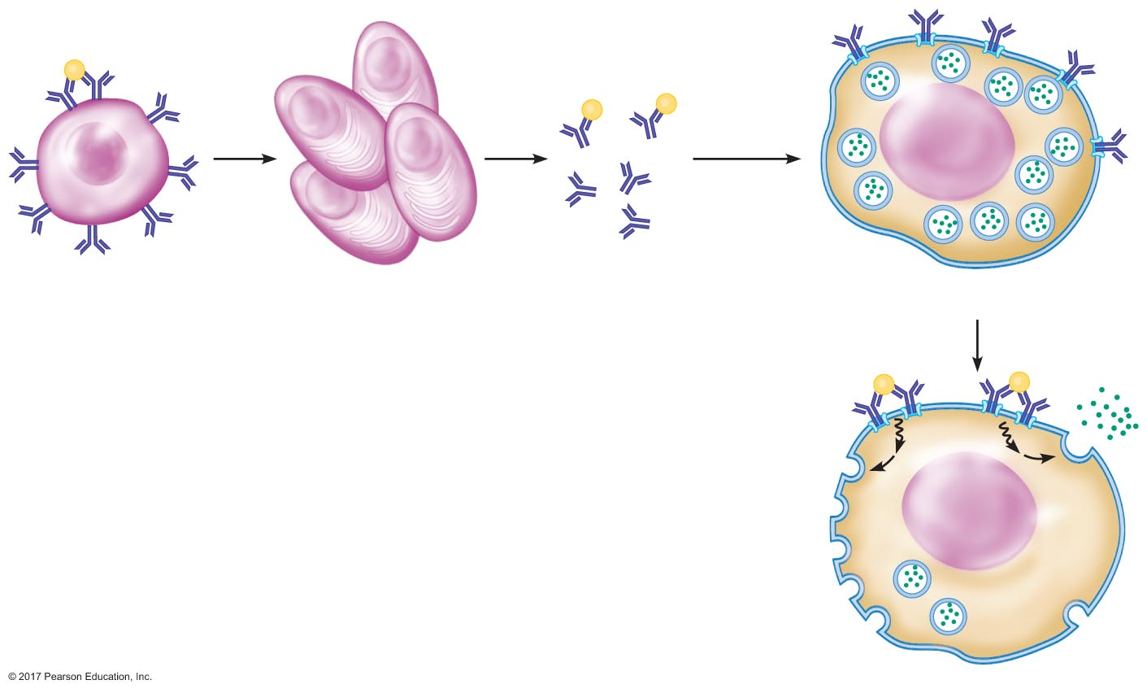
Figure 23.20 Events in hay fever, an allergic response.
Slide 6
Pollen
(ﬁrst exposure)
Pollen
Excess IgE
antibodies
B cell
Plasma cells
IgE antibodies
Mast cell
Pollen
(subsequent
exposure)

Slide 45
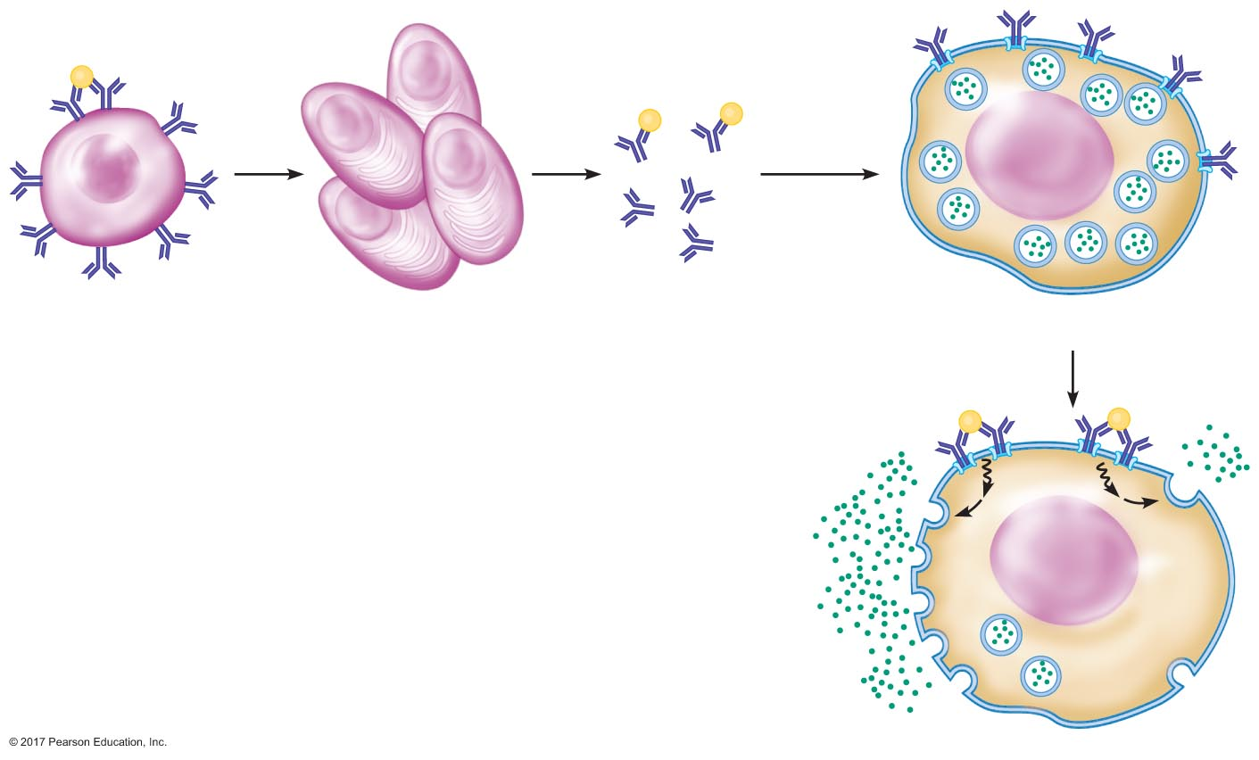
Figure 23.20 Events in hay fever, an allergic response.
Slide 7
Pollen
(ﬁrst exposure)
Pollen
Excess IgE
antibodies
B cell
Plasma cells
IgE antibodies
Mast cell
Pollen
(subsequent
exposure)
Histamine and other
inﬂammatory agents

Slide 46
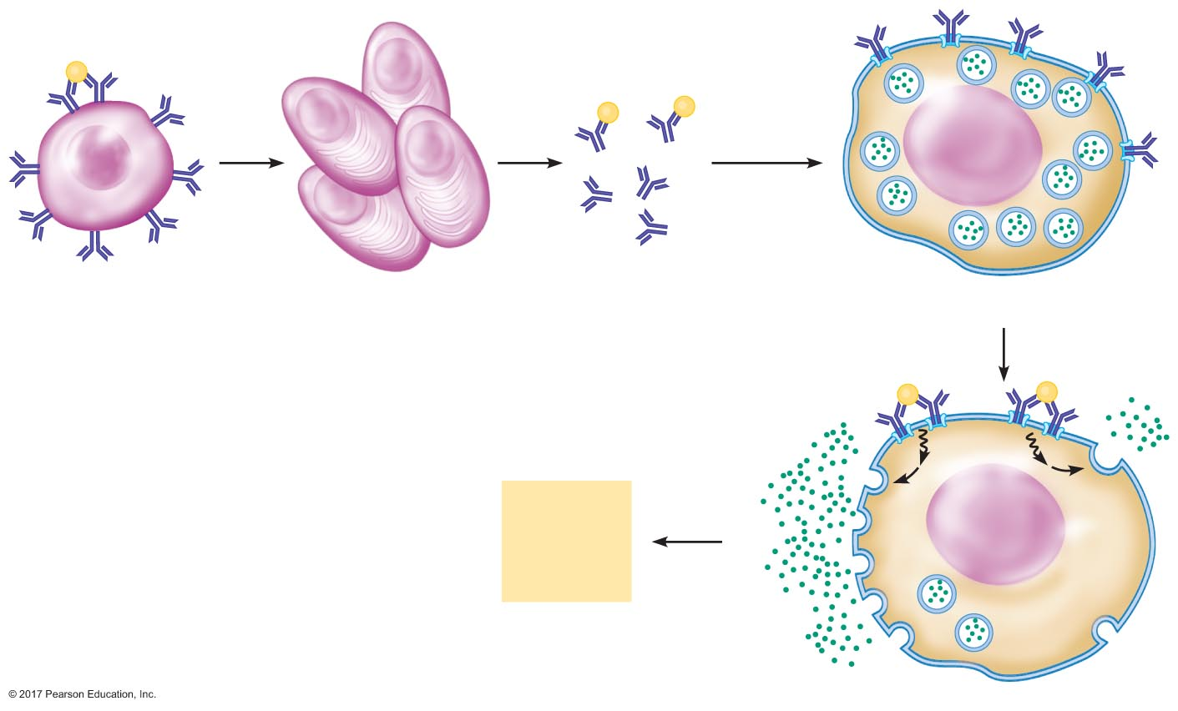
Figure 23.20 Events in hay fever, an allergic response.
Slide 8
Pollen
(ﬁrst exposure)
Pollen
Excess IgE
antibodies
B cell
Plasma cells
IgE antibodies
Mast cell
Pollen
(subsequent
exposure)
Histamine and other
inﬂammatory agents
Vasodilation
Increased
capillary
permeability

Slide 47
Figure 23.20 Events in hay fever, an allergic response.
Slide 9
Pollen
(ﬁrst exposure)
Pollen
Excess IgE
antibodies
B cell
Plasma cells
IgE antibodies
Mast cell
Pollen
(subsequent
exposure)
Histamine and other
inﬂammatory agents
Symptoms of
hay fever:
coughing, sneezing,
snifﬂes
Vasodilation
Increased
capillary
permeability

Slide 48
Immune Dysfunctions
Anaphylactic shock
Severe allergic reaction
Massive release of histamine from mast cells throughout the body
Vasodilation → decreased TPR → decreased MAP
Prophylactic: epinephrine
Increases CO and TPR → increased MAP

Slide 49
Immune Dysfunctions
Autoimmune diseases
Immune system treats a part of self like a pathogen
Immune response is induced against that part
Examples
Insulin-dependent diabetes mellitus
Lupus
Rheumatoid arthritis
Multiple sclerosis

Slide 50
Immune Dysfunctions
Immunodeficiency diseases
Weak or underactive immune system
A problem in any factors of immune response can impair immune function
Examples
Severe combined immunodeficiency disease (SCID)
Affects humoral and cell-mediated immunity
Hodgkin's disease: cancer of lymphatic system
AIDS: affects helper T cells

Slide 51
Immune Dysfunctions
The role of stress in the immune response
Stress suppresses the immune system
Steroid hormones (cortisol)
Decrease number of leukocytes
Anti-inflammatory activity
Environmental chemicals
Autonomic neural input to lymphoid tissue
Multiple levels of interaction between stress and immune system

