Slide 1
1. 系統方塊圖
IP Camera
Android Devices
Player App
Streaming Video (RTSP)

Slide 2
系統架構
Player App
Apps
App Framework
3rd party SDK ( Vitamio )
JNI
Libraries
OpenGL/ES
FFMpeg
Runtime
Surface Manager
Stagefright
Android Device

Slide 3
2. 產品內容
IP camera RTSP live video streaming playback
On Screen Display
  Dimension / Duration / Source Identification / Date Time Display
  ( Pre-Start Buffering indication ) / ( Buffer level display )
Video Source ( URL ) list management
  Add / Modify / Delete / Alias
  Save as Key/Pair list ( Import, Export )
  (Discover)
Streaming on screen video quality setting
  High / Medium / Low
Screen control
  Orientation / Brightness / (Aspect Ratio) / Snapshots
Audio
  (Volume control)
Others - Android standard style setting menu

Slide 4
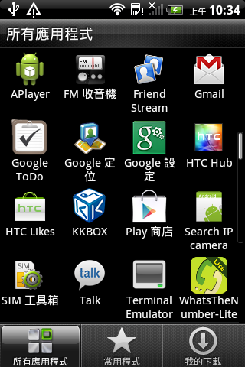
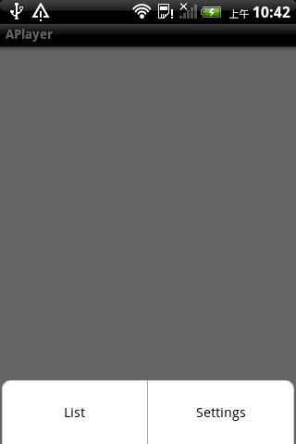
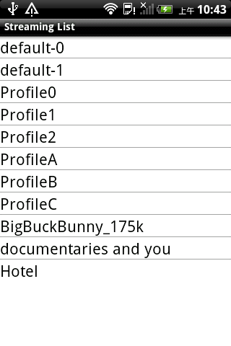
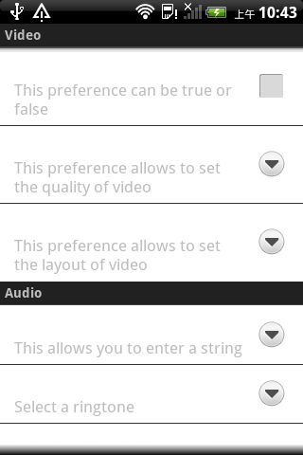
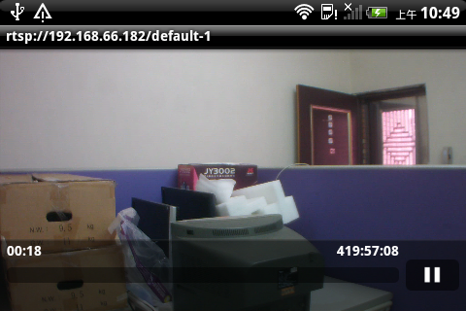
2.1使用情境

Slide 5
3. 工作項目
Survey – Multimedia frameworks
More Apps (oplayer/vplayer/Ipcam viewe/Eagle Eye/Onvif viewer/...more)
What do they do? / How to improve?
Application Framework ( Android MediaPlayer )
Open source SDKs ( Vitamio / oplayer )
Evaluate development framework and determine approaches
Development
Android SDK programming ( Media Player user interface / Discovery )
Android NDK / Java Native Interface ( JNI ) / Ffmpeg
Test
  User Experience / Performance / Reliability / Simplicity

Slide 6
4.1 Survey / Evaluation
What solutions are available and what are the pros and cons?
Android SDK / Application Framework
  Pros: Richest application development building blocks
  Cons: Independently basic functionality
Android SDK / Vitamio SDK ( 3rd party SDK )
  Pros: Integrated as a whole for media playing
  Cons: Poor documentation and support
Android SDK / JNI / Ffmpeg
  Pros: Highly customizable / control
  Cons: Require good grasp of understanding of Android platform
Approaches
  Vitamio SDK / Android SDK
  JNI / FFMpeg

Slide 7
4. 可能困難點與需要支援項目
To Get Familiar – Frameworks / Tools / Languages / Apps
  Understanding of multimedia frameworks
  To know lot of App for reference as well
  MediaPlayer Class / Vitamio / Oplayer / ...
  JNI / FFMpeg / StageFright integration
Development
  Platforms – ARM
  Devices ( Emulation and Real device interchangeably)
  We need to get familiar with development environment
  Java / Android SDK / NDK / JNI / Ffmpeg
  Platform – Focus on Android version 4.0 / API Level 14 Test

Slide 8
5. 分工
Survey - Done
Development
  George – ONVIF service discovery
  Bryan – Media Player / User Interface
Test
  George / Bryan
Deployment
  George

Slide 9
6. 時程
Development - Milestones
  Milestone 1 ( Done ) - RTSP/UDP live video playback through web/URL
  Milestone 2 ( Kickoff ) - Skeleton App
    Propose a skeleton APP UI flow/menu for open discussion on requirements
    By the end of April
  Milestone 3 ( TBD ) - 640X480, H.264 or MPEG4
    Integrated playback with UI menus
    Provide settings based on Vitamio SDK interfaces
  Milestone N – To Be Defined
    Prepared for the upcoming requirements
Test
  Test driven development

