Slide 1
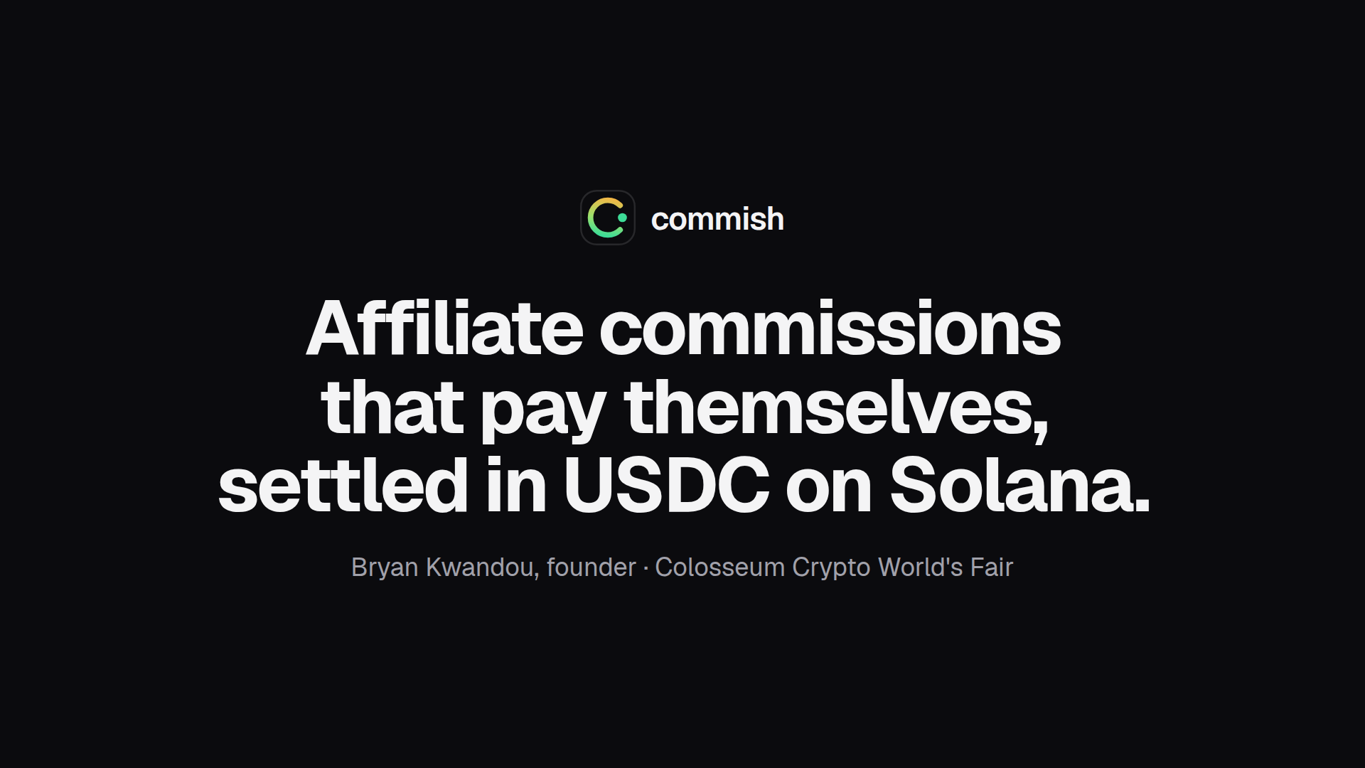
Notes:
I'm Bryan, and this is Commish. When a creator sends a buyer to a shop, the commission they earn is a promise in the brand's spreadsheet. Commish turns it into money locked on Solana the moment the sale is recorded, and paid out in USDC when the refund window closes.

Slide 2
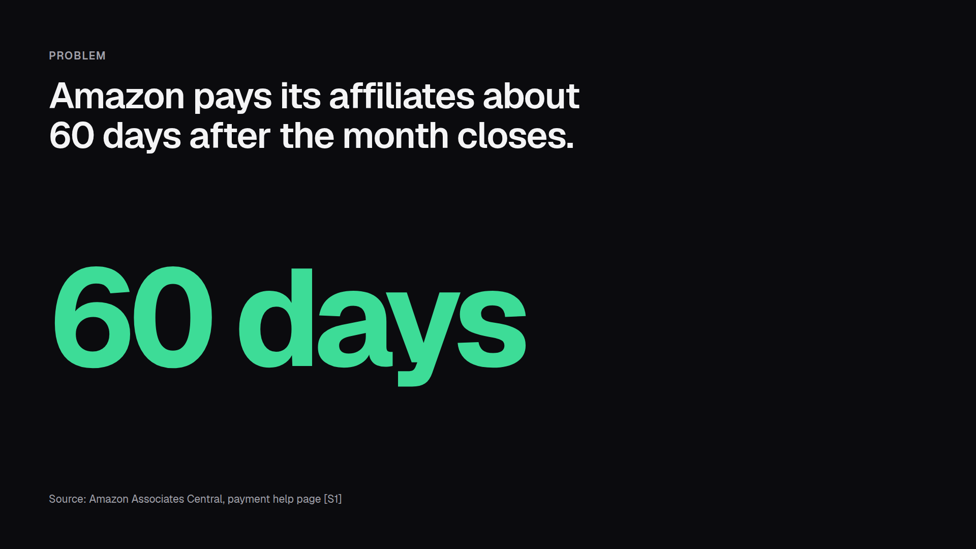
Notes:
Take the biggest affiliate program there is. Amazon pays commission about sixty days after the end of the month it was earned [S1]. A sale on January 2nd becomes money around the end of March. And until the brand pays, the creator has nothing but the brand's word that it will.

Slide 3
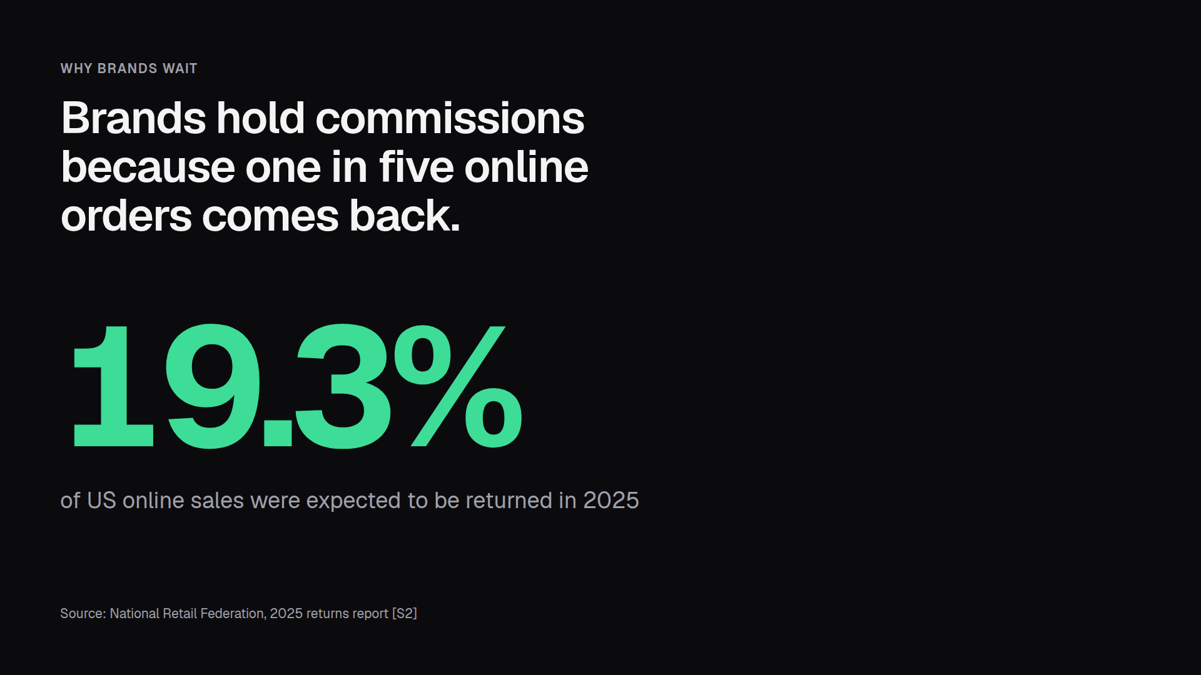
Notes:
Brands don't wait to be difficult. About nineteen percent of online sales in the US come back [S2], and nobody wants to pay commission on a refund. So the hold is fair. What's missing is a guarantee: during that hold, the money is still the brand's to spend.

Slide 4
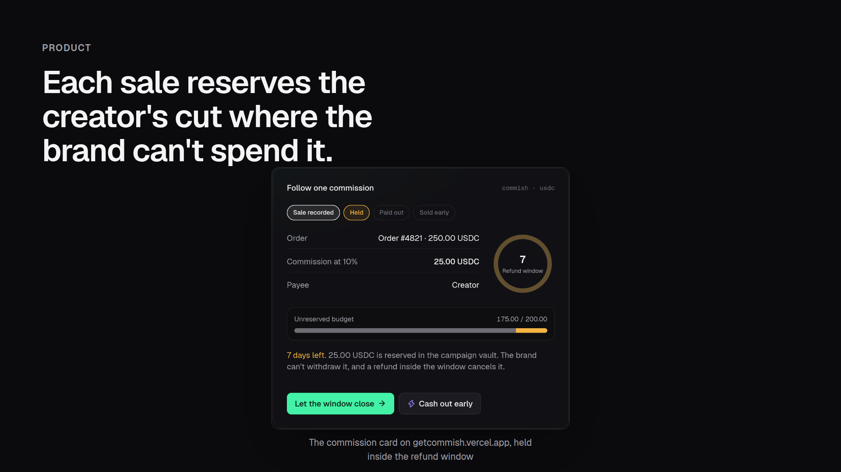
Notes:
Here's what changes. A brand funds a campaign vault in USDC. When a referred order is paid, the brand's server records it, and the program sets aside the creator's cut in its own account. From then on the brand can withdraw everything except what it owes. A refund inside the window cancels the commission.

Slide 5
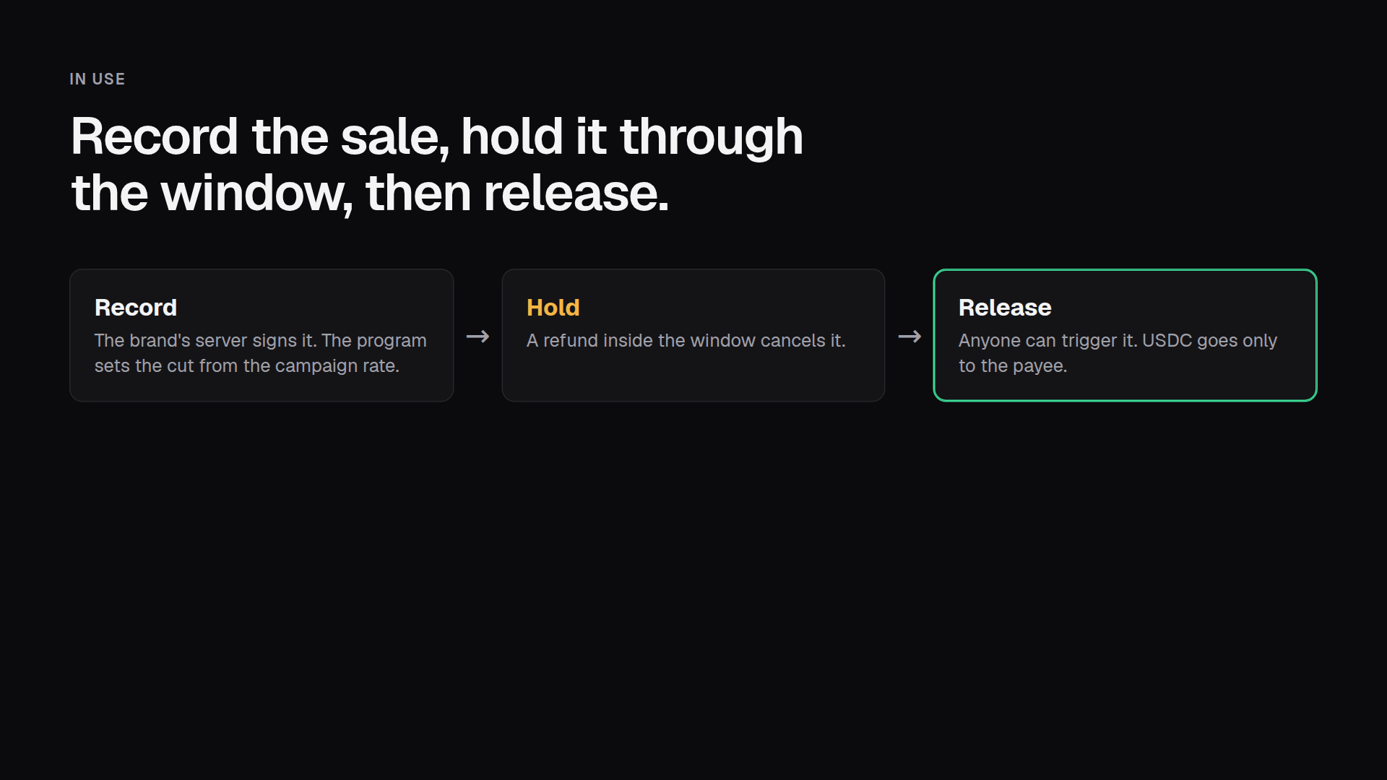
Notes:
Three steps. The attestor records the sale, and the program computes the cut, not the caller. The commission sits through the refund window. Then anyone can release it, the creator or a bot, and the money can only land in the payee's own USDC account. If this website went offline tomorrow, creators could still collect.

Slide 6
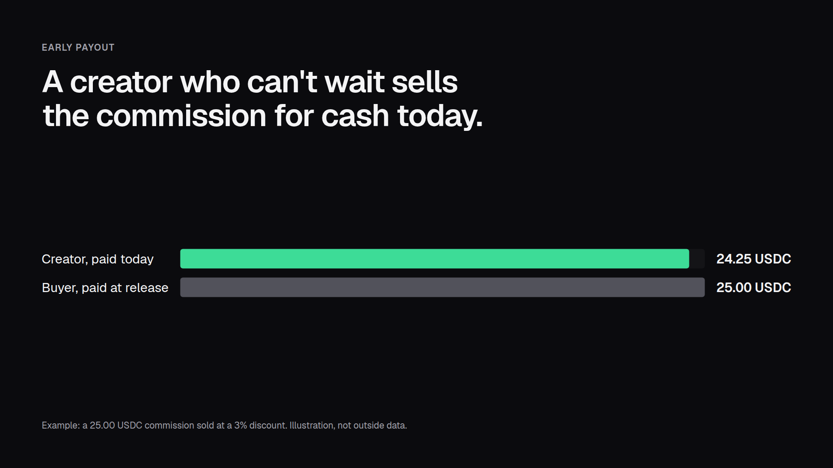
Notes:
A pending commission is money owed on a known date, so it can be sold. Here the creator sells a twenty-five dollar commission for 24.25 and is paid right away. The buyer becomes the payee, collects the full amount at release, and takes over the refund risk. It all settles in one transaction.

Slide 7
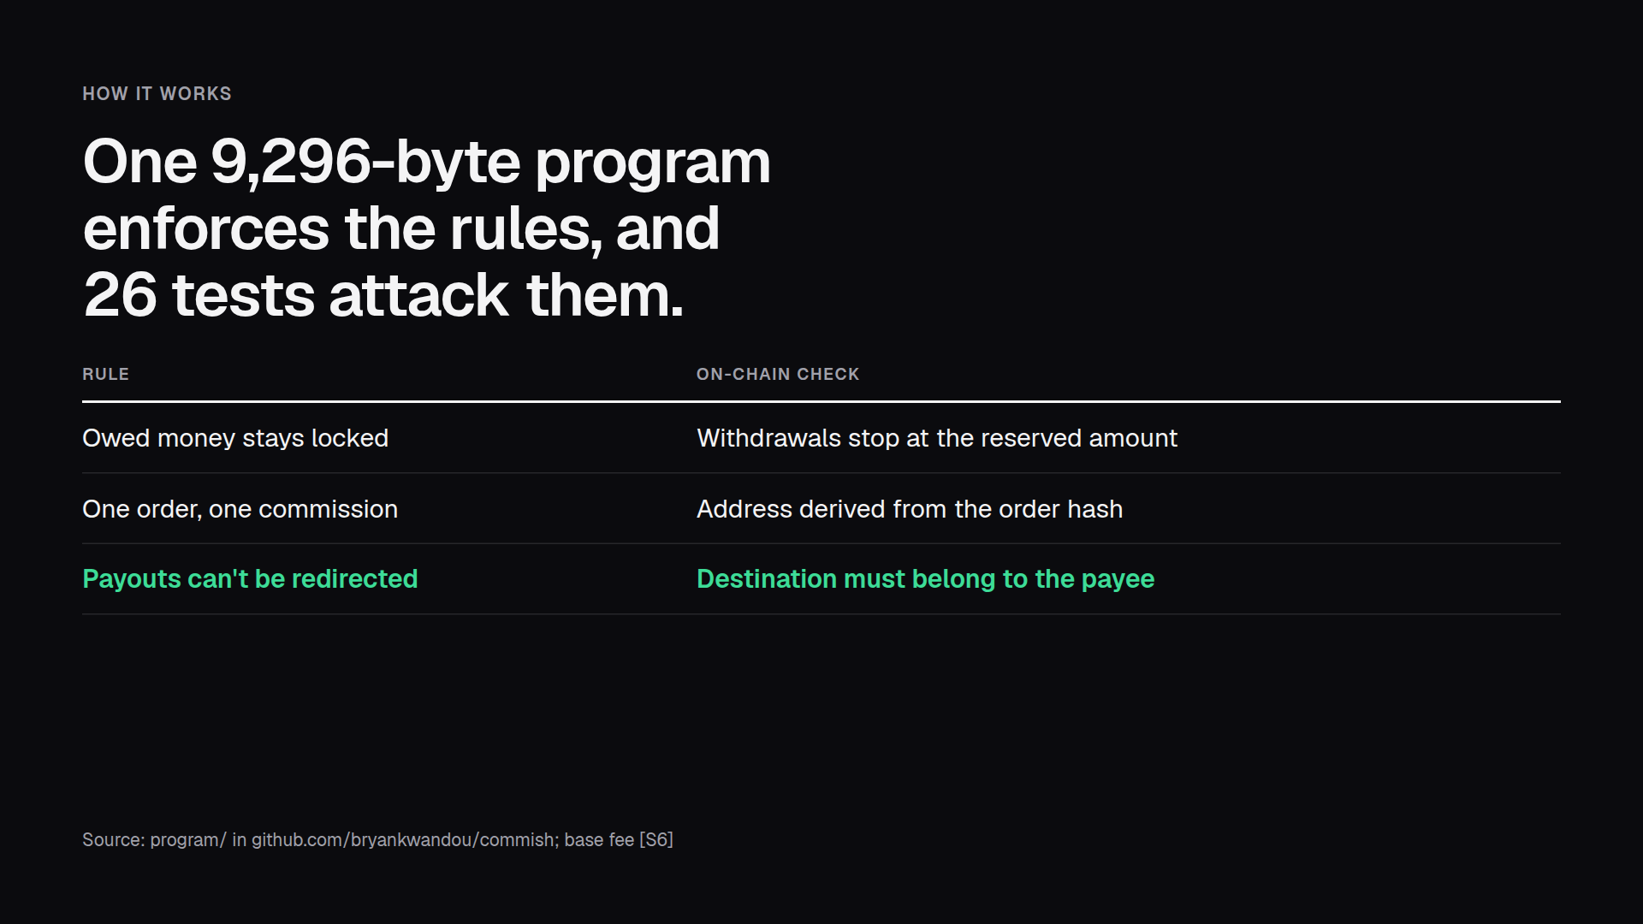
Notes:
All of it is one Solana program written with Pinocchio: 9,296 bytes, small enough that deploying it to mainnet costs under 0.05 SOL. Each rule here is checked on-chain, and the test suite has an attack for each one that has to fail. A transaction's base fee is 5,000 lamports per signature [S6], cheap enough to run for every order.

Slide 8
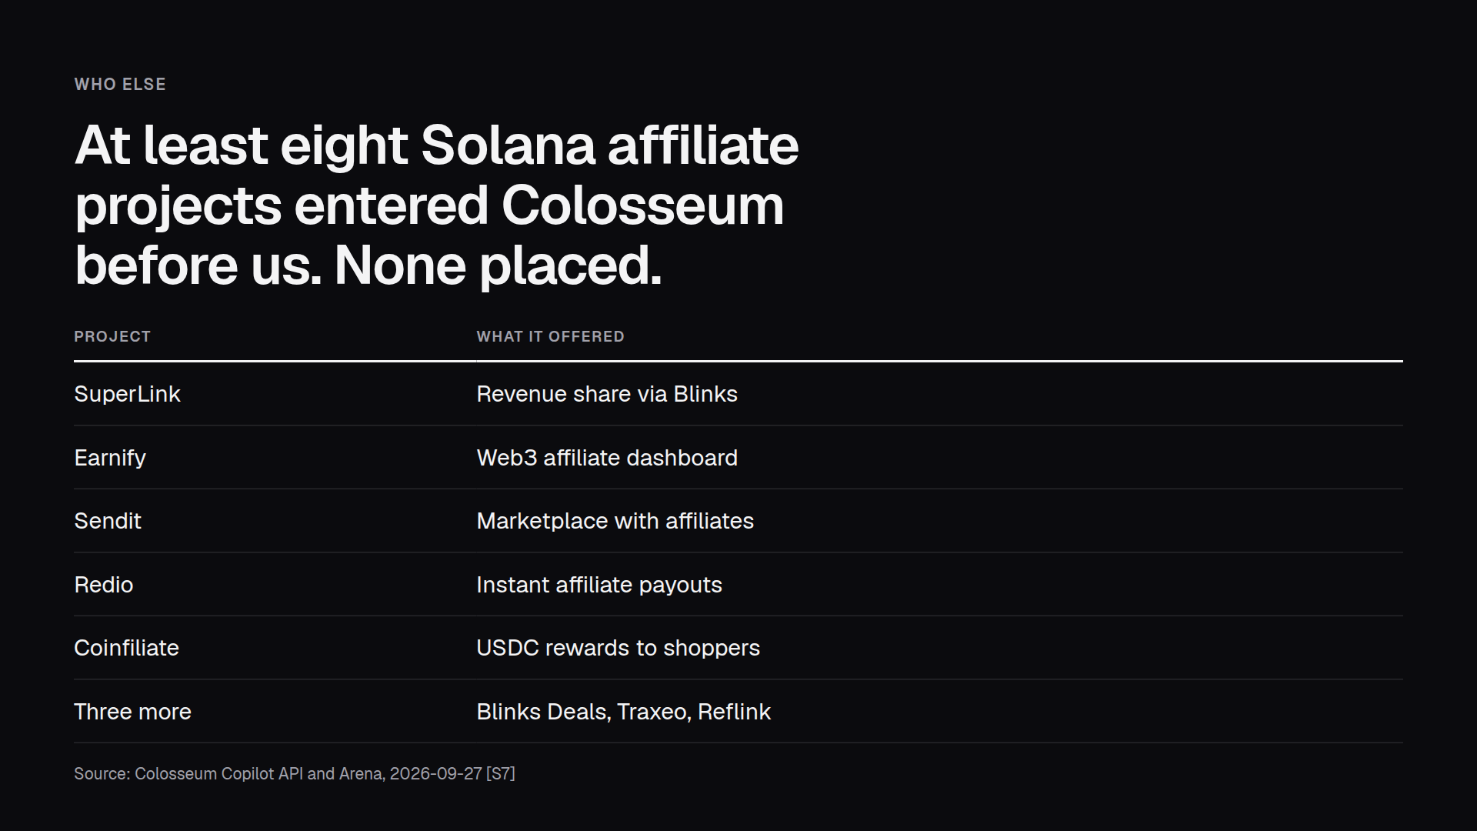
Notes:
We checked before building. Colosseum's project search turns up eight earlier Solana affiliate or referral projects, and none placed [S7]. Three of them promised instant payouts, which no brand accepts while one online order in five comes back. Commish keeps the refund window brands already use, and guarantees the money inside it.

Slide 9
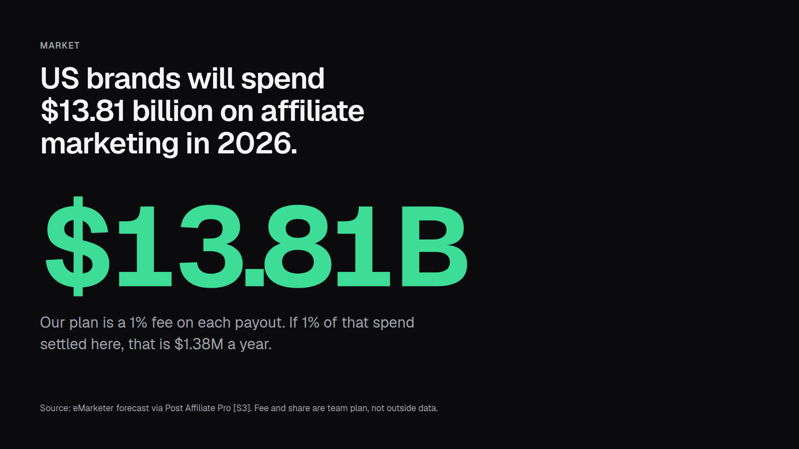
Notes:
US affiliate spend alone is forecast at about fourteen billion dollars this year [S3], and Goldman Sachs counts fifty million creators worldwide [S4]. Our own plan is a one percent fee on each payout. If one percent of US affiliate spend settled through Commish, that's about 1.4 million dollars a year. Dollar stablecoins have had a US law behind them since July 2025 [S5].

Slide 10
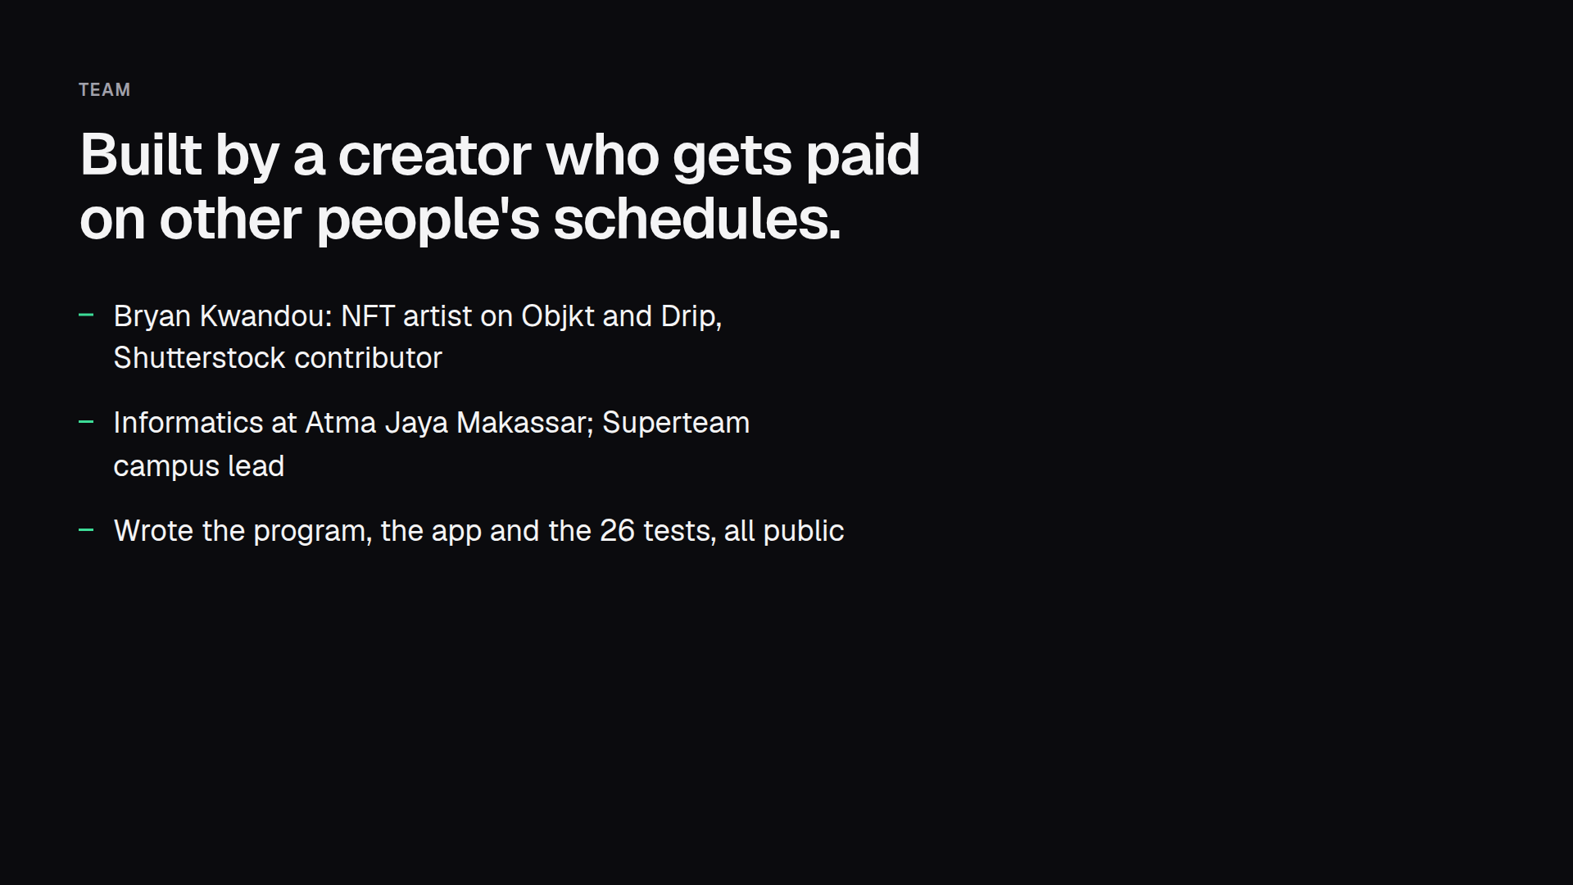
Notes:
I'm Bryan Kwandou. I've sold my own art on Objkt since 2022 and on Drip since 2024, and I earn through Shutterstock and Upwork, so every payout I get runs on someone else's schedule. I study informatics in Makassar and lead the Superteam campus club there. I built Commish's program, app and tests myself.

Slide 11
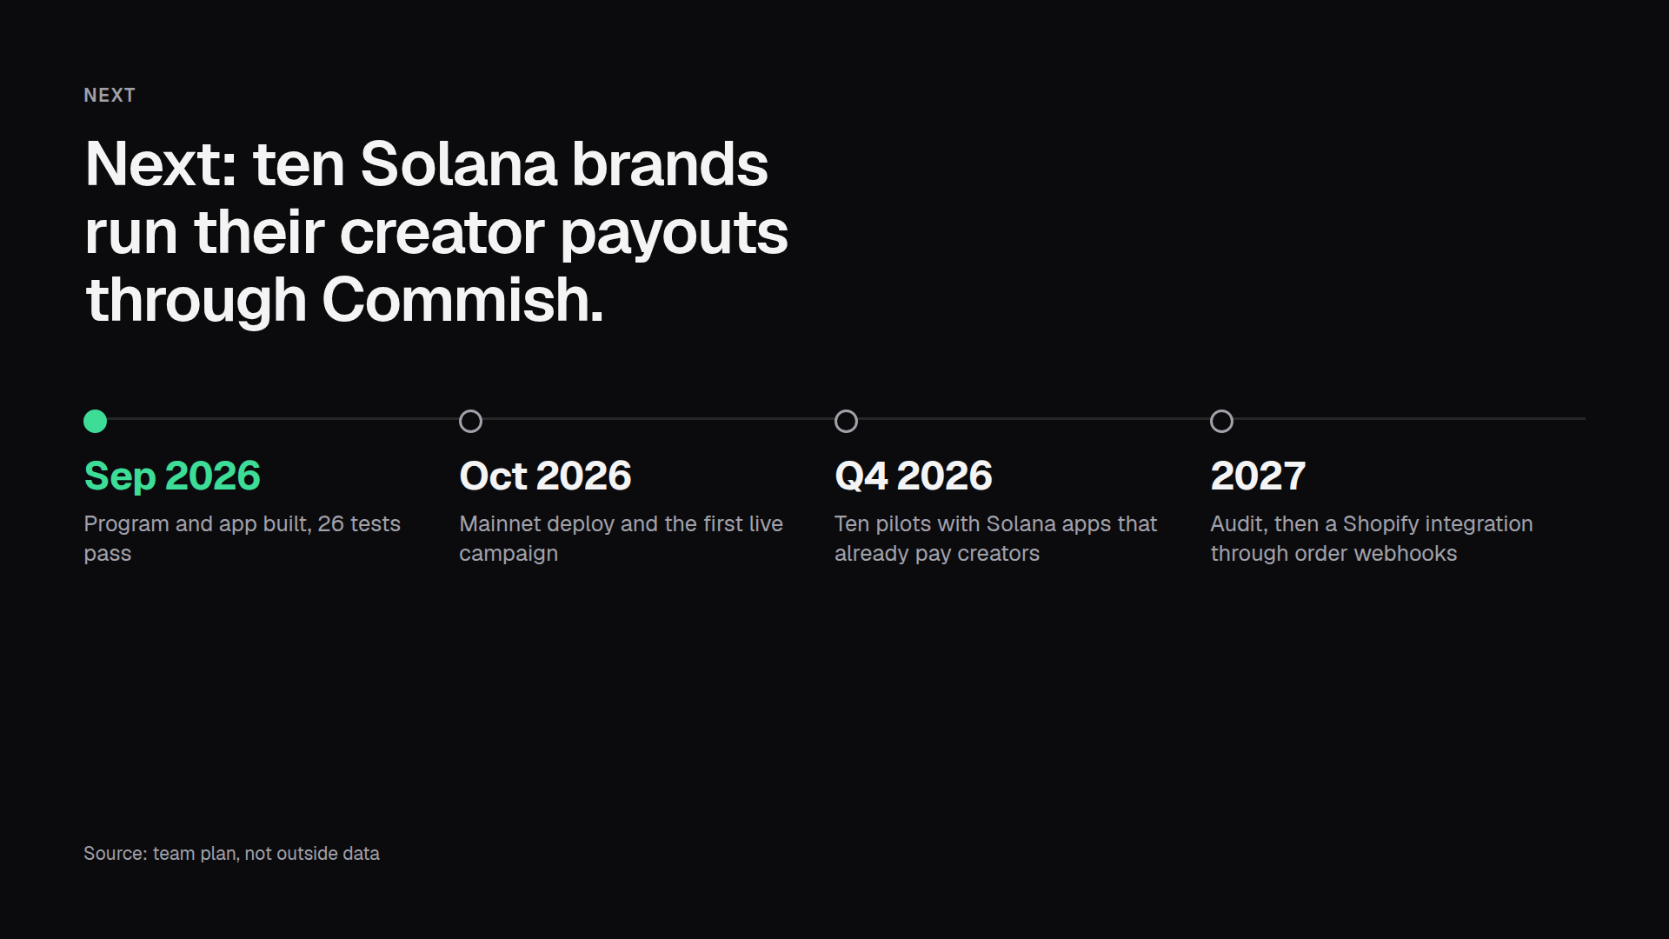
Notes:
Here's the plan. The program and the app are done. Next is the mainnet deploy and a first live campaign, then ten pilots with Solana apps that already pay creators and hold USDC. After that, an audit and a Shopify integration through order webhooks. If you run an affiliate program, try it at getcommish.vercel.app.

