Slide 1
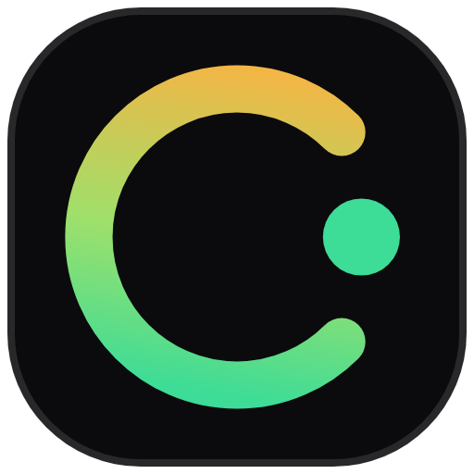
commish
Affiliate commissions
that pay themselves,
settled in USDC on Solana.
Bryan Kwandou, founder · Colosseum Crypto World's Fair
Recorded
Held
Paid
getcommish.vercel.app · github.com/bryankwandou/commish
Notes:
I'm Bryan, and this is Commish. When a creator sends a buyer to a shop, the commission they earn is a promise in the brand's spreadsheet. Commish turns it into money locked on Solana the moment the sale is recorded, and paid out in USDC when the refund window closes.

Slide 2
PROBLEM
Amazon pays its affiliates about 60 days after the month closes.
60 days
Jan 2
Sale made
Jan 31
Month closes
+60 days
Commission paid
Source: Amazon Associates Central, payment help page [S1]
02
Notes:
Take the biggest affiliate program there is. Amazon pays commission about sixty days after the end of the month it was earned [S1]. A sale on January 2nd becomes money around the end of March. And until the brand pays, the creator has nothing but the brand's word that it will.

Slide 3
WHY BRANDS WAIT
Brands hold commissions because one in five online orders comes back.
19.3%
kept
kept
kept
kept
back
of US online sales were expected to be returned in 2025
Commission paid on a returned order is money the brand does not get back.
Source: National Retail Federation, 2025 returns report [S2]
03
Notes:
Brands don't wait to be difficult. About nineteen percent of online sales in the US come back [S2], and nobody wants to pay commission on a refund. So the hold is fair. What's missing is a guarantee: during that hold, the money is still the brand's to spend.

Slide 4
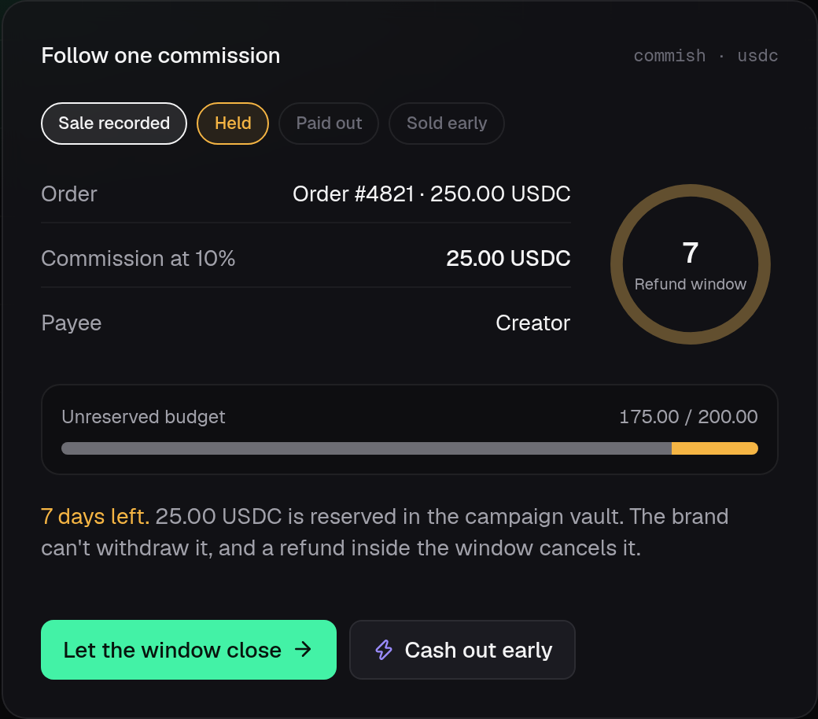
PRODUCT
Each sale reserves the creator's cut where the brand can't spend it.
RESERVED
The cut sits in its own account. Withdrawals stop at the reserved amount.
THEN
A refund inside the window cancels it. After the window it can only be paid.
The commission card on getcommish.vercel.app, held inside the refund window
04
Notes:
Here's what changes. A brand funds a campaign vault in USDC. When a referred order is paid, the brand's server records it, and the program sets aside the creator's cut in its own account. From then on the brand can withdraw everything except what it owes. A refund inside the window cancels the commission.

Slide 5
IN USE
Record the sale, hold it through the window, then release.
01
02
03
Record
Hold
Release
→
→
The brand's server signs it. The program sets the cut from the campaign rate.
A refund inside the window cancels it.
Anyone can trigger it. USDC goes only to the payee.
record_sale · cancel · release
05
Notes:
Three steps. The attestor records the sale, and the program computes the cut, not the caller. The commission sits through the refund window. Then anyone can release it, the creator or a bot, and the money can only land in the payee's own USDC account. If this website went offline tomorrow, creators could still collect.

Slide 6
EARLY PAYOUT
A creator who can't wait sells the commission for cash today.
Creator, paid today
24.25 USDC
Buyer, paid at release
25.00 USDC
The buyer becomes the payee and carries the refund risk.
Example: a 25.00 USDC commission sold at a 3% discount. Illustration, not outside data.
06
Notes:
A pending commission is money owed on a known date, so it can be sold. Here the creator sells a twenty-five dollar commission for 24.25 and is paid right away. The buyer becomes the payee, collects the full amount at release, and takes over the refund risk. It all settles in one transaction.

Slide 7
HOW IT WORKS
One 9,296-byte program enforces the rules, and 26 tests attack them.
RULE | ON-CHAIN CHECK
Owed money stays locked | Withdrawals stop at the reserved amount
One order, one commission | Address derived from the order hash
Payouts can't be redirected | Destination must belong to the payee
9,296
bytes, deploy under 0.05 SOL
6
instructions
26
tests, most of them attacks
Source: program/ in github.com/bryankwandou/commish; base fee [S6]
07
Notes:
All of it is one Solana program written with Pinocchio: 9,296 bytes, small enough that deploying it to mainnet costs under 0.05 SOL. Each rule here is checked on-chain, and the test suite has an attack for each one that has to fail. A transaction's base fee is 5,000 lamports per signature [S6], cheap enough to run for every order.

Slide 8
WHO ELSE
At least eight Solana affiliate projects entered Colosseum before us. None placed.
PROJECT | HACKATHON | WHAT IT OFFERED | PLACED
SuperLink | Radar 2024 | Revenue share via Blinks | No
Earnify | Radar 2024 | Web3 affiliate dashboard | No
Sendit | Radar 2024 | Marketplace with affiliates | No
Redio | Cypherpunk 2025 | Instant affiliate payouts | No
Coinfiliate | Cypherpunk 2025 | USDC rewards to shoppers | No
Three more | 2024-2025 | Blinks Deals, Traxeo, Reflink | No
Source: Colosseum Copilot API and Arena, 2026-09-27 [S7]
08
Notes:
We checked before building. Colosseum's project search turns up eight earlier Solana affiliate or referral projects, and none placed [S7]. Three of them promised instant payouts, which no brand accepts while one online order in five comes back. Commish keeps the refund window brands already use, and guarantees the money inside it.

Slide 9
MARKET
US brands will spend $13.81 billion on affiliate marketing in 2026.
$13.81B
$13.81B
1%
1%
$1.38M
×
×
=
US affiliate spend
settled on Commish
fee on each payout
a year
Source: eMarketer forecast via Post Affiliate Pro [S3]. Share and fee are team plan, not outside data.
09
Notes:
US affiliate spend alone is forecast at about fourteen billion dollars this year [S3], and Goldman Sachs counts fifty million creators worldwide [S4]. Our own plan is a one percent fee on each payout. If one percent of US affiliate spend settled through Commish, that's about 1.4 million dollars a year. Dollar stablecoins have had a US law behind them since July 2025 [S5].

Slide 10
TEAM
One founder built the program, app and tests in five days.
BK
Bryan Kwandou
Founder
BUILT
The Pinocchio program, the four-language app and 26 tests
SHIPS
Open-source tools for builders: Plinth, Lugas, Splicecraft
CODE
github.com/bryankwandou/commish, every commit public
10
Notes:
I'm Bryan Kwandou. I built Commish on my own: the program, the app in four languages and the tests, across five days of public commits. I also publish open-source tools for decks, writing and video editing. The code is the proof, and all of it is on GitHub. The next step is real campaigns.

Slide 11
NEXT
Next: ten Solana brands run their creator payouts through Commish.
Sep 2026
Oct 2026
Q4 2026
2027
Program and app built, 26 tests pass
Mainnet deploy and the first live campaign
Ten pilots with Solana apps that already pay creators
Audit, then a Shopify integration through order webhooks
getcommish.vercel.app
Source: team plan, not outside data
11
Notes:
Here's the plan. The program and the app are done. Next is the mainnet deploy and a first live campaign, then ten pilots with Solana apps that already pay creators and hold USDC. After that, an audit and a Shopify integration through order webhooks. If you run an affiliate program, try it at getcommish.vercel.app.

