Slide 1
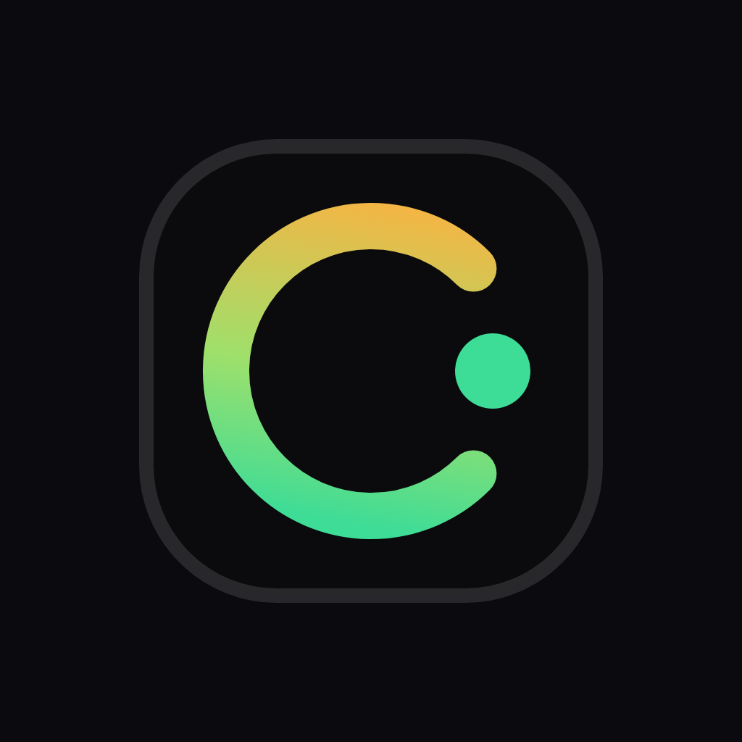
COMMISH
Commish holds the router's cut
until the agent call cannot be refunded
USDC holdback for x402 agent payments on Solana
Vincentius Bryan Kwandou · Live on mainnet · getcommish.vercel.app
01 / 11

Slide 2
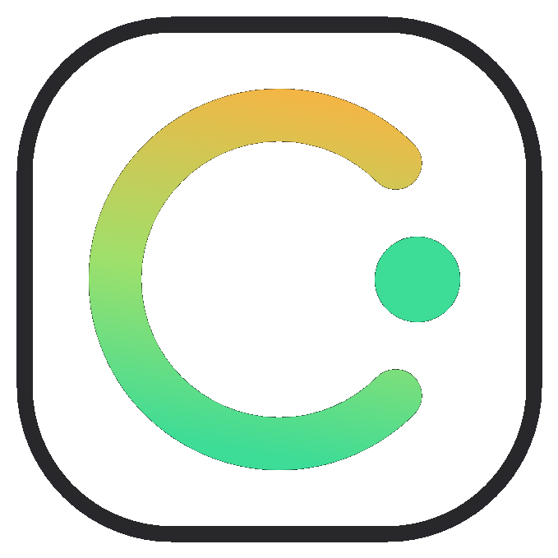
PROBLEM
If the tool refunds the call, the router must not keep the cut
HTTP 402
600s
10%
agent pays tool per call
refund window on mainnet
router cut held on-chain
Source: Commish mainnet campaign · 600s hold · 10% router cut (README)
COMMISH
02 / 11

Slide 3
WHY NOW
Solana already carries most x402 agent payments
23.2M
76%
$24.2M
x402 transactions on Solana
in 4 weeks
of all-chain x402 activity
on Solana
30-day volume across
all chains
Source: Artemis / Solana Compass, 22 Sep 2026
COMMISH
03 / 11

Slide 4
PRODUCT
Four steps, one program: pay, record, hold, release
01
02
Pay
Record
Agent pays USDC into the campaign vault with a memo that names its router, then retries with the payment signature and gets the data.
Relayer verifies the payment on-chain and calls record_sale. The program reserves the router's 10% where the tool cannot withdraw it.
03
04
Hold
Release
For 600 seconds a refund can cancel the cut. If the tool refunds the call, the router gets nothing.
After the window anyone can release. The cut can only pay the named router, minus a 1% protocol fee.
COMMISH
04 / 11

Slide 5
DEMO
Mainnet released one held cut and cancelled another
RELEASE · 6 OCT
REFUND · 9 OCT
Agent paid → recorded → 10 min hold → released 0.00495 USDC to the router
Agent paid → recorded → tool refunded → cancel. Router received nothing.
Pay
Record
Release
47MtDwTY…
2GXGEqG9…
5UP1zayt…
Pay
Refund
Cancel
2j1px41k…
4b1FAR1L…
44iK8DZt…
COMMISH
05 / 11

Slide 6
GUARANTEES
The program locks the cut where the tool cannot spend it
Owed money stays locked
One payment, one cut
Router cut sits in a program account the tool cannot withdraw from.
Commission address is derived from the payment signature. No double record.
Only the attestor records
Payouts cannot be redirected
Only the named relayer can call record_sale for that campaign.
Release pays only the current payee token account for that cut.
No cancel after the window
Works without this website
After 600s the cut can only be released, never cancelled.
Anyone with an RPC can release. No backend required.
COMMISH
06 / 11

Slide 7
TRACTION
Program is live; outside agent volume is still zero
9,272
33
0
byte Pinocchio binary
on mainnet
LiteSVM attack tests
passing
outside agents
so far (honest gap)
Source: team deploy & tests · stated on project page
COMMISH
07 / 11

Slide 8
BUSINESS MODEL
One percent of each released cut funds the protocol
1%
THE BET
A tiny fee per call only works at agent scale. That is the bet on x402 volume continuing to grow on Solana.
fee on release (FEE_BPS = 100)
Already live on mainnet
0.005 USDC cut → 0.00005 USDC fee
Revenue only works at high call volume.
COMMISH
08 / 11

Slide 9
GO-TO-MARKET
First users are tool providers that already sell to agents
01
Tools
Panta is the first paid endpoint. Next: other x402 tool sellers on Solana.
02
Routers
Directories and orchestrators name themselves in the payment memo and earn the cut.
03
Agents
Pay, retry with signature, get data. No human in the loop.
COMMISH
09 / 11

Slide 10
TEAM
One founder who already shipped two Solana products to mainnet
Vincentius Bryan Kwandou
Founder & engineer · 20 · Makassar · Superteam Campus Lead
Shipped SOLQ (QRIS pay with SOL / USDC / IDRX) and SolGig escrow — both mainnet.
Built Commish end-to-end: Pinocchio program (25k → 9,272 bytes), 33 attack tests, x402 endpoint, relayer, keeper, Next.js app, demos.
Creator since 2022 (Objkt, Drip, Shutterstock) — lived the affiliate payout problem that started Commish.
COMMISH
10 / 11

Slide 11
COMMISH
Next: two outside tool providers
and one agent directory
Product
getcommish.vercel.app
Demo
getcommish.vercel.app/en/demo
GitHub
github.com/bryankwandou/commish
Program
CmSHpw9QTwvRSNCCBrQz275ESTCw8D79Z8jjhWmPJfFB

