Slide 1
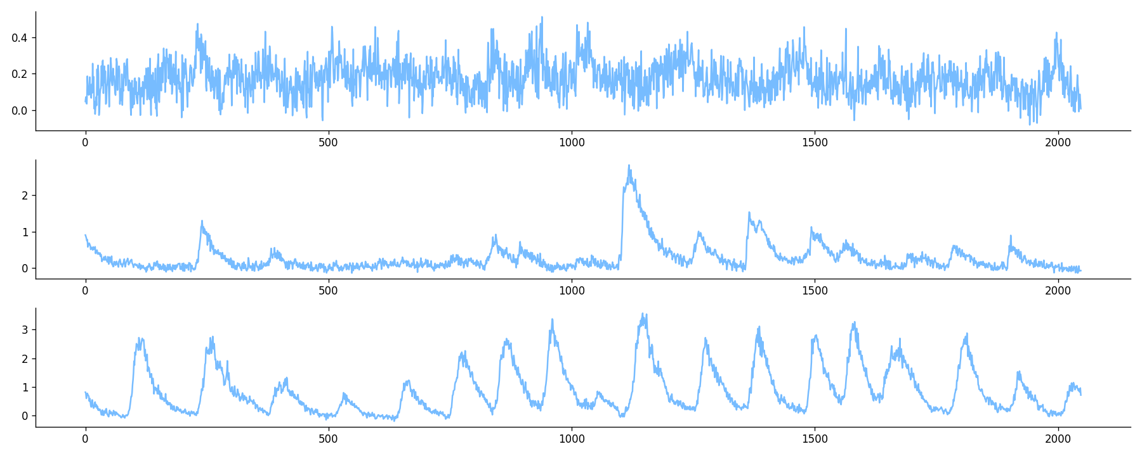
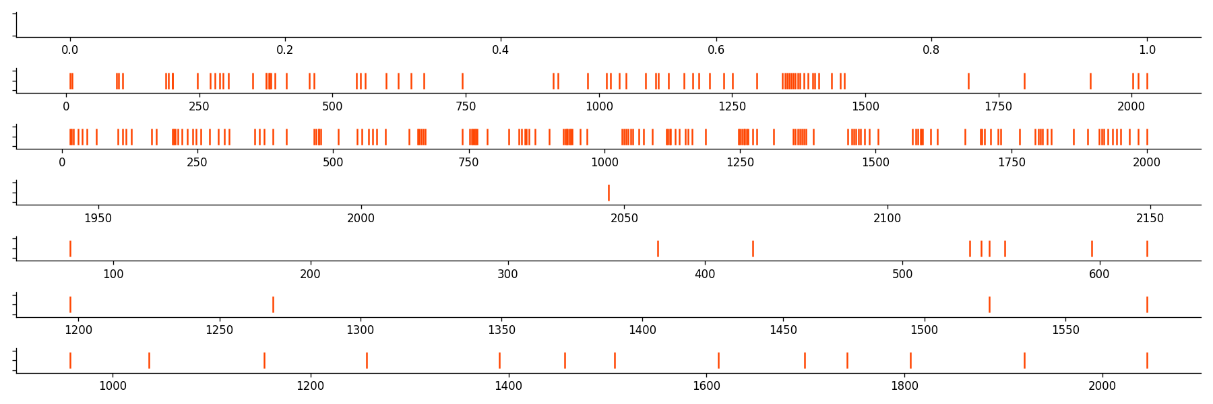
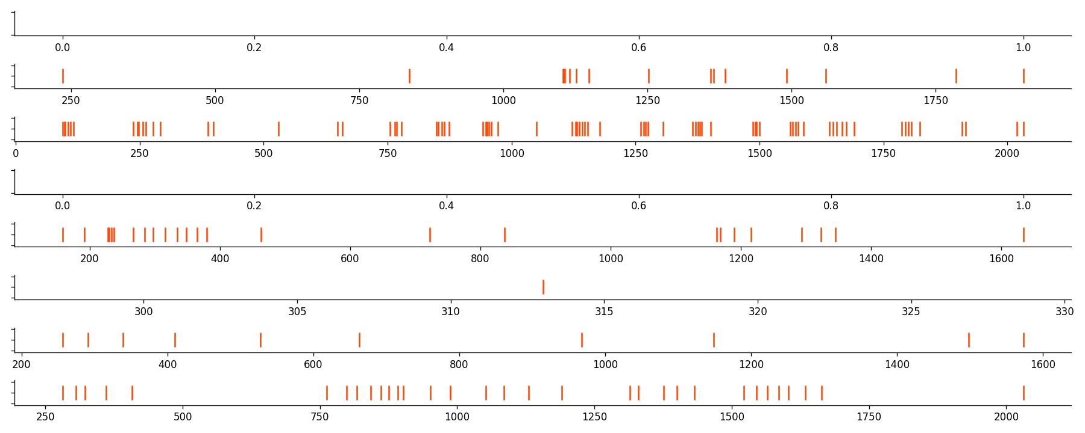
input noise z
synthetic signals
synthetic spikes
normalization
segmentation
segmented signals
CalciumGAN
OASIS
recorded signal
Spike analysis
inferred spikes
OASIS

