Slide 1
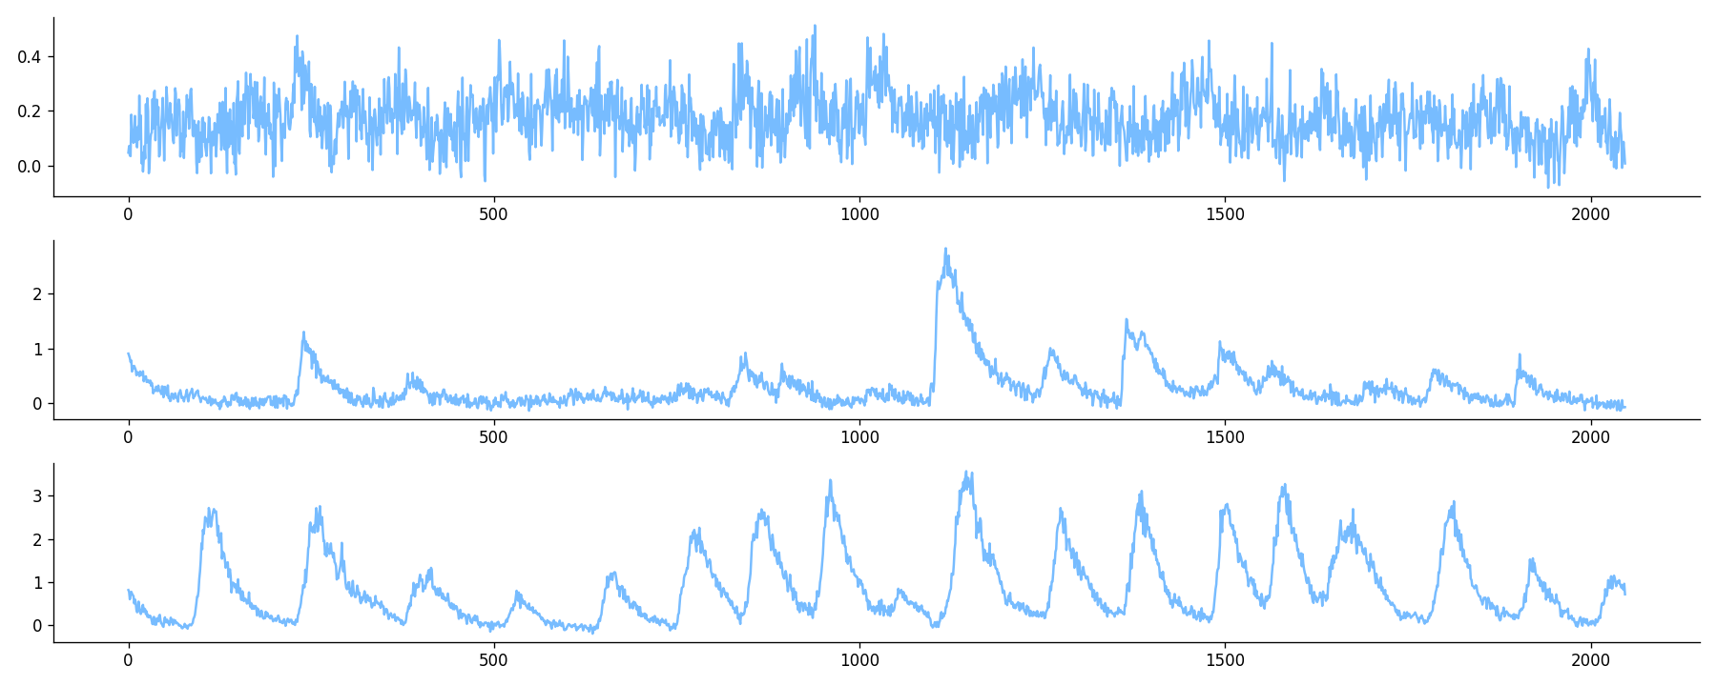
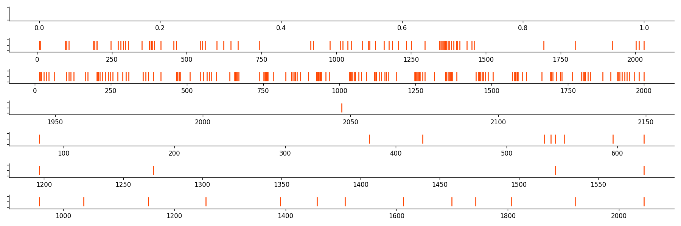
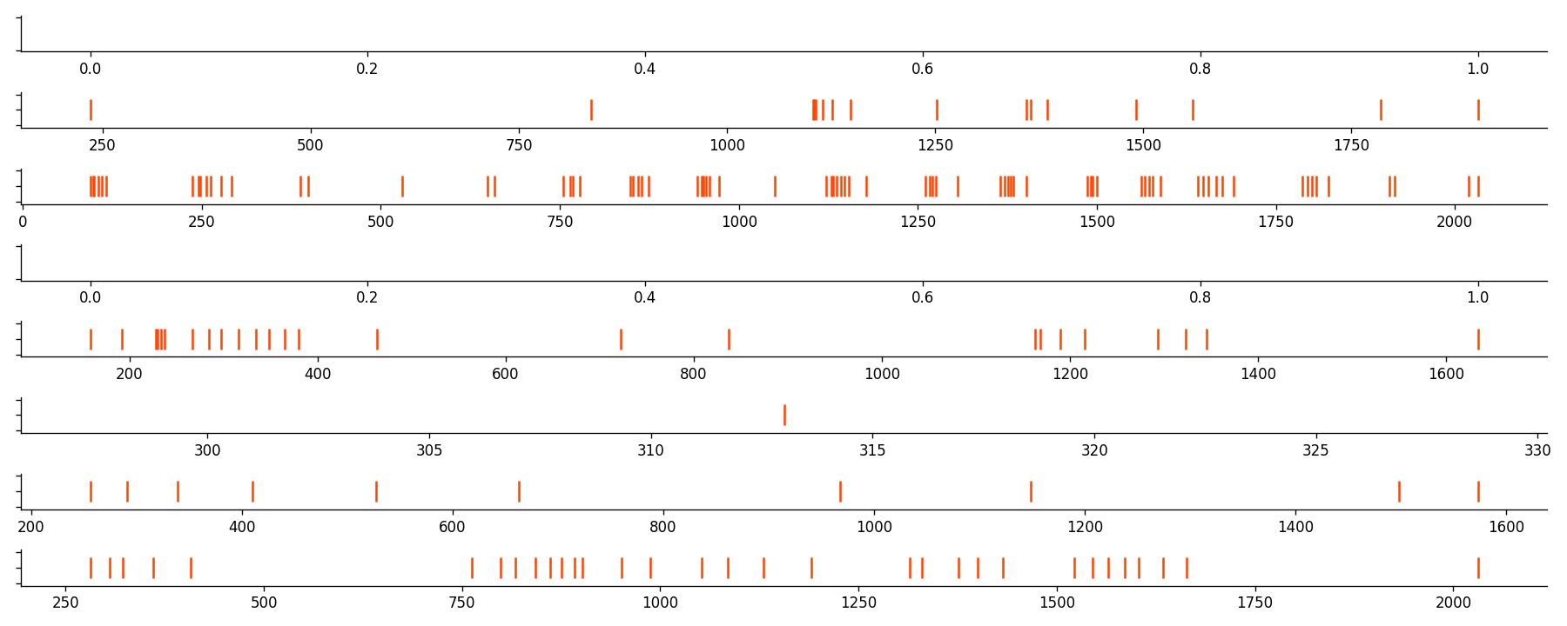
random noise
synthetic signals
synthetic spikes
normalization
segmentation
CalciumGAN
OASIS
recorded signal
segmented signals
Spike analysis with Elephant
inferred spikes
OASIS

