Slide 1
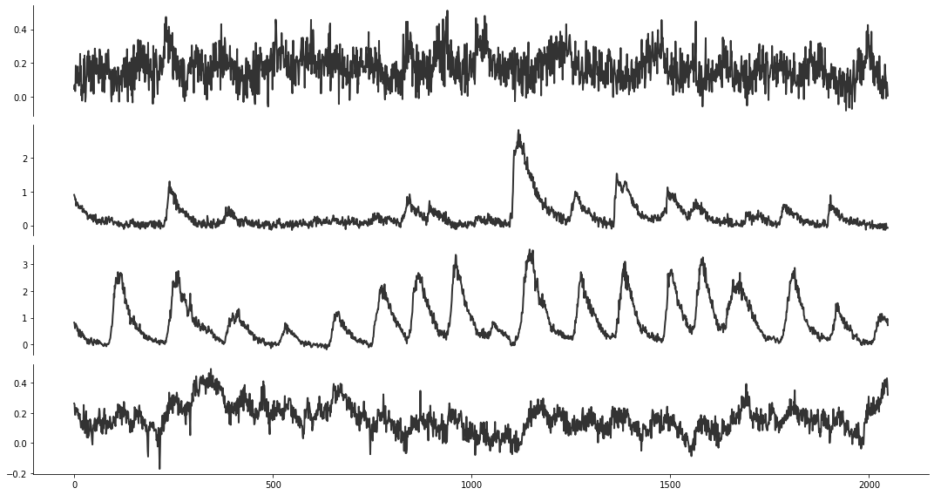
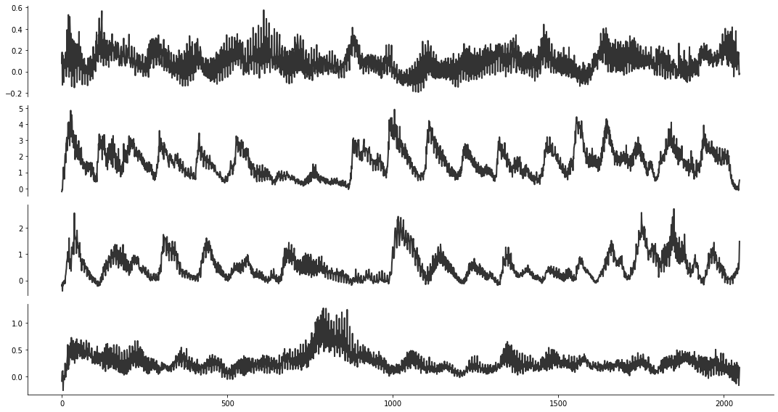
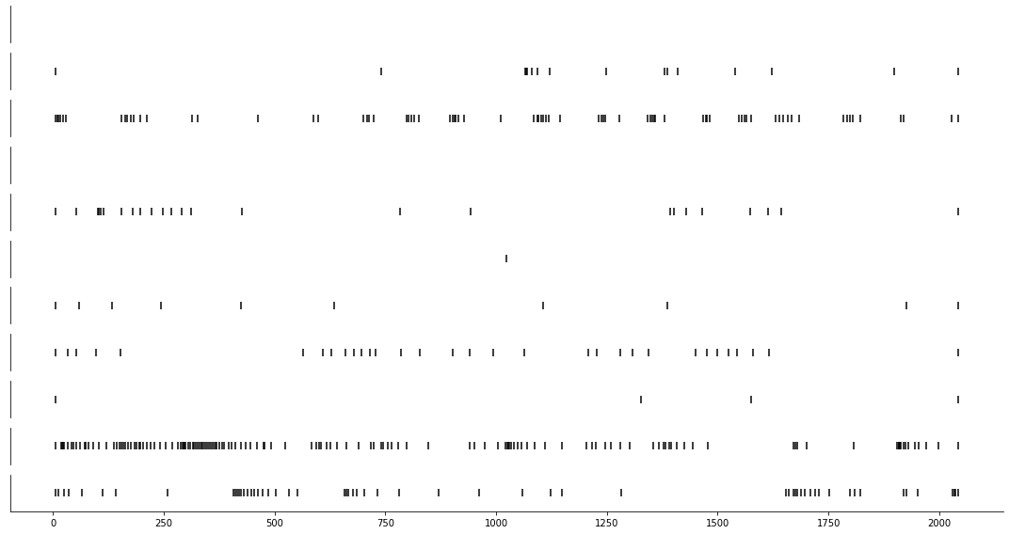
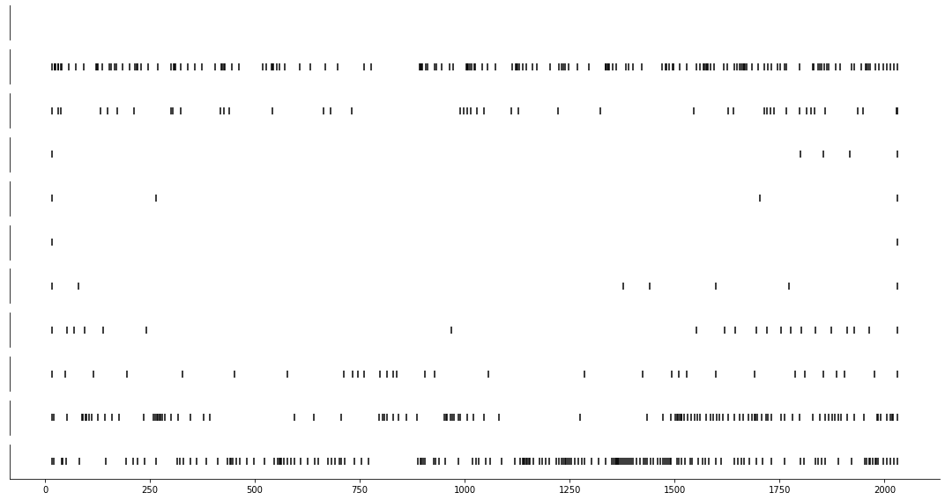
recorded signals
pre-processing
FFT
OASIS
segmentation
reshape
scale
input x
noise z
CalciumGAN
synthetic signals
post-processing
rescale
reshape
iFFT
OASIS
recorded spikes
synthetic spikes
spike analysis

