Slide 1
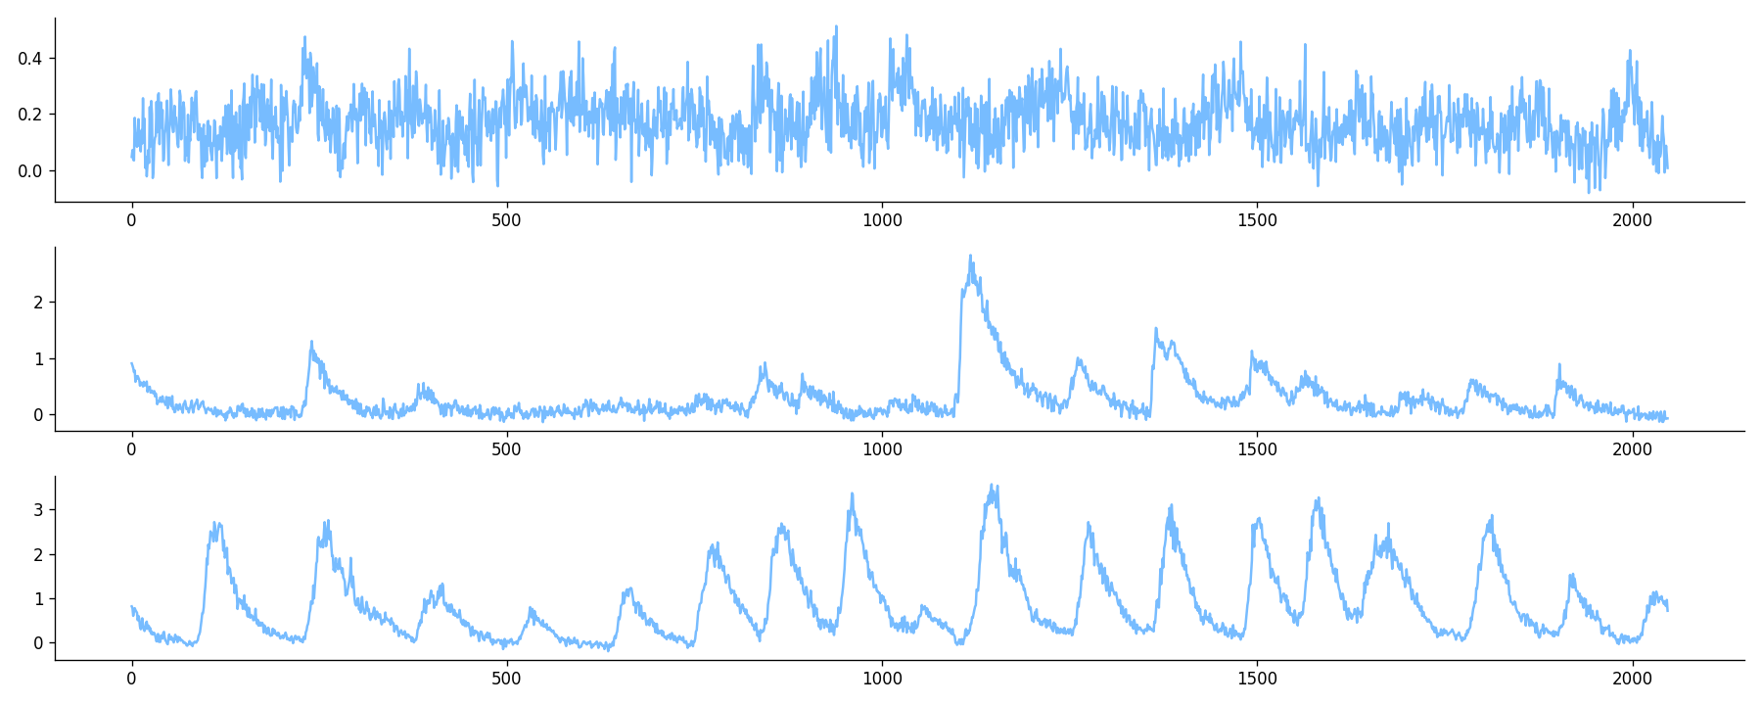
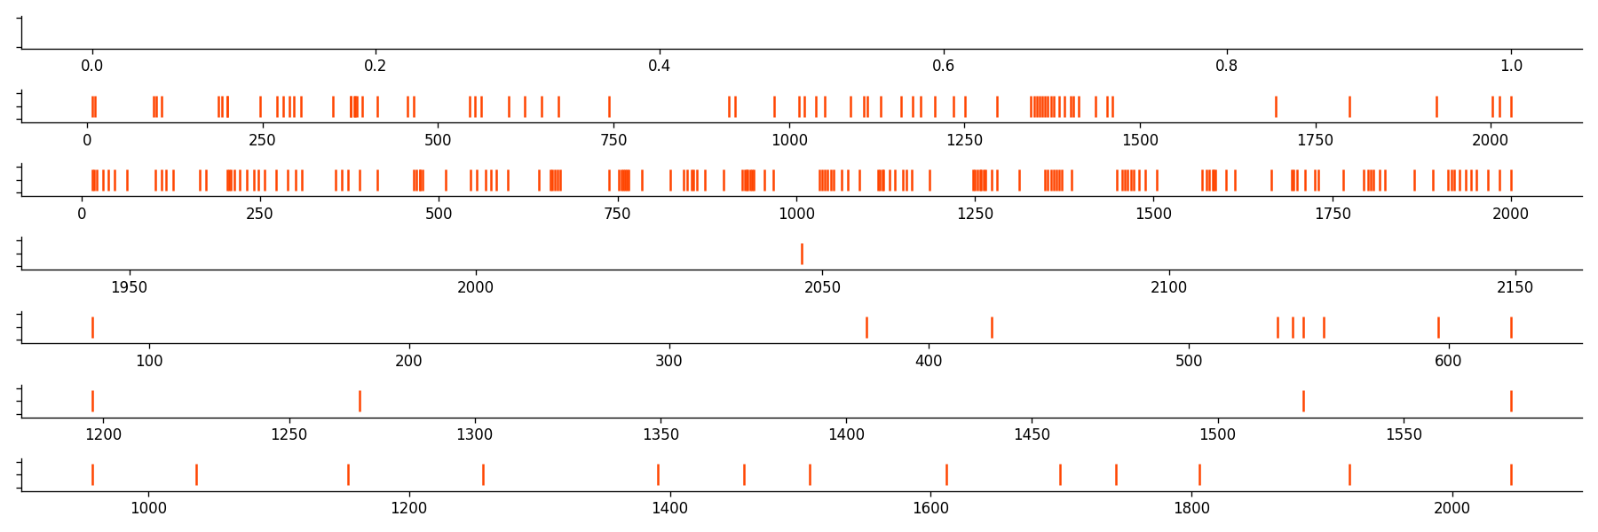
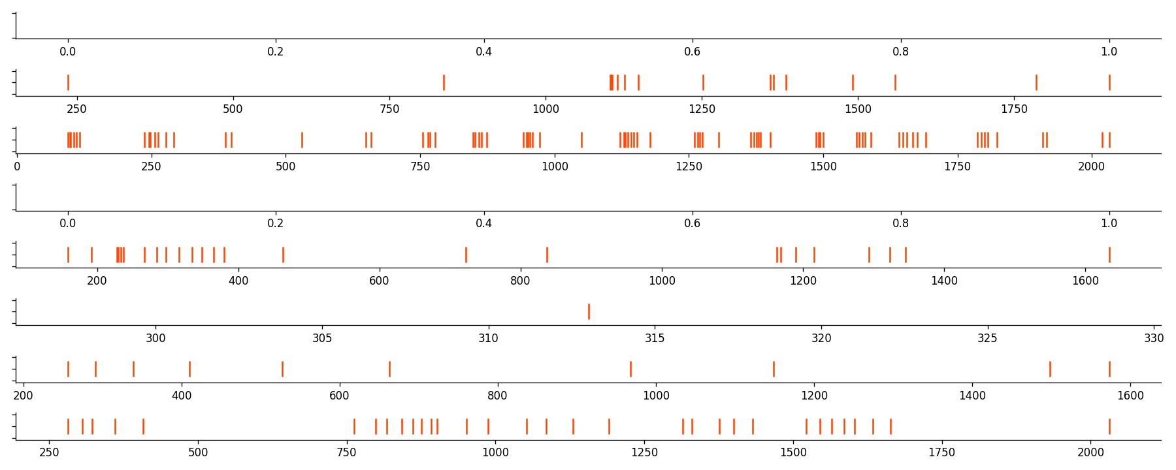
random noise
fake signals
fake spikes
Normalization
Segmentation
CalciumGAN
OASIS
raw signals
real signals
Spike analysis with Elephant
real spikes
OASIS

