Slide 1
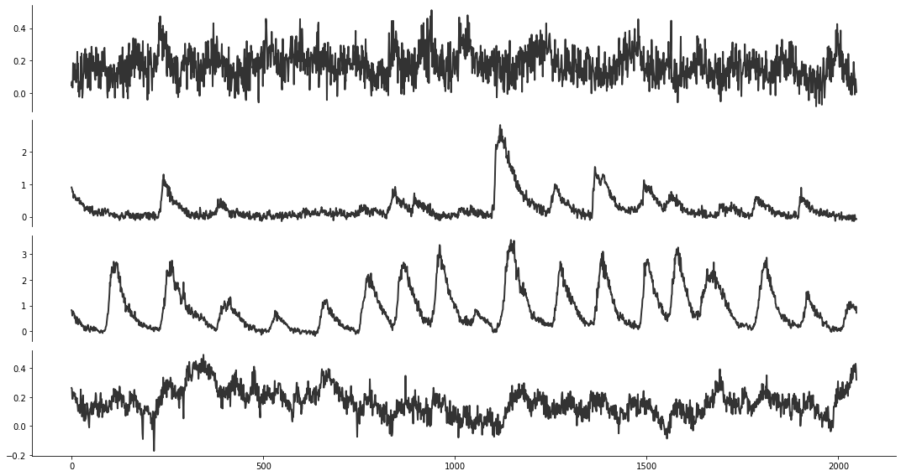
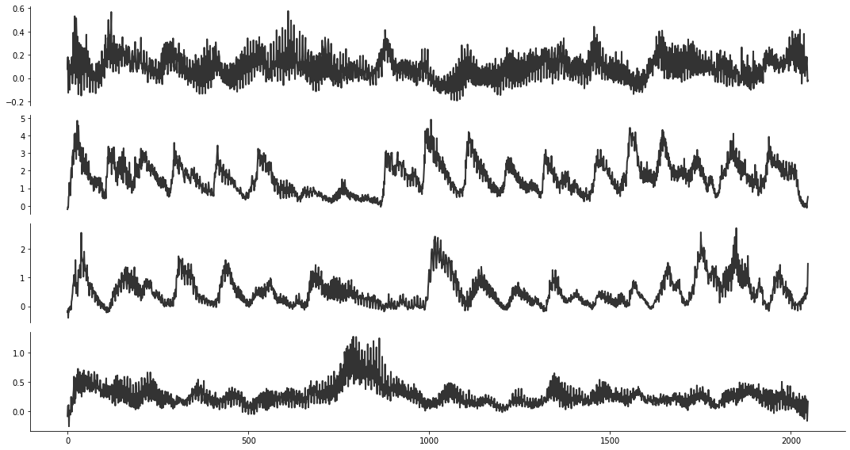
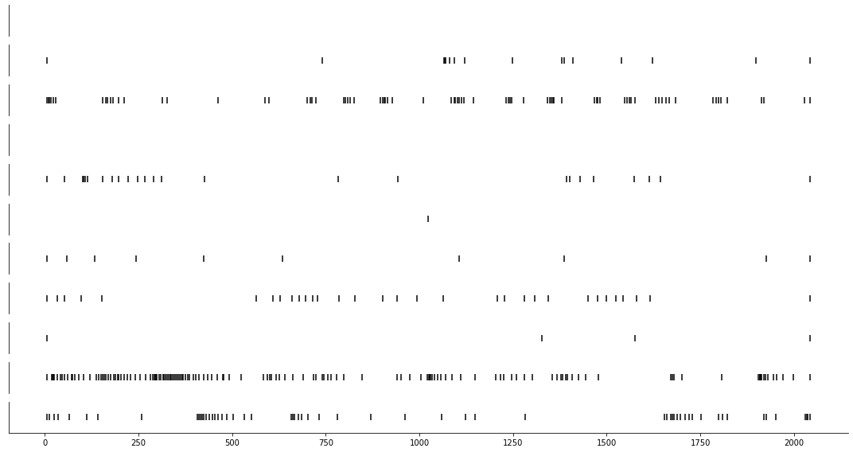
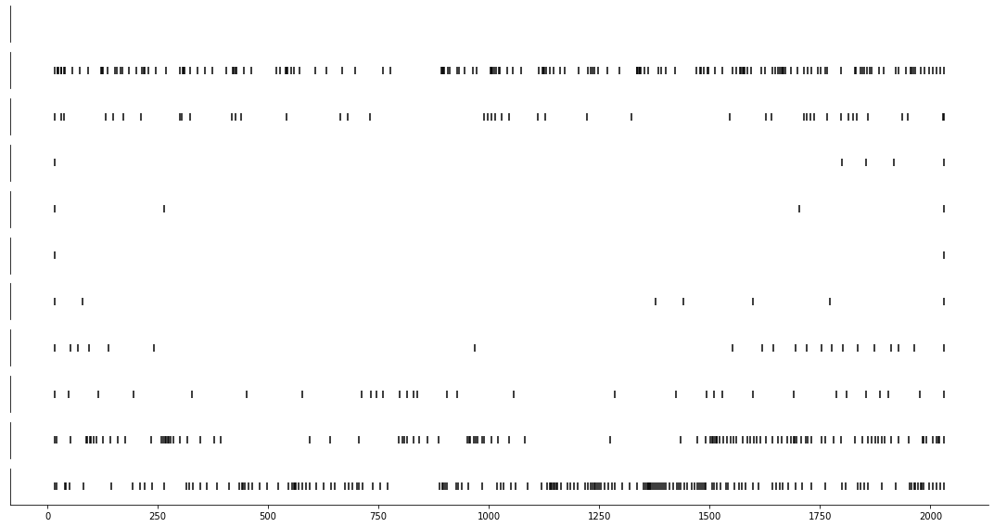

recorded signals
pre-processing
FFT
OASIS
segmentation
reshape
scale
input $x_{[0, 1]}$
noise z
CalciumGAN
synthetic signals
post-processing
rescale
reshape
iFFT
OASIS
recorded spikes
synthetic spikes
spike analysis

