Slide 1
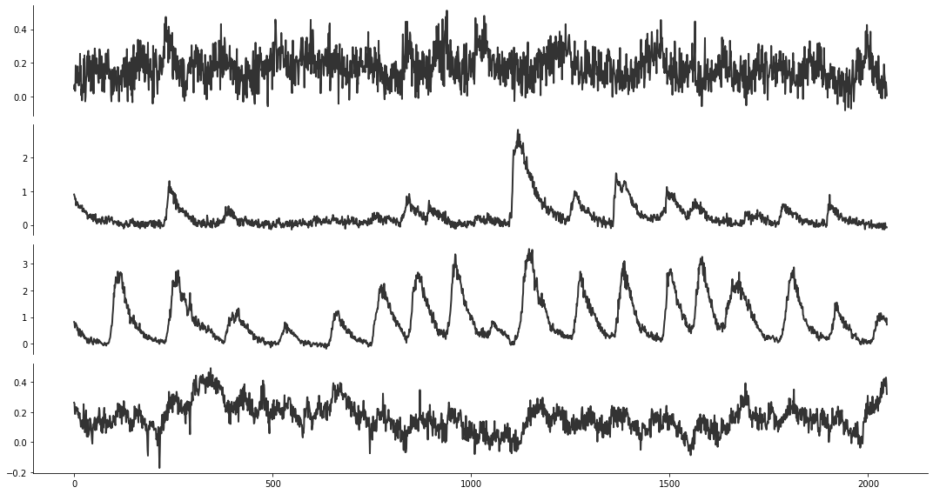
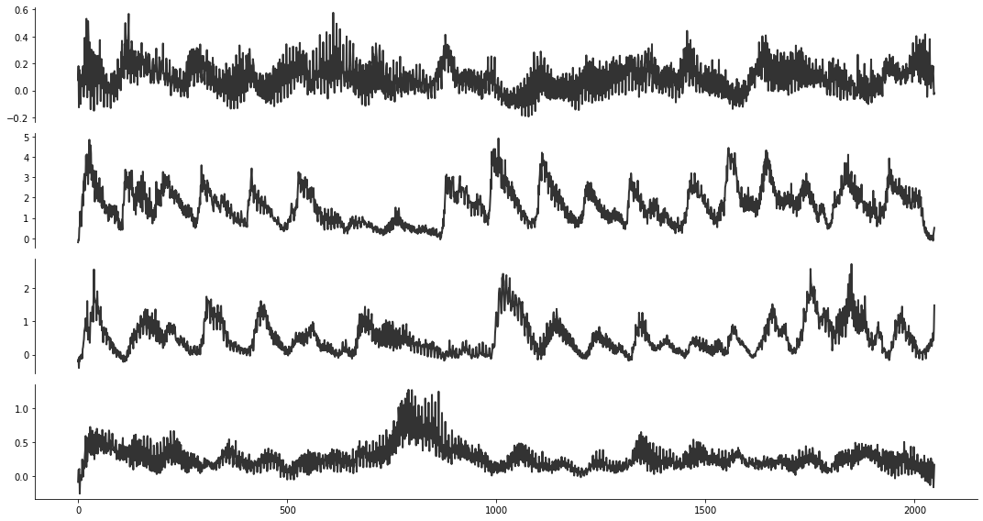
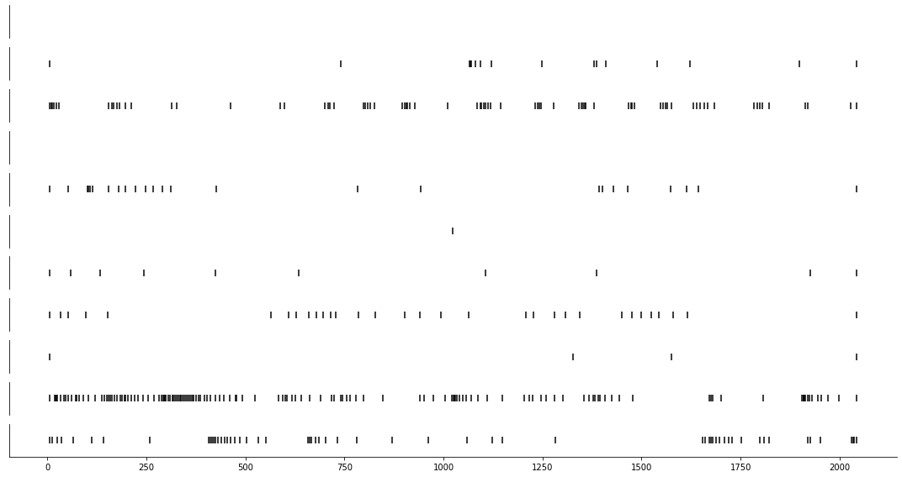
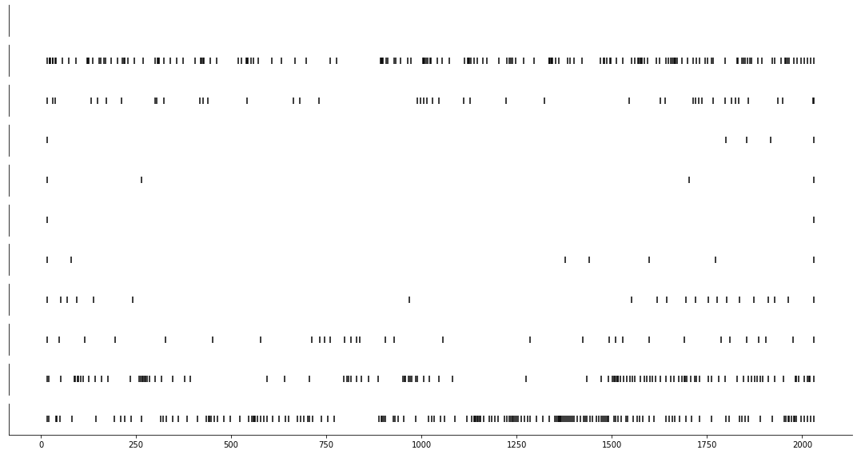

recorded signals
OASIS
segmentation
pre-processing
input $x_{[0, 1]}$
noise z
CalciumGAN
synthetic signals
post-processing
OASIS
recorded spikes
synthetic spikes
spike analysis

