Slide 1

User Interface Design Presentation
Project: Online Ordering System
Presented by: Mondejar, Diana Rose
Cortes, Jojilyn
Paler, Jemaphi

Slide 2
Introduction
The Online Ordering System for Island Fried Chicken was created to make the ordering process faster, easier, and more convenient for both customers and staff. As more people prefer ordering food online, this system helps the business keep up with current trends and customer needs.
With the system, customers can view the menu, place orders, and choose their payment method without going to the store or calling. This helps avoid long lines and waiting times. It also reduces mistakes when taking orders and makes sure the kitchen receives the correct details. For the staff, the system lessens their workload by handling order-taking automatically. This allows them to focus more on preparing food and serving customers.

Slide 3
Objectives
• Develop a simple and user-friendly online ordering system for customers.
• Reduce manual errors by automating the order-taking process.
• Speed up order processing and improve service efficiency.
• Allow customers to place orders anytime and anywhere.

Slide 4
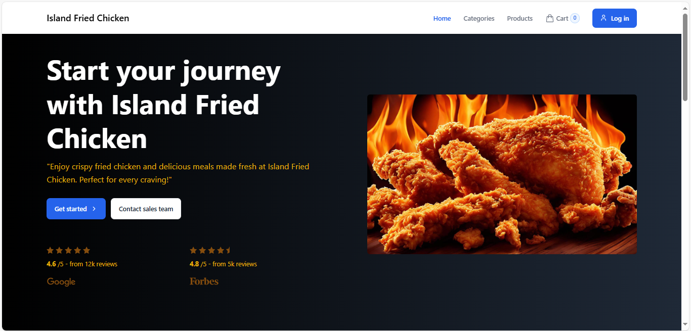
Home Page/Landing Page

Slide 5
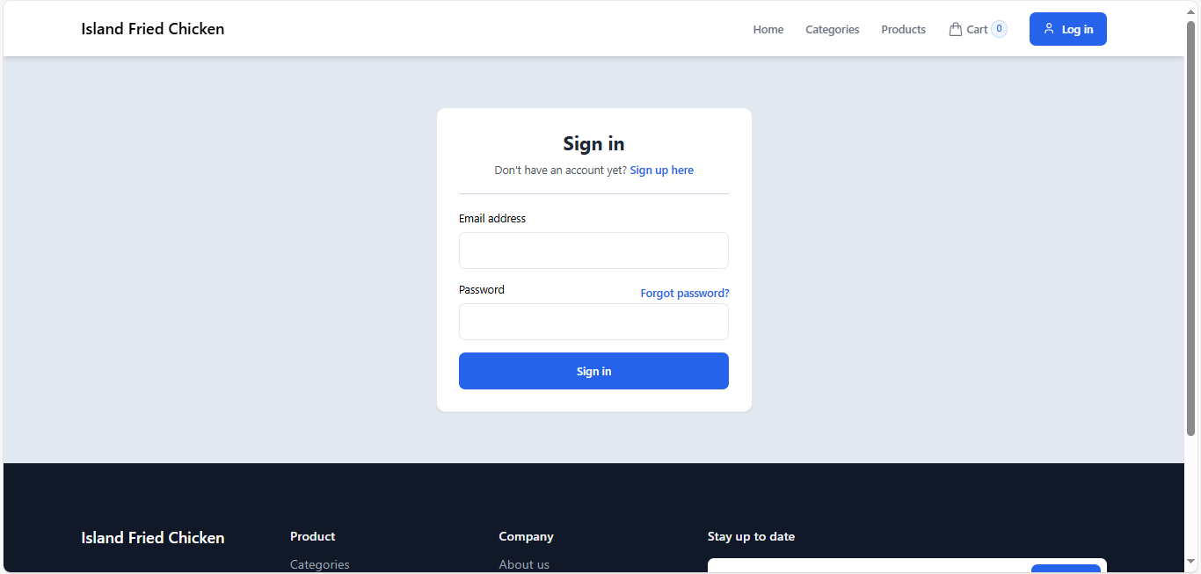
Login Page/Sign Up Page

Slide 6
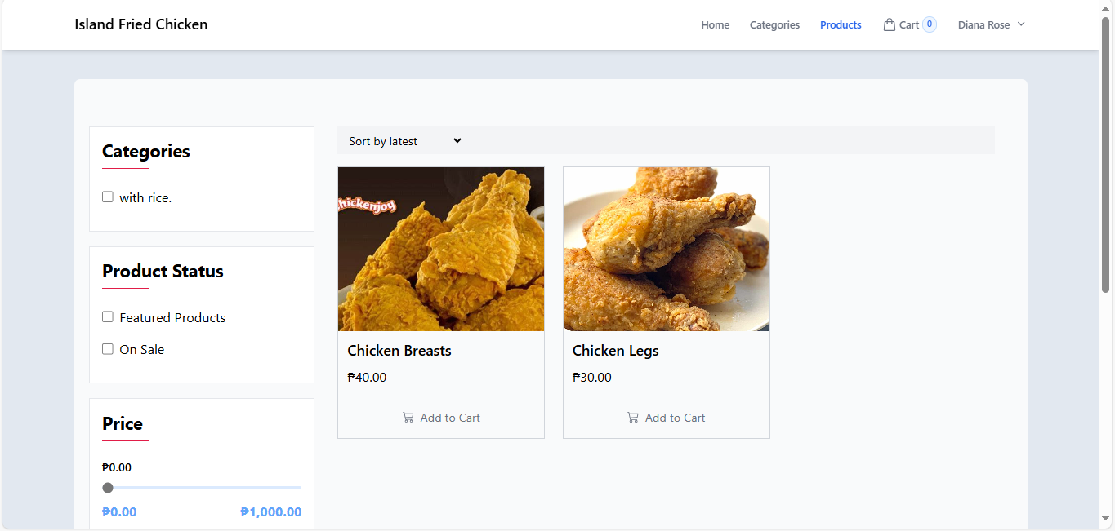
Product Page

