Slide 1
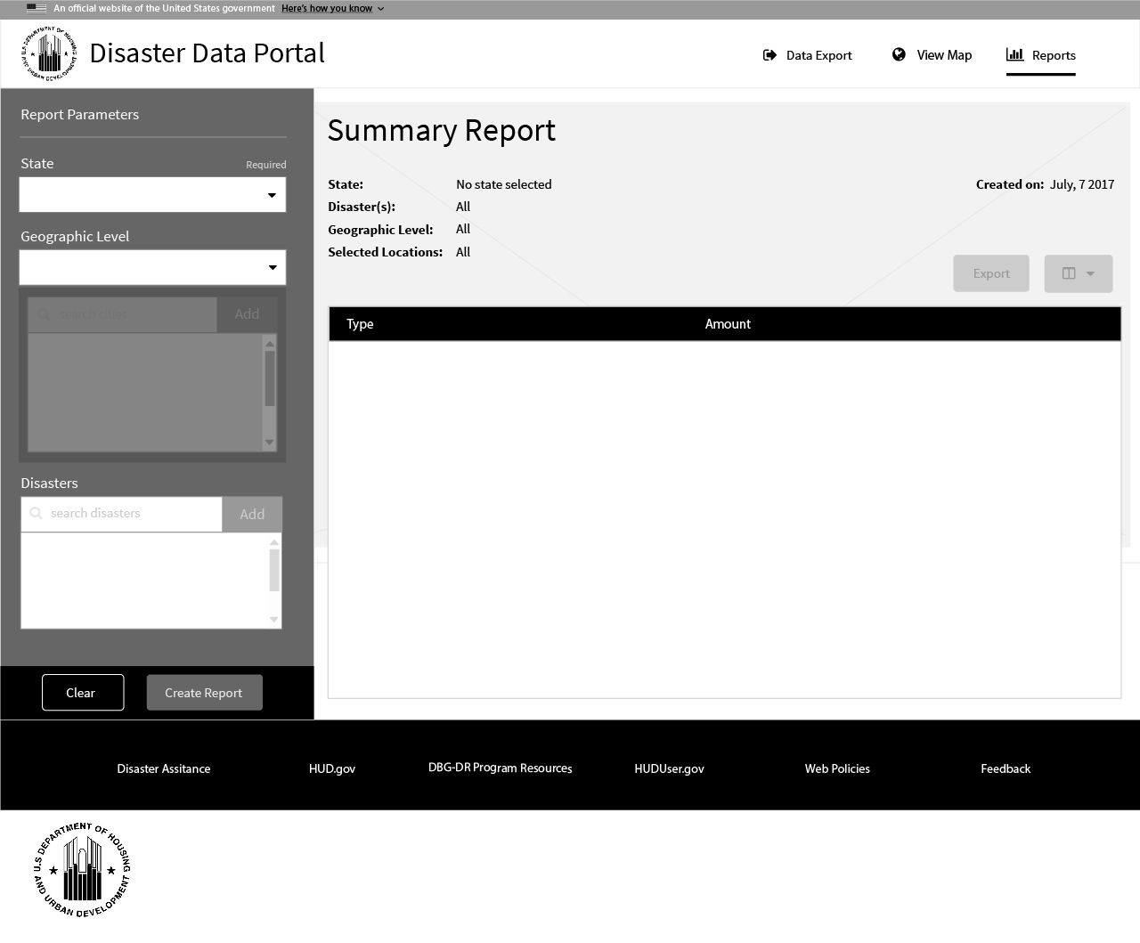
As the user lands on the reports page, the current date is pre-populated.
1
1

Slide 2
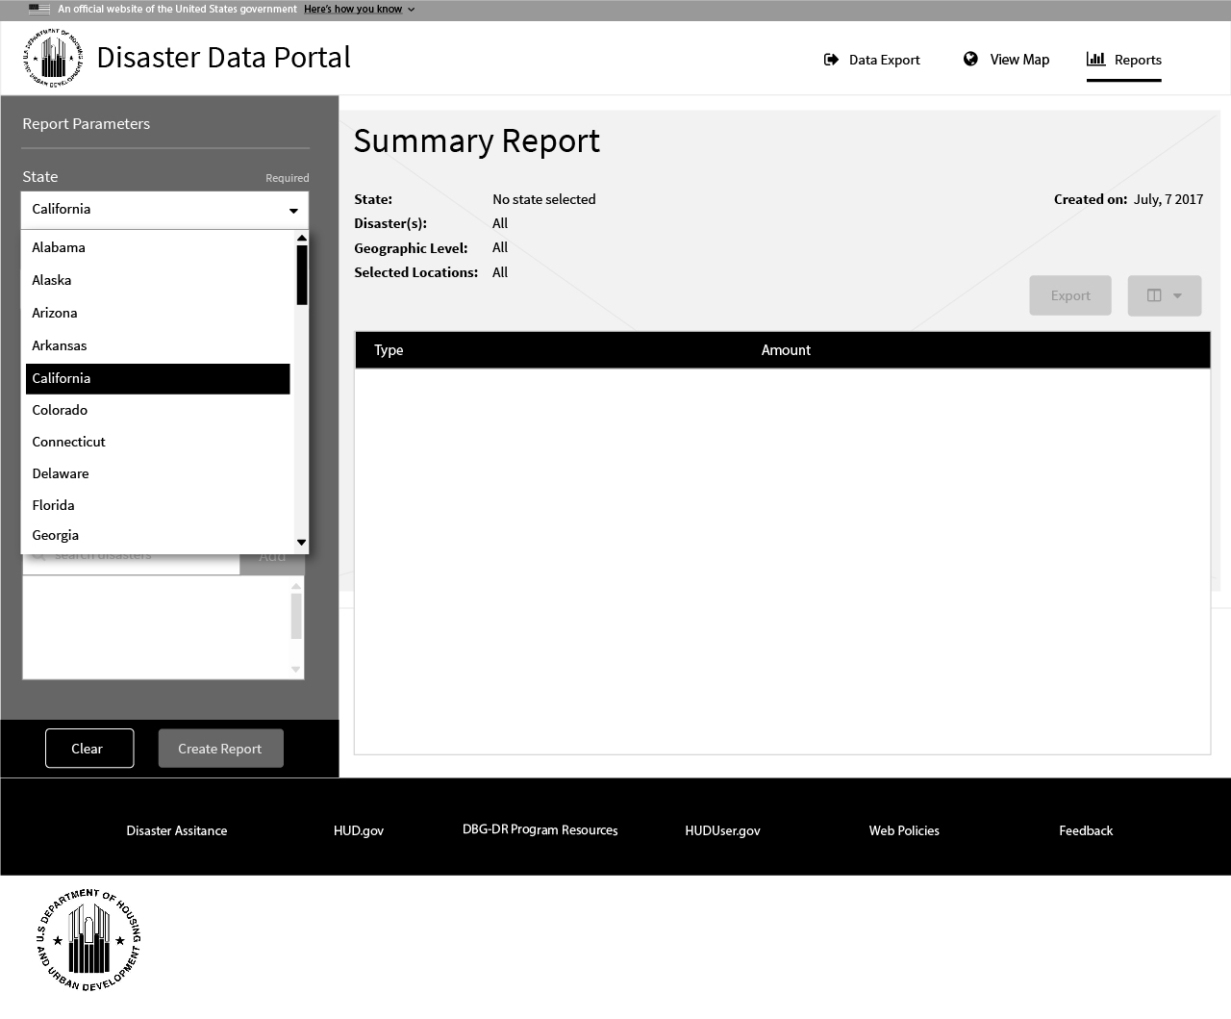
State selection from the user is required before reports can be generated.
*note – Generating a report with only a state selection will provide data for all disasters in all cities/counties/congressional districts.
1
1

Slide 3
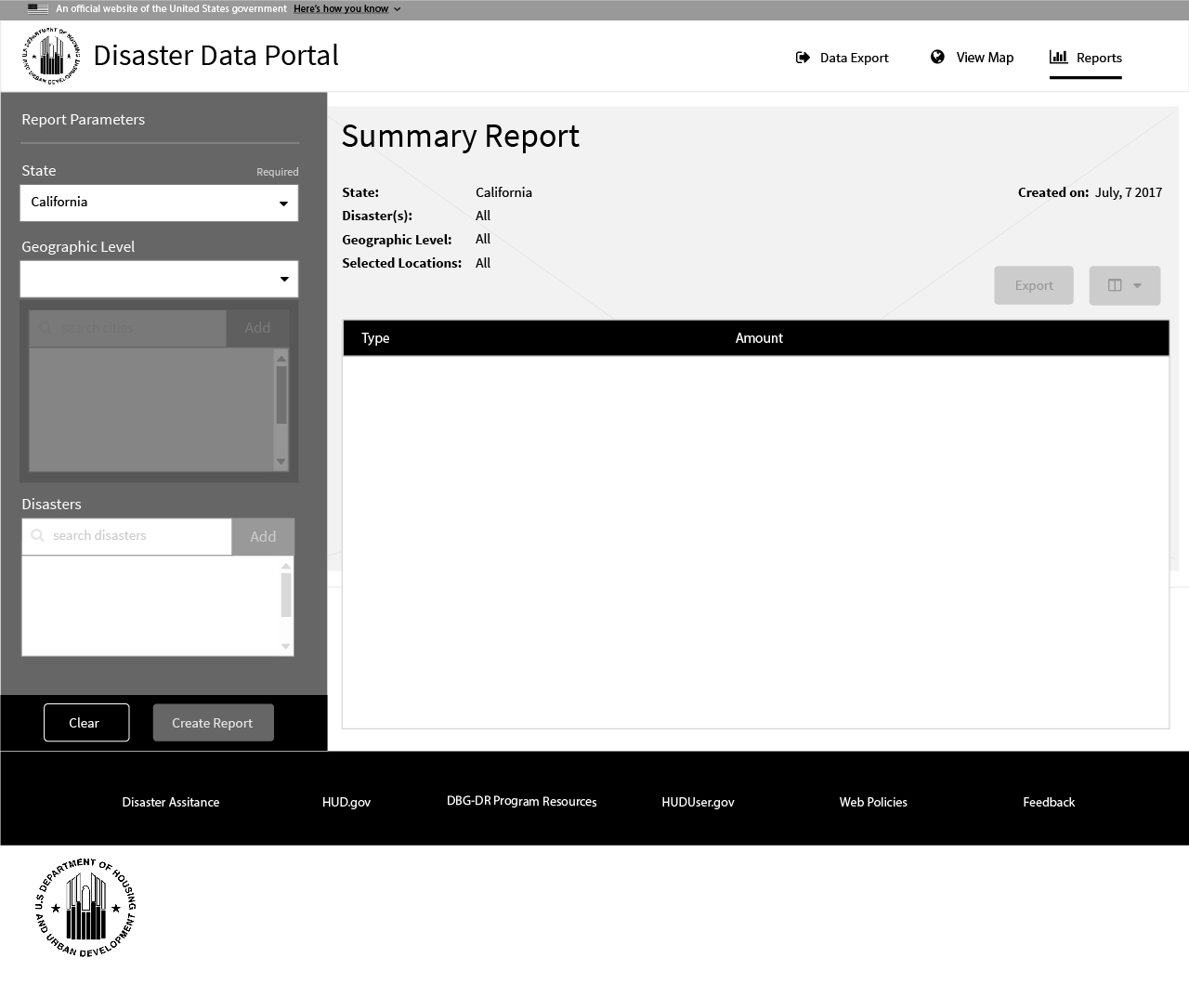
Once the state has been selected , it is added to the report title heading for user reference and when exporting.
1
2
1
2

Slide 4
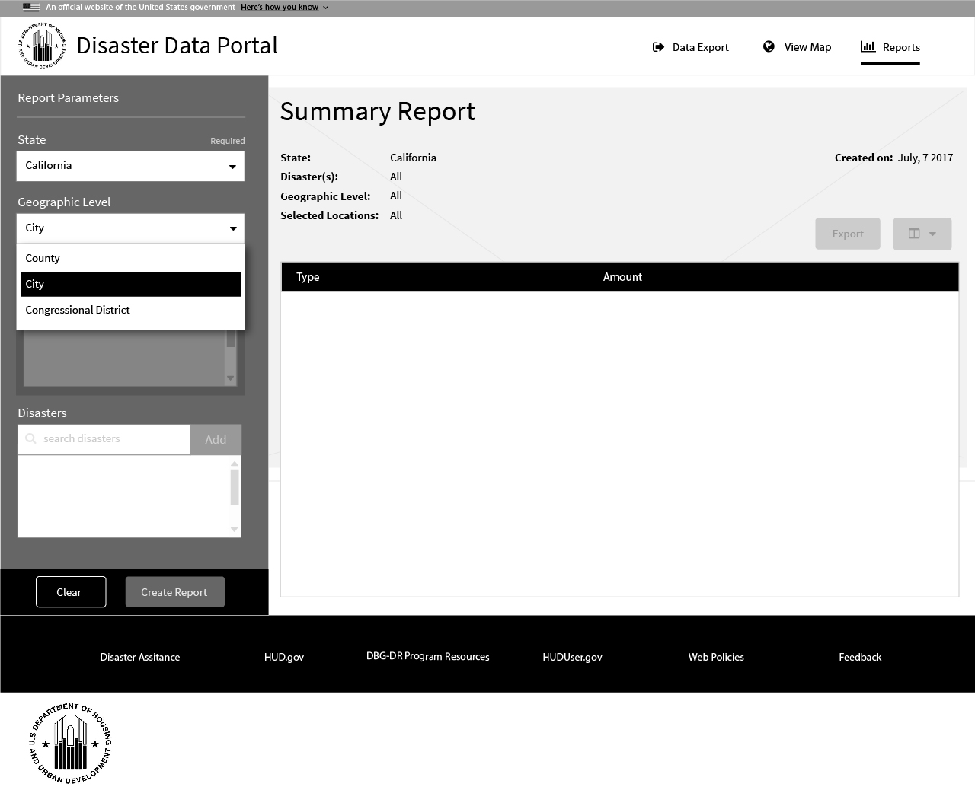
The user has the option of selecting a Geographic Level to limit the reporting summary data to a group or specific counties, cities or congressional districts.
1
1
The user may type in the Locations Interface input to add a location. On the 3rd character input, the type-ahead feature will provide suggestions based on the Disaster ID state code (last 2 characters) and the Geographic Level selected.
In the example, the typeahead suggests cities in Texas that were affected by the disaster
DR-1151-TX.
Note –
, which is
Then added to the report title heading for reference when exporting.
The user may select any of the Geographic Levels from the dropdown selector. Once selected, the titles text changes for reference when exporting.
Note – After a Geographic Level is selected, the locations interface becomes active. If at any point the Disaster ID or Geographic Level is changed, the Locations interface may clear all values or become disabled.

Slide 5
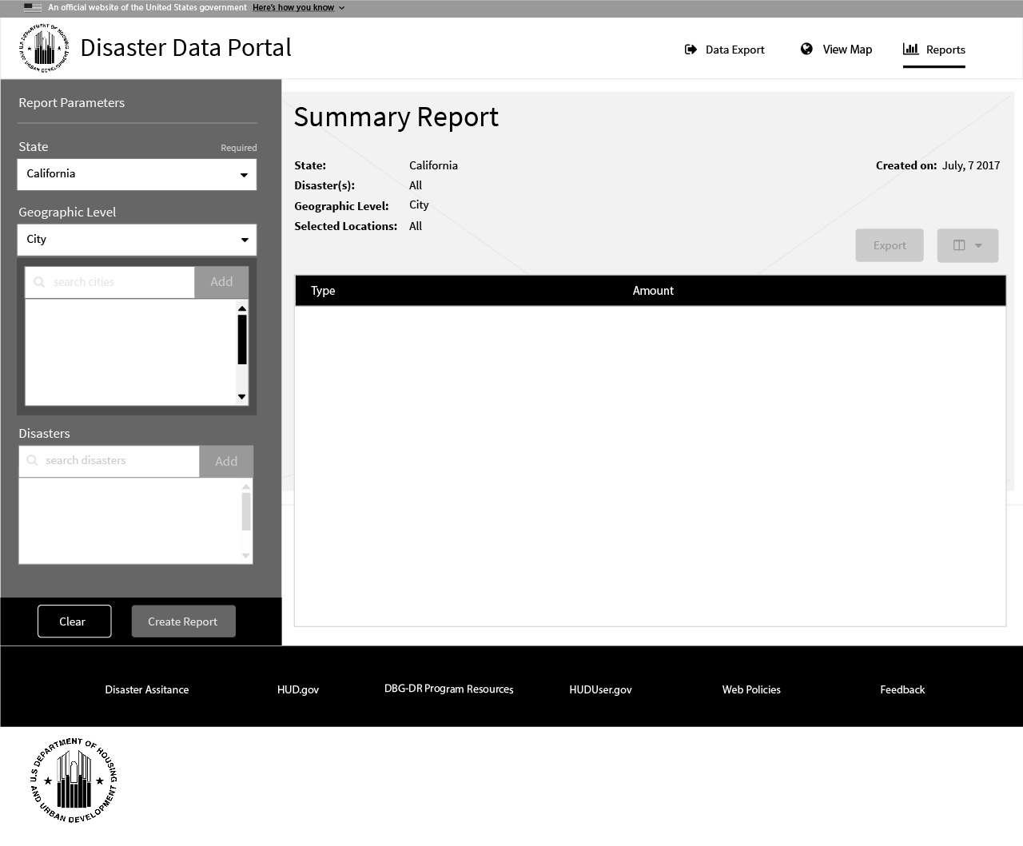
Once the geographic level has been selected , like the required state selection, it is added to the report title heading for user reference and when exporting.
*note – When a geographic level is selected, it activates the geo-selection interface allowing the user to select specific locations based on the level selected.
In the example, since the selected geographic level was ‘City’ the geo-selection interface searches cities within the state of California.
1
2
2
1
The user may type in the Locations Interface input to add a location. On the 3rd character input, the type-ahead feature will provide suggestions based on the Disaster ID state code (last 2 characters) and the Geographic Level selected.
In the example, the typeahead suggests cities in Texas that were affected by the disaster
DR-1151-TX.
Note –

Slide 6
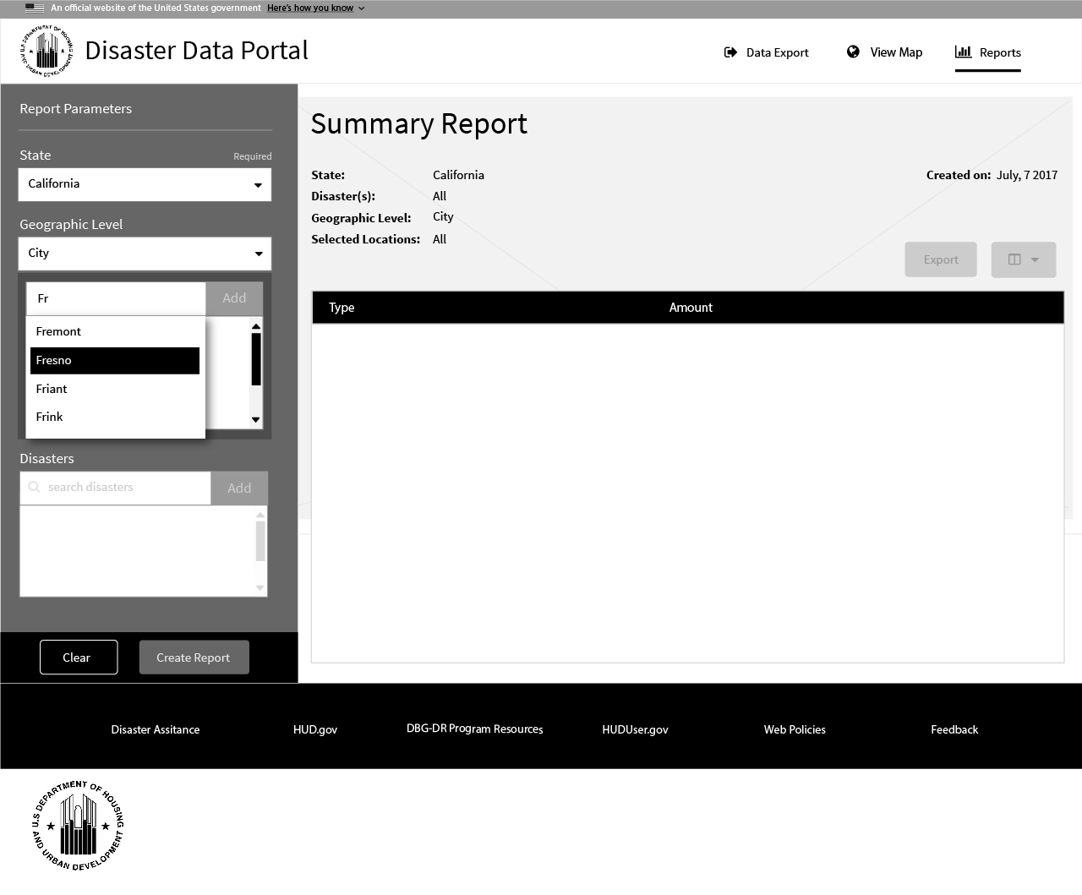
When searching for locations in the geo-selector typeahead functionality is provided to the user suggesting possible locations as the user types.
1
1

Slide 7

When a location has been entered and validated, the “Add” button becomes enabled allowing the user to add it to the geographic level report parameters
1
1

Slide 8

Once added , the location shows as a selection and is added to the report title heading for user reference and exporting.
1
2
2
1

Slide 9

The user may add as many geo-locations as they wish while the selections continue to be added to the report title heading for reference when exporting.
1
2
2
1

Slide 10
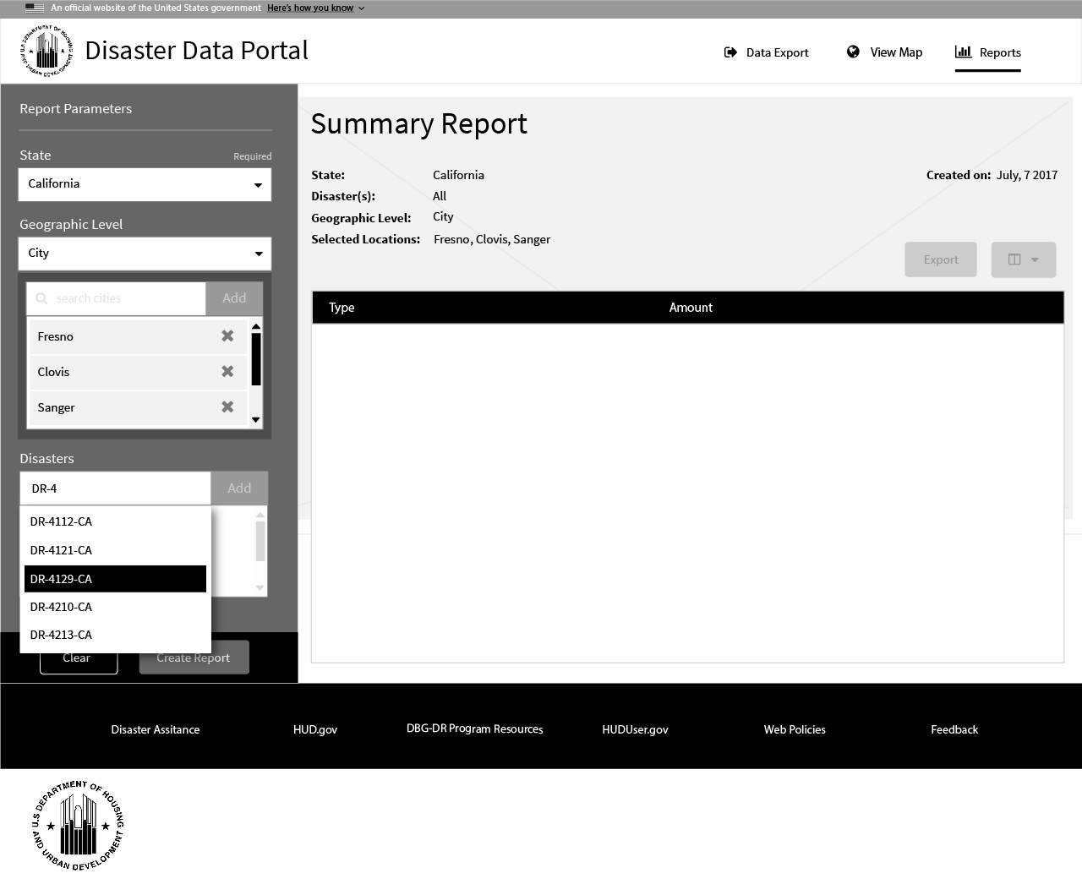
When searching for disaster ids, the typeahead functionality is provided to the user suggesting possible disaster to the user as they type.
1
1

Slide 11
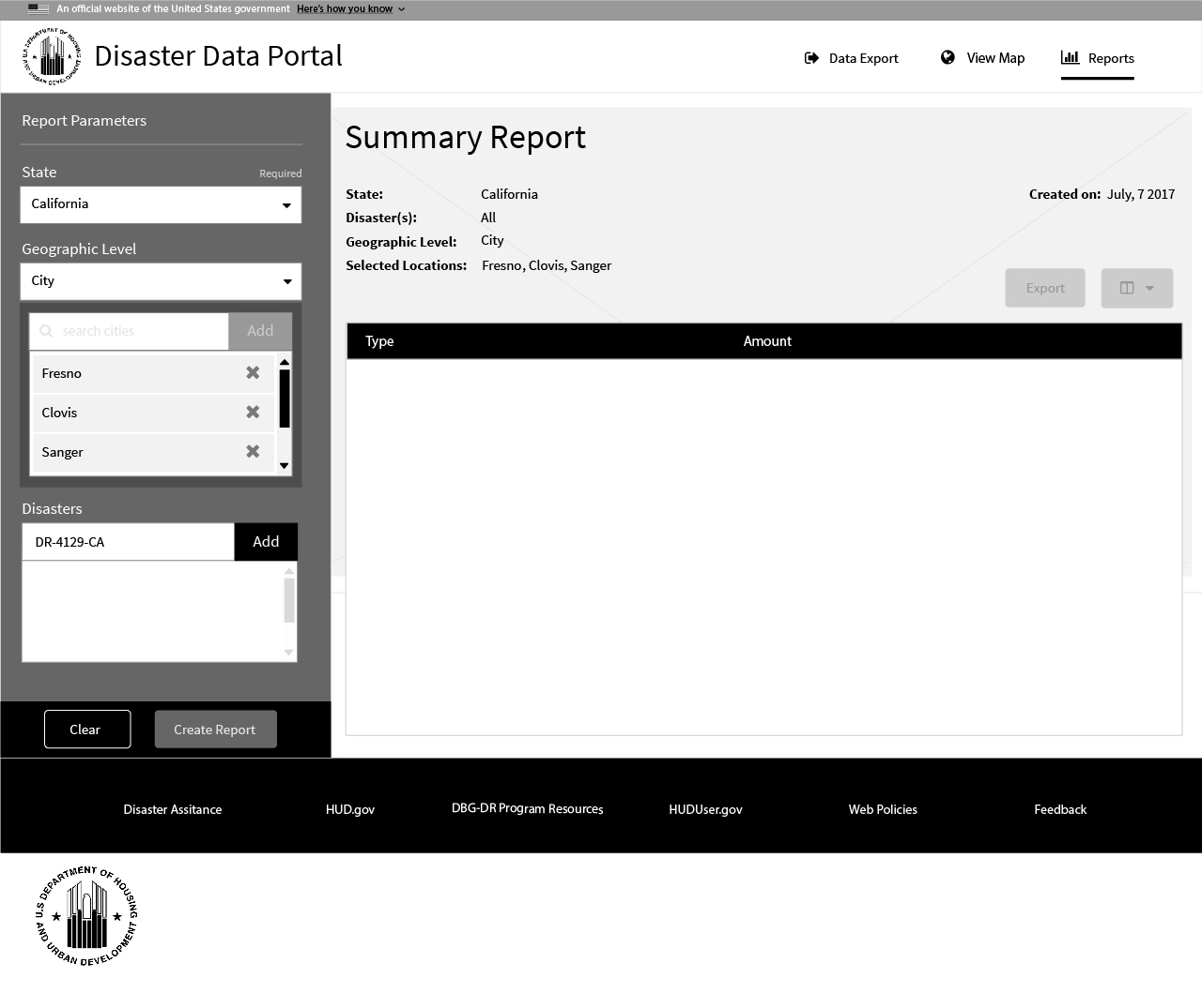
When a disaster id has been entered and validated, the “Add” button becomes enabled, allowing them to add it to their list of report parameters.
1
1

Slide 12

Once added , the disaster id shows as a selection and is added to the report title heading for user reference and exporting.
1
2
2
1

Slide 13
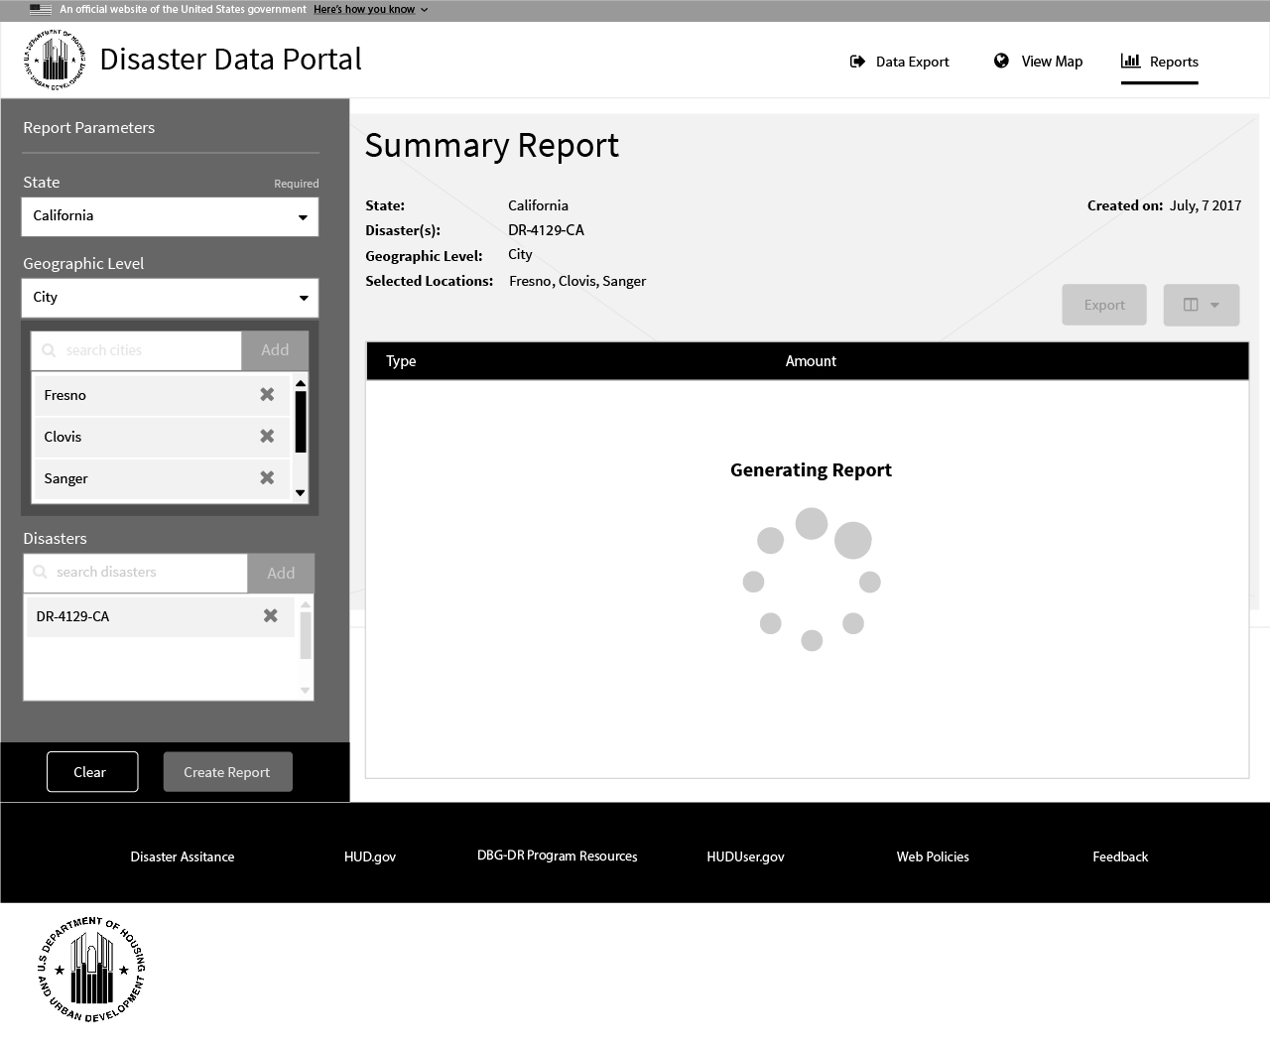
As the parameters are defined, the user may chose to generate a report which may take a few moments based on connection speeds and load times. At this point, a user will be greeted with a loading animation.
1
2
2
1

Slide 14
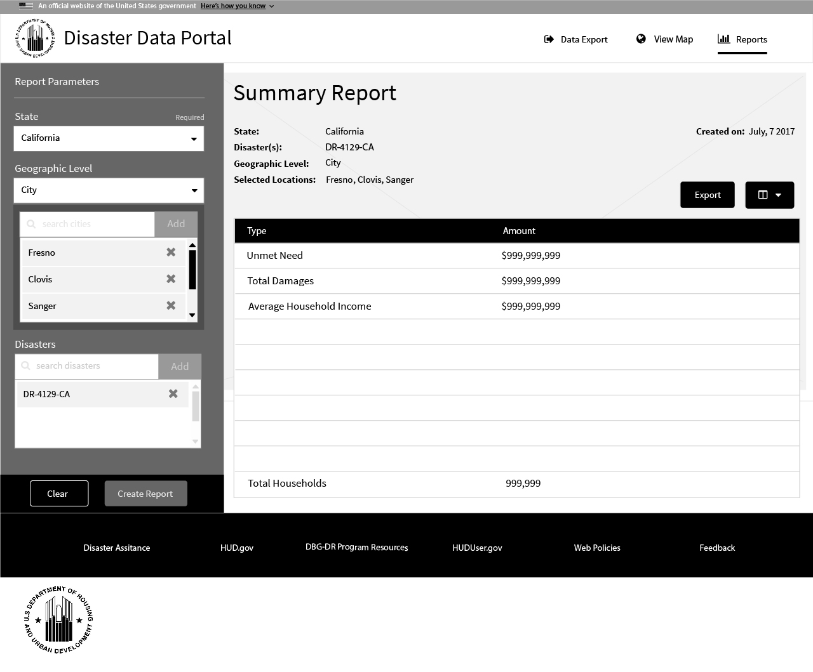
Once the report has been generated and loaded into view , the export and summary value selector are enabled.
*note – After the report is generated and in view, the user may choose to export the report. The report should be exported to look exactly as shown in the app with the exception of the summary value and export buttons shown.
1
2
2
1

Slide 15
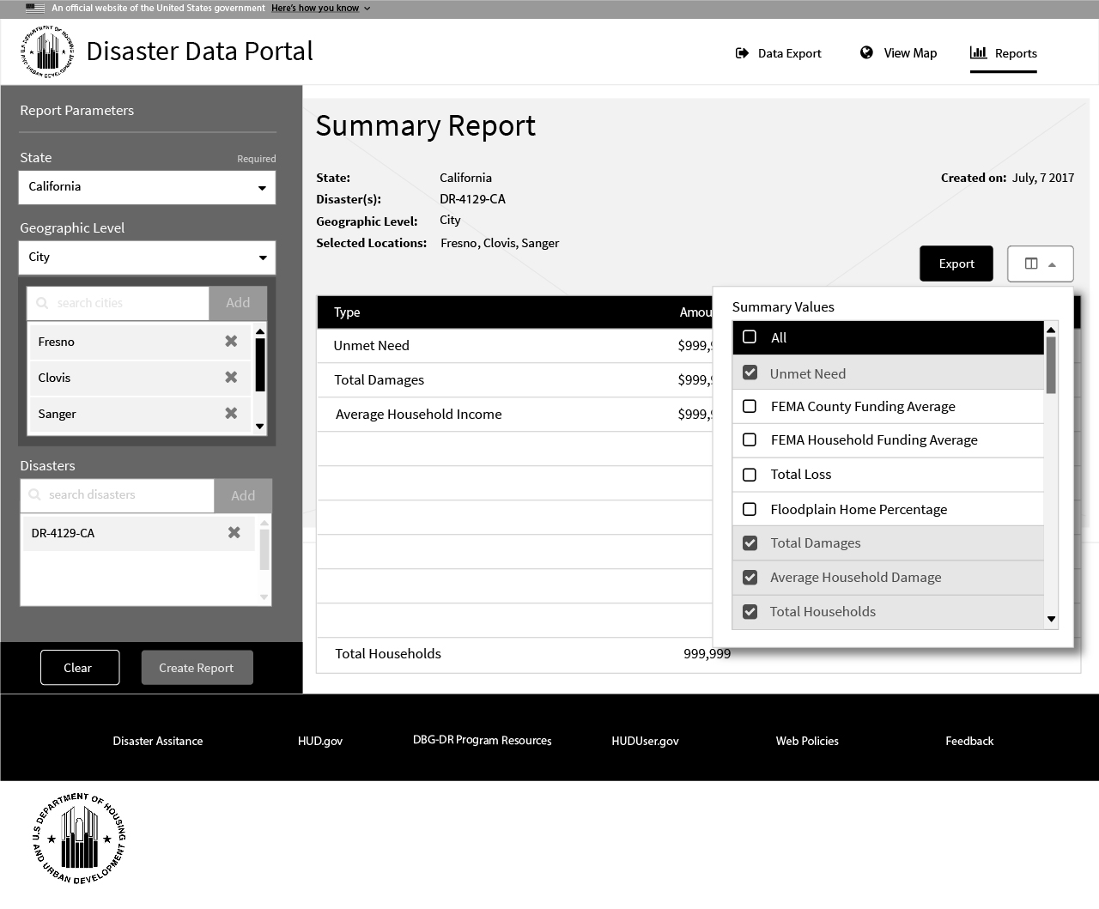
Future Functionality:
The user may want to view or export other summarized values which are not included in the defaults. This can be done by selecting the summary value chooser button and selecting the values desired.
*note – Selecting other summary values not included in the defaults results in regeneration of the report. The user will be presented with another loading screen as the report is produced.
1
2
1
2

