Slide 1

INFO 5100 APPLICATION ENGINEERING AND DEVELOPMENT FINAL PROJECT
TEAM: NB
NAVANEETA G. NAIK
NUID: 001027107
BRYAN PEREIRA
NUID: 001020476

Slide 2

Problem Statement
The MeToo movement has brought forward many victims of sexual assault on public platforms
The victims often find it difficult to register cases against the predators because of lack of knowledge of resources available
We aim to provide such victims a platform to seek legal help from Lawyers
We aim to help the victims to voice their concern and take the necessary steps of moving forward

Slide 3

What our system does?
We have designed an application for these victims to take necessary steps forward
Our system allows the client to choose to go the legal way and choose a lawyer or seek help from NPO
Client can apply to seek help resources from NPO
The victims(client) can find lawyers based on specialization and locations
Clients can communicate with lawyers for advises
Lawyer can communicate with clients and setup meetings if needed
The Lawyer’s assistant helps manage lawyer’s schedule

Slide 4

Which issue has our system solved?
Our system helps clients who are not aware of available options and resources
It provided a solution to connect lawyers, npo and clients without having to step out of their house

Slide 5

Has it solved the issue?
We aimed to solve the issue of the victim being able to choose at their comfort, which we did
We have tried to solve this issue and given flexibility to further develop the application for more causes and resources

Slide 6

Roles & Capability
Admin: Manages organizations employees and users
Client: Find and choose a lawyer, communicate with lawyer, book appointments with lawyer, apply for NPO resources
Lawyer: Communicate with client, suggest if meeting is needed, manage his schedule, communicate with assistant
Assistant: Communicate with lawyer, can edit and manage lawyer’s schedule
Examiner: Receives application from client, can accept or decline the application

Slide 7
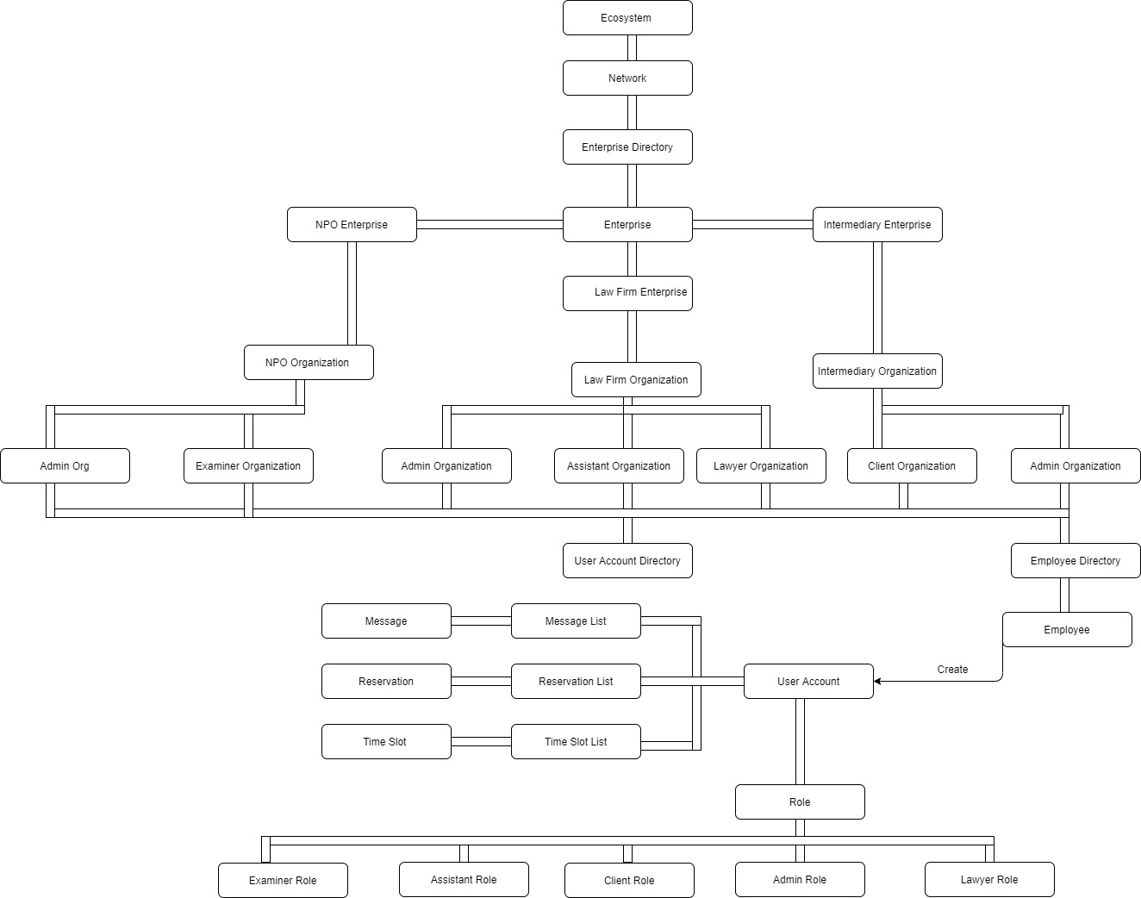
Eco System Architecture Diagram

Slide 8
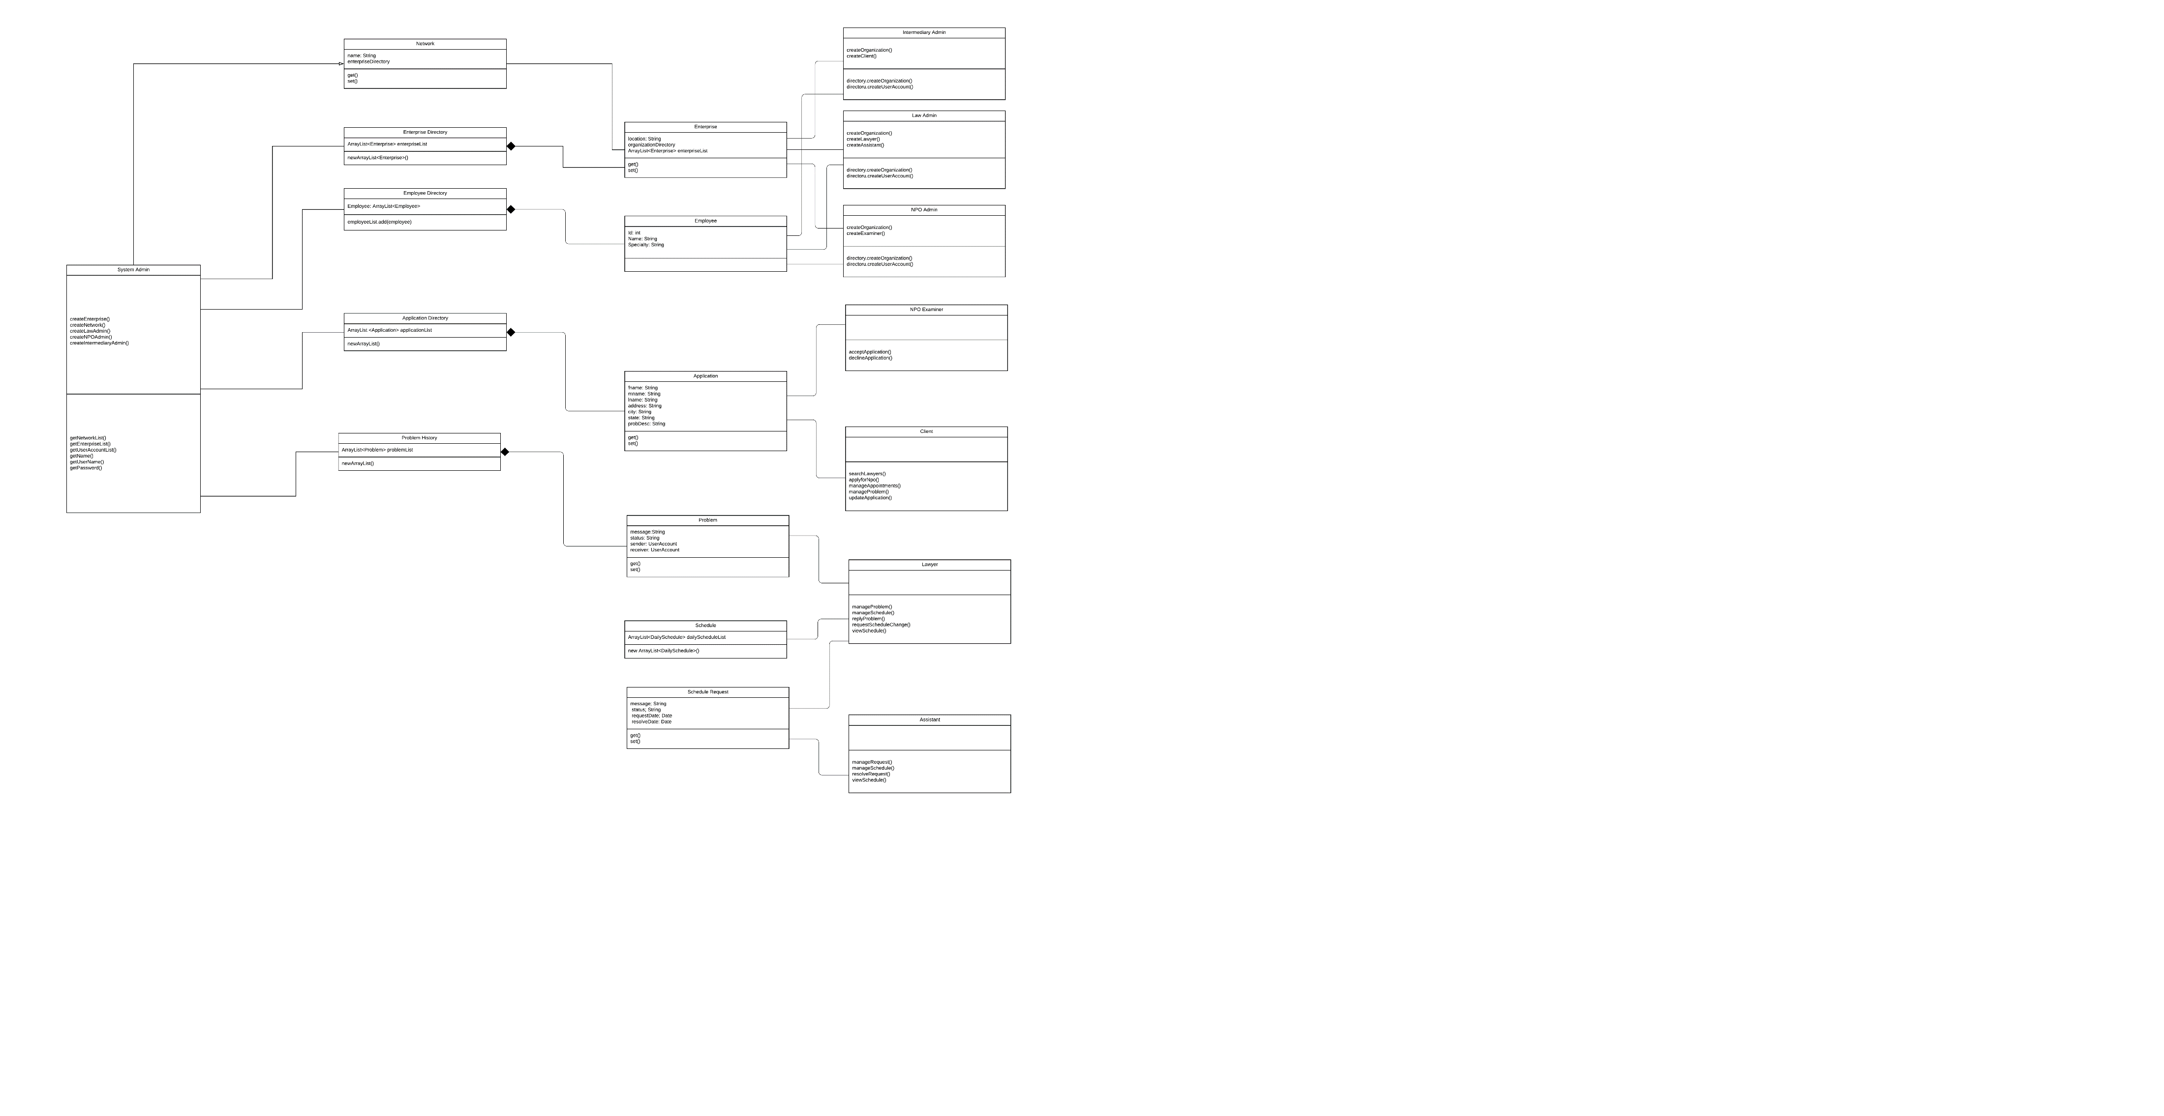
UML Diagram
UML Diagram

Slide 9
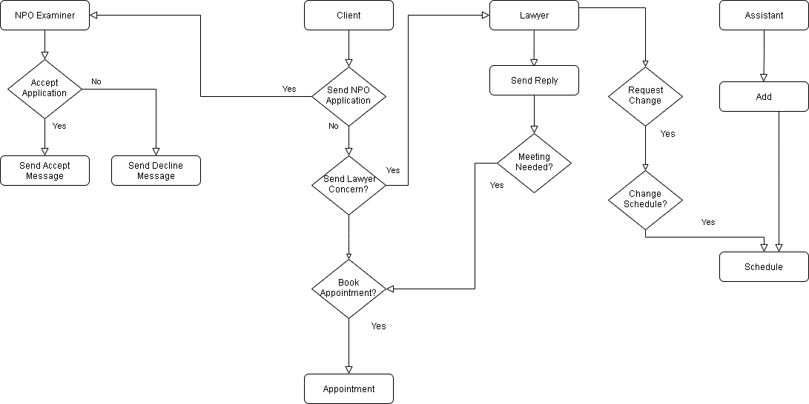
Work Flow
Work Flow

Slide 10
Thank You

