Slide 1
STAR: Semantic Targeting Matching Model for Exact/Phrase Expansion
SB Retrieval team
Presenter: Hao Wei, Bingyin Hu

Slide 2
Exact/Phrase Expansion
Sponsored Brands team plans to adopt semantic matching for exact and phrase keyword matching, beyond the existing string matching method. ^{[1]}
Exact match: query and keyword are semantically equivalent.
Phrase match: query includes the meaning of phrase keyword.
Examples:
Query | Keyword | Ground Truth | String Match Prediction
barbeque grill brushes | barbeque grill brush | exact match | exact match
portable charger | power bank | exact match | not match
shark nv750w parts | shark navigator model nv351 replacement parts | not match | not match
adidas shoes | sneaker | phrase match | not match
sneaker | adidas shoes | broad match | not match
[1] [PRFAQ] - Semantic Keyword Targeting

Slide 3
Embedding Model
We started the experiments by re-using the embedding model and used cosine similarity between query embedding and keyword embedding to measure the query-keyword relevance.
Limitation 1: lack token-level comparison across query and keyword due to the two tower structure, e.g., “nv750w” vs. “nv351”.
Limitation 2: problematic to phrase match as it generates the same cosine similarity regardless of the ordering of query and keyword, e.g., “adidas shoes” vs. “sneaker”.
Query | Keyword | Ground Truth | Embedding Prediction
barbeque grill brushes | barbeque grill brush | exact match | match
portable charger | power bank | exact match | match
shark nv750w parts | shark navigator model nv351 replacement parts | not match | match
adidas shoes | sneaker | phrase match | match
sneaker | adidas shoes | broad match | match

Slide 4
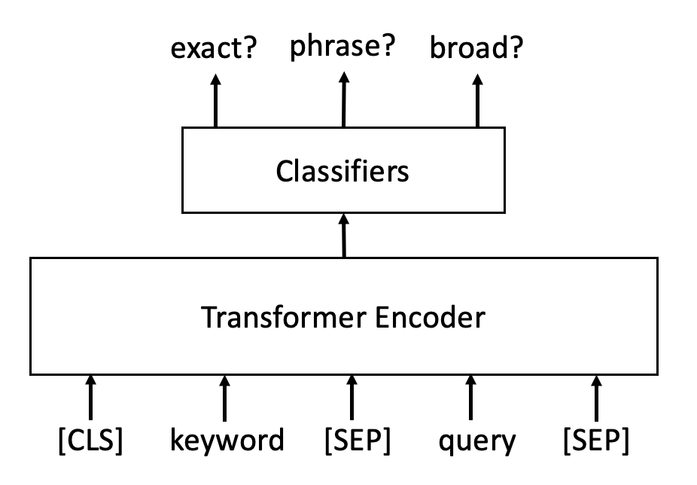
STAR: Semantic Targeting Matching Model
STAR model: Semantic TARgeting Matching Model
Model structure: transformer encoder + classification heads
Input: concatenated string of keyword and query
Output: three classification scores for exact/phrase/broad respectively, which are compared against the corresponding thresholds online.
A query and an exact match keyword is a semantic match if the prediction score for exact match is above the corresponding threshold. Same applies to phrase match.

Slide 5
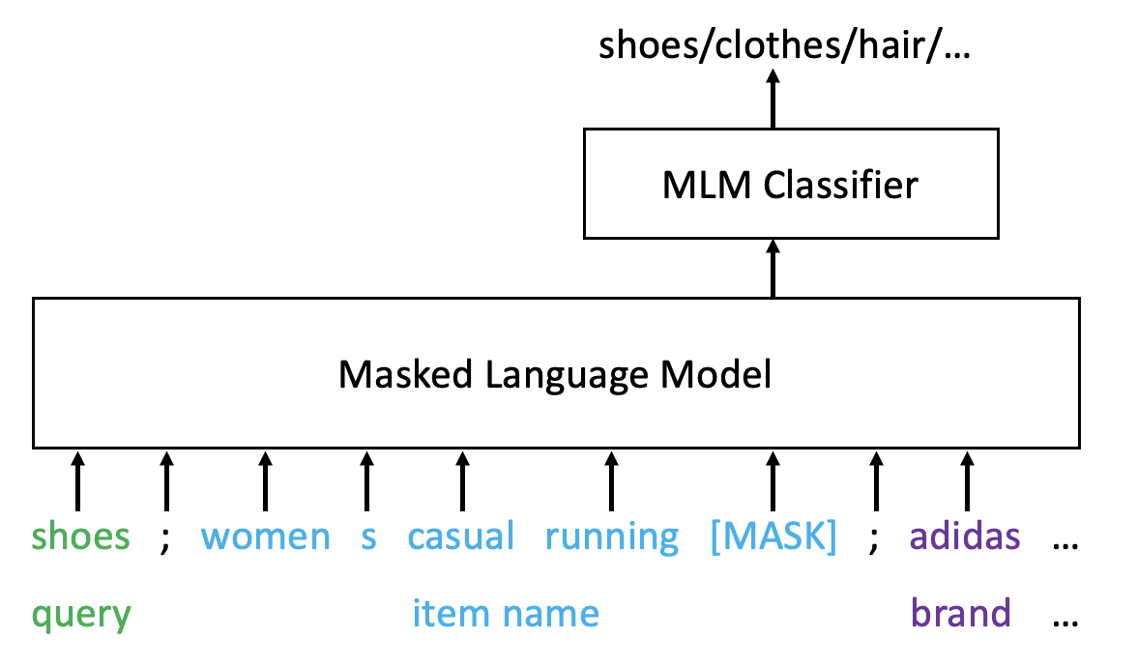
STAR: Semantic Targeting Matching Model
Model Training: Masked Language Pre-training → Pre-finetuning → Finetuning
Mask Language Pre-training: builds language understanding capability.
Pre-training corpus is built by 300MM query-ASIN pairs collected from Tommy ASIN data.
The training task is to predict the masked token given the context.
Kept after pre-training

Slide 6
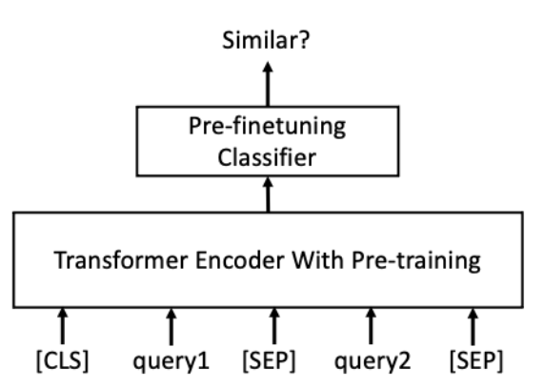
STAR: Semantic Targeting Matching Model
Model Training: Masked Language Pretraining → Pre-finetuning → Finetuning
Pre-finetuning: trained on label data from similar tasks to incorporate task knowledge into model
Public dataset: paraphrase detection dataset
Nota Query Graph: similar/irrelevant query pairs based on semantic and behavior information.
Train the whole model with cross entropy loss to predict whether the given input pairs are similar or not. Pre-finetuned with 290MM pairs.
Kept after pre-finetuning

Slide 7
STAR: Semantic Targeting Matching Model
Model Training: Masked Language Pretraining → Pre-finetuning → Finetuning
finetuning: use query-keyword relevance human labeled data to further finetune the model.
Label data: 18.6K query-keyword relevance human label data, 8.6K for training and 10K for evaluation.
Data augmentation: 8.6K training data is augmented to be 17.3K by swapping the query and keyword and adapting the label accordingly.

Slide 8
Offline Pipeline
Our offline pipeline has four main steps
Use the existing SB Retrieval models to retrieve ads for queries.
Use embedding model to choose to top exact/phrase keyword for each query-ad pair. This step is needed for now due to the low TPS of STAR model.
Apply STAR model to compute the query-keyword relevance score, also called STAR score, and filter the query-ad-keyword data based on STAR score.
Apply a branded filter to allow query-keyword pairs with 1) non-branded keyword, and 2) shared brand in query and keyword.
With our current STAR score threshold, on US Sparkle, the strategy covers 22MM queries, 200K ads and 52MM query-ad pairs (2.4 ads per query). On US Video, the strategy covers 13MM queries, 221K ads and 36MM query-ad pairs (2.7 ads per query).
We have launched our weblab on Sparkle/Video in US/UK:
Business metrics: combined +$106.8MM Net CP, +$184.5MM GCCP, and +$340.4MM OPS
Ad performance metrics: positive impact on impressions, CTR, CPC, CVR, and auction density
[2] https://weblab.amazon.com/wl/SB_SPARKLE_EXACT_PHRASE_EXPANSION_623957

Slide 9
Offline Evaluation
Evaluation data: 10K query-keyword relevance human label data
Metrics:
AUC measures the model’s ability to rank positive data over negative data. It is weighted by the clicks of query within a 1-year window.
Recall@90% Precision measures the coverage at the given 90% precision threshold.
Performance: STAR model performs significantly better than string matching method and embedding model.
Model | Exact Match Weighted AUC | Phrase Match Weighted AUC | Exact Match Recall@90% Precision | Phrase Match Recall@90% Precision
STAR Model | 0.921 | 0.916 | 0.720 | 0.839
Embedding Model | 0.726 | 0.746 | 0.108 | 0.174
String match | 0.509 | 0.508 | N/A | N/A

Slide 10
Offline Evaluation – Effectiveness of Pre-training and Pre-finetuning
Out-of-box model without any pre-training and pre-finetuning doesn’t work well.
Pre-training brings language understanding capability to the model and significantly boosts the performance.
Pre-finetuning further improves the performance by incorporating task knowledge into the model.
Pre-training? | Pre-finetuning? | Finetuning? | Exact Match Weighted AUC | Phrase Match Weighted AUC | Exact Match Recall@90% Precision | Phrase Match Recall@90% Precision
No | No | Yes | 0.702 | 0.744 | 0.104 | 0.196
Yes | No | Yes | 0.876 (+0.174) | 0.886 (+0.142) | 0.597 (+0.493) | 0.756 (+0.560)
Yes | Yes | Yes | 0.921 (+0.045) | 0.916 (+0.030) | 0.720 (+0.123) | 0.839 (+0.083)

Slide 11
STAR Model – TPS Challenges
To increase the TPS of STAR model, we
use the first 3 layers of pre-finetuned model for finetuning.
use FP16 throughout the training process.
convert pytorch model to ONNX and use ONNX optimizer.
STAR achieves 76k TPS on one p3.2xlarge instance with comparable performance to complex public pretrained models like DeBERTa-base but 15x faster.

Slide 12
Case Study
Query | Keyword | Ground Truth | STAR Model Prediction | String Match Prediction | Embedding Prediction
barbeque grill brushes | barbeque grill brush | exact match | exact match | exact match | match
portable charger | power bank | exact match | exact match | not match | match
running shoes | running sneakers | exact match | exact match | not match | match
shark nv750w parts | shark navigator model nv351 replacement parts | not match | not match | not match | match
adidas shoes | sneaker | phrase match | phrase match | not match | match
sneaker | adidas shoes | broad match | broad match | not match | match

Slide 13
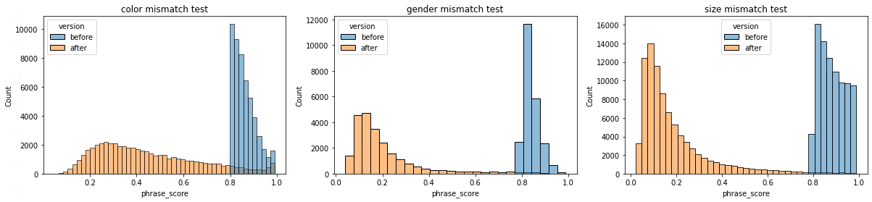
Improvement on Attribute Mismatch
A color/gender/size patching dataset of size 108/108/122 added for finetuning.
Significant negative shift observed for phrase score on 50.7k/23.2k/87.0k query-keyword pairs with mismatched attributes.

Slide 14
Improvement on Attribute Mismatch
Brand awareness incorporated via input sequence decoration:
“nike shoes” => “nike shoes {decoration}” decoration can be special token [BRD] or normal tokens like | branded
Evaluated on 1.4k branded query-keyword pairs.
Decoration | Exact Match Weighted AUC | Phrase Match Weighted AUC | Exact Match Recall@90% Precision | Phrase Match Recall@90% Precision
No brand awareness | 0.872 | 0.886 | 0.581 | 0.739
[BRD] | 0.910 | 0.914 | 0.593 | 0.737
(is branded) | 0.879 | 0.891 | 0.590 | 0.724
| branded | 0.880 | 0.905 | 0.593 | 0.772
[BRD] with brand string | 0.897 | 0.905 | 0.544 | 0.710

Slide 15
Multi-lingual STAR
A multi-lingual STAR model has been developed for non-English marketplaces.
Language: EN/FR/DE/ES/IT/JP
Benchmark | Exact Match Weighted AUC | Phrase Match Weighted AUC | Broad Match Weighted AUC | Exact Match Recall@90% Precision | Phrase Match Recall@90% Precision | Broad Match Recall@90% Precision
US + WW | 0.965 | 0.968 | 0.950 | 0.602 | 0.698 | 0.940
WW | 0.971 | 0.964 | 0.950 | 0.382 | 0.590 | 0.900
US | 0.937 | 0.942 | 0.935 | 0.776 | 0.868 | 1.000

Slide 16
Next Steps
Coverage improvement: we are improving the offline pipeline and enable STAR model to choose the keyword directly for query-ad pairs, instead of relying on embedding model.
Model improvement: we will continue improving the STAR model, including using Sherlock to collect more human label data for model training and knowledge distillation etc.

Slide 17
Question & Answer

