Slide 1
Bike Share Case Study: The Differences in Customer Utilization
October 2021
Bryan Rillstone

Slide 2
Business Task
Identify the differences between casual riders and annual members to help design marketing strategies to convert casual riders into annual members.

Slide 3
Goals for our discussion today:
Share an overview of bike sharing trip data
We will cover differences in trip data by customer type.
Examine trends in bike sharing customer type data
Understand daily and weekly trends.
Discuss any potential areas for further exploration
Focus on areas important to business task

Slide 4
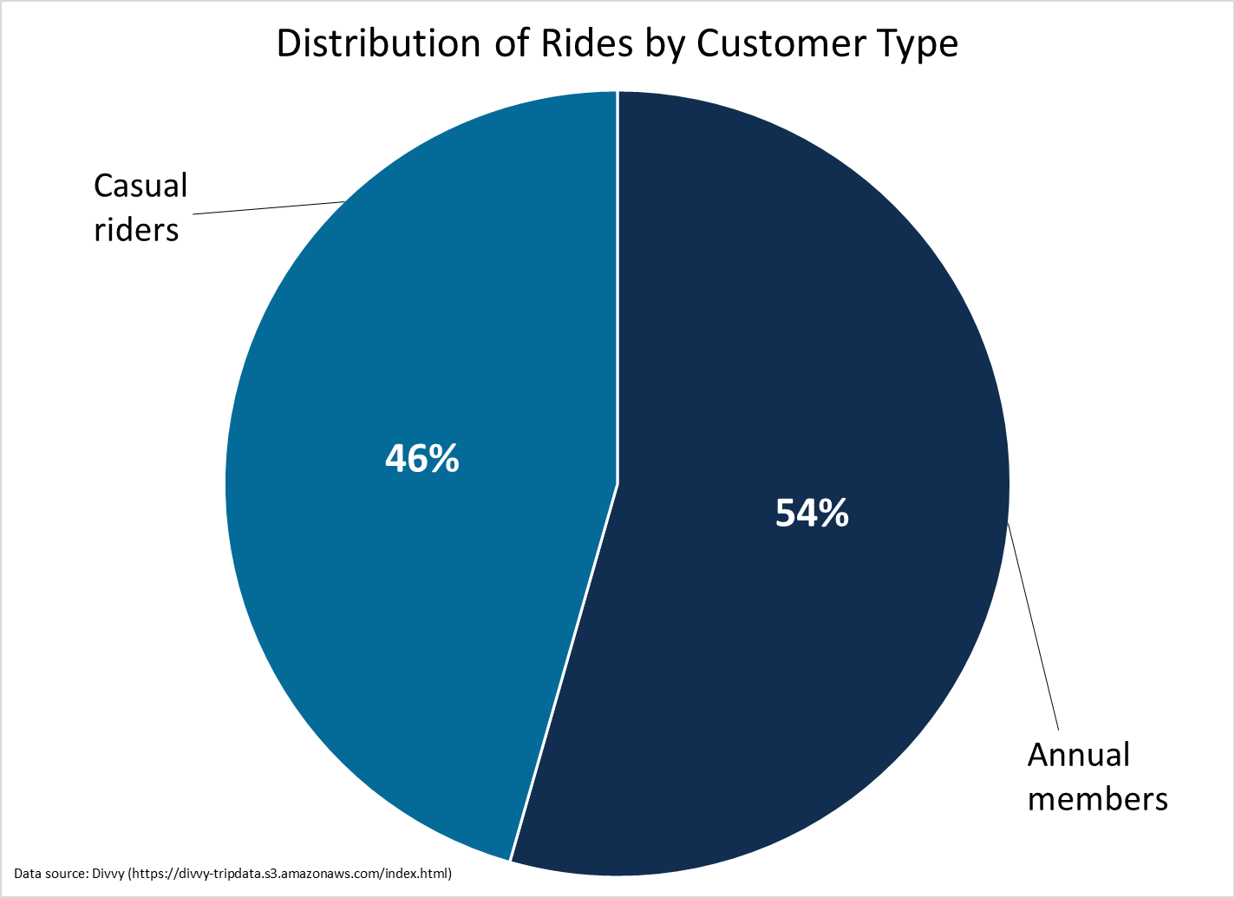
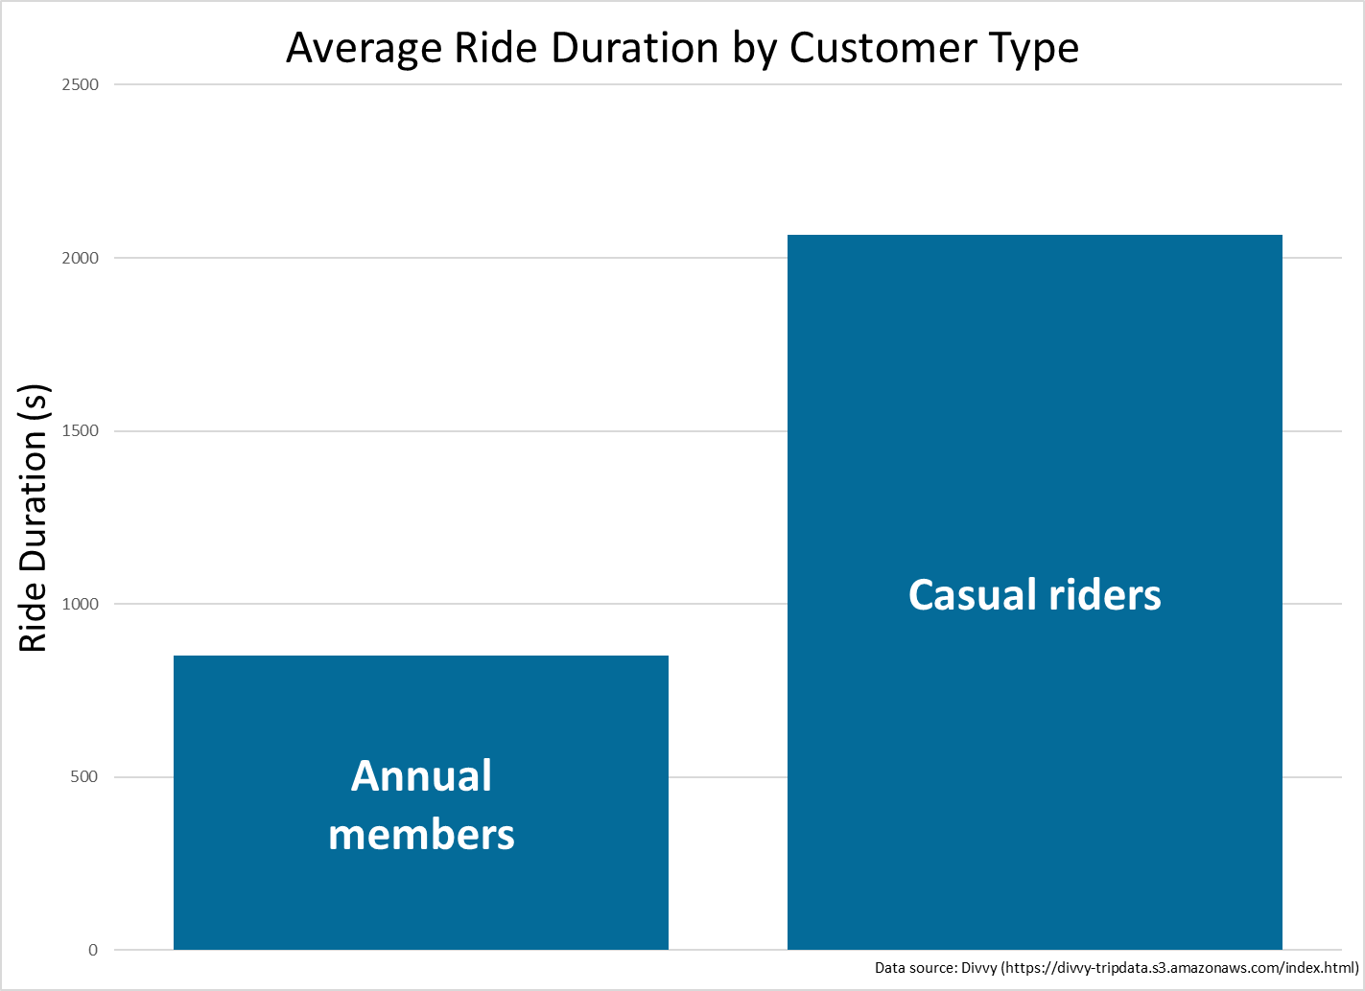
Trip data differences by customer type
Data overview
Bike sharing trip data from October 2020 through September 2021
Key takeaways
Casual riders’ average ride duration is more than 2 times longer than annual members
Annual members account for slightly more rides
Notes:
These charts show the distribution of total rides by customer type on the top and the difference in average ride duration by customer type on the bottom.
Data was provided by the City of Chicago’s Divvy bicycle sharing service operated by Motivate International Inc.
“Bad” data removed accounted for approximately 0.1%.

Slide 5
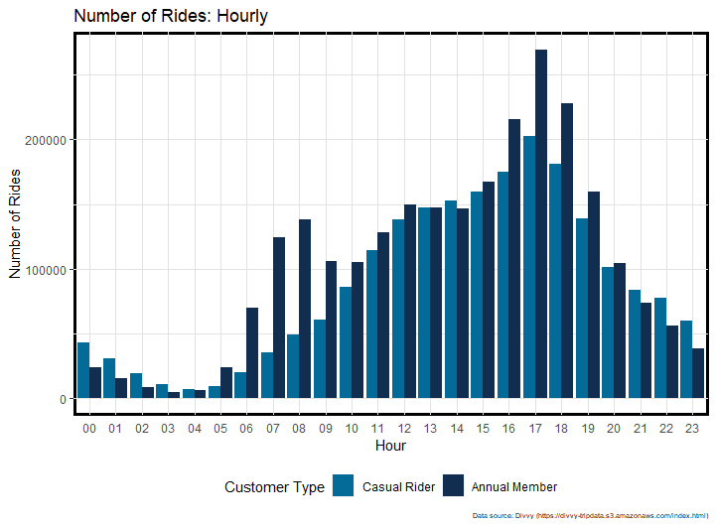
Daily Ridership Trends
Key Takeaways
By looking at one year of trip data aggregated by hour, we have identified daily trends
Casual riders’ utilization exhibits a single peaks around 1700
Annual member’s utilization exhibits two peaks, a smaller peak around 0800 and a larger peak around 1700
Notes:
This chart shows the number of rides by customer type through a day. Hours along the bottom and number of rides along the side.
Annual members utilization indicated they are using the bike sharing program to commute to work.
Casual riders do not appear to be using the program to commute to work.

Slide 6
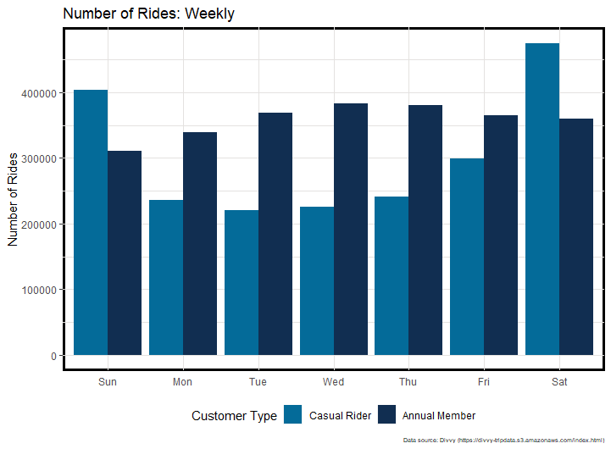
Weekly Ridership Trends
Key Takeaways
By looking at one year of trip data aggregated by day, we have identified weekly trends
Casual riders’ utilization peaks on the weekend and exceeds annual members’ utilization
Annual members’ utilization peaks during the week
Notes:
This chart shows the number of rides by customer type throughout the week. Days along the bottom and number of rides along the side.
Annual member data indicates they are using the bike sharing program to commute to work.

Slide 7



What should your company start doing now after seeing these trends?
Account for higher average ride duration for casual riders
Account for different daily utilization for casual riders and annual members
Account for higher frequency of weekend trips for casual riders
Notes:
Casual riders take trips 2 times longer than annual members.
Annual members commute around 0800 and 1700. Casual riders peak around 1700.
Annual members are commuters and casual riders are not commuters.
Casual riders' trips exceed annual members trips on weekends. Annual members take more trips during the week.
Why don’t casual riders use the bike share system to commute to work?

Slide 8
Sources
City of Chicago’s Divvy bicycle sharing service operated by Motivate International Inc. Data retrieved from: https://divvy-tripdata.s3.amazonaws.com/index.html
Google Data Analytics Professional Certificate courses offered by Coursera

