Slide 1
Week 6 Day 1
Intro to Spring

Slide 2
Reflections API
Allows us to peak into java classes, and modify their states and behaviors at runtime
Provided in java.lang.reflect package
Provides information about the class
Methods names
Method return types
Annotations
Used with many frameworks such as Junit and Spring
Spring uses it to know which classes to control and to configure your app

Slide 3

Spring Intro
Family of frameworks
Create loosely coupled apps
Inversion of control container
Uses dependency injection
Enables developers to build java applications with POJO’s
Spring manages the dependencies between our services
Allows developers to focus on business logic

Slide 4
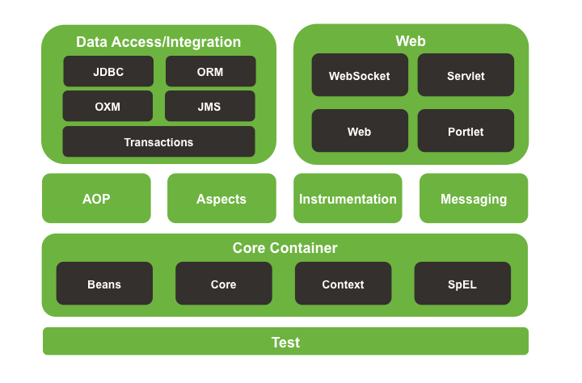
Spring: Modules
Image source: https://medium.com/@prabhur24/why-spring-101-on-spring-start-3be672f9d75

Slide 5
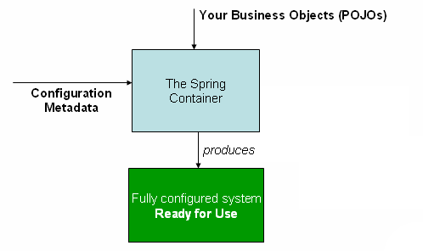
Spring: Inversion of Control
Design pattern where control over certain components is inverted to achieve loose coupling
Giving control of modules/classes to spring
Spring uses an IOC Container
Gathers this information from beans.xml
Image source: https://docs.spring.io/spring-framework/docs/3.2.x/spring-framework-reference/html/beans.html

Slide 6
Spring: Inversion of Control Containers
BeanFactory
Most basic IOC Container
ApplicationContext
Implements BeanFactory and extends its features
Integration with Spring AOP
Event propagation
Message resource handling
Application layer specific context

Slide 7
Spring: Dependency Injection
Remove dependencies by providing configurations in external files
Loosely couples your code
Easier to test (mocking capabilities/inject mocks)
Implement in a wider variety of environments
Don’t need to manually create/pass objects your classes depend on

Slide 8
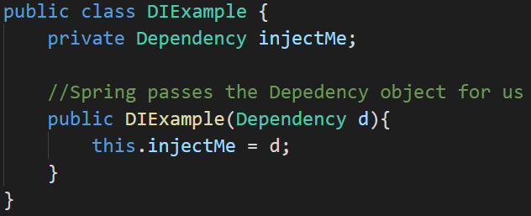
Spring: Constructor Injection
Constructor Injection
Injected through constructors
More secure
Enables ability for immutable objects

Slide 9
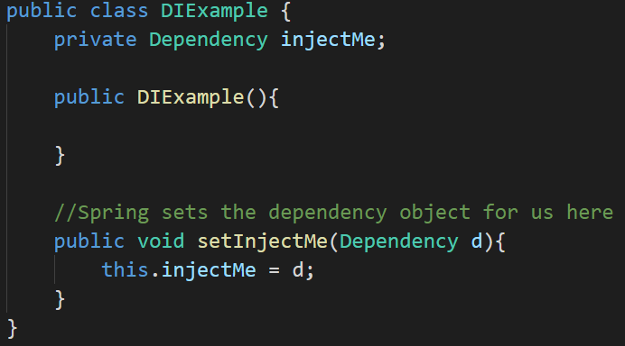
Spring: Setting Injection
Setter Injection
Injected through our setters after a no-args constructor is called
Allows for partial dependencies
More flexible
Used to resolve circular dependencies

Slide 10
Spring: Bean Life Cycle
Instantiated
Bean properties set
Associated interfaces are made aware
Bean is made aware of associated interfaces
Custom methods are invoked
Bean is ready
Bean is marked for removal, and destroy method is invoked
Custom destroy methods invoked
Bean is destroyed

Slide 11
Spring: Bean Scopes
Scope is a sub-section of a larger application
Singleton
Prototype
Request
Session
Global
Application

Slide 12
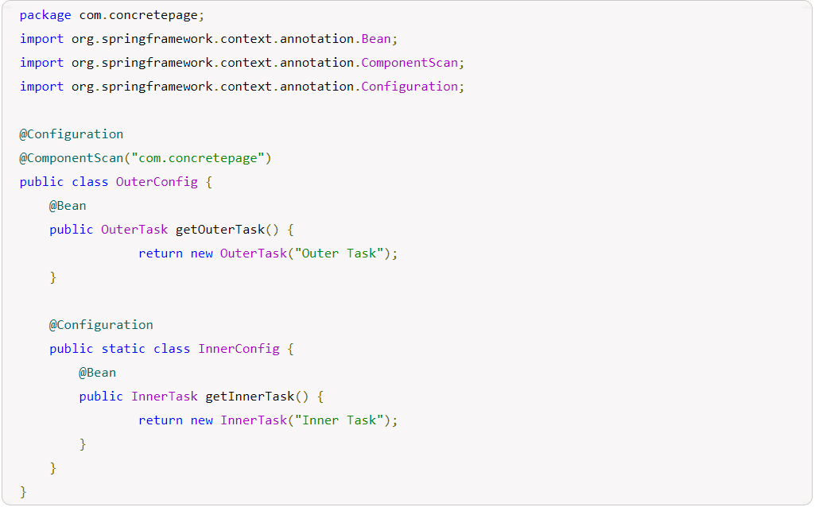
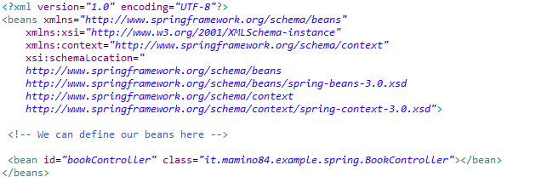
Spring: Configuration
Two ways to configure our beans
XML files
Annotations and Configuration class
Image source: https://medium.com/quick-code/xml-or-nnotations-this-is-the-dilemma-6c00cfbf8746
Image source: https://www.concretepage.com/spring-5/spring-nested-configuration-classes

Slide 13
Spring: Annotations
@Autowired
@Bean
@Component
@ComponentScan
@Configuration
@Inject
@Qualifier
@Required
@Resource

Slide 14
Spring: Autowiring
Autowiring allows us to tell Spring to find the beans and register itseld
“no”: no autowiring
“byType”: look at the class’ property datatypes
“constructor”: uses the constructor with the most distinct dependencies
“byName”: finds beans in the container with the same name

Slide 15
Spring: Stereotypes
Tells Spring what kind of components it is creating
@Component
@Repository
@Service
@Controller

